Slide 1
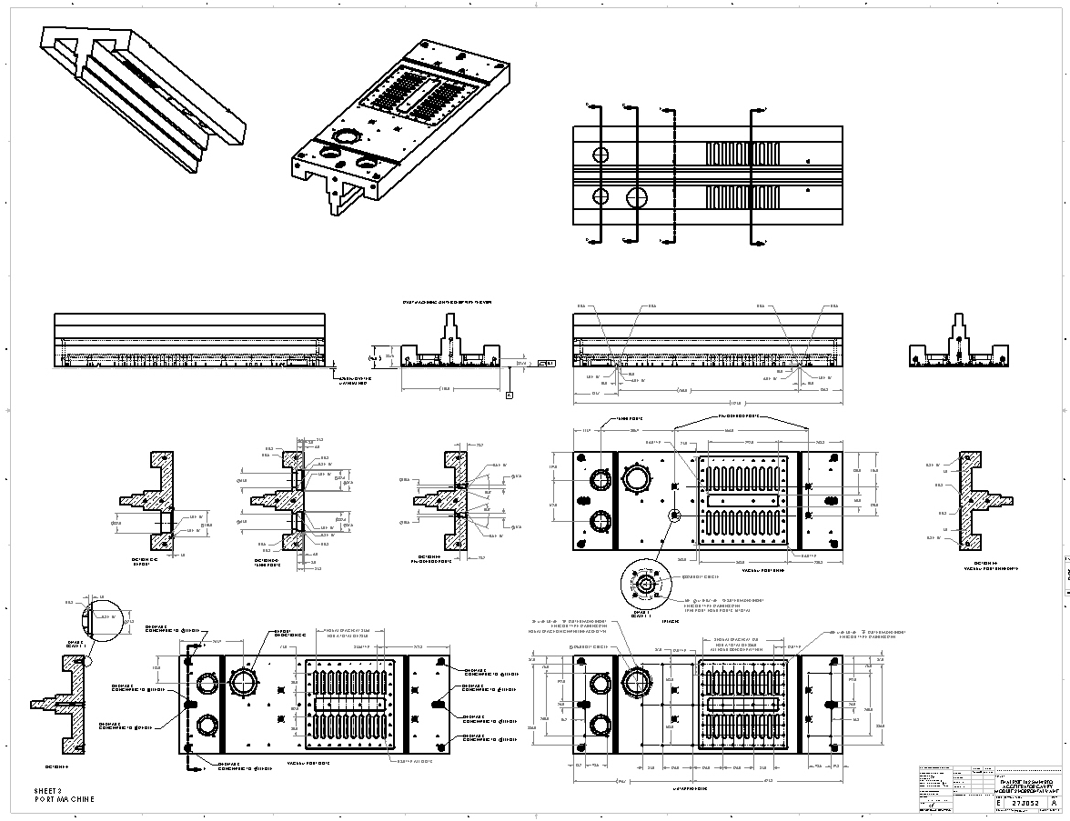
PXIE RFQ MECHANICAL DESIGN STATUS
Matt Hoff LBNL NOVEMBER 29, 2012

Slide 2
Bolt Circle Pi-mode Cooling Connector Change
M20 thread is in the soft copper
Similar to how the sensing loops are held in place
M4 x .7 tapped holes (helicoil inserts)
Compatible with brazing in the rod and ferrule
Easy to repair
The old design
Sensing loop
Water connector is held in place with 4 M4 screws (not shown)
O-ring seal
Weep hole

Slide 3
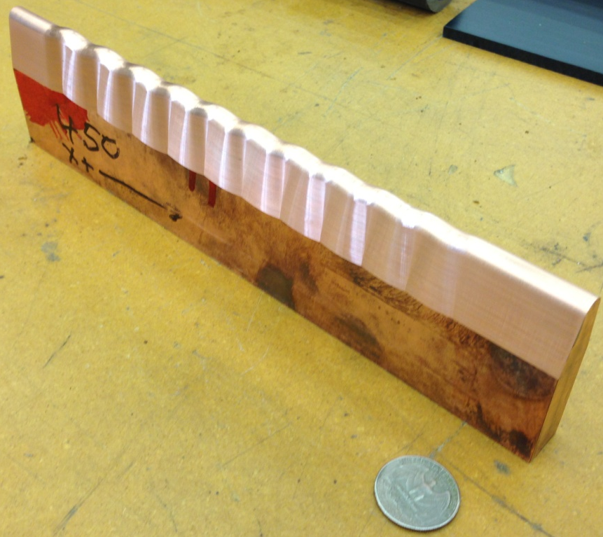
Profile Cutter Update
A purchased 2 flute cutter with chip relief. LBNL will wire EDM the actual tip profile this month and test
CAD model of the most difficult modulation section. This is the model the shop uses for its test.
A purchased 4 flute cutter with profile. The profile was incorrect. The LBNL shop has been correcting the profile by wire EDM. They are within .005 inch of correct. The pictured copper bar was cut with the shown cutter.

Slide 4
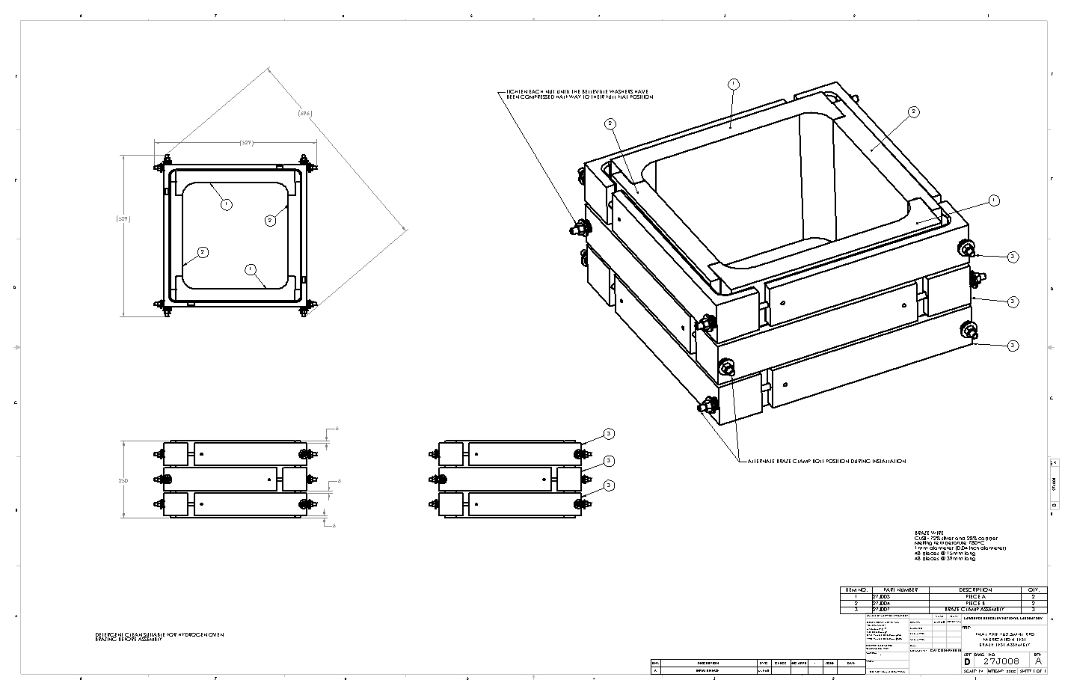
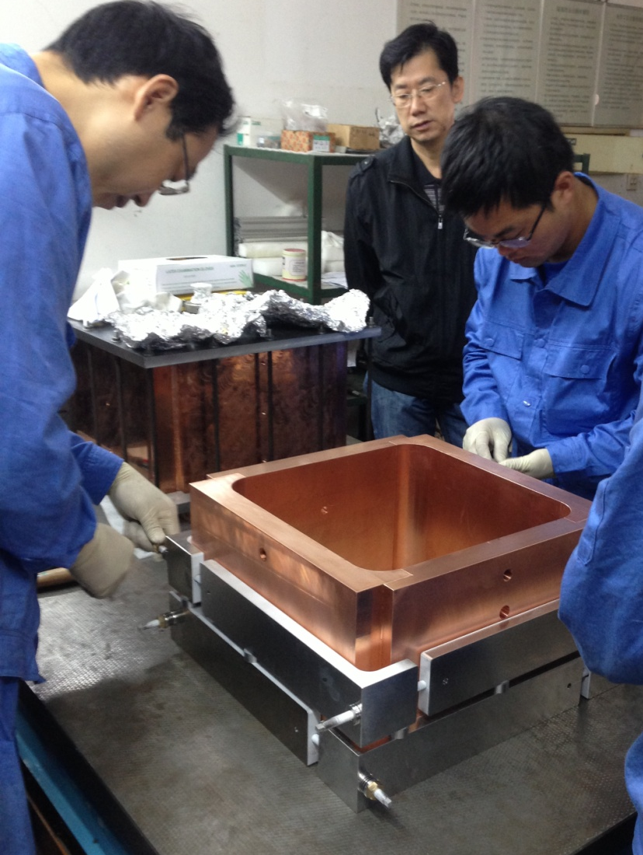
Braze Test
Drawings are done
The IMP braze test

Slide 5
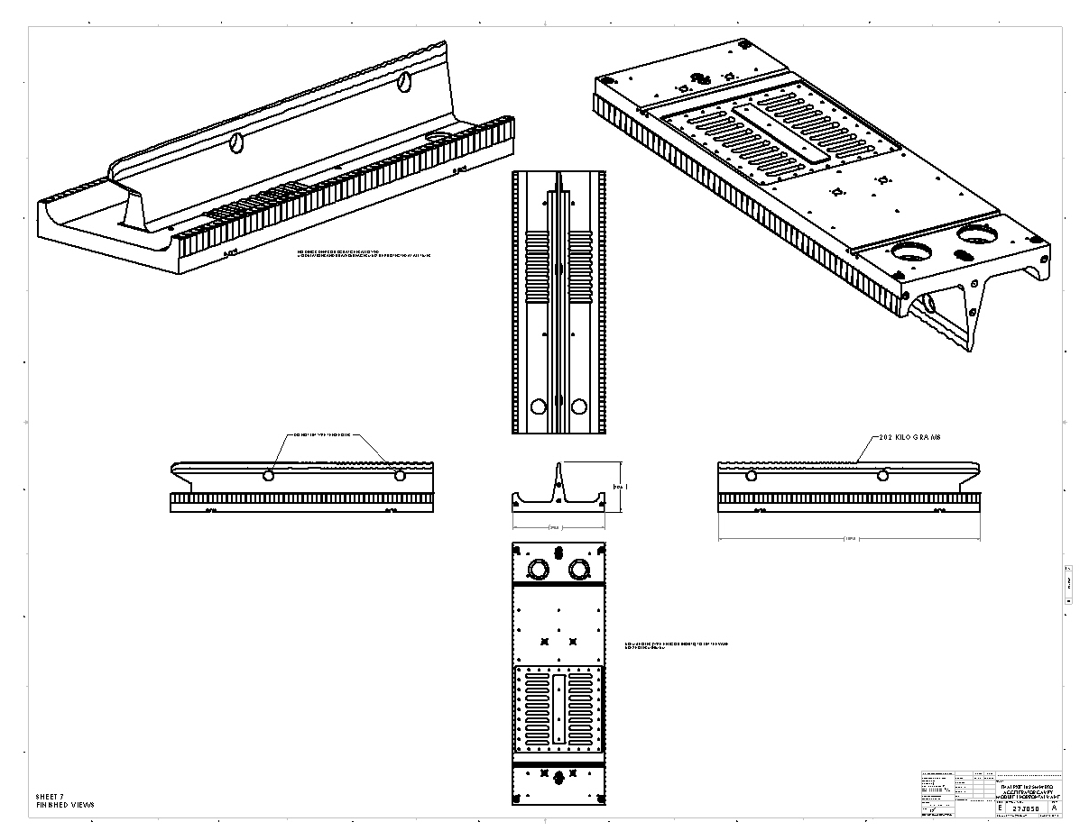
Full vane test piece
We plan on using Module 1 Horizontal vane as the test vane. The drawing is complete.
The IMP test vane

Slide 6
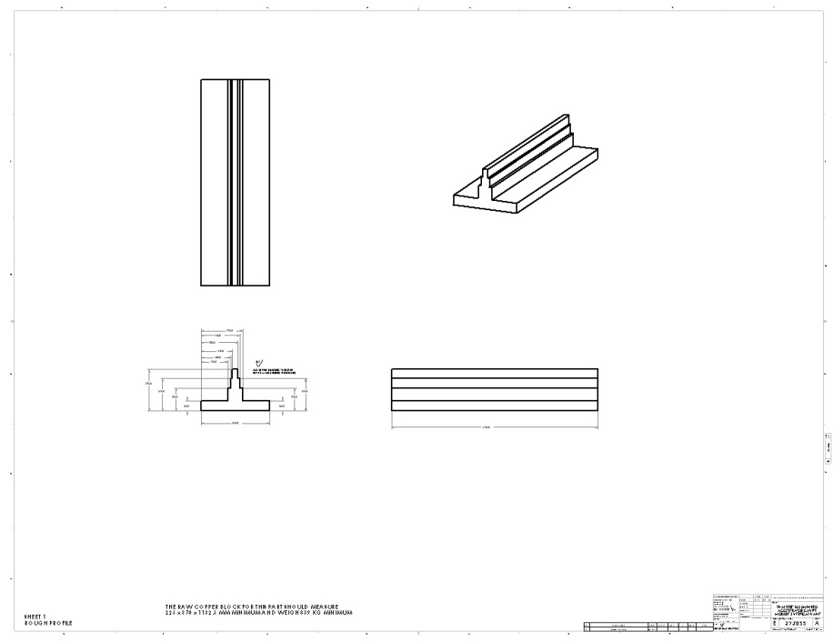
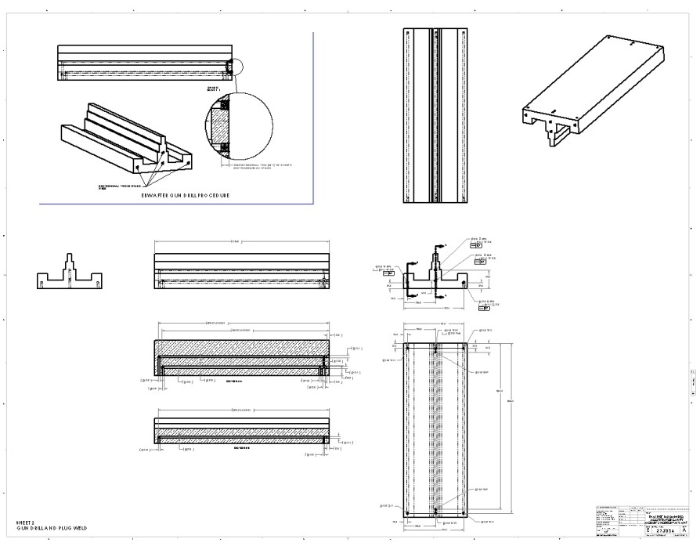
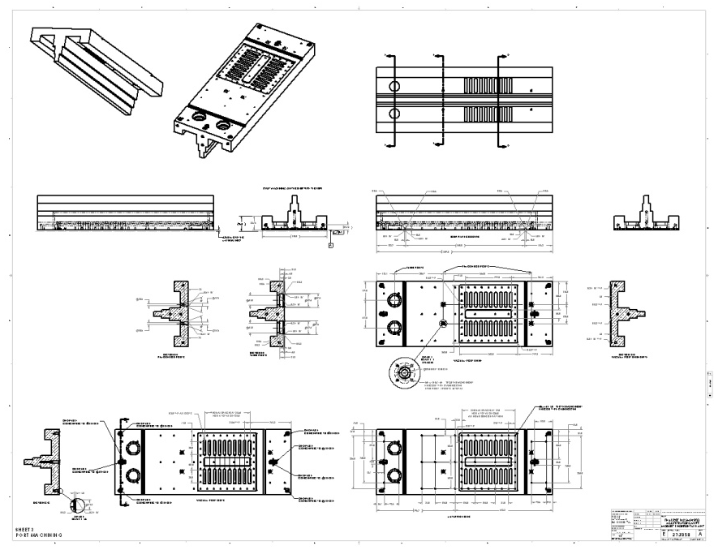
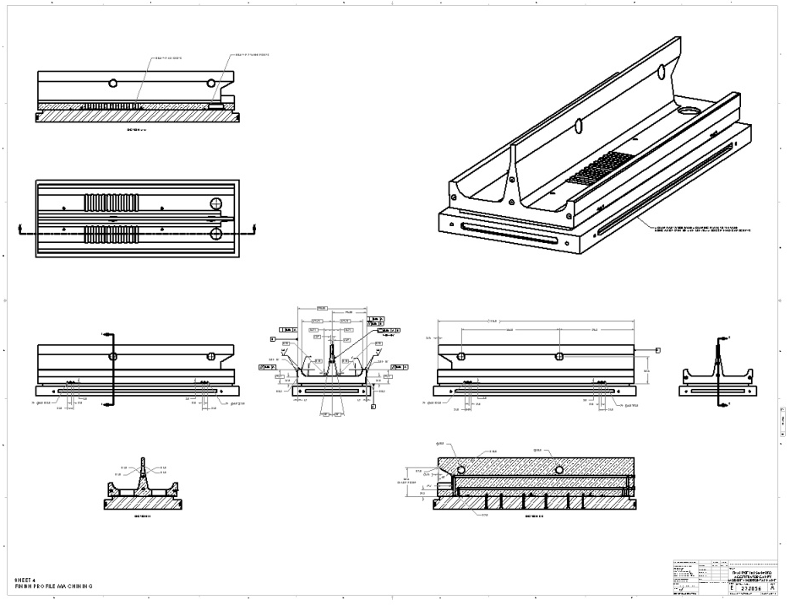
RFQ Part Drawings
Vane drawing – rough machine
Vane drawing – gun drill
Vane drawing – finish profile
Vane drawing – port machining

Slide 7
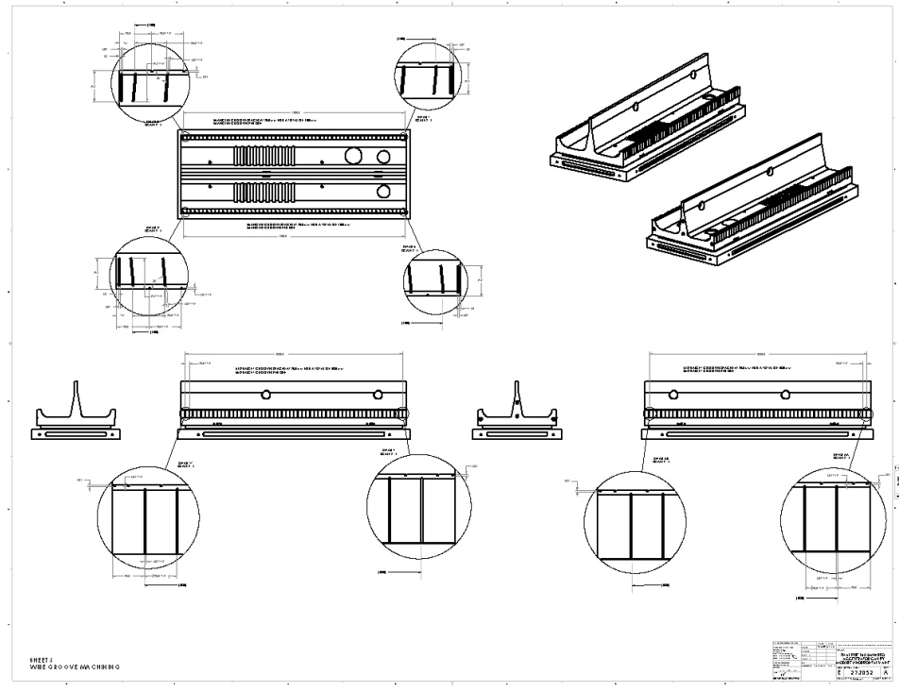
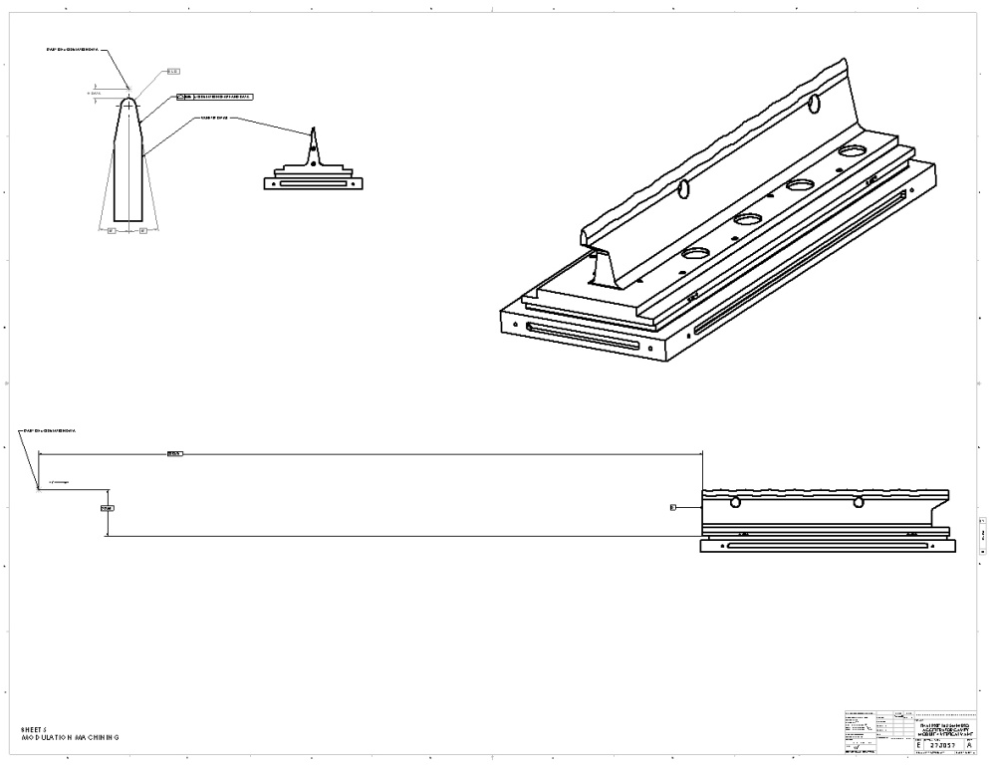
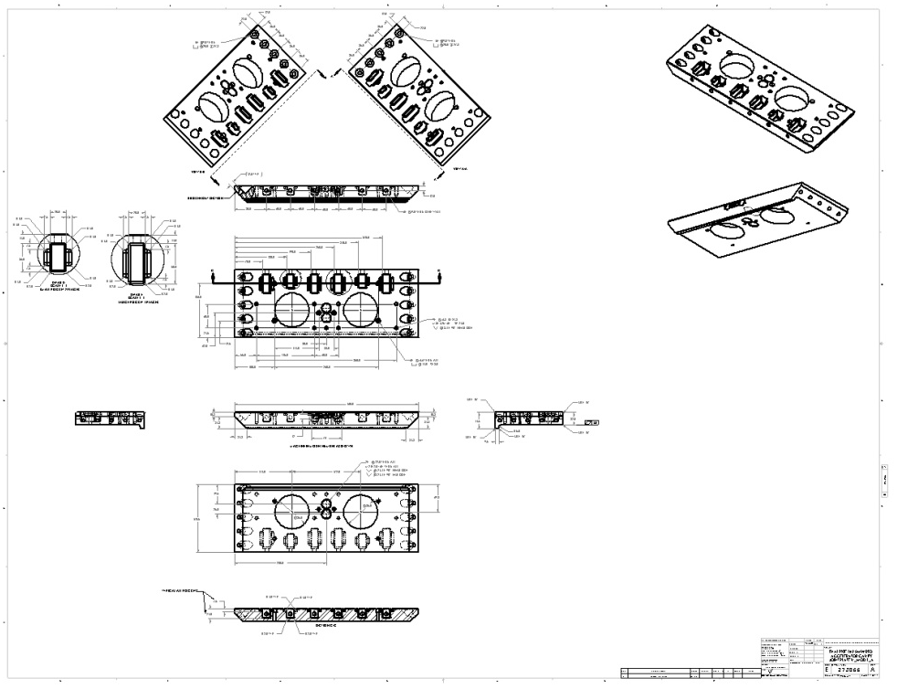
Vane drawing – modulation machining
Vane drawing – wire grooves
Joint plate drawing
Vane drawing - Finished views

Slide 8
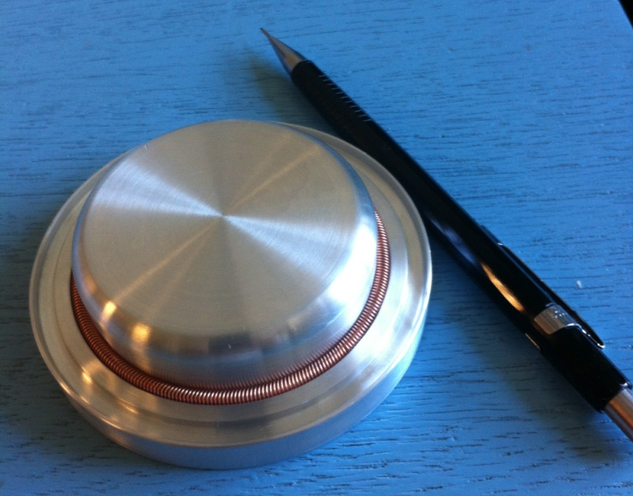
Drawings
Fabrication test part drawings are done, but not checked.
Individual vane drawings are done, but not checked.
Joint plate drawings are done, but not checked.
Tuners, Pi-mode rods, ferrules and vane mounting plate drawings are done, but not checked.
Next
Completed drawings get checked.
Braze assembly drawings created.
Post braze module end machining drawings created.
Find loose ends and resolve.
A mock tuner was fabricated to test the fit of the O-rings and canted spring. Everything fit nicely.
Another designer is being arranged to assist me with designing and drawing assembly fixtures, bead pull equipment, adjustable tuners, adjustable end caps, storage pallets and sensing loops.

Slide 9
End Cap
An endcap model has been made to assist Richard Andrews with designing the LEBT endcap.
11.06mm
Inside view of LEBT End Cap

Slide 10
Teamcenter and NX software
Teamcenter and NX software have been installed on my LBNL computer
Teamcenter training was completed Tuesday morning at FNAL
Bob Andree working remotely on my computer November 20, 2012

Slide 11
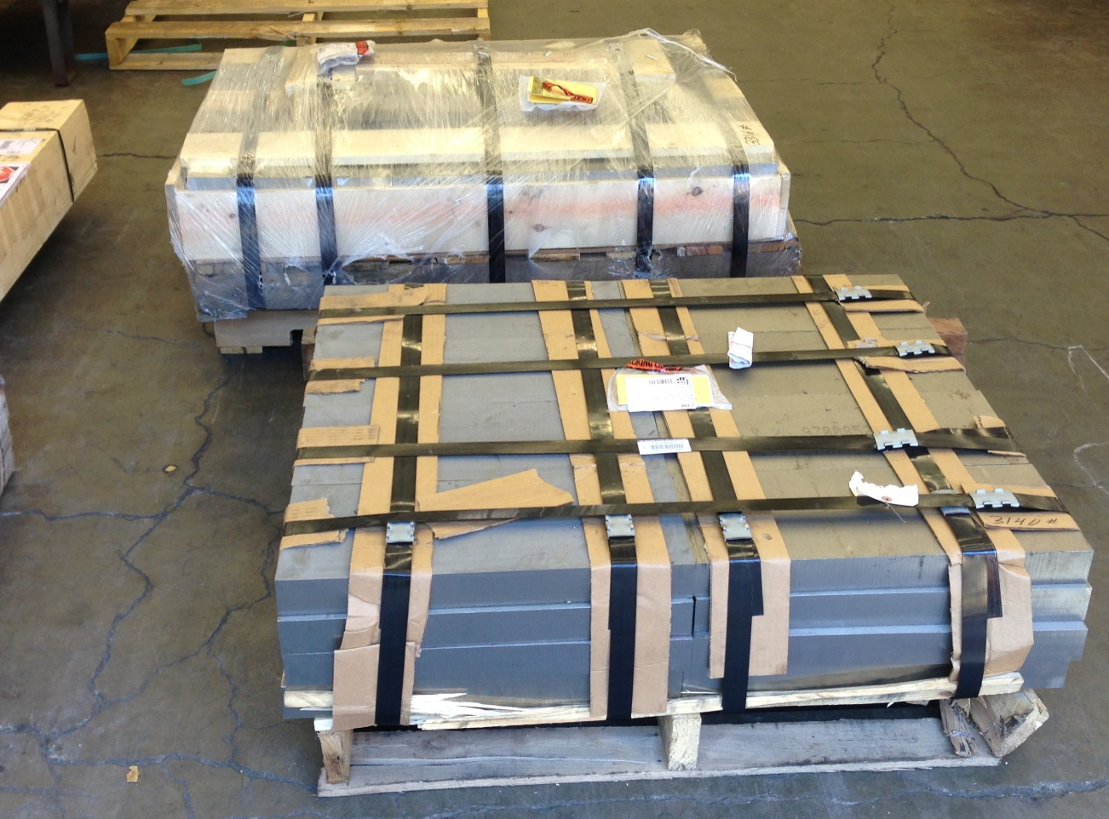
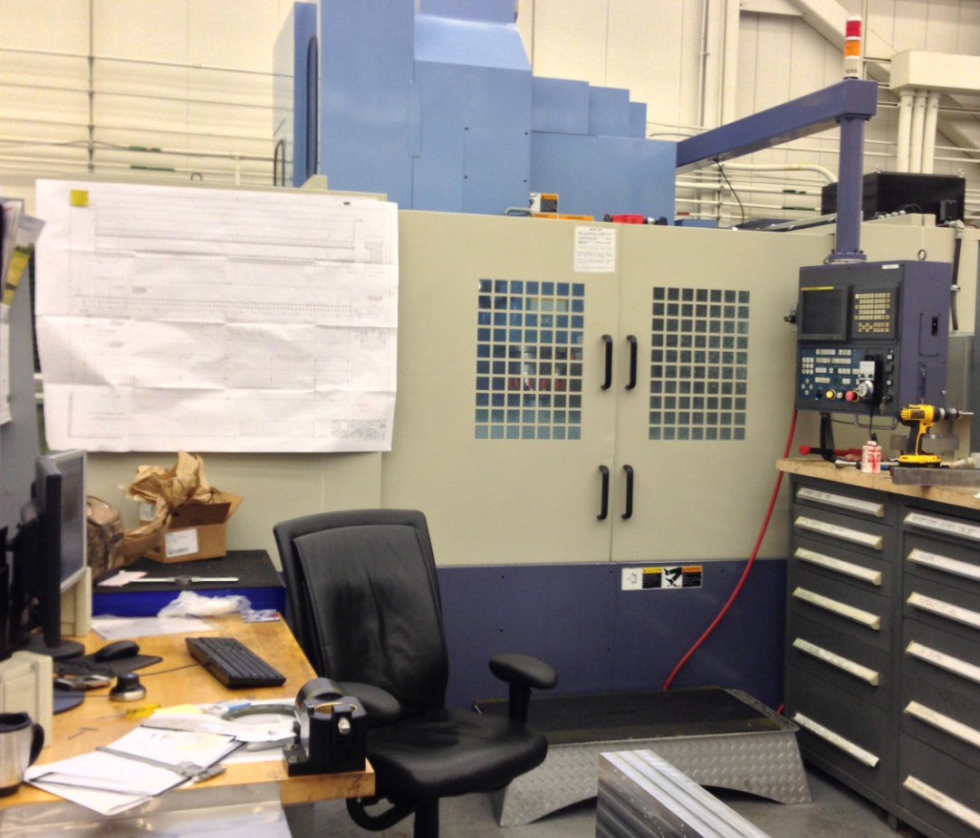
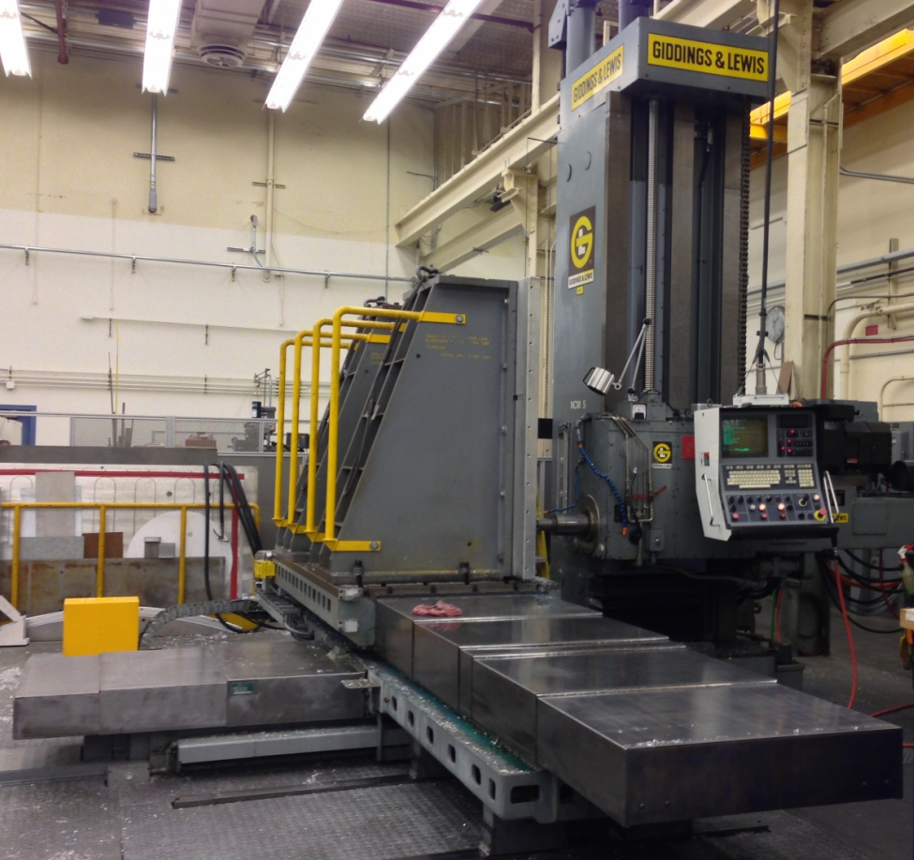
PXIE material at LBNL. One pallet of stainless for joint plates. One pallet of stainless for braze clamps.
The Giddings & Lewis 450, LBNL’s largest mill. Slow but very accurate. It will do all the finish machining and modulations.
One of LBNL’s fast machining centers for roughing out the vanes. This one is large enough to handle the 1 ton copper blocks
Spindle

