Slide 1
Coupler for PXIE RFQ
S. Kazakov
11/29/2012

Slide 2
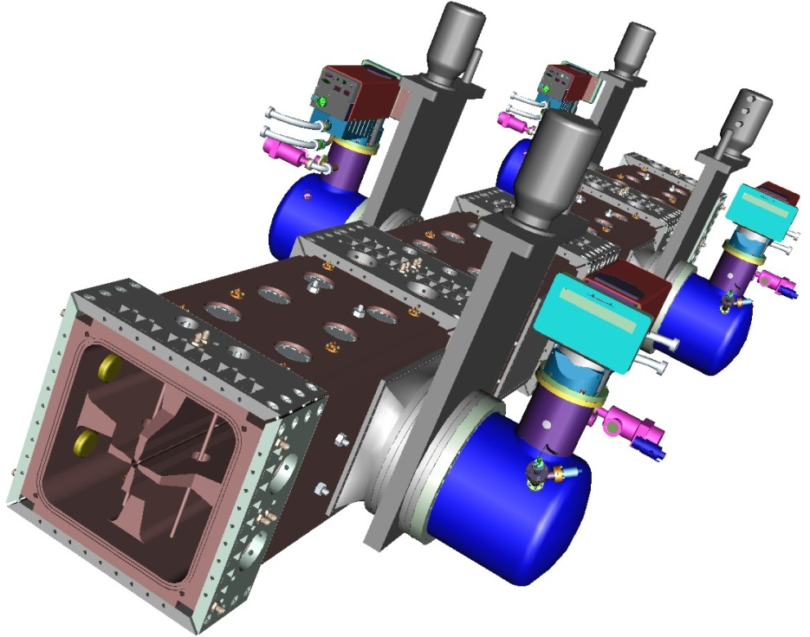
5mA H-, 30 kV -> 2.1 MV
10.5 kW beam, 12% loading
Total RF power ~ 90 kW
Requirements:
F = 162.5
Two couplers , ~75 kW CW each
Input port ~ 3’’
Inductive coupling (loop)

Slide 3
What we did after last meeting:
Bent coupler to reduce the transverse size of RFQ
Changed loop geometry to improve cooling efficiency
Simulated miltipactor in coupler region

Slide 4
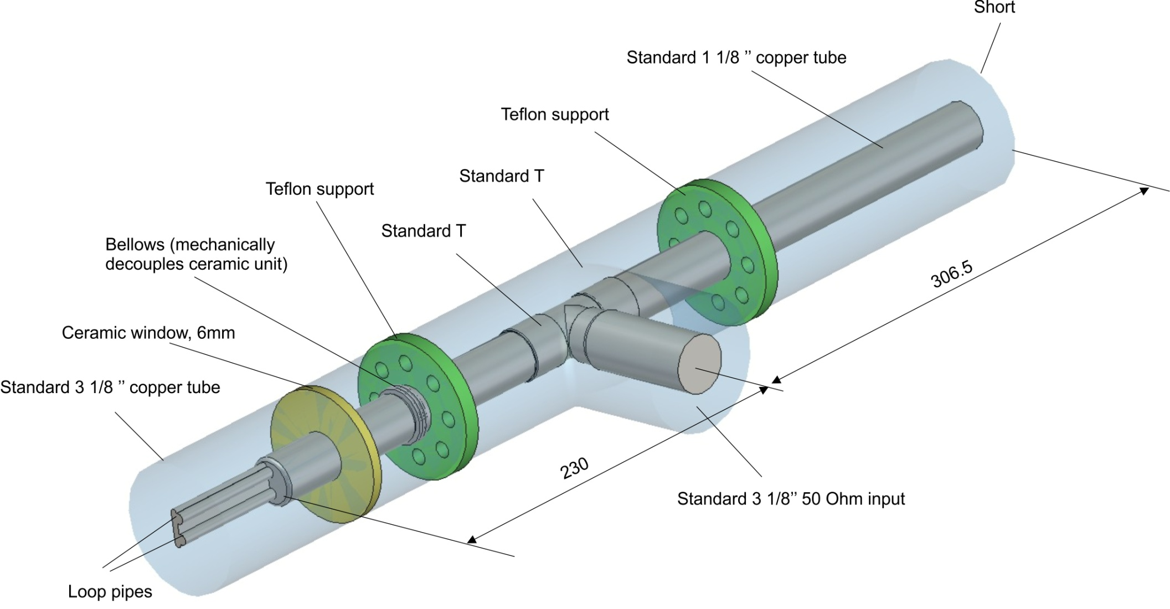
RF structure of coupler (Old)

Slide 5
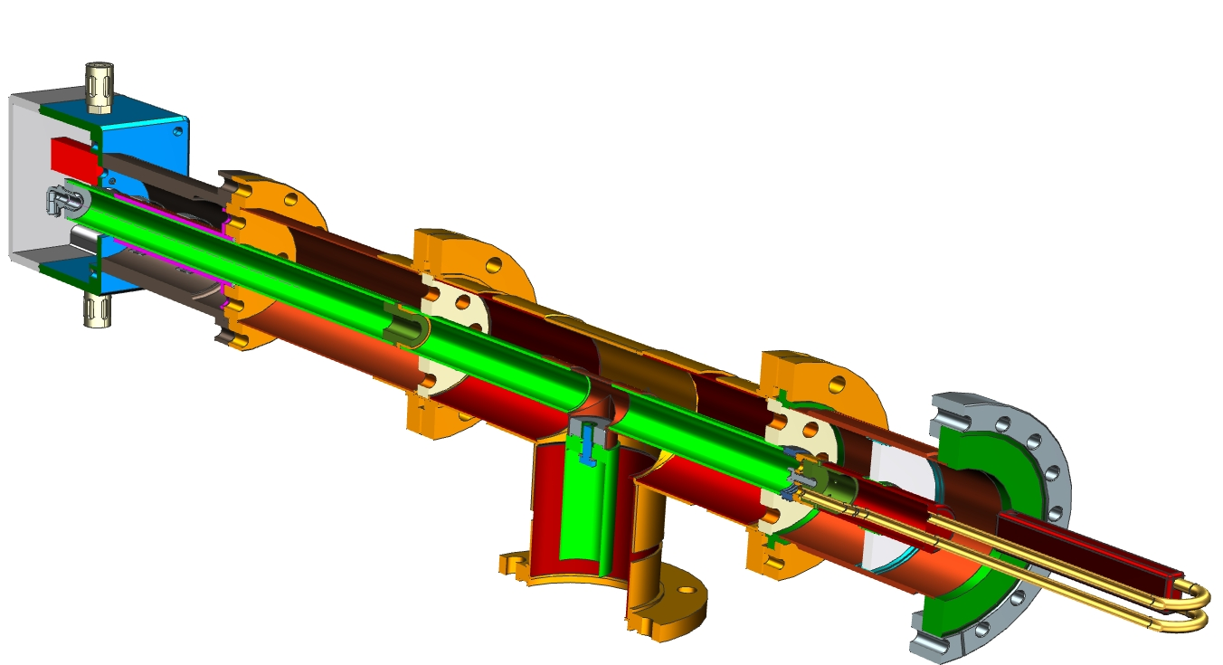
Mechanical design of the coupler (Old)
Arc detector
Air outlet
Capacitor
Copper tubes
Teflon supports
Ceramic window,
Conflate flange
Air inlet
Air outlet
Standard 3-1/8’’ coaxial input
Bronze bellow
Copper tube
Rotatable flanges
Antenna loop

Slide 6
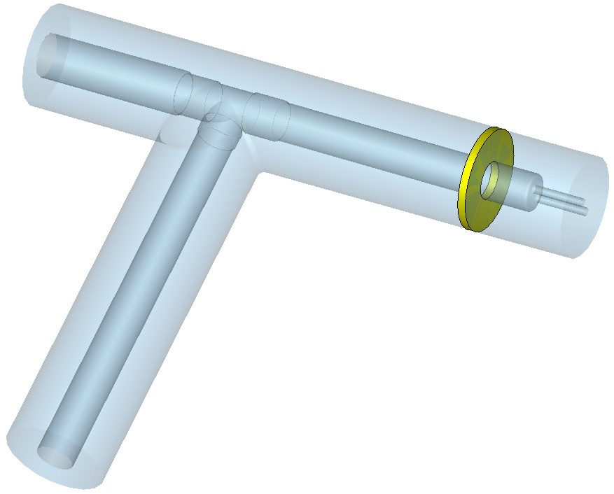
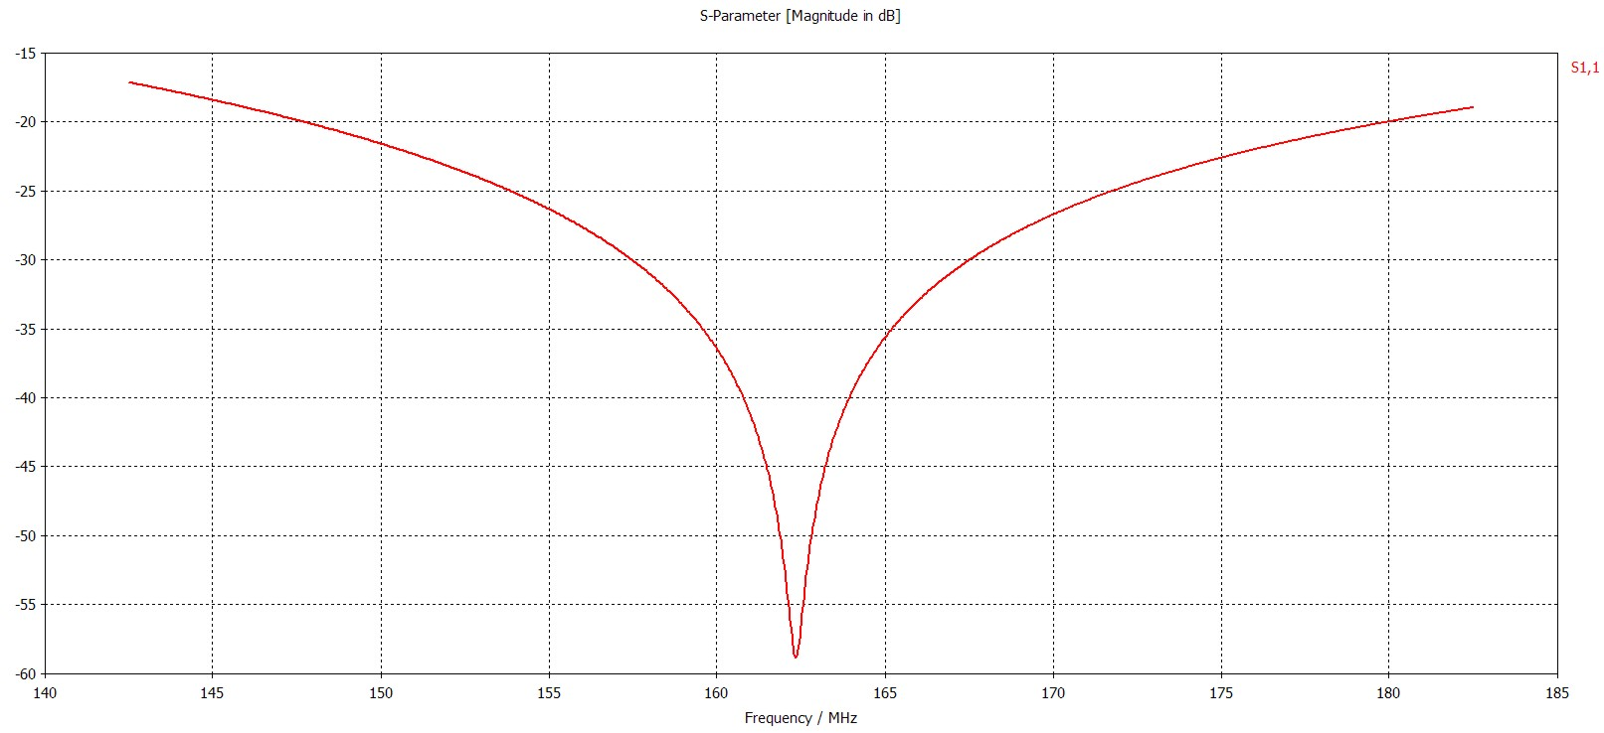
Bent geometry (new), S11
50 Ohm, 3-1/8’’ input
to loop
Pass band (-20 dB) ~ 30 MHz
Short

Slide 7
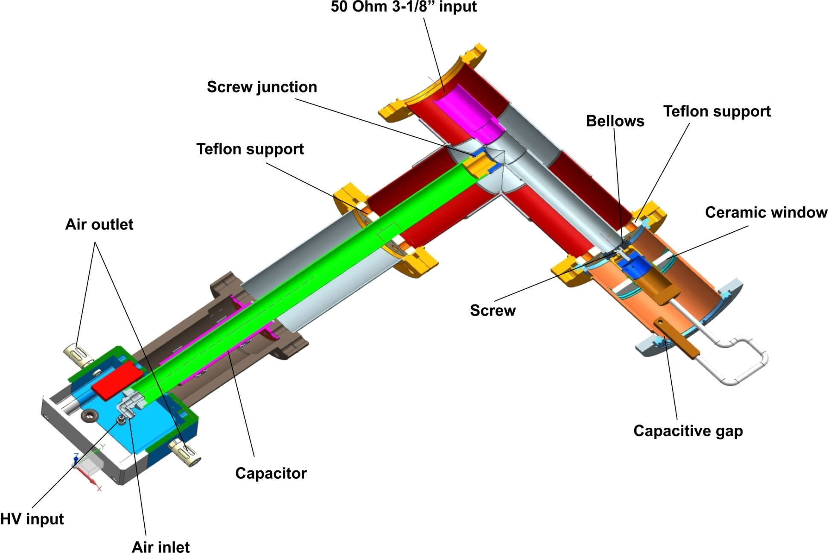
Bent (new) geometry

Slide 8
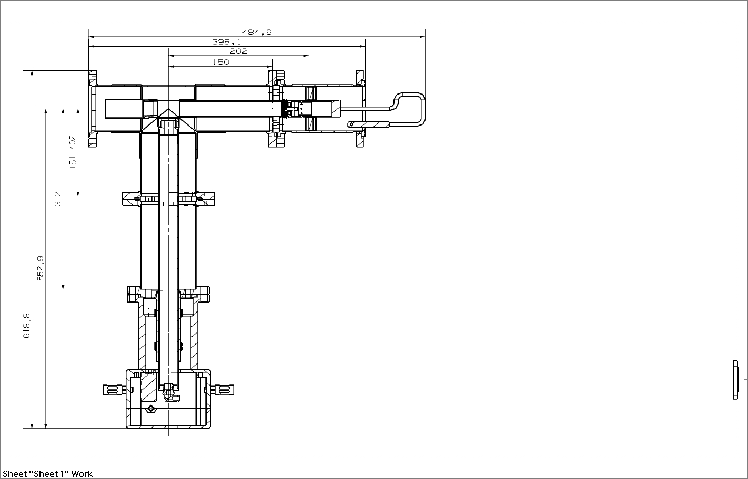
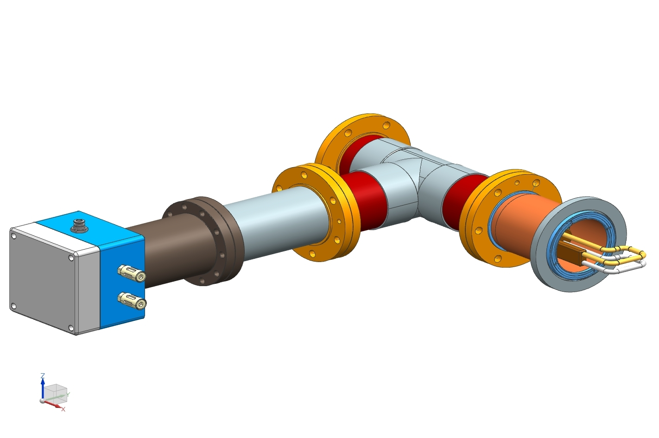

Slide 9
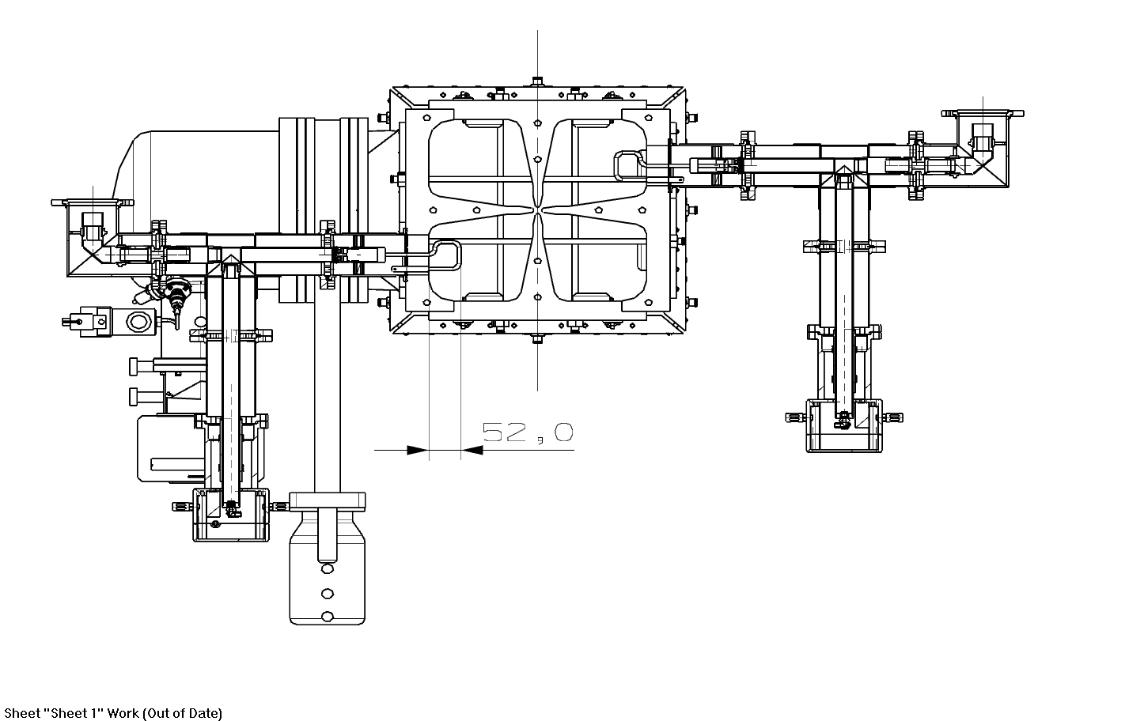

Slide 10
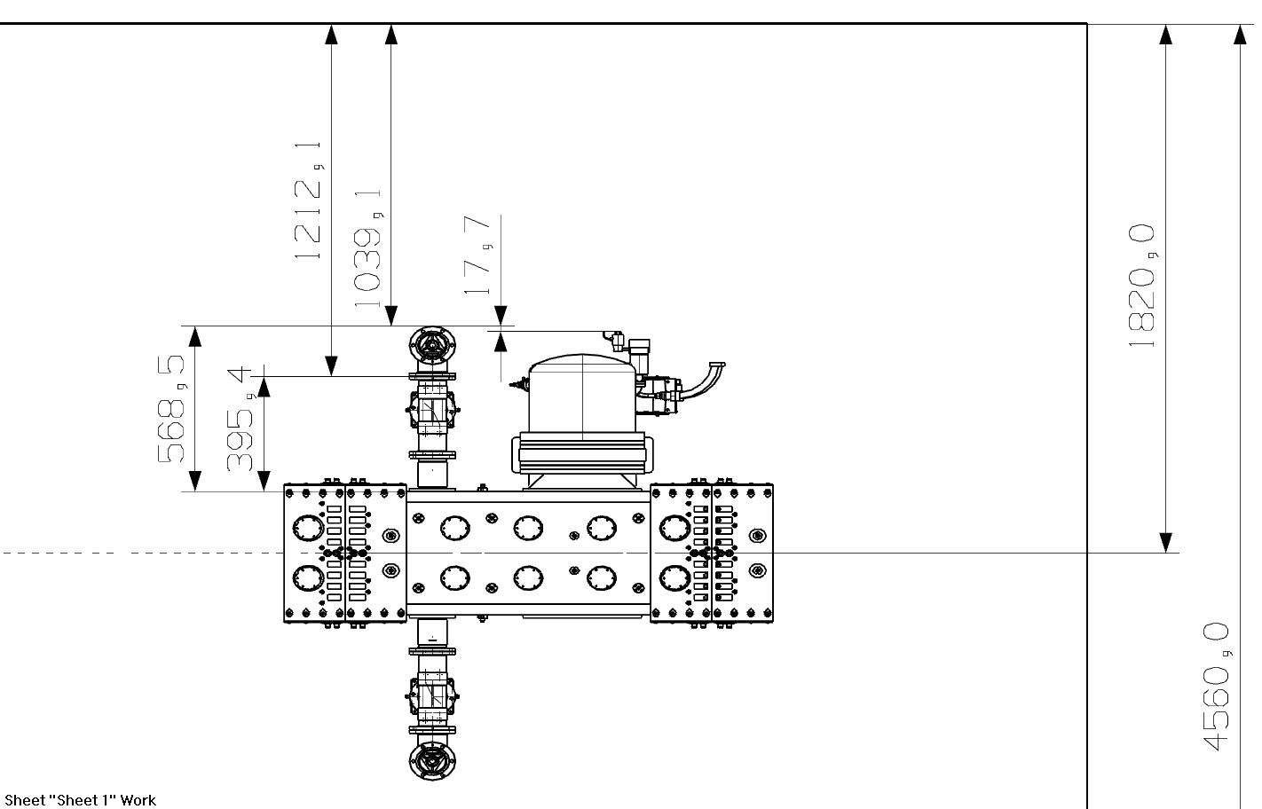

Slide 11
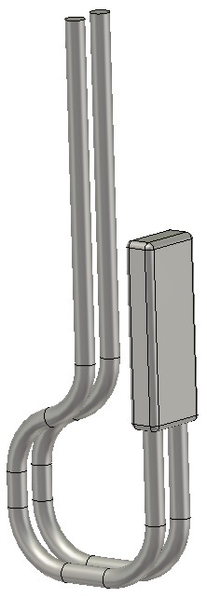
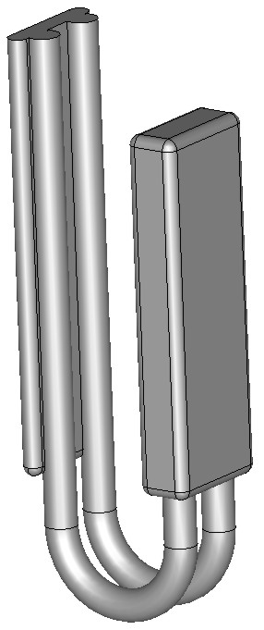
Geometry of loop was changed
Supporting plate is removed.
Cooling efficiency of new geometry is higher ~ 17%.

Slide 12
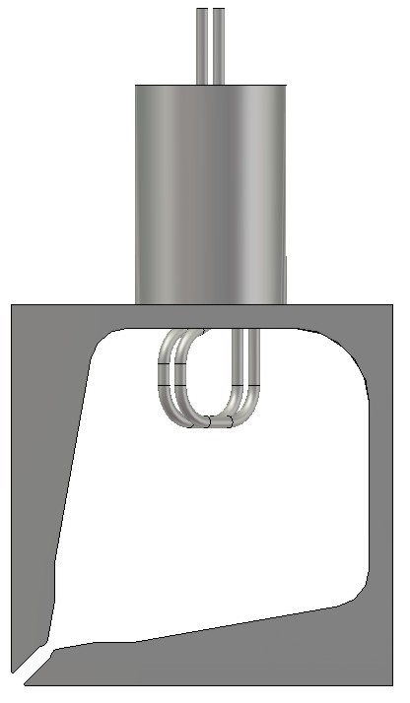
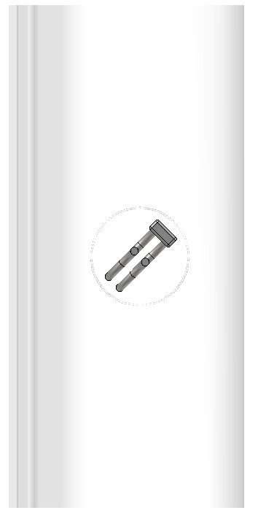
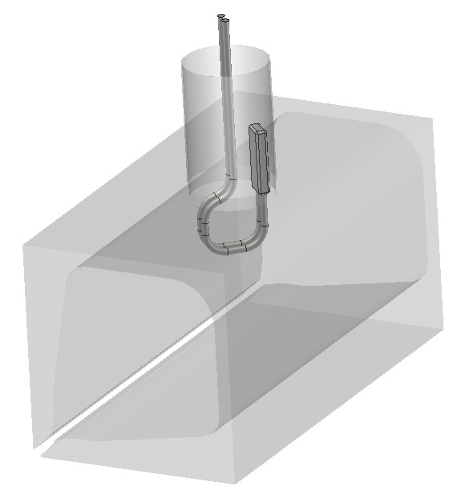
Loop penetration and orientation
Operating angle ~ 45 dgr

Slide 13
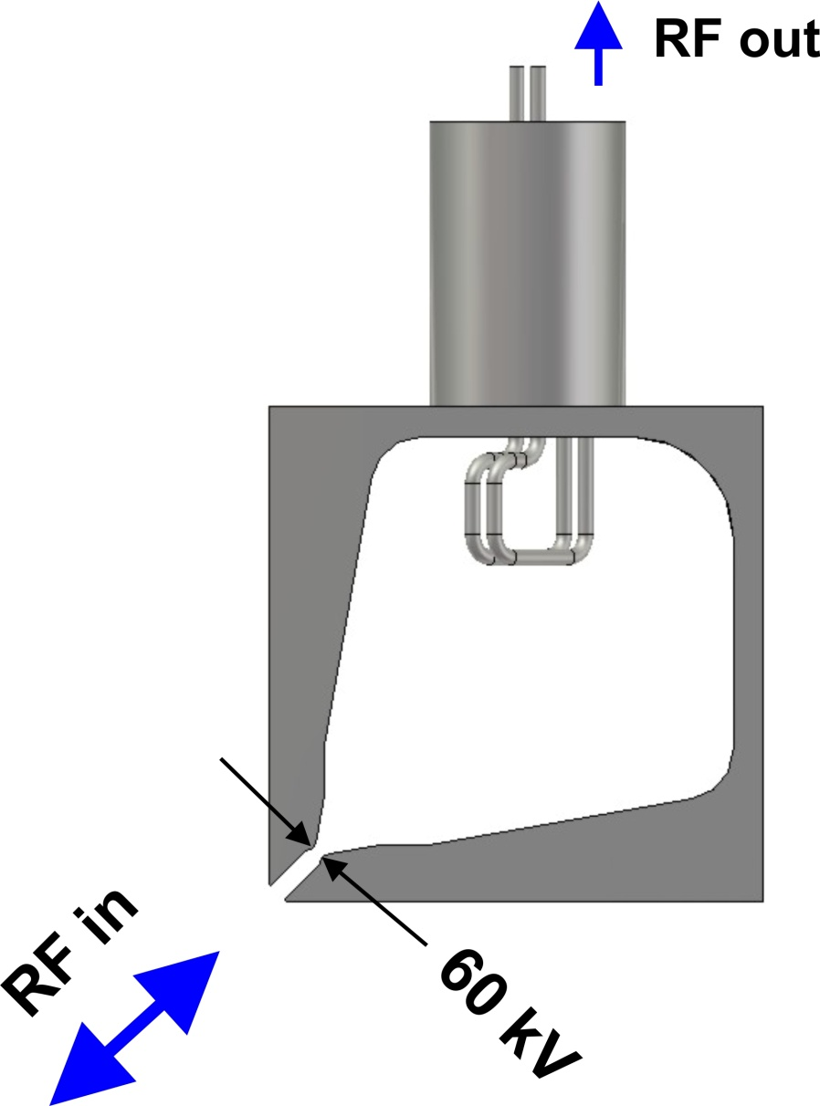
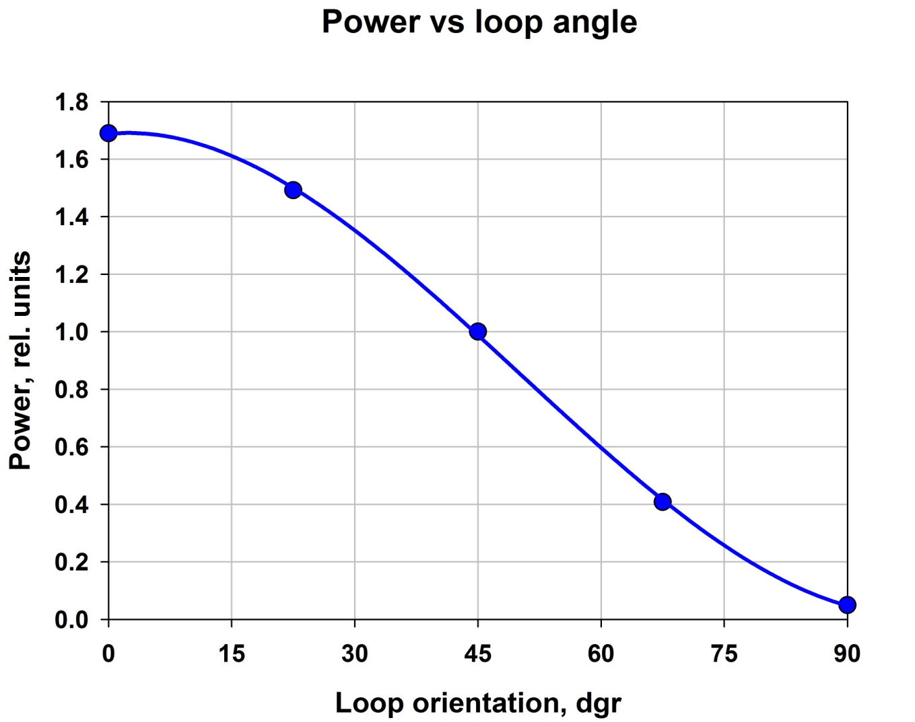
Angle (dgr) | RF out (kW)
0 | 101 kW
22.5 | 90 kW
45 | 59 kW
67.5 | 24 kW
90 | 3 kW

Slide 14
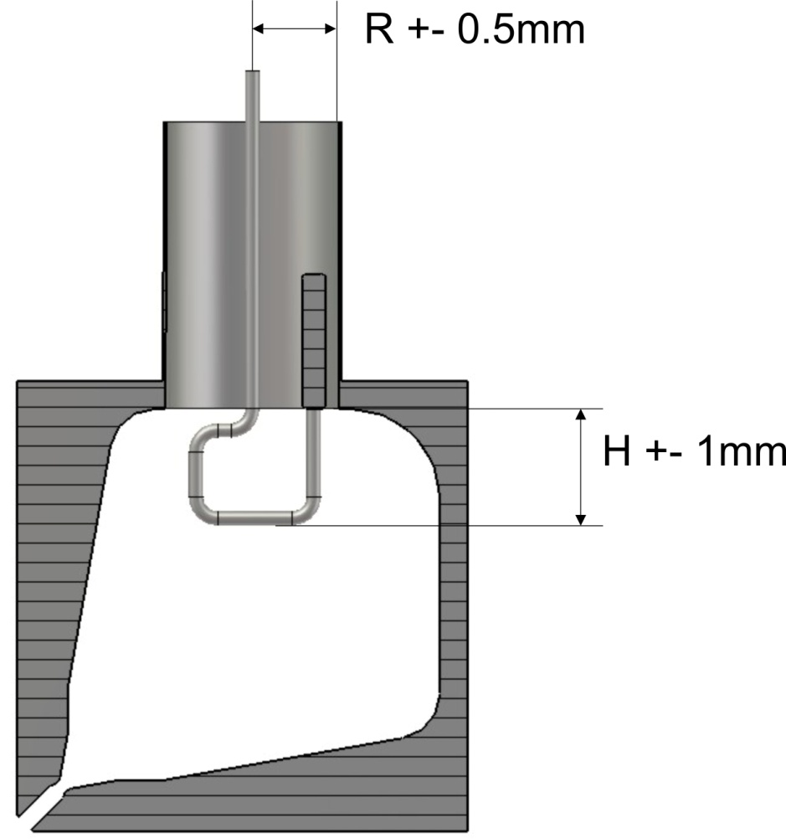
Sensitivity to loop sizes
R | RF out (rel. un)
R - 0.5mm | 1.0274
R | 1.0000
R + 0.5mm | 0.9348
H | RF out (rel. un)
H + 1mm | 1.0870
H | 1.0000
H- 1mm | 0.9605

Slide 15
Multipactor

Slide 16
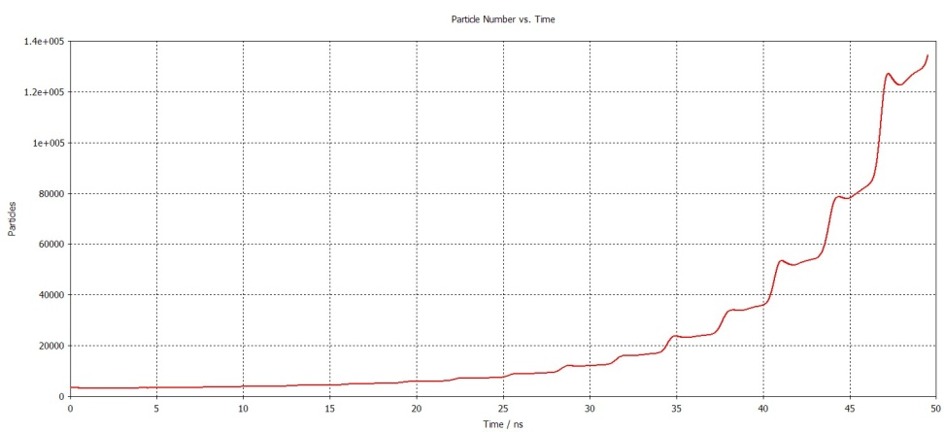
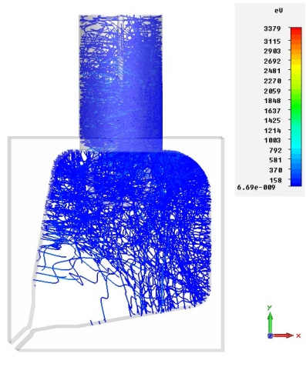
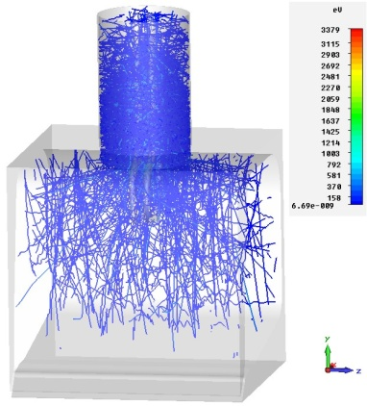
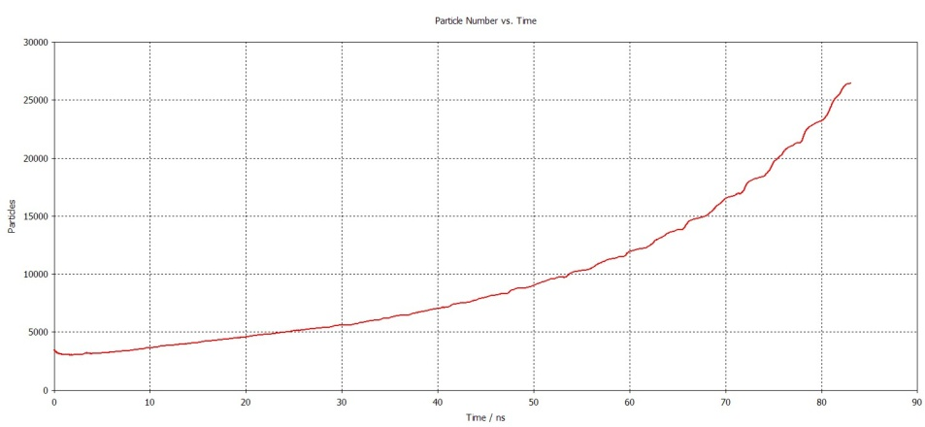
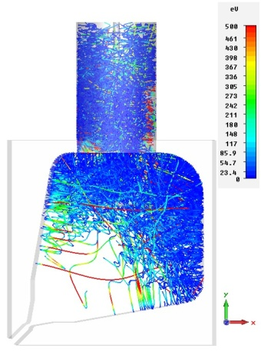
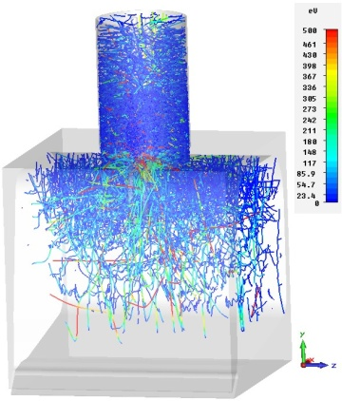
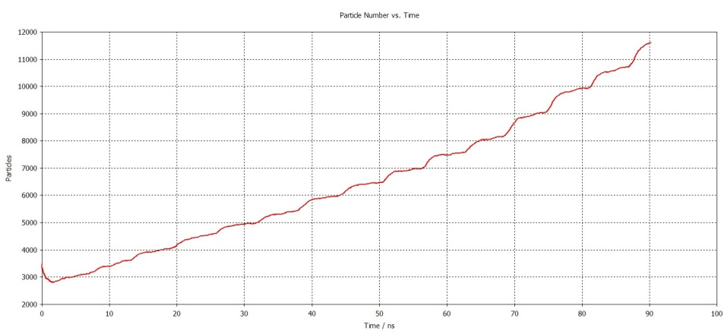
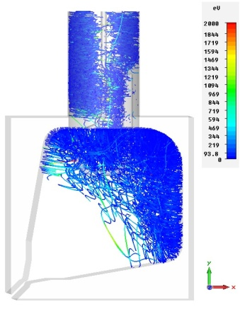
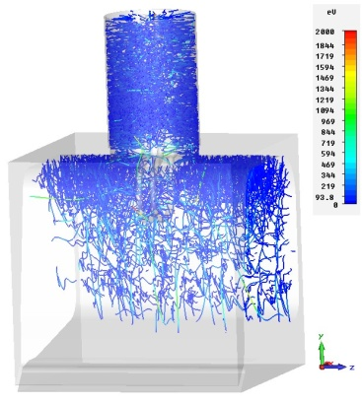
Vane V
3.8 kV
7.5 kV
15 kV

Slide 17
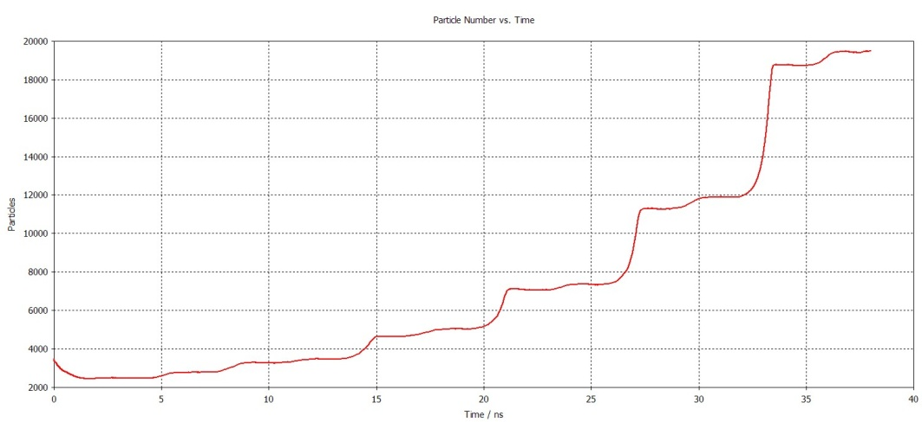
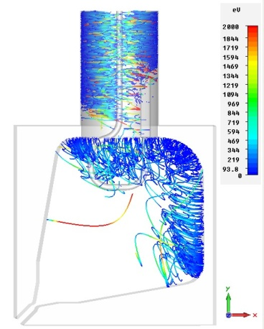
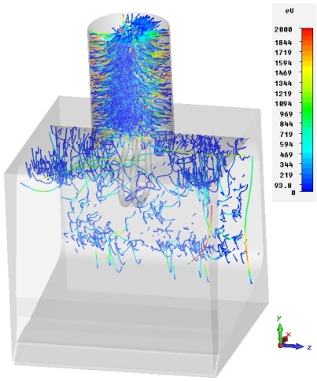
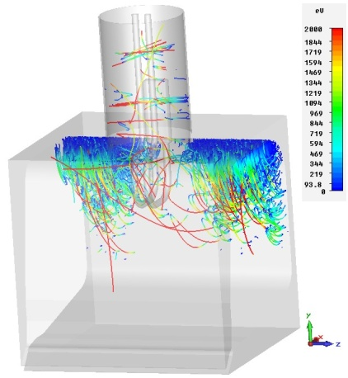
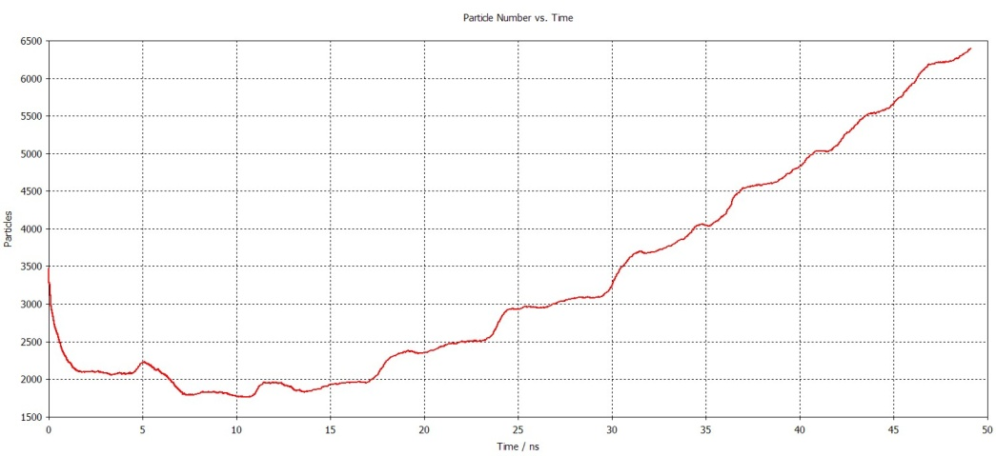
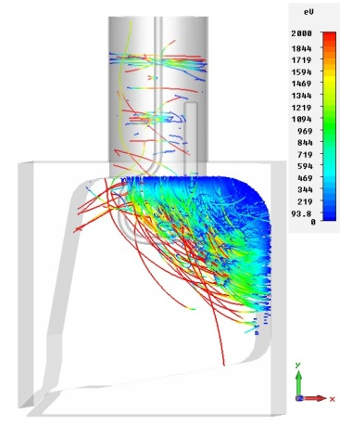
Vane V
30 kV
60 kV
Simulations show that
multipacor exists at 4 KV – 60 kV range of vanes voltage
(in input coaxial and cavity volume)

Slide 18
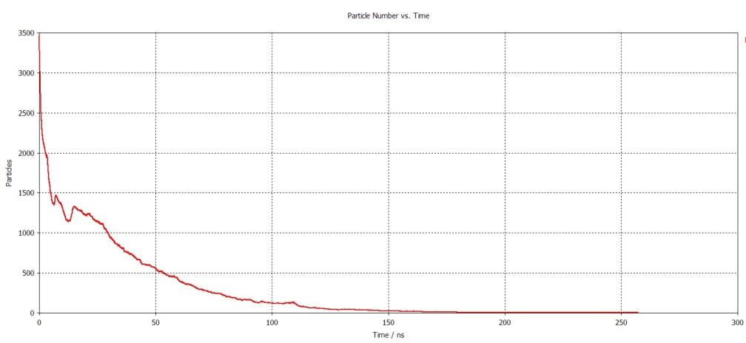
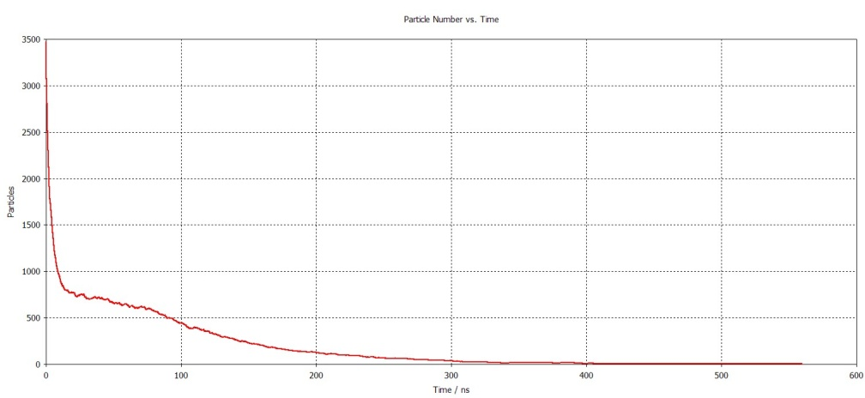
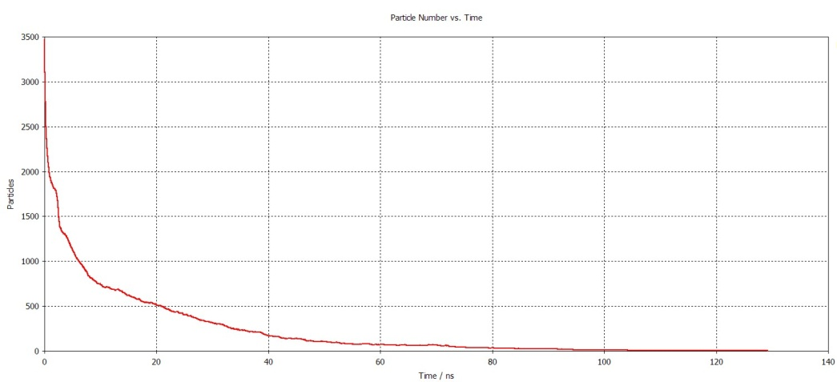
Multipactor suppression by HV bias
Vanes voltage 3.8 kV
HV bias 1.0 kV
Vanes voltage 7.5 kV
HV bias 2.0 kV
Vanes voltage 15 kV
HV bias 2.0 kV

Slide 19
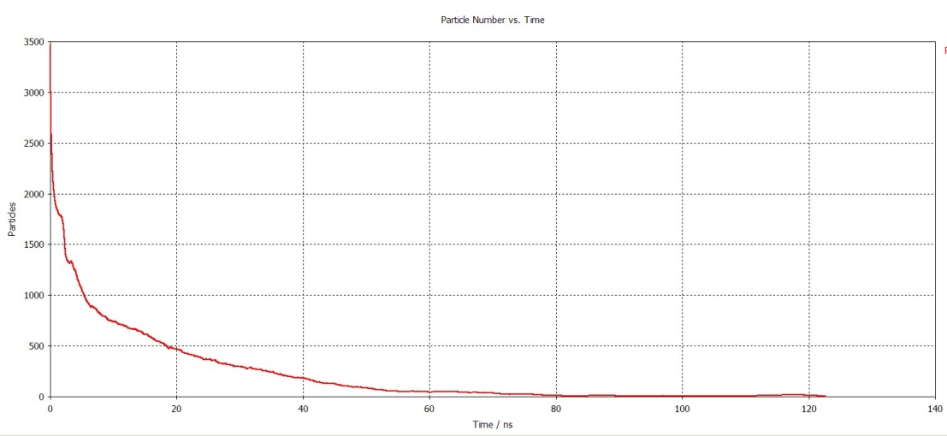
Vanes voltage 30 kV
HV bias 4.0 kV

Slide 20
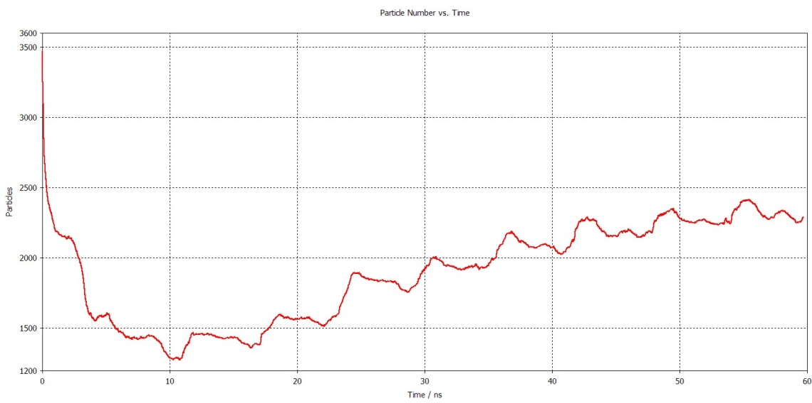
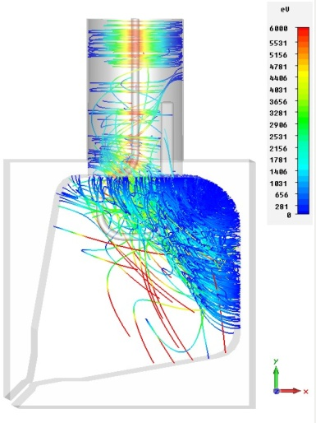
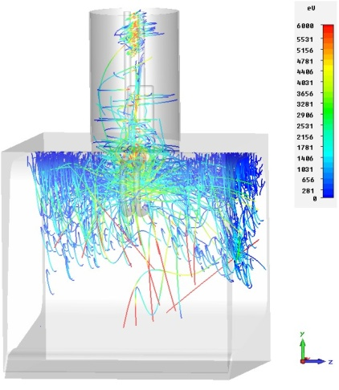
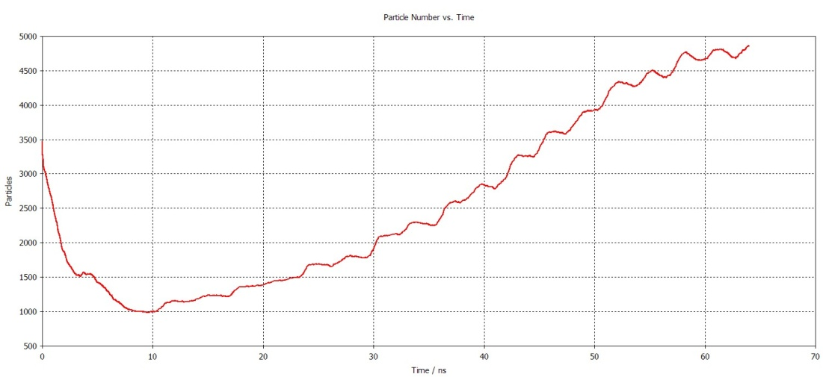
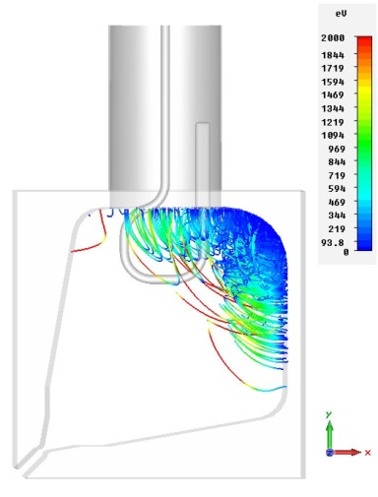
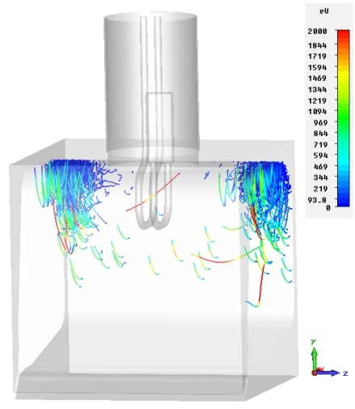
60 kV, +2 kV
60 kV, -2 kV

Slide 21
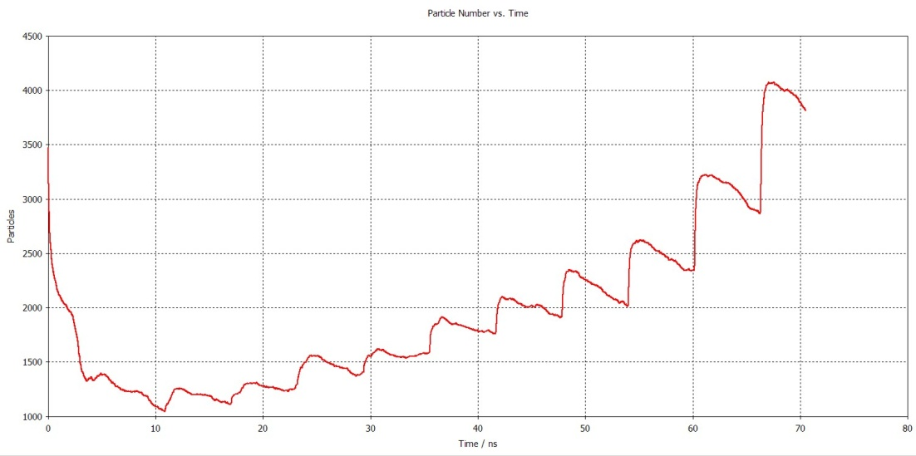
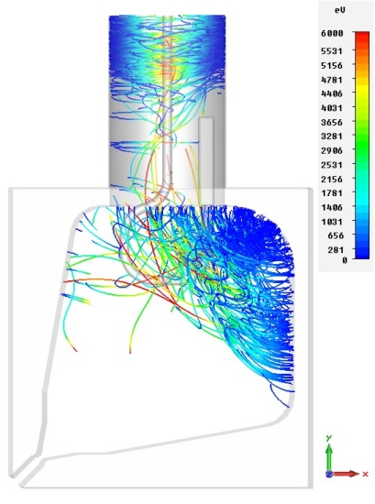
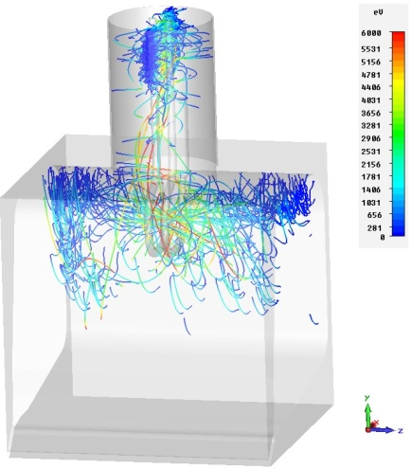
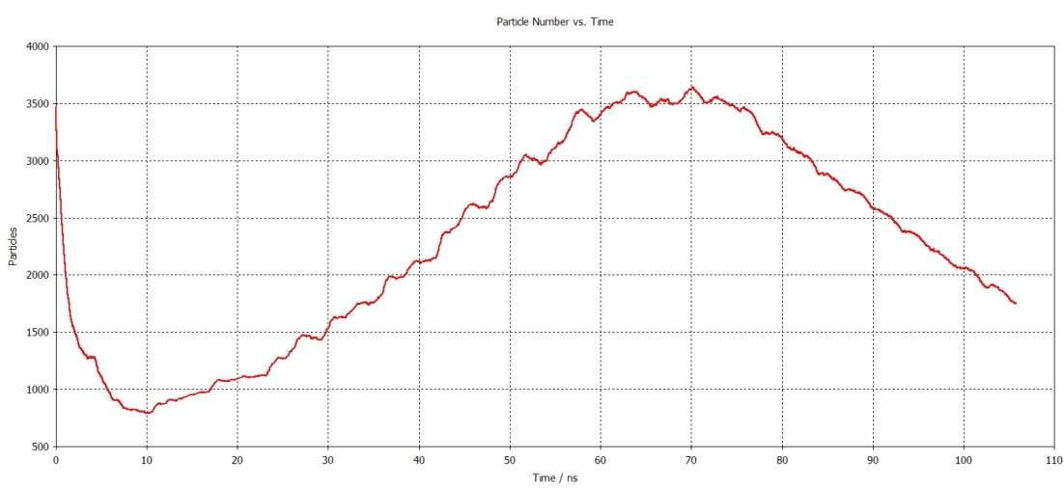
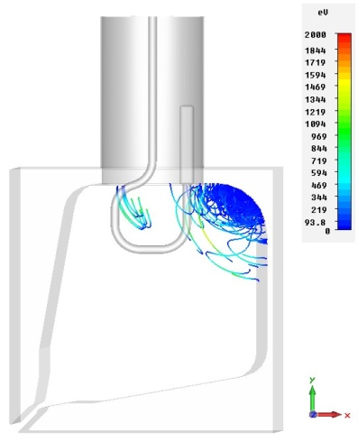
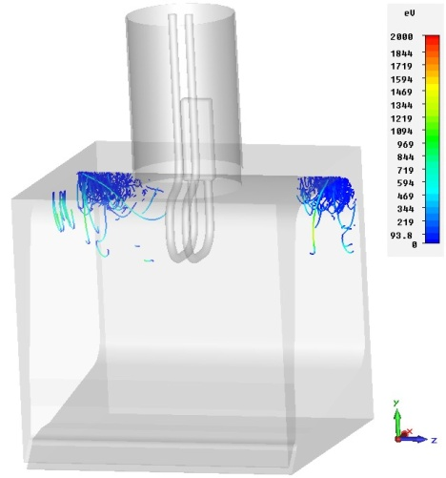
60 kv, + 3 kV
60 kV, -3kV

Slide 22
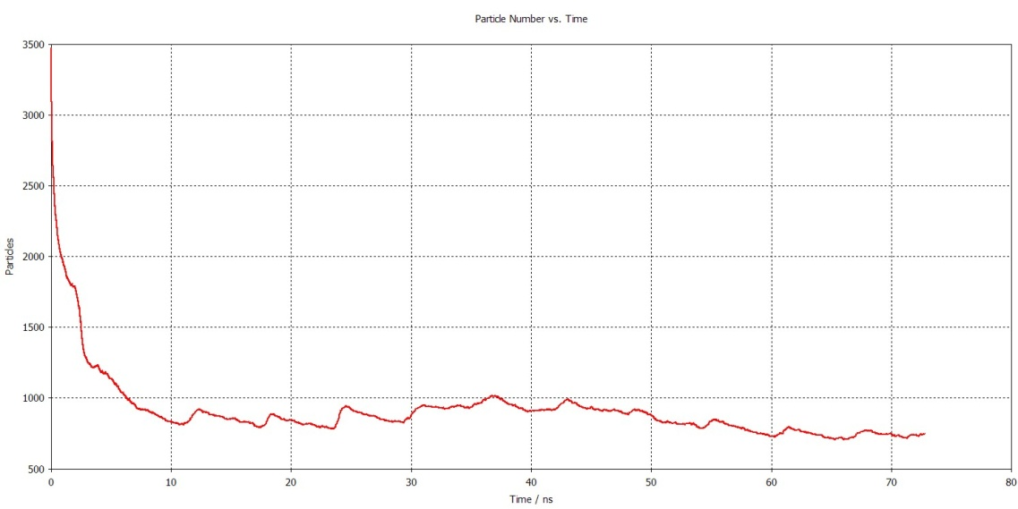
60 kV, +4 kV
60 kV, -4kV

Slide 23
60 kV, +5 kV
60 kV, -5 kV

Slide 24
60 kV, +6 kV
60 kV, -6 kV

Slide 25
Conclusion:
Multipactor exists in coupler and cavity volumes.
HV bias suppresses multipactor on coupler region
Multipactor in cavity can be a problem and requires additional study.

Slide 26
Coupler connection to RFQ body

Slide 29
Our suggestion (following LBNL style).
LBNL should provide flange design.

Slide 30
Future plans:
Thermal and stress analyses
Finalizing design
Design of test facilities
Drawings
Production
High power test

