Slide 1
IMP RFQ Status and Fabrication Tests
Derun Li
Center for Beam Physics
Lawrence Berkeley National Laboratory
PXIE RFQ Meeting, Fermilab, IL
November 29, 2012

Slide 2
IMP RFQ Status
Beam dynamics frozen
Beam dynamics design is optimized for 15 mA
Error analysis complete
Thermal and mechanic analysis complete
Engineering design complete
RF design complete
Collaboration with Fermilab
Validation of the RF simulations by IMP in progress
Fabrication tests started
Formed cutter
Full length vane (gun drill, e-beam plugs and modulation)
Braze tests
Half module (including all features of tuners, pi-mode rods, two ends) in progress
Allow for low power RF measurements

Slide 3
IMP RFQ Status
Fabrication drawings
Delivered rough machining drawings last week
Production copper (from Hitachi) received
Fabrication (rough machining) to start next month
RF source purchased and will arrive next month
200 kW total
Interface with LEBT and MEBT to be finalized
RF power couplers
Design and fabrication by IMP (with LBNL’s assistance)
IMP RFQ schedule
Fabrication will be carried out at IMP machine shop (upgrade of the shop in progress)
New hydrogen furnace (arrived in August 2012)
Complete by end of 2013 (aggressive)

Slide 4
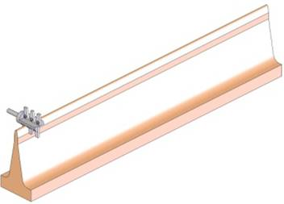
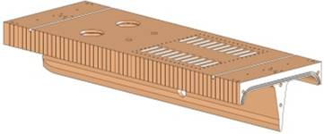
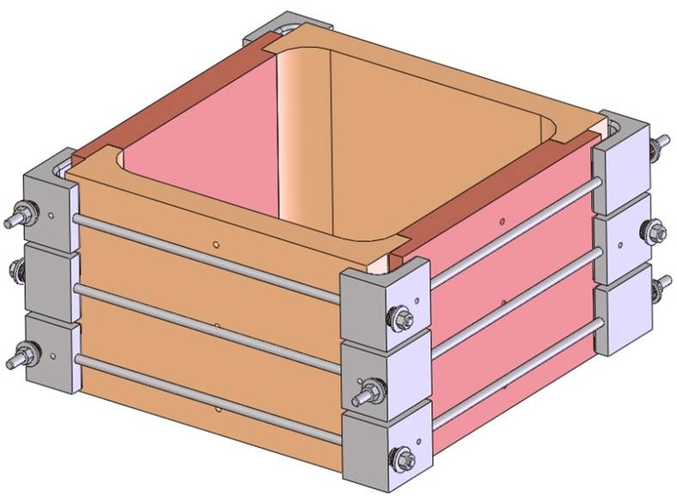
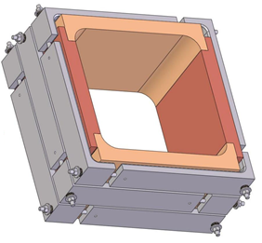
Fabrication Tests at IMP
Vane cutting tool test
Full length vane fabrication test
Vane braze test
New braze clamp design
Half module

Slide 5
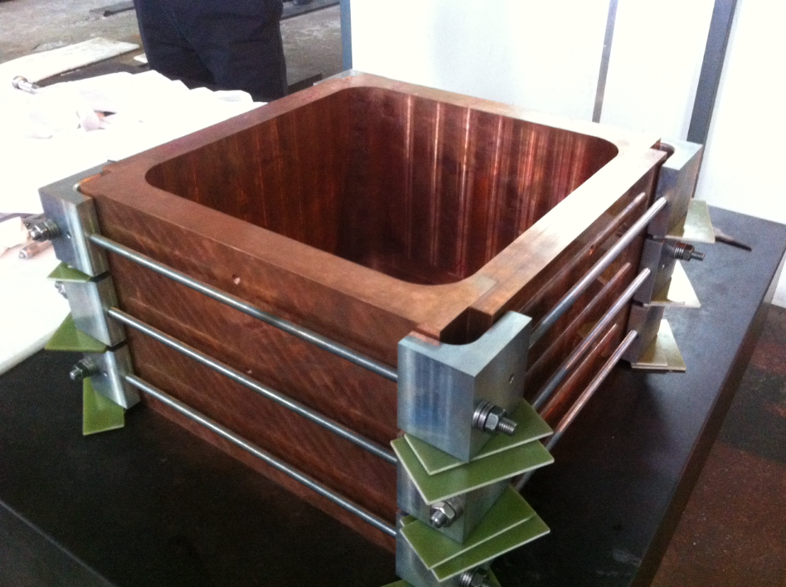
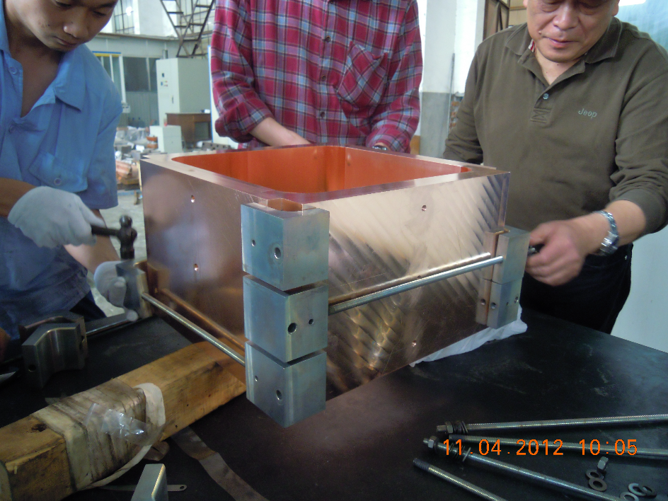
Braze Tests at IMP
Two braze tests were conducted in the summer of 2012 with unsatisfactory results
Updated clamp design
Provide strong support to copper
Reduce and control the torque force on the clamps

Slide 6
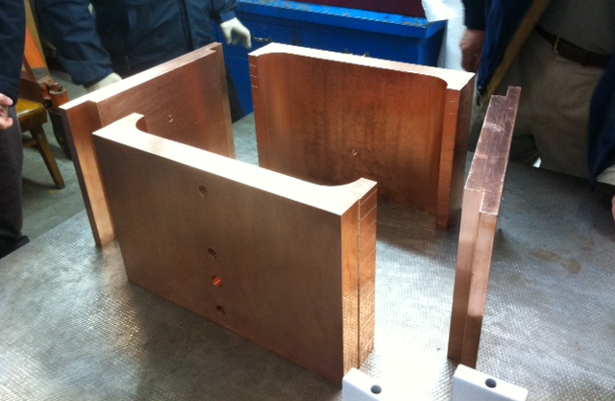
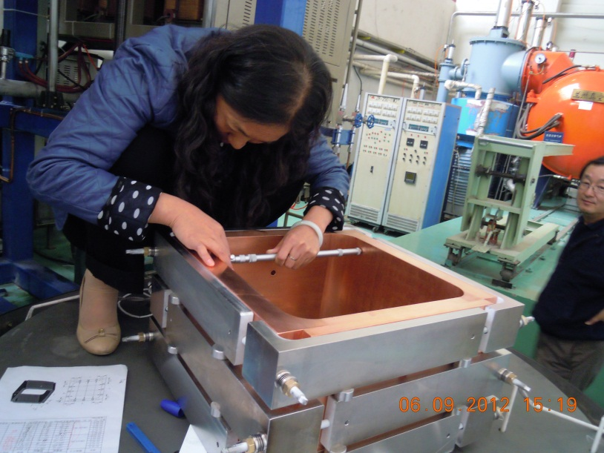
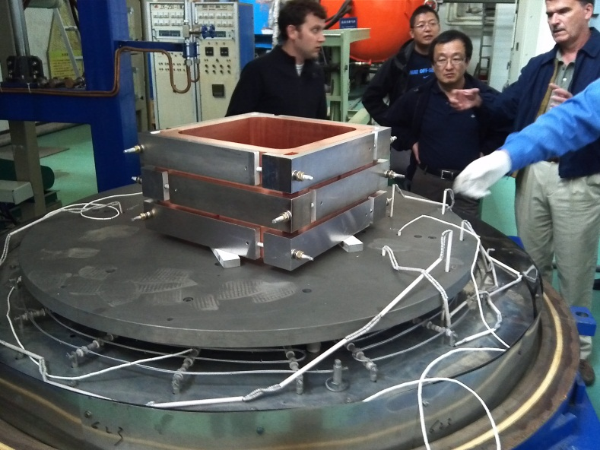
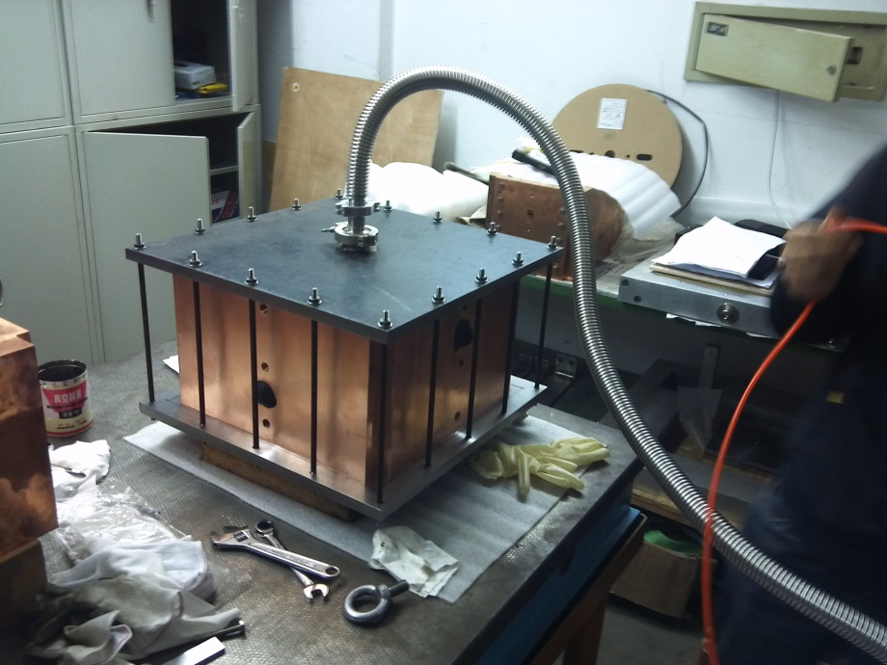
Braze Test using New Clamp
Vacuum tight & acceptable distortion

Slide 7
Temperature Ramping Profile
Used SNS RFQ temperature ramping profile & the total braze cycle: is 32 hours; Temperature difference between the part and clamps is within ± 3 degrees

Slide 8
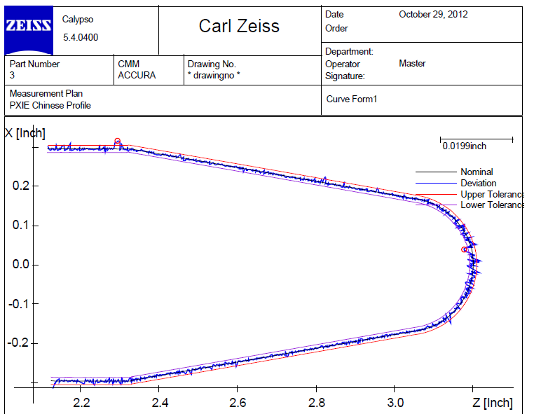
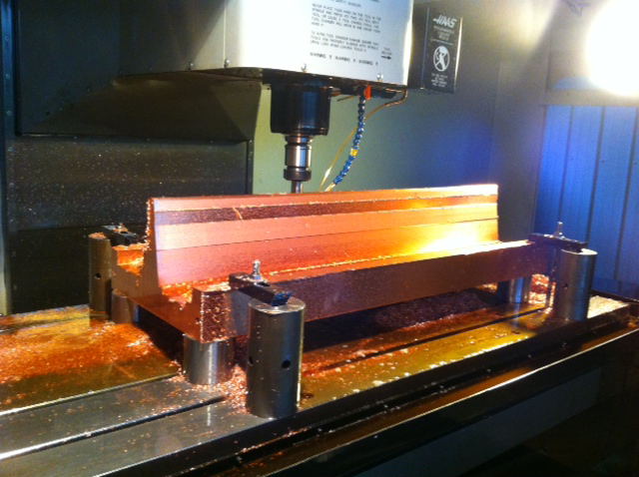
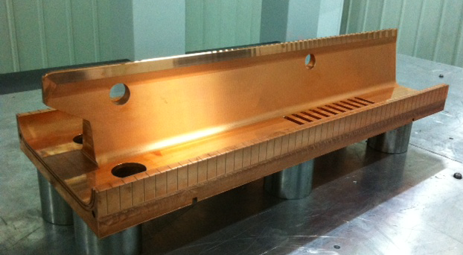
Formed Cutter & Full Length Vane
Formed cutter
Sample part with modulation made by IMP was measured at LBNL → Good profile
A full length vane was machined at IMP

Slide 9
Module RF Simulations at LBNL
To validate the RF simulation results by Romanov, ANSYS code was used to perform RF simulations on RFQ geometry for Modules 1, 3, & 4 with magnetic BC on one end, not the full RFQ length
Module 1: Cutbacks (entrance), radial matcher, slug tuners, Pi-rods
Module 2&3: slug tuners, Pi-rods
Module 4: Cutbacks (exit), slug tuners, Pi-rods
For the RF simulations, the model does not have vane modulations
The ANSYS simulations done by Andrew Lambert

Slide 10
Module 1
Vacuum geometry is one quadrant and contains
Slug Tuners
Pi-Rods
Cutbacks
Radial Matcher

Slide 11
Electric Field Flatness of Module 1
Field is flat within 8-9%
Some level of noise due numerical simulation and interpolation
Frequency = 159.5 MHz

Slide 12
Electric Field Flatness of Module 3
Finer meshes
Zoomed in portion of the plot shows noise more clearly
Not considering large peaks, the field is still flat within 3-4%
Frequency = 162.0 MHz

Slide 13
Electric Field Flatness of Module 4
Coarse meshes
Field is flat within 8-9%
Frequency = 162.1 MHz

