Slide 1
Transforming Geant4 for the Future
Bob Lucas and Rob Roser

Slide 2
Geant4 is Important to HEP
Big computation
Large ensembles of sequential jobs
Runs on a worldwide Grid of processors
$10M per year of HEP H/W investment
Big data
HEP has more simulated than collected data
Geant4 generated most of HEP’s O(100) PBytes
Any useful data curation must also curate the experiment’s Geant4 program

Slide 3
Challenges for Geant4’s Future
Geant4 is a sequential C++ toolkit
MC runs are ensembles dispatched to the Grid
It can take months to simulate a billion particles
CPU capability has plateaued
Dennard scaling has ended
This constrains progress in HEP
Precludes more sophisticated physics packages
Precludes real-time adaptation of data analysis
Hampers analysis of individual events in isolation

Slide 4
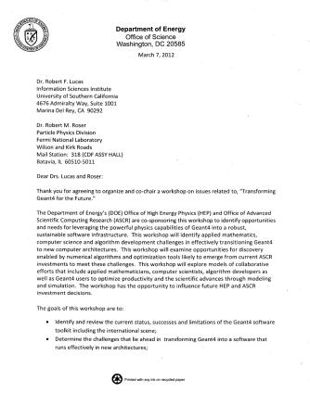
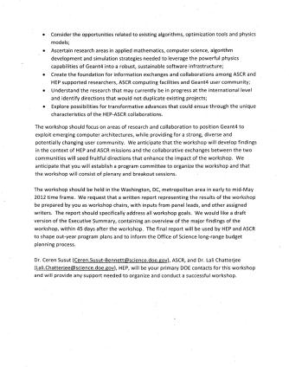
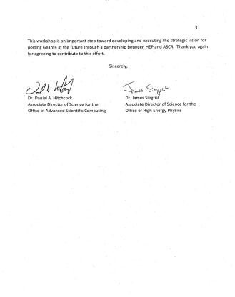
Charge from Dan Hitchcock (ASCR)
and Jim Siegrist (HEP)

Slide 5
Summary of Charge from Dan and Jim
Bob Lucas and Rob Roser to co-chair workshop
Ceren Susut and Lali Chatterjee are DOE contacts
Goals:
Review status, successes and limits of Geant4
Determine challenges posed by new architectures
Consider opportunities in algorithms and optimization
Ascertain research for robust, sustainable code
Create foundation among ASCR and HEP investigators
Understand and not duplicate international efforts
Explore transformative advances via HEP-ASCR collaboration

Slide 6
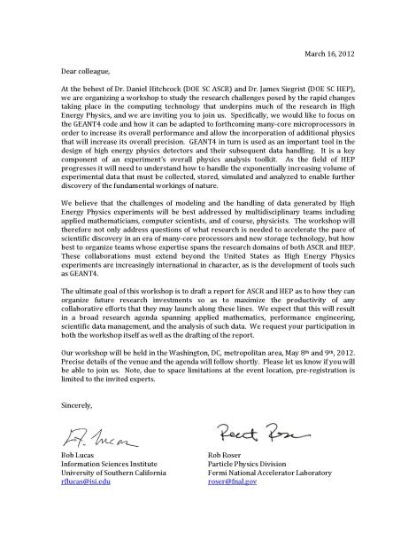
Invitation to Participants

Slide 7
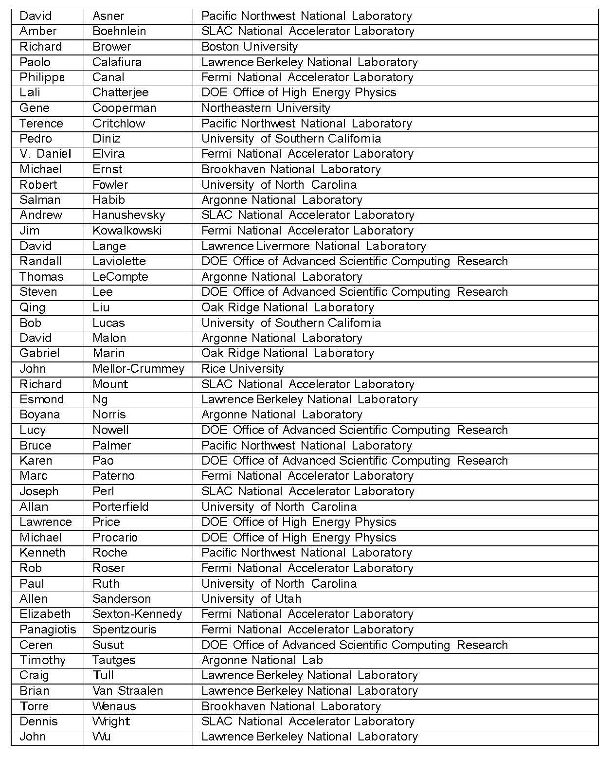
Participants
DOE 8
Labs 31
Academe 9
Total 48

Slide 8
Logistics
Dates: May 8-9, 2012
Location: Rockville Hilton, Rockville, MD
Run by Donna Nevels
Oak Ridge Institute for Science and Education

Slide 9
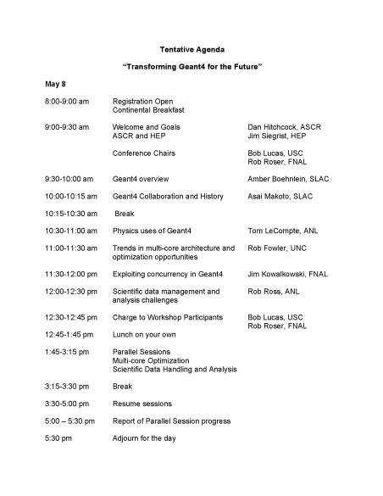
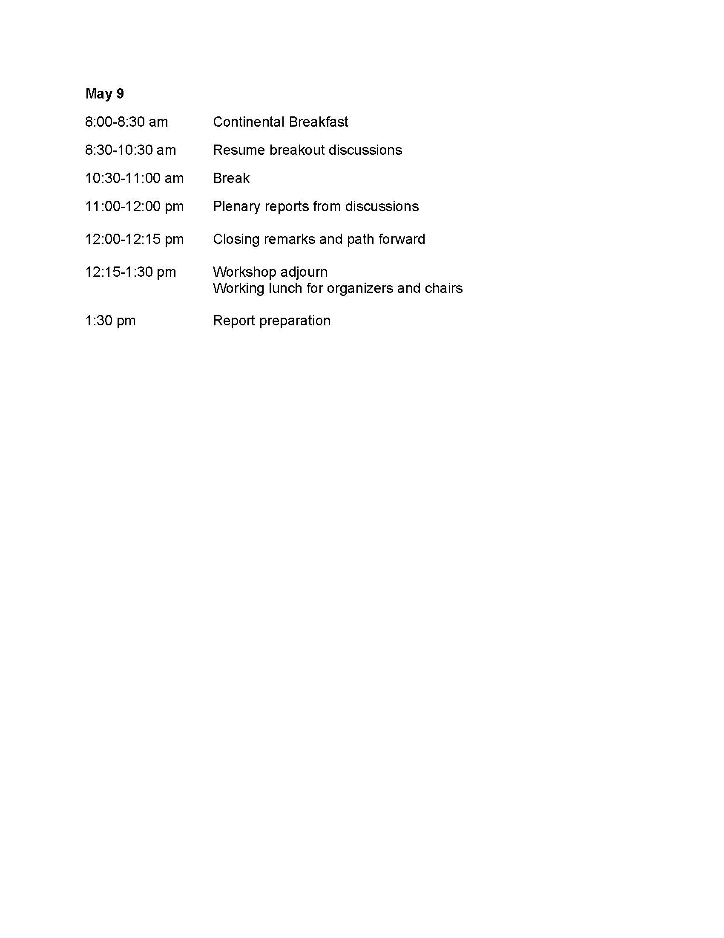
Agenda

Slide 10
Challenges Discussed
Low-level Code Enhancements
Multi-threading
S/W Reengineering
Domain Specific Optimization
Early Adoption of ASCR Research
CAD Interface for Geometry
Parallel I/O
Data Access
Distributed Data Management
Workflow and Provenance
Visualization and Analysis

Slide 11
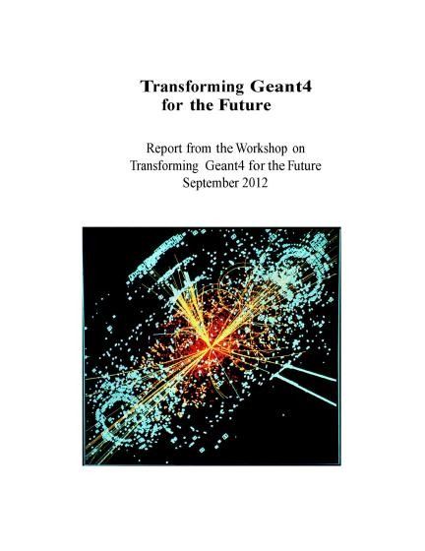
Report
Rob Fowler from UNC created a shared SVN repository
All participants were invited to contribute
Finalized in Sept. 2012

Slide 12
Summary
Increasing the capability of Geant4 is important to HEP
ASCR and HEP should investigate this together
Optimize today’s Geant4 for immediate impact
Refactor Geant4 for future computing systems
Address challenges from the PBytes of data generated
Must coordinate with worldwide Geant4 collaboration

