Slide 1
ALICE concurrency needs and plans
Andrei Gheata
Annual Concurrency Meeting
FERMILAB 04/02/2013

Slide 2
Simulation today and tomorrow
Today: mostly GEANT3-based
~15% of the real data events, eating ~60% of the current consumed CPU in GRID
Event level parallelism has been prototyped in the past (M.Tadel)
Performance studies at different levels (detector & physics performance) done with GEANT4
G4 not in production
FLUKA VMC interface discontinued for few years (licensing issues), now back in usage by ALICE only
Radiation protection studies, but also full detector simulation

Slide 3
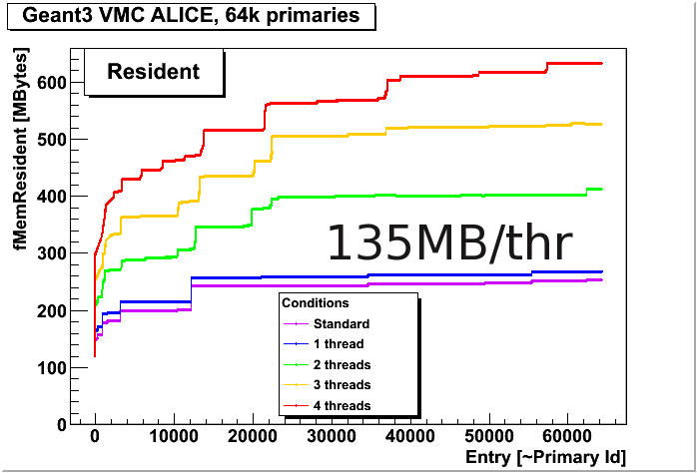
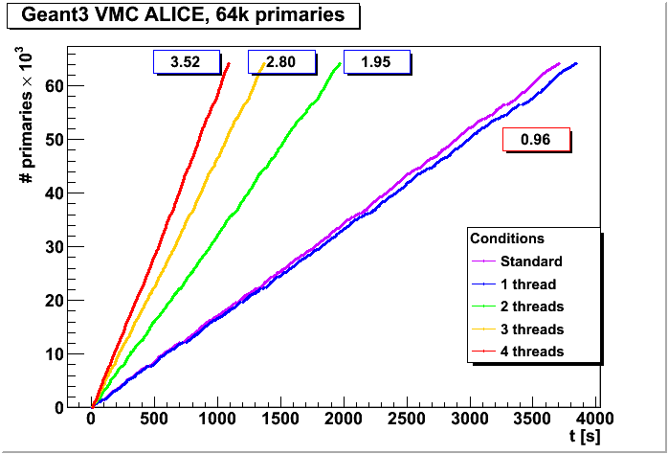
Simulation today and tomorrow
Multithreading scaling for parallel GEANT3 based simulation (M.Tadel, 2009)

Slide 4
Simulation today and tomorrow
Tomorrow – different scenarios for LS1, LS2
LS1 – same running scenario as today, but putting GEANT4 in production
Tuning the physics list & understanding remaining differences (G3)
Understanding performance issues, usage of GEANT4-MT (?)
Concurrency not foreseen in production for LS1, but:
Thread safety and cleaning-up detector code
Understanding the issues related to scheduling events and possibly tracks in parallel
LS2 upgrade: high intensity regime
x50 event rate, same ratio for simulated events
Computing resources not scaling in the same way…
We will need a computing solution for simulation that increases the throughput…

Slide 5
Reconstruction & calibration – a future challenge
The most challenging tasks
Running on both real and reconstructed data
Doing mostly local I/O (RAW data + CDB snapshot as input, ESD’s as output)
Using ~10% of resources
Long turnaround cycle: several calibration passes, including manual interventions
Not a problem of throughput for the moment
A real issue for LS2 rates !!!
Main focus of the LS2 upgrade
A completely different approach

Slide 6
LS2 upgrade – a major challenge
x50 rates, only x3 increase in resources !
No way to store the raw data!
Data has to be calibrated and reconstructed close to the online systems
Big central computing cluster, used by common DAQ/HLT/offline SW
O(250000) cores
Understand better calibration online
Common SW using parallelism, sharing the same resources in a load balanced way
R&D groups will study many aspects of the project
Steering, parallel technologies, online calibration, data model, …

Slide 7
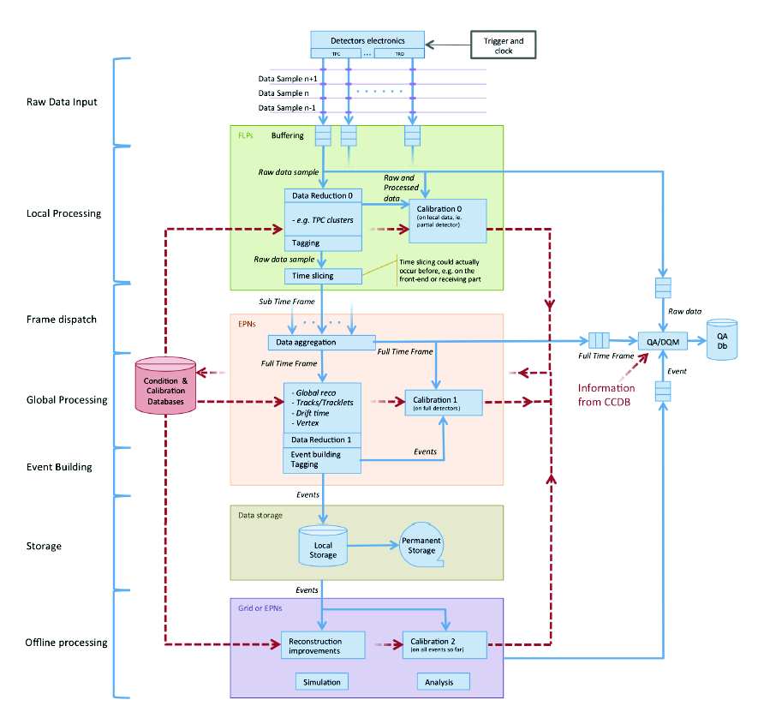
Gradual migration towards a common online-offline framework
A possible approach for the data processing stages in the future online cluster. The actual solution will be the outcome of R&D efforts

Slide 8
Analysis today and tomorrow
Input: ~4 PBytes/month data suitable for analysis stored
Processing rate: ~20 PBytes/month (x5 factor)
1/3 of total CPU consumed in GRID
Does this satisfy the needs ?
What about "tomorrow" (LS1, LS2)?
About 20% increase/year in computing capacity
Less than double by LS1 and x3 by commissioning after LS2
Event rate after LS2 x50 higher
Reconstruction & calibration done mostly online, GRID will be shared mostly by analysis and MC (50/50 ?)
Projecting the current numbers, we will be able to analyze a bit more than half of what we will produce
The rest of x10 has to be recovered from the additional increase in capacity AND analysis efficiency

Slide 9
Efficiency components (serial processing)
task1
task2
task3
The analysis flow involves mixed processing phases per event
Reading event data from disk
De-serializing the event object hierarchy
Processing the event
Cleaning the event structures - sequential
Writing the output
Merging the outputs
The efficiency of the analysis job:
job_eff = (t_{ds}+t_{proc}+t_{cl})/t_{total}
analysis_eff = t_{proc} / t_{total}
Time/event for different phases depending on
many factors
T_{read}~ IOPS*event_size/read_throughput – to be minimized
Minimize event size, keep under control read throughput
T_{ds}+T_{cl}~ event_size*n_branches – to be minimized
Minimize event size and complexity (analysis mini AOD?)
T_{proc} = ∑_{wagons}T_{i} – to be maximized
Maximize number of wagons and useful processing
T_{write} = output_size/write_throughput – to be minimized
t_{read}
Event #0
t_{ds}
Event #0
t_{proc}
Event #0
Event #1
Event #1
Event #1
t_{cl}
t_{write}
Join jobs
t_{merge}

Slide 10
Few numbers for I/O bound analysis
Spinning 50 MB/s | Access time 13 ms | Read size 270 MB AOD PbPb
Job time 45.5 sec | Throughput 5.93 MB/s | Job efficiency 86.5 %
SSD 266 MB/s | Access time 0.2 ms | Read size 270 MB AOD PbPb
Job time 39.5 sec | Throughput 6.83 MB/s | Job efficiency 94.1 %
Inter site 7.4 MB/s (JINR) | Access time = RTT 63 ms + local disk access time (?) | Read size 21.53 MB AOD PbPb
Load=200, time 258 sec | Throughput 0.083 MB/s | Job efficiency 2.5 %
Load=5, time 46.8 sec | Throughput 0.46 MB/s | Job efficiency 13.4 %
Storage speed cannot largely improve performance in the current event model
I/O latency is a killer if no caching is done
De-serialization is determinant for locally available data – it depends on the size, but ALSO on the complexity (number of branches)
data size is the main limitation

Slide 11
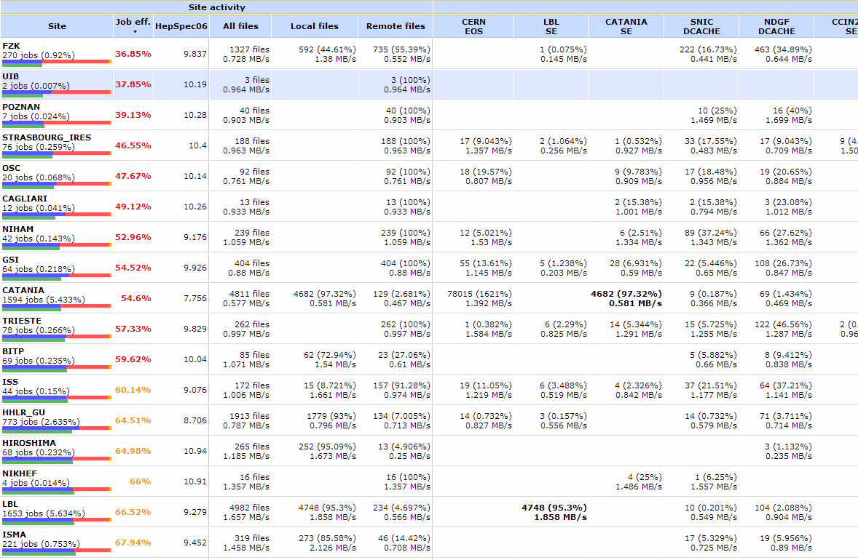
Hunting for GRID inefficiency

Slide 12
Parallelism – will we need this in future analysis ?
"Parallelizing makes only sense for CPU bound applications"
A node with 8 cores running 8 analysis sessions in parallel will require 8 times the input throughput
Bound by input pipe throughput/8
Can we sustain the throughput required by distributed parallel analysis ?
Parallel I/O (aka deserialization) is very important
Will have to be implemented in ROOT and followed in the processing flow (TSelector)

Slide 13
A possible parallelism model
Device 1
Device 2
Device 3
file1
file2
file3
file4
file5
file6
Raw event buffer
(work queue)
Reader 1
Reader 2
Reader 3
DS
DS
DS
DS
DS
DS
DS
workers
AM
AM
AM
AM
AM
AM
AM
Histogram buffers
Histo fill
Output

Slide 14
Current merging
analysis.root
wn.xml
Output/001/
results.root
MyAnalysis_merge(“…/Output, stage=1, chunk)
MyAnalysis_merge(“…/Output, stage=2, chunk)
analysis.root
wn.xml
Output/002/
results.root
Output/
results_
Stage01_000.root
analysis.root
wn.xml
Output/003/
results.root
MyAnalysis.root
wn.xml
MyAnalysis.root
wn.xml
MyAnalysis.root
wn.xml
MyAnalysis.root
wn.xml
MyAnalysis.root
wn.xml
MyAnalysis.root
wn.xml
MyAnalysis.root
123456.xml
MyAnalysis.root
wn.xml
MyAnalysis.root
123456.xml
analysis.root
wn.xml
Output/004/
results.root
Output/
results.root
Output/
results_
Stage01_001.root
analysis.root
wn.xml
Output/005/
results.root
analysis.root
wn.xml
Output/006/
results.root
2 parameters: number of stages and maximum number of chunks to be merged per job
Stages can be skipped if reduction is enough
For production jobs: max_stages=5, split=20 (less for AOD merging)
Output/
results_
Stage01_002.root
MyAnalysis.root
wn.xml
Output/00n/
results.root
Scales like t_{job}* log(Nstages)

Slide 15
Possible future buffer merging
Process 1
Merging service process on cluster
Process 2
Process 3
Single merging process if this scales (?)
Merged.root
Process 4
Process 5
Process N
Needs improvements in ROOT (planned)
Not obvious for histograms unless enabling “buffered” mode
Needs fast network to the merging service

Slide 16
Outlook
In the short perspective, we are trying to tackle the efficiency problems related to:
I/O, distributed computing, turnaround cycles, merging
Parallelism is a potential lever to improve throughput in some applications (like simulation)
Code review, data structure re-shaping, thread safety
Will increase in importance in the coming years
LS2 has to come after a major software upgrade allowing to deal with x50 higher event rates
Online computing cluster sharing online-offline tasks
No RAW written to disk, buffering limited
Software flaws will imply data loss due to the backpressure
Concurrency and load balancing will be a must in the new system
We are based on ROOT, we hope for increased support for parallelism
I/O, merging, thread safe libraries and containers

