Slide 1
NOvA Computing &
Needs for Concurrency
Andrew Norman, Fermilab
Annual Concurrency Forum 2013

Slide 2
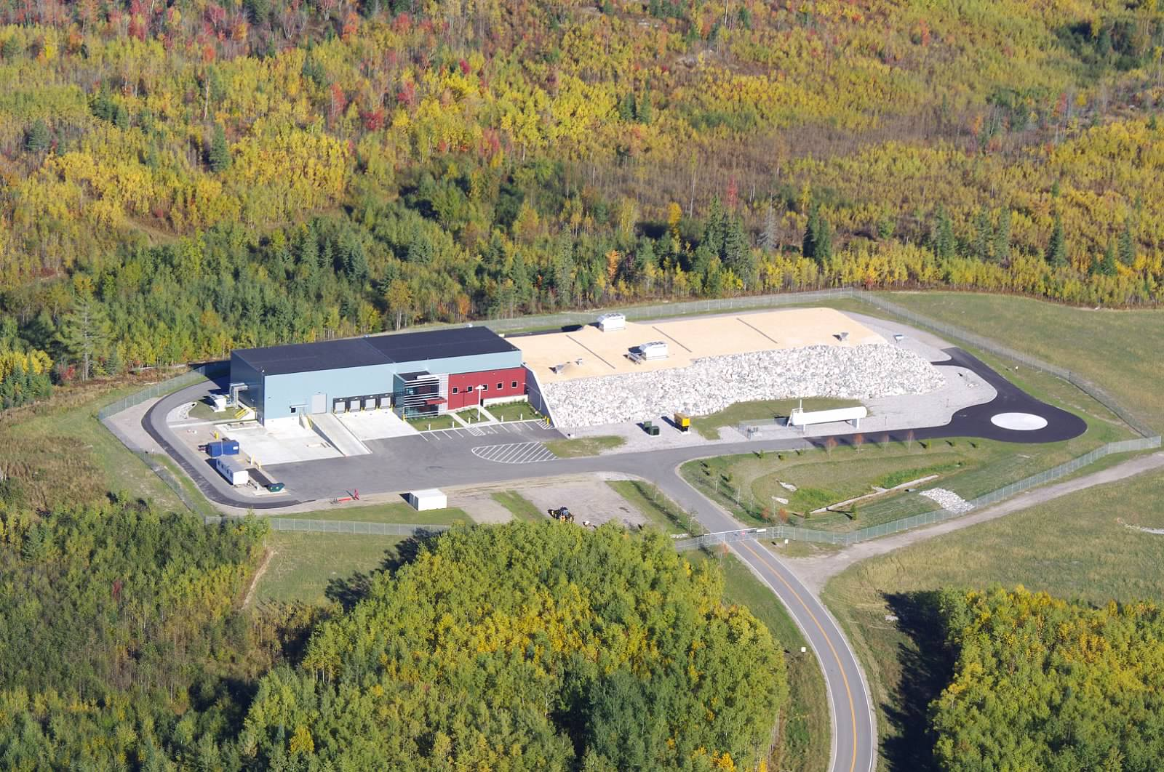
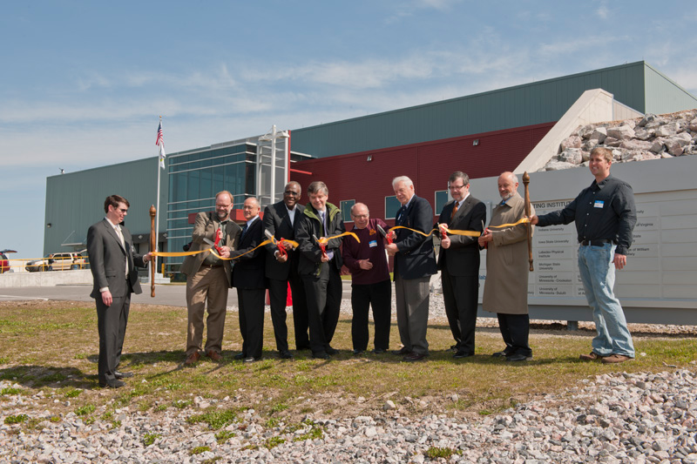
NOνA
NOνA is a program to investigate the properties of neutrinos
It includes:
  Doubling of the Fermilab NuMI beam power to 700 kW
  An 15kTon totally active surface detector, 14 mrad off axis at 810km
  (first oscillation max for 2GeV )
  A 220 Ton totally active near detector
It has been optimized as a segmented low Z calorimeter/range stack to:
  Reconstruct EM showers
  Measure muon track
  Detect nuclear recoils and interaction vertices
It presents a challenge for modern computing and data acquisition
Far Det.
NuMI Beam @ 14mrad (810 km)
Fermilab

Slide 3
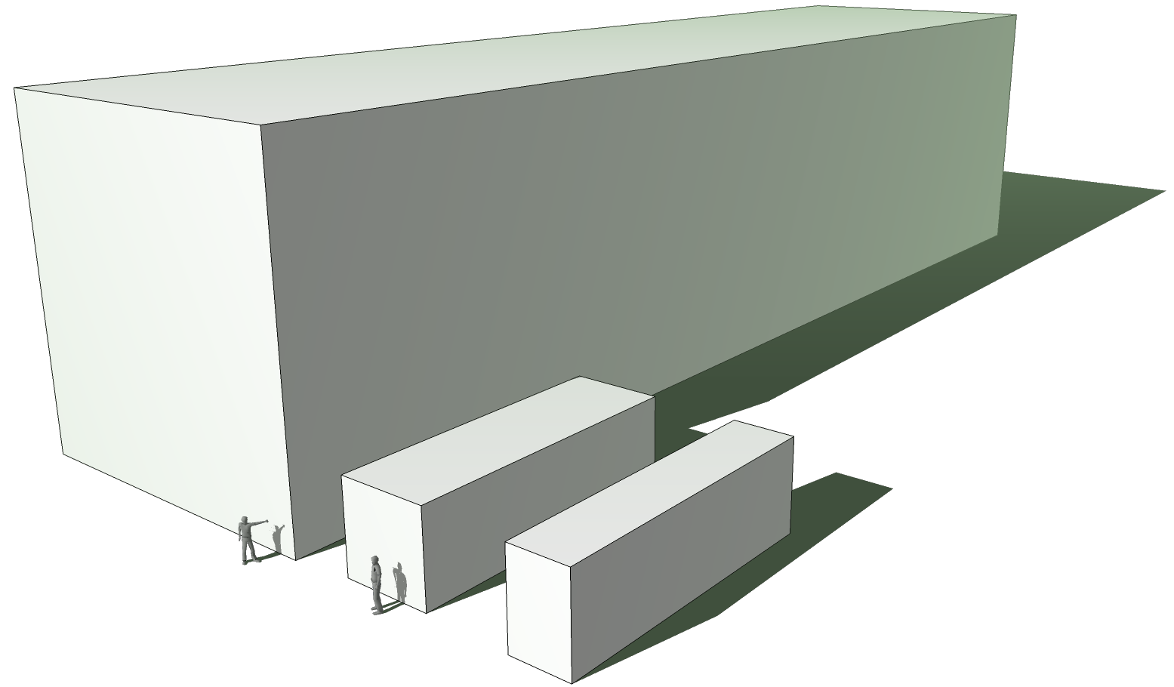
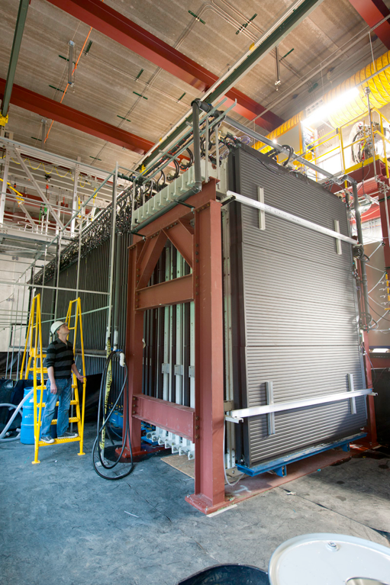
The 3 NOνA Detectors
Far Detector
15kT “Totally Active”, Low Z, Range Stack/Calorimeter
Surface Detector
Liquid Scintillator filled PVC
960 alternating X-Y planes
Optimized for EM shower reconstruction & muon tracking, X₀ ≈40cm, R_{m}≈11cm
Dims: 53x53x180ft
“Largest Plastic Structure built by man”
Began construction May 2012
First operation est. Feb. 2013 (cosmics)
Near Detector
Identical to far detector
1:4 scale size
Underground Detector
Optimized for NuMI cavern rates -- 4x sampling rate electronics
Near Det. Protype
In operation 2010-Present on surface at FNAL in NuMI and Booster beam line

Slide 4
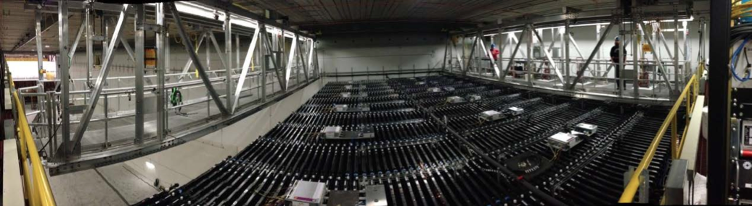
The 3 NOνA Detectors
Far Detector
4 kt in place, in process of instrumenting
First Physics Data
May/Jun 2013
Near Detector
Identical to far detector
1:4 scale size
Underground Detector
Optimized for NuMI cavern rates -- 4x sampling rate electronics
Near Det. Protype
In operation 2010-Present on surface at FNAL in NuMI and Booster beam line
Far Detector (Feb 2013) ≈4 kt

Slide 5
Nova Computing Overview
Time critical, requires vectorization, multi-core, many-core to meet trigger goals
Realtime data processing (trigger)
  Continuous data stream off detector (peak 4.3 GB/s)
  3200 core L3 style cluster
  ARTDAQ framework used for realtime
  analysis/trigger processing
  Maximum latency to trigger decision ≈20 s
Offline data processing
  Need to process ≈ .75 PB/yr
  Use the ART framework
Monte Carlo generation
  Want ≈ 10⁹ evt/yr (30x beam data)
  Use Genie, Geant4 with ART framework
Embarrassingly parallel at event level
Current model uses job level parallelism and grid computing

Slide 6
NOvA Examples:
Realtime Hit unpacking
  Vectorization
Pattern Recognition (Hough Transforms)
  Ideal parallelism mappable to many-cores
Event Classification (Library event matching)
  Shared resources in a parallel environment
Timing & Pulse height extraction on waveforms
  “Fitting” w/ GPUs

Slide 7
Readout Decoding
To save bandwidth hit data is compressed
  Convert raw 12 bits ADC values into a 8 bit representation (lossy compression)
  Allows for 16 sample (8 μs) waveform readout
  Induces a small (1.5% fractional error on single samples)
  Improves timing resolution by >10x
Fractional Error in ADC Compression
Requires that data be “decompressed” within the online
Realtime decoding is required to be as fast as possible in order to match maximum trigger latencies

Slide 8
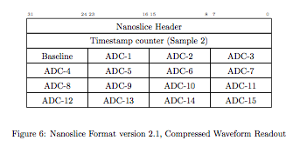
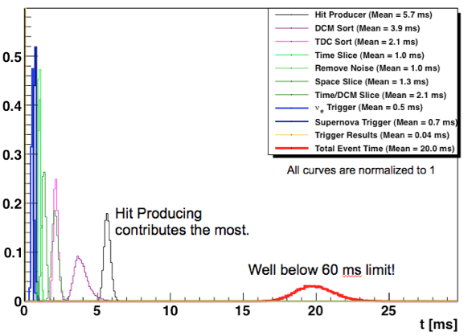
Vectorization – Readout Decoding
NOvA hit data is ideally packed to take advantage of vectorization
Small computational kernel:
  To small for thread based solutions
  Data aligned on 32/64 bit word boundaries
  Potential to give a 4x – 16x speed up in decode using SSE3 SIMD
Many similar hit processing tasks that are ideal for vectorization and are required to be fast for triggering
NOvA Near Detector Trigger Profiling
out_vector = ((0x1 << ((in_vector >> 5) - 1)) *
((in_vector & 0x1f) + 32.5)) -0.5;
Hit Unpacking
Total processing
Projects underway within NOvA to understand how to exploit vectorization

Slide 9
NOvA Trigger
Realtime processing of “live” detector data
L3 style computing farm (3200 cores)
Stores continuous streaming zero-bias readout stream from detector
Acts as a “buffer” to allow accelerator information from FNAL to transit to Far Detector in Minnesota (810km away)
  ALL data from the detector goes into this farm
  Gives an opportunity to examine the raw data for “interesting” topologies (horizontal cosmic, fully contained events, upward going tracks etc…)
System is designed to be able to tolerate long latencies prior to triggering (i.e. ~20s)
  But the number of hits that need to be processed per time frame are large (100,000+)

Slide 10

Architecture
11520 FEBs
(368,4600 det. channels)
FEB
FEB
FEB
FEB
11,160 Front End Boards
FEB
FEB
FEB
FEB
FEB
FEB
FEB
FEB
ARTDAQ Data Driven Triggers System
FEB
FEB
Shared Memory DDT event stack
DCM 1
ARTDAQ-1
Processor
ARTDAQ-2
Processor
….
ARTDAQ-N
Processor
DCM 1
Zero Suppressed
at
(6-8MeV/cell)
DCM 1
5ms data
blocks
DCM 1
180 Data Concentrator Modules
DCM 1
Data Buffer
DCMs
Minimum Bias
0.75GB/S Stream
Data Driven
Trig. Decisions
Event builder
COtS Ethernet 1Gb/s
Grand
Trigger OR
Trigger Reception
Data Slice Pointer Table
Triggered
Data Output
»140-200 Buffer Node Computers
Data Time Window Search
Data
Buffer Nodes
Data
Buffer Nodes
Trigger Broadcast
Buffer Nodes
Buffer Nodes
Buffer Nodes
Buffer Nodes
Data Logger
200 Buffer Nodes
(3200 Compute Cores)
Buffer Nodes
Global Trigger Processor
Beam Spill Indicator
(Async from FNAL @ .5-.9Hz)
Calib. Pulser ( 50-91Hz)

Slide 11
Architecture
ARTDAQ framework
Includes a separate data queue and then the appropriate input/unpacker modules, physics module and decision module
Shared Memory Interface layer to detector data.
Insulates the Event Builder from the ARTDAQ process.

Slide 12
Pattern Recognition
General class of realtime PatRec algorithms
  Identify track/cluster candidates
  Structured with many repetitive, independent computations over the hit field
  Ideal for parallelization on many-core
Example: Linear Hough Transform

Slide 13
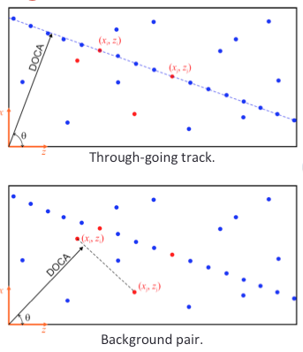
Linear Hough Transform
2-D Hough uses pair-wise combinations of hits to map from geometric space into an accumulation space
  Characterizes lines by an angle θ and distance to reference point
  Changes the problem of track finding to a “peak finding” problem
  Simple computational kernel
  Independent N² complexity

Slide 14
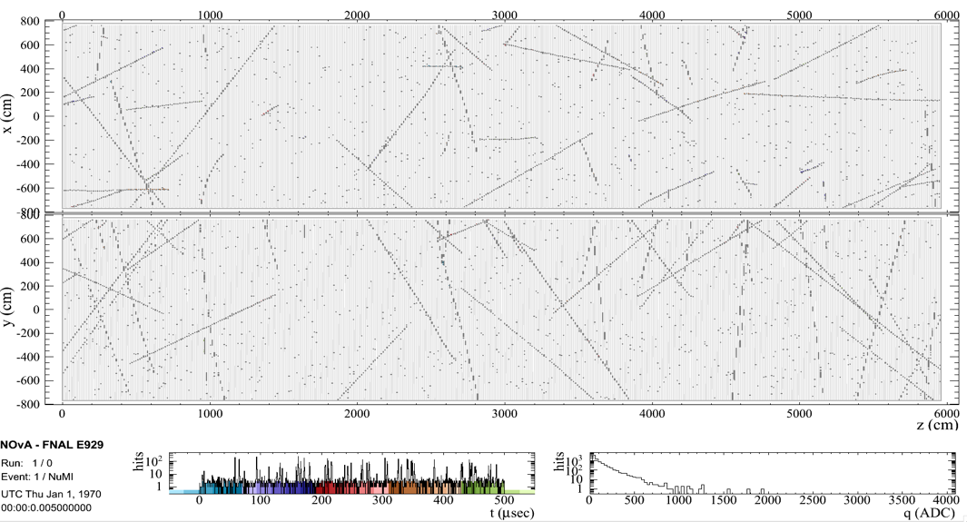
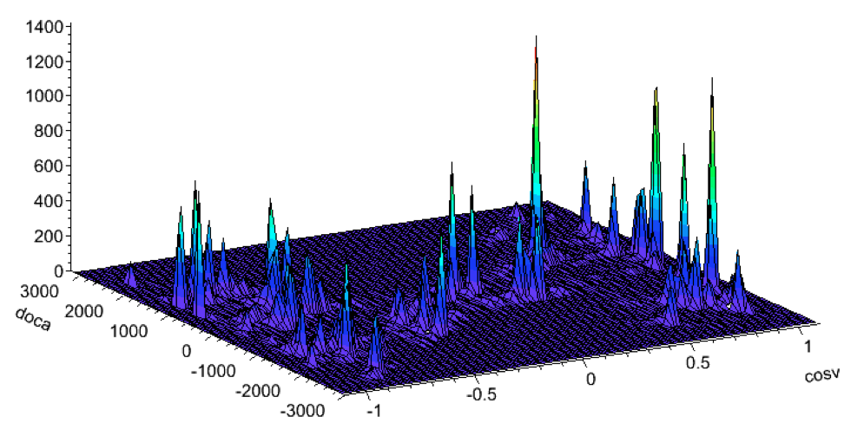
2D-Hough map detector hits into peaks in the Hough space

Slide 15
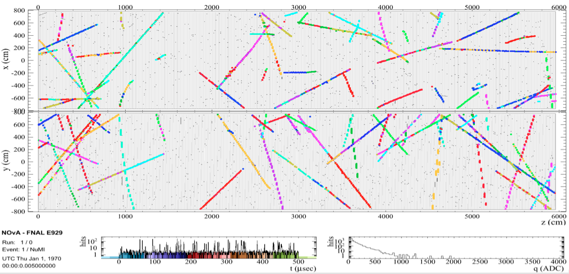
Peaks identify the cosmic rays in the detector.
Extensible to 3D and 4D using timing and Pulse Height information (complicated)
Better isolation of cosmic background at higher dim. (allows for bkg subtraction)

Slide 16
Hough Transform
Algorithm is easy to parallel
  Can unroll at hit loop levels
  Maps onto large thread pools or GPU
  Performance varies widely depending on how the actual parallelization is done
  Projects underway within NOvA and Fermilab-SCD to explore performance of these types of algorithms
See talk from ART framework group

Slide 17
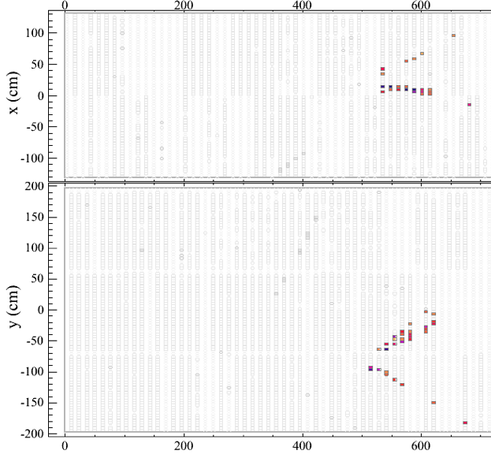
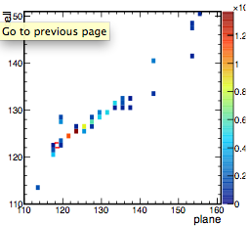
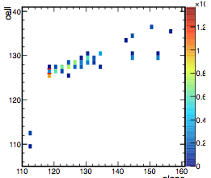
Library Event Matching
Real Event
Offline event classification in NOvA is difficult
  ν_{e}-Charged Current events (signal)
  Almost identical to ν_{μ} Neutral Current + π⁰ (background)
One approach compares an candidate event to a large library of template MC events
  Establishes a metric for the degree of matching
  Extracts event type and critical parameters from best matches
MC Template
MC Template

Slide 18
Library Event Matching
Analysis Job
Event Library
Library is Large
(∼10⁶ templates)
Needs to be memory resident and cycled through for EACH event
Memory footprint ≈6 GB
Each iteration/comparison is independent
i^{th} Event
Template-1
Event Compare
Template-2
Job Module-1
Template-2
Job Module-2
….
….
Event Matching
Job Module-N
….
Template-10⁶
Size 6GB

Slide 19
Library Event Matching
Analysis Job
Event Library
Analysis Job Slot 2
Represents a static resource that ideally would be shared across a parallel environment
Would allow for larger libraries
Need to understand how to match to Grid computing models
i^{th} Event
Template-1
i^{th} Event
Event Compare
Template-2
Job Module-1
Template-2
Job Module-1
Job Module-2
….
Job Module-2
….
….
Event Matching
Event Matching
Job Module-N
Job Module-N
….
Template-10⁶
….
Size 6GB

Slide 20
Library Event Matching
Analysis Job (Threaded)
Threading represents another option in sharing the libraries
Not clear how caching helps/hurts
Need to understand how this can be matched to current Grid computing
Thread-1
Thread-2
Thread-N
Event Library
i^{th} Event
i^{th} Event
i^{th} Event
Template-1
Event Compare
Template-2
Job Module-1
Job Module-1
Job Module-1
Template-2
Job Module-2
Job Module-2
Job Module-2
….
….
….
….
Event Matching
Event Matching
Event Matching
Projects within NOvA to understand shared resource management in grid environments
Job Module-N
Job Module-N
Job Module-N
….
….
….
Template-10⁶
Size 6GB

Slide 21
Offline Simulation
Event Generation
  Need parallel event generation
  (neutrino & rock muon generation)
  Sharing of common resources (Flux files)
Detector Simulation
  Need to move towards parallel
  tracking of particles within Geant4
  Particularly important for cosmic
  ray overlays (180kHz muon rate)
Goal is to increase performance enough to expand MC/Data ratio from 30:1 to 150:1 within same computing budget (driven by ND cross section analysis)
Generally desired for g-2 and other intensity frontier experiments

Slide 22
Summary
NOvA has many different algorithms which are inherently parallel
  Some areas have obvious “best” solutions
    Challenge is using standard tools + hand tweaking to map the solution into the machine (vectorization)
  Other algorithms have multiple solutions
    Challenge is understand performance balance between threads, processes, GPU implimentations
  Different class of problems is how to scale and share resources
    Applies more generally to offline & Monte Carlo generation w/ grid resources

