Slide 1
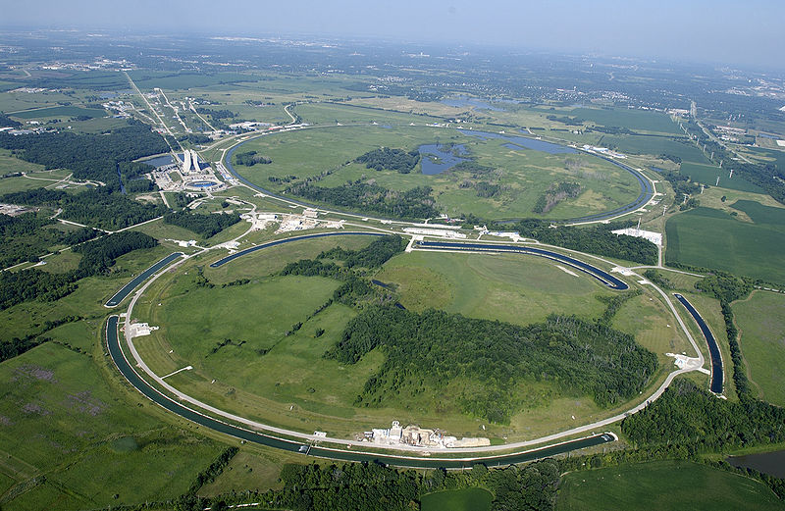
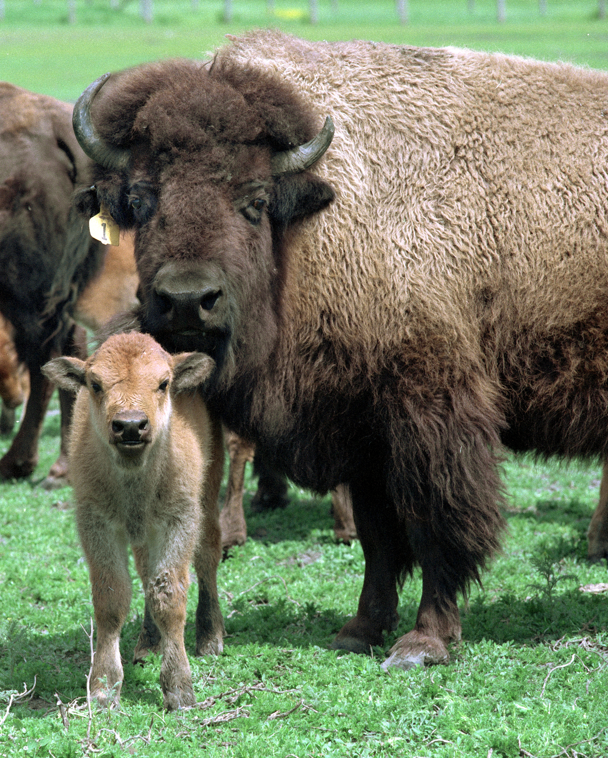
Welcome to Fermilab
The land of elementary particles and buffalos

Slide 2
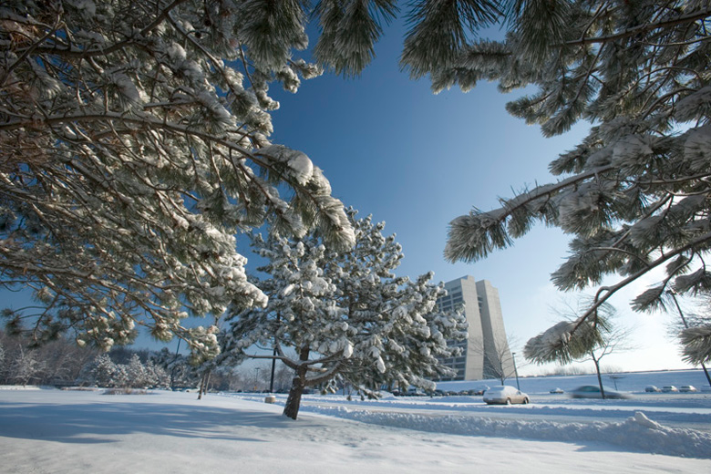
Welcome to Fermilab
We hope you enjoy the charms of our winter season

Slide 3
Welcome to Fermilab
Be extra careful and watch for ice !

Slide 4
Welcome to the Annual Concurrency Forum Meeting The Concurrency Forum is an outcome of the "Workshop on Concurrency in the many-Cores Era" held at Fermilab in November 2011 to explore the possibility that interested High Energy Physics (HEP) institutions and projects collaborate on concurrent frameworks and applications R&D. The function of the Forum is to communicate and exchange information and results.

Slide 5
Welcome to the Annual Concurrency Forum Meeting
This is the First Annual Meeting after the workshop
(Pere Mato will discuss the goals in a few minutes)
Discuss results of our R&D activities (demonstrators)
Listen to the experiments and projects, listen to each other
Strategy to move forward

Slide 6
Logistics
All sessions and coffee breaks will be held at “The CDF Big Room”
A mini-bus will take us to the Wilson Hall cafeteria at 12:30pm for lunch … you are also free to walk (10 min) – No more food after 13:30pm !
Feel free to send me e-mail or call my cell if you need anything
The FNAL team will be happy to provide advise on restaurants for dinner and tourist information if you plan to stay in Chicagoland for a few days

Slide 7
Wireless Network Connection
In indico, under "Overview", there is "Useful Information for your trip to the US and access to Fermilab" that includes instructions for wireless connection to the FNAL network.
http://www-ppd.fnal.gov/conf-w/UsefulLinks.htm
(second line)

Slide 8
Bathrooms
… are located to my left

Slide 9
Thanks for coming … … and enjoy the meeting

