Slide 1
LQXFA/B01 Documentation
Jamie Blowers (AUP), Hector Garcia Gavela (CERN)
05.10.2023 – AUP-CERN Meeting

Slide 2
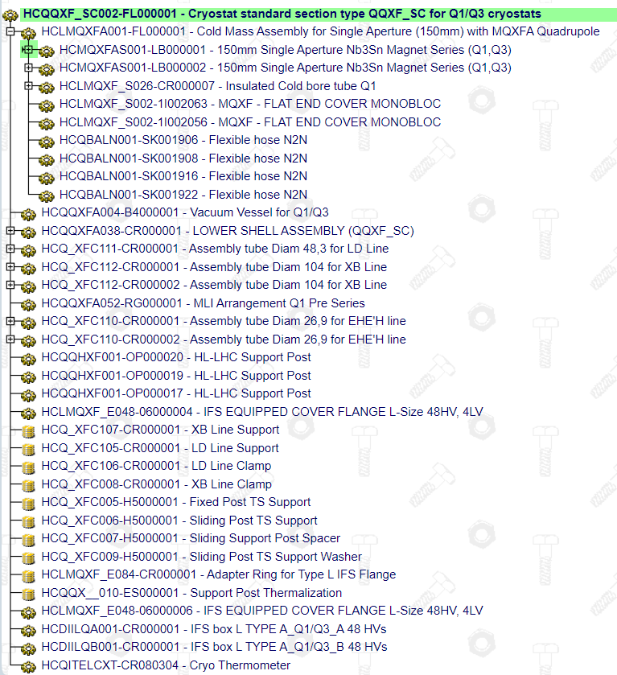
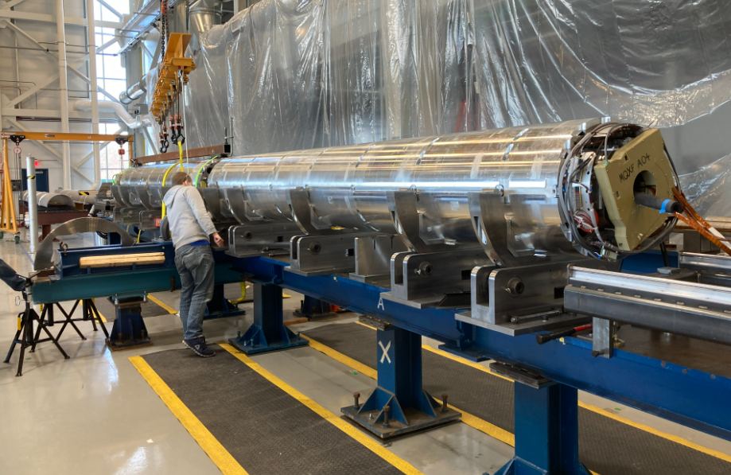
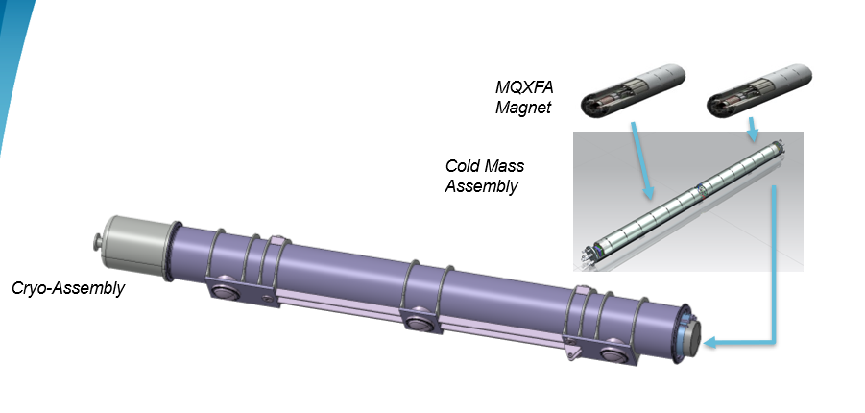
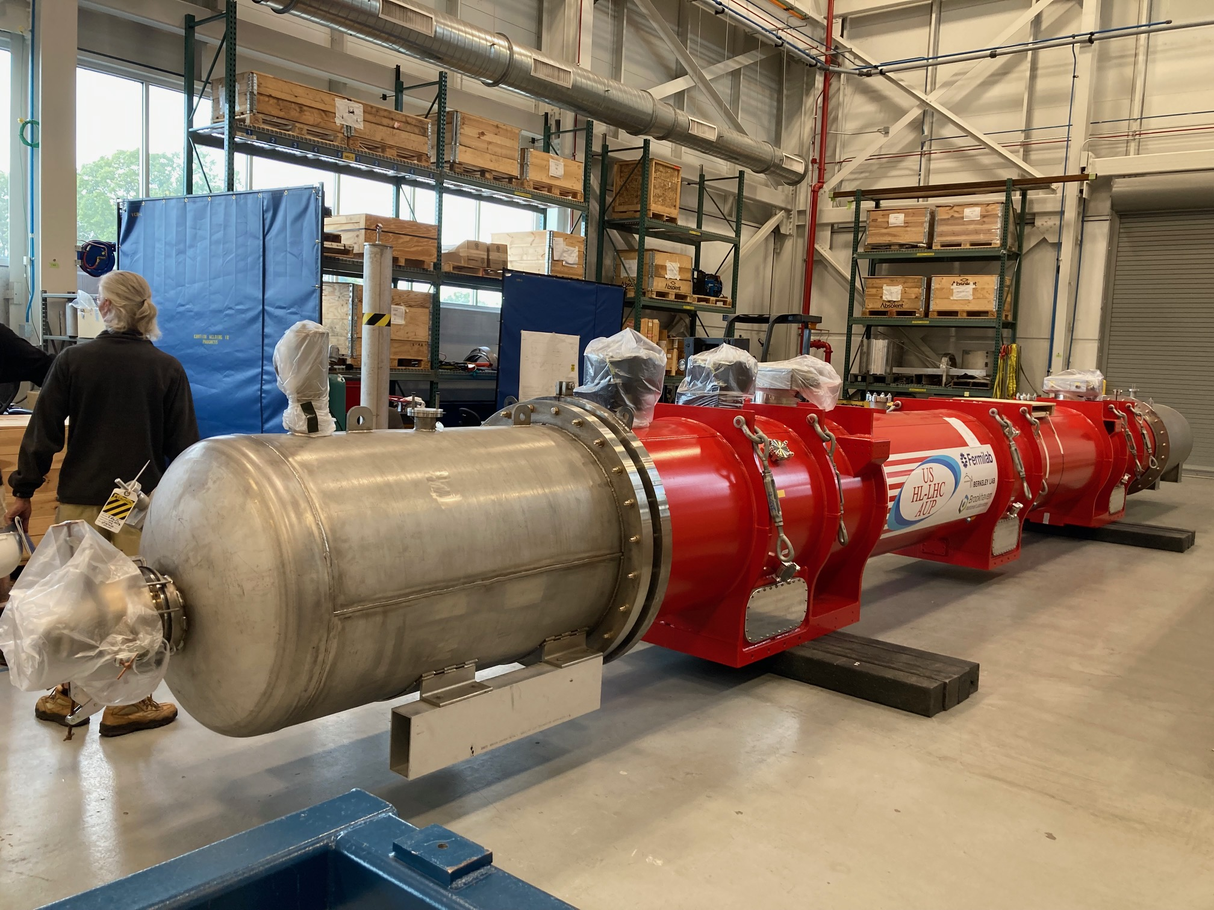
1st Cryossembly built by AUP (LQXFA/B01)
Cold Mass LMQXFA01 / CM01 (HCLMQXFA002-FL000001)
Magnet MQXFA03 (HCMQXFA001-LB000001)
Magnet MQXFA04 (HCMQXFA001-LB000002)

Slide 3
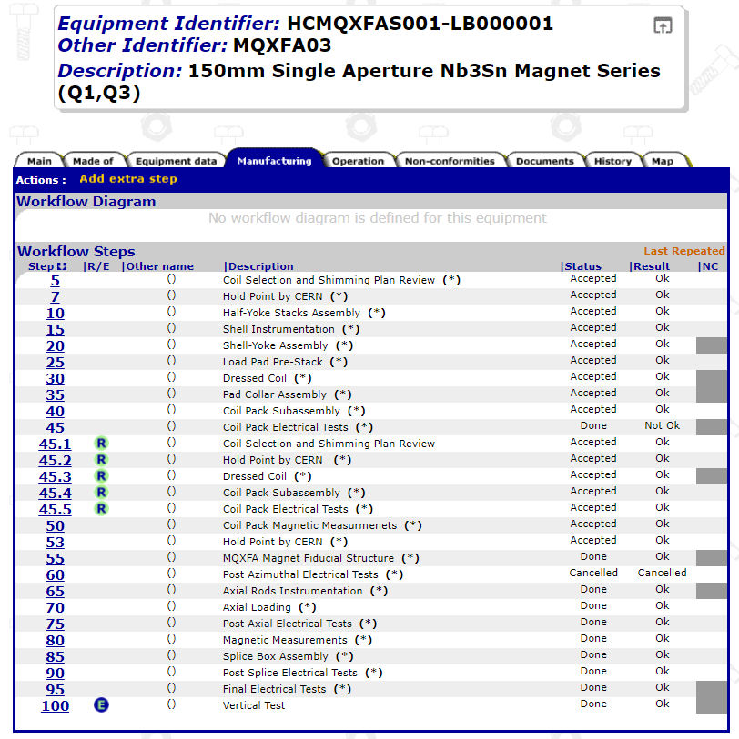
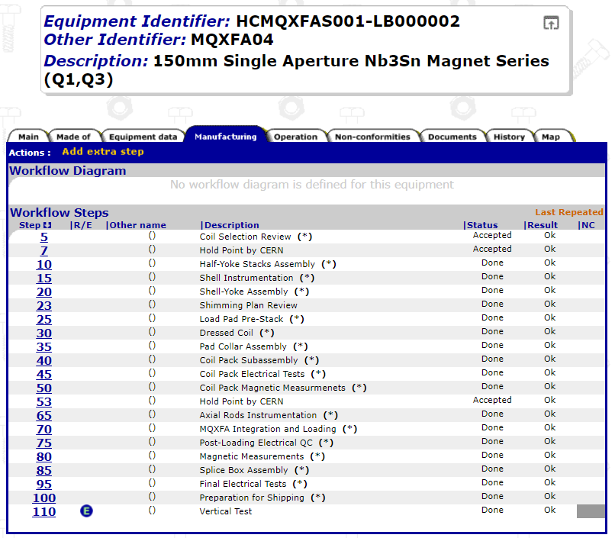
Magnets – MQXFA03 and MQXFA04
Documentation related to MQXFA03 and MQXF04 (including cables and coils) is complete and released
During the Coil Selection Review (1st step of the workflow), the data of the coils is assessed and validated prior to starting the magnet manufacturing (Hold Point by CERN)

Slide 4
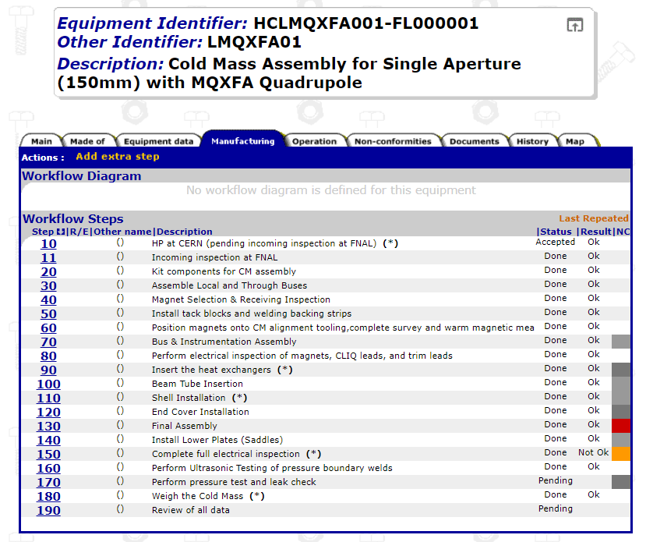
Cold mass – LMQXFA01
Documentation related to CM01 is now mostly complete (still to be released)
This was the main missing point in terms of documentation for several months (AUP could not close the related traveller due to the NCR related to the nodal points)
Main missing document is the leak test report of the cold mass prior to cryostating (under preparation)
For future cold mass, it should be important to validate together the completeness and compliance of the manufacutring data prior to starting the cryostating (same process followed for the magnets)

Slide 5
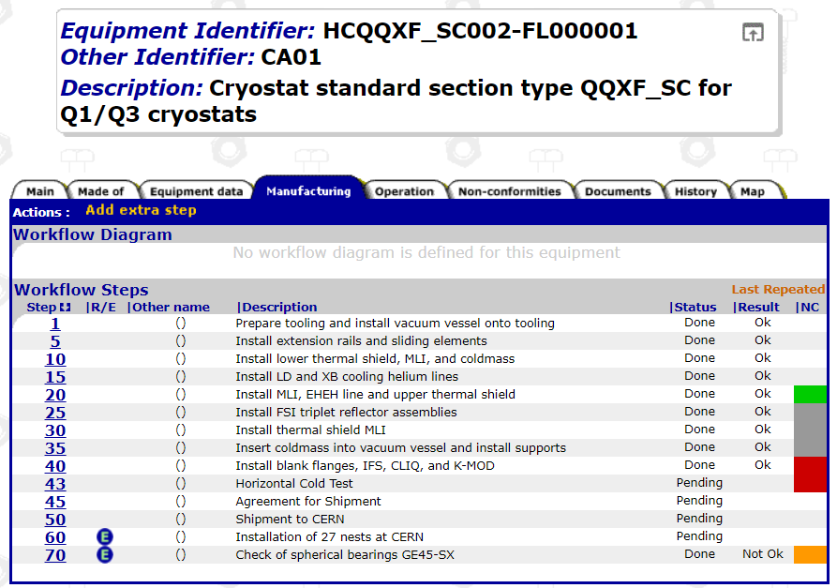
Cryoassmbly Standard Section – LQXFA01
Documentation related to CA01 is complete (still to be released)
This batch of documents was already provided in August
Main missing document is the Horizontal cold test report (under preparation)
Some Non-critical NCRs to be closed
Some DRs (Discrepancy Reports) have been issued by AUP wrt the deviations found (see slide #8)

Slide 6
Main Nonconformities
Total of ~180 AUP-internal Discrepancy/Nonconformance reports (integrated for cables, coils, magnets, cold mass and cryo-assembly CA01); most were minor and handled within AUP
Total of five major nonconformances for which we are working closely with CERN to resolve:
EDMS 2515070: "nodal" distance between two magnets out of spec; NCR accepted and closed with warnings – Decision to wait for the results of CM02 before changing the acceptance criteria
EDMS 2905753: leak check of CM in the CA was not able to achieve necessary background to verify spec; NCR has been accepted by WP3 and CERN TE-VSC – Waiting for final approval from TE DH and HL PL (already given offline), will be closed with warnings – Results of the Leak Test to be done at CERN after phase II cryostating shall be added to this NCR. Leak Test procedure to be shared with CERN/TE-VSC before the next test and results to be immediately share with CERN/TE-VSC for validation. OK for installation in the IT String
EDMS 2937955: VT EE152 is open; NCR under review. Suggestion from TE-MPE to disconnect VT EE152 completely at the IFS, and use VT EE151 instead (bridge at IFS). To be closed with warning adding this remark and also adding preventive actions
EDMS 2769128 and 2883868: two QH failures; NCR under review – OK for installation in the IT String. The NC shall be repaired via a disassembly of the cold mass and (if needed) a magnet replacement prior to installing the machine (or to be considered as spare)

Slide 7
Deviation Request
Deviation Request (EDMS 2939701) for CM01 which was welded prior to formal and timely (i.e. before weld execution) approval of WPS/PQR by CERN. Discrepancies related to the ASME vs ISO requirements during the qualification (this was solved during the discussion held in Q1 2023) Deviation accepted by WP3, TE-MSC, TE DH, HL PL and HSE Head - OK for testing in SM18 test bench and later installation in the IT String
“This is a clear example that we might need approval from external bodies at CERN, which is usually a long and tedious process for everyone (we must avoid this kind of situation as much as we can in the future)”

Slide 8
Recent Discrepancy Reports (by AUP)
DR 13367 (EDMS 2959632) for length of CM (0.46mm above max 10.1m)
DR 13366 (EDMS 2959633) for a3 and a8 field harmonics outside expected values
DR 13368 (EDMS 2959634) for magnetic axis alignment (MQXFA04 ~0.68mm, spec is 0.5mm max)
These are being treated as minor issues

Slide 9
Additional Documents to be Delivered (by AUP)
Survey Report
Acceptance Criteria Report
Spreadsheet listing all MQXFA, LMQXFA, and LQXFA Acceptance Criteria, their results, and references to the records that support them

Slide 10
Conclusions (and lessons learned)
Intermediate steps for revision of documentation is proven to be effective (coils, magnets) and avoid unnecessary overload to everyone at the end of the production
Timely issuing of critical NCRs (i.e. leak test NCR) to trigger the discussions and the formal approval process. We sometimes need external colleagues to WP3 (or even the Project) to give feedback and grant concessions (if any)
Documentation is in good shape for CA01 and main subassemblies
Deviation request fully approved by HSE granting the use of CA01 for testing in SM18 and later installation in the IT String
Critical NCRs closed or on the way to be closed (all of them have at least been treated and main feedback is given). Formal closure (with warnings) will come shortly
We all should make sure to feed forward lessons learned and improve workflow and procedures/test-protocols where applicable as of CA02

Slide 11
Looking forward to receiving CA01 at CERN

