Slide 1
TPC Electronics Update
Cheng-Ju Lin
FD1 Technical Board Meeting
20 September 2023

Slide 2
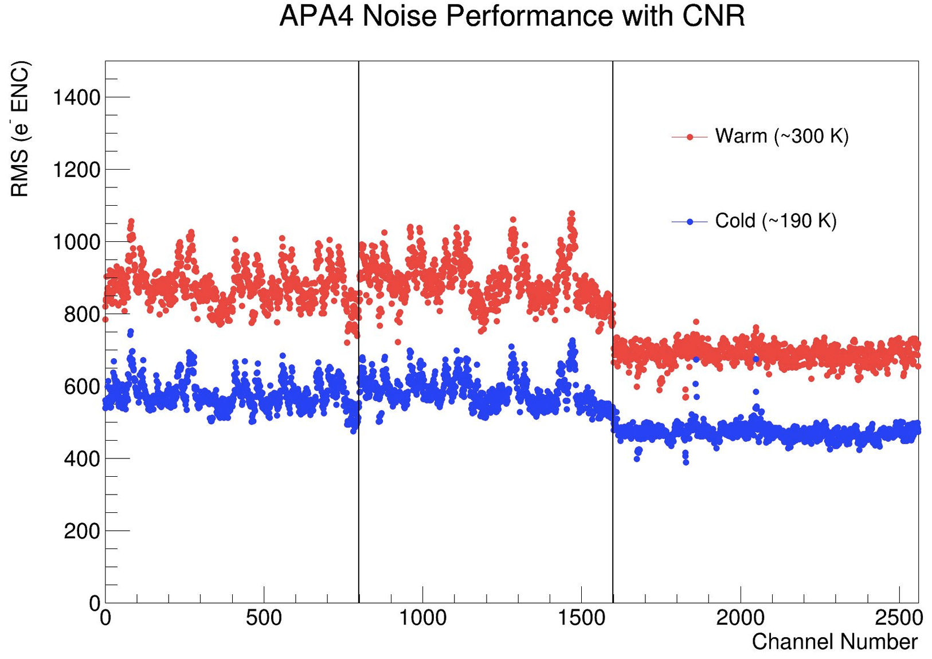
Status at CERN
Four APAs installed in NP04. Stable noise condition and no new problems observed
TPC Electronics readout migrated from FELIX to Ethernet. All four APAs are now on ethernet readout
Prepared a TCO Closure Checklist for the TPC electronics (CERN EDMS#2954805)
Working with DAQ group on the integration between readout electronics and the DAQ control, configuration and monitoring system. Have a joint session at the Collaboration meeting next week
DUNE Requirement
< 1000 e⁻ (ENC) in LAr

Slide 3
Power & Timing Card Upgrade
ProtoDUNE-I PTC has limited functionality: distribute power to the WIBs and FEMBs, and also the timing signal
New PTC (v4) has a FPGA for monitoring and controlling the cold electronics, can communicate with the slow control, and has a dedicated interface to the cold electronics safety interlock system
New PTC has been tested at CERN with a full crate → performed all functionality of the old PTC; no additional noise introduced
Another new PTC has been integrated into the ICEBERG test-stand at Fermilab for integration with the cold electronics safety interlock system (Beckhoff PLC)

Slide 4
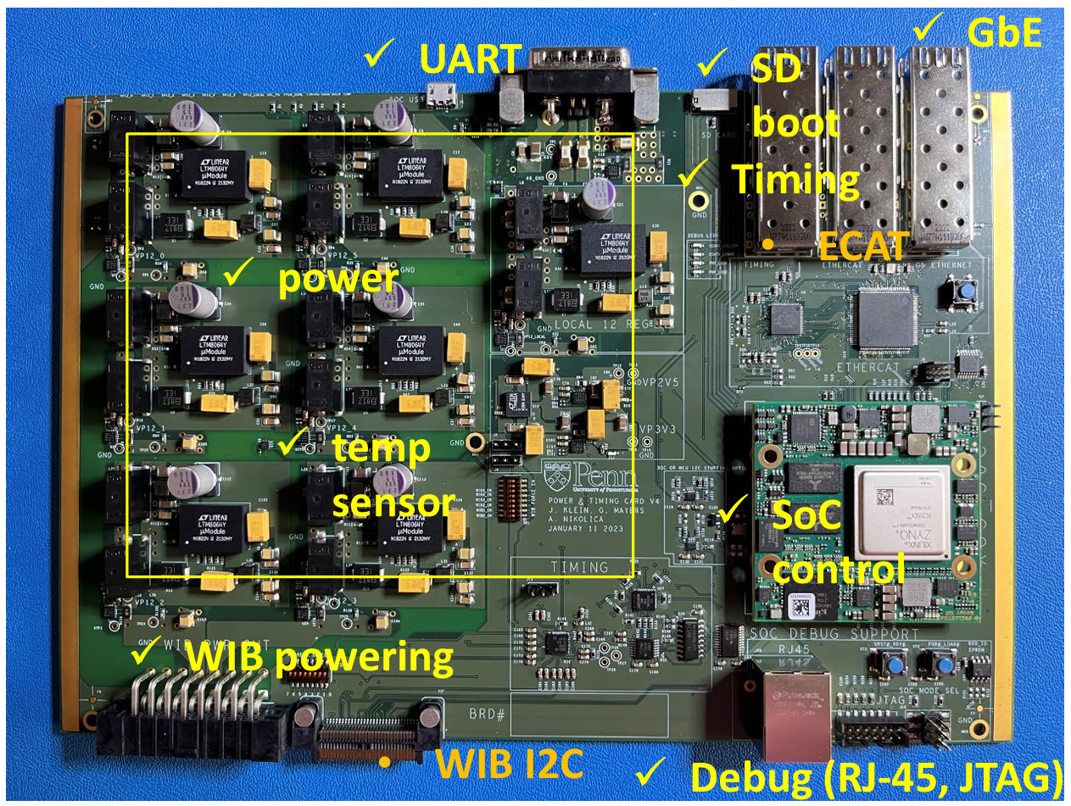
Power & Timing Card (v4)

Slide 5
COLDATA Lifetime Study
CMOS circuits can suffer from premature aging when operated at cryogenic temperature due to hot carrier effect
Performed accelerated aging study by stressing the chips to higher operating voltage
LArASIC, ColdADC, COLDATA and other CMOS components have been studied. All have a lifetime well exceed the lifetime of DUNE
With “failure” = 1% loss in I(Vdda)
V_stress (volts) | 1/V_stress | time (hrs) | log_10(time) | time(years)
2.5 | 0.40 | 2.5 | 0.40
2.25 | 0.44 | 30 | 1.48
2 | 0.50 | 225 | 2.35
1.2 | 0.83 | 736376635 | 8.87 | 86186
1.1 | 0.91 | 2.1573E+10 | 10.33 | 2524974

Slide 6
Robotic Test System (RTS)
For ProtoDUNE, we tested the custom ASICs manually
For production QC, plan to use a robotic system to handle the chips
For FD1+FD2, need to test :
~40K LArASICs,
~40K ColdADC,
~10K COLDATA
A timelapse of the RTS swapping a batch of 8 chips in the sockets in the current prototype setup
Testing the cryogenic operation with liquid nitrogen

Slide 7
FD1 Procurement Status
CD-3a (long lead items) procurements are progressing well !
LArASIC for FD1 and FD2 : all 250 wafers received from vendor
First 25 wafers of packaged LArASIC chips (~78k P5B chips) are undergoing QC
Next 50 wafers of LArASIC wafers have been sent to the packaging house
WIB FPGA (FD1): All 800 FPGAs received from vendor (~5 months ahead of schedule)
ColdADC/COLDATA (FD1) production: CERN submitted the PO to TSMC in July. Expect to receive the wafers before the end of 2023
WIB and FEMB discrete components: received some components already. About 50% of the orders have gone out to the vendors
PTC FPGA for FD1 order is ready to go out, pending the UPenn subcontract to go through the Fermilab procurement system

