Slide 1
Status of Vertical Test Stand at RRCAT
November 14, 2012
S C Joshi, S Raghavendra, S K Suhane
P Shrivastava, P Mohania
RRCAT, Indore

Slide 3
Status of VTS Facility at RRCAT
Staging towers for insert assembly
Assembly of components of Insert assembly
Installation of the cryostat in the pit is planned in this week.
Development of VTS RF System

Slide 4
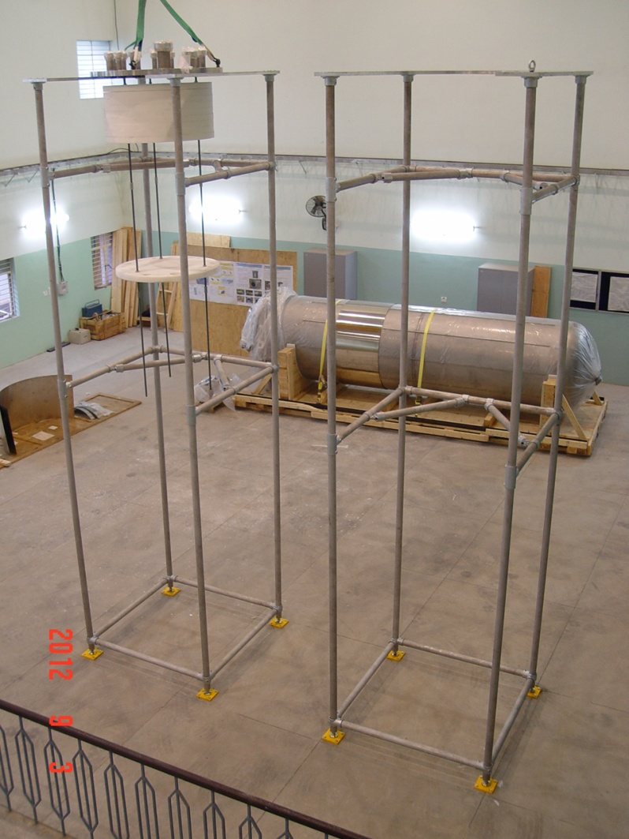
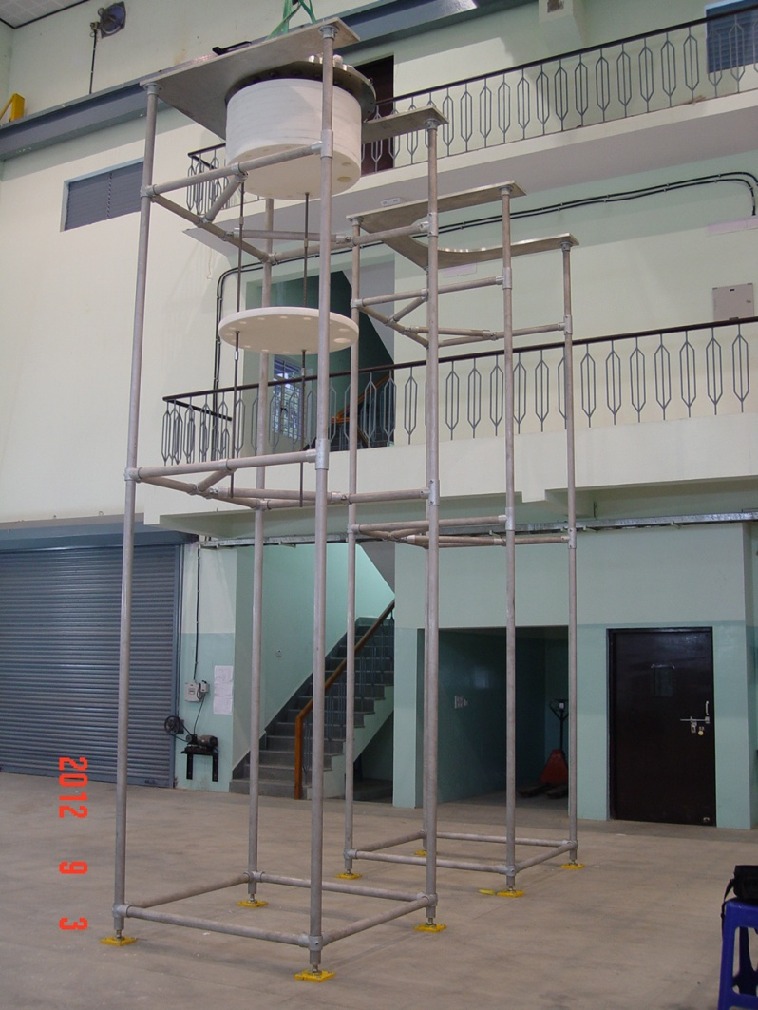
Installation of staging towers
The installation of staging towers for cavity insert assembly is in progress. Two staging towers have been erected. Installation of HEPA filters, anti-static PVC curtains etc is in progress.
Staging Towers

Slide 5
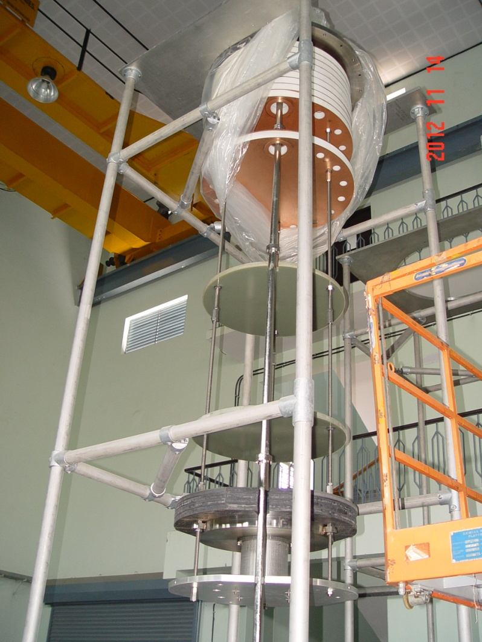
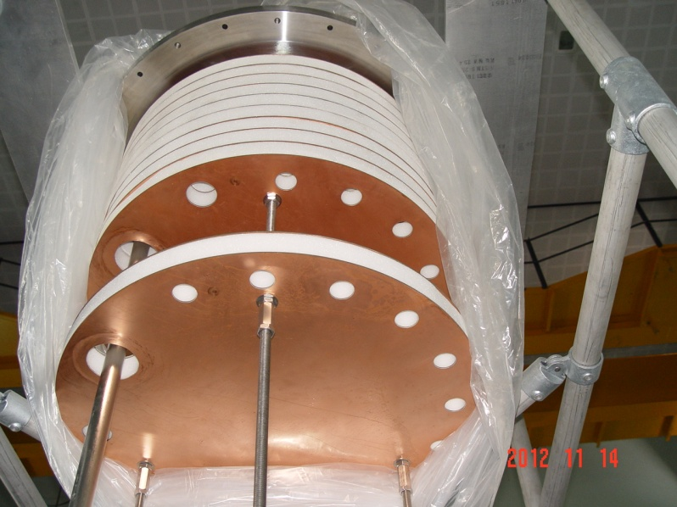
Cavity Insert Assembly
All the components of the insert assembly have been fabricated
Assembly of the insert is in progress
Thermal baffle assembly of insert
Insert Assembly

Slide 6
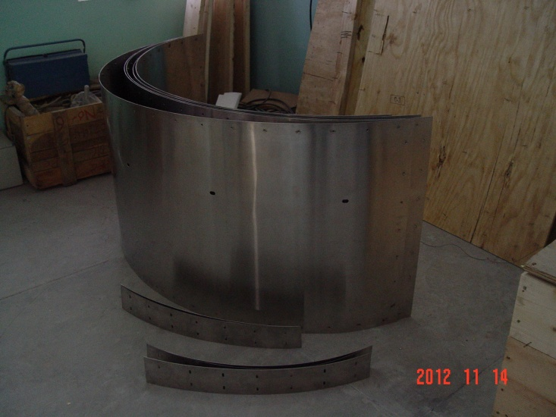
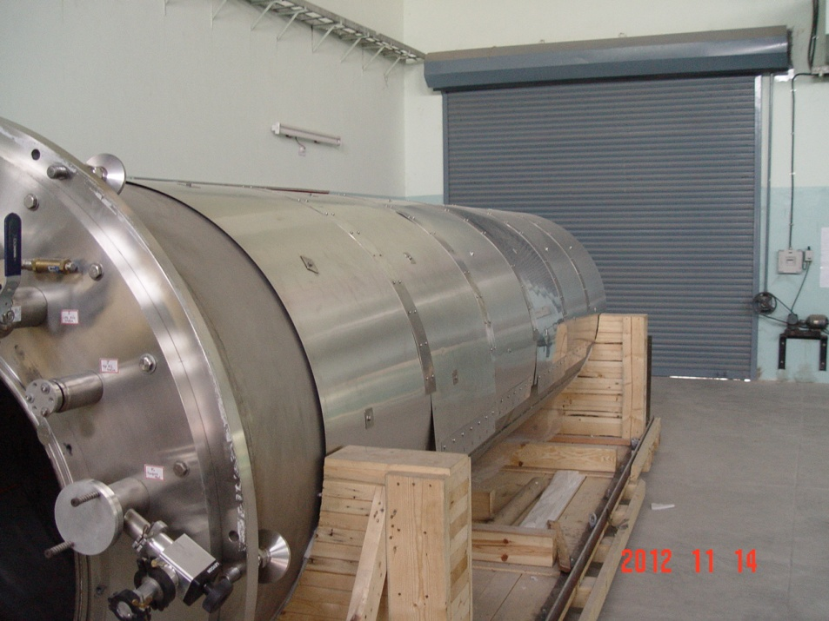
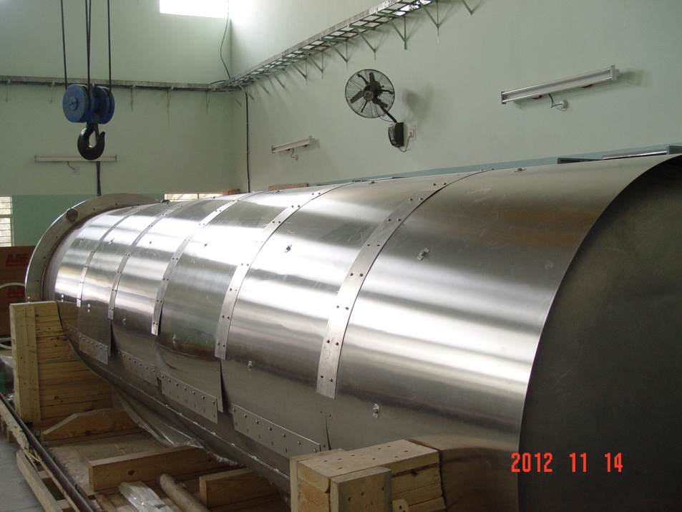
External Magnetic Shield
External magnetic shield segments have been fabricated
One half of the shield has been trial assembled on the Vacuum vessel (in horizontal position)
Final assembly shall be carried out once the cryostat is moved in vertical position

Slide 7
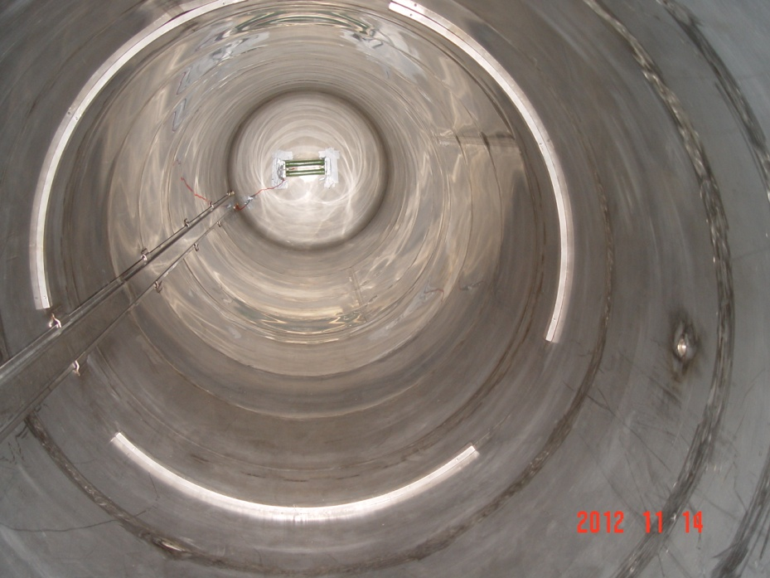
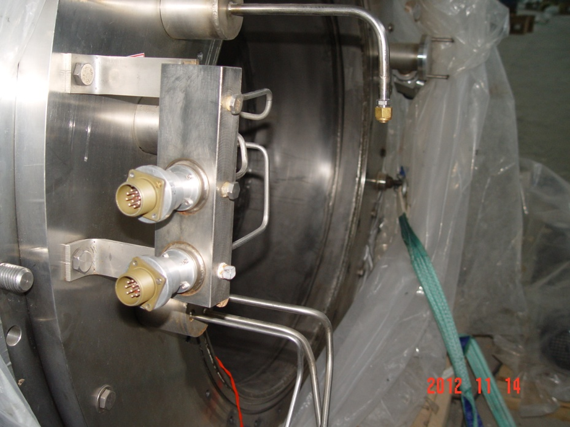
Assembly of Heaters
Heaters required during LHe boil off have been assembled. Power supply for the heaters have been tested.
Multi pin connectors for Cernox RTDs installed in the instrumentation tubing have been soldered & tested.
Heaters
Multi pin connectors

Slide 8
Cryogenic system for VTS
Installation of helium gas recovery lines is in progress.
Procurement for Helium gas compressor for pumping recovered helium gas into high pressure storage cylinders is under advance stage.

Slide 9
Status of VTS RF System at RRCAT Indore

Slide 10
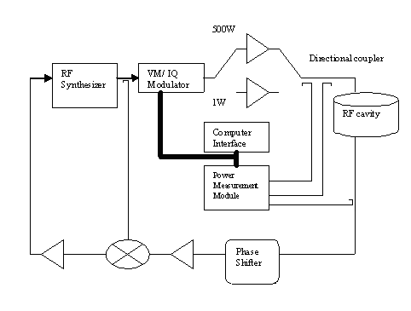
VTS Block Diagram & Software Description

Slide 11
Status of RF System
High Power RF Supply has been developed and tested up to 430W of CW Power (sufficient for up to 5 cell cavity).
RF Switching Network has been developed and integrated with the high power amplifier.
All sub modules of the VTS have been developed and tested except PLL module.
- The “Loop AMP” PCB in PLL Module was found to be faulty, new PCB has been designed. Fabrication of PCB underway

Slide 12
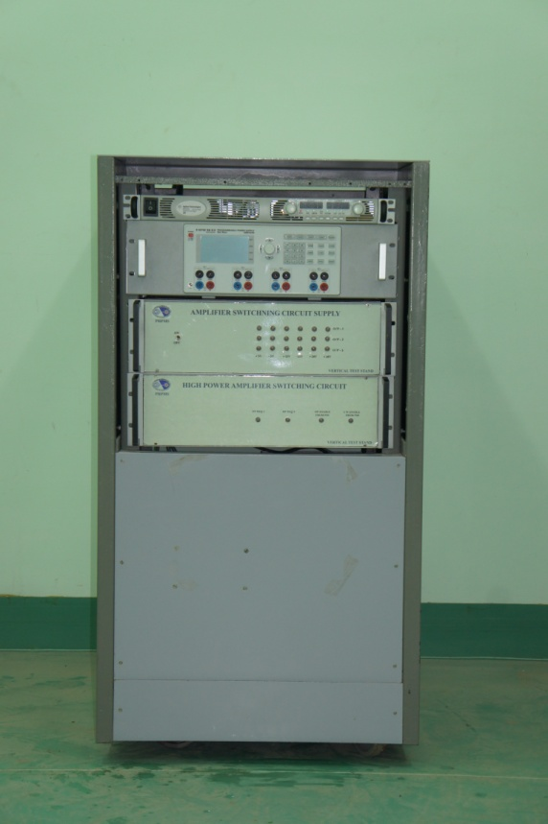
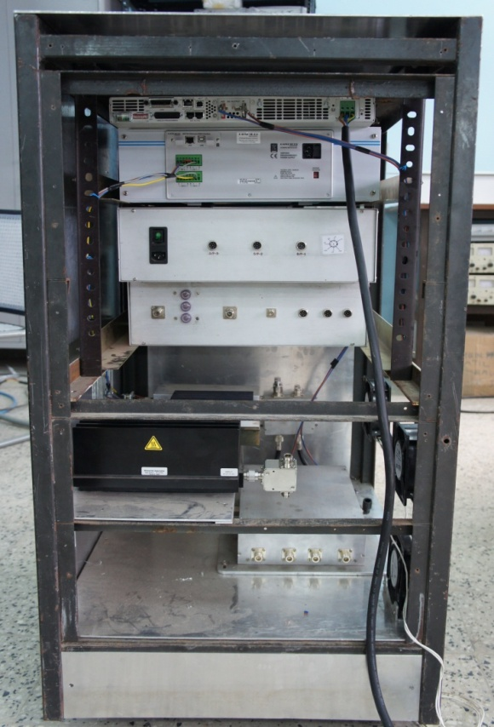
RRCAT VTS Status
- High power RF Supply for VTS has been developed and tested on passive load.
Front View
Rear View
Power Supplies
HP Switching Network
Driver Amplifier
Circulator and load
High Power Amplifier

Slide 13
50 W & 500 W CW Amplifier
50 W Amplifier Module
500 W Amplifier Module

Slide 14
Difficulties
Lack of practical exposure to similar systems. Visit of personnel shall help
Missing interface circuit information (PXI-digital-IO interface card)
- Problem reported to FNAL, in absence of information PCB was analyzed and components identified.
- After assembly PCB is functional.
Minor software issues
-In main LLRF control software some data acquisition linking and loops needs further clarifications.
“Loop Amp” PCB file received contains several errors
- Problem reported to FNAL
- Response received containing corrections to be made. Changes were implemented however Short circuit between supply and GND still remains.
- New PCB designed, fabrication underway.
PCB for IQ modulator contains errors
- After analysis problems were identified and connections were rectified.
- PCB functional now

Slide 15
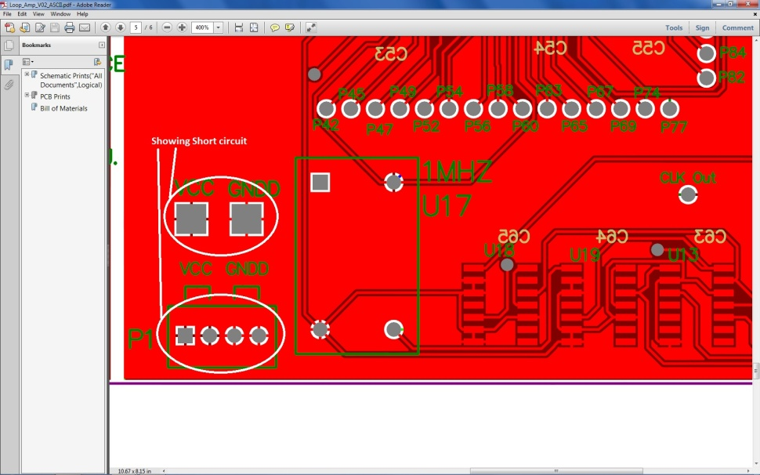
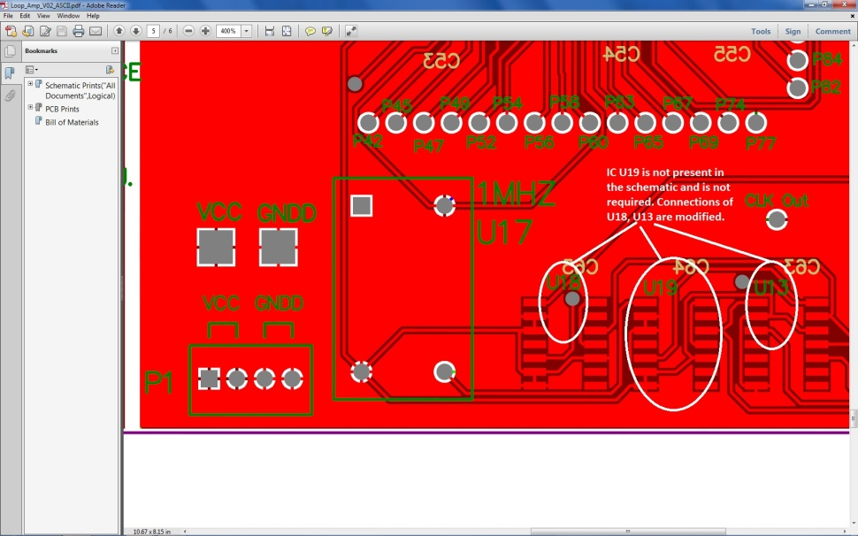
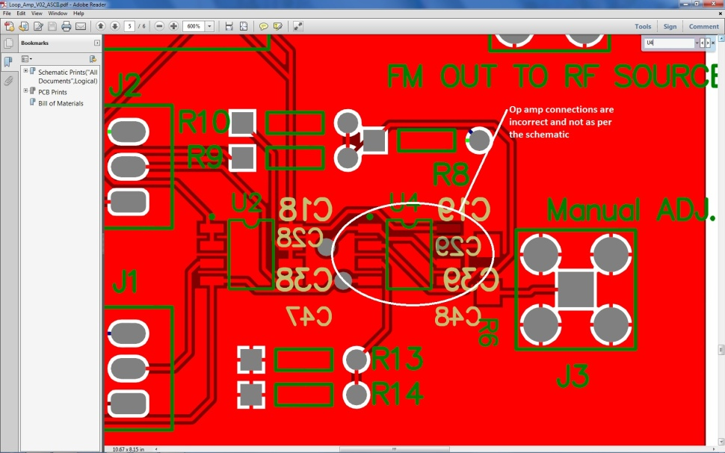
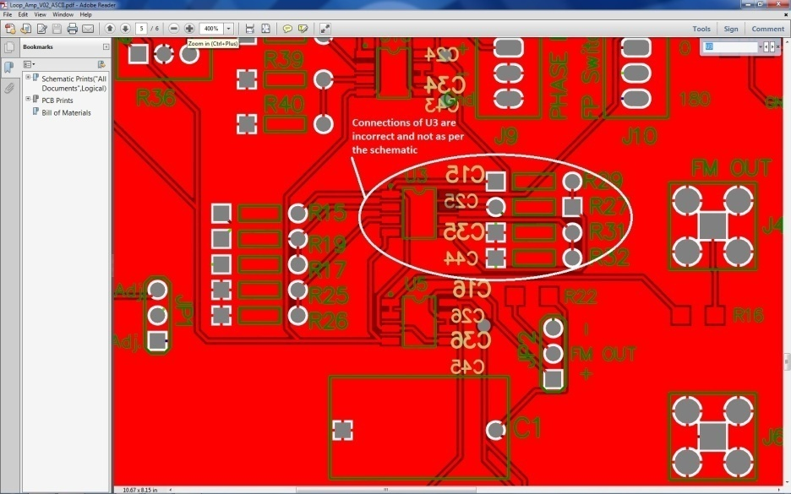
PCB connection errors shown in white

Slide 16
Conclusion:
The 500 W RF system for the VTS at 1.3 GHz has been developed and tested.
The microwave equipments have been procured and interfaced with PC using LabView.
All sub modules have been designed and developed pending only the PLL module as “Loop AMP” PCB in PLL Module was found to be faulty, new PCB has been designed by RRCAT engineers. Fabrication of PCB underway

Slide 17
Thank You

