Slide 1
HTS2 Update
A. Hocker
Fermilab
14-NOV-2012

Slide 2
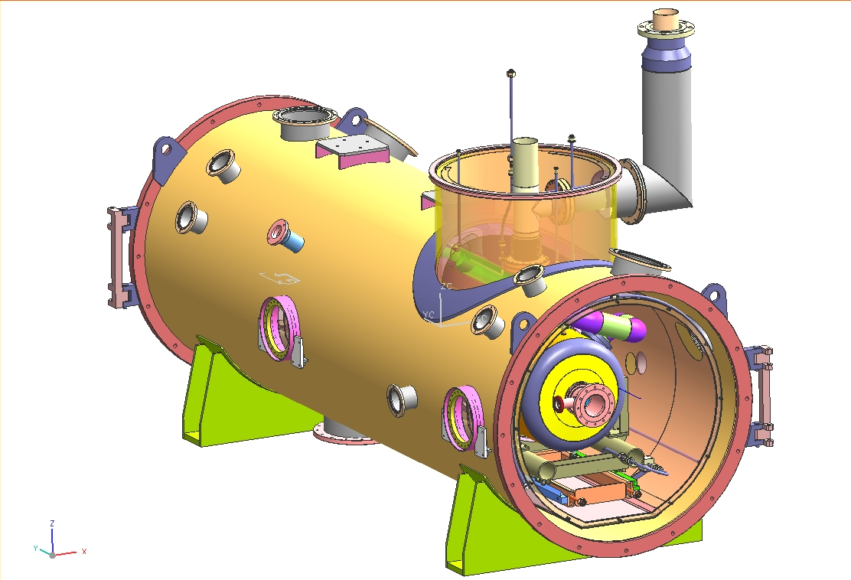
Cryostat: latest snapshot
This needs to swing around to here

Slide 3
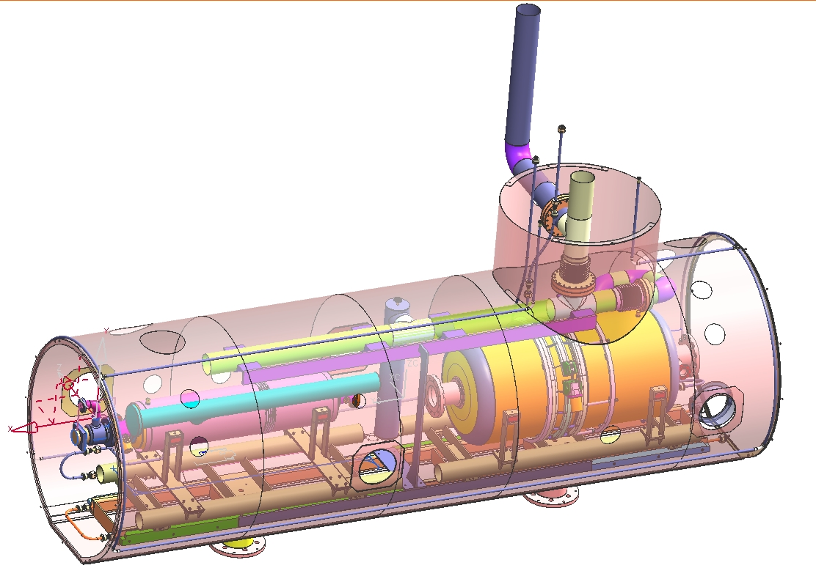
Internal piping: snapshot
LN2 (80K shield)
1ph He (5K intercepts, rail)
2ph He w/ relief (cavity)
Warmup/cooldown (cavity)

Slide 4
Cryostat: to do
Layout of cavity pumping lines (in progress)
Incoporating couplers
Supports, intercepts
Magnet leads
Feedthroughs, intercepts

Slide 5
Feedcan
FNAL has agreed to take on feedcan design in parallel with remaining cryostat work
Engineering: Michael Geynisman, Ronak Patel
Design/drafting: Frank McConologue, Clark Reid
Wisdom: Tom Peterson, Brian DeGraff
FNAL will deliver a set of “build-to-print” drawings to RRCAT for fabrication in India
Also some specialized hardware (e.g. bayonets)
RRCAT will be responsible for assembly, QC (leak-checking etc.), and documentation for integrated system
Line/valves sized, HX chosen, first modeling underway to make it all fit together

Slide 6
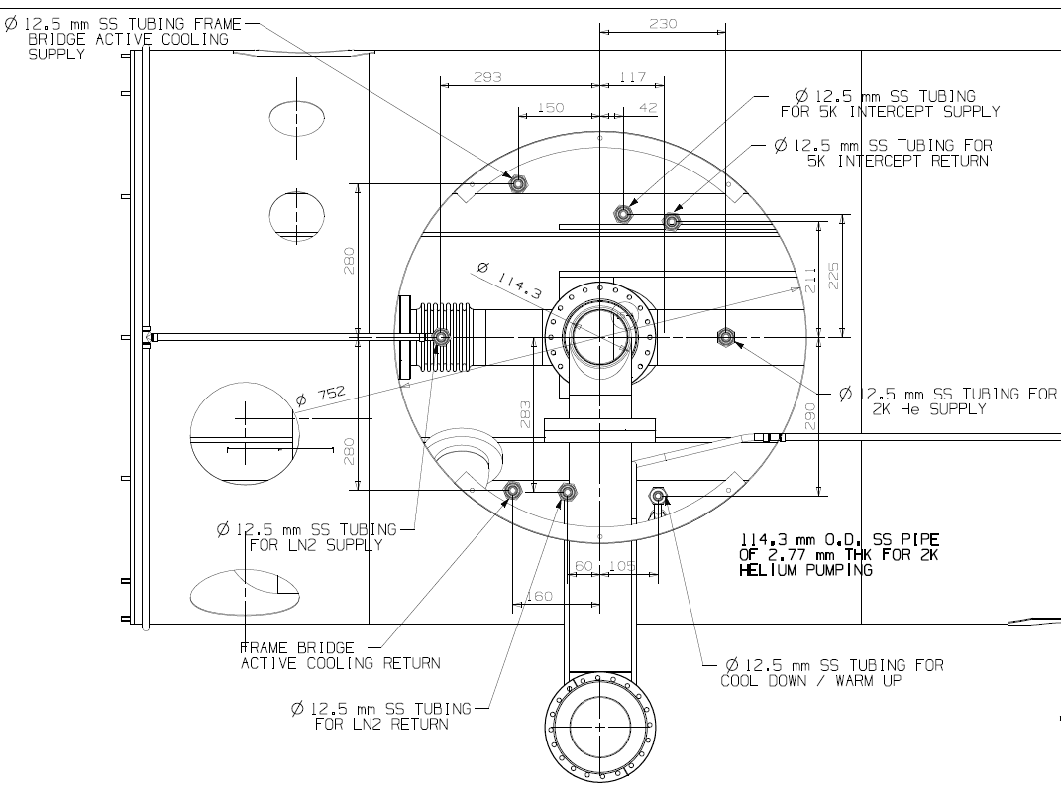
Feedcan interface layout
From RRCAT

Slide 7
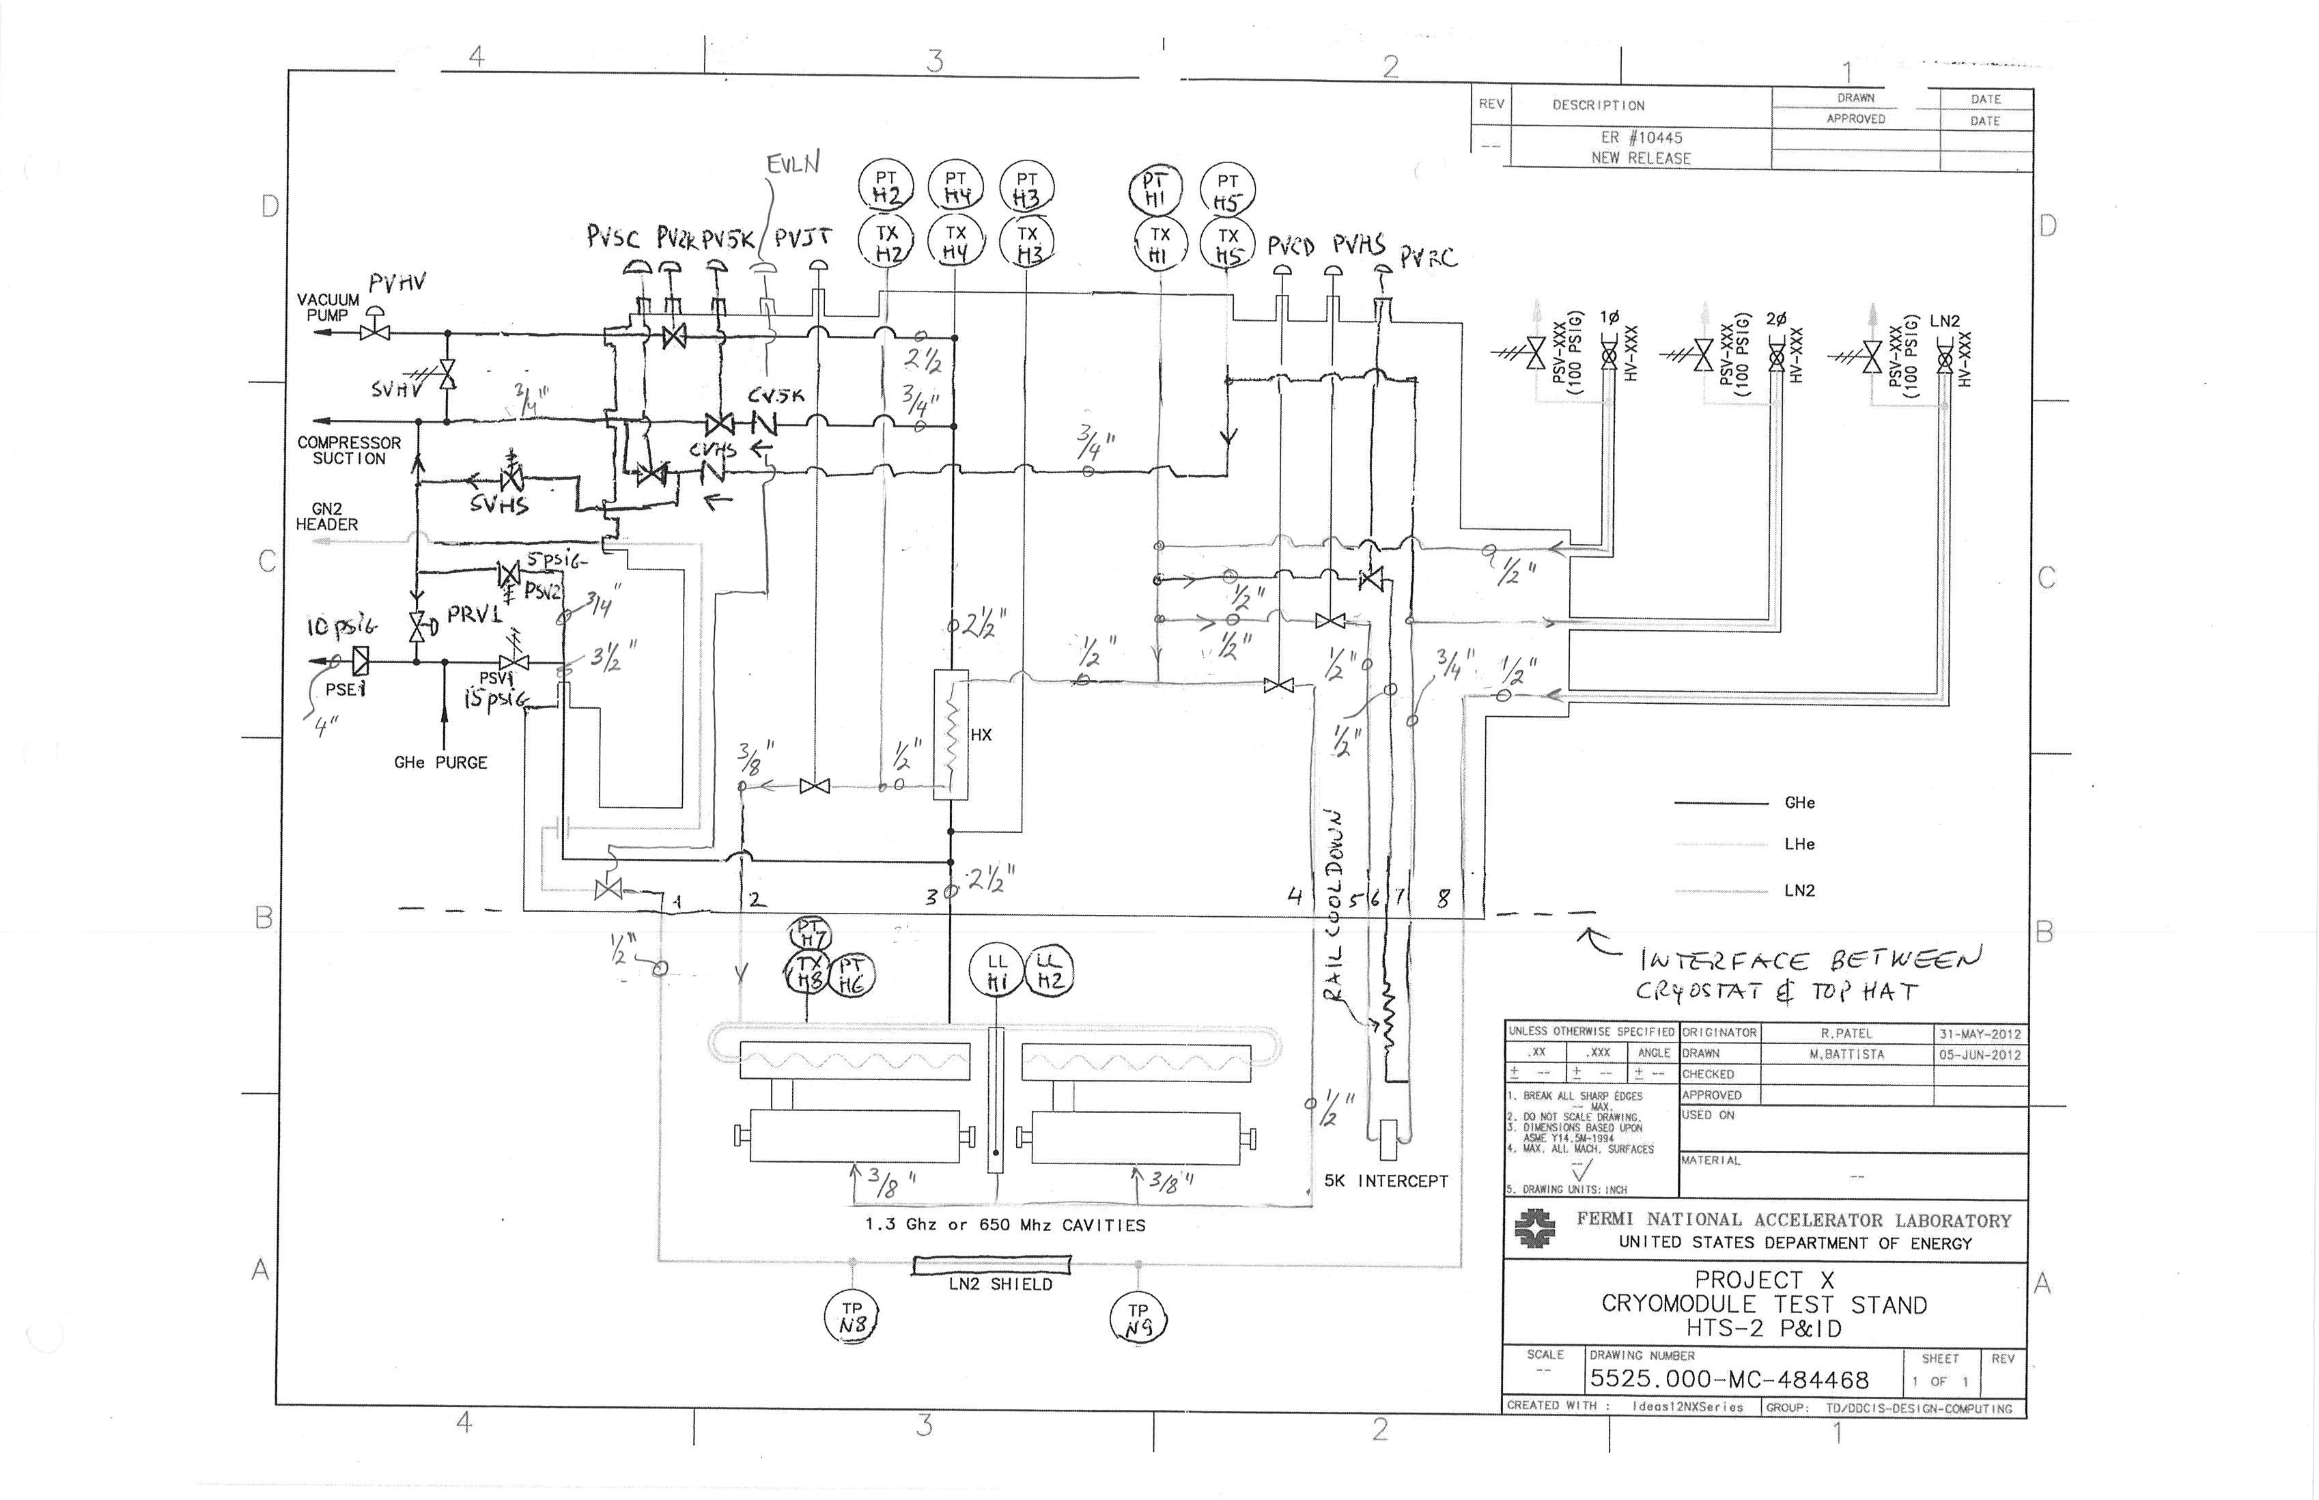
Feedcan P&ID

