Slide 1
Current Program Overview
Maddie Schoell
DOE O 420.2D Assist Visit
September 26-27, 2023

Slide 2
Outline
Safety Notes
Scope
Brief Timeline
SAD & ASE
  New Credited Controls
RGDs & Equivalencies
USI Program

Slide 3
Safety Notes
In the event of an emergency or alarm, we’ll go to the south (enclosed) stairs and go downstairs
  For tornados: proceed to the basement/ground floor
  For fire: proceed outside
Emergency phone number
  From cell phone: 630-840-3131
  From lab phone: x3131
Safety briefings and PPE will be provided to you for Site Visits today and tomorrow
As Business Visitors, you are required to be escorted by a Fermilab employee. We’ll guide you in the event of an emergency.

Slide 4
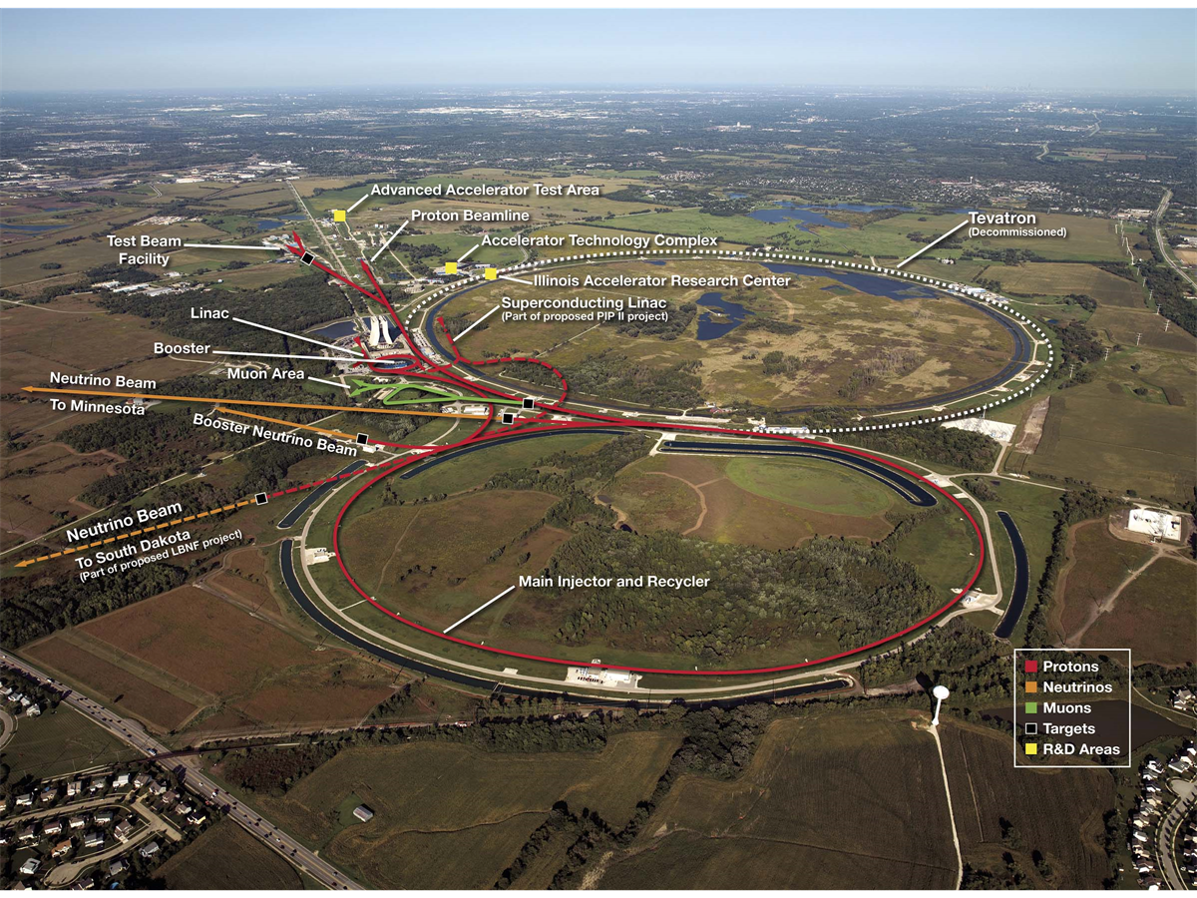
Scope – Fermilab
Fermilab Overview
6,800 acre site
High energy physics and particle beam physics research
Frontiers:
  Energy
  Intensity
  Cosmic
Managed fully within DOE O 420.2D (no nuclear facilities)

Slide 5
Brief Timeline
Date | Event
 | DOE O 420.2D revision published
11/18/2022 | Fermilab submits DOE O 420.2D Implementation Plan to FSO
12/20/2022 | FSO approves Fermilab DOE O 420.2D Implementation Plan
11/21/2022 | Fermilab submits ASE Revision 13 to FSO for FSO Manager Approval
1/4/2023 | In response for ASE Rev. 13 approval request, FSO instead sends letter to Fermilab including 39 comments and requests Fermilab provide a proposed solution for each comment
4/21/2023 | Fermilab submitted formal response with proposed solutions to 1/2023 Letter concerns
5/9/2023 | FSO notified Fermilab that initial proposed solutions were not all accepted
6/5/2023 | Sunsetting of initial Implementation Plan Working Groups
7/5/2023 | Fermilab submitted updated solutions to 1/2023 Letter
8/15-17/2023 | Fermilab conducted SAD/ASE ARR
9/1/2023 | CRO issued email indicating that the Fermilab Main Accelerator would not resume following the summer maintenance period until DOE O 420.2D implementation complete
9/14/2023 | Formal Project created for SAD/ASE Revision
Anticipated | FSO intends to send Fermilab another letter with comment/resolution form in response to proposed updated ASE as presented during SAD/ASE ARR
9/26-27/2023 | DOE O 420.2D Assist Visit

Slide 6
Fermilab Safety Assessment Document (SAD) Structure
Fermilab has one modular Safety Assessment Document (SAD)
Section I – Overview of Fermilab Facilities
Section II – Support Facilities
Section III – Fermilab Main Accelerator (Accelerator Segments)
Section IV – Fermilab Main Accelerator (Experimental Areas & Detectors)
Section V – FAST Accelerator
Section VI – Test Stand Accelerators
Section VII – Appendices
  VII-A – Accelerator Safety Envelopes
  VII-B – Fermilab Accelerator Safety Policies & Programs
  VII-C – Standard Industrial Hazard (SIH) Risk Matrix Tables

Slide 7
Fermilab SAD Structure – SAD Chapters
SAD Chapters prepared by Machine/Area Owner, Department Head, or Primary Point of Contact
SAD Chapters reviewed by Line Organization Owner, ES&H Division Accelerator Safety Department Head and SAD Review Subcommittee Chair
All Chapters have same Outline, consistency in formatting and creates ease for reader to find the same type of information across Chapters
Chapter nomenclature
II-1.2.1.1
SAD Section
Information section within the Chapter
Chapter within the SAD Section

Slide 8
Fermilab Accelerator Safety Envelopes (ASEs) Structure
Multiple Accelerator Safety Envelopes (ASEs)
  One ASE for each accelerator
ASEs prepared by the ES&H Division Accelerator Safety Department Head and Accelerator Machine/Area Owner, Department Head, or Primary Point of Contact
ASEs Reviewed and Recommended for approval by the Directorate Associate Lab Director or Division Senior Director, the Accelerator Safety Department Head and SAD Review Subcommittee Chair
Final approval of the ASE granted by the Fermilab Director and the DOE Field Element Manager

Slide 9
Fermilab ASE Structure
ASE Outline
  Section 1 Introduction and Scope
  Section 2 Select Definitions and Acronyms
  Section 3 Description of Credited Controls
  Section 4 ASE Violation Determinations and Actions
  Section 5 Configuration Management for Credited Controls
  Section 6 Unreviewed Safety Issue (USI) Process
  Section 7 Summary of Credited Controls for [all Segments of] the Accelerator
    For the Fermilab Main Accelerator, this will be subdivided for each segment (i.e., Linac, Booster, Main Injector, Switchyard, etc.)

Slide 10
Fermilab SAD/ASE Structure – New Credited Controls
During SAD/ASE updates, several new Credited Controls were identified and are being incorporated into the SAD and ASEs
  Identified fluorinert byproducts as being an accelerator specific hazard
  ODH Safety System components necessary to maintain ODH postings in applicable accelerator facilities
  Required radiation monitors
More details in presentation Wednesday morning.

Slide 11
Continued Updates to SAD & ASE Following ARR
Aug SAD/ASE ARR Provided several recommendations to further update and improve our SAD and ASEs
  See list on Slide 14, also in Document #5.4
Kicked-off new Project to complete next iteration of SAD/ASE Updates
  Formal Project structure: org chart & timeline
  Beginning new round of efforts Thursday
    Updating SAD/ASE outline/templates
    Ensuring clear/detailed connection of Credited Controls through SAD to ASE
  Phased approach for updating documents, performing IRRs/ARRs and resuming beam operations

Slide 12
RGDs & Equivalencies
Utilizing interpretation from DOE HQ Assist visit to JLab, established new “flow” for determining if device was an accelerator or RGD, and if accelerator if it could be eligible for an equivalency
Updated Fermilab RGD Program to include requirements from all five invoked standards from the DOE O 420.2D equivalency categories
Devices granted an equivalency will be managed under RGD Program
More details in the next presentation.

Slide 13
USI Program
Incorporating USI Program into Appendix B of the SAD.
Updated USI determination questions to align with updated risk assessment methodology.
Included Reviewed Safety Issue (RSI) conclusion step.
Intended to use USI/RSI to implement Compensatory Measures.
Aug SAD/ASE ARR Provided several recommendations to further update and improve our SAD and ASEs
  See list on Slide 14, also in Document #5.4
More details in presentation Wednesday morning.

Slide 14
ARR Recommendations
SAD
  Fermilab should evaluate recent SADs from other facilities for ideas on structure and content.
  Fermilab should establish contacts for reviews of interim work products.
  The SAD should contain facility descriptions with sufficient detail to understand the source of the hazards.
  The SAD should clearly describe the unmitigated accelerator specific hazards and non-accelerator specific hazards (NASH) that initiate accelerator-specific hazards.
  The SAD should specifically define the credited controls being applied to the hazard to reduce either the likelihood or consequences of the hazard to an acceptable risk level. Defense in depth measures should not be used to reduce risk.
  Compensatory actions must be evaluated in the SAD with the same rigor as the credited controls in the SAD.
  The SAD should present the final mitigated hazards.
  The SAD should summarize the hazards evaluated in the risk tables.
  Ensure that the SAD addresses the comments received from the Fermi Site Office (FSO) on the reviewed SAD and ASE.
  The applicability of ODH credited controls beyond exclusion areas should be evaluated and clarified in the SAD.
  The controls used for fluorinert decomposition products (HF, perfluoroisobutylene) should be evaluated and clarified in the SAD.
ASE
  Credited Controls must be directly related to the hazard analysis documented in the SAD.
  The ASE must be written to clearly define the limits and how they are measured.
  Administrative Credited Controls that support multiple activities should be addressed in the SAD and identified in the ASE.
  Direct reference to Shielding Assessments in the ASE is problematic. Instead, the Shielding Assessments should be referenced and described in the SAD, such that the ASE rolls up the required and credited shielding without directly referencing these documents.
  The ASE currently references longitudinal and transverse spreadsheets. These spreadsheets should instead be referenced and summarized in the SAD.
  Some credited control sections in the ASE define the components that are required to be present. These lists are better placed in the SAD.
  As a test, the ASE should be written such that any three individuals could evaluate a potential ASE violation and reach agreement.
USI
  The USI process and forms should state how to properly determine if the activity/discovered condition is fully covered in the SAD or ASE, and therefore the necessary level of approval.
  The initiator of the USI process must have a detailed understanding of the SAD and ASE. Consider implementing a screening process that does not require detailed knowledge of the SAD or ASE.
  Update the training process for USI initiators and evaluators to incorporate the new process.

Slide 15
Questions?

