Slide 1
M12 welded tubes

Slide 3
DSM product

Slide 4
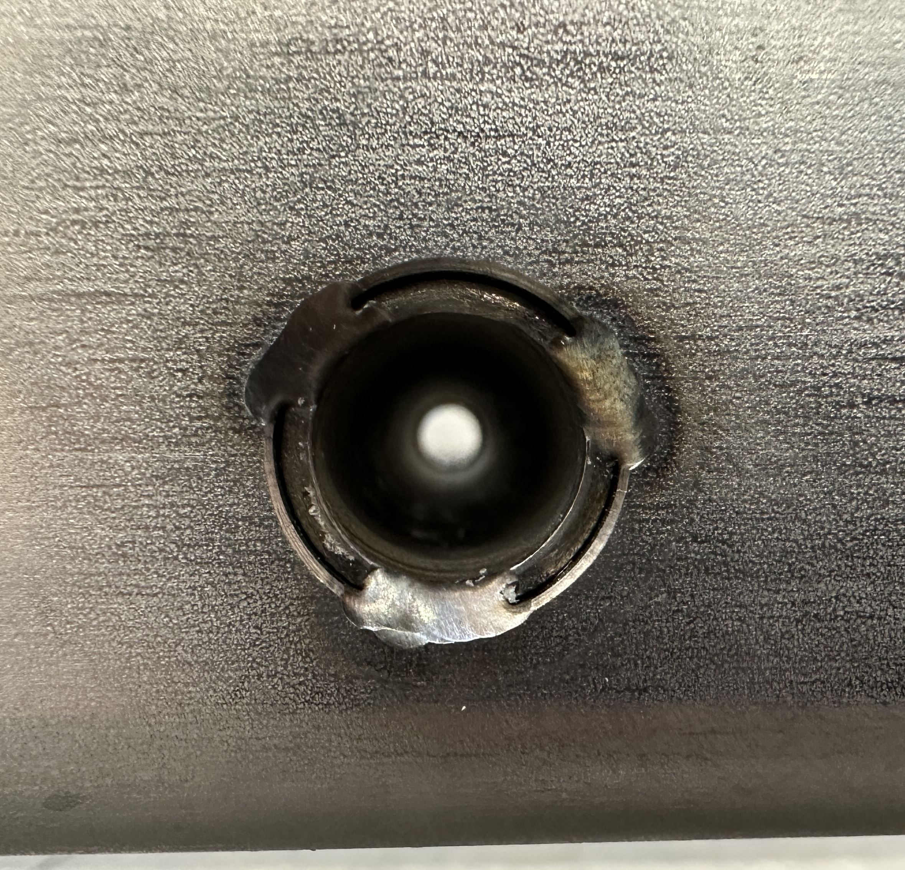
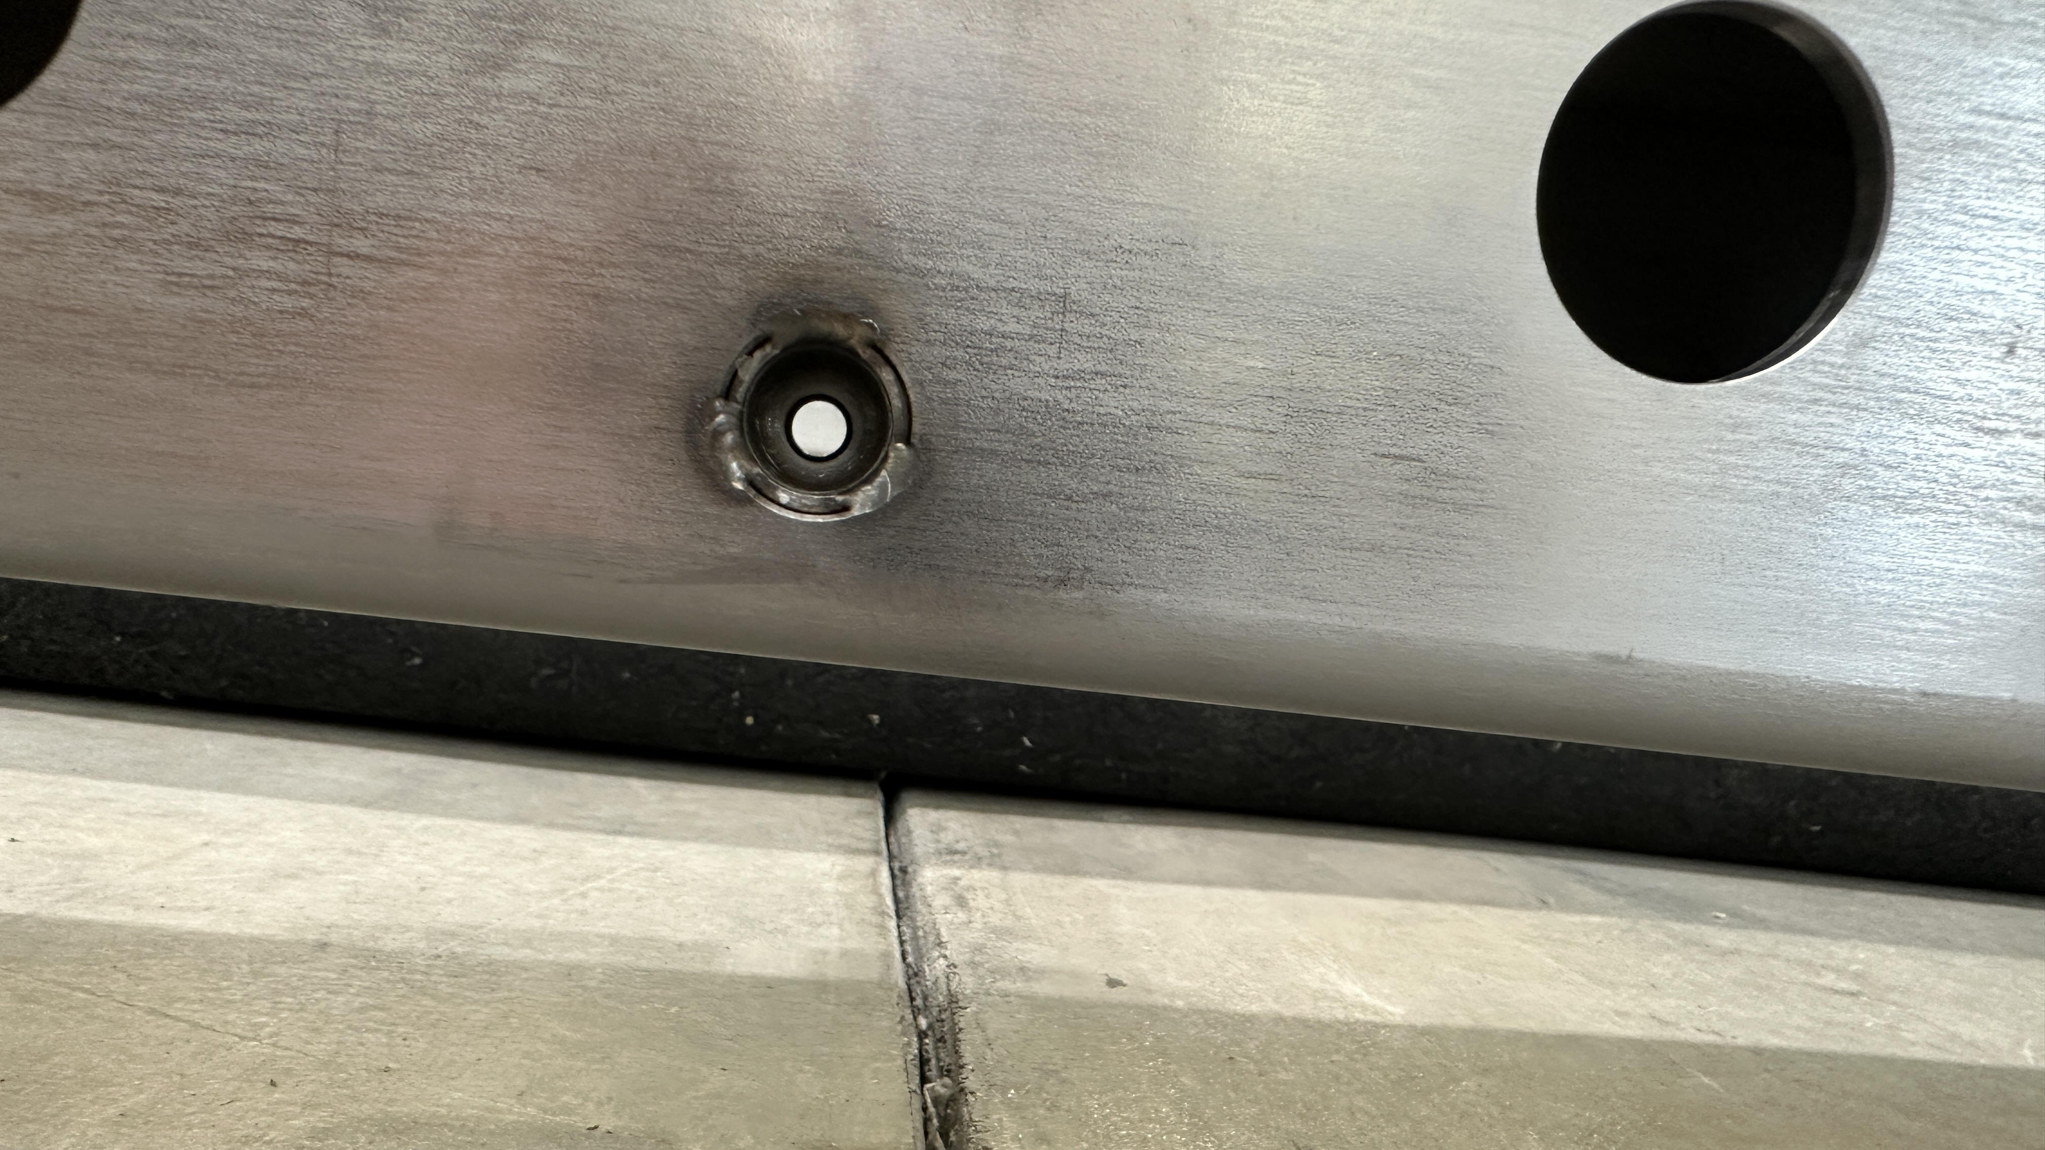
PSL product

