Slide 1
APA wire spool qualification procedure Maximum tension allowed
Sotiris Vlachos

Slide 2
Spool Qualification procedure Max wire tension
Before using a spool
Three strength measurements
Accept spool if mean value ≥ 25 N
Record results
If mean value < 25 contact QC responsible
Every time after soldering pads
Three strength measurements using wire trims
Record results
If mean value < 25 N contact QC responsible
During winding accept wire tensions below 9 N as measured with current systems (having ∼0.5 N measurement error)

Slide 3
APA wire tension parameters
Wire Strength Std. dev. = 0.16 N (Measured)
Elastic limit = Strength – 6 N (measured)
wire tension measurement error = 0.6N (Estimated)
Max APA wire tension : 14.2N (wire tensions < 7.5)
➞ Max APA wire tension : 15.7N (if wire tension 9 N)
(simulation: https://edms.cern.ch/document/2915042/1)

Slide 4
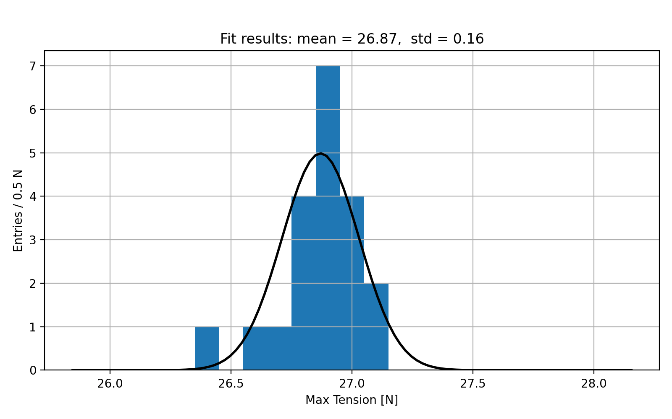
Max Tension measurements
LFA wire spool #3
Mean : 26.9 N
Standard deviation : 0.16 N

Slide 5
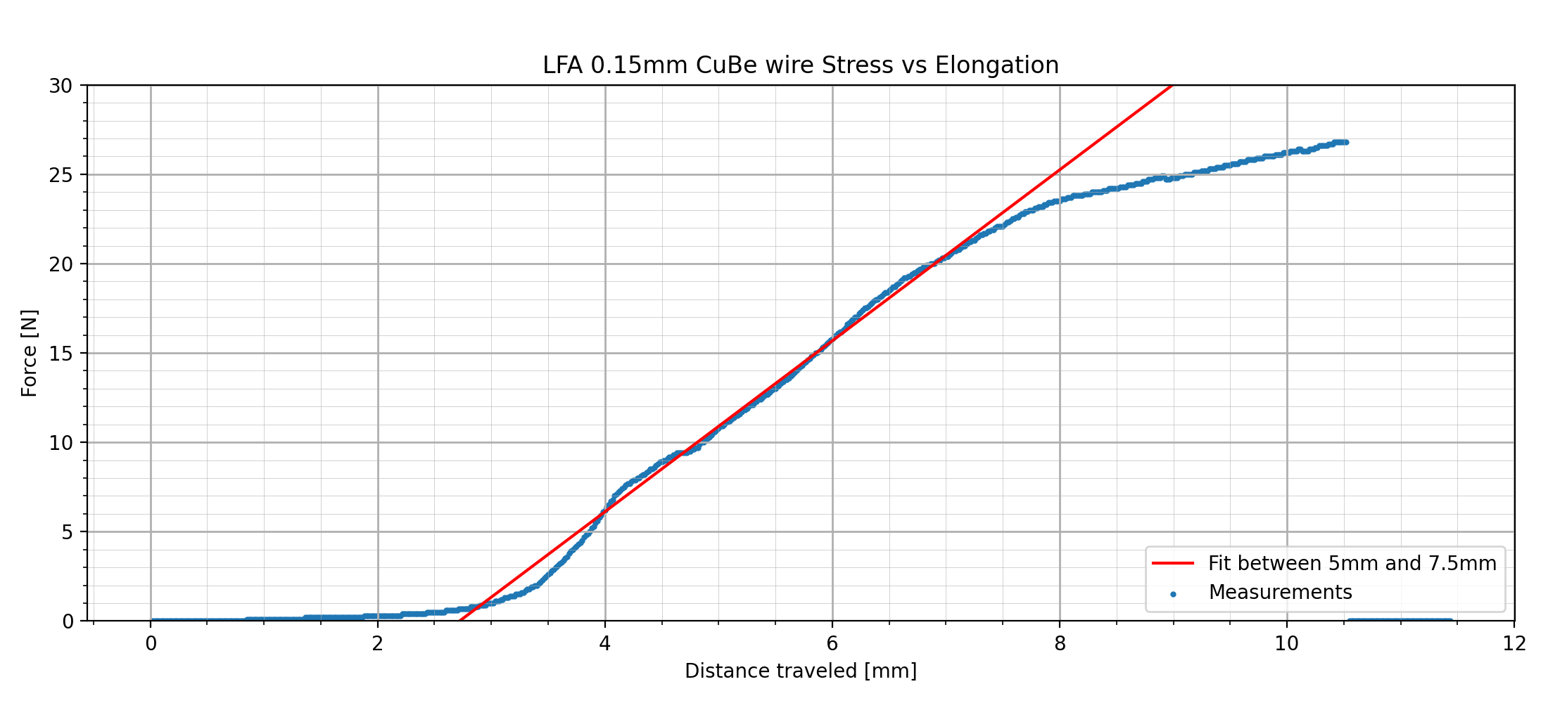
Stress – Strain Measurements
Max Stress : 26.9 N
Limit of elastic deformation : 21 N

Slide 6
Maximum wire tension Wire strength
Max APA wire tension : 9 N /Measured/
➞ Max APA wire tension : (15.7 ± 0.6) N
5 sigma away from elastic limit:
➞ Minimum Elastic limit required: 18.7 N
➞ Minimum wire strength accepted: 25.0 N /Measured/
Since actual strength of wire is measured and
Tension measurement error includes diameter variation
➞ no need for exact diameter knowledge

