Slide 1


MQXFA08b, MQXFA13 and MQXFA14b Test Results
Anis Ben Yahia
Brookhaven National Laboratory

Slide 2
Outline
Quench test results
  MQXFA08b
  MQXFA13
  MQXFA14b
Splice measurements
Magnetic measurement results

Slide 3
Outline
Quench test results
  MQXFA08b
  MQXFA13
  MQXFA14b
Splice measurements
Magnetic measurement results

Slide 4
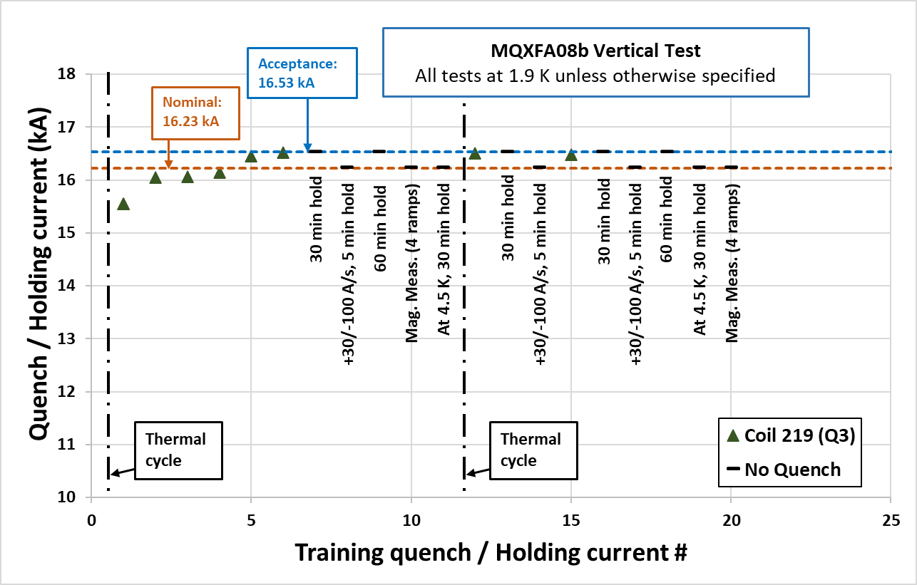
MQXFA08b
First re-assembly: built by replacing the limiting coil (213) in MQXFA08 by a new coil (219) in quadrant 3.
All quenches occurred in coil 219.
After the thermal cycle 2 additional quenches above nominal current (at 16.51 kA and 16.48 kA)

Slide 5
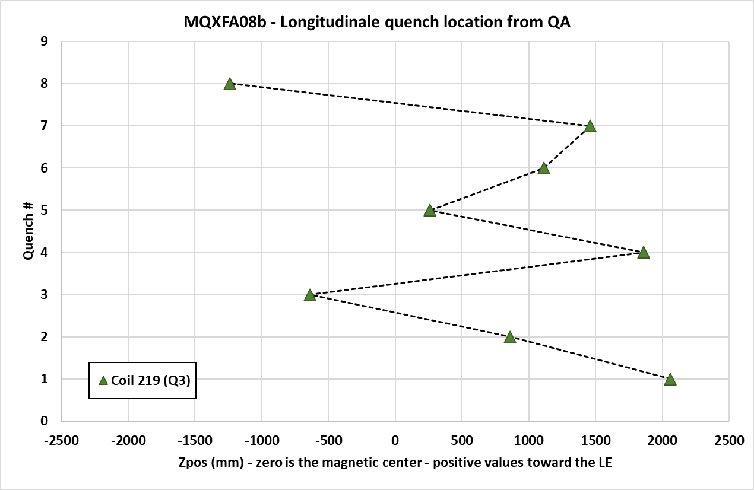
MQXFA08b – Quench localization from the Quench Antenna Array
First quench in the lead end of the coil.
Following quenches in the straight section (no recurring location).
Return end
Lead end

Slide 6
Outline
Quench test results
  MQXFA08b
  MQXFA13
  MQXFA14b
Splice measurements
Magnetic measurement results

Slide 7
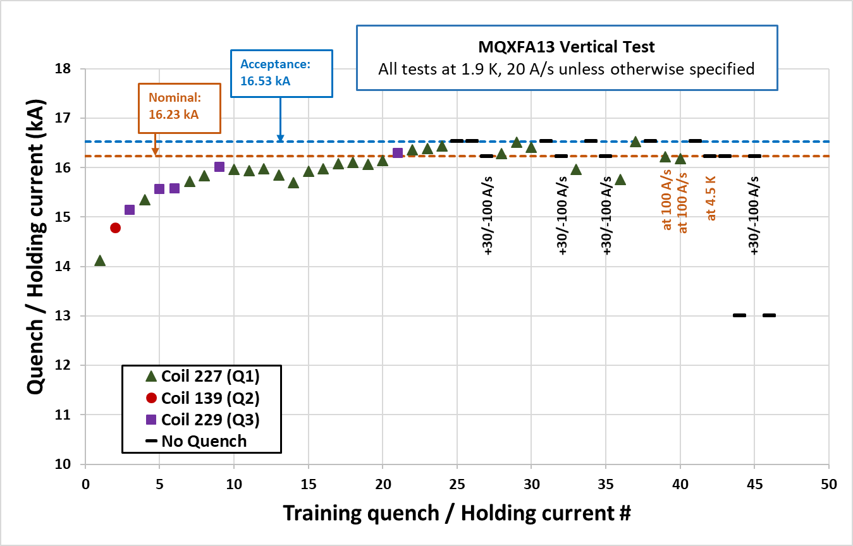
MQXFA13
Training “typical” up to quench #9.
Drop in quench current (315 A) between quench 10 and 14.
Training continued from quench 15.
Reached 16.53 kA on the 25th ramp.

Slide 8
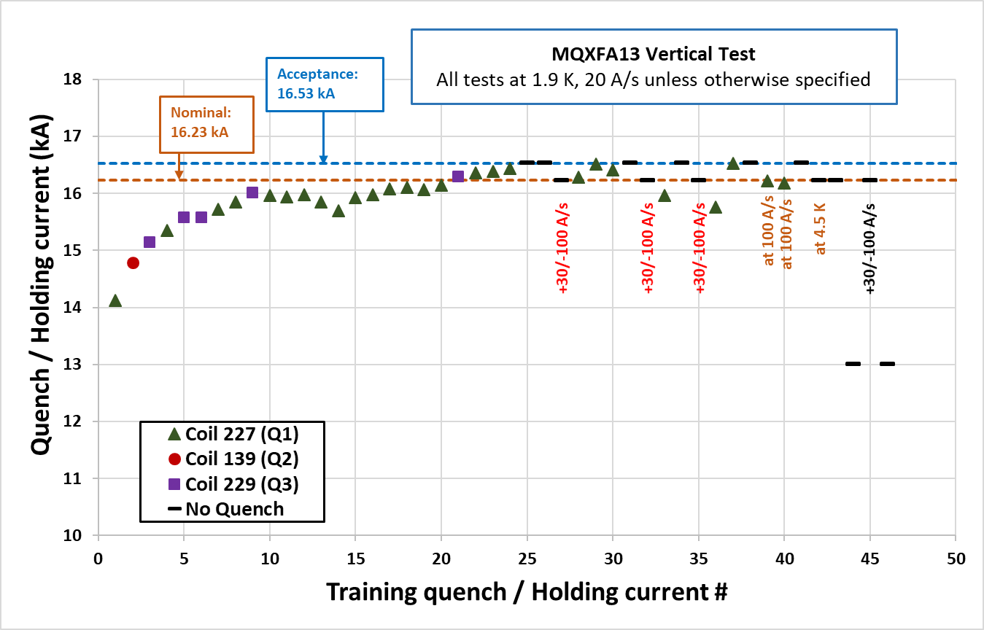
MQXFA13
Following the ramp at +30/-100 A/s, there was a drop in quench current in the subsequent ramp at 20 A/s.
Magnet trains back again to 16.53 kA.
Behavior was repeatable 3 times.
Ramps at 100 A/s showed lower quench current (16.22 and 16.21 kA).
All these quenches occurred in coil 227 (Q1.).

Slide 9
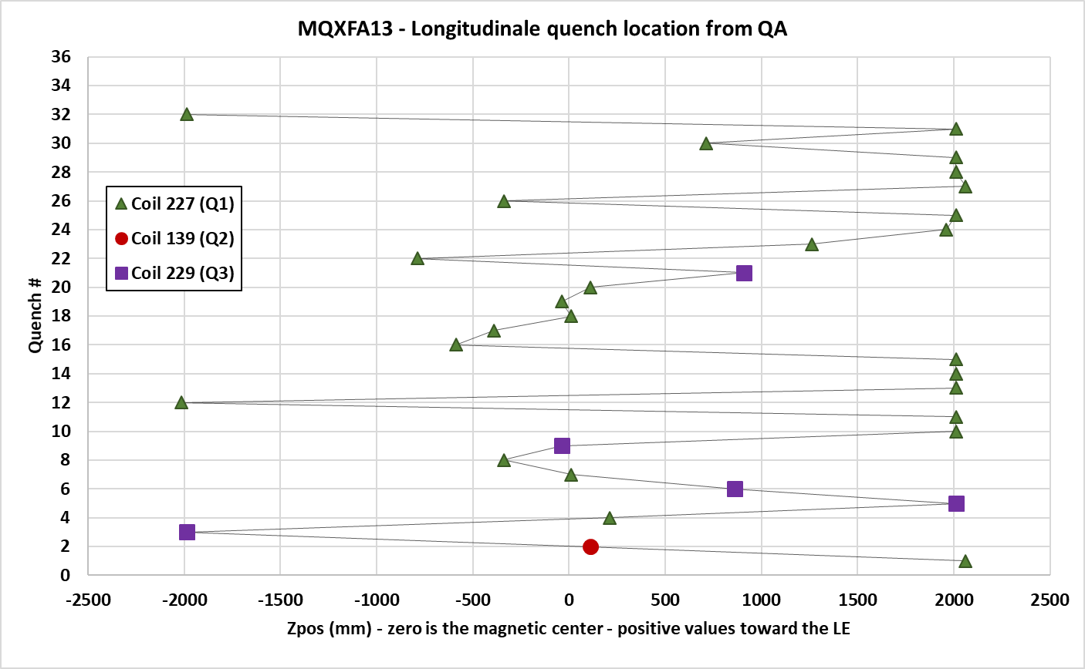
MQXFA13 – Quench localization from the Quench Antenna Array
Recurring quenches in the coil ends.
Quench 10 to14
Return end
Lead end

Slide 10
MQXFA13 – Quench localization from the Quench Antenna Array
Recurring quenches in the coil ends.
Quenches following the +30/-100 A/s ramp.
Return end
Lead end

Slide 11
MQXFA13 – Quench localization from the Quench Antenna Array
Recurring quenches in the coil ends.
Quenches at 100 A/s.
Return end
Lead end

Slide 12
MQXFA13
Analysis of CMM data showed that all MQXFA13 coils had small arc-length in the ends, with coil 227 the smallest ever.
FEM analysis of MQXFA13 as built showed risk of high strain with moderate prestress, and this issue may be prevented with higher local prestress.
MQXFA13 test was stopped in order to replace coil 227 and avoid damage to the other coils.

Slide 13
Outline
Quench test results
  MQXFA08b
  MQXFA13
  MQXFA14b
Splice measurements
Magnetic measurement results

Slide 14
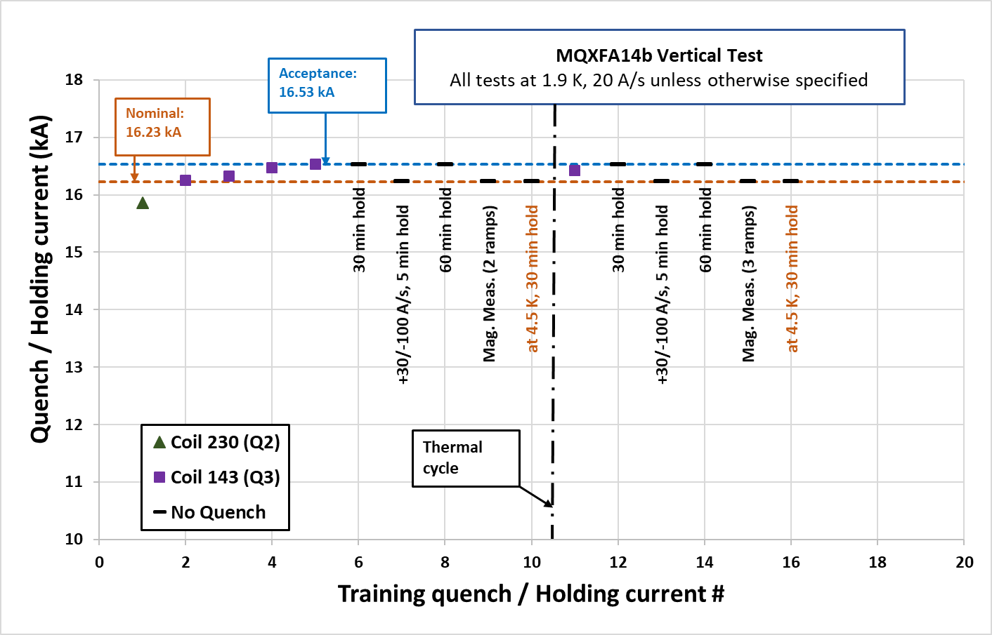
MQXFA14b
Assembled using revised MQXFA specifications and targets.
Achieved nominal + 300A after 5 quenches.
All quenches except the first were in quadrant 3 (coil 143).
After the thermal cycle
  One quench at 16.42 kA.
  7 ramps without quench (2 to nominal + 300 A).

Slide 15
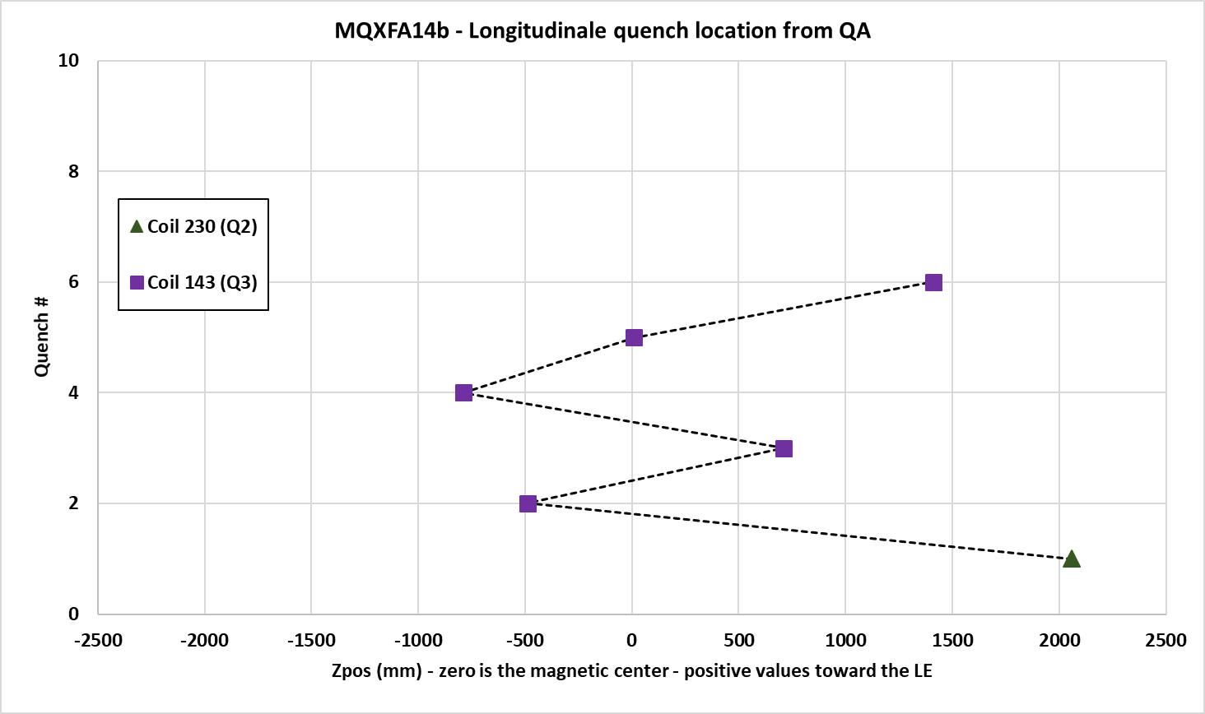
MQXFA14b – Quench localization from the Quench Antenna Array
No recurring quench location.
Return end
Lead end

Slide 16
Outline
Quench test results
  MQXFA08b
  MQXFA13
  MQXFA14b
Splice measurements
Magnetic measurement results

Slide 17
MQXFA08b – Splices measurements

Slide 18
MQXFA13 – Splices measurements

Slide 19
MQXFA14b – Splices measurements

Slide 20
Outline
Quench test results
  MQXFA08b
  MQXFA13
  MQXFA14b
Splice measurements
Magnetic measurement results

Slide 21
MQXFA08b
Mix of previously tested coil and one new coil (coil 219 in Q3).
The field errors after loading were within the bounds, except for a₅ and a₇ that are on the boarder line.
No magnetic shims installed.
Change in the low order multipole from warm pre-test to cold to the final warm measurement.
Measured integrated gradient at 16.23 kA: 562.41 T

Slide 22
MQXFA08b
Variation of a₃/b₃ along the length warm and cold measurements at 10 and 16.3 kA.

Slide 23
MQXFA08b
Variation of a₃/b₃ vs current.

Slide 24
MQXFA13
At the end of the quench tests, two sets of magnetic measurements were taken.
The difference was in the pre-cycle:
  1st pre-cycle was at +/- 20 A/s.
  2nd pre-cycle was at +30/-100 A/s.
The measurements were taken at 13 kA.

Slide 25
MQXFA13
The two measurements were identical.
(“fast” refers to the measurement with +30/-100 A/s pre-cycle).

Slide 26
MQXFA13
Example of the variation along the length.

Slide 27
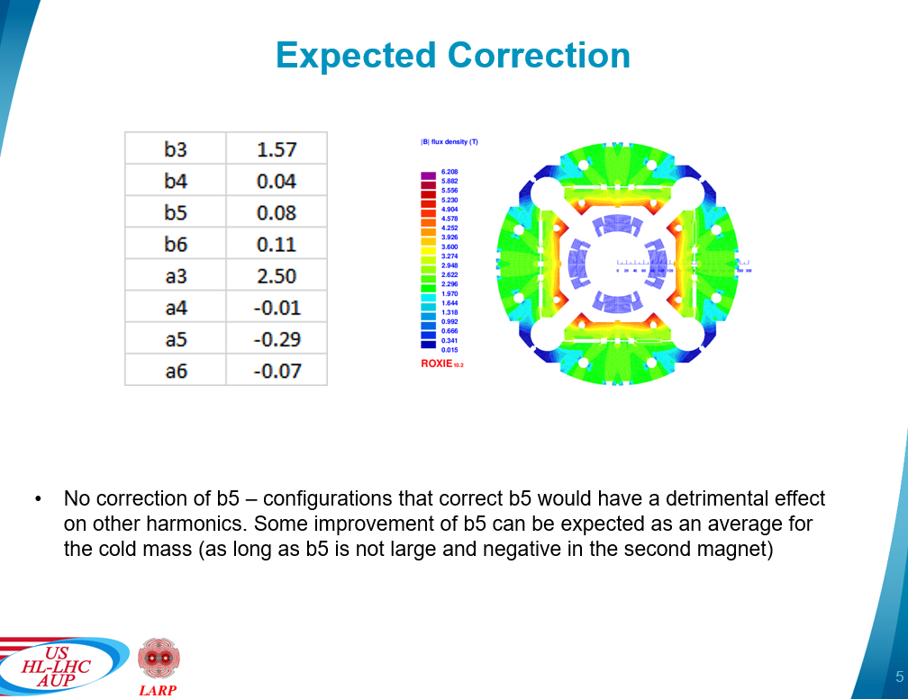
MQXFA14b
Warm measurements and magnetic shim configuration.
G. L. Sabbi

Slide 28
MQXFA14b
Field quality at nominal current and change from the magnetic shims.
 | Integ harmonics variation (unit)
 | Measured | Expected | Difference
b3 | 1.83 | 1.57 | -0.26
a3 | 2.82 | 2.50 | -0.32
b4 | -0.06 | 0.04 | 0.10
a4 | 0.37 | -0.01 | -0.38
b5 | 0.38 | 0.08 | -0.30
a5 | -0.05 | -0.29 | -0.24
b6 | 0.77 | 0.11 | -0.66
a6 | 0.06 | -0.07 | -0.13
Measured integrated gradient at 16.23 kA: 563.14 T

Slide 29
Summary
MQXFA08b:
  First successful test of an MQXFA magnet after replacing a coil.
  All quenches occurred in the new coil.
MQXFA13:
  Test stopped for replacing the coil showing ramp-rate dependence.
MQXFA14b:
  Assembled with revised specs and pre-load targets.
  5 quenches to reach acceptance current.
Magnetic field measurements:
  Field quality generally within the expected bound.
  Correction from the magnetic shims in A14b in agreement with calculated values.
All cold and warm high voltage withstand tests were successful.
All magnet splices are less than 0.5 nΩ.

Slide 30
THANK YOU

Slide 31
Additional slides

Slide 32
Integrated Gradient and Field Quality
Average integrated gradient at 16.23 kA: 562.38 T
Correction factors applied to account for measurements taken at different currents as well as changes in the measurement setup and coil design.

Slide 33
Field Quality – All tested magnets

