Slide 1


MQXFA Status
Maria Baldini, Paolo Ferracin, Giorgio Ambrosio,
with contributions from the whole MQXFA team

Slide 2
Conductor Procurement & QC
Conductor delivery:
  ~98% conductor received (out of 260 km, including LARP proc.)
  Last shipment (40 km) expected in September 2023
Strand verification 98% complete
Cable qualification 100%
Witness Sample tests ~94%

Slide 3
Cable Fabrication & Insulation
Cable Fabrication & Insulation Status:
  Fabricated: 111
  To be fabricated: 2
Cable yield:
  Yield is 95.5% (4 rejected, 2 on-hold), vs. 91% assumed in Baseline
    Some cables (5) were on-hold because of strand lubrication issue causing cable mechanical instability
      Coil fabrication teams (at FNAL and BNL) were able to fix all popped strands and winding 4 coils

Slide 4

Coil Fabrication at FNAL & BNL
Coil fabrication is 95% complete (out of 106 coils)
¹Assuming to use some coils on hold

Slide 5
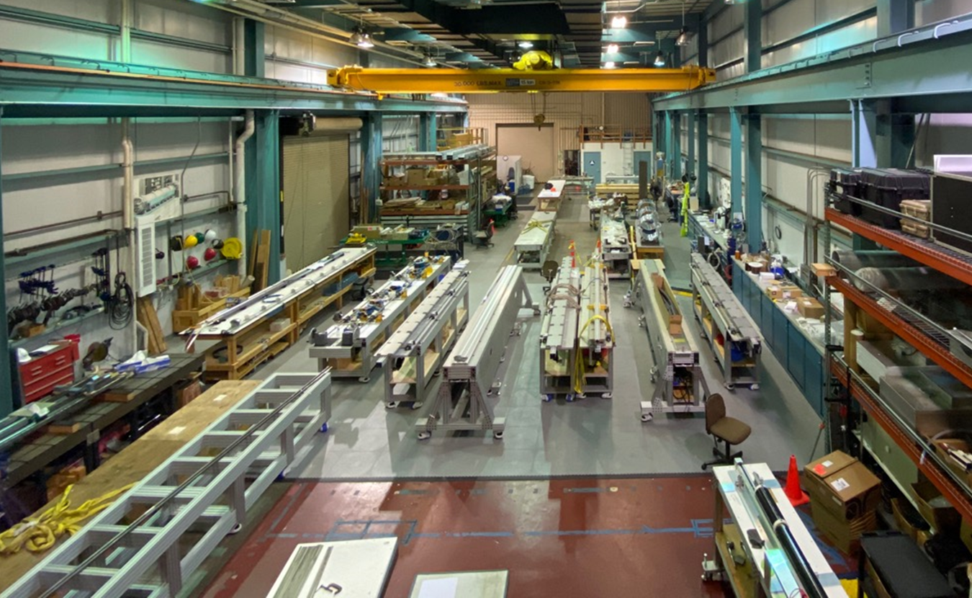
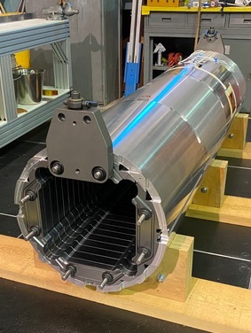
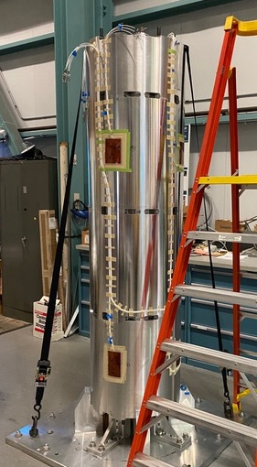
MQXFA Structure Proc. & Magnet Assembly
Procurement of main parts is complete
Two assembly lines at LBNL are fully operational
  staggered mode
15 magnets have been assembled
  11 tested (8 successful, 2 reworked, 1 to be reworked)
  2 disassembled for NCRs
  1 (MQXFA15) preload is to be adjusted based on lessons learned from MQXFA13
  1 ready for test (MQXFA07b)
Assembly of MQXFA16 is in progress.
Two MQXFA assembly lines at LBNL
MQXFA shell-yoke assembly in process

Slide 6
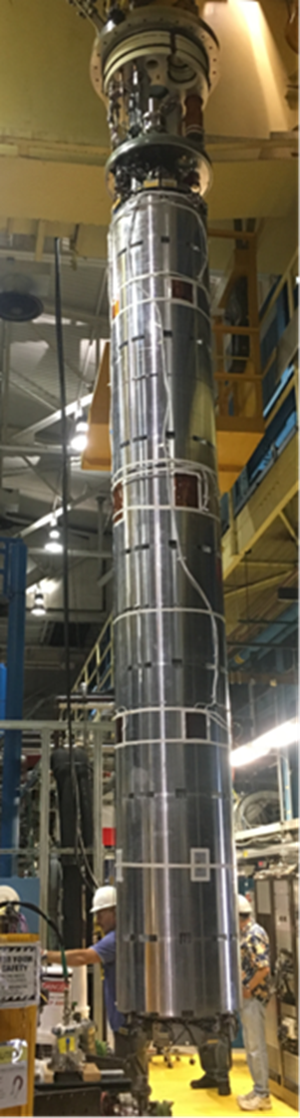
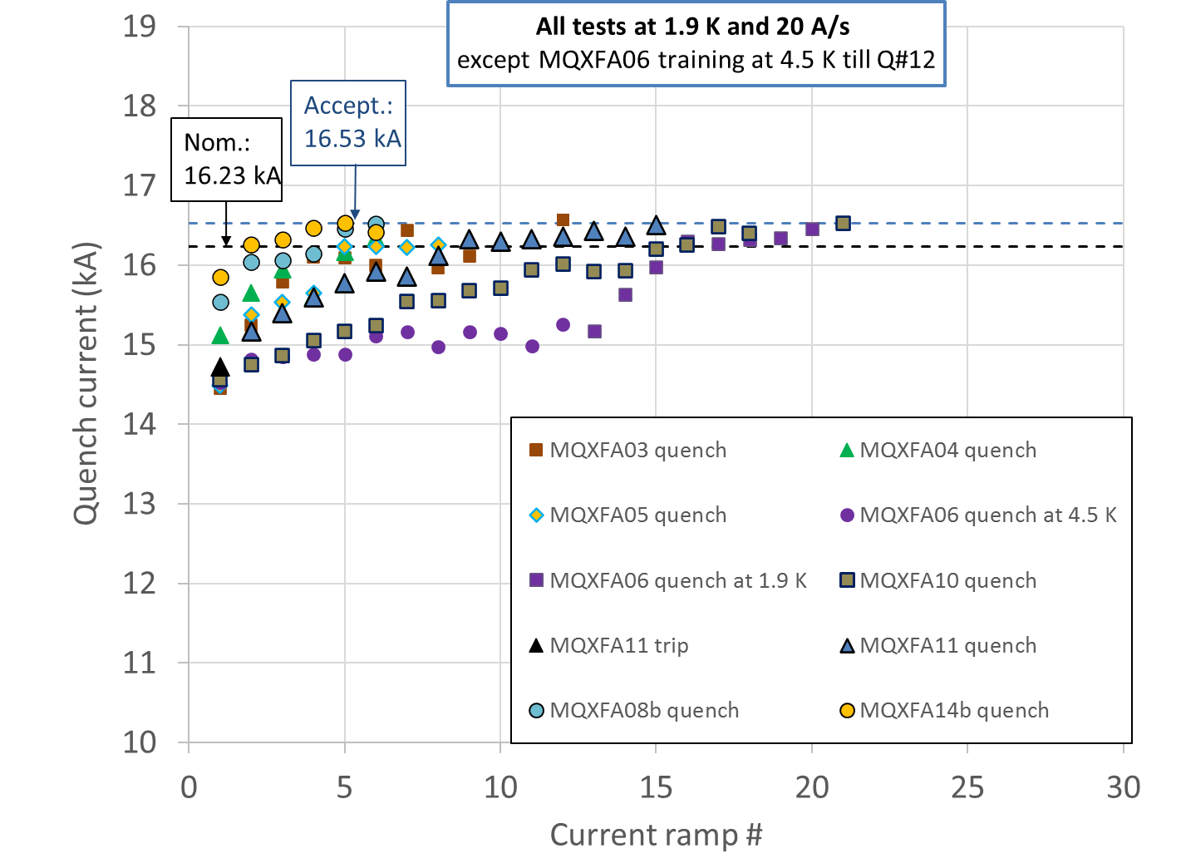
MQXFA Vertical Test (by 302.4)
8 magnets met requirements out of 11 tested
Thorough analysis of non-conforming magnets
  Complete for MQXFA07/08
  In progress for MQXFA13
Lessons learned from non-conforming magnets are being applied to all subsequent magnets
MQXFA magnet being moved to vertical test station at BNL

Slide 7
Back up Slides

