Slide 1
Lessons Learned from MQXFA13 Vertical Test
Paolo Ferracin, G. Ambrosio, Dan Cheng, Laura Garcia Fajardo, Giorgio Vallone
on behalf of the MQXF collaboration
PMG Meeting #54
LBNL, USA
September 19th, 2023

Slide 2
Outline
A13 Test results
A13 coil dimensions
Finite element analysis of A13
Action items

Slide 3
A13 test results

Slide 4
A13 test results

Slide 5
A13 test results
Many of A13 quenches in the same location (according to quench antenna) as the A07/A08 limiting quenches

Slide 6
Outline
A13 Test results
A13 coil dimensions
Finite element analysis of A13
Action items

Slide 7
Arc length excess

Slide 8
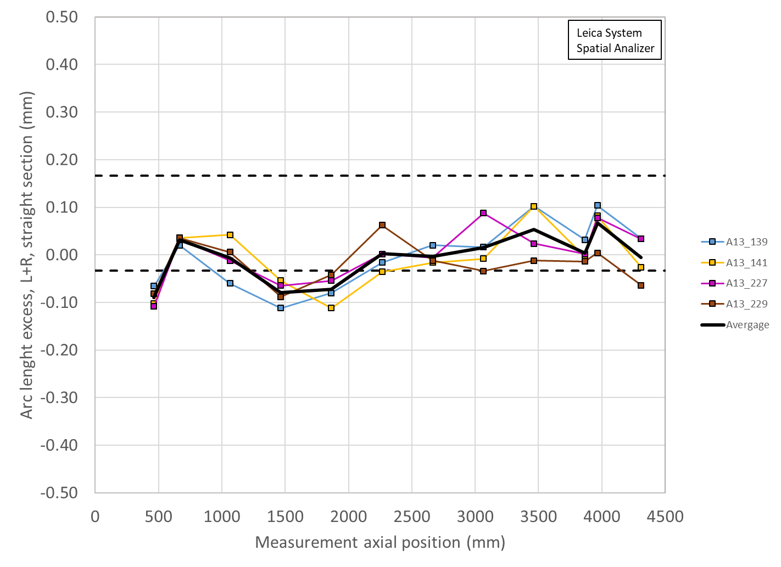
A13 coil size (unshimmed and shimmed)

Slide 9
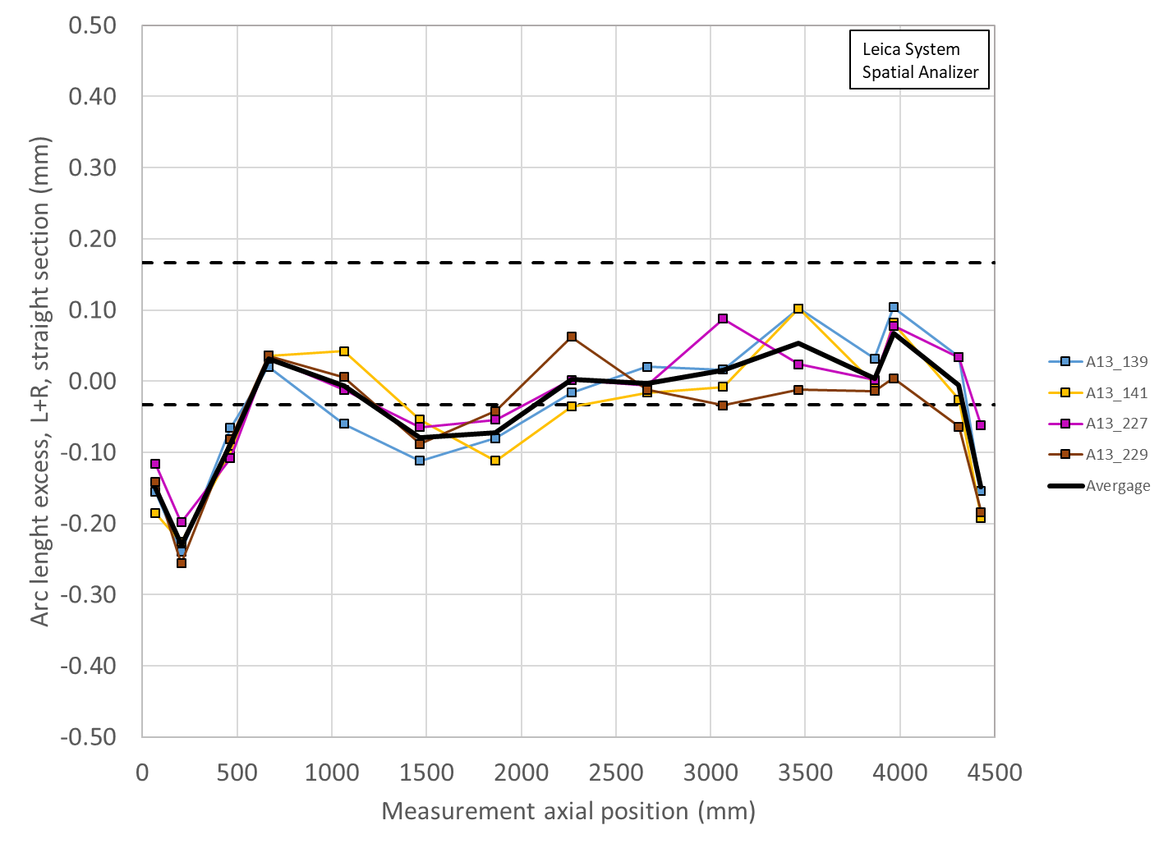
A13 coil size (shimmed including ends)
Significant reduction of coil size in the ends
Visible in all magnets

Slide 10
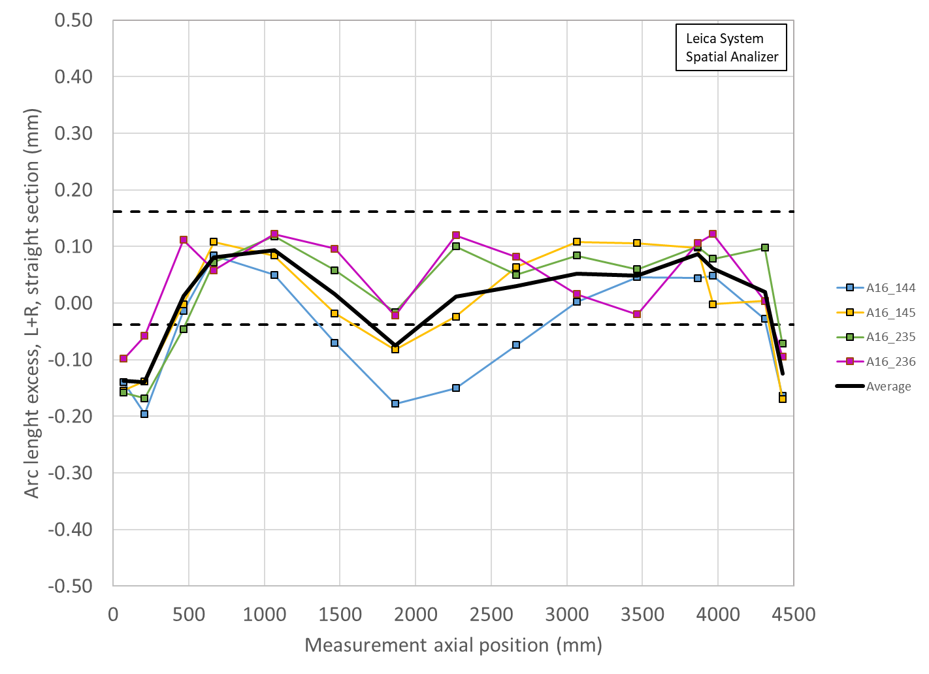
Summary Coil radial (shimmed) deviation and key/shim size
In A13, small coils and small loading shim
 | Ave ss | LE min | RE min | Key | Shim | Shim | Ave ss + shim | LE + shim | RE + shim
 | mm | mm | mm | mm | mils | mm | mm | mm | mm
A14b | -0.007 | -0.129 | -0.106 | 13.84 | 43 | 1.092 | 1.085 | 0.963 | 0.986
A13 | -0.004 | -0.146 | -0.094 | 13.72 | 38 | 0.965 | 0.961 | 0.819 | 0.871
A8b | -0.001 | -0.181 | -0.136 | 13.77 | 40 | 1.016 | 1.015 | 0.835 | 0.880
A11 | 0.004 | -0.125 | -0.047 | 13.74 | 39 | 0.991 | 0.995 | 0.866 | 0.944
A10 | -0.092 | -0.222 | -0.199 | 13.82 | 42 | 1.067 | 0.975 | 0.845 | 0.868
A8 | -0.029 | -0.216 | -0.171 | 13.72 | 38 | 0.965 | 0.936 | 0.749 | 0.794
A7 | -0.035 | -0.139 | -0.114 | 13.77 | 40 | 1.016 | 0.981 | 0.877 | 0.902
A6 | -0.046 | -0.138 | -0.178 | 13.72 | 38 | 0.965 | 0.919 | 0.827 | 0.787
A5 | -0.024 | -0.153 | -0.105 | 13.79 | 41 | 1.041 | 1.017 | 0.888 | 0.936

Slide 11
Outline
A13 Test results
A13 coil dimensions
Finite element analysis of A13
Action items

Slide 12
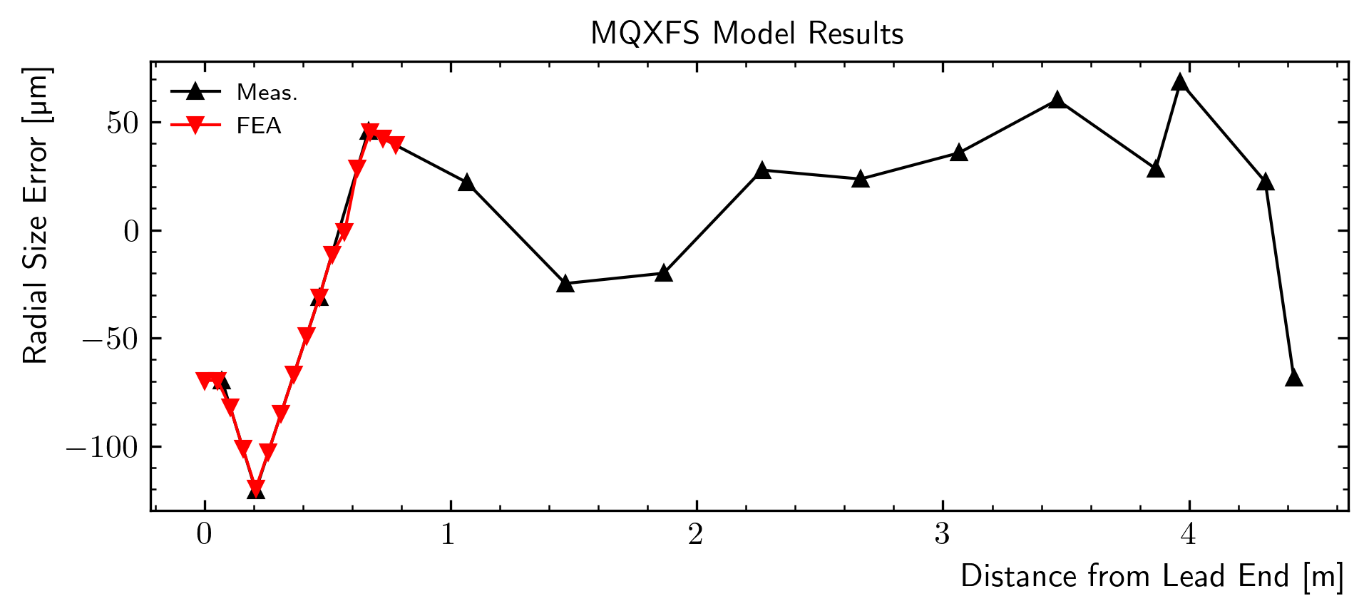
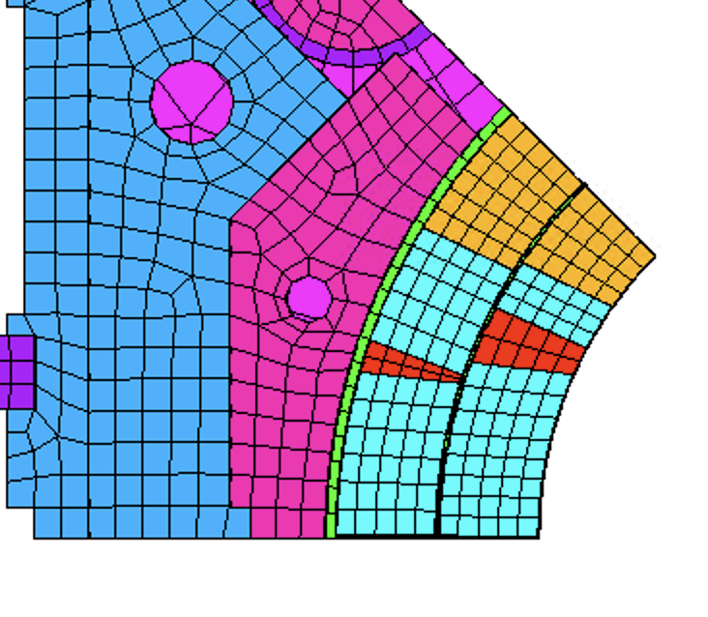
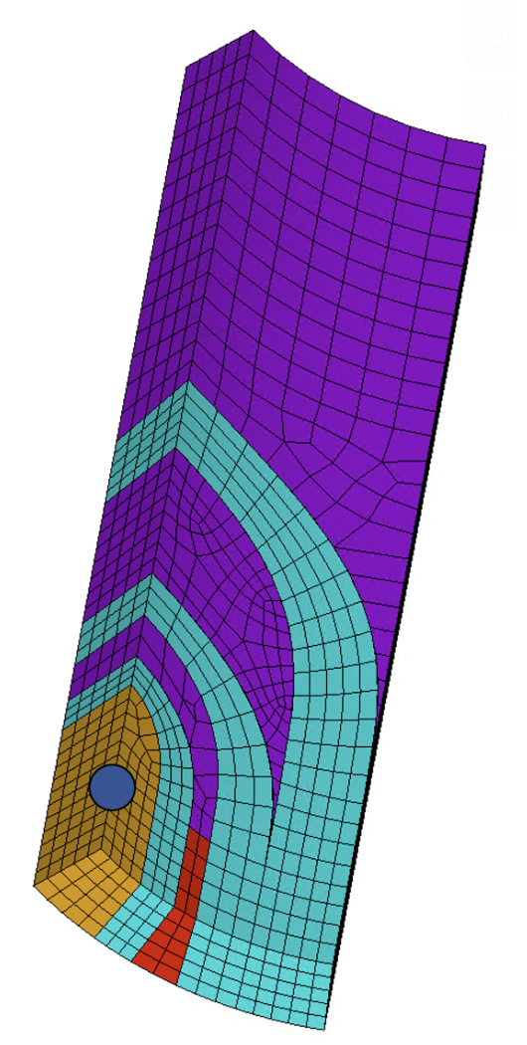
Finite element model assumption
Contact
Offset
Study of the impact of the coil pack size on the coil strain
in particular in the ‘wedge/end-spacer transition’ region

Slide 13
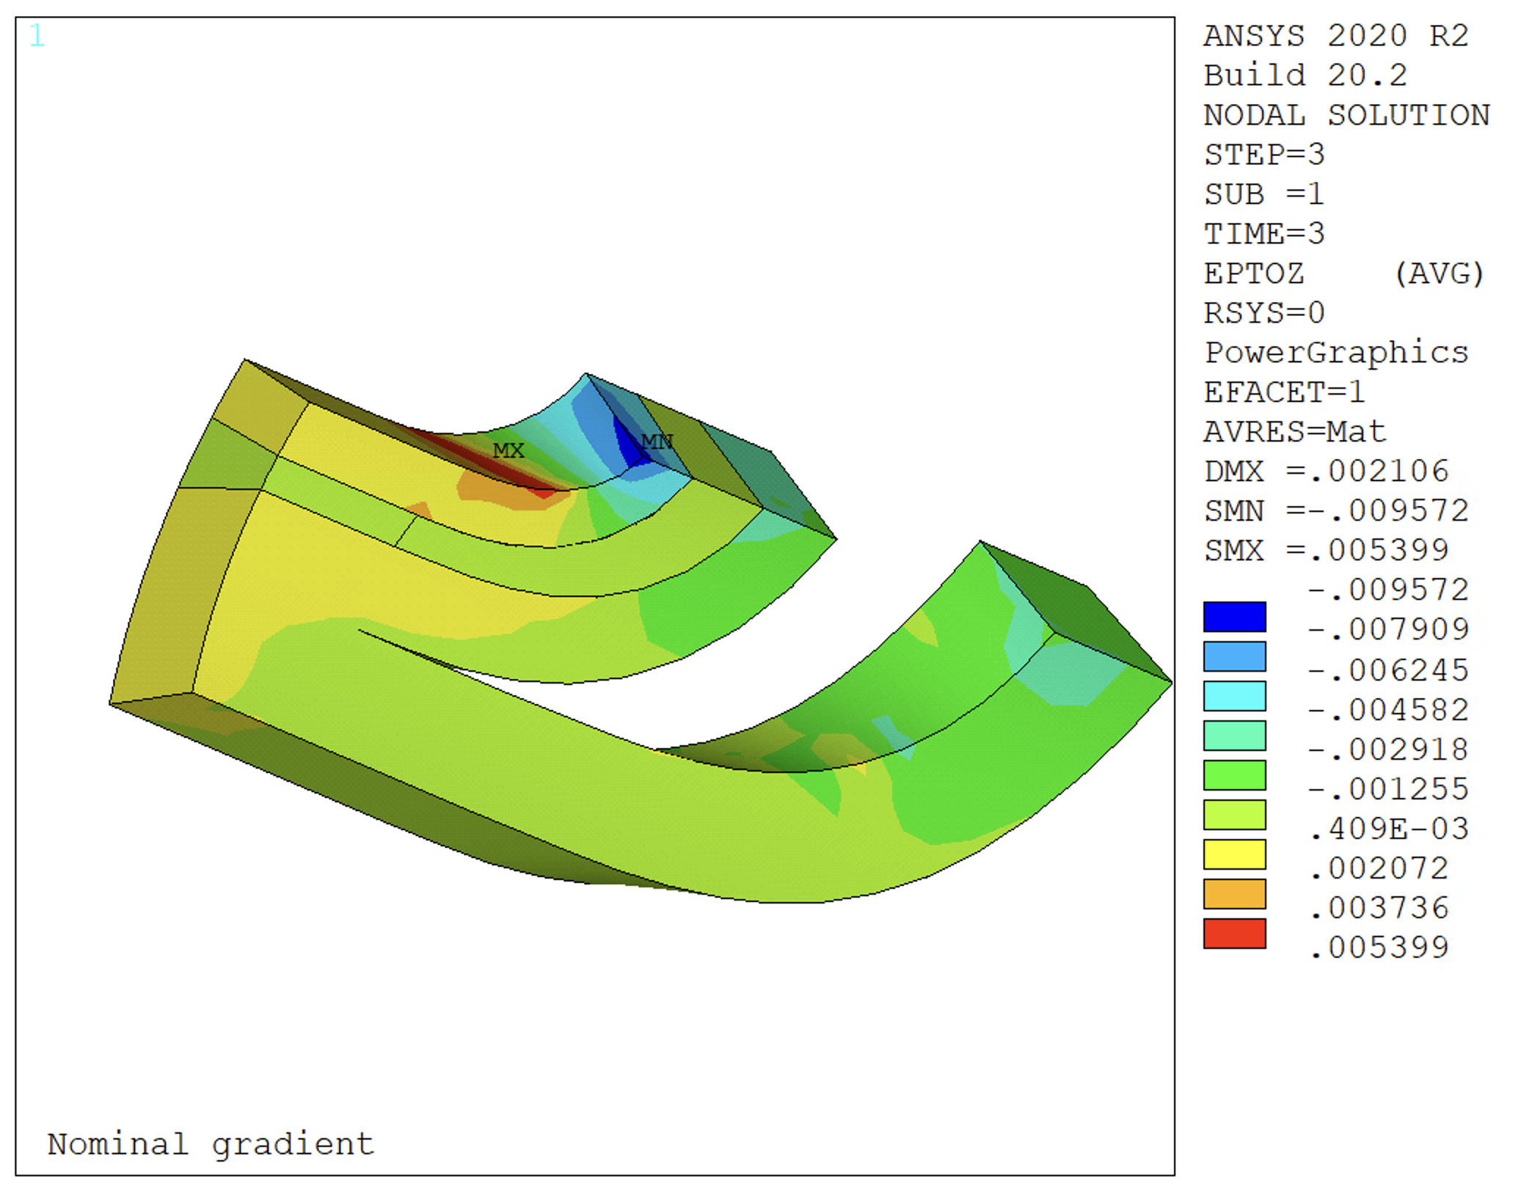
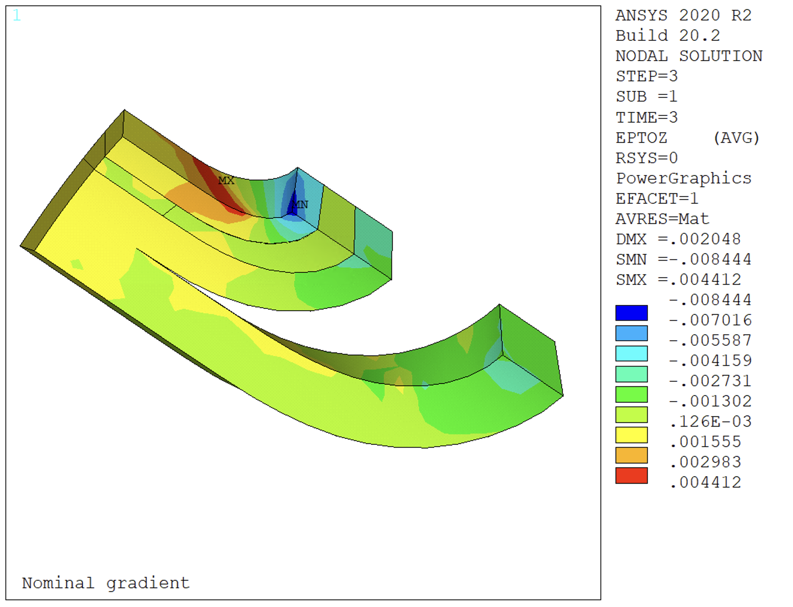
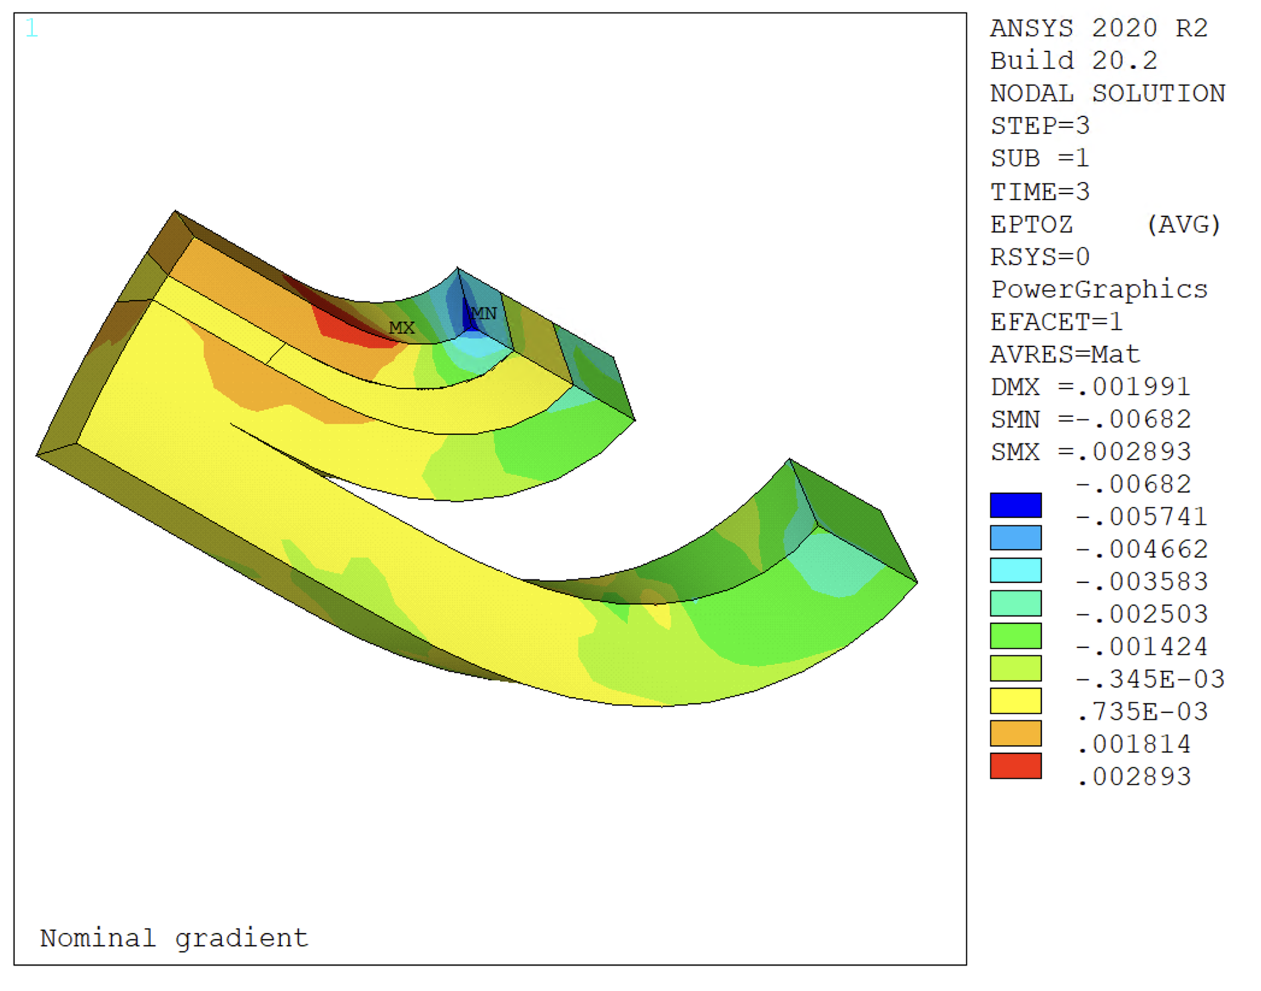
Peak Strain as a function of the pre-stress
Pole Turn
Transition
A13 - 50 MPa
A13 - 80 MPa
A13 - 100 MPa
Strain increases reducing the azimuthal prestress at R.T.
Two critical locations:
Pole turn:
Real peak might be lower because of some remaining pole turn bonding
Wedge/endspacer transition
Peak might be significantly higher due to the discontinuity (after a gap opens), not fully captured by the FE model

Slide 14
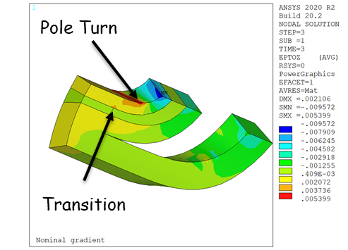
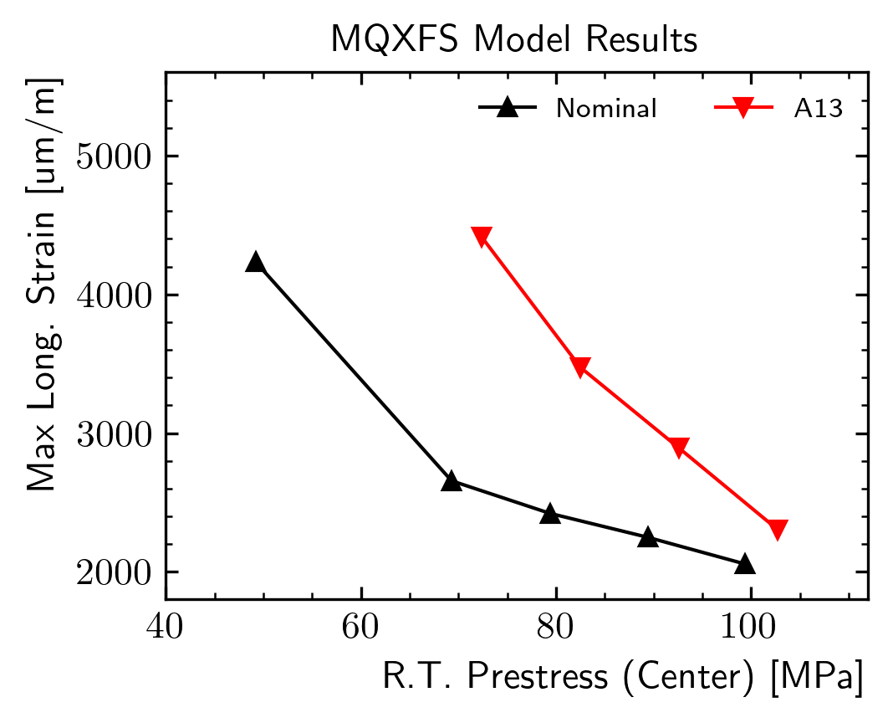
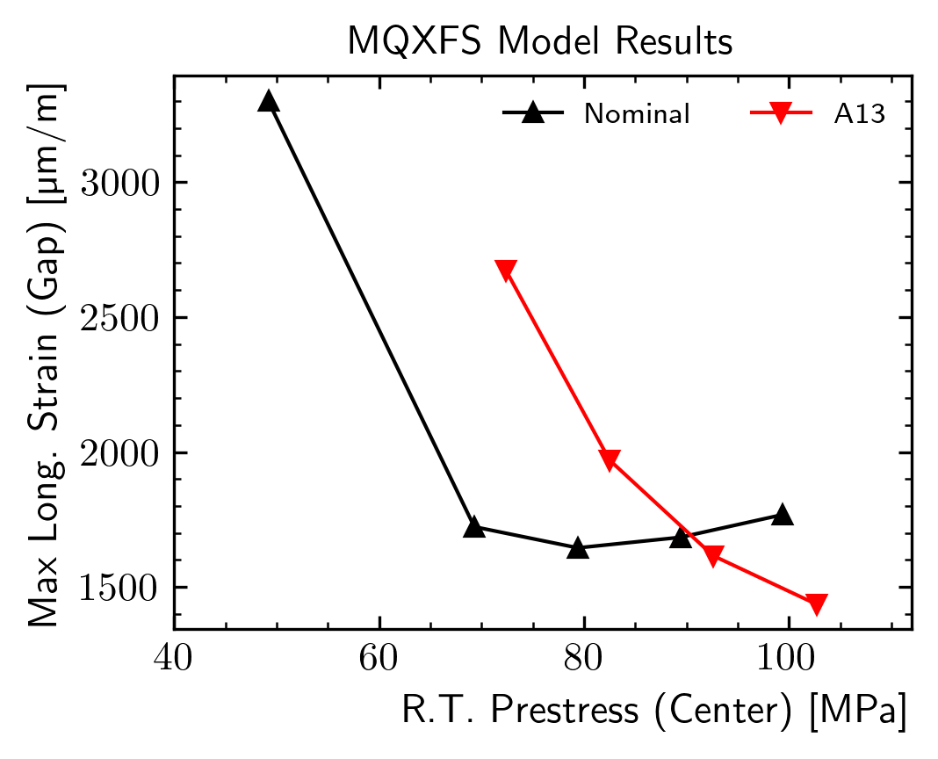
Peak Strain as a function of the straight section pre-stress
The peak strain is a function of the applied prestress
Effect on max strain on the transition seems similar:
A13 requires higher room temperature prestress to keep the strain below the ‘knee’

Slide 15
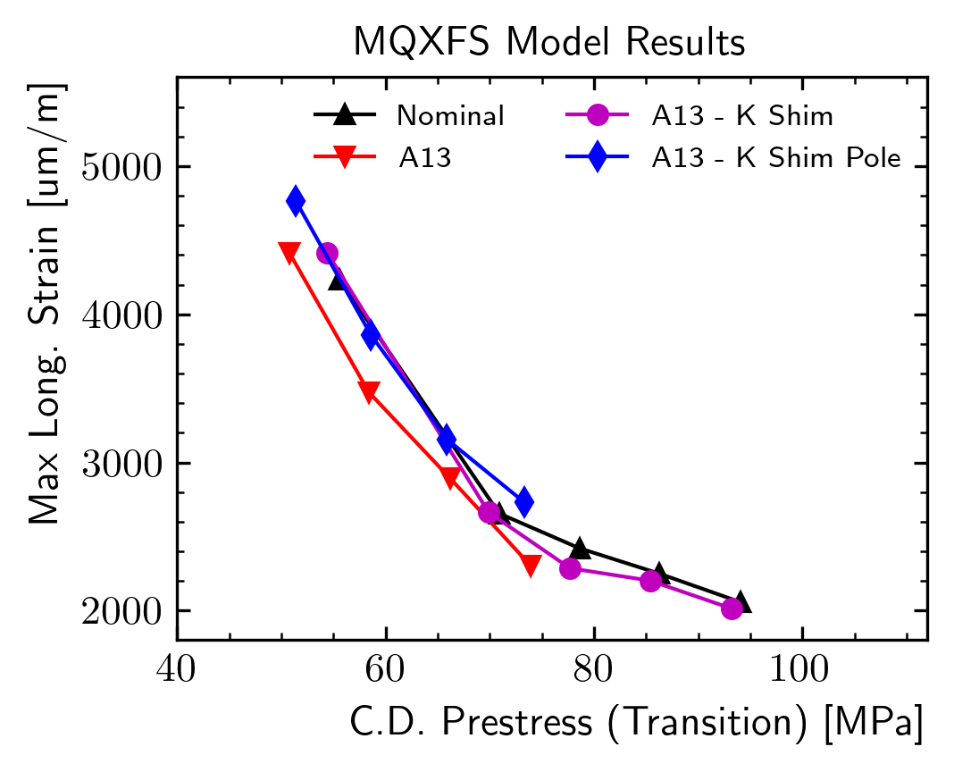
Peak Strain as a function of the local pre-stress
Pole stress at cold computed on the same z location of the wedge/end-spacer transition
Blue/magenta lines represent end-region modifications
All the points are on the same lines!
The effect seems to be controlled by a local prestress loss

Slide 16
Conclusions finite element analysis
The size variation of the coil can significantly increase the longitudinal strain in the ends
This effect is due to a local prestress loss in the end region
Possible solutions:
Increase the prestress everywhere in the coil
Might not respect established limits
Local prestress modifiers (e.g. different keys in the ends)
Currently under investigation

Slide 17
Outline
A13 Test results
A13 coil dimensions
Finite element analysis of A13
Action items

Slide 18
Action items
Before magnet assembly/loading
Include analysis of coil size in the ends and expected coil pre-stress in the ends to ensure sufficient azimuthal pre-stress everywhere
Approach validated with A14b
Determine pre-load shim size based on values from A14b and A05 (best performing magnets so far)
During pre-load, target shim size, and monitor SG and fiber optics to ensure that stress limits are not passed
Maximum allowed peak stress increased from 110 to 120 MPa
In parallel, investigation with FEM of variable size loading shims (thicker in the ends)

Slide 19
Example from A16 loading and shim review (Aug 24th)

Slide 20
Appendix

Slide 21
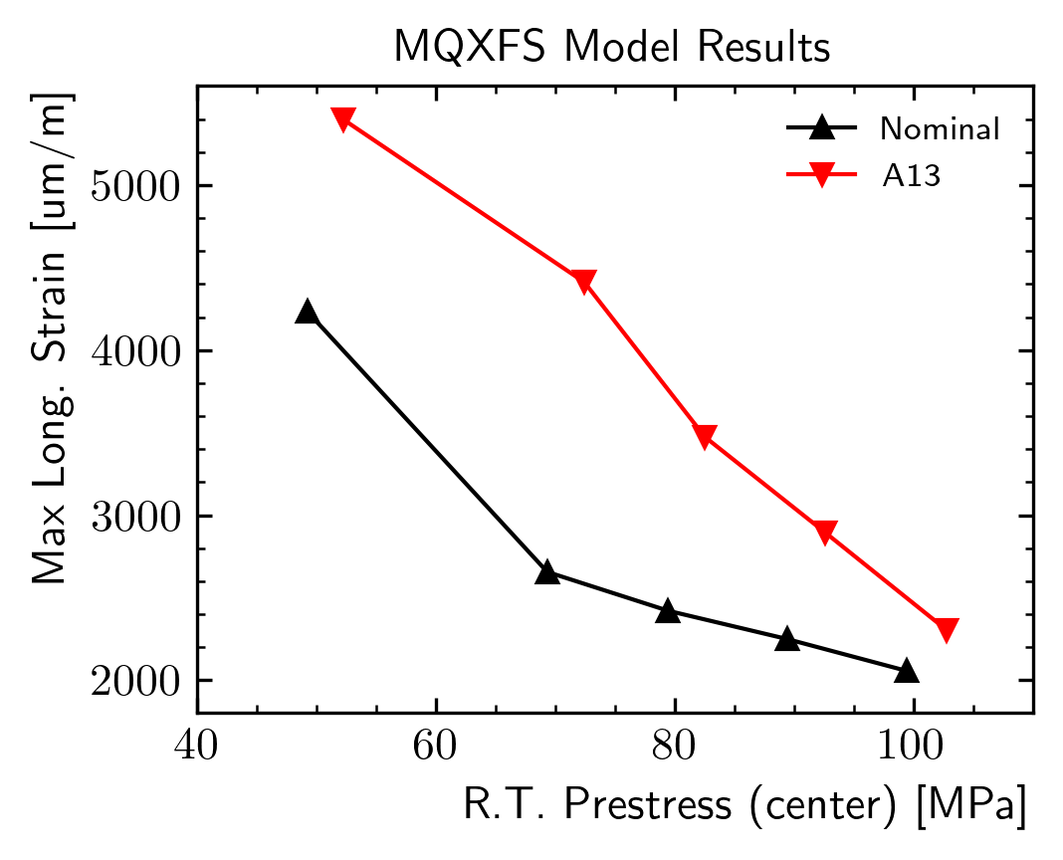
Possible pre-load criteria
Nominal
Minimum
Minimum
Maximum
The peak strain is a function of the applied prestress
The distance between the red and black line will be different for each coil pack shape
We could define an unique criteria on the required minimum prestress at room temperature
E.g. limit strain = 0.3%
For MQXFA13, this would require a prestress of ~92 MPa
Seems reasonable also looking at the transition peak strain

Slide 22
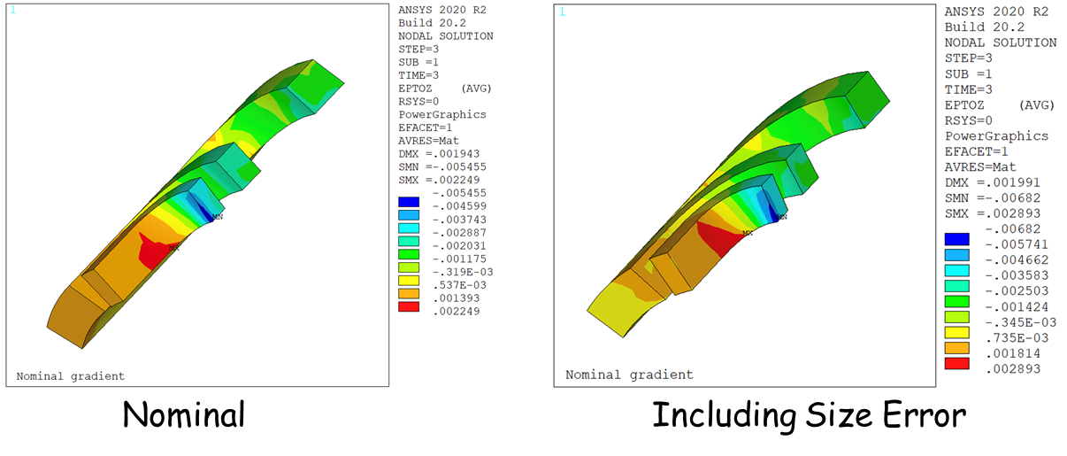
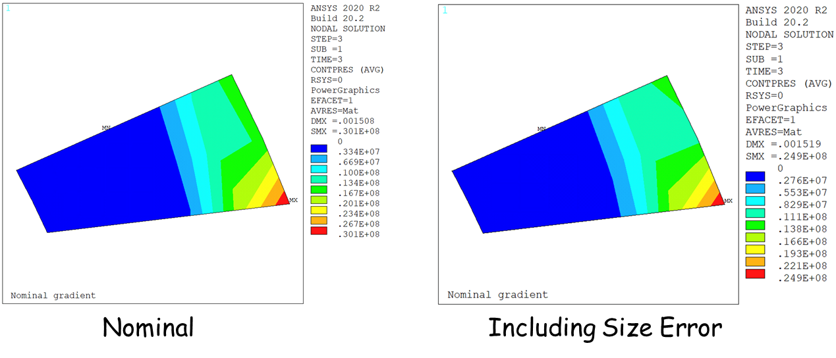
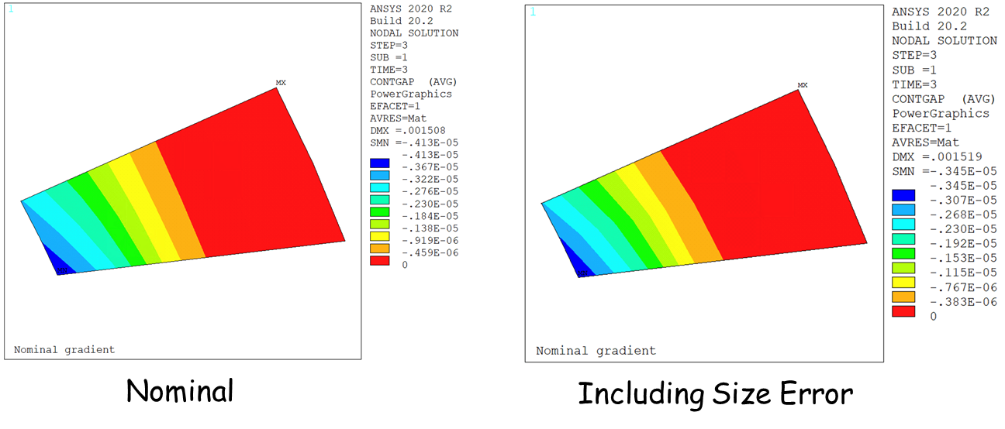
Finite element results
Peak longitudinal strain increases from 2249 µm/m to 2893 µm/m
5 MPa reduction on peak pressure
Slightly larger debonded region

Slide 23
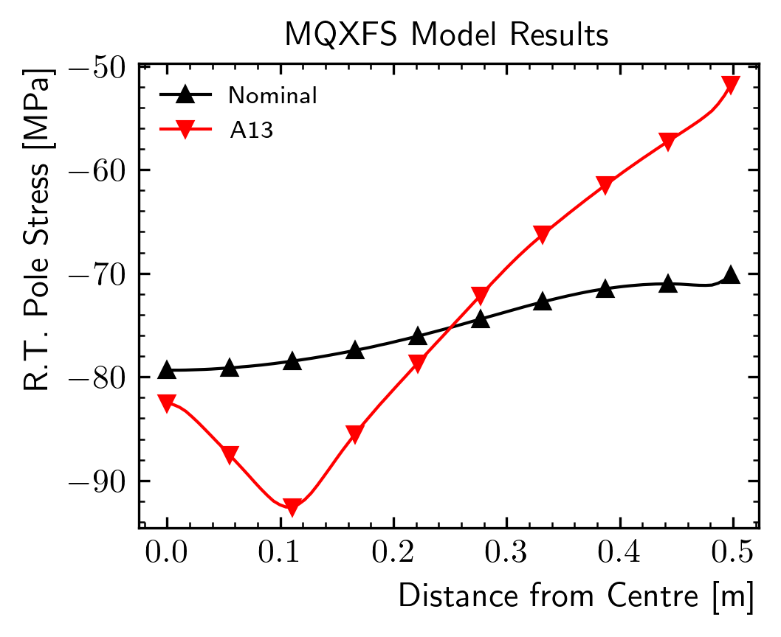
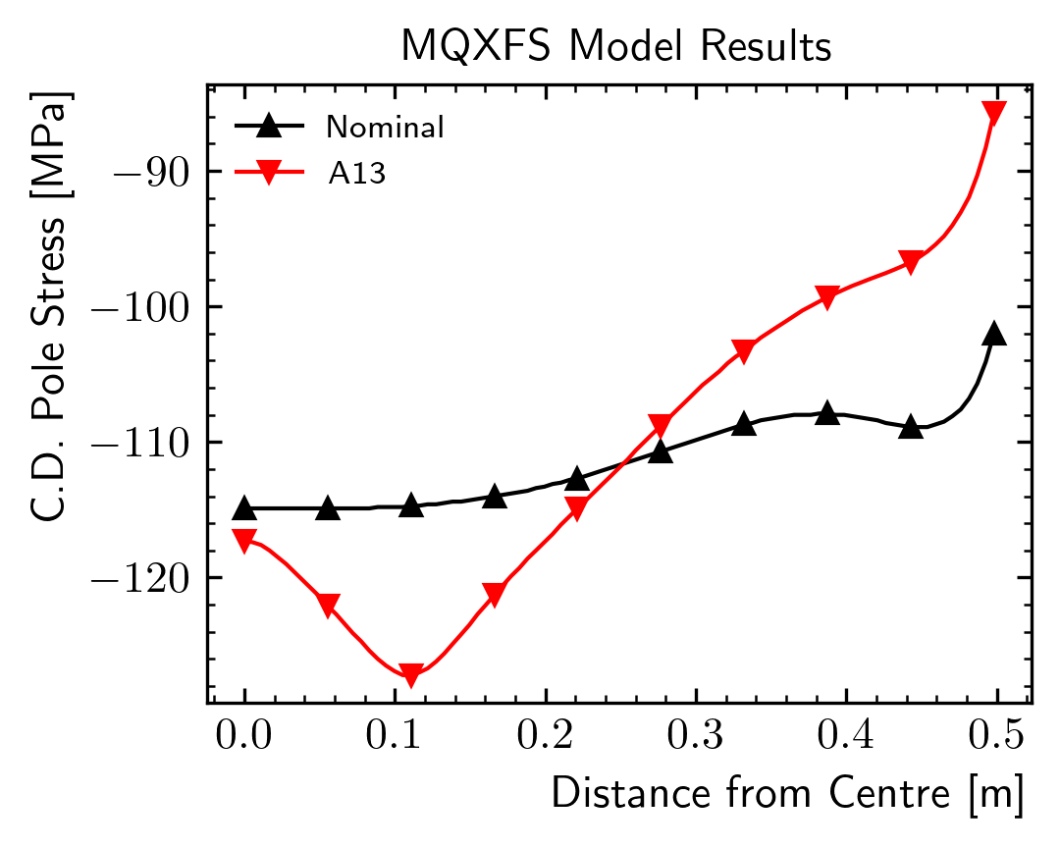
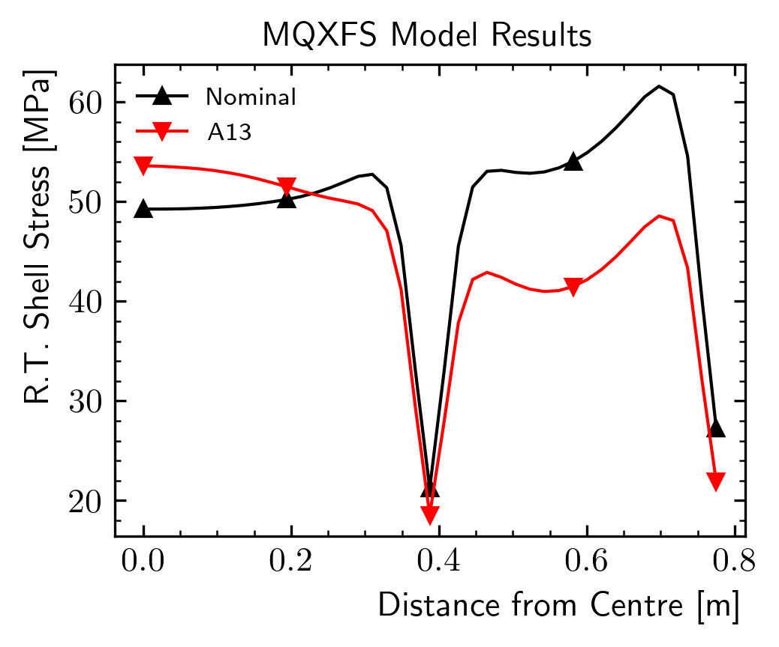
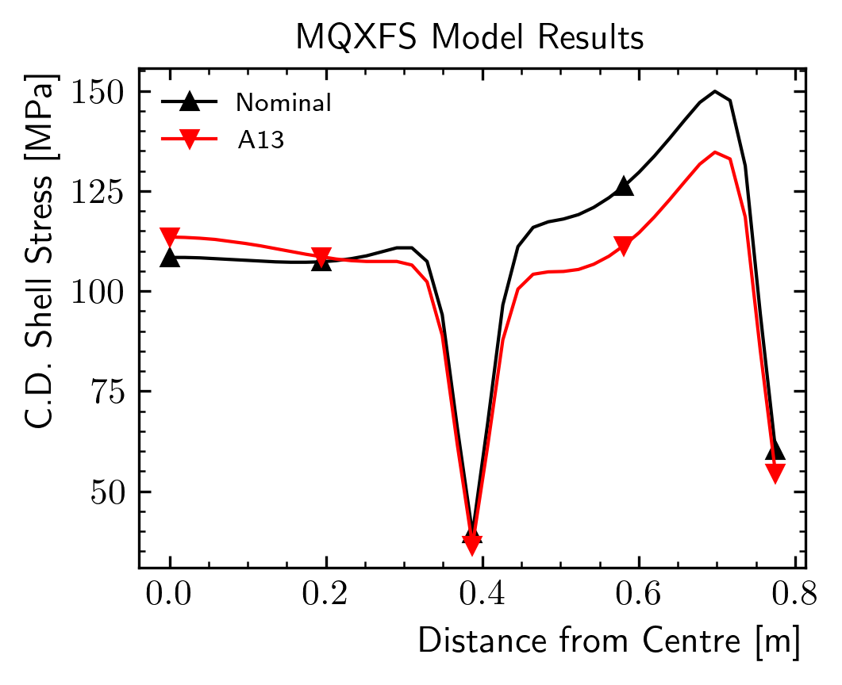
A13 pre-stress in the ends
A13 prestress is much less uniform
Significant prestress loss in the end region both at room temperature and after cooldown
Measurable difference on the shell stress at warm and at cold
Could add a sensor….

Slide 24
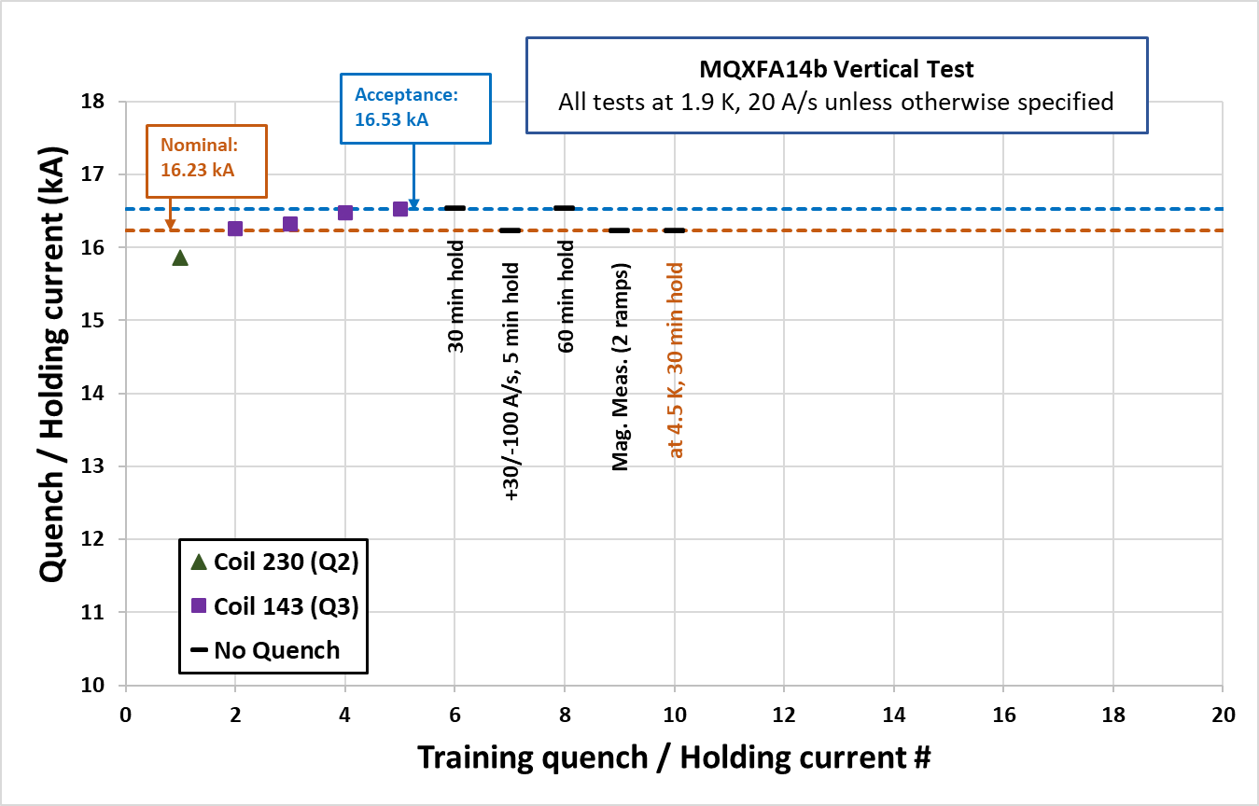
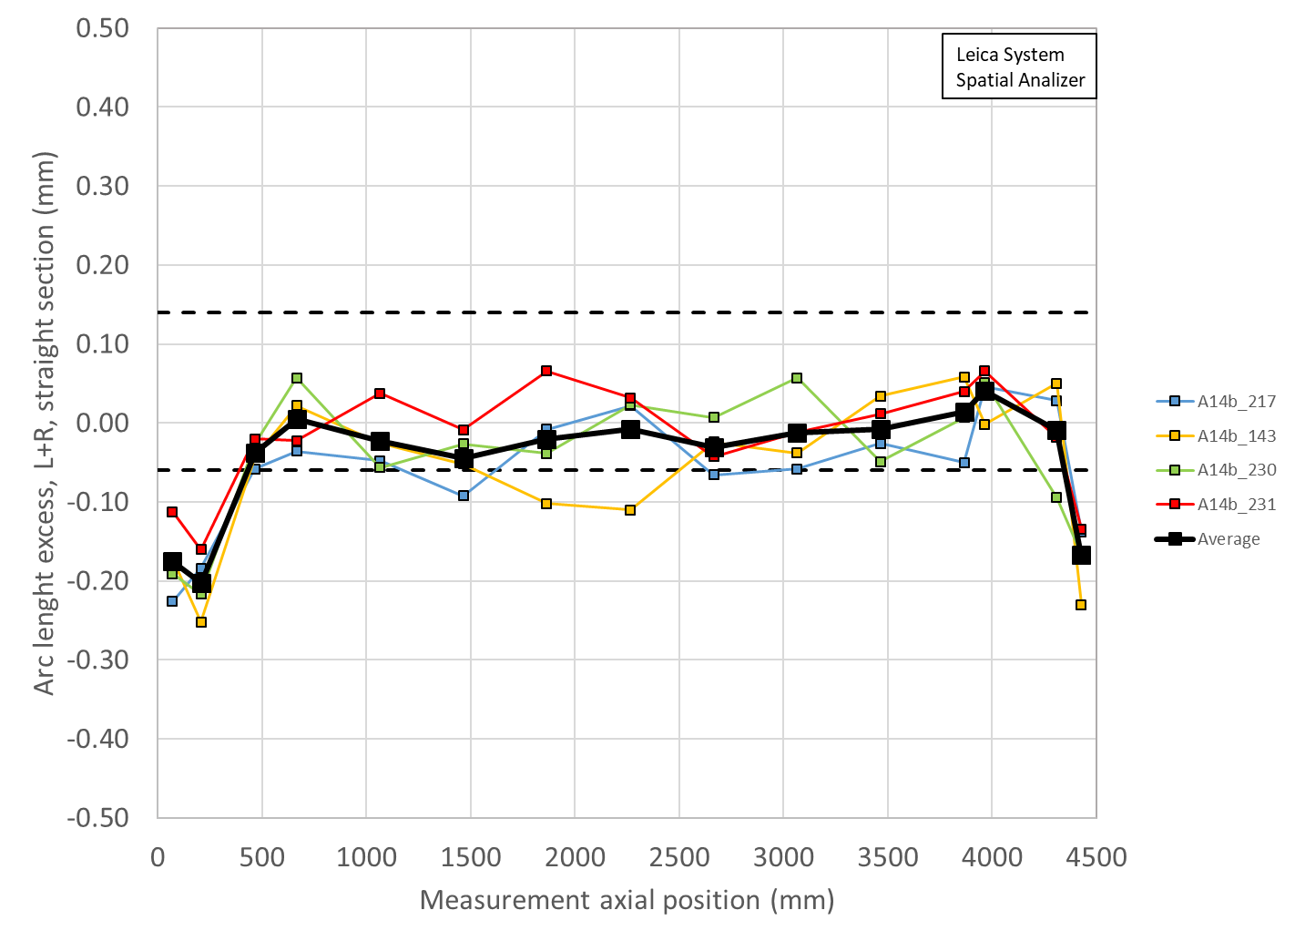
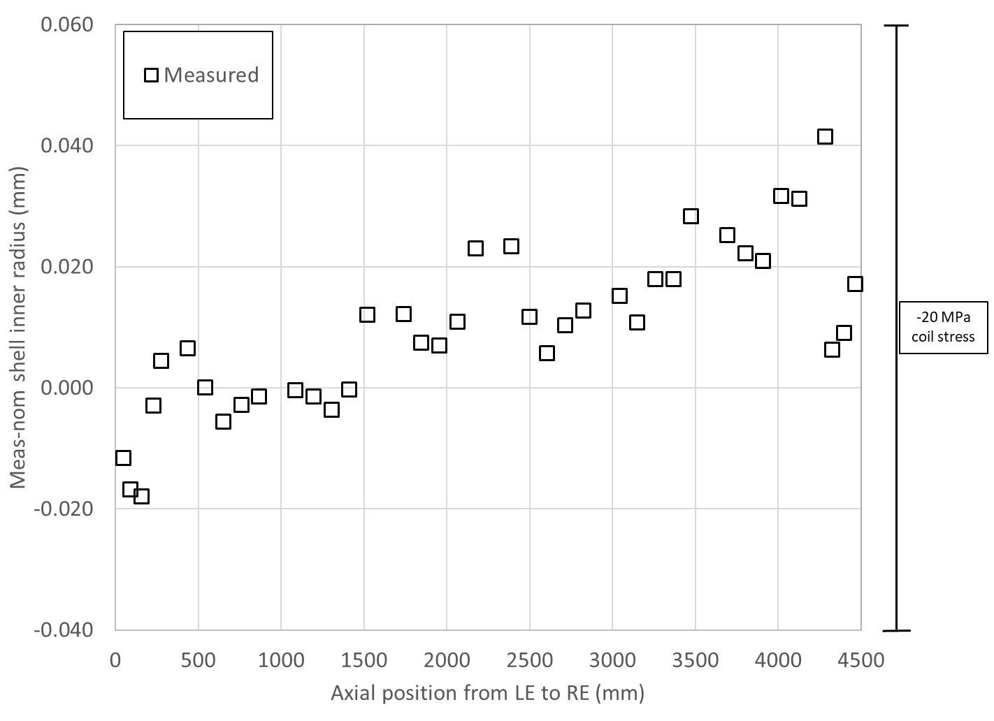
A14b quench performance, shimmed coil size, shell size, and loading key size
Loading shim size: 43 mils, 1.092 mm
Total key size: 13.84 mm

Slide 25
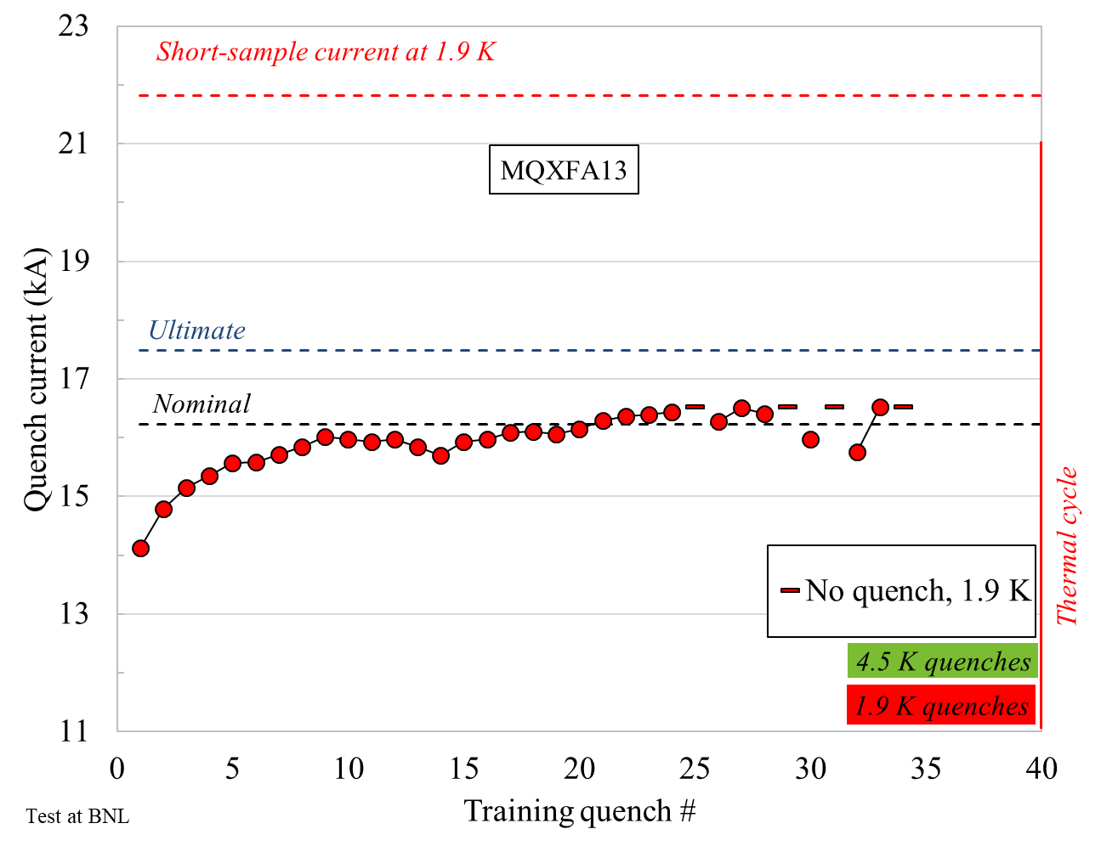
A13 quench performance, shimmed coil size, shell size, and loading key size
Loading shim size: 38 mils, 0.965 mm
Total key size: 13.72 mm

Slide 26
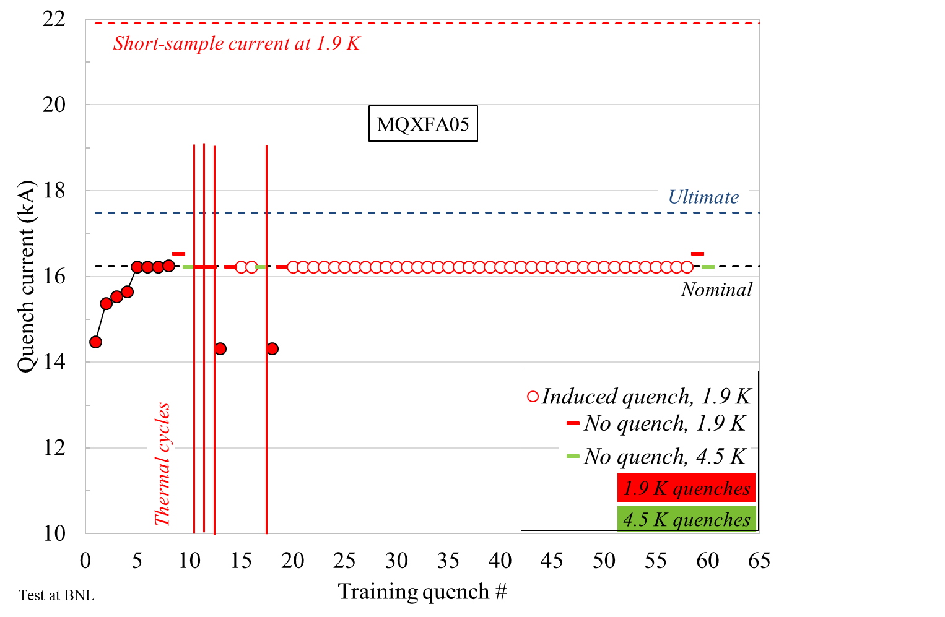
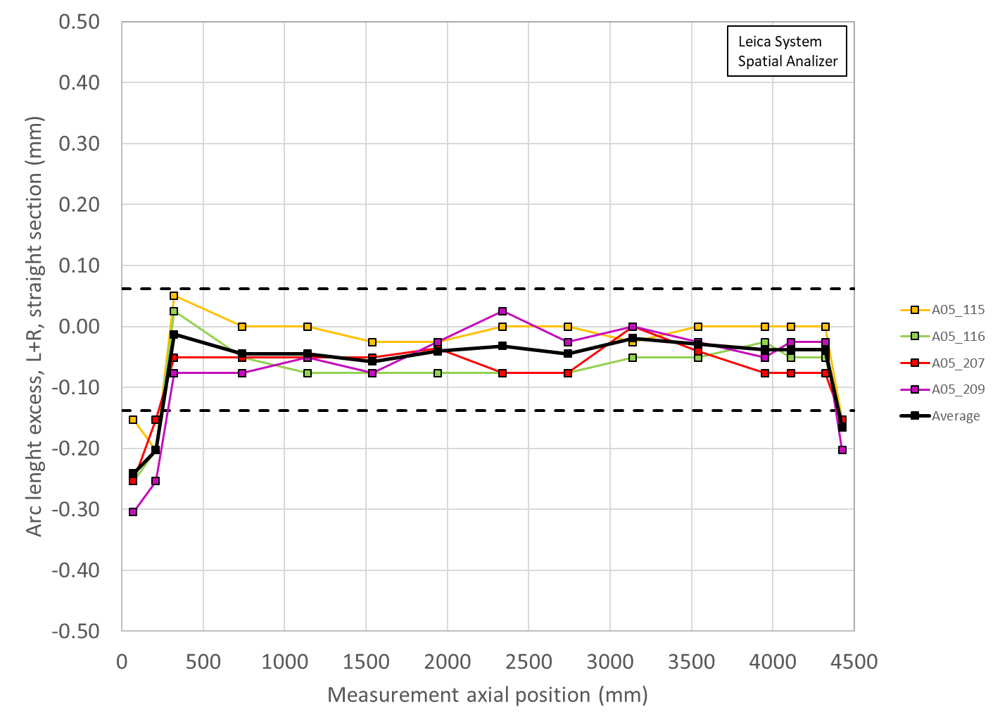
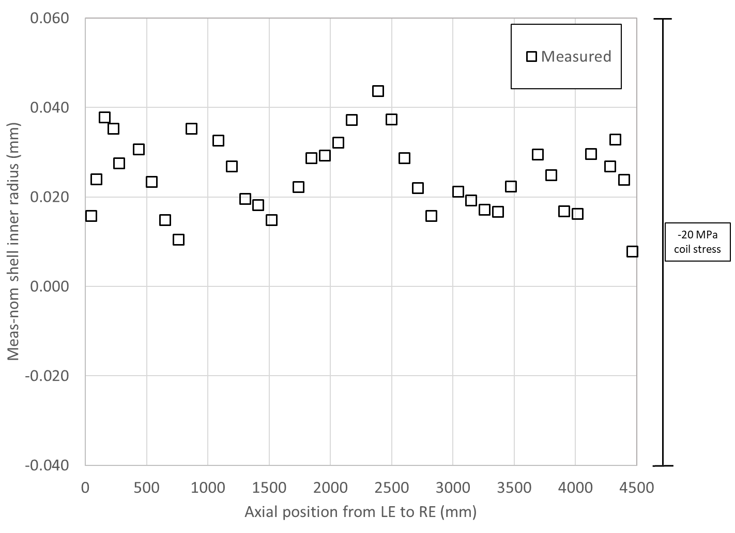
A05 quench performance, shimmed coil size, shell size, and loading key size
Loading shim size: 41 mils, 1.041 mm
Total key size: 13.79 mm

Slide 27
Summary A14b, A05, A13
Loading shim size: 43 mils, 1.092 mm
Total key size: 13.84 mm
Loading shim size: 41 mils, 1.041 mm
Total key size: 13.79 mm
Loading shim size: 38 mils, 0.965 mm
Total key size: 13.72 mm

