Slide 1
PPD Department Heads Meeting
ESH
20 September 2023

Slide 2
Summary
Training/ITNA Status
Injuries in August
ORPS/NTS in August
FESHM Updates

Slide 3
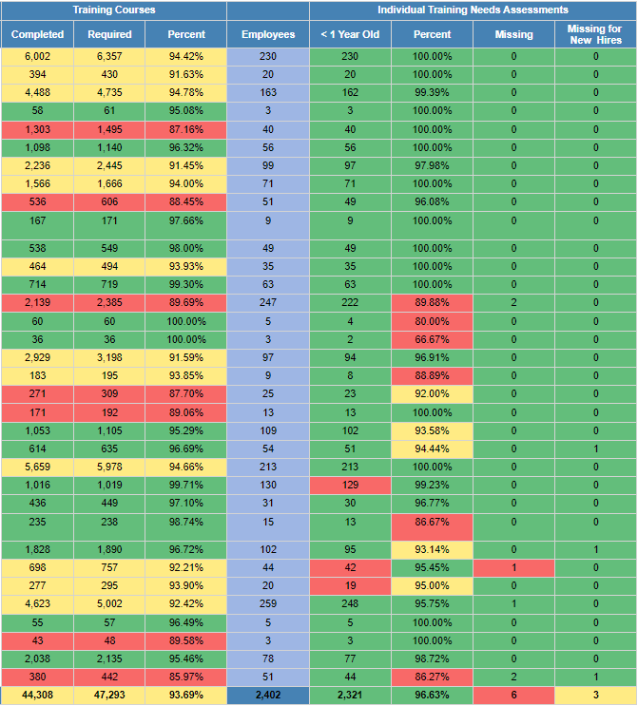
ES&H Training and ITNA Status for employees – as of 09/15/2023
Last month:

Slide 4
Injuries/Illnesses in August
8/1/2023 – First Aid, AD
Employee was walking through the designated detour to avoid the construction zone and had his lunch bag and coffee cup in one hand and keys in the other. While trying to unlock a door to reenter the booster, stepped on some loose gravel and debris on the uneven ground. Slipped and fell, landing on right hand, elbow and knee. Scrapes and bruises. Reported to supervisor and followed up with FOMO on 8/2/23. First aid given.
8/2/2023 – Report Only, ESH
Employee was working in field checking on sanitary sewer lift station from FCC to MI65 and to MC1, walked across grass and then back to FCC, after work was working in his garden and wife noticed a tick latched to arm. Tick was removed by wife. Experienced no symptoms. Reported to FOMO 08/10/23.

Slide 5
Injuries/Illnesses in August - Continued
8/3/2023 – First Aid, ND
Employee was using an alcohol spray bottle to clean stainless steel piping to apply pipe markers. While on a ladder (less than 4 ft) wearing safety glasses, he went to spray the alcohol, the bottle separated from the sprayer, fell onto top of ladder and splashed into the face. Mostly right eye. Went into building to rinse and then went to FOMO. First aid given.
8/10/2023 – Report Only, COM
Employee exposed to dust particles from cooler system and developed symptoms of itchy eyes, nausea, itchy skin, and a metal taste in their mouth. There is a vent that leads directly to office. Employee reported to FOMO.
8/10/2023 – Report Only, COM
Employee noticed dust coming out of a cooling vent for past few weeks and developed symptoms of nausea, vomiting, metallic taste in mouth, itching eyes. Notified building manager and supervisor, reported to FOMO.

Slide 6
Injuries/Illnesses in August - Continued
8/21/2023 – First Aid, SEC
Employee was guiding traffic, walked back to the officer booth and walked close to the edge of the pavement where it dips to gravel and slipped landed on left knee and stood back up. Reported to FOMO. First aid given.
8/24/2023 – First Aid, AD
Employee was cutting the plastic wraps on the hose pipes with a cutter when it slipped and cut her right thumb.
8/30/2023 –First Aid, ISD
Employee was moving a desk onto a refrigerator dolly, walked around the desk to strap in place and hit head on the desk leg. Reported to FOMO, first aid given.

Slide 7
ORPS/NTS in August
Incorrect Dosimetry Badge Used (ORPS event, Level 2)
An APS-TD worker used a temporary dosimetry badge that was not assigned to them for magnet repair work during the week of 7/24/23. The event was identified by the Fermilab Dosimetry Manager after noting the individual had reported 15 mrem into the GetDose system but did not have a dosimetry badge assigned to them.

Slide 8
FESHM Updates
The following chapters have been updated for the month of August 2023. A brief summary of this is provided below.
FESHM 4140 – Hearing Conservation
Changes are:
Minor editorial changes to reflect the reorganization of the ES&H Division.
FESHM 4280 –Ultraviolet Radiation Exposure
Changes are:
Minor editorial changes to reflect the reorganization of the ES&H Division.
FESHM Chapter 5031.7 - Membrane Cryostats
Changes are:
Minor editorial changes to reflect the reorganization of the ES&H Division.
Updated "D/S/P" to "ALD/SD/PD" Associate Lab Director, Senior Director, and Project Director.

Slide 9
FESHM Updates - Continued
The following chapters have been updated for the month of August 2023. A brief summary of this is provided below.
FESHM Chapter 4290 – Occupational Medicine
Changes are:
Updated the immunization program, references for blood-borne pathogens, and biohazardous waste.
Added international travel information notification
FESHM Chapter 4310 – Nanomaterials, is out for lab-wide review until September 22, 2023
Changes are:
Minor grammar and editorial changes to reflect the reorganization of the ES&H Division
Added Section 3.4 – Responsibilities for Hazard Control Technology Team (HCTT)
Added REL for nanoscale silver published by NIOSH in 2021
Added reference to NIOSH Publication No. 2022-153 Occupational Exposure Sampling for Engineered Nanomaterials

Slide 10
FESHM Updates - Continued
The following chapters have been updated for the month of August 2023. A brief summary of this is provided below.
FESHM Chapter 4190 – Special Toxic Hazards, is out for lab-wide review until September 22, 2023.
Changes are:
Minor grammatical and editorial changes to reflect the reorganization of the ES&H Division
Added “as an inhalable fraction” to definitions for “Action Level” and “Beryllium Activity”
Added 2023 ACGIH TLV book to Section 6 and reformatted standards
Added Attachment C “Table of Regulatory Limits”

