Slide 1
2023 Summer Shutdown Planning
9/22/23
Cons Gattuso / Tony Busch

Slide 2
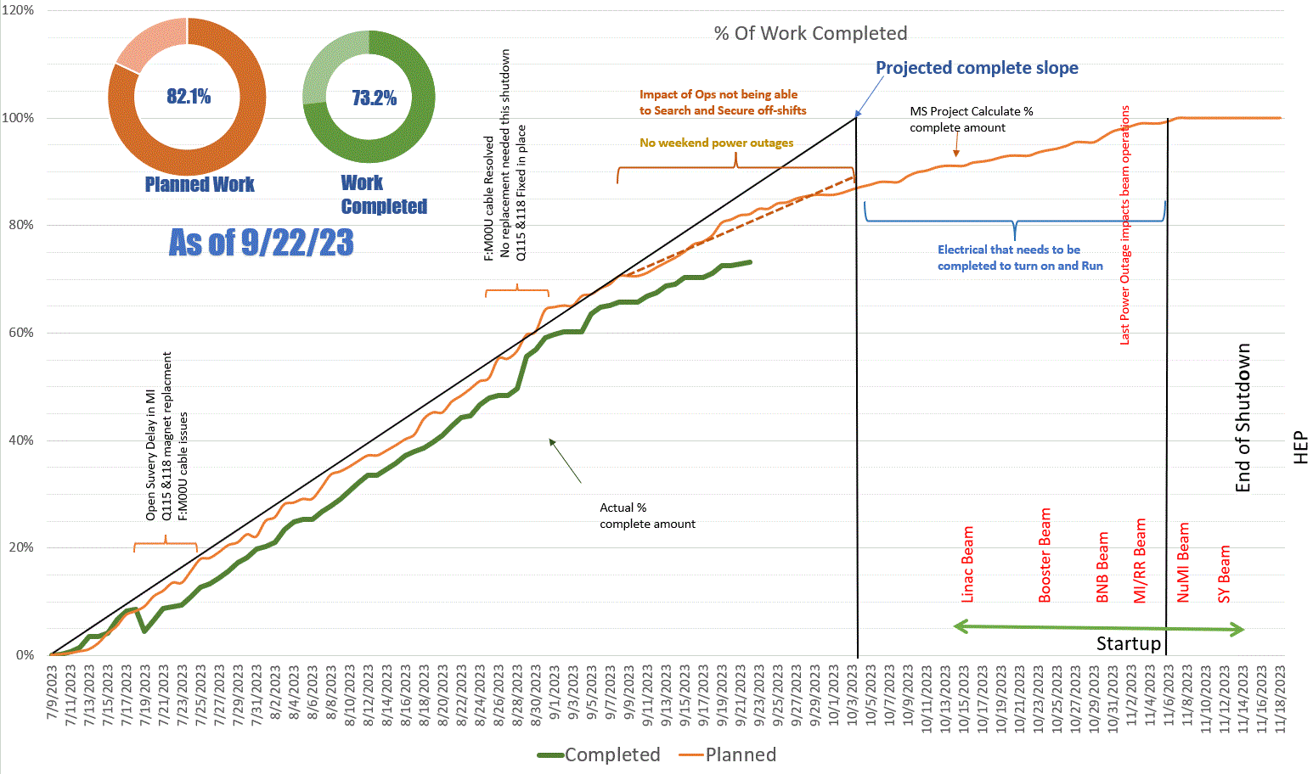
Earliest Start Up

Slide 3
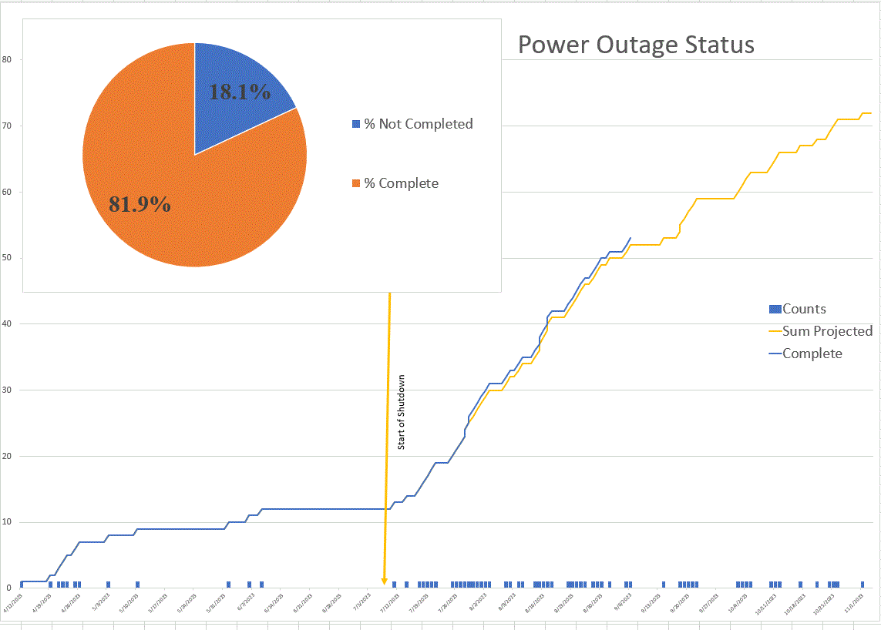

Slide 4
Power Outages
Next week
  MS3 Oil Switch Replacement OUTAGE TO RE-ESTABLISH POWER AFTER WORK IS COMPLETED
      LLRW (Site 40) and ENTIRE MESON AREA INCLUDING MESON DETECTOR BUILDING, ALL MESON BEAMLINE ENCLOSURES, ALL MESON BUILDINGS INCLUDING MESON CENTRAL CRYO, MESON ASSEMBLY BUILDING, MP9, MW9
      Location: FULL OUTAGE OF ALL BUILDINGS FED FROM FDR30 AND FDR31
      Schedule: Tuesday 9/26/23 from 0730 - 1500
Two Weeks out and then some
  MSS and KRS
      10/02, Monday 0800-0830
        KRS power outage (loads). Switching back to KRS
        MSS loads not impacted/ KRS Loads impacted
Building/Feeder Outages
  10/02 FDR49 FCC
  10/04 FDR 31 - MS1, M01, MS2, M02
  10/05 FDR 31 MS3, M03, M04
  10/10 NWA, NS4, NS2
  10/11/ FDR 37 NM3, NM4, Spin Quest
  10/12/ FDR 32 NS1, NS0, NL1, NL1A NS1, NS0, NL1, NL1A
  10/17 IARC, HAB, Bld 327
  10/19 IBA Campus
  10/24 CMTF Building, Andy's pond pump station, Feeder 32/35
  10/25 NML, Feeder 35
  10/26 LAB B, NML Cryo, LAB E&F, ABX, FDR 35
  11/1 Feeder 45, TEV Ring, Transfer Hall, All MR Service Buildings

Slide 5
Controls Outages
There will be two Acnet database interruptions for OS upgrades:
  The first will be up to two minutes, and the second, several hours later, will be up to 30 minutes. During the interruptions, all services that interact with the DB will be impacted. After each interruption, there will be some ACNET services that need to be manually restarted in order to restore their connection to the DB.
  Here is the proposed schedule. These time were chosen to maximize availability to experts who might be needed to identify and recover services that need manual intervention.
- First interruption for active-standby switchover:
        Thursday, 9/28 - 09:00 (lasting a few minutes)
- Second outage for configuration rebuild:
        Thursday, 9/28 - 14:00 (lasting up to 30 minutes)

Slide 6
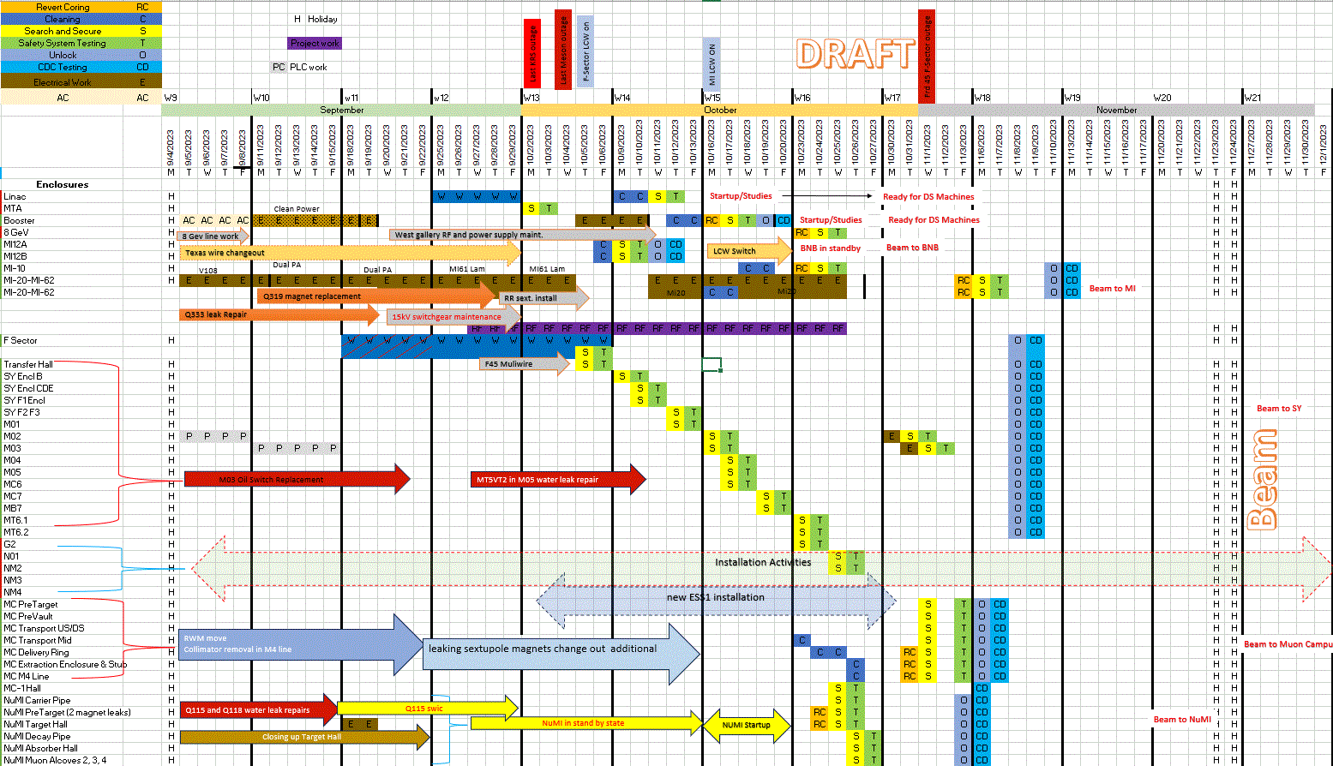
Draft Out Look
Previous weeks

Slide 7
Long Term Keys
Vetting process used for long-term key
  All training to access the enclosure must be up to date at the time the key is issued and be valid for 30 days post the end of the projected end of the shutdown.
    Start of the shutdown projected date of October 2nd so training need to be valid until November 1st.
    New End of Shutdown would be November 6th
      Individuals will need to be re-vetted OR we vert back to operational key sets.
        New validation date would be Dec 4th
  Current areas that are on shutdown cores and Have long term keys issued
    Booster
    MI-8 line, MI10, MI20-62
    Muon campus Delivery rings, M4 line extraction line
  Current discussion are underway as to when we re-core particular enclosures.

Slide 8
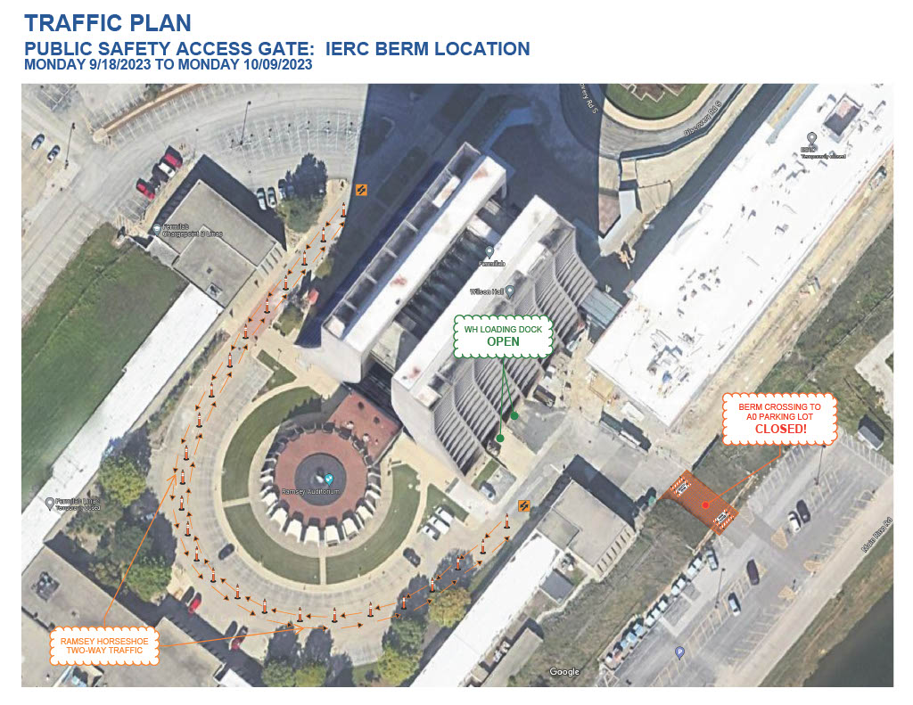
9/25/23
10/16/23

Slide 9
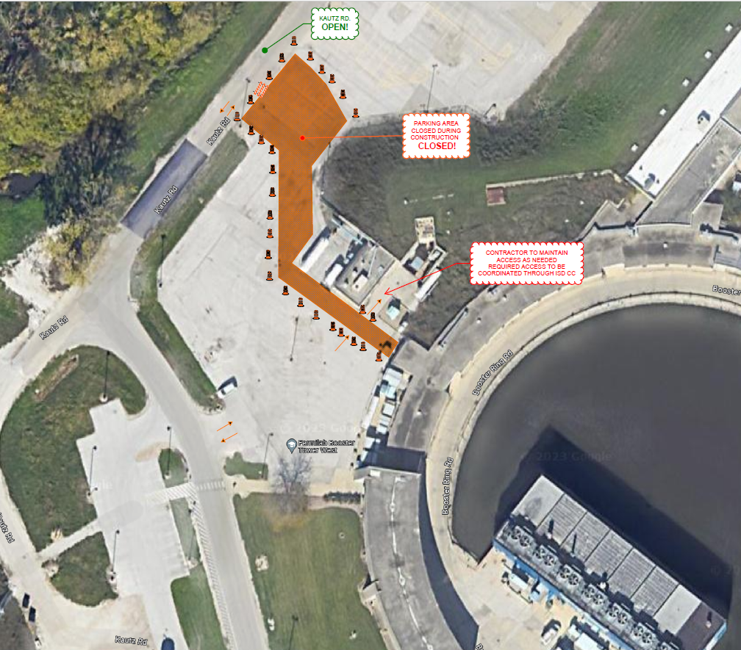
Public Access Control Gates-Linac Area
Stefan Stoica is the construction Coordinator

Slide 10
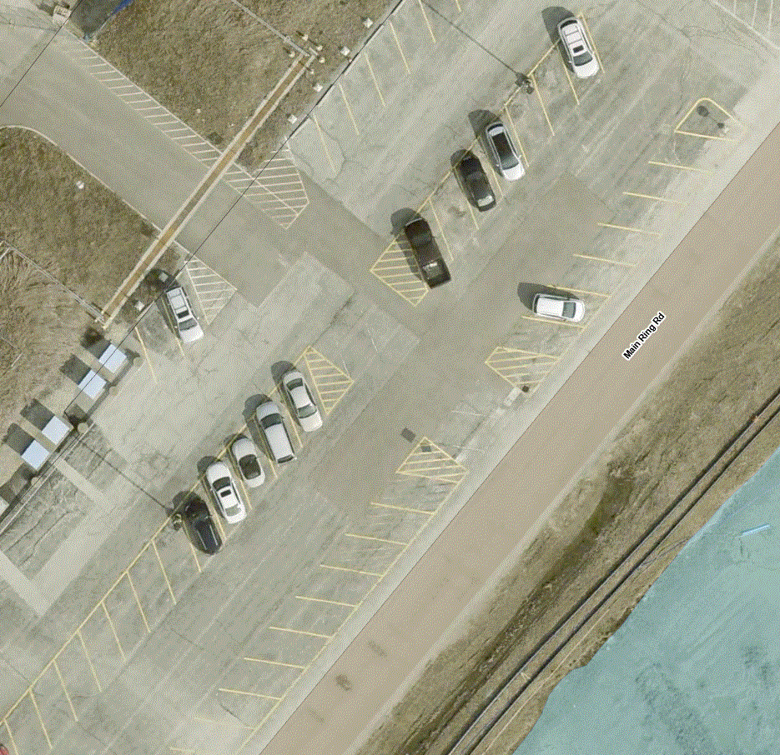




Safety Successes
Trailer
Many individuals have pointed this out.
Several Issues
Cars pulling out from parking spots
Additional Stop signs

Slide 11
Linac 9/11 - 9/15
!
RF Maintenance
Preparing for LRF5 Water leak repairs
  Week before we on opening up the tank and complete as much prep work that can be done
  Looking on site the Sept 25th to equipment shipping issues
    This shift has effectively taken up the Linac contingency week and this process will impact the Linac Startup date that was to occur the week of the 25th

Slide 12
Booster 9/11- 9/15
  Clean power upgrade in West gallery
    Access to the West gallery will be limited
      Sept 7th Tinners retune
      Construction zone until Sept 22th
  General RF Maintenance
    west Gallery and Tunnel
  Ion Pump done
  Power Supply Maintenance
    Both in the gallery and the Tunnel
      West gallery RF and Power supply will not start until Clean power upgrade is complete. Start the week of September 15th
Choke 12-1 pulling to the alise in place re ferb being installed

Slide 13
BNB 9/11- 9/15
Remaining Shutdown Work
  Water leak repair on 874
  DI Bottle change out
  Switching back from Chiller back to MI LCW heat exchanging
  Texas Wire Removal (2–3-day job) treating this as filler work
    Needs to be schedule

Slide 14
MI/RR/MI8 9/11- 9/15
Ring
  Q319 Magnet replacement (new magnet at MI60)
    magnet being removed
    Tuesday Alingment
  Q333 leak repair
    Pressure testing
    Reconnect BPM
    Reposition elements and Alignment
      This will not occur until mid next week Due to Alignment issues
  Mechanical
    Water/Vacuum issues
    VCB maintenance work
      ~ 2 weeks to complete starting in 2 weeks
    RF
      Maintenance will continue
  MI-8
    Clena up
  Mi60 cable pulls preps
  IMP work
Marv Air unit replacement Building | Start | Finish | Status
MI-10 | 8/21/2023 | 8/25/2023 | Running*
MI-20 | 8/22/2023 | 8/31/2023 | Running*
MI-30 | 8/28/2023 | 9/6/2023 | Work in progress
MI-40 | 9/1/2023 | 9/12/2023 | Work in progress
MI-50 | 9/7/2023 | 9/18/2023 | Finsh this week
MI-62 | 9/13/2023 | 9/19/2023

Slide 15
NuMI – TSD 9/11- 9/15
  Target Hall
    Munters switch replacement when available
    Continued PM’s Inspections of underdrain cleaning etc.
    Put R block inplace unto to target.
      Being held off due to fall protection issues
        Inspection)
        Removing tracks
        Cleaning up a and sealing
        Scans are request with evernthig in place
  Pre Target
    Q115 Inspection/Work Planning
      done
    Q115 swop multi wire
    Q118 Manifold replacement / rework (in place)
      Done

Slide 16
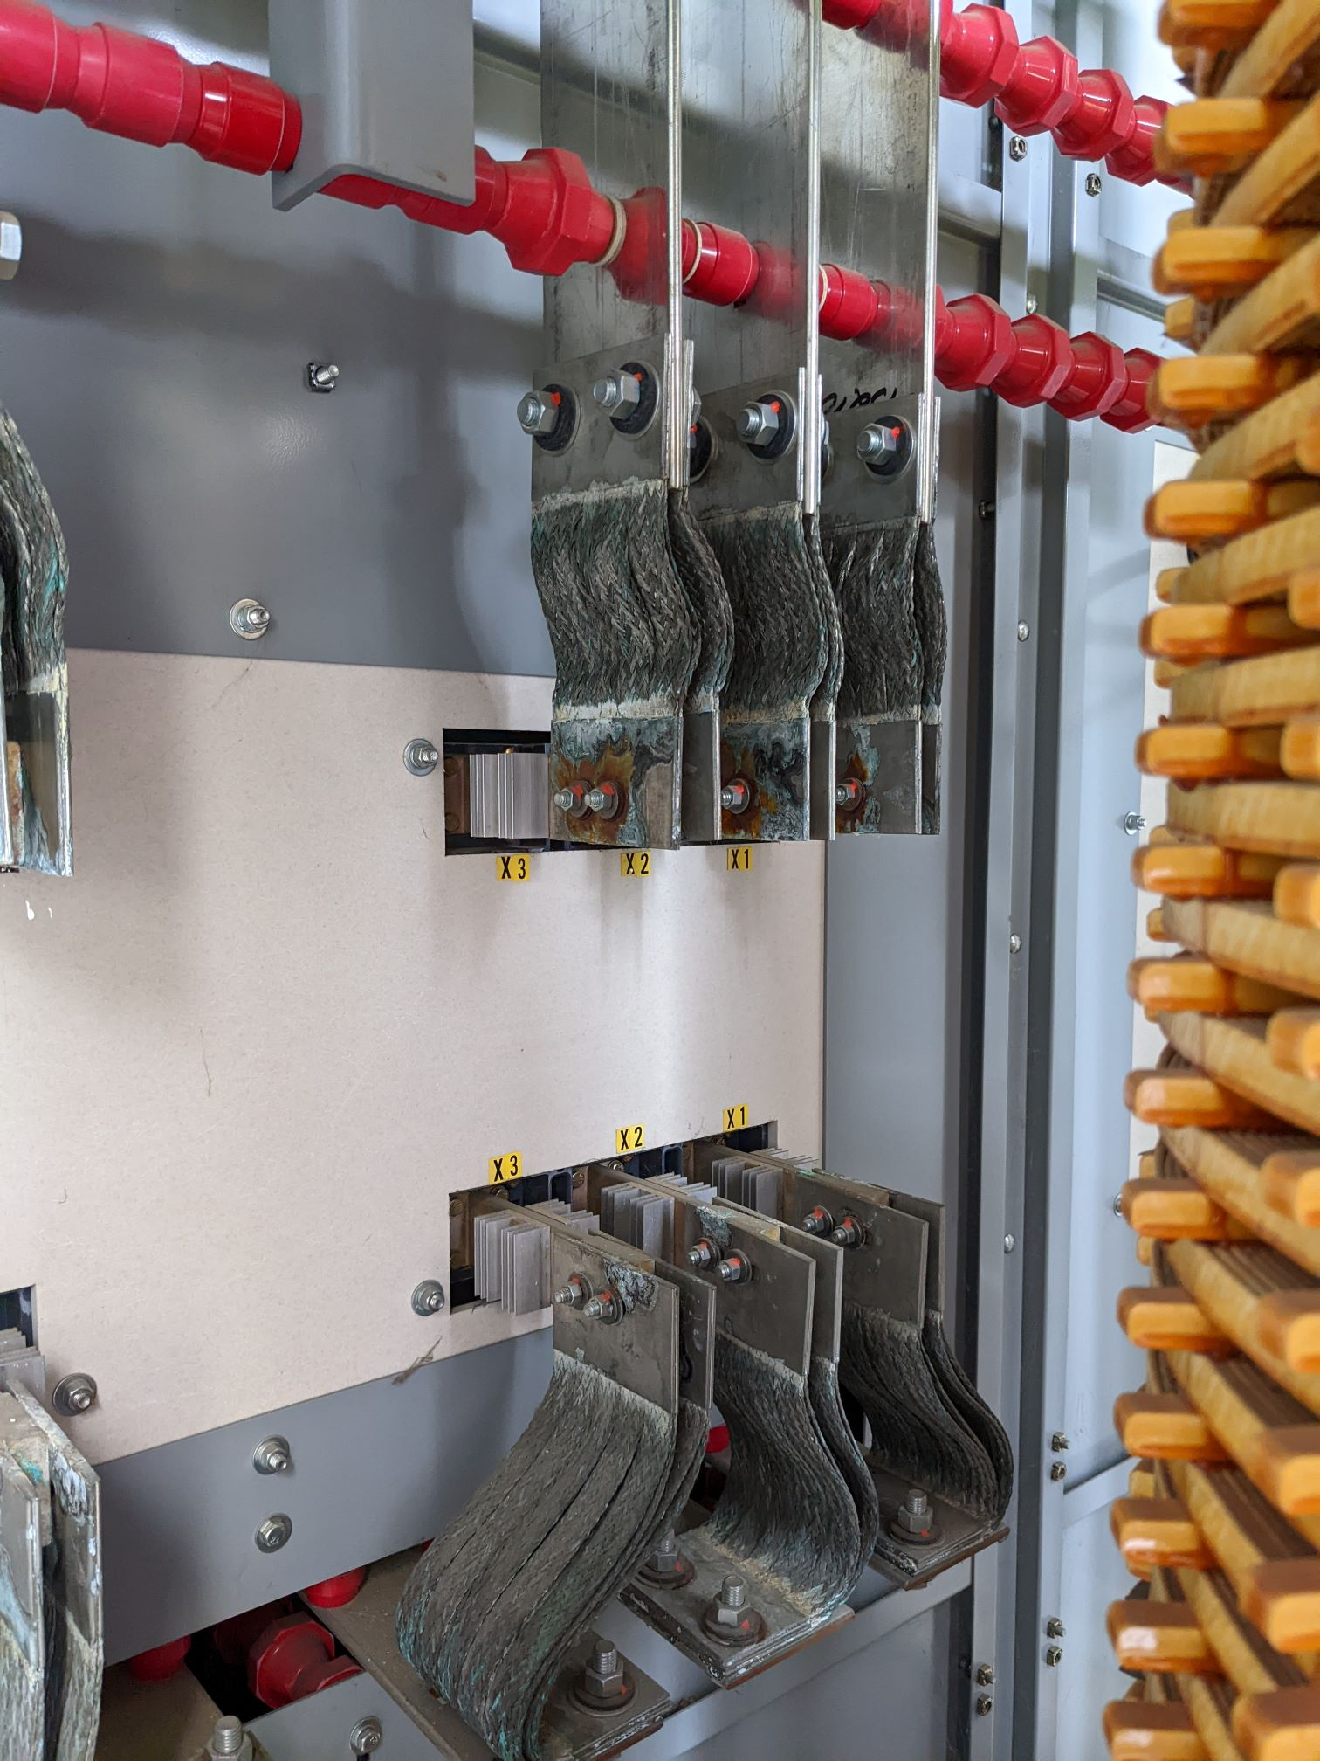
External Beam Delivery Department 9/11- 9/15
Muon Campus
  AP30 power outage has been postponed until much later in the shutdown (at a convenient time). The Braided connections fabrication is underway.
  AP0 AC work has resumed but now is paused
    Design change for return air ducting required due to interference from cable tray
    System testing was scheduled for 2nd week of September, may now be delayed further
  Underway: Resistive Wall Monitor from the 10 straight (it gets moved to 907 in the M4 line).
  Draining AP0 water system is being planning
    Have a draft been
    Ess1 survey mond and Tuesday
  Waiting spool pieces

Slide 17
Switchyard
Switchyard
  Water leak repairs
    MTS5VT2
  PLC work did slit
  Vacuum Maintenance
    M02, 03, and 05 that electrical work to get these pumps up and running.
  F3 Manhole
    Remove from the Beam line M00U3

Slide 18
ISD Maintenance
Plan for the week of Sept. 11th
  AP0 torrom
  No Monday to Wednesday
    Due do ISD Availability
  Thursday
    APO PMs (next of the 29th )
  Friday
    Corrective, Troubleshooting
      Area include, Main Ring, Switchyard,
  Sept 14th Thursday
    Change Sump Pump @ MI 20

Slide 19
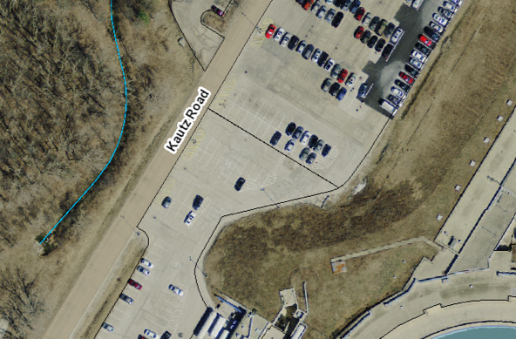
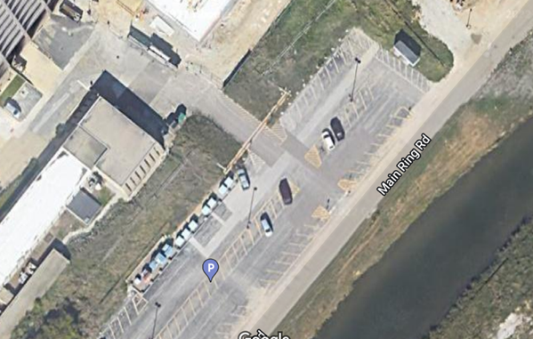
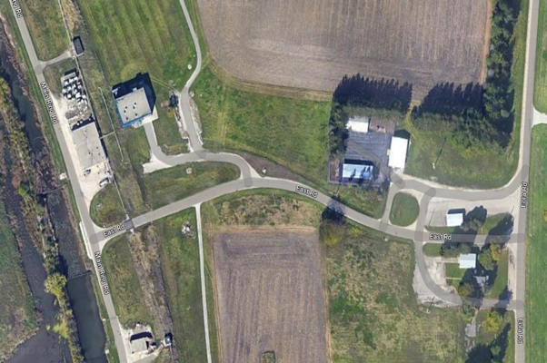
Gate access
Gates equipped with:
  Badge readers – so authorized personnel can pass through
  Intercoms – so deliveries and other persons can be assisted by security
Emergency vehicles will have an override
All gates engineered so all highway-legal traffic (including tankard trucks) can pass through an open gate
Gates are located at:
  Kautz Road (1) near the end of the linac
  SE corner of Wilson Hall (2) before connecting to Main Ring Rd.
  E Road (3) near Main Ring Rd. (at C0)
  Starting At IREC excavation
    Starting next week (18th startup)
      Crossing will be closed for 2 weeks while this work goes on.
      10/9
    Gate 1 and 3
      Done by the end of the week of 10/3 Excavation
  Booster tower west
    West side tie into booster gallery next week
    Change order in the works.
    Start in the next few week
1
Guard booth
Chain-link fence
Jersey barrier
2
3

Slide 20
ISD Engineering
Fences
Wilson Hall East gate (2)
Willson Hall West Gate (1)
Tev C0 gate (3)
This project has an expected completion date of Oct 3rd
Various location impact operations due to work on in near the berm.
Change order in process
MI12
AP0
Booster West
tower

Slide 21
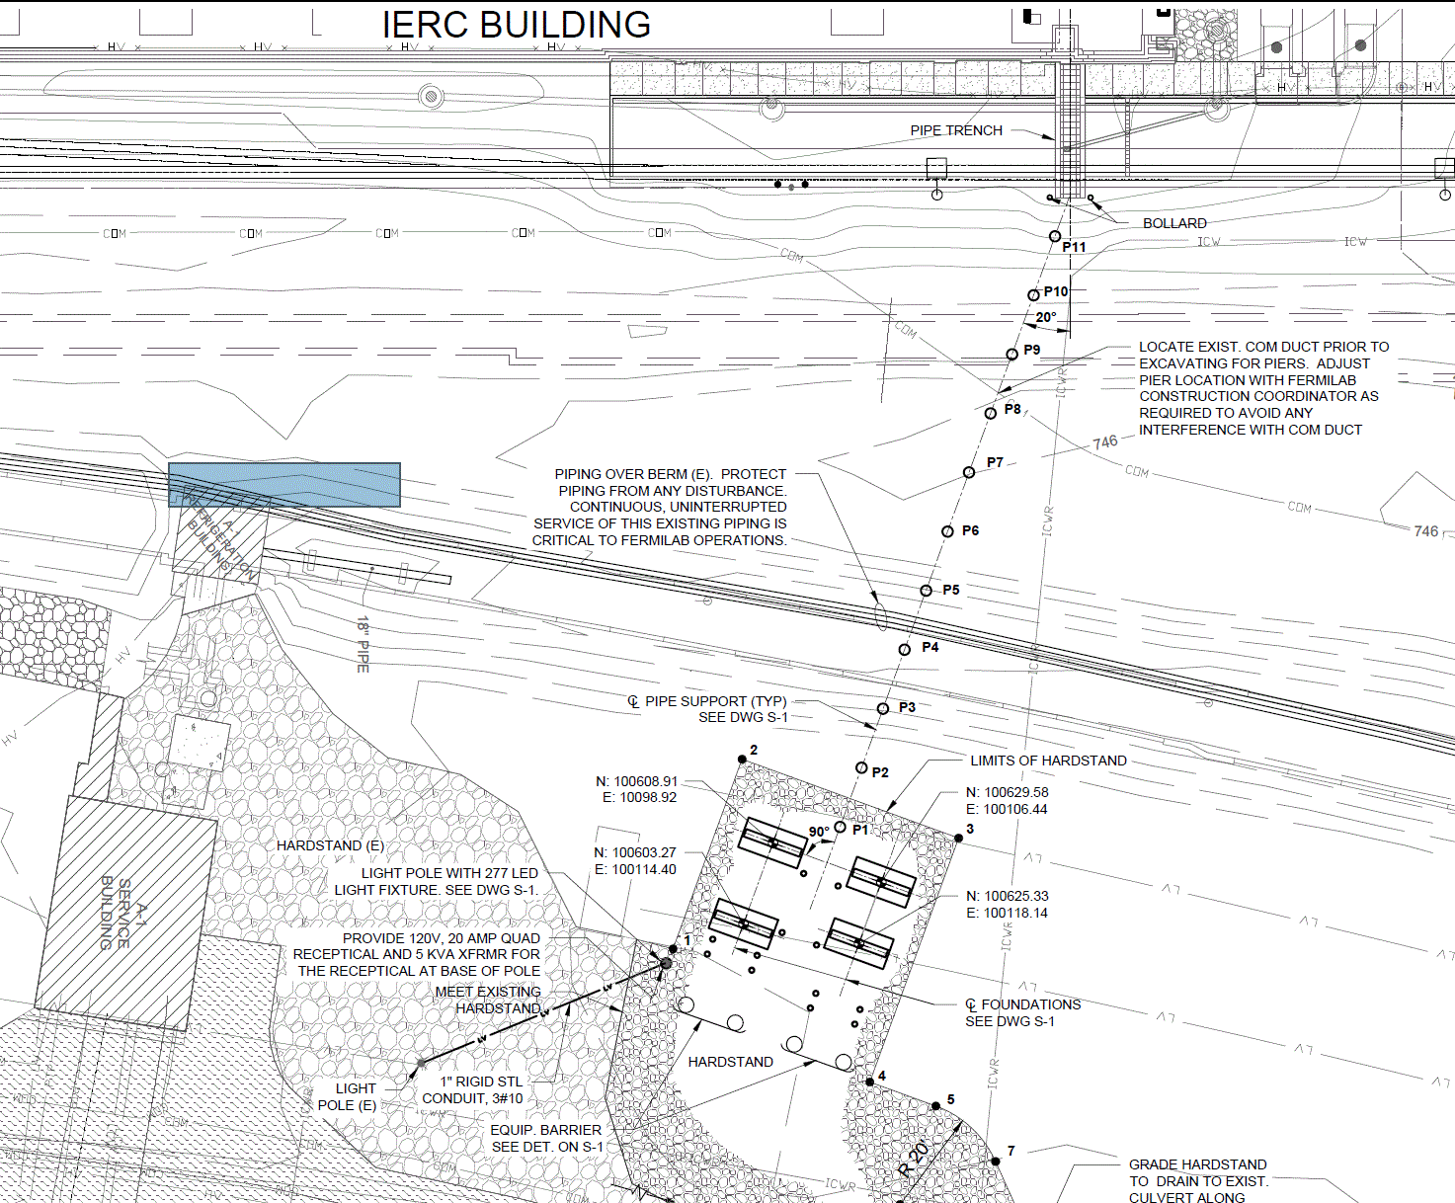
A1 Dewar installation for IERC Building
Approximate Berm locations
Contractor will mobilize.
Poured the piers
Dewar foundation pour tomorrow.
Topo ready next week
Off the berm after alignment is done

Slide 22
MS3 oil switch change out
Generator issues
Job is progressing
  Pushed to Thurs-Mon 9/21/23 - 25
  NS2 Lift stations NS3 and EAB training center
    Power down 1-2 days
    Put back in service at end of the day.
Expected end date 2 weeks from 29th with weather delays
  Week of next week (sept 15th)

Slide 23
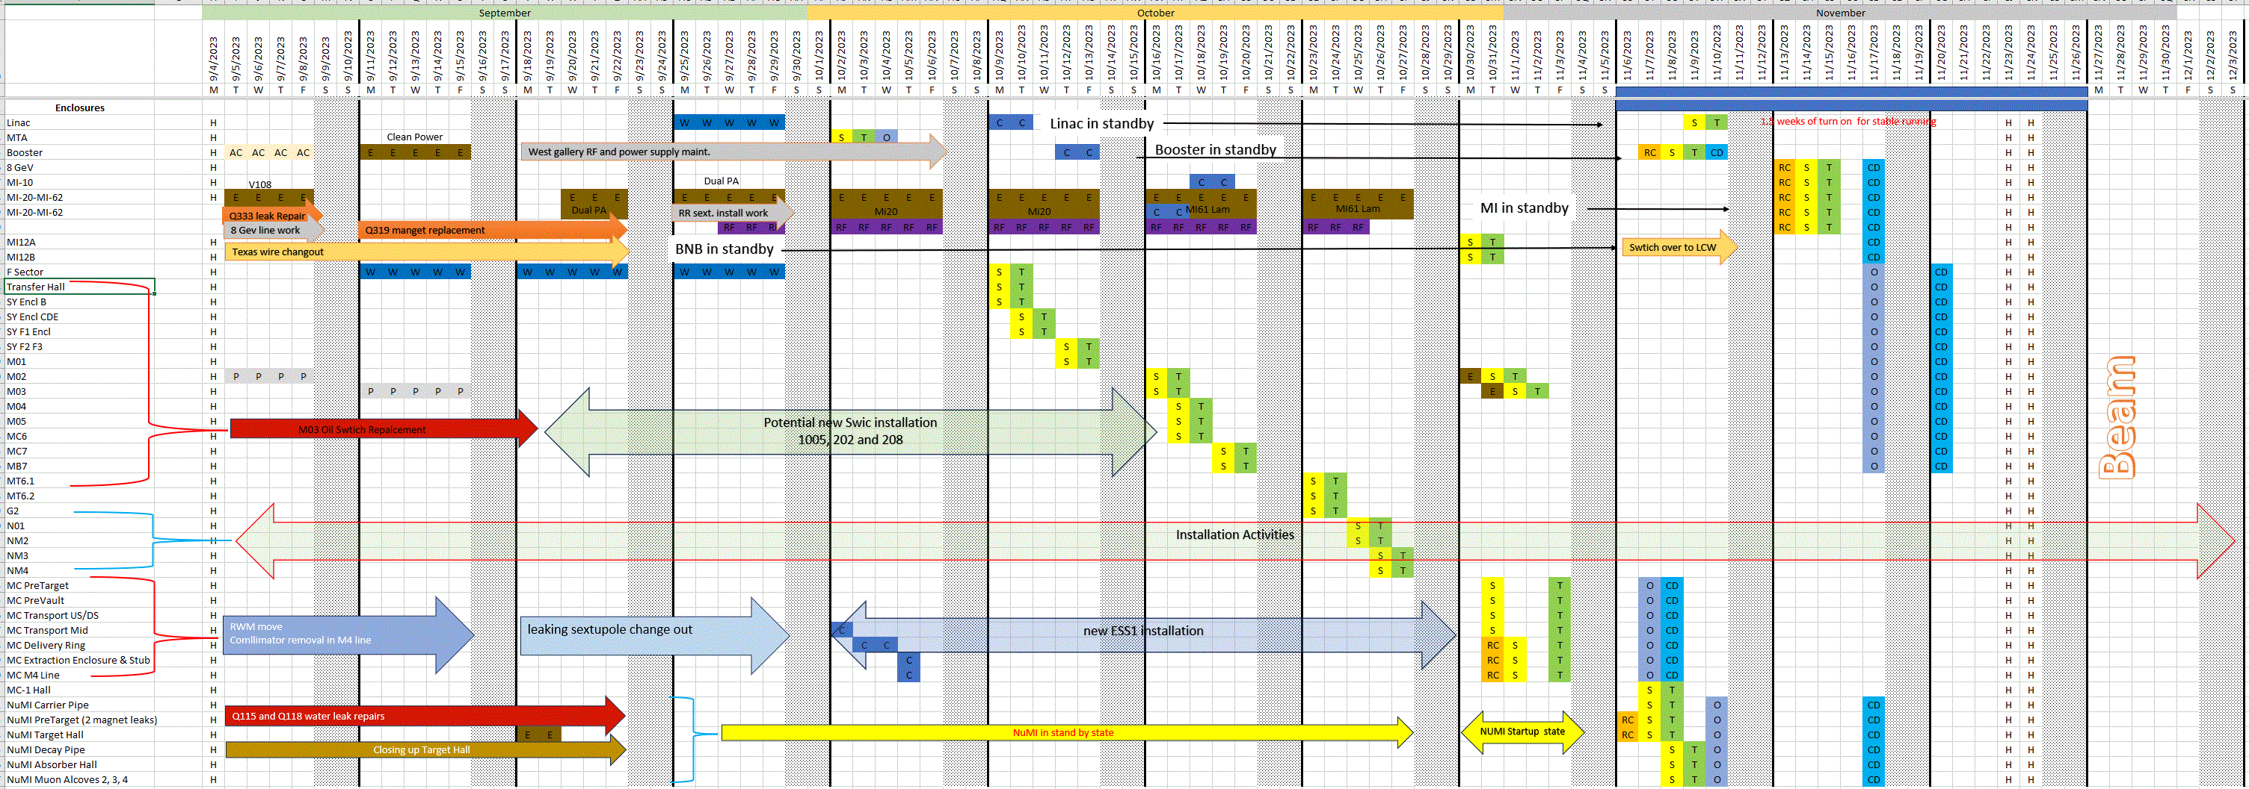
DRAFT

