Slide 1
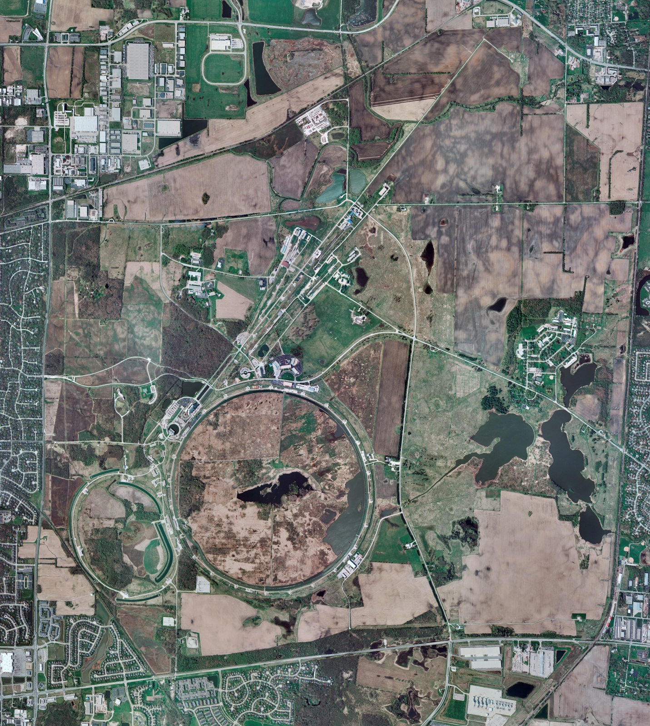



Helium Cryogenics
Status 9/22/2023 J.Makara
CMTF: SCP is cold and operating fine now; planned power outage recovery was delayed to cryo controls issues
CMTS: HECM27 CM is cold at 2 K for RF testing
PIP2IT: SSR1 CM at RT, prepping for cooldown
North CM stand empty
MCTF: cryo system is shut down at RT
MDB/HTS: at RT
MDB/STC: at RT awaiting installation of SSR2 cavity
MDB Magnet: at RT
NML/FAST: Cryo system is being cooled down after 80 K purification period with regeneration of Purifiers.
CC1: at 20 K
CC2: at 20 K
CM: at 23 K
IB1: cryo system is cold and was running fine
Muon Campus: A0 comprs (3) online with MC-1 g-2 cryogenic system being cooled down to 5 K.
Misc: .

