Slide 1
Decay Pipe and Absorber Complex Status
Jonathan Lewis for Mandy Kiburg
AD 9am Meeting
22 September 2023

Slide 2
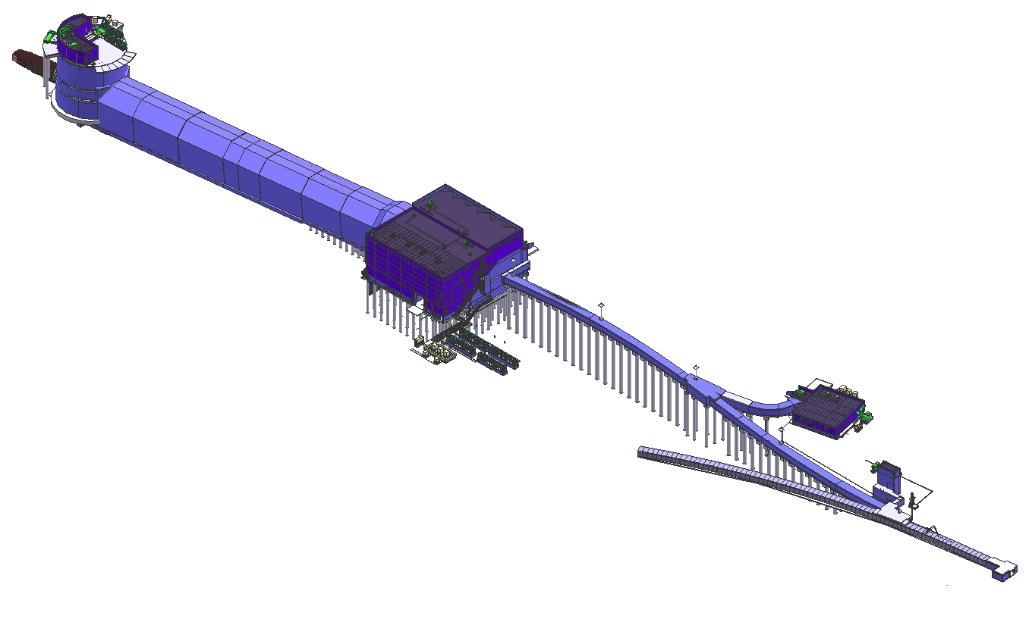
Overview of Decay Pipe and Absorber Complex
Neutrino Beam
to SURF, SD
Absorber Complex
(LBNF-30)
Target
Complex
(LBNF-20)
Primary
Beamline
Enclosure
Decay Region
Primary Beam Service Building
(LBNF-5)
Major
Vehicle
Access
Includes the Absorber, Instrumentation,
DS end of Decay pipe
Includes the US Decay Pipe window
The Primary beam window, Instrumentation
Fermilab
Main Injector
Tunnel
Extraction
Enclosure
Proton Beam
From MI-10

Slide 3
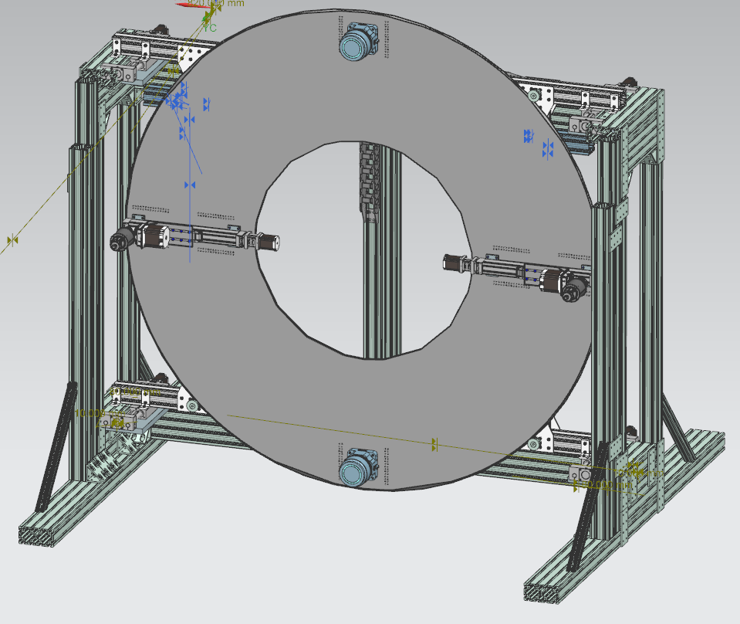
Decay Pipe and Beam Windows
Decay pipe is CF scope – most of the design work is done or outside AD
Beam window design is nearly complete
Primary Beam window and Decay Pipe Upstream Window
Beam window support structures in Preliminary design
Primary beam window cartridge being prototyped and final design questions being answered
US Decay pipe window change mechanism preliminary design and prototyping in progress
To be finished late October

Slide 4
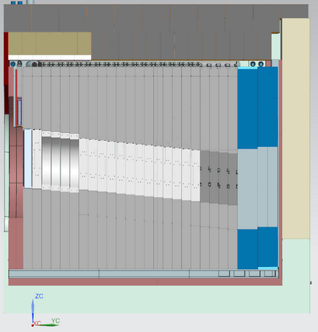
Absorber
Currently in Final Design
Final design review set for Feb/March 2024
Work includes
Transportation fixtures
Drawings for absorber components
Installation planning
Concrete blocks
Steel shielding and support module
256”
360”

Slide 5
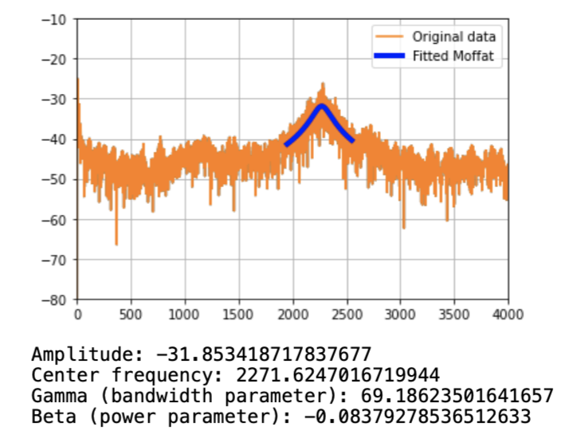
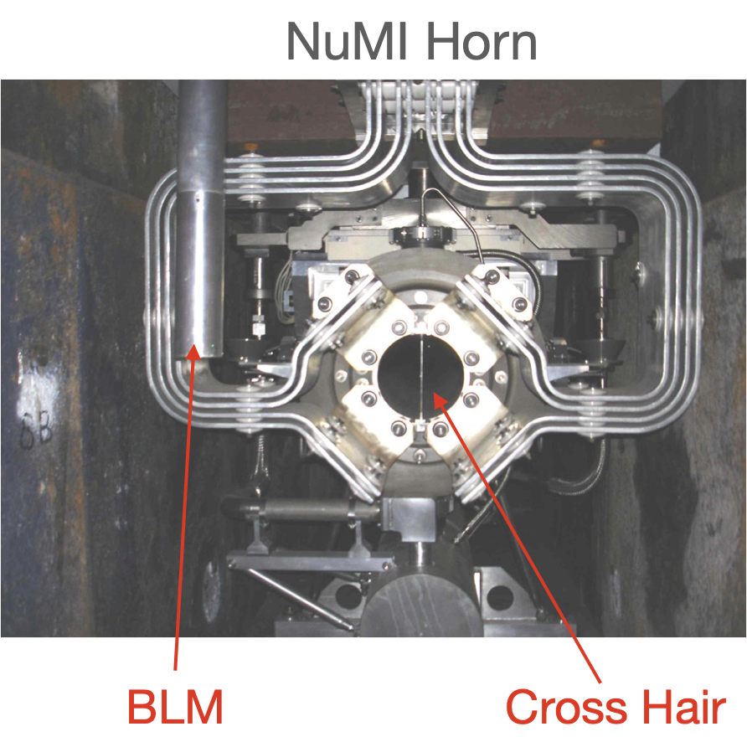
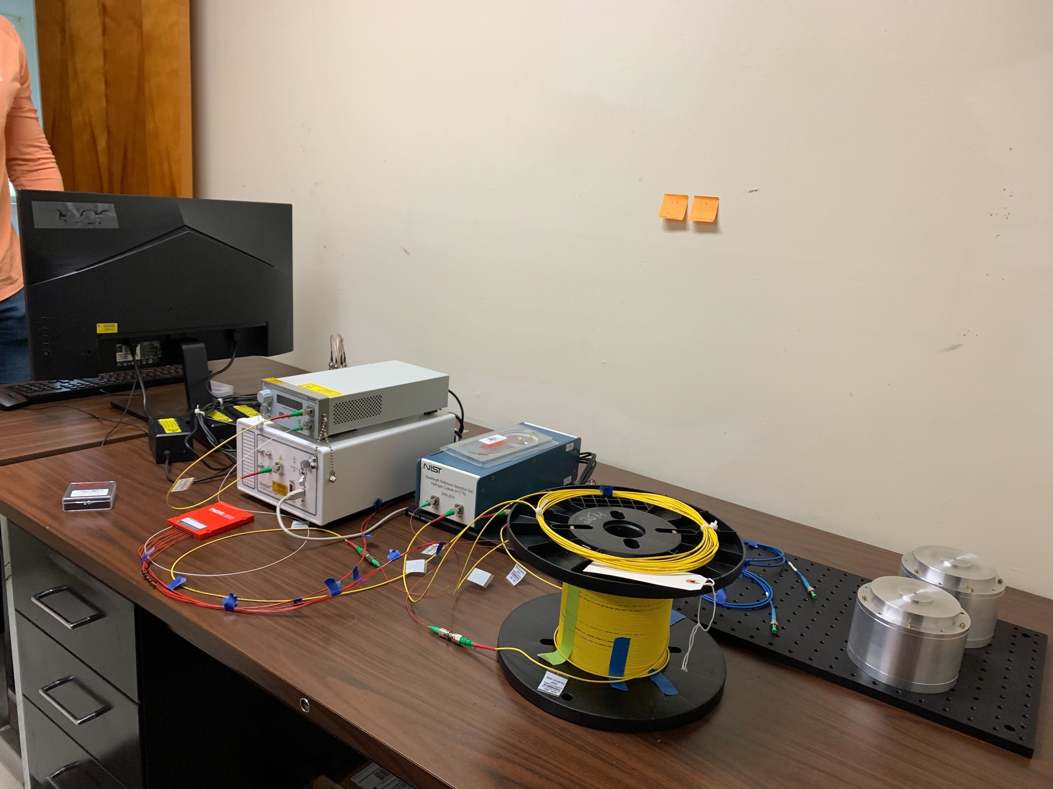
Neutrino Beam Instrumentation
Includes detectors for beam-based alignment and monitoring
Currently preparing for Final design Review for Target Hall instrumentation
TPT, Crosshairs
HLS

