Slide 1
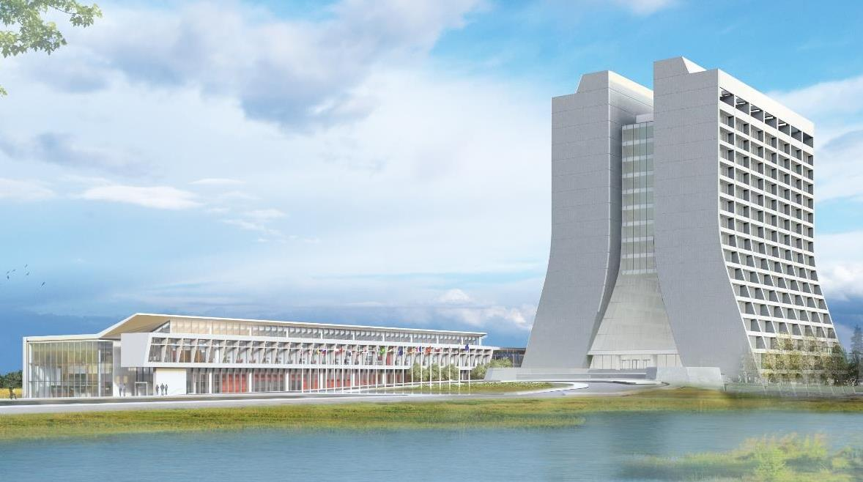
Infrastructure Services Division Updates
Pressing Issues / Special Topic: Safety around Monsters
If You Notice Topic: Cameras
Utility Outages – See the QR code for the most current outage
EOL - Expired Equipment Update
EOL – Equipment Package Planning
Current Happenings
More Current Happenings
Even More Current Happenings

Slide 2
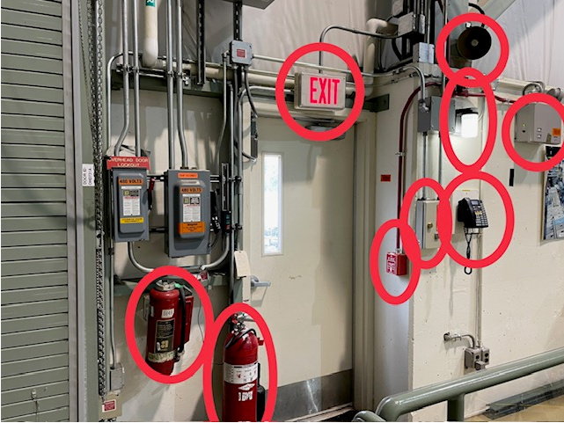
Just for information's sake.
We played the Safety Game, seeing how many pieces of safety you can find.
Special Topic: Shutdown Work: MI-31

Slide 3
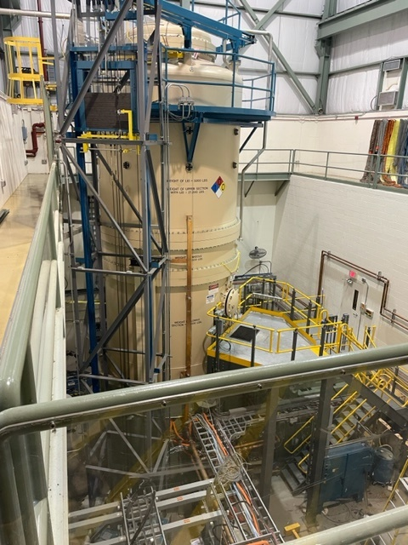
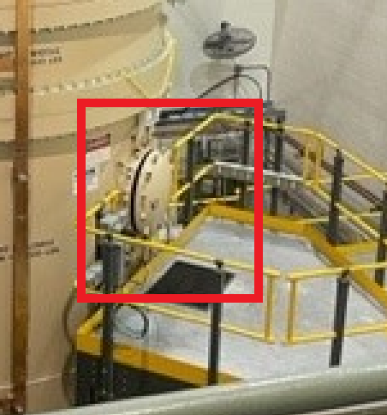
Just for information's sake, but there have been some full moon’s lately and Halloween is coming.
I’m betting something got out.
Special Topic: Shutdown Work: MI-31

Slide 4
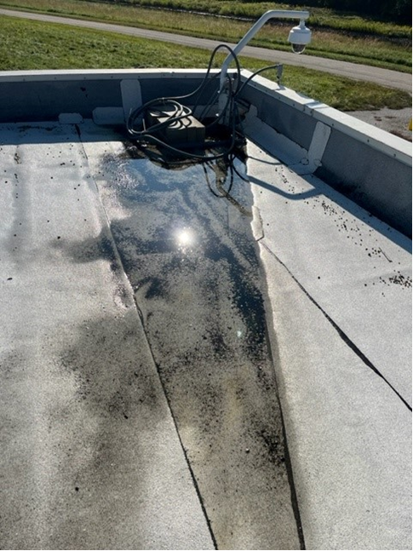
If You Notice This happening, please call, text, email your AFM.
The placement of this camera is causing a roofing concern.
Instead of mounting it to the building they placed it on a cement pad. That pad, beside being too heavy for the insulation and creating a depression where water is pooling – it is also right in front of a scupper, so no water is draining.
If You Notice: MI40 Camera placement

Slide 5
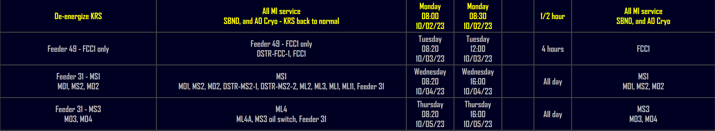
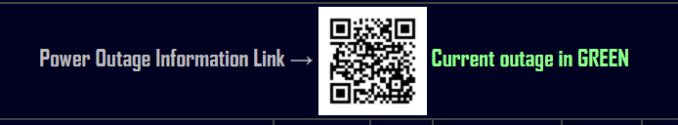
Utility Outages

Slide 6
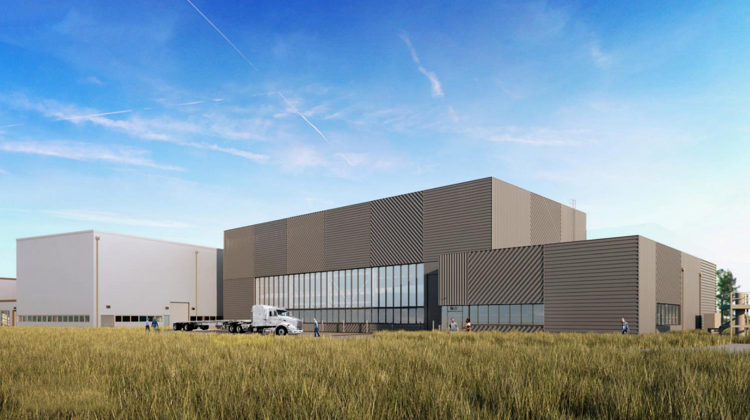
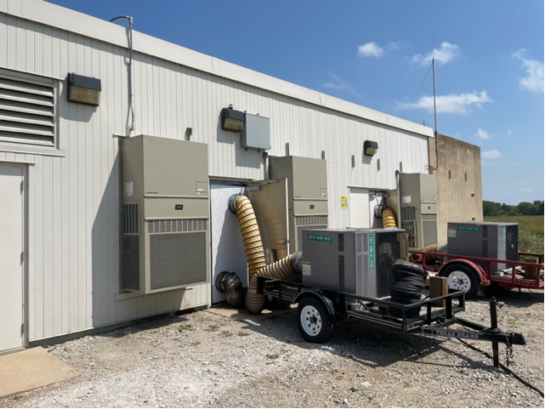
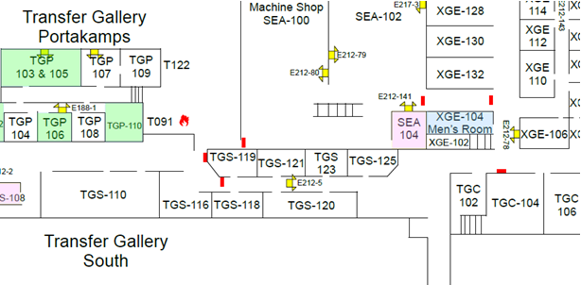
EOL HVAC
The Marv Air Project.
MARVAIR –These include HVAC projects at MI10, 20, 30, 40, 50, and 62. Replacing a series of Marv Air wall mounted unit around the main injector ring. In Progress
HVAC – Cooling issue concerns recently are partly due to the power outages, we have been running down systems that need to be reset. In Progress

Slide 7
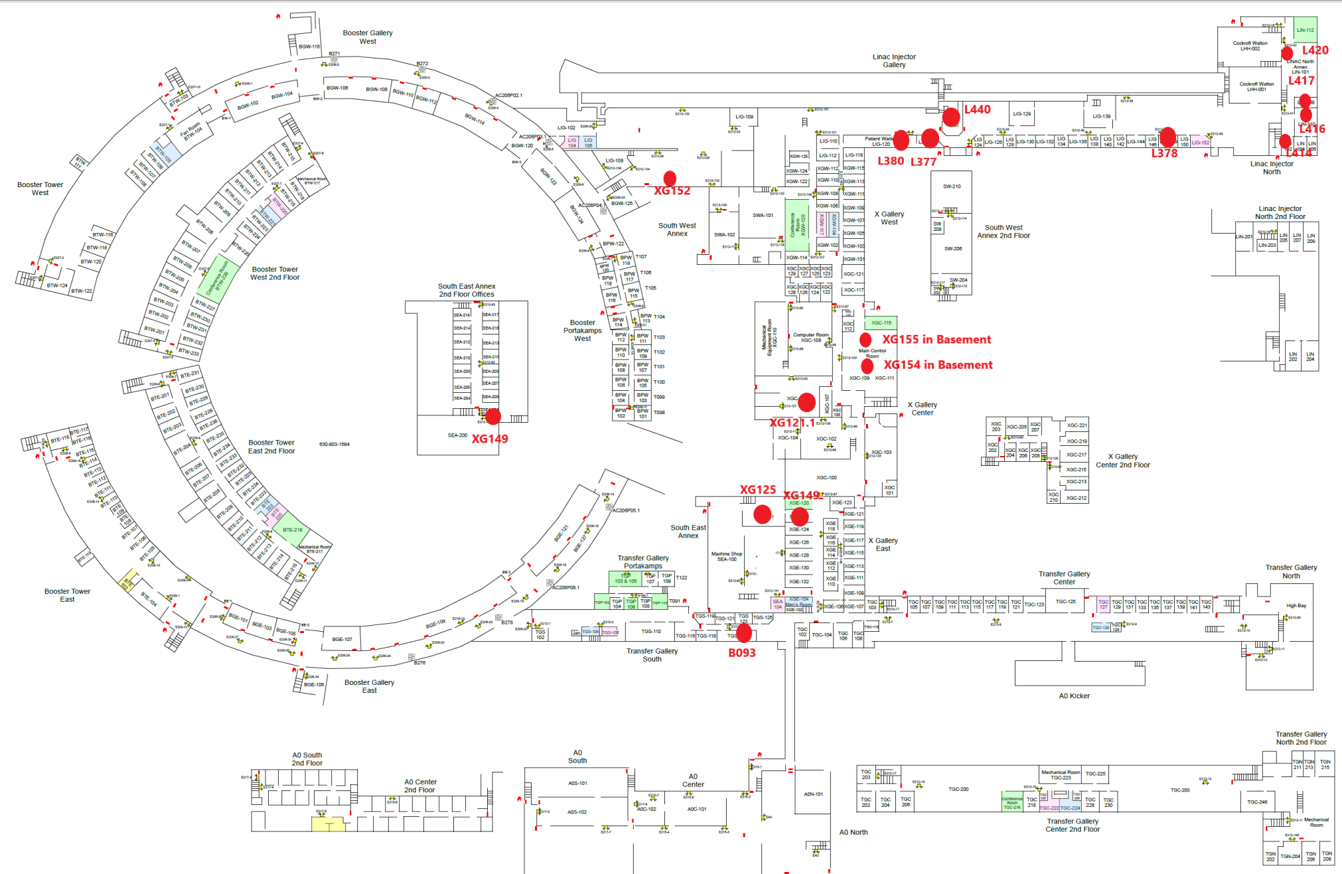
Big Thank You for the teams that assist in this work. Digging out of this hole will not be fun or easy.
EOL HVAC cont.
Equipment has been ordered

Slide 8
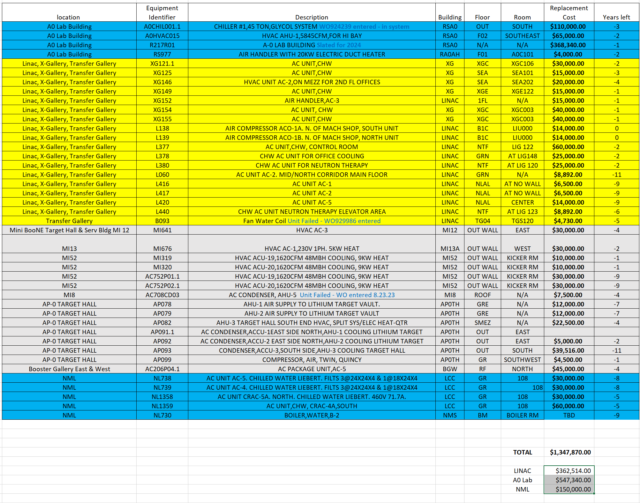
Big Thank You for the teams that assist in this work. Digging out of this hole will not be fun or easy.
EOL HVAC cont.

Slide 9
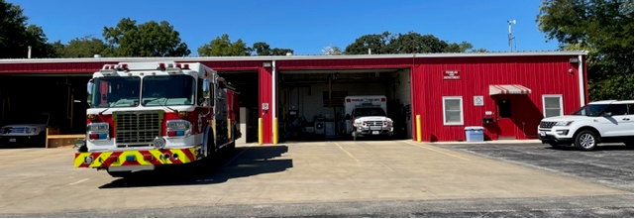
Current Happenings:
Fire Department Temp Relocation
IN PROGRESS
Please program the new phone numbers into your phone(s) as appropriate.
Fire Department personnel will be located at the PAD (Dorm 1) during off-hours for the ongoing bunk room remodeling. We expect the construction work at the FD to last approximately 8-10 working days. The Ext # at the PAD is #3583.
During off-hours, calls to the FD phone lines will be forwarded to the Battalion Chief's phone at 630-817-0607.
The vehicles stationed at the PAD for the duration of our temporary quarters will include; Engine 702, Ambulance 751, and Battalion 701. If required, the Battalion Chief (B/C) will request a second Engine from our community partners.

Slide 10
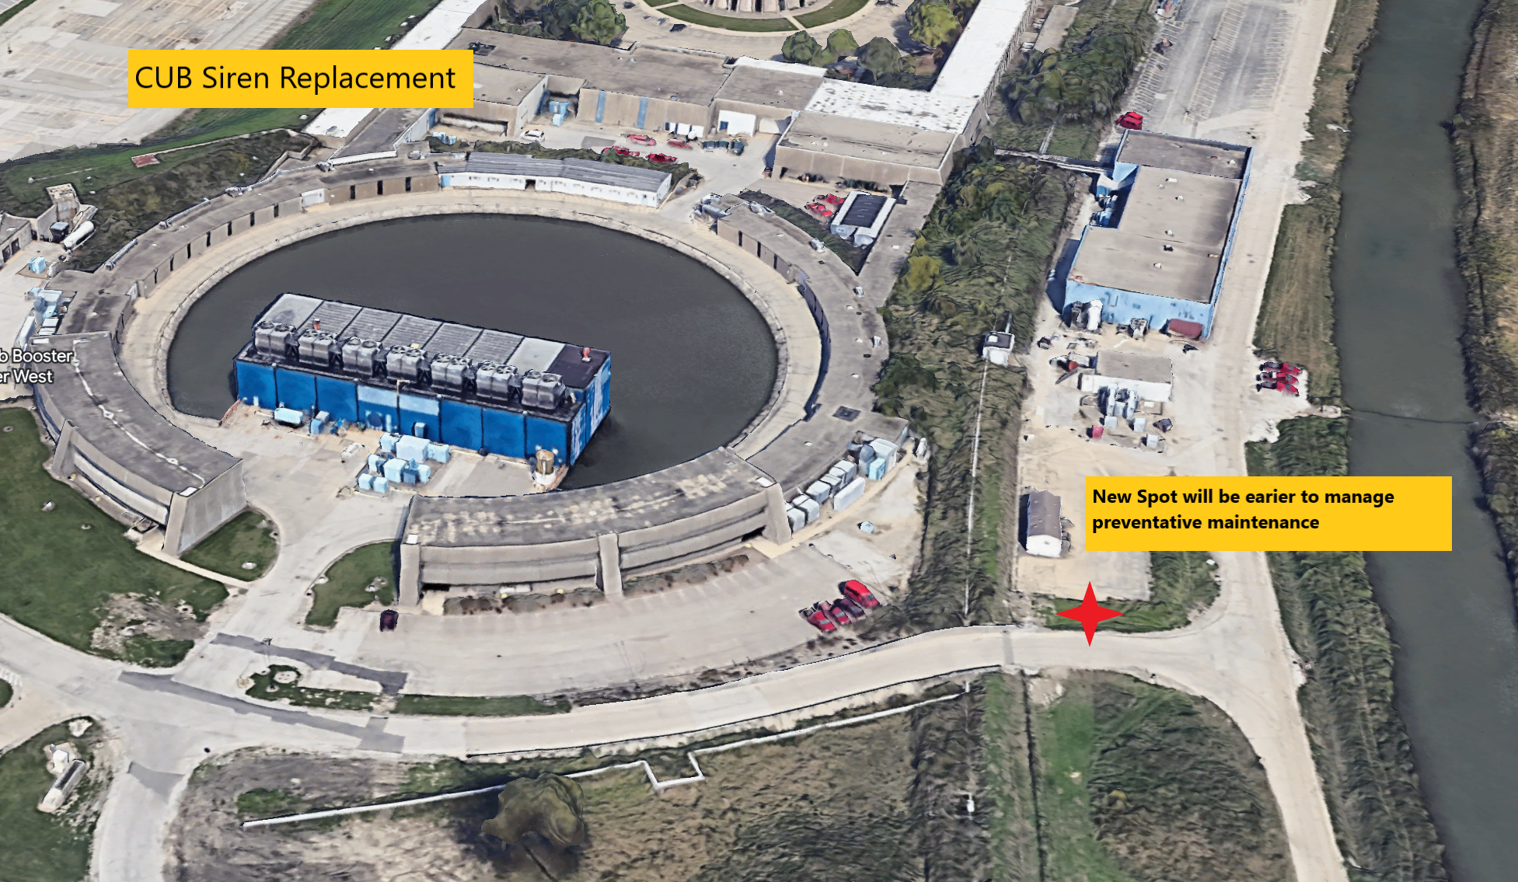
Current Happenings

Slide 11
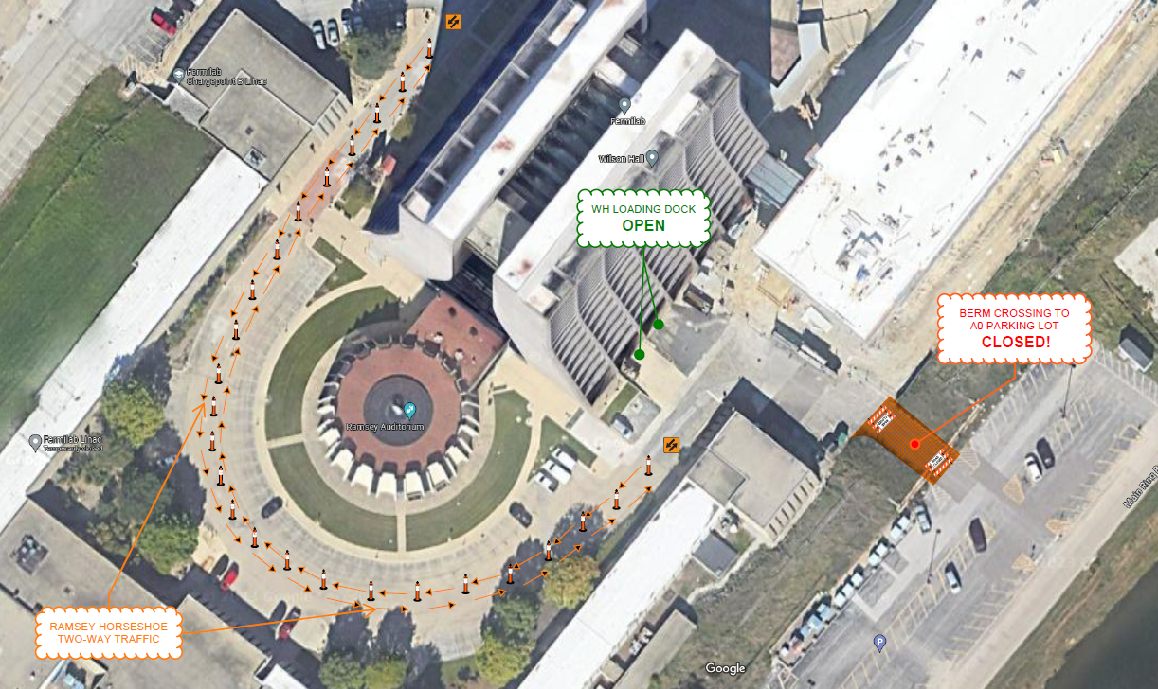
Current Happenings

Slide 12
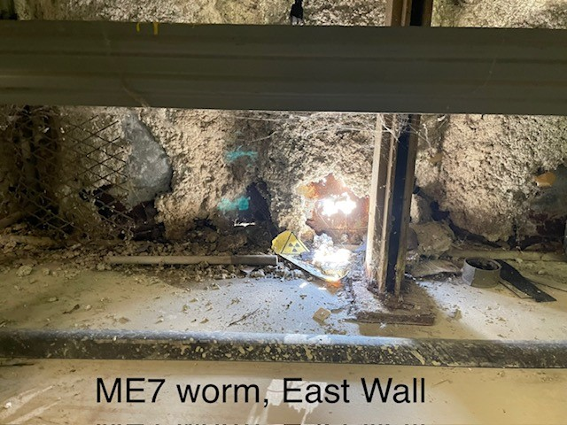
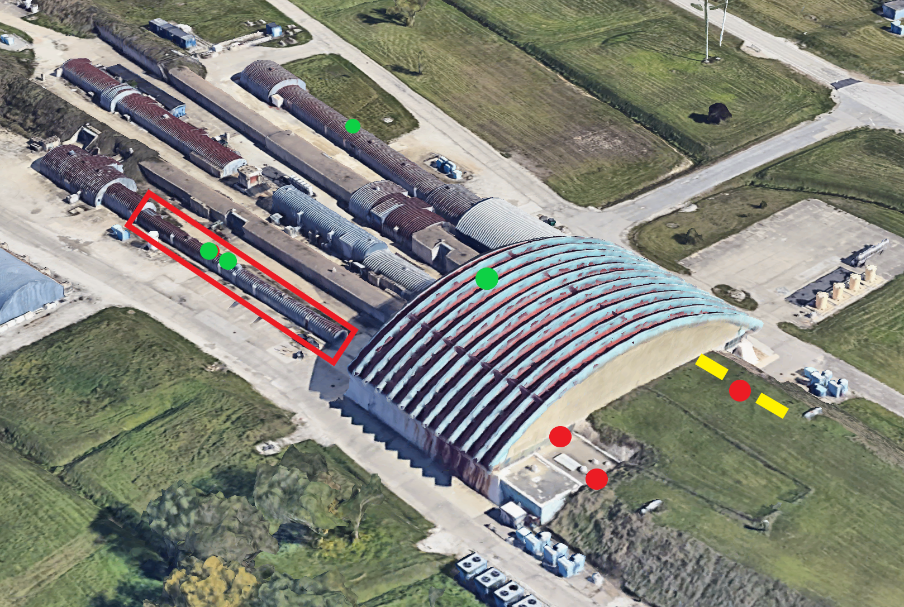
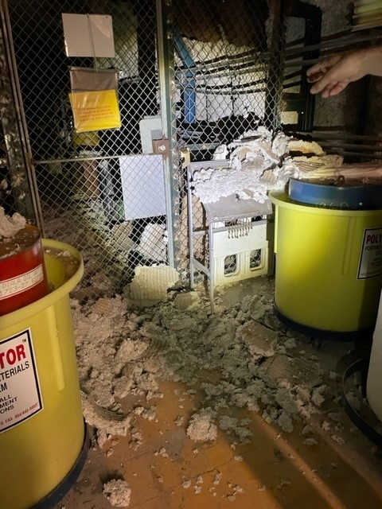
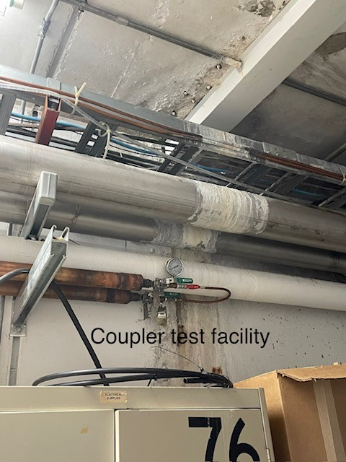
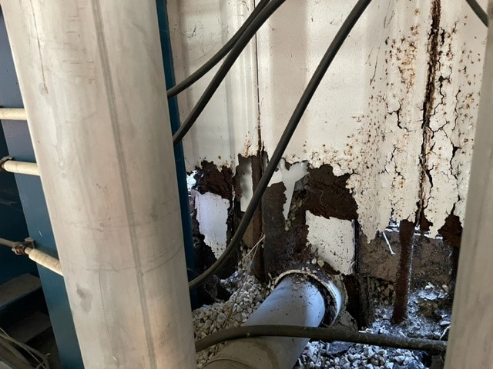
Current Happenings

Slide 13
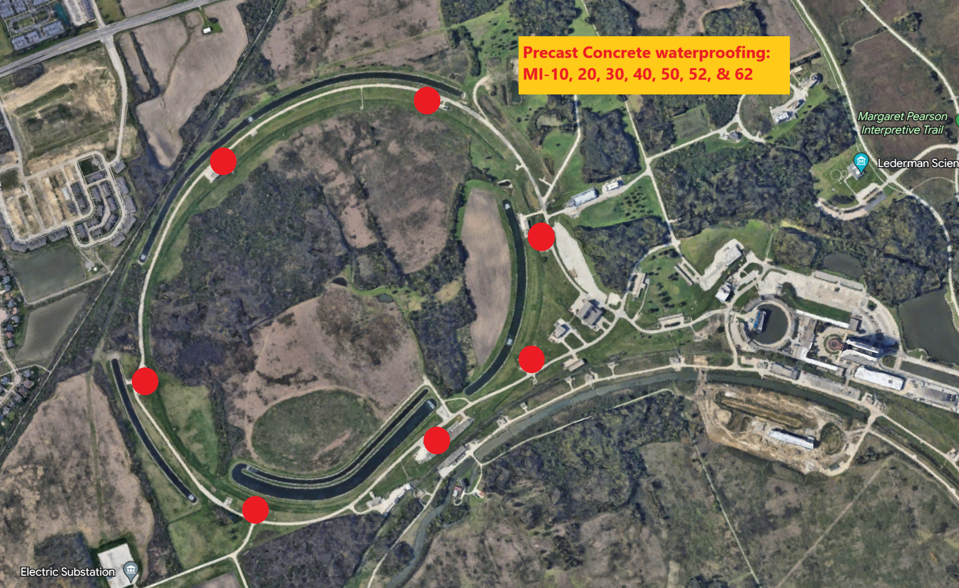
Current Happenings

Slide 14

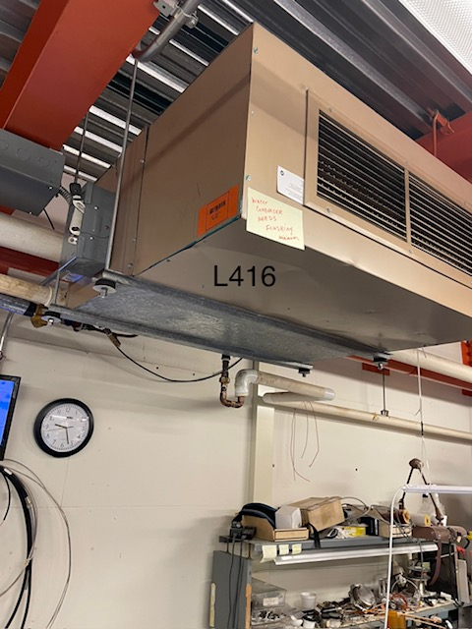
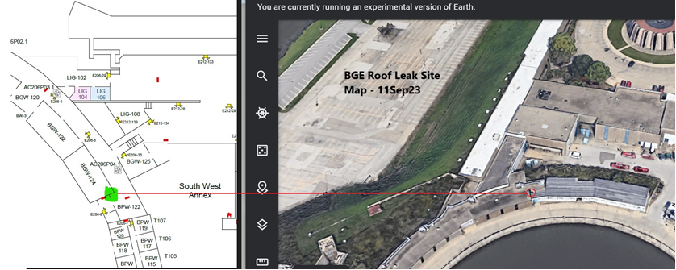

Current Happenings
Sustainability Walks –Wilson Hall, to look at water savings and other projects.
Weed Spraying – Neutrino Service bldgs. And NWA.
Roof Repairs, HA’s are complete, we are currently working on a few badging issues. Roofer has been onsite accessing jobs in the cue. In Progress

Slide 15
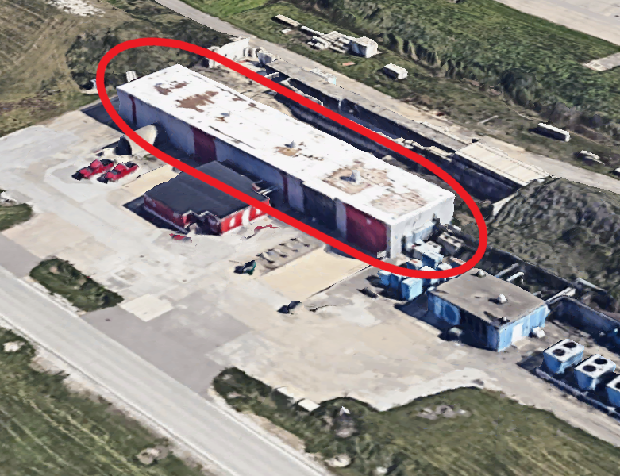
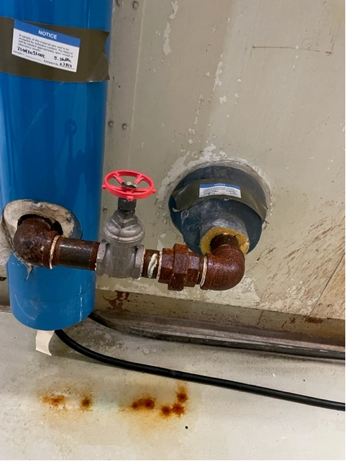
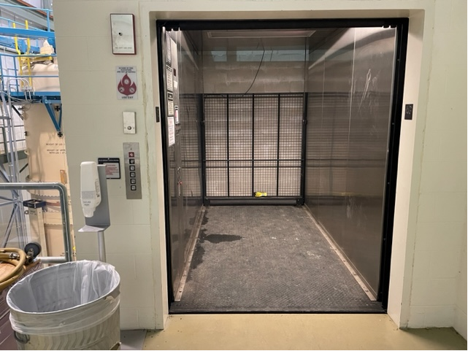
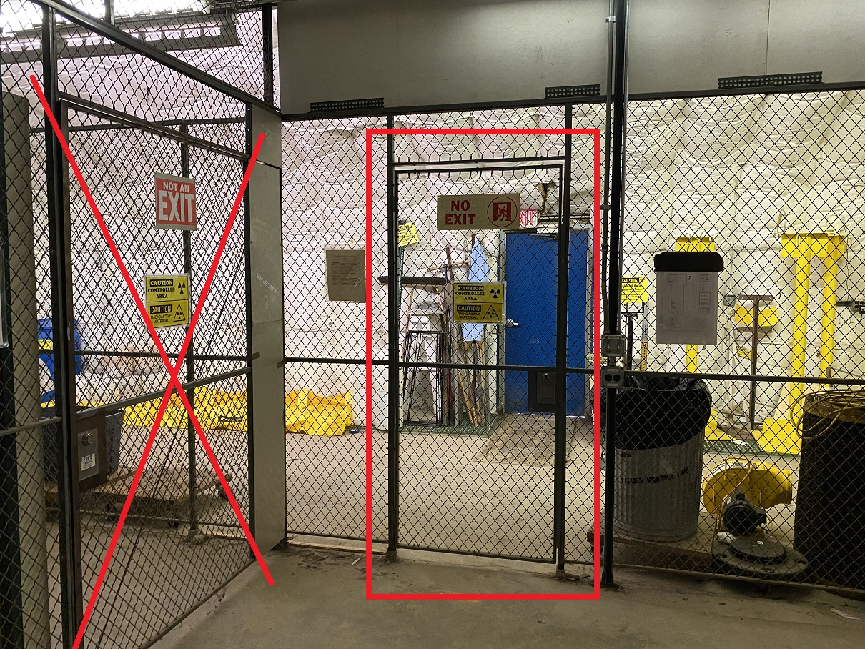
Current Happenings Still..
Asbestos Abatement, Starting to get some movement on the asbestos contract and the Lab is working to get the contractor onsite. We currently have 3 little projects that are held up with remediation activities.
Elevator Maintenance, Identified the main elevators for AD and have been trouble shooting MI-31.
Roof Replacement, NWA has a contractor awarded and is in line after Lab F & B get done. Those roofs are being scheduled currently.
Door Lock Maintenance, Worked with RAD Safety to get a cage door lock repair.
Also Thank you Amber Zapisek - for helping crews access ME7 and NTSB.

Slide 16

Contractors on Site

Slide 17
Big Thank You!!
Thank You!
Thanks for this week
Rad Safety, for helping us get into ME7 for inspections.
Our main goal in the service industry is to allow you to focus on what you do best: Science.
We got the rest!

Slide 18
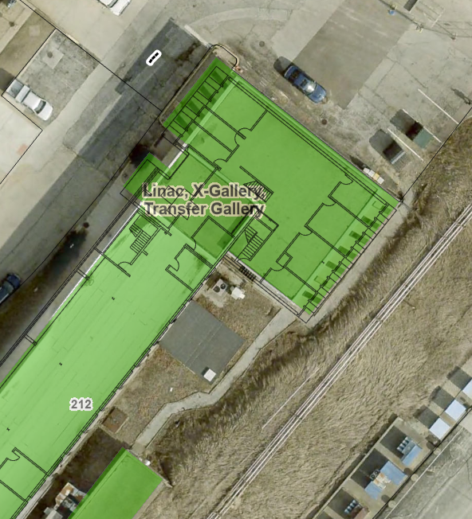
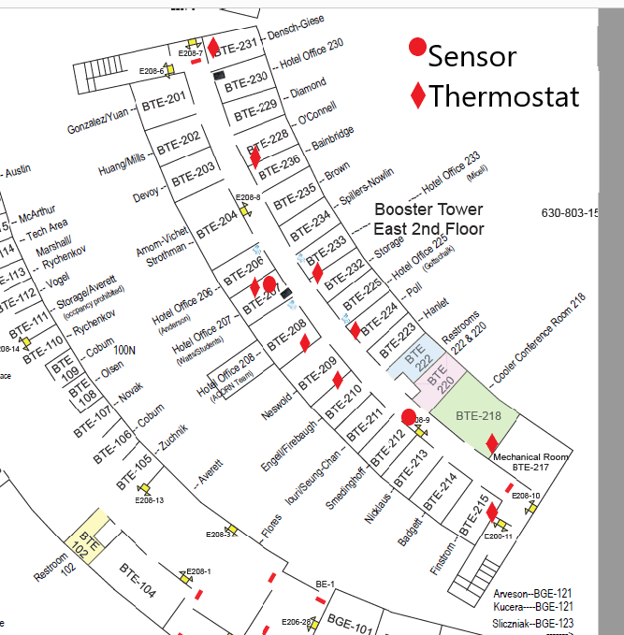
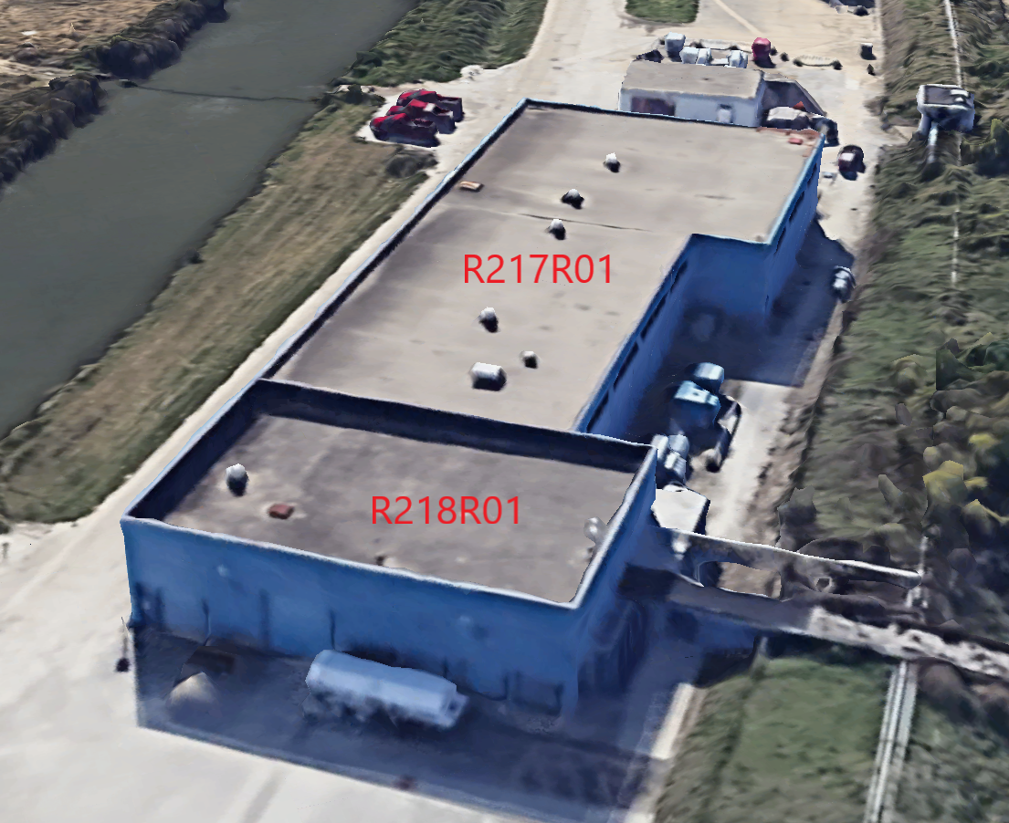
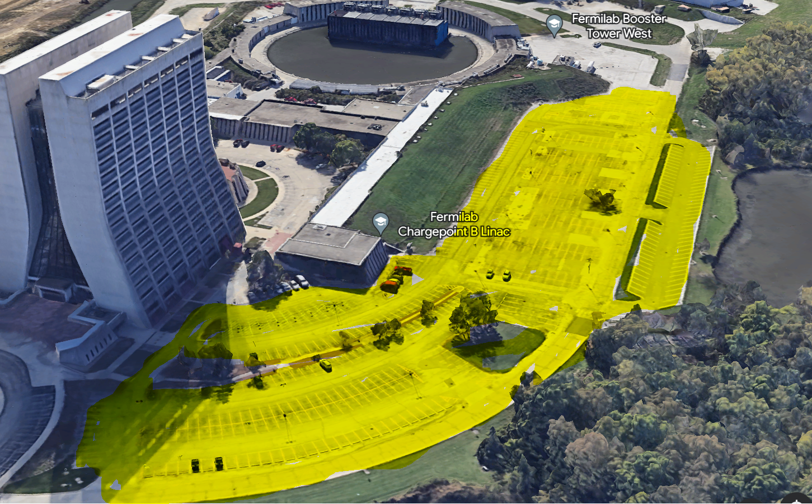
Current Happenings Still Going..
Space Planning – working on standardizing the space development across the lab. Packaging EOL life office remodels, interior painting, etc. to cut down on the one off requests.
Wilson Hall Parking Lot – word on the street is that the project may start next spring.
Roof Replacements – The current ETR’s for Roof packages for summer 2024 have moved to the next stage and have been assigned. Next batch of ETR’s (summer of 25’ & 26’) are in leadership review.
Door Replacements – Currently bundling 10 more door replacements for AD, on top of the 7 we have in progress and awaiting quotes and HA’s.

Slide 19
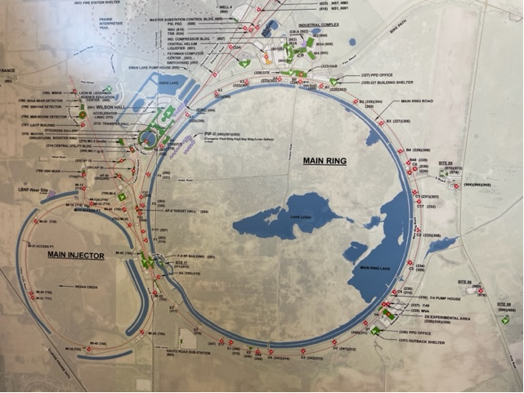
Roofing Update
Current Replacements.
F0 and PS1 are currently getting prepared for the whip extensions. In Progress
Tin work to start next week (fingers crossed). In Progress
Painting of iron at PS1, PS2, G2, then NS7. In Progress
Roof Replacement Packages for 2024. Submitted (yellow)
Working on Summer of 2025 package now. Building now.
NS3, is being planned now as an emergency project – In progress
10
1
3
2
8
11
5
7
4
9

Slide 20
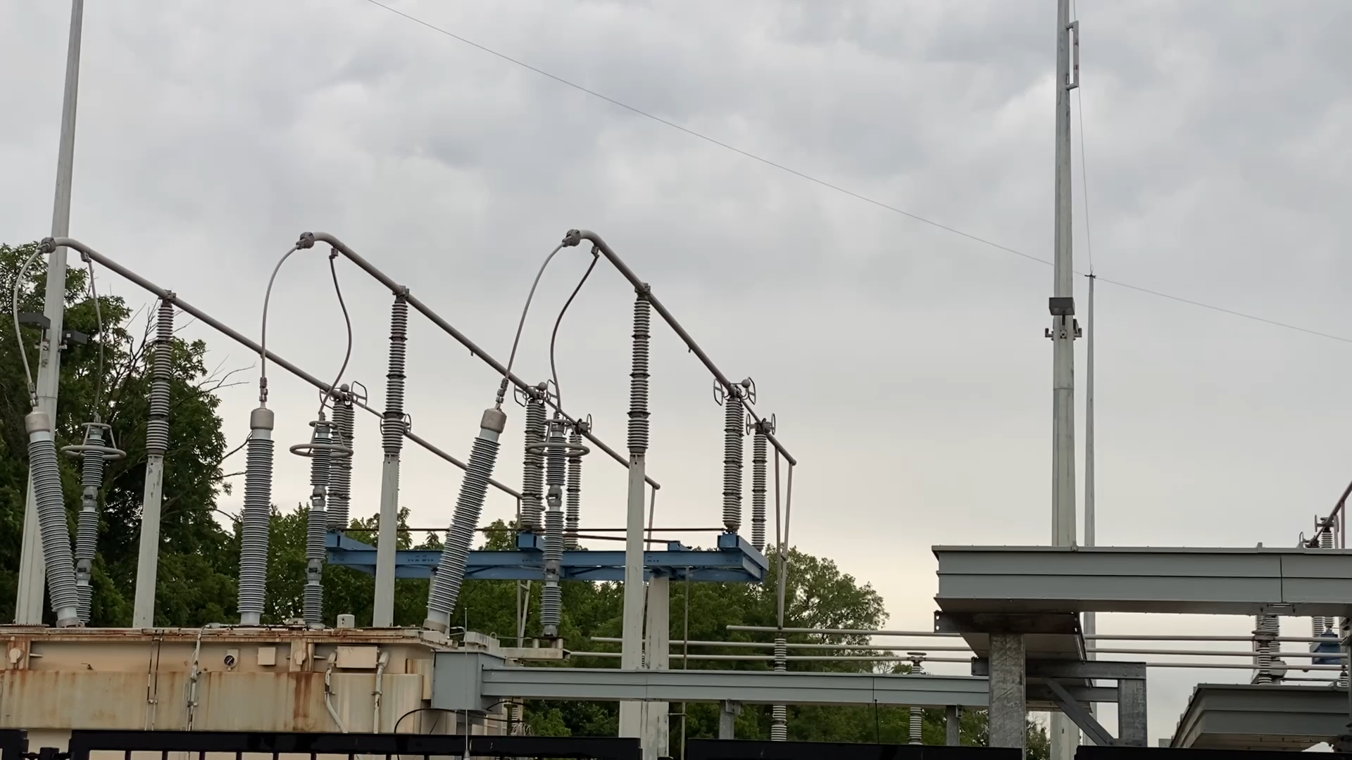
Just for information's sake.
During this transfer 340kv were changed over to another transformer.
Crews had to be on site, plenty of planning, co-operation from ½ the lab had to be established. This is incredible.
Special Topic: Shutdown Work

Slide 21
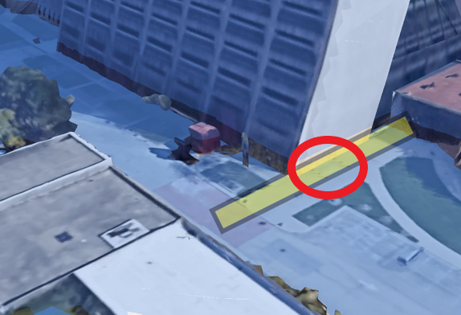
Just a reminder.
Access and egress to & from the Wilson Hall auditorium will be under construction, entrance will be maintained, however the work will last approximately 2 months.
I would expect that from time to time some construction vehicles will need to be present.
Good News – There is talk that a equipment lift has been approved and will be installed to be able to get large equipment in the tunnel area.
Special Topic: WEmail Follow upsilson Hall Work

Slide 22
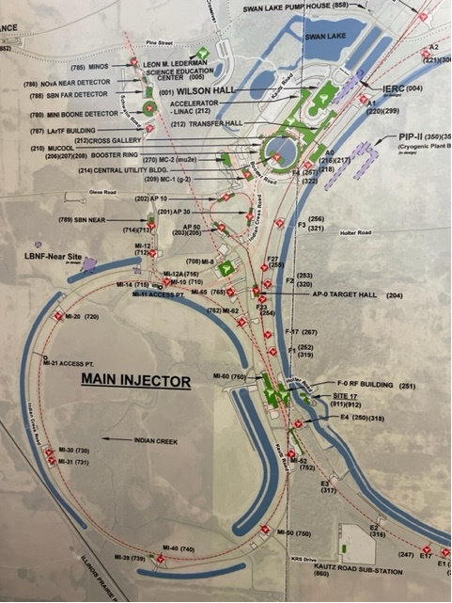
PO’s that have dropped Recently
4
Scheduling pending receipt and approval of HA’s
1

Slide 23
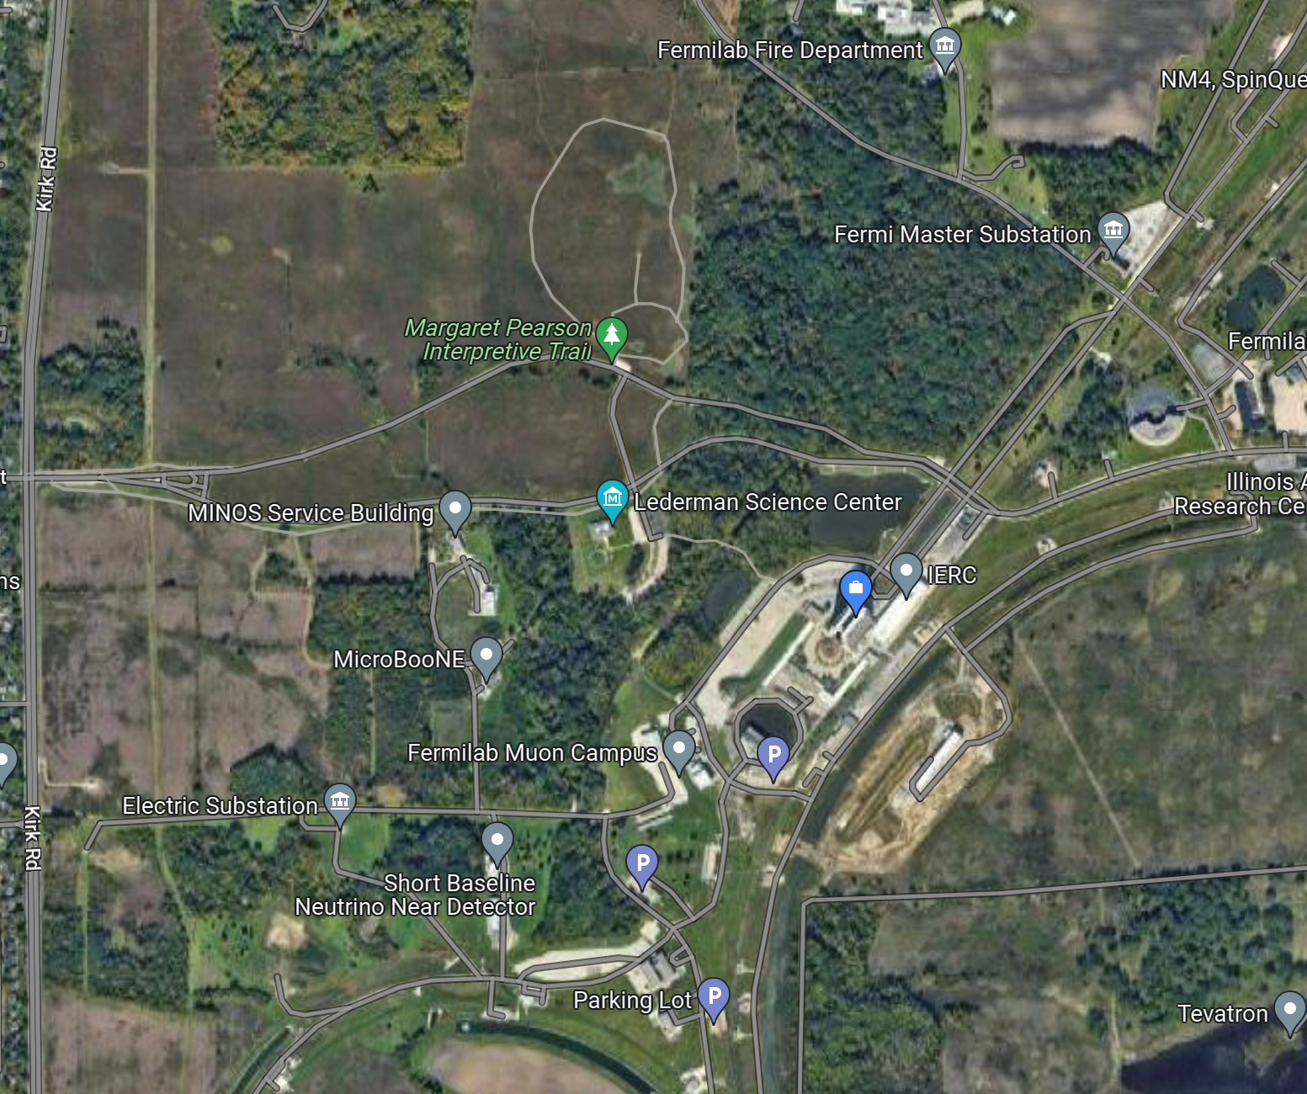
Parking Mitigations
IERC Parking lot will be open and available
Walkway from Lederman Science Center will be maintained open as much as possible, use will be coordinated as construction progresses
Shuttles can be run from CHL overflow parking to Wilson Hall

Slide 24
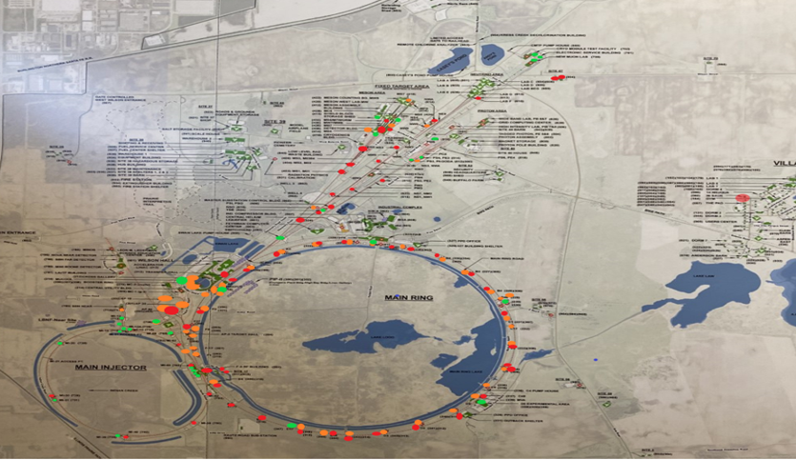
Parasitic Study: Wilson Hall Work
To the right highlights the current situation on roof conditions. RED (56 sites) indicates that a roof is end its life this year or has past is life already, YELLOW (53) indicates that it will end within the next 5 years, GREEN (50) indicates that a roof has at least 6 years of life left or more.
Current building roof Average Age 7.229 years over 159 buildings with 111 open roof repair WO’s in the system.
The ideal situation is to keep the roof age average between 9.25yrs to 10.50yrs to stay out of the danger zone.
ISD and Upper Management are working on a long-term plan to address this issue.

Slide 25
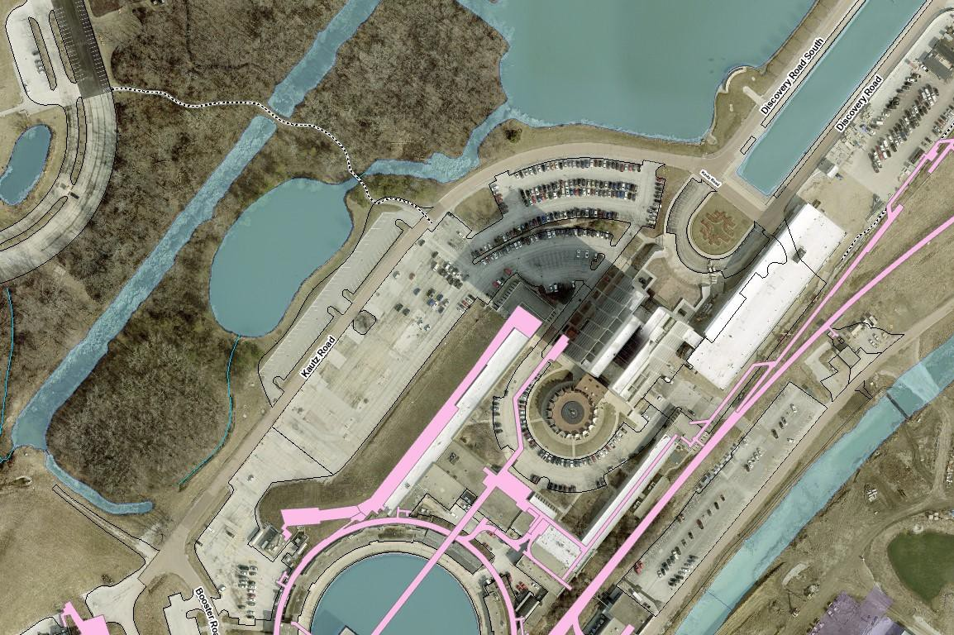
UPDATE: Loosely scheduled for the fall
Kautz Road Mill and Overlay new Pavement
Kautz Road Reconstruction and Grade change built first and in Phases, utilizing parking drive aisles to maintain traffic flow
Public Access Gate and Guard Booth Construction coordinated with Katz Road Construction
Kautz Road Mill and Overlay Constructed last and staged to maintain access
Wilson Hall West Parking Lot reconstruction coordinated with maintenance of traffic requirements and completed when Kautz Road work is complete.
Public Access Gate and Guard Booth
Wilson Hall West Parking lot
Reconstruction
Kautz Road Mill and Overlay new Pavement

Slide 26
Current Happening
And More…

Slide 27
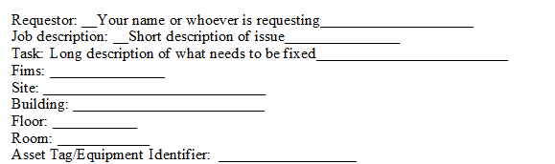
Current Happening
Office Maintenance/Painting in progress
Bird Removal Complete
Sent some projects out to rebid – In Progress
A few LED upgrades and E/E Light replacements are starting to happen. – In Progress
And More…
If requesting a WO we will be asking for the above information.

Slide 28
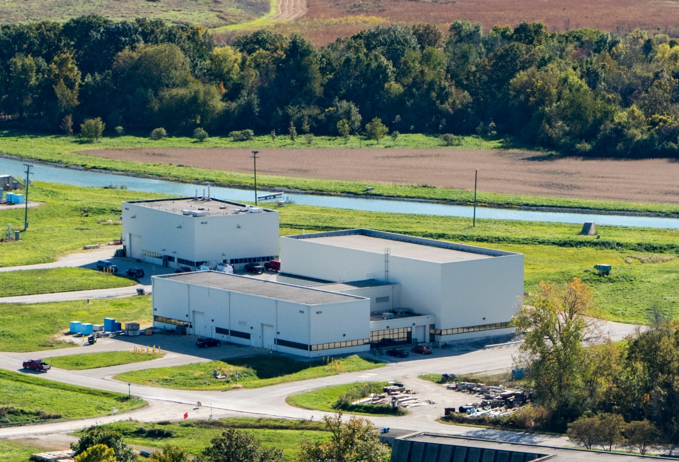
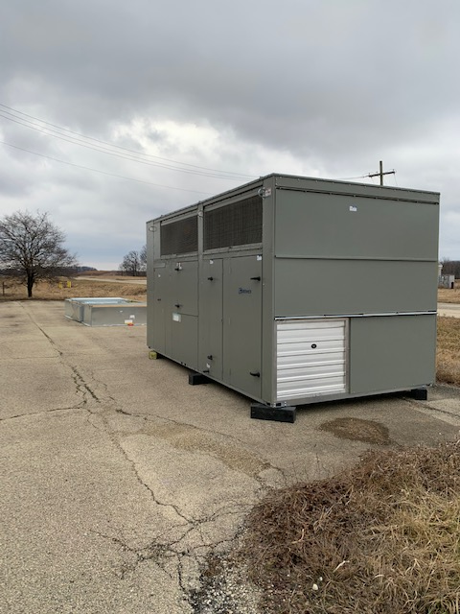
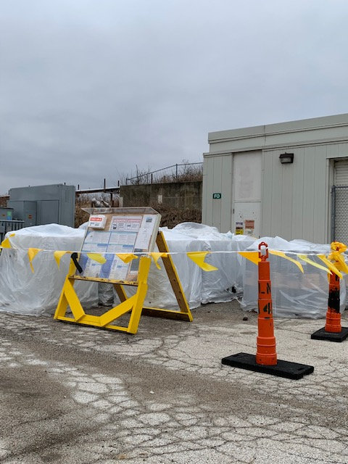
AP0
Items of Note
MCR utility tunnel hatch catchment system in place.
AP0 AC replacement project, materials delivered
F0 Roof replacement project, materials delivered. (Very)Tentative start date early March. Contractor working on submittals
F0

Slide 29
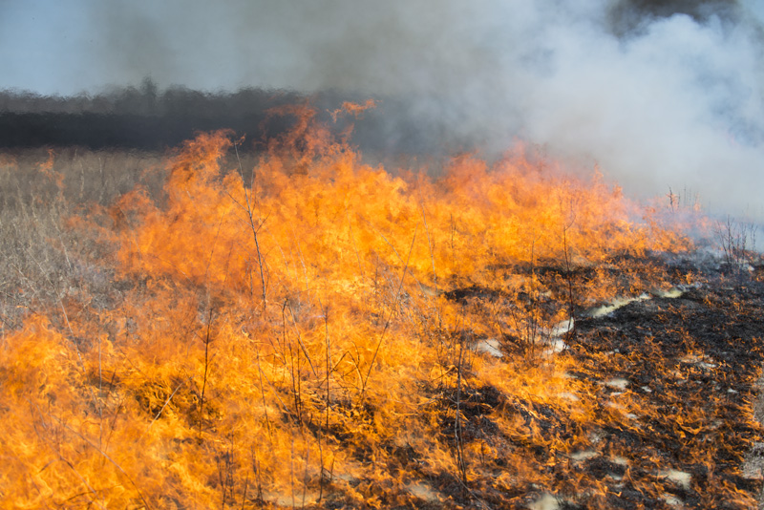
Prairie Burns
None Scheduled

Slide 30
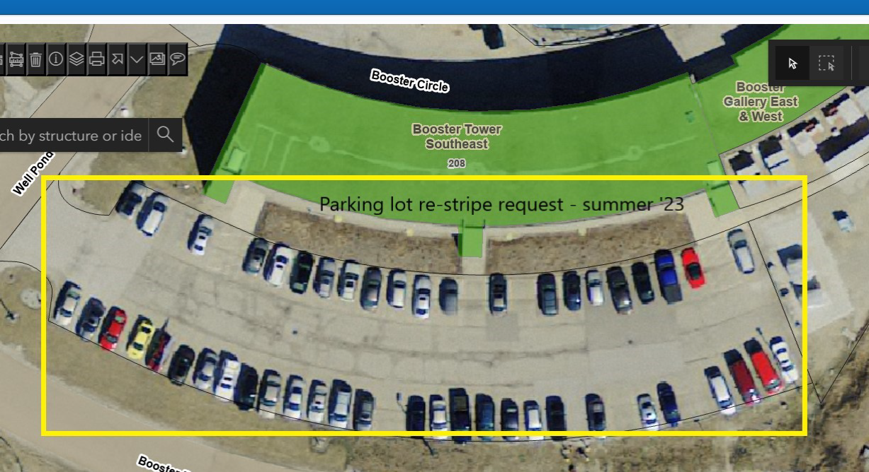
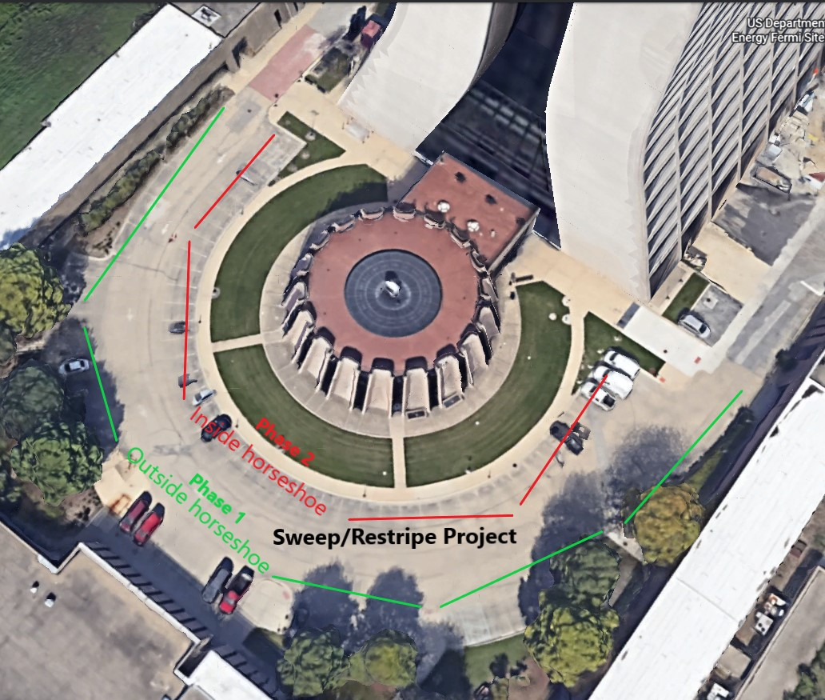
Integrated Engineering Research Center(IERC)
Lot Striping
Special Topic
Saturday – (tomorrow)
Weather permitting, we plan on striping the back of the auditorium parking along with all the other parking behind Wilson Hall.
We will also try to get to Booster Tower East

