Slide 1
PIP-II Weekly Report
22 September 2023
the PIP-II team

Slide 2
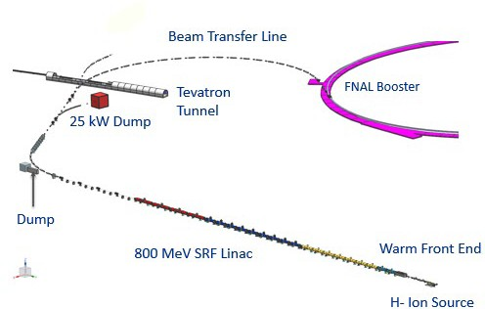
Introduction
PIP-II is an essential upgrade to Fermilab accelerator complex to enable the world’s most intense beam of neutrinos to LBNF/DUNE, and a broad physics research program for decades to come.
PIP-II Capabilities
Beam Power
PIP-II Scope
800 MeV H− SRF linac CW RF Operations
Linac-to-Booster transfer line Accelerator Complex Upgrades
Booster Recycler Main Injector
Conventional Facilities
Space reserved for two CMs for 1 GeV Upgrade
1.2 MW proton beam
Upgradeable to multi-MW
Flexibility, multi-user capability
CW-compatible
Customized beams
Multi-user delivery
Reliability
Modernizes Fermilab accelerator complex

Slide 3
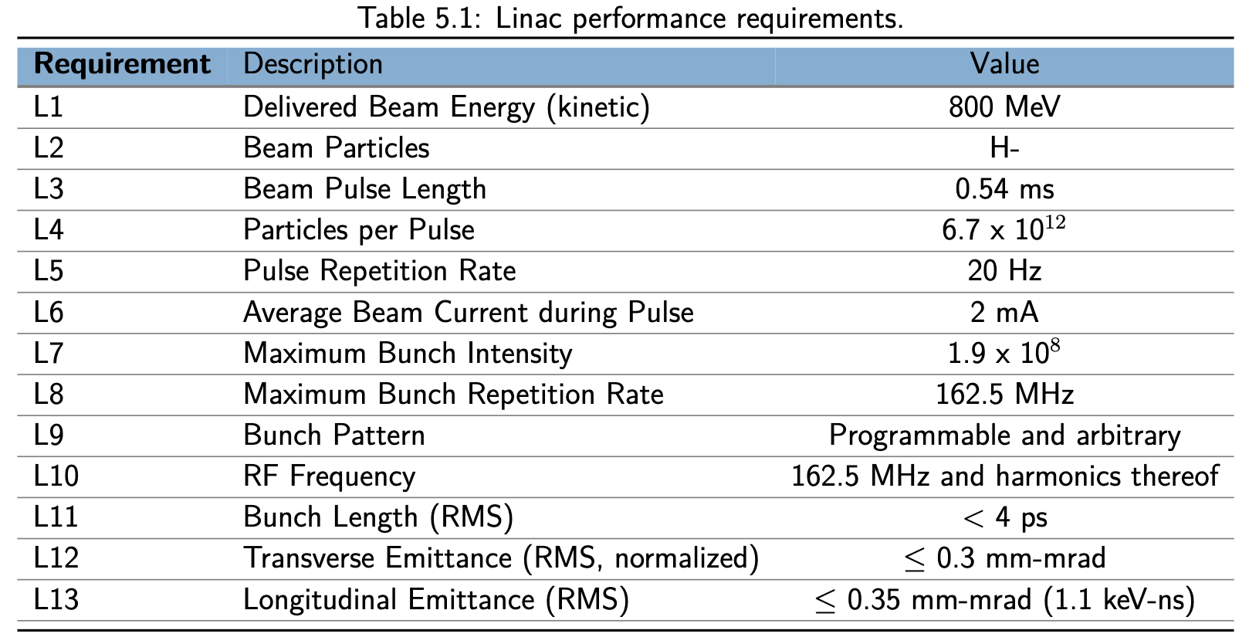
Parameters

Slide 4
