Slide 1
ACORN Update
Adam Watts
22 September 2023

Slide 2
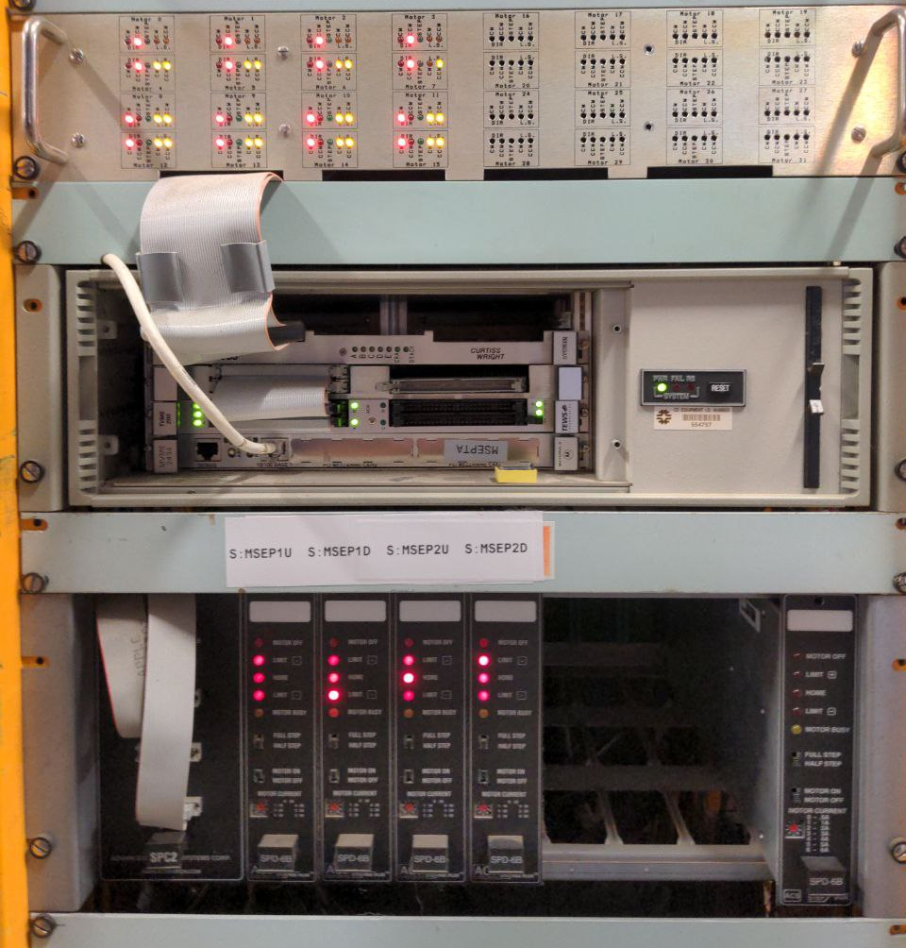
AD Motion Control
Very successful use of StepPak systems from ACS Scientific
Interface to ACNET requires VME crate, MVME processor card, VME mezzanine card, IP stepper modules
IP stepper modules discontinued
VME good for fast, “real-time” control, which isn’t necessary for most motor control applications
Issues with limit switch signal path, requires custom box (top of photo)for interfacing
Phasing out VME not specific ACORN focus, but good benefit

Slide 3
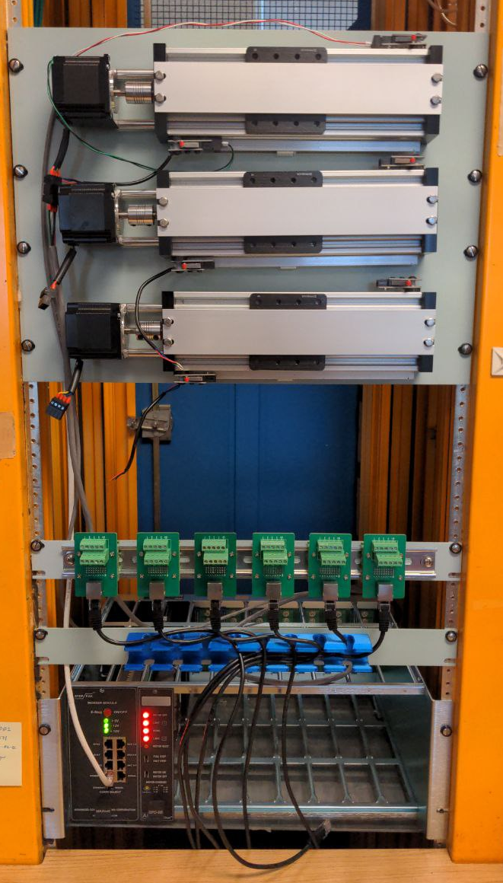
Motion Control Test Stand
Under 204.03 (Data Acquisition and Control) portion of the project
R&D to test and integrate new motor control systems into the control system
Dedicated, stand-alone motion tables with position sensors and limit switches
Test basic functionality and synchronization without using operational systems
Test operational spares
First test: ethernet-enabled, EPICS-compatible indexer for StepPak systems
Wiring management and EPICS IOC work ongoing

