Slide 1
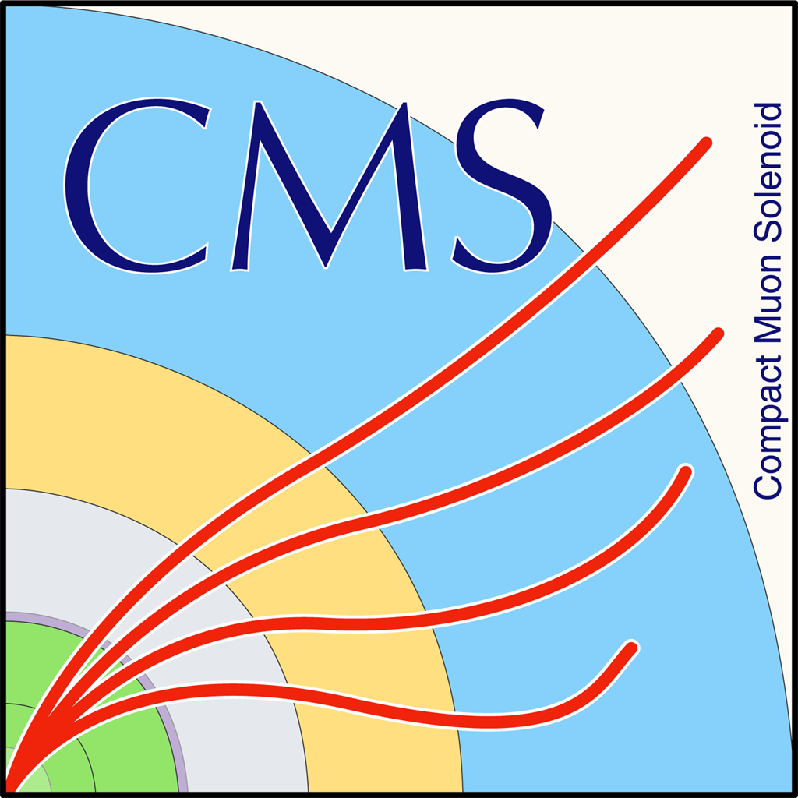
Trigger development for HGCAL’s cassette testing system for CMS experiment
Tinfena Mattia
Final presentation – Summer Italian internship
09/27/2023

Slide 2
Index
The LHC collider
The CMS experiment
The HGCAL – High Granularity CALorimeter
The testing system for the HGCAL’s cassette
Using an FPGA to substitute the meantimers

Slide 3
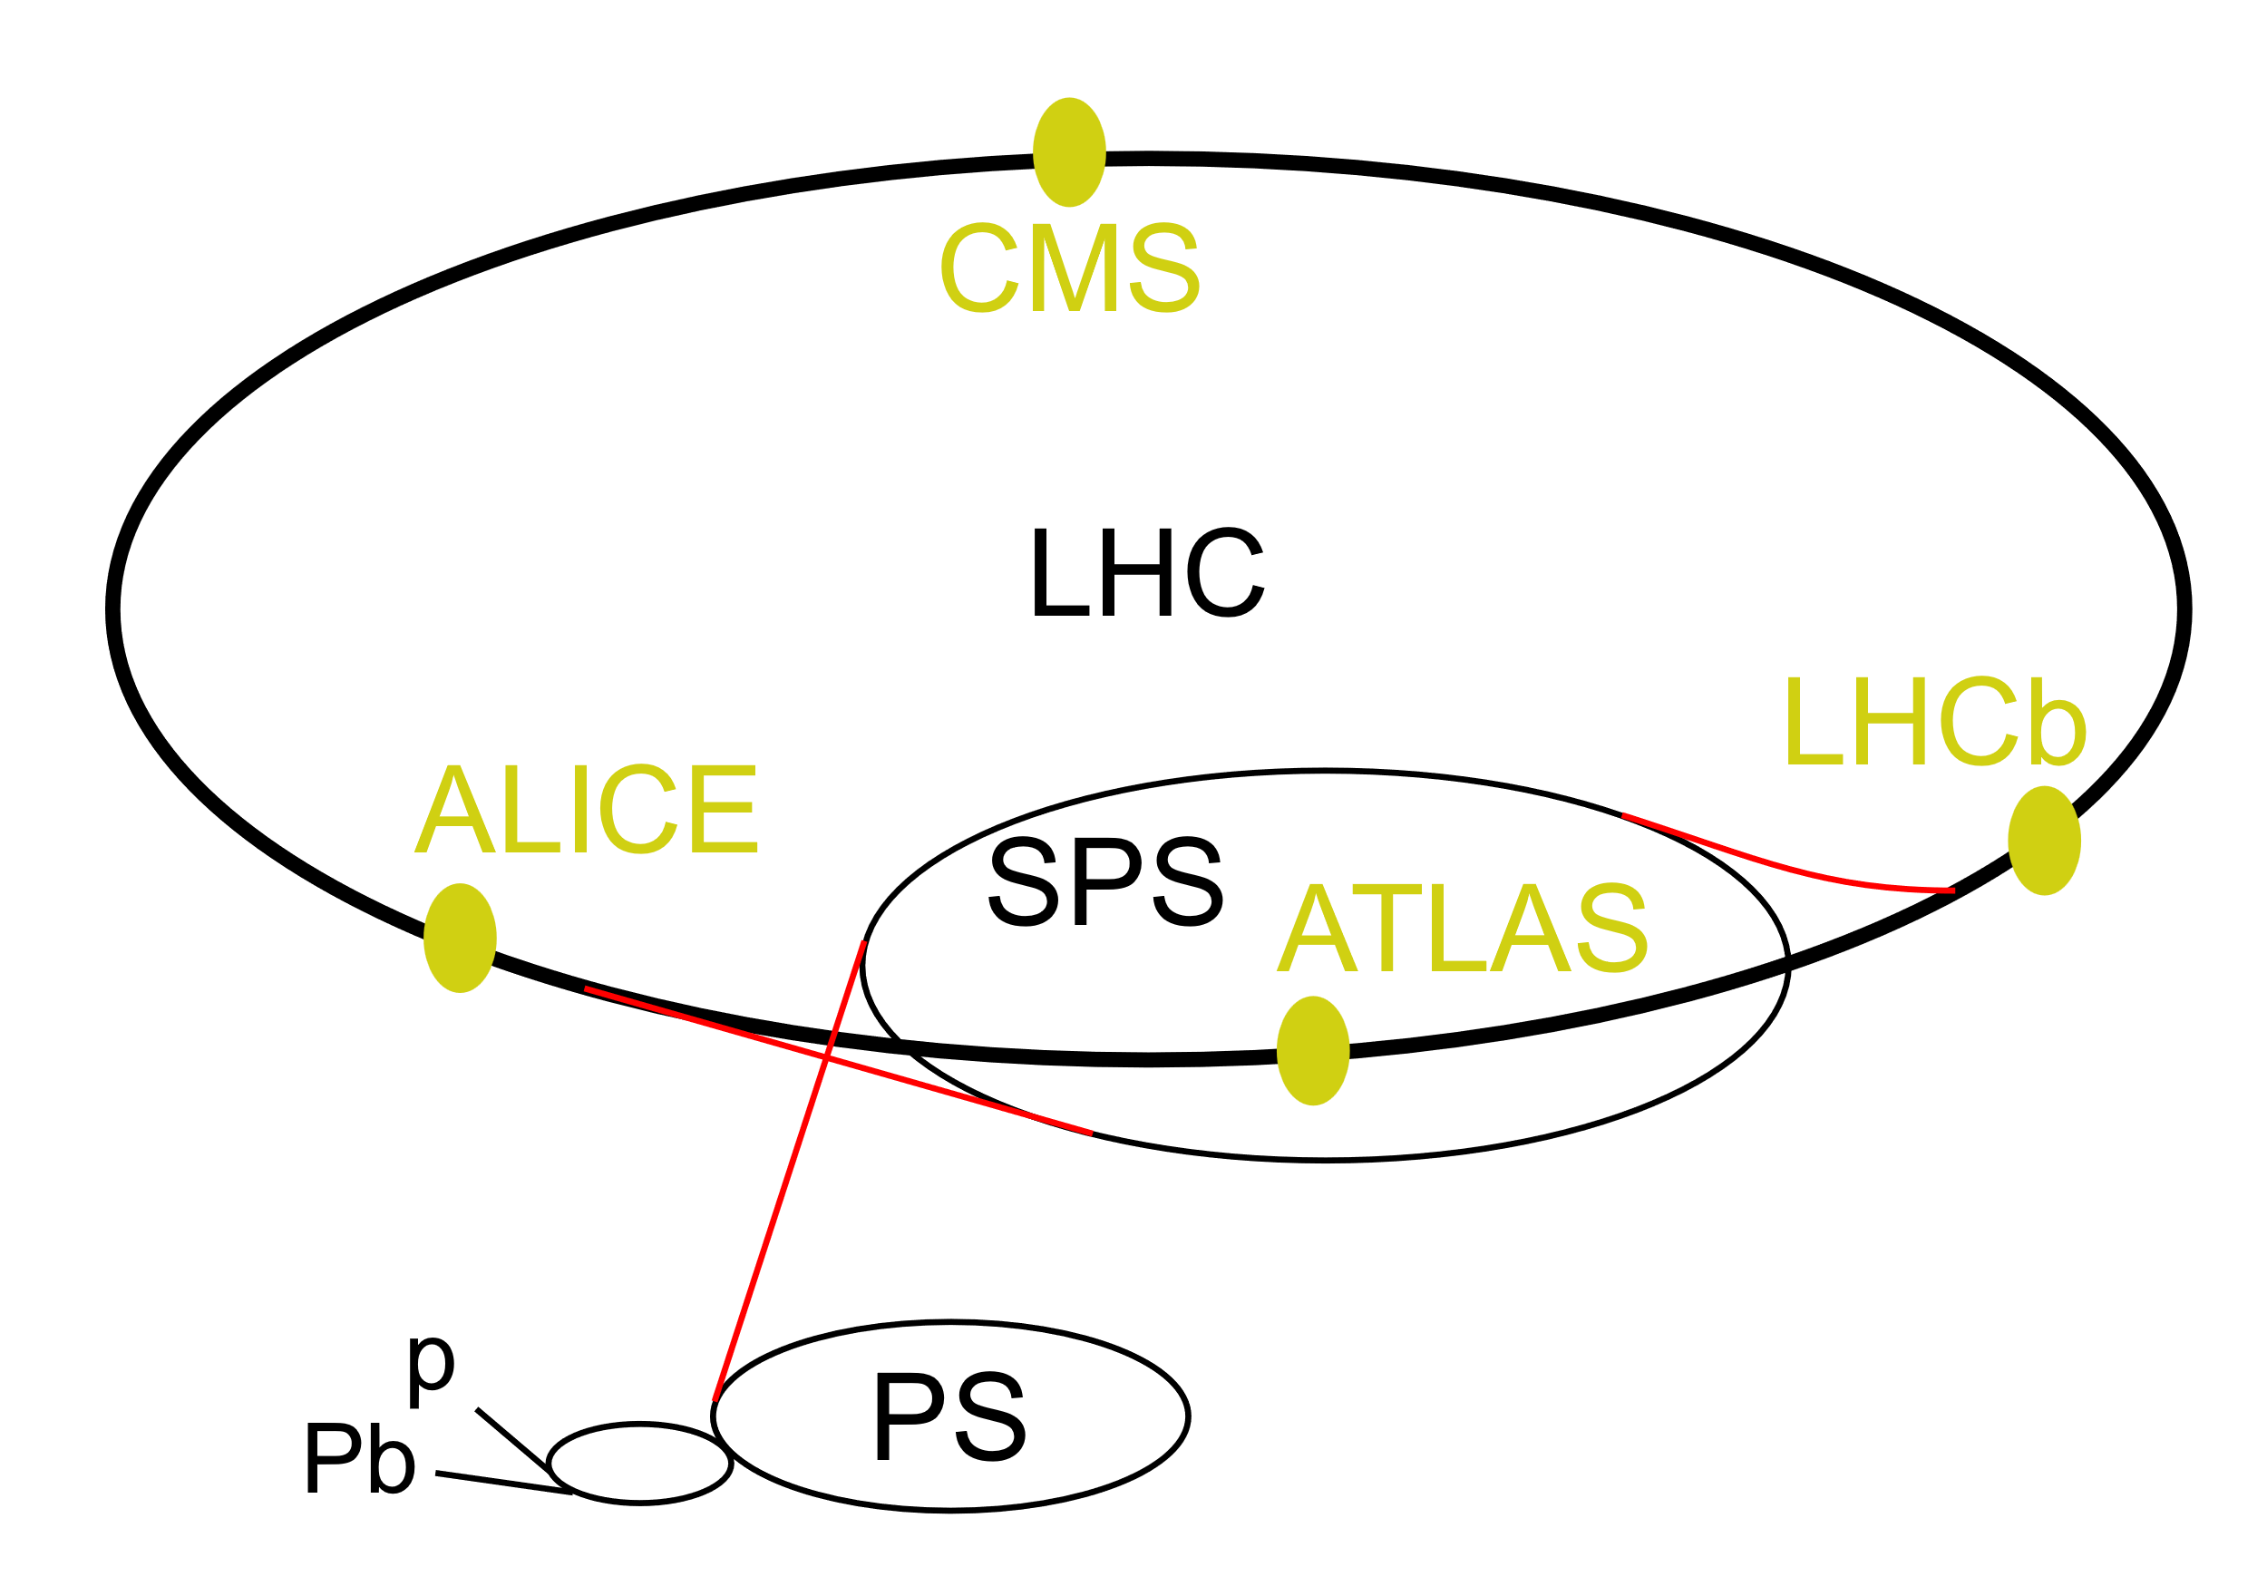
LHC – Large Hadron Collider
The world's largest and highest-energy particle collider.
17 mi in circumference
Deep 574 ft
Four crossing points where the accelerated particles collide.
Four detectors each designed to detect different phenomena:
ALICE
LHCb
ATLAS
CMS

Slide 4
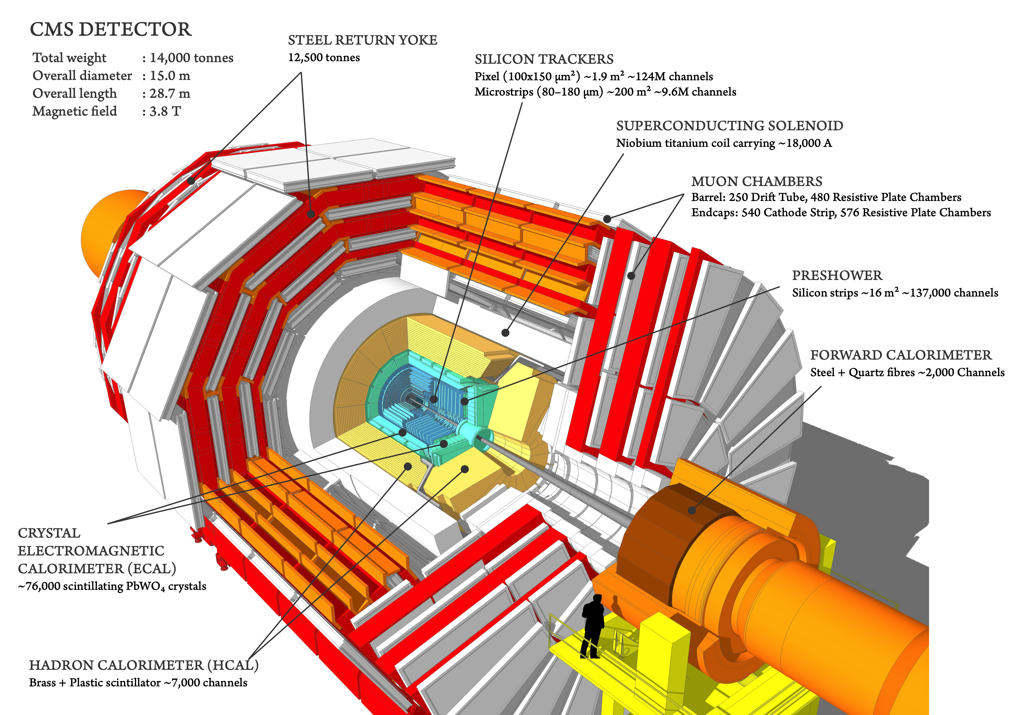
CMS experiment
The Compact Muon Solenoid (CMS) experiment is one of the two large general-purpose particle physics detectors.
The principal sensors that there are in the CMS are in the barrel and in the endcaps:
The tracker
The electromagnetical calorimeters
The hadronic calorimeters
The magnet
The muon detectors

Slide 5
CMS between past and future
CMS and ATLAS discovered the Higgs boson in 2012. But a lot of work still has to be done.
The main goals of the experiments are:
to explore physics at the TeV scale
to further study the properties of the Higgs boson
to look for evidence of physics beyond the standard model, such as supersymmetry, or extra dimensions
To do this a new version of the LHC (HighLuminosity-LHC) and the detectors are needed.

Slide 6
HL-LHC

Slide 7
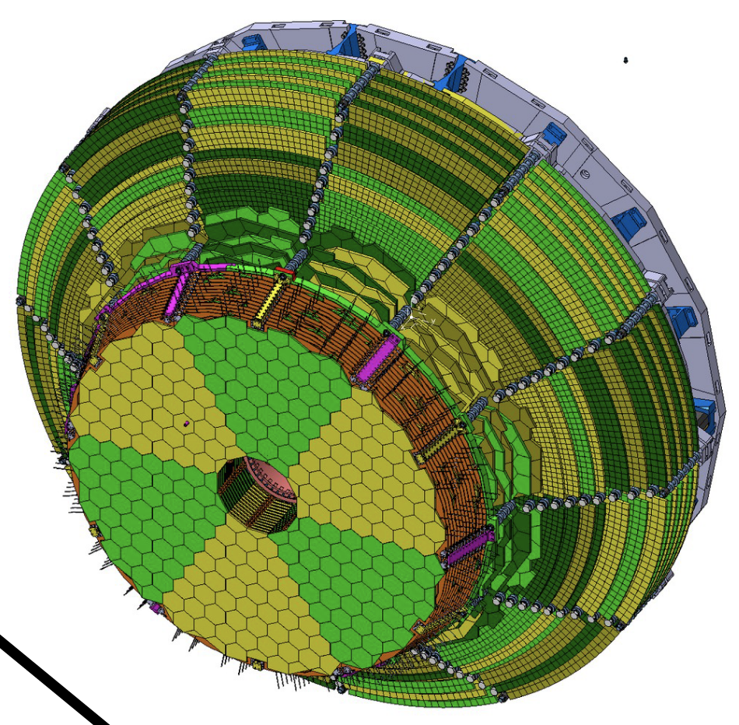
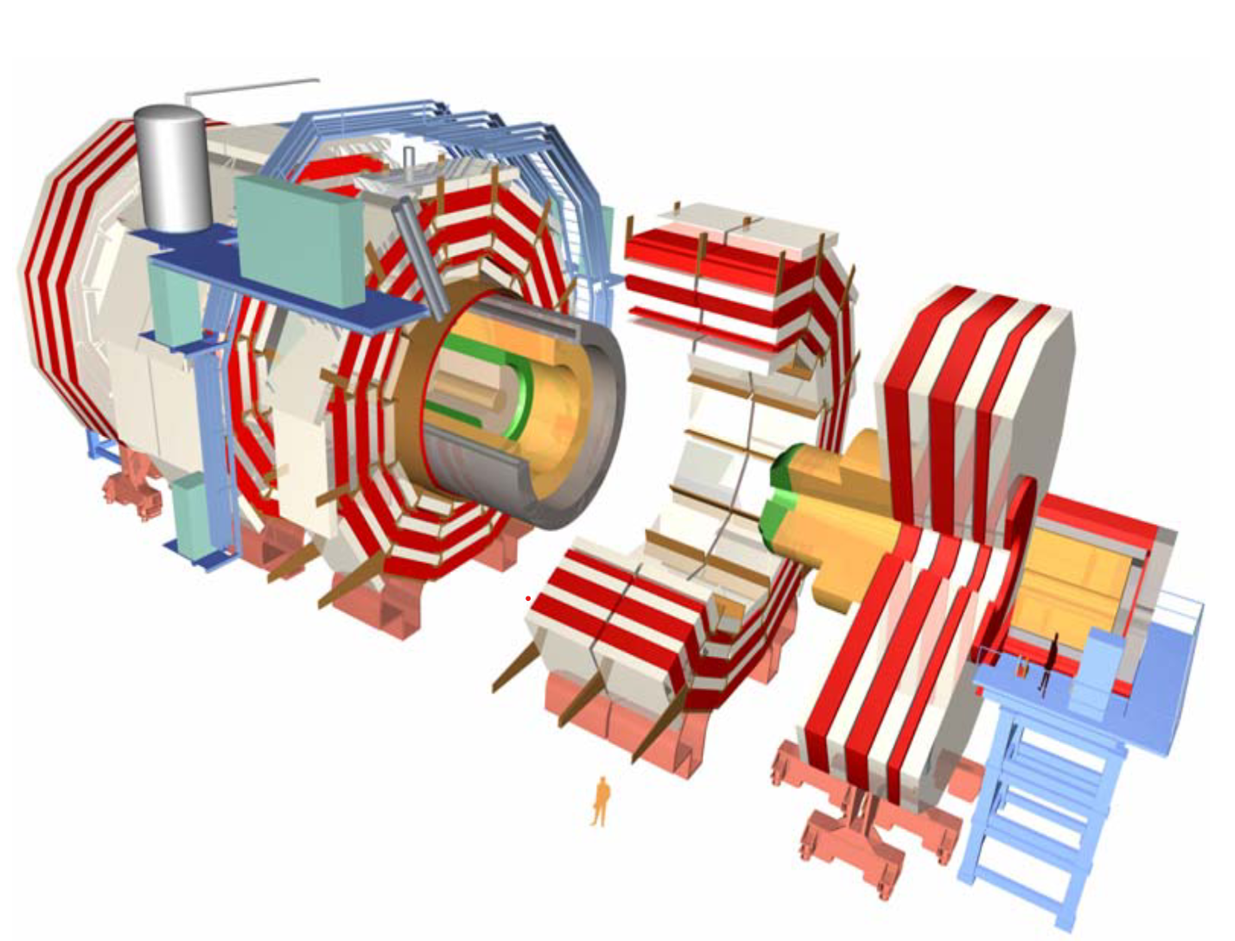
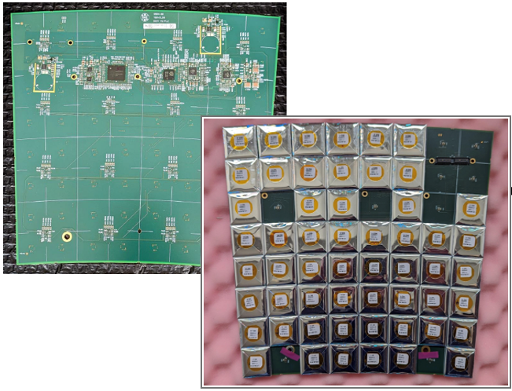
HGCAL - High Granularity CALorimeters
HGCAL
Cassette
Silicon sensors in the high radiation area
Plastic scintillators in the low radiation area

Slide 8
Cassettes production
All the 525 cassettes for the hadronic portion of the HGCAL are produced at the Fermilab and assembled in the SiDet facility.
The cassettes will be assembled in the Lab C where there are 4 assembling station and 2 cold rooms for long term testing.

Slide 9
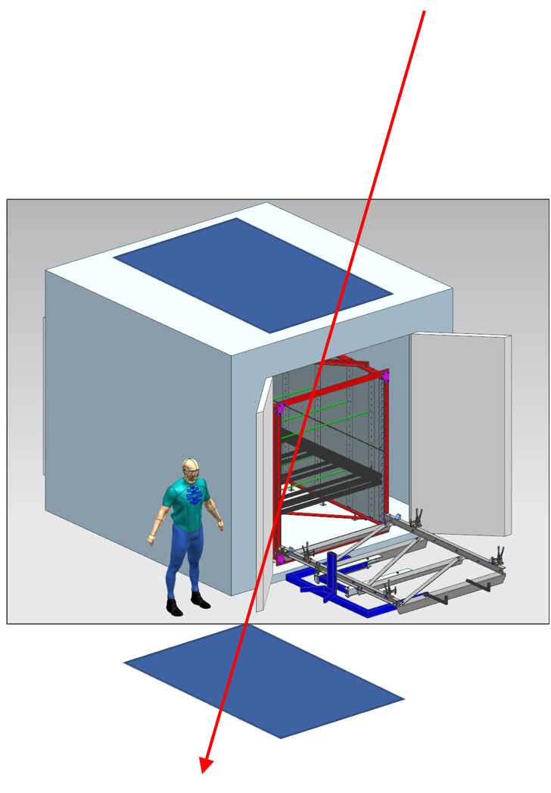
Cosmic Trigger System for Cassette Testing
The cassette burn-in test stand will have ~20 cassettes stacked and taking cosmic data for ~2 weeks
We plan to install 2 planes of scintillators, above and below the cassettes to detect cosmic events and trigger the recording of the corresponding Trigger and DAQ events

Slide 10
Trigger features
Time resolution:
The time resolution requirement is driven by the need to trigger the right edge of the 40MHz clock (~25ns)
But we could try to resolve the pulse shape of the HGCROC, so 1--5ns
Spatial resolution:
Knowledge of the exact muon path is not needed for triggering
The system upgrade to allows the offline analysis using the x-y location of the scintillator trigger hit should be too expensive
So, we do not need spatial resolution in the scintillator trigger, 1 channel per layer is enough

Slide 11
Technology adopted
The single channel requirement allows using a single slab of scintillator or an array of extruded scintillators with WLS fibers merged on one PMT
The 1-5ns timing requirement must be compared to the size of the plane 5m/(0.2m*ns)= 25ns
Using 2 PMTs allows to calculate the mean time of arrival
The mean time of arrival is independent of the location of the hit along the WLS fiber
It appears the hit is always in the middle of the fiber, regardless of the true origin
This eliminates the 10ns uncertainty

Slide 12
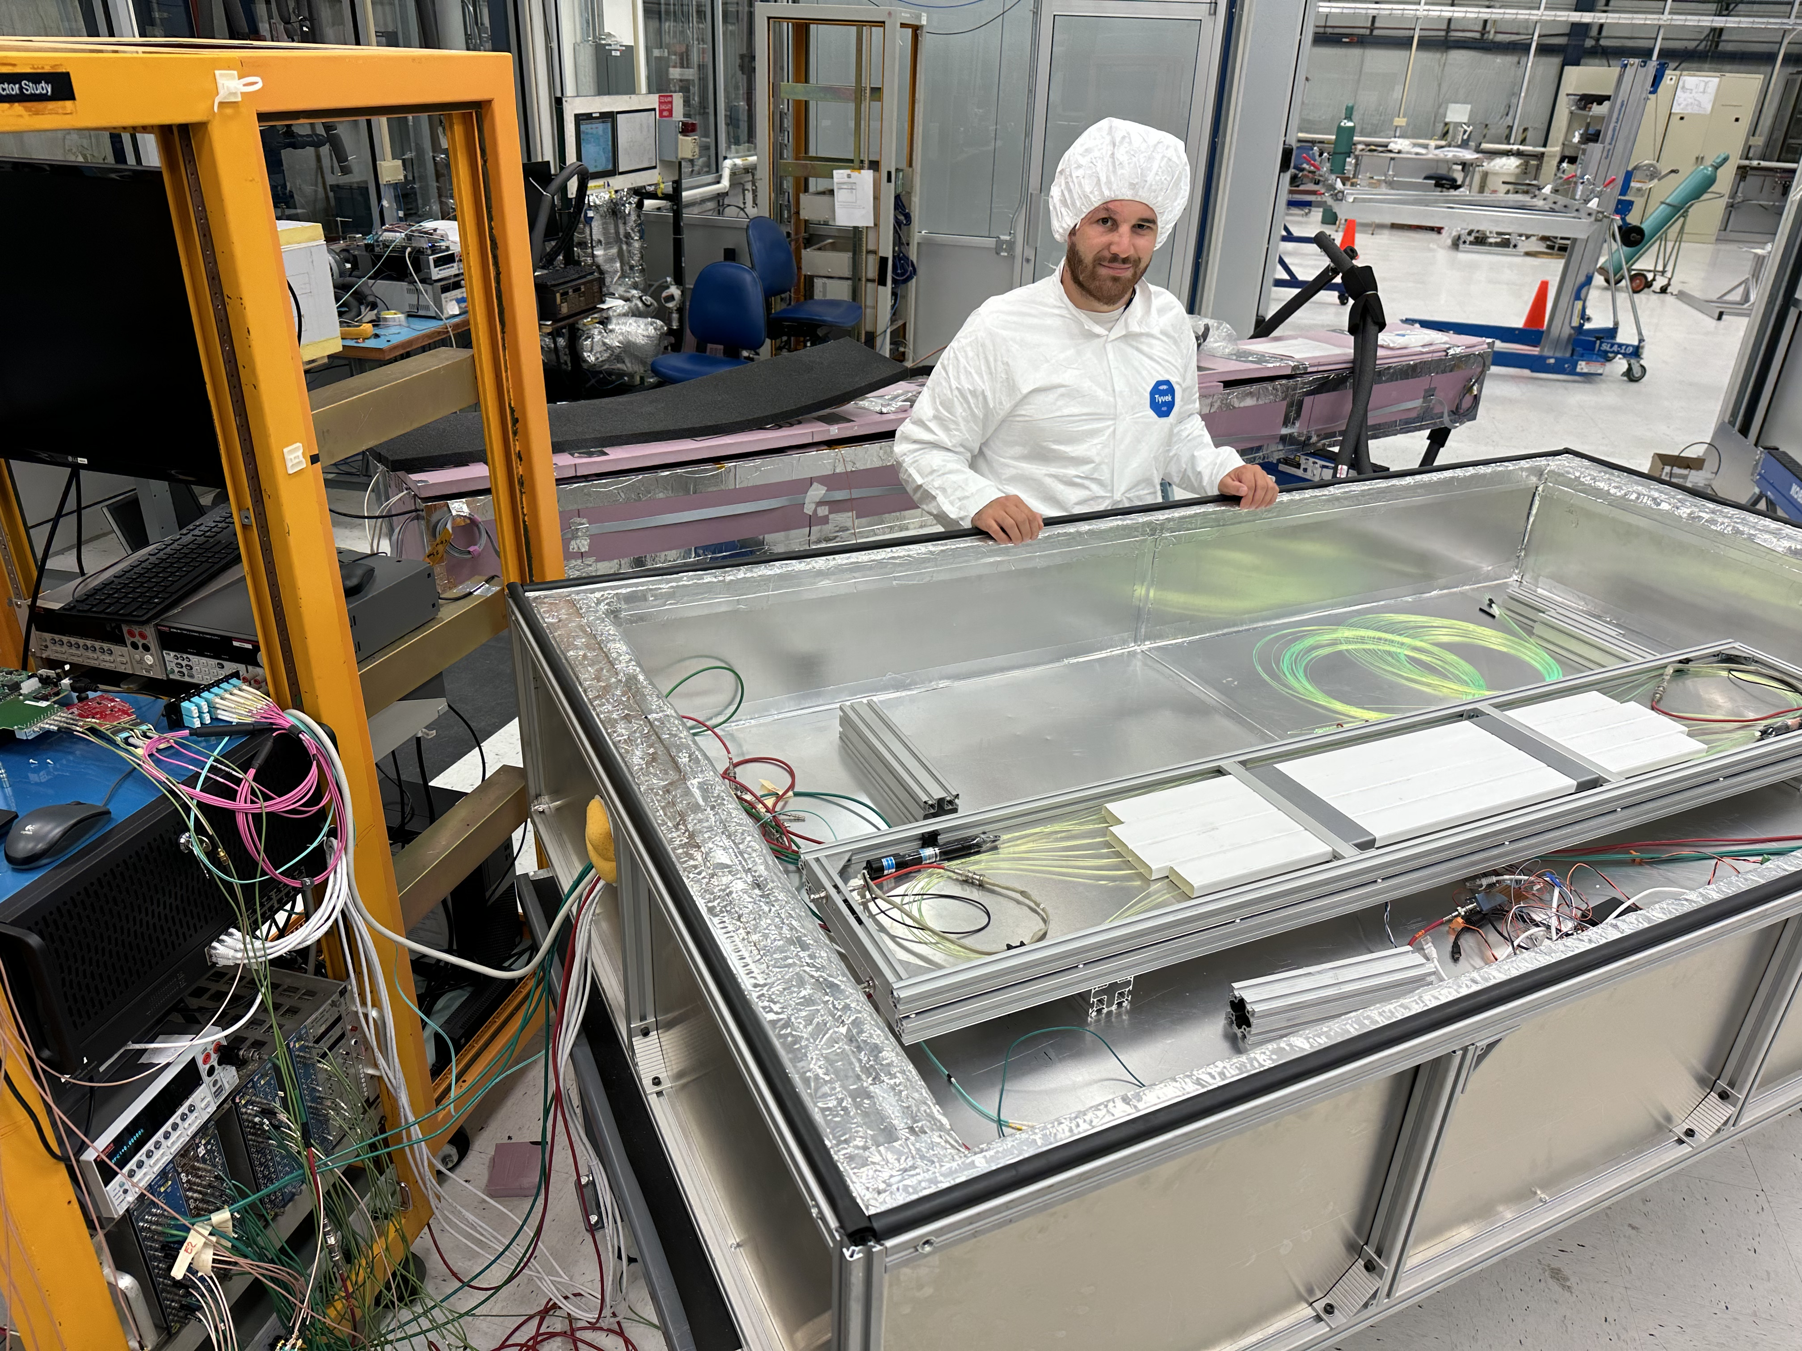
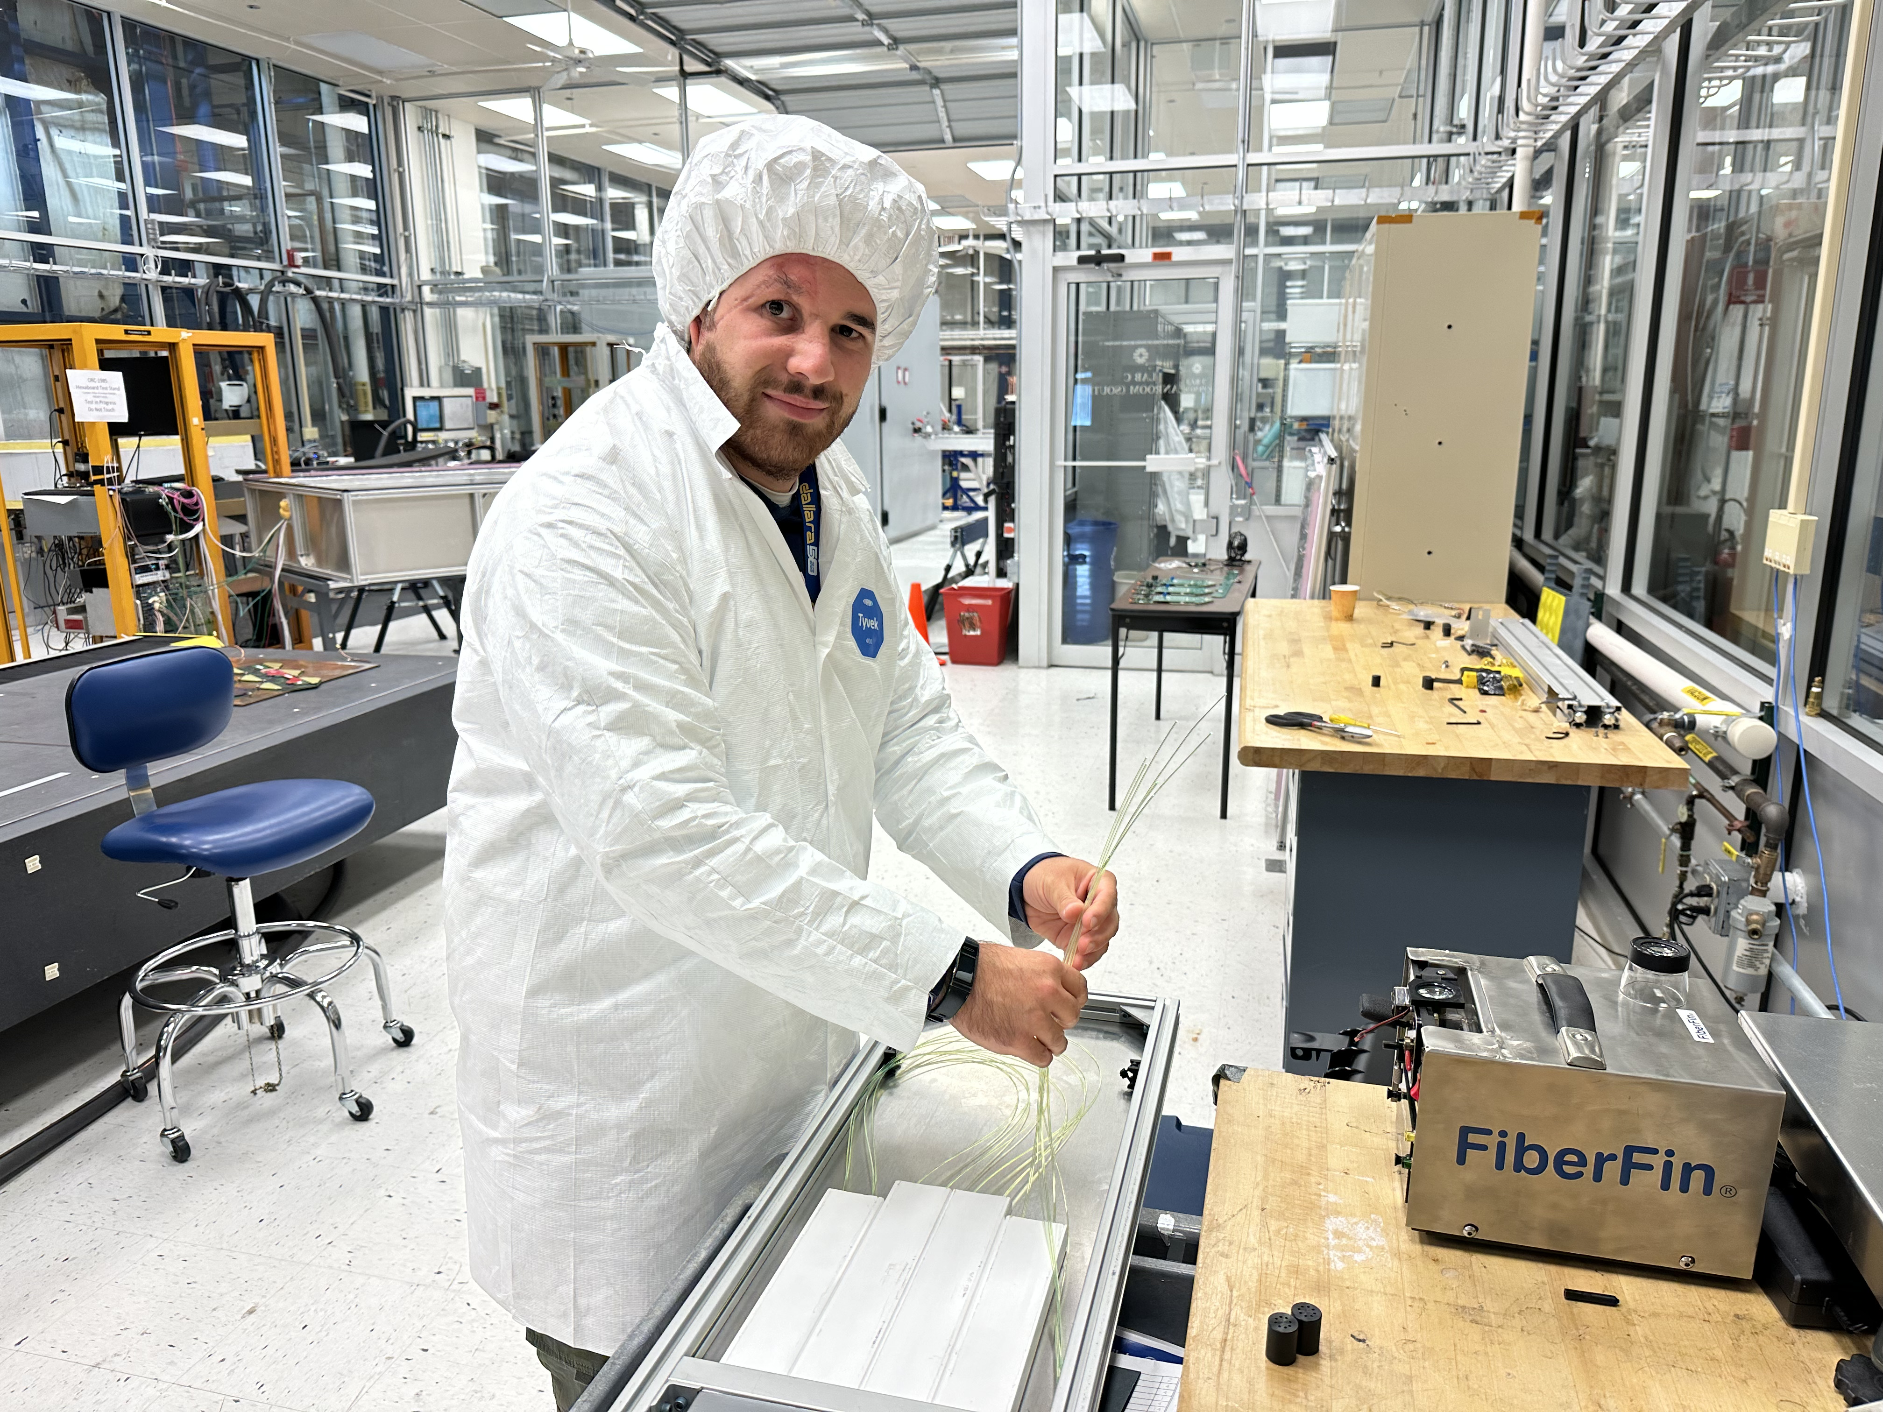
Testing system for the HGCAL’s cassette

Slide 13
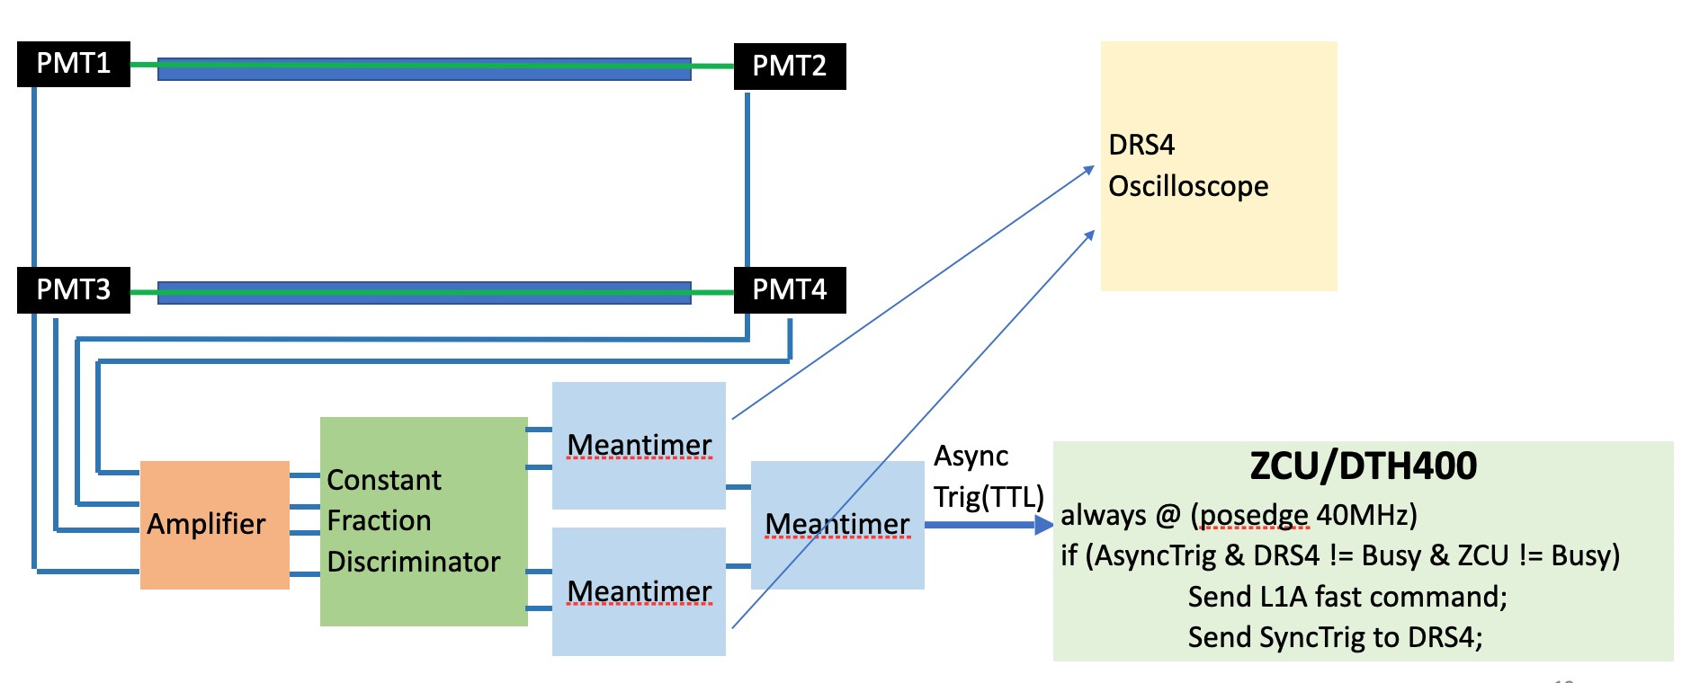
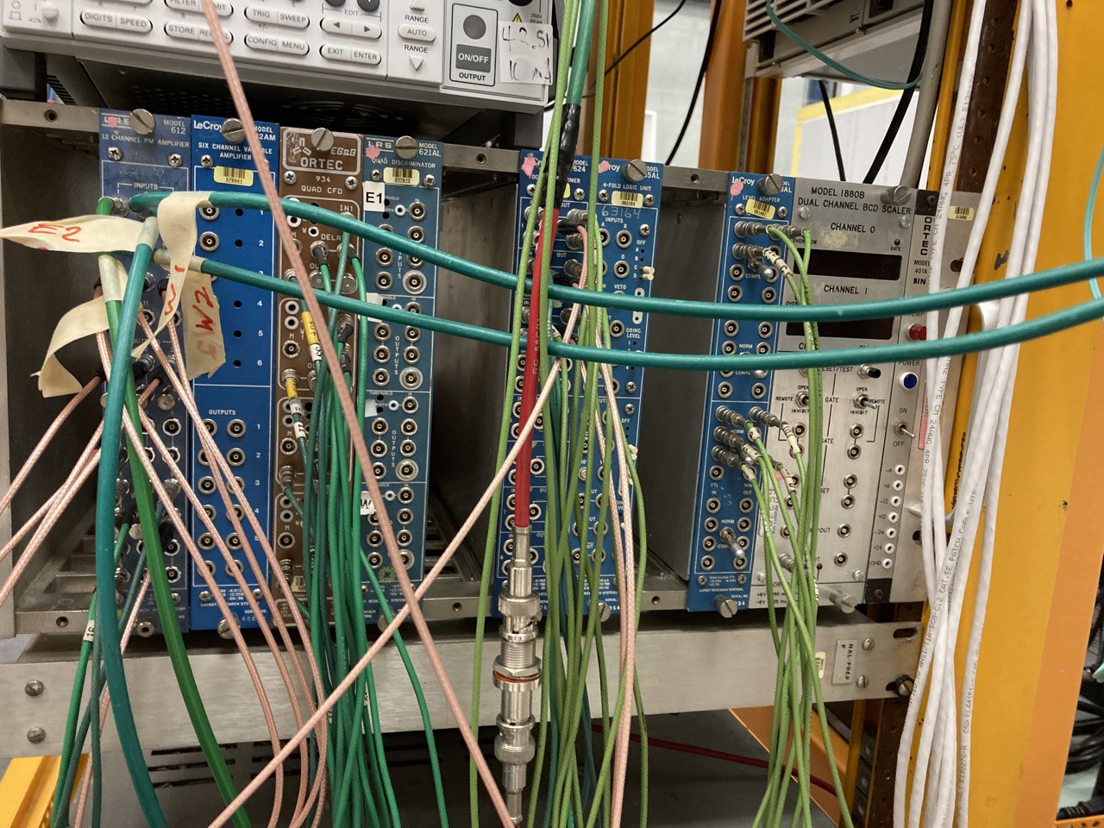
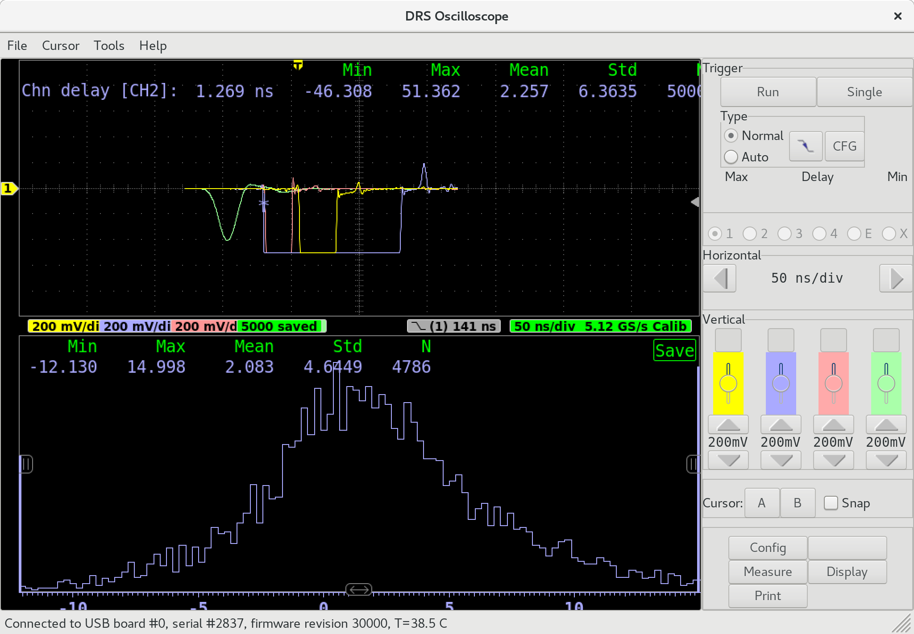
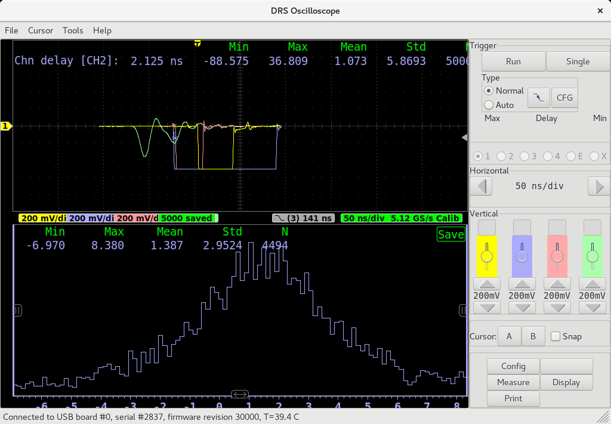
Testing system for the Fibers
Old fibers
New fibers

Slide 14
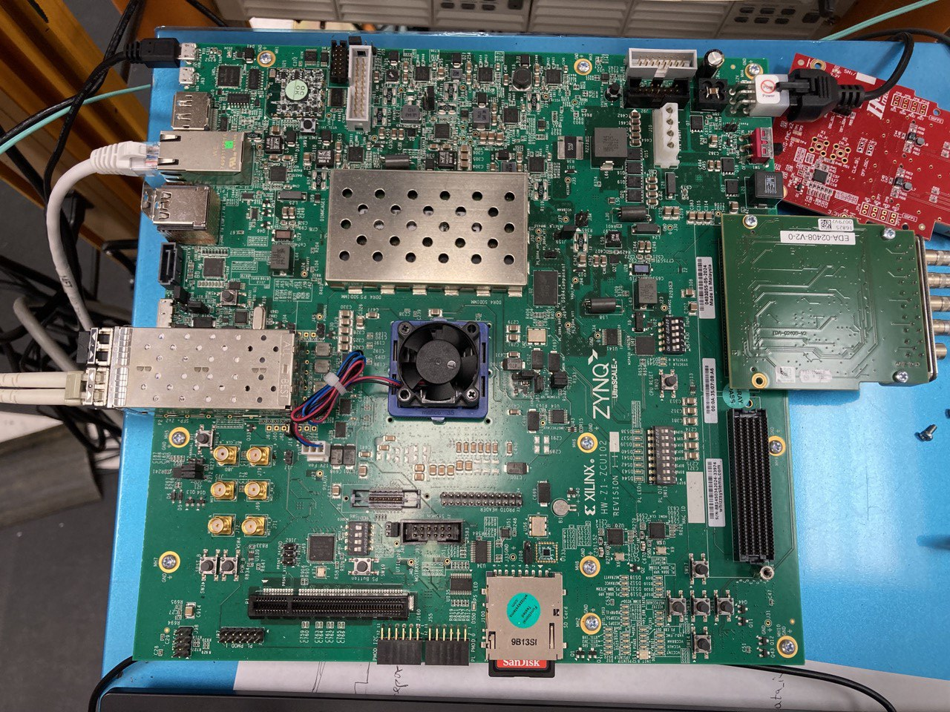
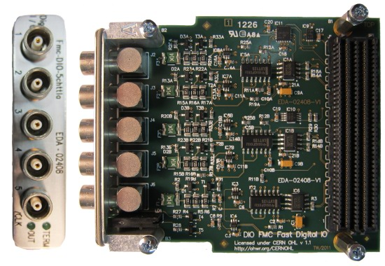
Actual testing system for the HGCAL’s cassette

Slide 15
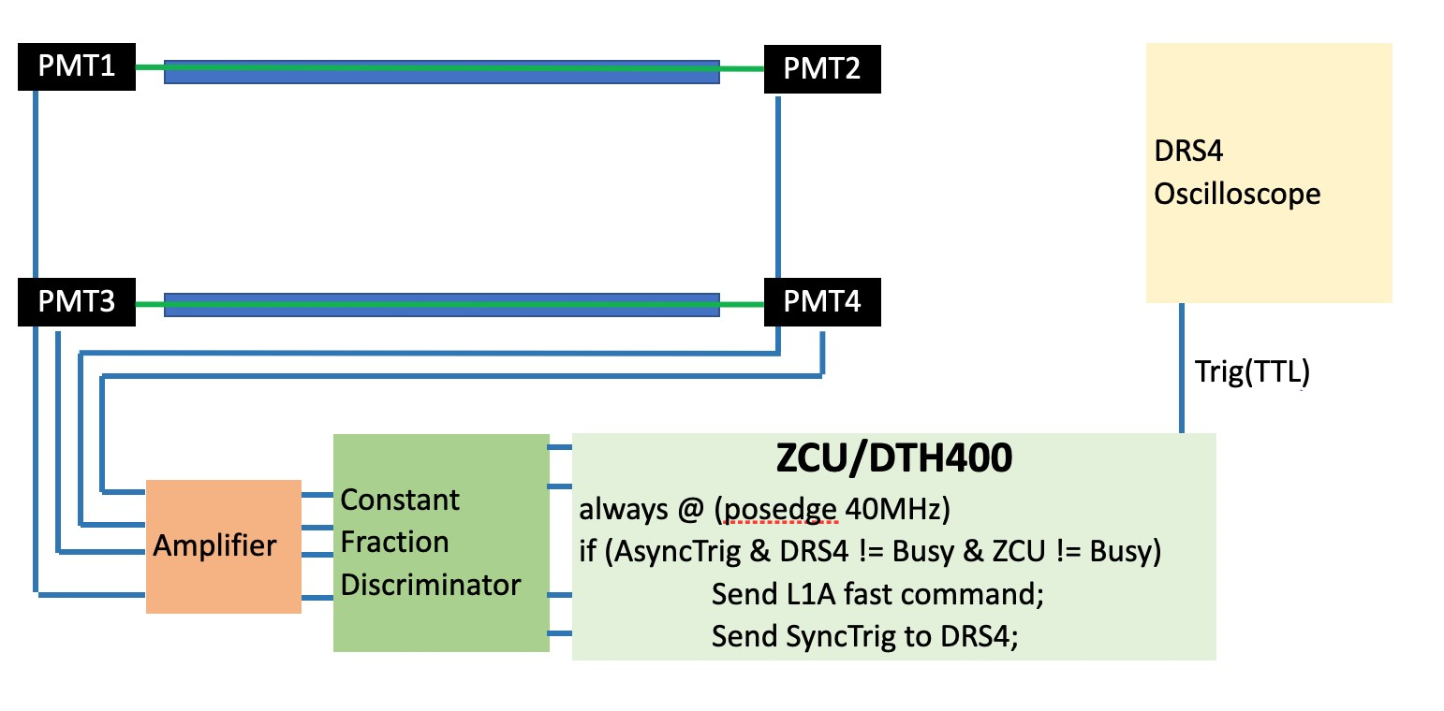
My Project Goal
Using an FPGA we can compute the meantime directly from the CFD, in this way we have 4 slower inputs instead of 1 faster and we can use the PMOD interface
Kria KR260 FPGA board

Slide 16
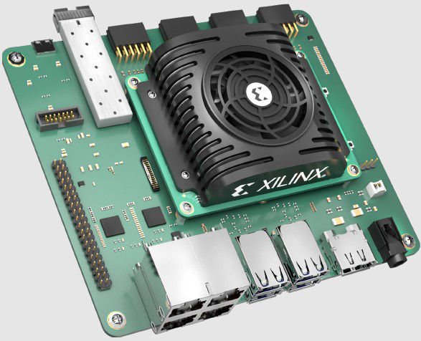
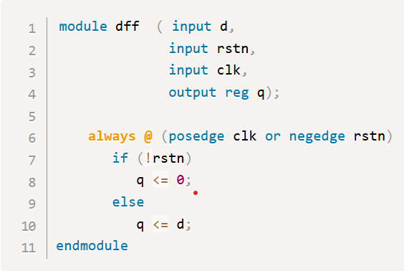
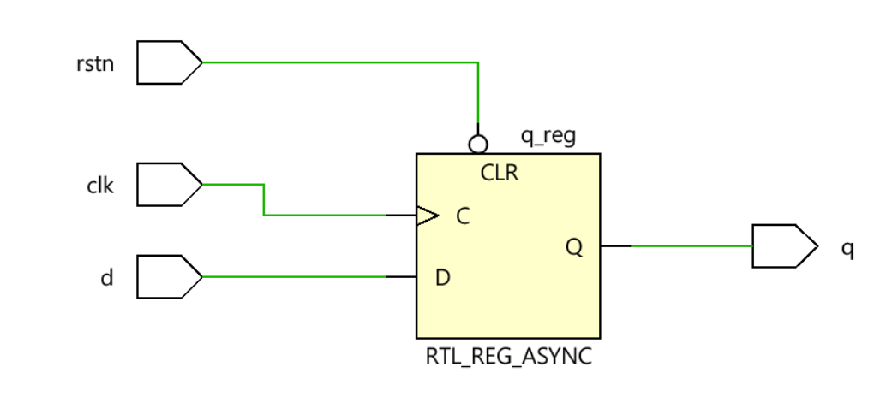
Xilinx FPGAs and Vivado suite
The FPGAs – Field Programmable Gate Array are electronics devices that contain configurable logic blocks and a set of programmable interconnects that allow the designer to connect blocks and configure them to perform everything from simple logic gates to complex functions.
FPGAs are programmed in Verilog that is an Hardware Description Language, a textual format for describing electronic circuits and systems
FPGAs are generally used for:
Hardware prototyping
Hardware acceleration
Space avionics
Neural networks
Data acquisition

Slide 17
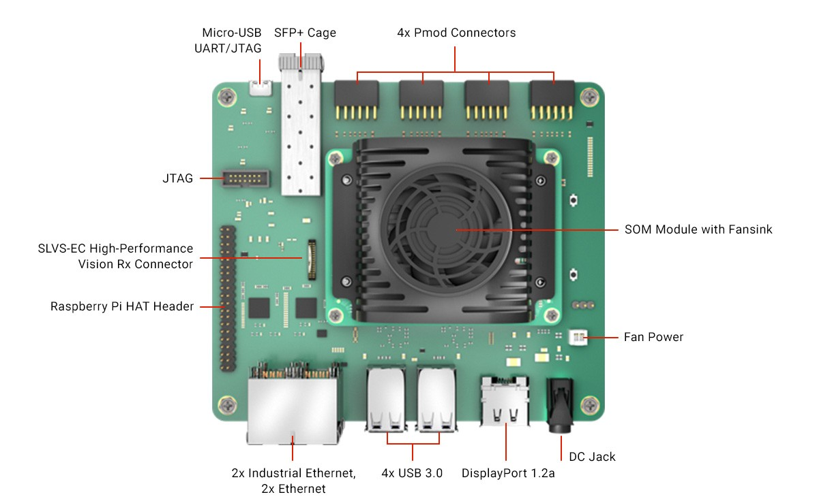
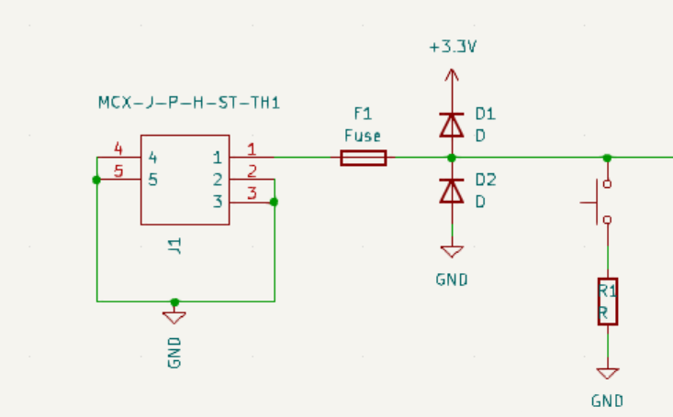
The Kria KR260 board
First, we built an input board to test the system using a breadboard

Slide 18
Firmware
1@1.28GHz
32@40MHz
Input 1
Deserializer
Edge Detector
5@40MHz
1@1.28GHz
32@40MHz
Input 2
Deserializer
Edge Detector
5@40MHz
Serializer
Oscilloscope
Meantime computation
1@1.28GHz
32@40MHz
Input 3
Deserializer
Edge Detector
Disk
5@40MHz
1@1.28GHz
32@40MHz
Input 4
Deserializer
Edge Detector
5@40MHz

Slide 19
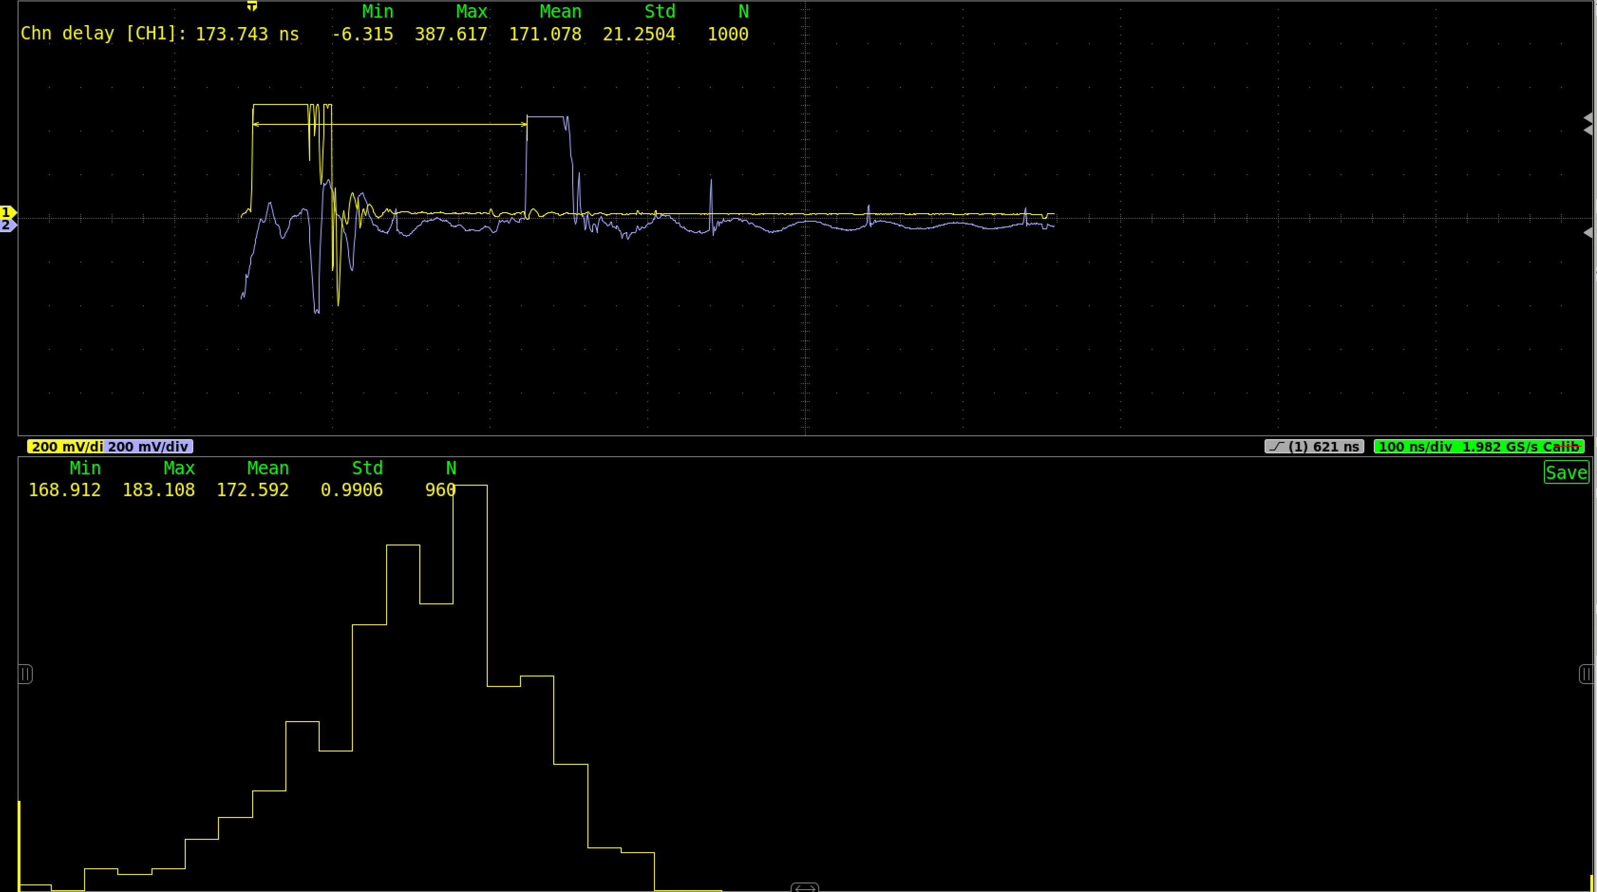
First tests
The first tests were encouraging because we had a standard deviation less than 1ns but we had a lot of noise on the output caused by the crosstalk

Slide 20
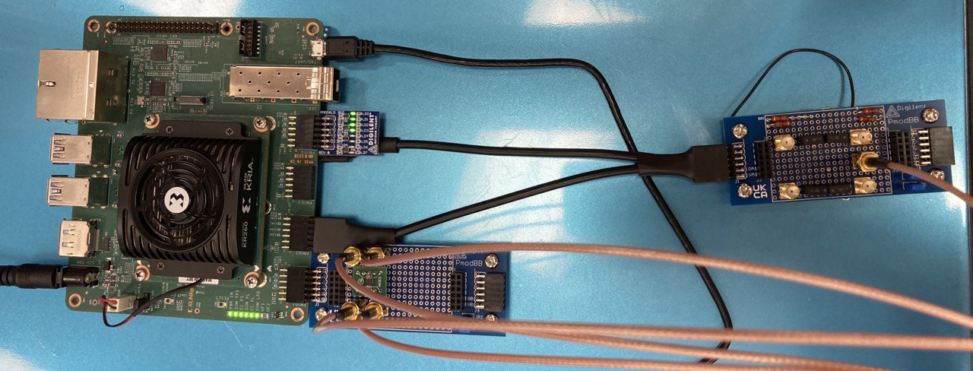
Solving the crosstalk problem
To solve the crosstalk, we improved the board design with only the 4 inputs, and we used the old board in one separate PMOD connector for the output

Slide 21
Solving the crosstalk problem

Slide 22
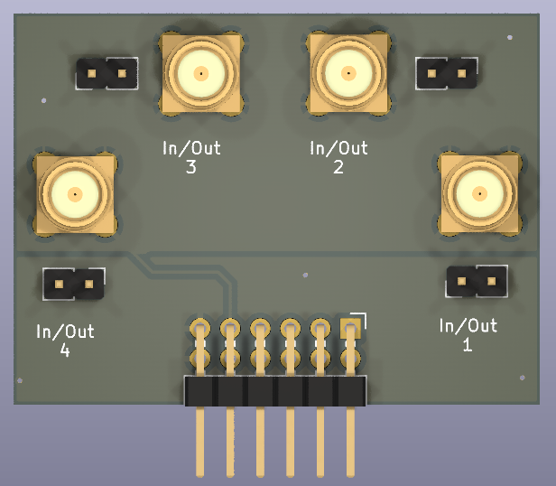
PCB development
I designed a PCB for the final project that will be produced and tested, and I’ll include the results in the final report

Slide 23
Summary
I really enjoyed this internship for the following reasons:
I had hands-on experience with all aspects of developing a trigger system
I assembled the scintillator trigger planes with WLS (wave length shifting) fibers and connected to PMTs
I connected the trigger planes to the NIM logic system
I developed a PMOD interface card to bring the signals to an FPGA board
I learned how to program FPGA with the Vivado suite and the SystemVerilog language
I developed the firmware to compute the meantime of the input signals
Tested the system and obtained good results

Slide 24
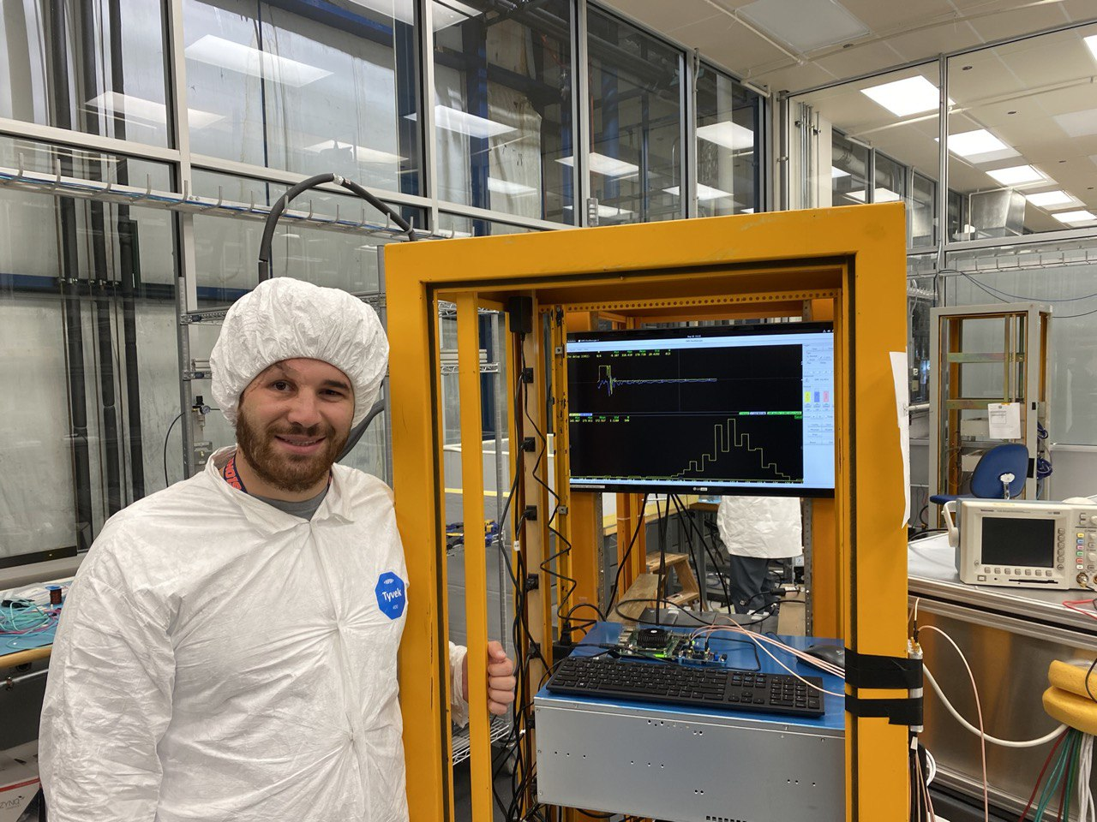
Thank you for your attention Any question?

Slide 25
Bibiography
[1] “HGCROC3-Si Datasheet”
[2] “Cosmic Trigger System for Cassette Testing”, Zoltan Gecse
[3] “Status and Overview of the CMS HGCAL”, Zoltan Gecse

