Slide 1
Low-latency quantum control using AI algorithms
on cryogenic microelectronic platforms
Marco Russo
Gabriel Nathan Perdue
Final presentation

Slide 2
Introduction
A qubit is the quantum equivalent of a bit
Instead of just 0 and 1, superposition:
$${\left|q\right\rangle }_{i}=α_{i}{\left|0\right\rangle }_{i}+β_{i}{\left|1\right\rangle }_{i}$$
$$\left|0\right\rangle ={\left(\begin{matrix}1 & 0\end{matrix}\right)}^{T}, \left|1\right\rangle ={\left(\begin{matrix}0 & 1\end{matrix}\right)}^{T}$$
$$α_{i},β_{i}∈ℂ → {\left|q\right\rangle }_{i}∈{ℋ=ℂ}^{2}$$
$${\left|α_{i}\right|}^{2}+{\left|β_{i}\right|}^{2}=1 ∀i$$
Defining $ℋ^{∗}=\{\left\langle f\right| :ℋ→ℝ\}$:
$\left\langle x\right| (|y⟩)=\left\langle x\right|y⟩={\left|x\right\rangle }^{\text{†}}|y⟩$
Norm of a state $|ψ⟩$ is $\left\langle ψ | ψ\right\rangle =1$
When putting n qubits together:
$$\left|ψ\right\rangle ={\left|q\right\rangle }_{n−1 }⊗…⊗{\left|q\right\rangle }_{0}∈ℂ^{2^{n}}$$
$${\left|ψ\right\rangle }_{AB}$$
$$z_{1}$$
$$z_{2 }$$
$$z_{3 }$$
$$z_{4 }$$
$${⟨ψ|}_{AB}$$
$$z_{1}^{∗} z_{2}^{∗}{ z}_{3}^{∗}{ z}_{4}^{∗}$$

Slide 3
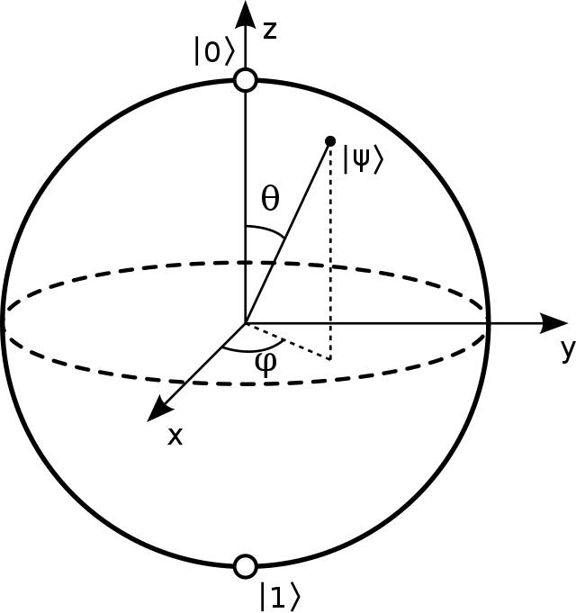
Introduction
Rotation $U_{\hat{n}}\left(ξ\right)=e^{−\frac{iξ}{2} \hat{n}⋅\vec{σ} }$along any axis $\hat{n}$can be expressed as
$$U\left(γ,θ,φ\right)=R_{z}\left(γ\right)R_{x}\left(θ\right)R_{z}\left(φ\right)$$
$$R_{z}\left(φ\right)= \left(\begin{matrix}e^{−\frac{iφ}{2}} & 0 \\ 0 & e^{+\frac{iφ}{2}}\end{matrix}\right), R_{x}\left(θ\right)=\left(\begin{matrix}\cos\left(\frac{θ}{2}\right) & −i\sin\left(\frac{θ}{2}\right) \\ −i\sin\left(\frac{θ}{2}\right) & \cos\left(\frac{θ}{2}\right)\end{matrix}\right)$$
But how is the rotation physically achieved?
$\left|ψ\right\rangle =\cos\left(\frac{θ}{2}\right)\left|0\right\rangle +e^{iφ}\sin\left(\frac{θ}{2}\right)|1⟩$, on the Bloch sphere:
$$(\sin\left(θ\right)\cos\left(φ\right),\sin\left(θ\right)\sin\left(φ\right),\cos\left(θ\right))$$

Slide 4
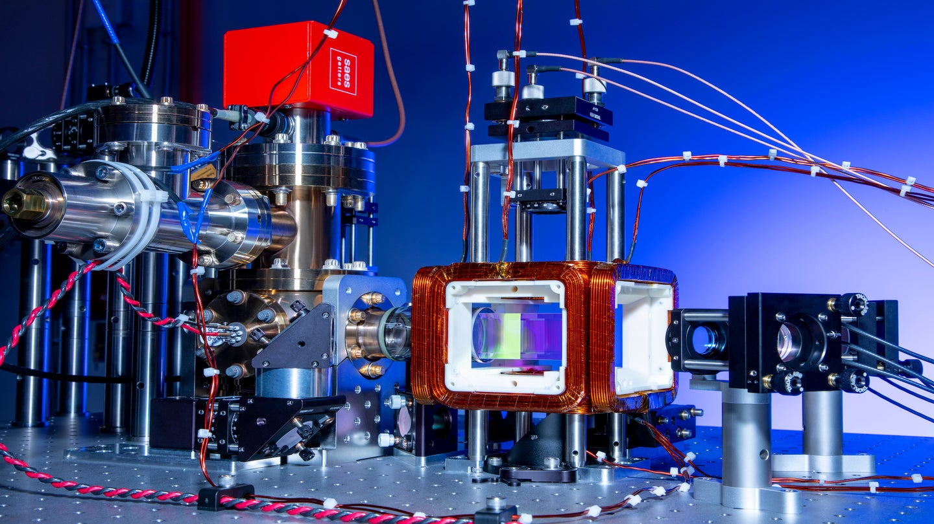
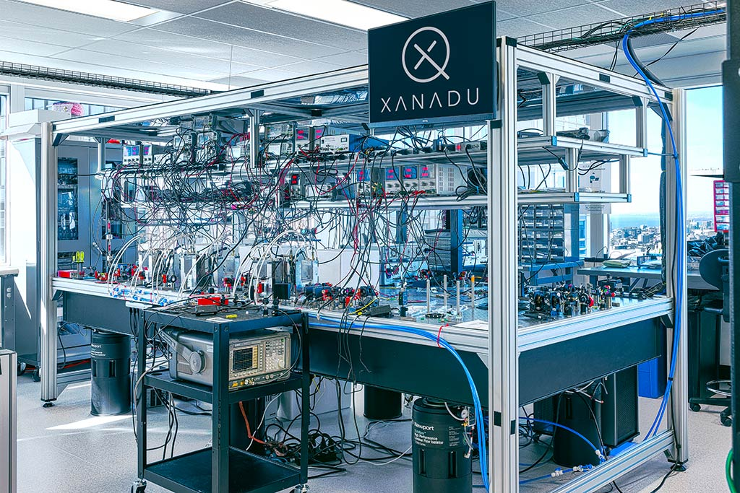
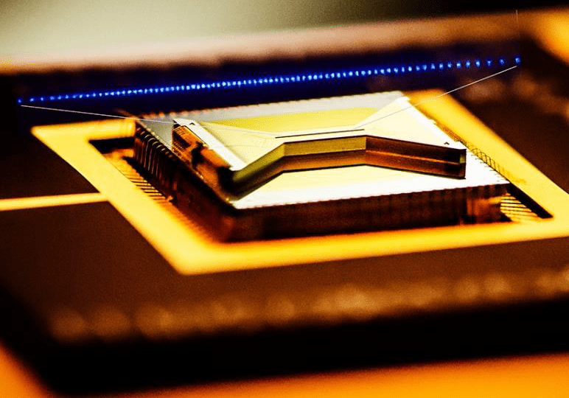
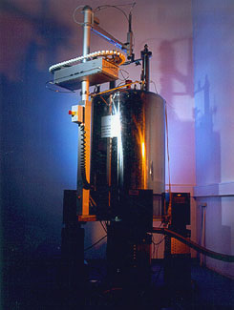
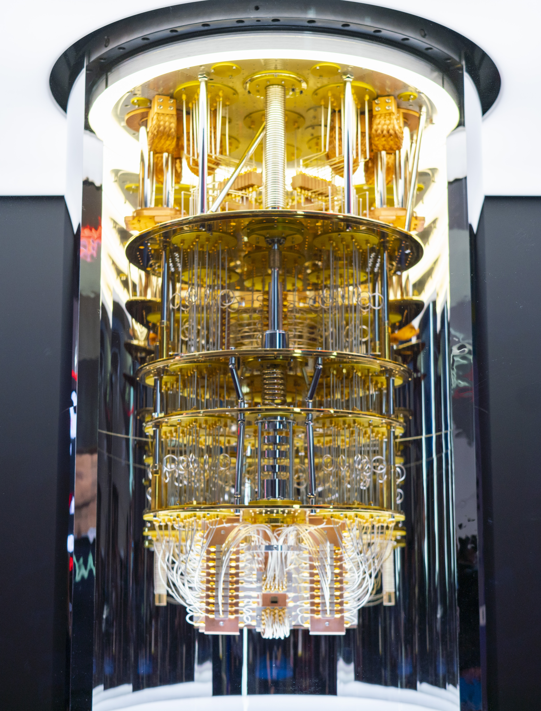
Introduction
Many ways to build a quantum computer:
Neutral atoms
Photons
Trapped ions
NMR
Transmon

Slide 5
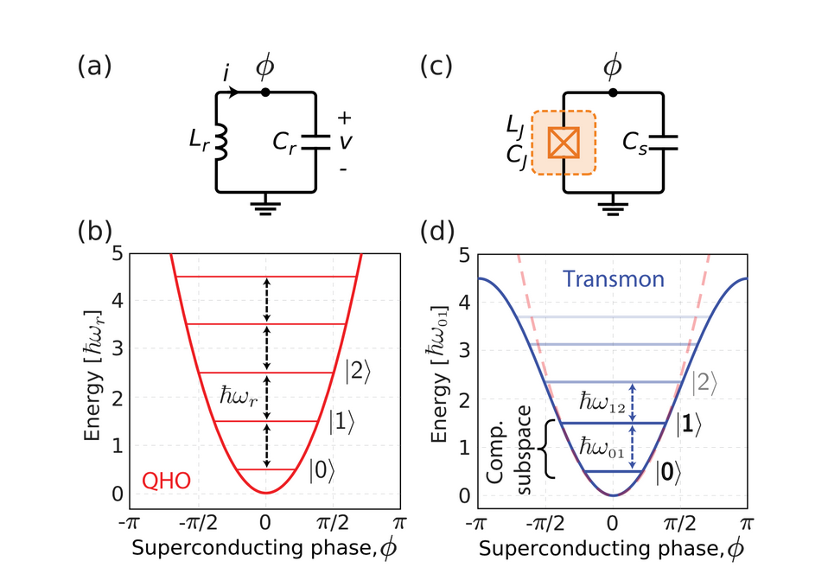
Introduction
Superconducting circuits without and with Josephson junction
Operating temperature $≈15mK$ (for obtaining superconductivity)
Transition between |0⟩ and |1⟩ is done using EM pulses (microwaves)

Slide 6
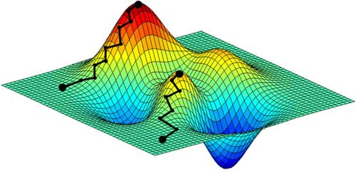
Quantum control with Juqbox [1]
Given a target gate $V_{tg}$, we want ${\left|ψ\right\rangle }_{T}≈V_{tg}{\left|ψ\right\rangle }_{o}$for any ${\left|ψ\right\rangle }_{o}$
Essential subspace of dim. $E$, guarded subspace of dim. $G$ ($E+G=N$)
Matrix $U_{0}∈C^{NxE}$provides a basis for the essential subspace
So the Schrodinger’s eq. for any initial condition is given by
$\frac{dU\left(t\right)}{dt}+iH\left(t\right)U\left(t\right)=0, 0≤t≤T, U\left(0\right)=U_{0}$
The optimization consists in calculating the $α^{∗}$ that minimizes:
$$\begin{aligned}\begin{aligned}\min_{α} 𝒢\left(α\right)≔1−\frac{1}{E^{2}}{\left|{\left\langle U_{T}\left(α\right),V_{tg}\right\rangle }_{F}\right|}^{2}+\frac{1}{T}\int_{0}^{T}{{\left\langle U\left(t;α\right),WU\left(t;α\right)\right\rangle }_{F}} \\ s.t. \frac{dU}{dt}+i\left(H_{s}+H_{c}\left(t;α\right)\right)U=0, 0≤t≤T, U\left(0;α\right)=U_{0,}\end{aligned} \\ α_{min}≤α_{q}≤α_{max}, q=1,…,20\end{aligned}$$

Slide 7
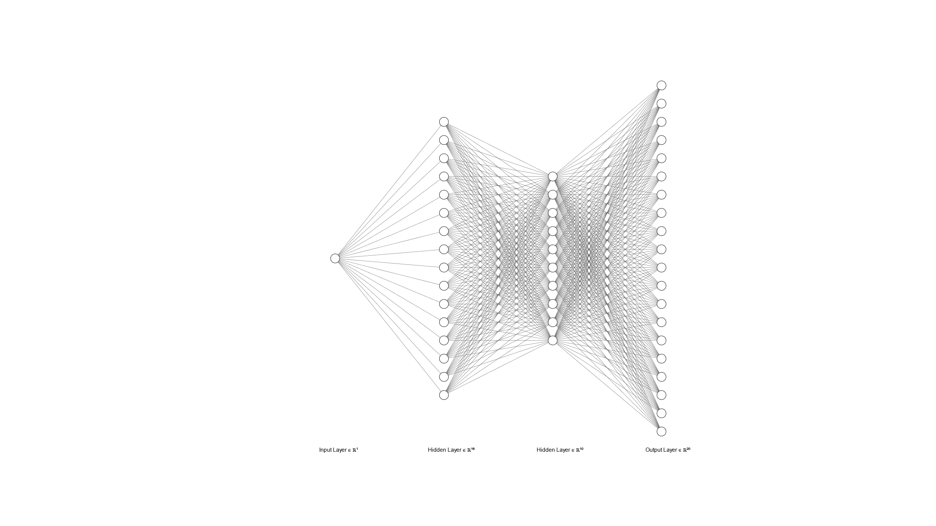
Problem
This is done for one gate $V_{tg}$
But $R_{z}\left(φ\right)$ and $R_{x}\left(θ\right)$ are arbitrary
Off-line generation should be done over an infinity of angles
On-line generation would take too long
Low latency is needed (gates should take O(10 ns))
A strategy mixed with ML is needed:
Use Juqbox to generate a finite dataset of params for $R_{x}\left(θ_{j}\right)$
Train an MLP neural network over the dataset
It should be accurate over any angle

Slide 8
Necessary steps
Dataset generation with Juqbox
Model training (simulated fidelity)
Quantization and synthesis on FPGA
Re-training on hardware (real fidelity)
Two problems:
Hardware constraints
How to estimate fidelity with statistical rigour?

Slide 9
Neural networks on hardware [2]
Control electronics has limited resources
The model is adapted to the HW: quantization
Weights are quantized from 64-bit to many fewer (16, 8, 4 bit)
The HW is adapted to the model: high-level synthesis
HLS for optimizing an FPGA / ASIC for the model
Pipelines for optimizing matrix mults
The architecture of the model is taken in consideration

Slide 10
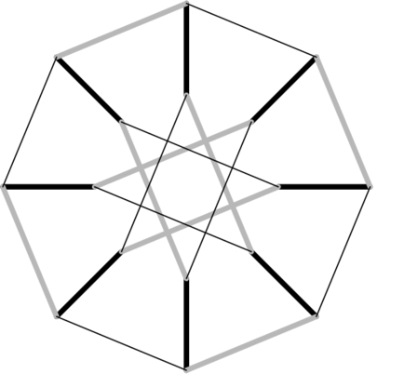
Randomized benchmarking [3]
Given $σ_{0}=I,σ_{1}=X,σ_{2}=Y,σ_{3}=Z$
Pauli group
$$P_{n}≔\left\{e^{\frac{ikπ}{2}}σ_{j_{1}}⊗…⊗σ_{j_{n}} | k=0,…,3,j_{k}=0,…,3\right\}$$
For 1 qubit, $P_{1}=\left\{±σ_{0},±iσ_{0},±σ_{1},±iσ_{1},±σ_{2},±iσ_{2},±σ_{3},±iσ_{3}\right\}=⟨σ_{1},σ_{2},σ_{3}⟩$
Clifford group
$$C_{n}≔\left\{V∈U_{2n} | VP_{n}V^{\text{†}}=P_{n}\right\}$$
For 1 qubit, $C_{1}=⟨H,S⟩$
Cayley graph for $P_{1}$

Slide 11
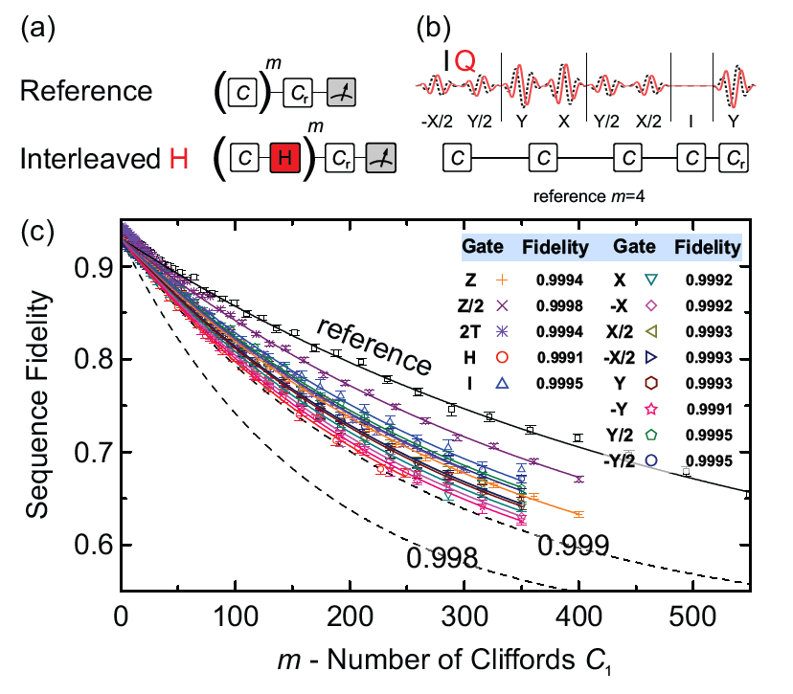
Randomized benchmarking
Group of gates $𝒢=\left\{g_{1},…,g_{\left|G\right|}\right\}⊂C_{1}$
Starting from an initial pure state $|ψ⟩$
Random sequences of these gates are used
Always possible to build a Clifford sequence $=I$
Final state should be $≈|ψ⟩$
Accuracy decays exponentially with sequence length
Fit for many lengths
Problem: $R_{X}, R_{Z}$ are not Clifford

Slide 12
Adapted RB for non-Clifford gates (empirical)
We want to test $|𝒢|$ $R_{x}$gates ($|𝒢|$ possible angles)
For each seq. length $m∈[M_{1},…,M_{M}]$:
For each seq. number $k∈\left\{0,…,K\right\}$:
generate a random sequence $s_{k}=s_{1_{k}}…s_{{m−1}_{k}}, s_{i_{k}}∈\left\{1,…,|𝒢|\right\}$
each $s_{i_{k}}$ corresponds to the gate $R_{x}\left(θ_{s_{i_{k}}}\right)$
prepare initial state $\left|0\right\rangle$
apply $R_{x}\left(θ_{s_{1_{k}}}\right),…,R_{x}\left(θ_{s_{{m−1}_{k}}}\right)R_{x}\left(−\sum_{i=0}^{m−1}{θ_{s_{i_{k}}}} \right)$
perform N measurements: ${\hat{p}}_{k}=\frac{zeros}{N}, {SE}_{{\hat{p}}_{k}}=\frac{\sqrt{{\hat{p}}_{k}\left(1−{\hat{p}}_{k}\right)}}{N}$
calculate average $avg_{\hat{p}}$ over the K sequences: $SE_{avg_{\hat{p}}}=\frac{\sqrt{∑SE_{{\hat{p}}_{k}}^{2}}}{K}$

Slide 13
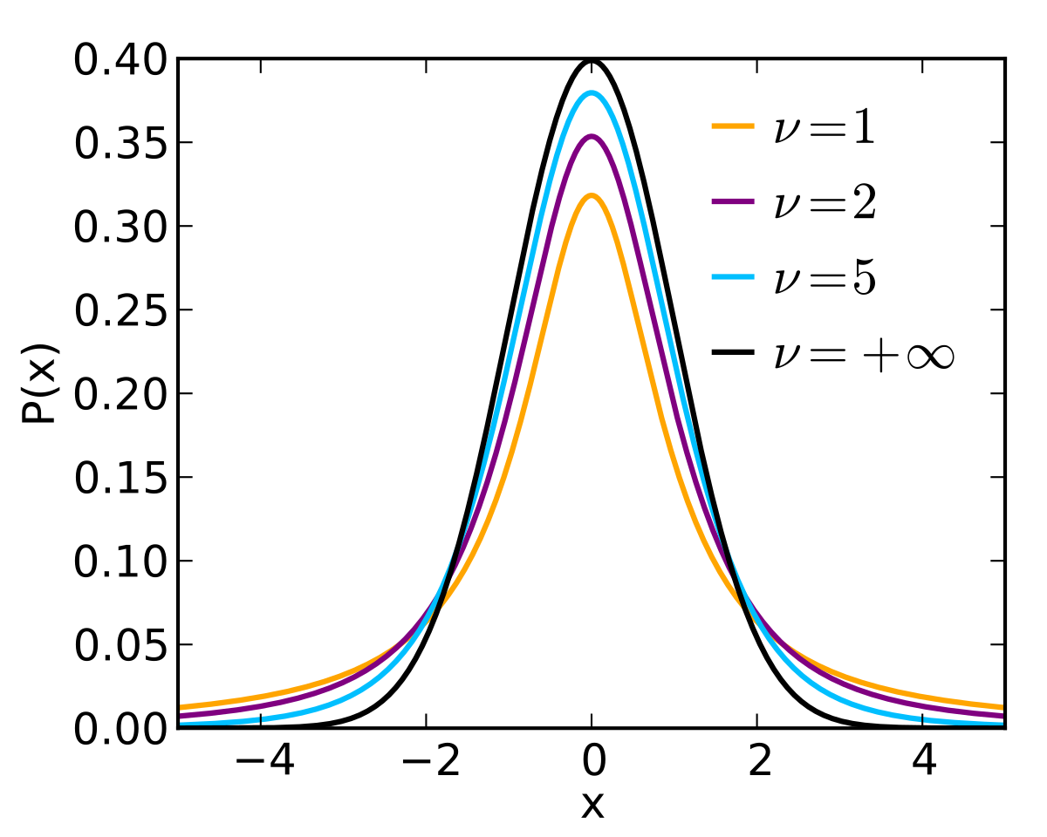
Adapted RB for non-Clifford gates (empirical)
Set ${\hat{ℱ}}_{m}=avg_{\hat{p},m}$ and $err_{m}=SE_{avg_{\hat{p},m}}$
Fit ${\overline{ℱ}}_{m}=A+Bf^{m}$ to find $A,B, f$ using $err_{m}$ as uncertainties on the ${\hat{ℱ}}_{m}s$
$A={\overline{ℱ}}_{m}\left(+∞\right)=\lim_{m→+∞}{{\overline{ℱ}}_{m}}, B={\overline{ℱ}}_{m}\left(0\right)−{\overline{ℱ}}_{m}\left(+∞\right)$
Bounds: $0≤A≤1, 0≤B≤1, 0≤f≤1$
$\hat{f}$ is the estimated fidelity for a single gate
take cov. $Σ∈R^{3,3}$ of the estimated parameters:
$Σ\left(3,3\right)={SE}_{\hat{f}}^{2}$
2-tailed t-student test, with $dof =\left|M\right|−3, α=0.05$
we get the CI radius = $\left[ \hat{f}−t_{α}\sqrt{Σ\left(3,3\right)},\hat{f}+t_{α}\sqrt{Σ\left(3,3\right)} \right]$

Slide 14
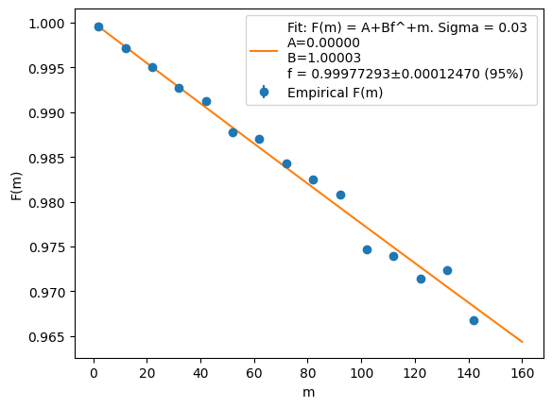
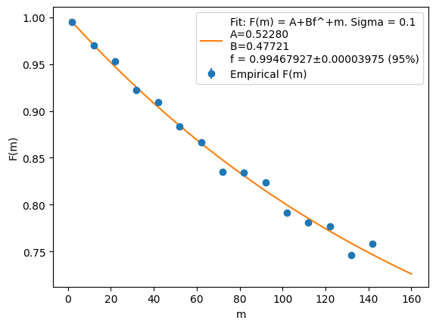
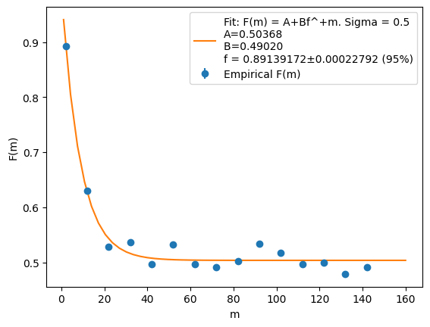
Simulation
Gate imperfections simulated with $\hat{θ_{i}}=θ_{i}+𝒩\left(0,σ\right)$
M=range(2,150,10), K=500, 10 000 meas.
$$σ=0.05 rad$$
$$\hat{f}=(99.9773±0.0125)\%$$
$$σ=0.1 rad$$
$$\hat{f}=(99.4679±0.0040)\%$$
$$σ=0.5 rad$$
$$\hat{f}=(89.1392±0.0228)\%$$

Slide 15
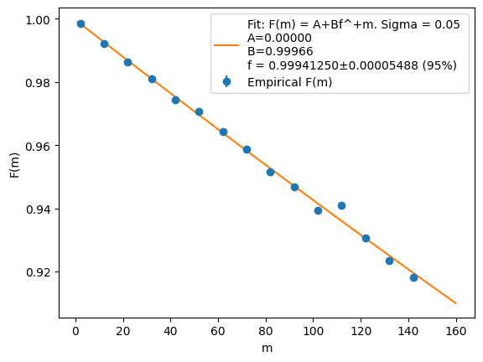
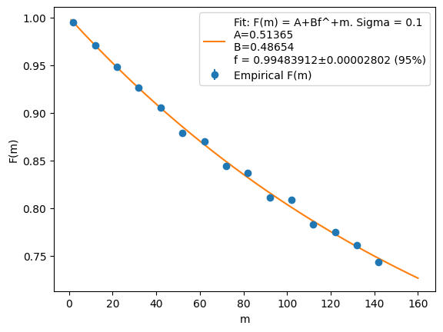
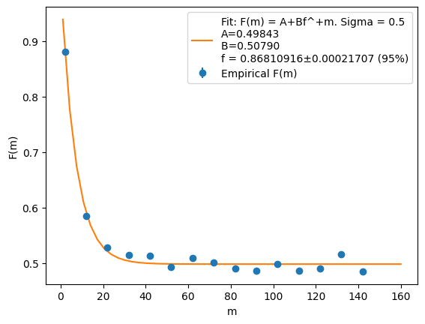
Simulation
Gate imperfections simulated with $\hat{θ_{i}}=θ_{i}+𝒩\left(0,σ\right)$
M=range(2,150,10), K=1000, 10 000 meas.
$$σ=0.05 rad$$
$$\hat{f}=(99.9413±0.0055)\%$$
$$σ=0.1 rad$$
$$\hat{f}=(99.4839±0.0028)\%$$
$$σ=0.5 rad$$
$$\hat{f}=(86.8109±0.0217)\%$$

Slide 16
RB on NN-generated pulses
NN trained on Juqbox (Python)
1000 angles from $–π$to $+π$(Python)
NN generates pulse params for each one (Python)
Params $→$ unitaries with Juqbox (Julia)
RB with resulting unitaries (Python)
IPC (JSON format)
Unitaries result from evolution with limited precision, so they are not normalized.
They are re-normalized in Python
IPC (JSON format)

Slide 17
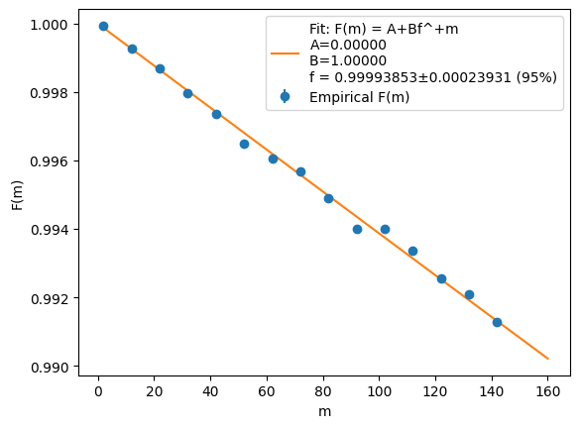
RB on NN-generated pulses
N = 10000 measurements
K = 500

Slide 18
Next steps
How well does it perform on different physical conditions?
NN was pre-trained with G=0
Actual system has infinite guarded levels
Anharmonicity hystheresis due to temperature cycles
Fine-tune the pre-trained NN
using RB inside the loss function

Slide 19
Testing with G guarded levels
Necessary changes:
Initial condition must be a vector $\left(\begin{aligned}\begin{matrix}1 \\ 0\end{matrix} \\ … \\ 0\end{aligned}\right)$
Unitaries coming from Juqbox have shape (2+G)x2.
They must be padded into a (2+G)x(2+G): $\left(\begin{matrix}… & … & 0 & 0 & 0 \\ … & … & 0 & 0 & 0 \\ … & … & 1 & 0 & 0 \\ … & … & 0 & 1 & 0 \\ … & … & 0 & 0 & 1\end{matrix}\right)$
} G
2 {
G {

Slide 20
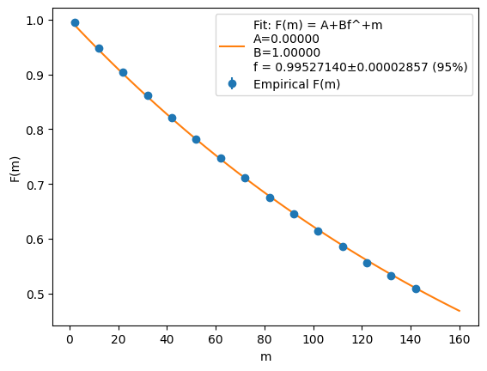
Results (NN trained on G=0)
With G=0, 0.99994…
G = 1
Anharmonicity x1 (=200 e-3)

Slide 21
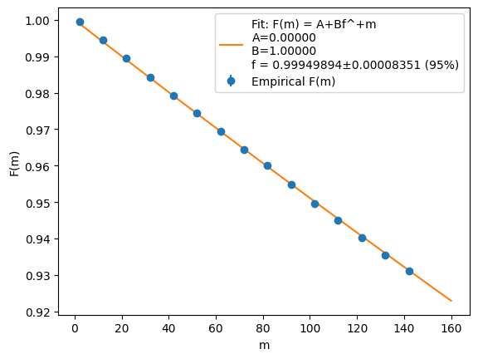
Results (NN trained on G=0)
With G=0, 4 nines
G = 1
Anharmonicity x10 (=200 e-2)
With G=0, 0.99994…

Slide 22
Fine-tuning on G=1
NN structure:
8 FC layers with ReLu
Total of 760 params
The loss involves numerical integration
non (automatically) differentiable with TF

Slide 23
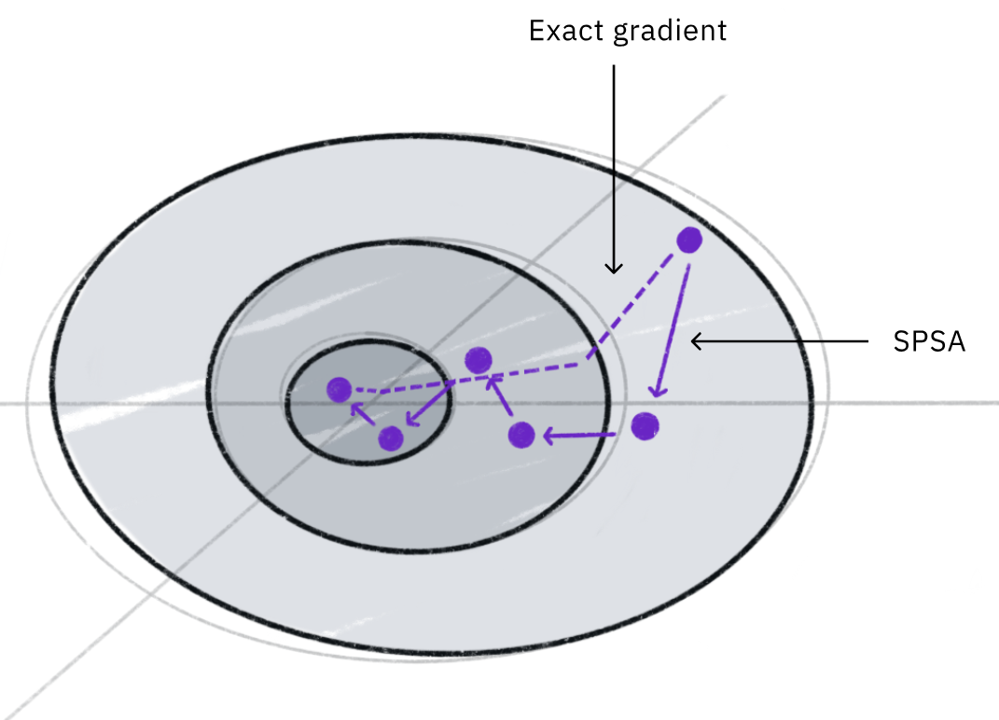
Fine-tuning on G=1
Gradient Descent must be done by hand
Gradient should be calculated varying one parameter at a time
For each epoch, 760x2 evaluations necessary
Faster method:
SPSA
$\vec{∇}f\left(\vec{θ}\right)=\left(\begin{matrix}\frac{∂f}{∂θ_{1}} \\ \begin{aligned}… \\ \frac{∂f}{∂θ_{n}}\end{aligned}\end{matrix}\right)≈\frac{1}{ε}\left(\begin{matrix}\begin{aligned}f\left(\vec{θ}+ε{\vec{e}}_{1}\right) \\ …\end{aligned} \\ f\left(\vec{θ}+ε{\vec{e}}_{n}\right)\end{matrix}\right)≈\frac{f\left(\vec{θ}+ε\vec{Δ}\right)−f\left(\vec{θ}−ε\vec{Δ}\right)}{ε} {\vec{Δ}}^{−1 }$
$\vec{Δ}∈{\left\{+1,−1\right\}}^{n}$

Slide 24
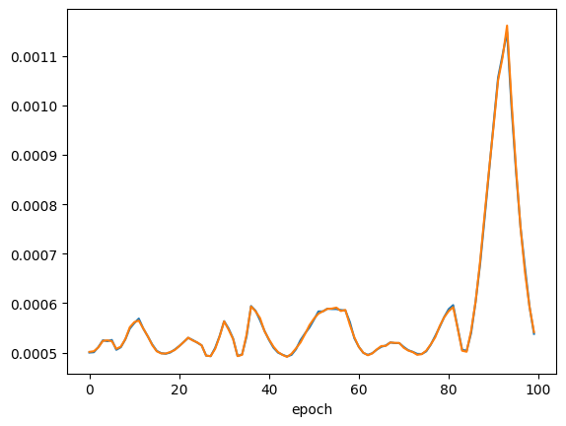
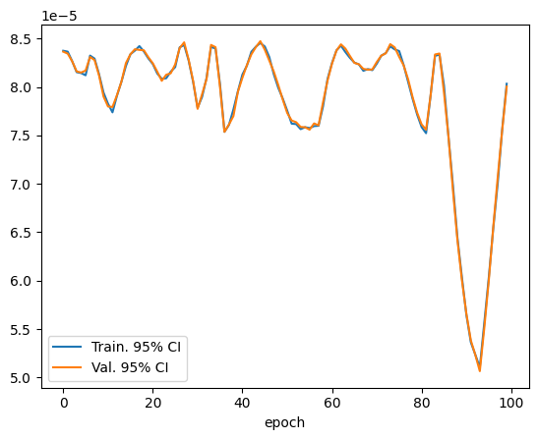
Retraining
Changing at each epoch
$ε=LR={10}^{−5}$
${X_{train}=U}^{500}\left(−π,+π\right),{{ X}_{val}=U}^{500}\left(−π,+π\right)$

Slide 25
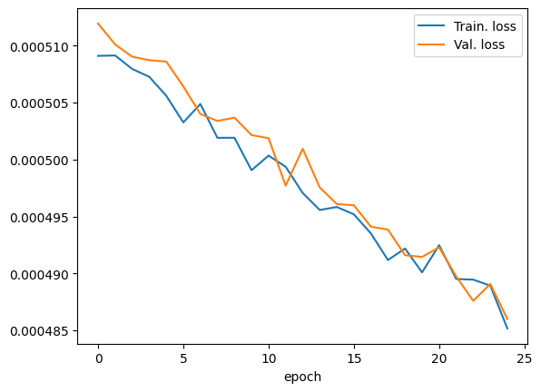
Retraining
10 fixed batches of 100 elements
$ε=LR={10}^{−6}$
$X_{train}=\left\{x_{i}=−π+iΔ \right| iΔ≤2π, Δ=\frac{2π}{1000}\},{{ X}_{val}=U}^{1000}\left(−π,+π\right)$

Slide 26
Conclusion
One possible path
Many epochs are needed + early stopping
Bigger NN for higher accuracy and faster convergence
Extreme path:
Perform full Gradient Descent: 76 000% more computations
Alternative:
Actually only $R_{z}, \sqrt{X},{\sqrt{X}}^{−1}$ are needed
$R_{z}$ is «free»: obtained varying the phase
$\sqrt{X},{\sqrt{X}}^{−1}$obtainable using only $R_{x}\left(\frac{π}{2}\right), R_{x}\left(−\frac{π}{2}\right)$: training necessary only for 2 angles!
Overall, RB is promising for adapting NN to varying phys. parameters

Slide 27
Thank you for your attention

Slide 28
References
[1] Petersson et al., Optimal Control of Closed Quantum Systems via B-Splines with Carrier Waves, arXiv:2106.14310
[2] Fahim et al., hls4ml: An Open-Source Codesign Workflow to Empower Scientific Low-Power Machine Learning Devices, arXiv:2103.05579
[3] Wallman et al., Randomized Benchmarking with Confidence, arXiv:1404.6025

