Slide 1
Thermal Analysis of the Bus Bars for the 800MeV Injection Era
Silvia Picchi, Victor Grzelak
Italian Summer School, final presentation
09/27/2023

Slide 2
Presentation Outline
Introduction
COMSOL thermal simulations for present conditions - Results - Validation
COMSOL thermal simulations for PIP-II conditions
Proposed changes - New busbars section - Results
Peak temperature tables
Conclusions
Notes:
State about the 2 different kind of heating Intro to: bus bars heating and RF line. The heating of the cavities have been studies while the tuning has not been studied yet (and that’s the problem I am trying to address) 2) present the layout
3) Busbars constructio

Slide 3
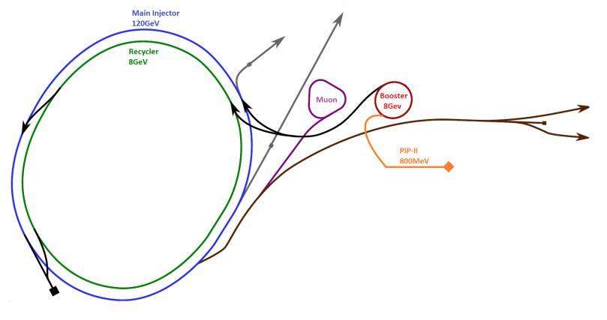
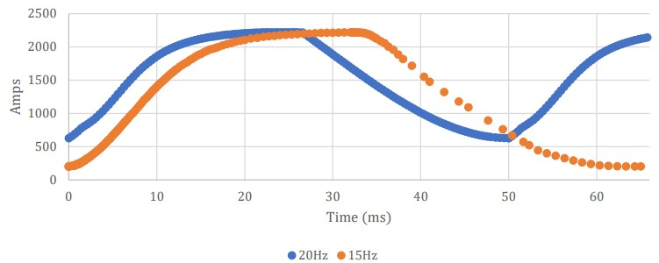
Proton Improvement Plan II
PIP-II is the plan to upgrade Fermilab’s present accelerator complex:
Building a new linear accelerator
Improvement of the Booster
Figure: future Fermilab’s accelerator complex
 | Present | PIP-II
Booster injection KE | 400 MeV | 800 MeV
Machine frequency | 15Hz | 20Hz
RF frequency range | 37.9-52.8 MHz | 44.7-52.8 MHz
RMS bias current (tuning circuit) | 1354 A | 1695 A
1695A
1354A
Bias current curve
Notes:
Synchrotrons by design, have to sweep f as KE increases. Higher injection KE –> higher injection f → and for tuning I need more current, consequently, (then point out the graph)

Slide 4
In the previous episode…
The components of the stations heat up due to these possible reasons:
Driver input 4 kW RF
High voltage from anode modulator
High current bus for cavity tuning
The goal of this work is to investigate the heating caused by the bias supply line in the new operational conditions.
1200kVA Transformer 480VAC
House power 480VAC
Anode supply 30KVDC
Bias curve
Utility yard
Frequency curve
Gallery
Solid State Driver
Bias supply
Modulator
Anode curve
Penetration
Tunnel
Power
amplifier
4kW
Bus Bars
0 -2250A
0-27kV
Cavity
Tuners
Figure: simplified system block diagram of a single station

Slide 5
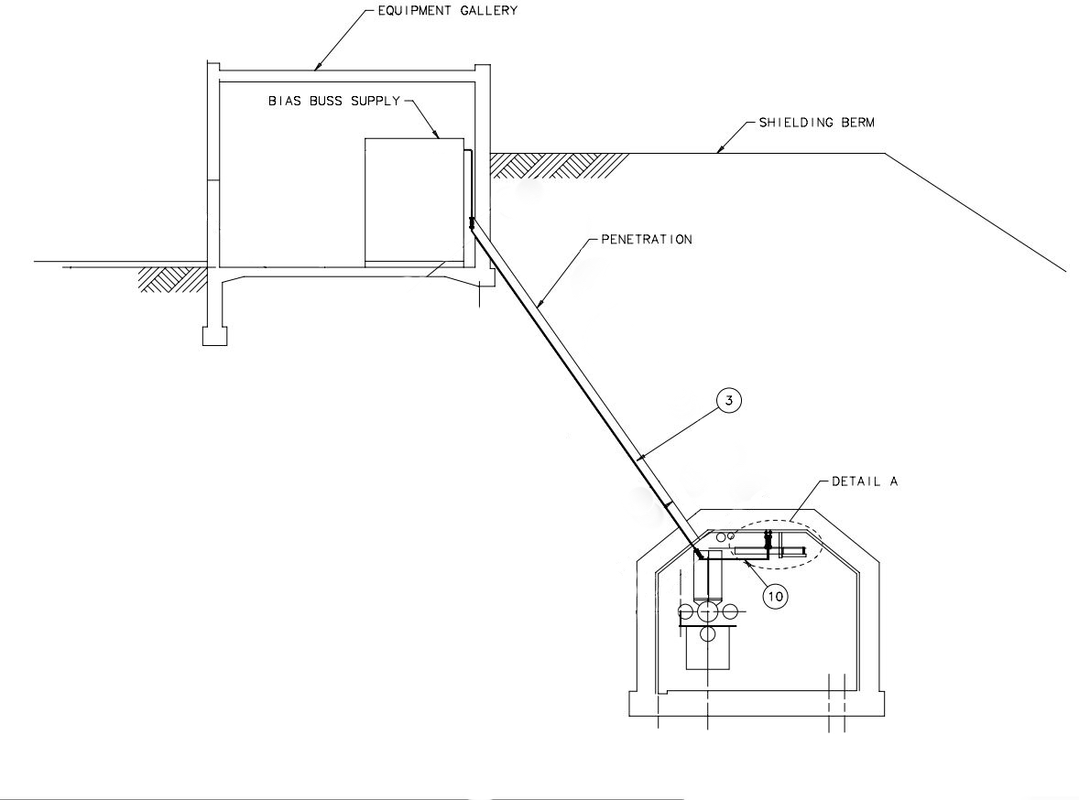
Booster station layout
The layout of each station of the Booster is composed by:
The gallery, where the bias supplies are placed
The penetration, which con-nects the gallery and the tunnel
The tunnel, where the RF ac-celerating cavities are placed.
(clean the drawing!!!!)

Slide 6
The bus bars
The devices that bring bias current to the ferrite tuners through the penetration are called bus bars.
Along the penetration, a fraction on their total length is exposed to air while the other fraction is wrapped in the neutron shield (poly-ethylene). This fraction is variable for each station.
During operation, bur bars heat up due to Joule effect. The heat generation and the lack of appropriate cooling could cause the overheat of the neutron shield.
Dielectric layer (Nomex)
Kapton tape
(layer 1)
Bus bars
Aluminum Clampshell
Bus bars assembly
$${\dot{Q}}_{Joule}=I^{2}R$$
Bus bars assembly, technical drawing
(measurements in inches)

Slide 7
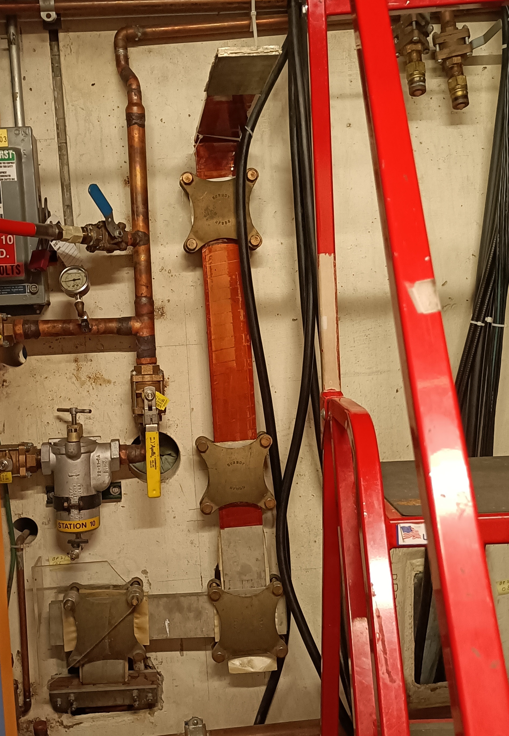
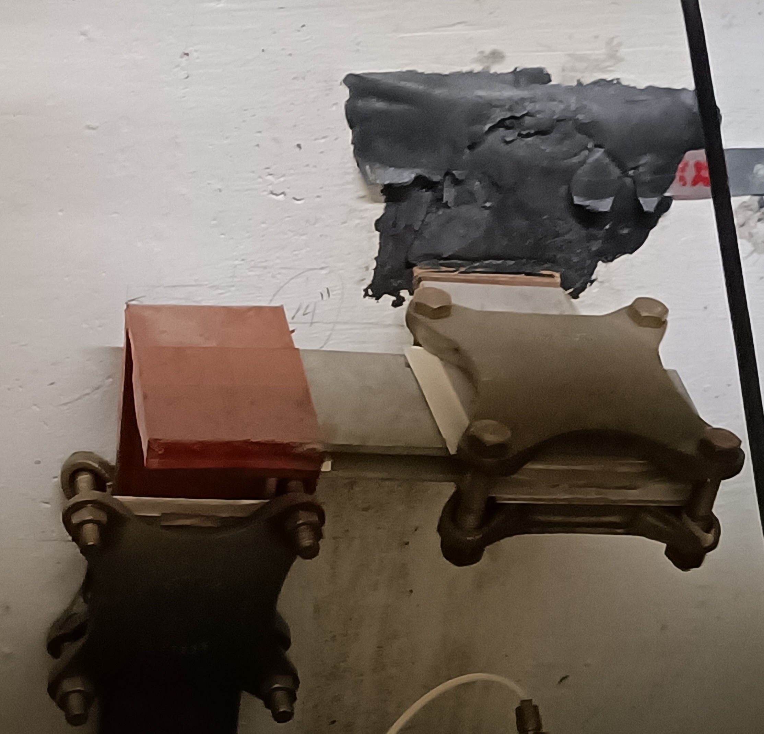
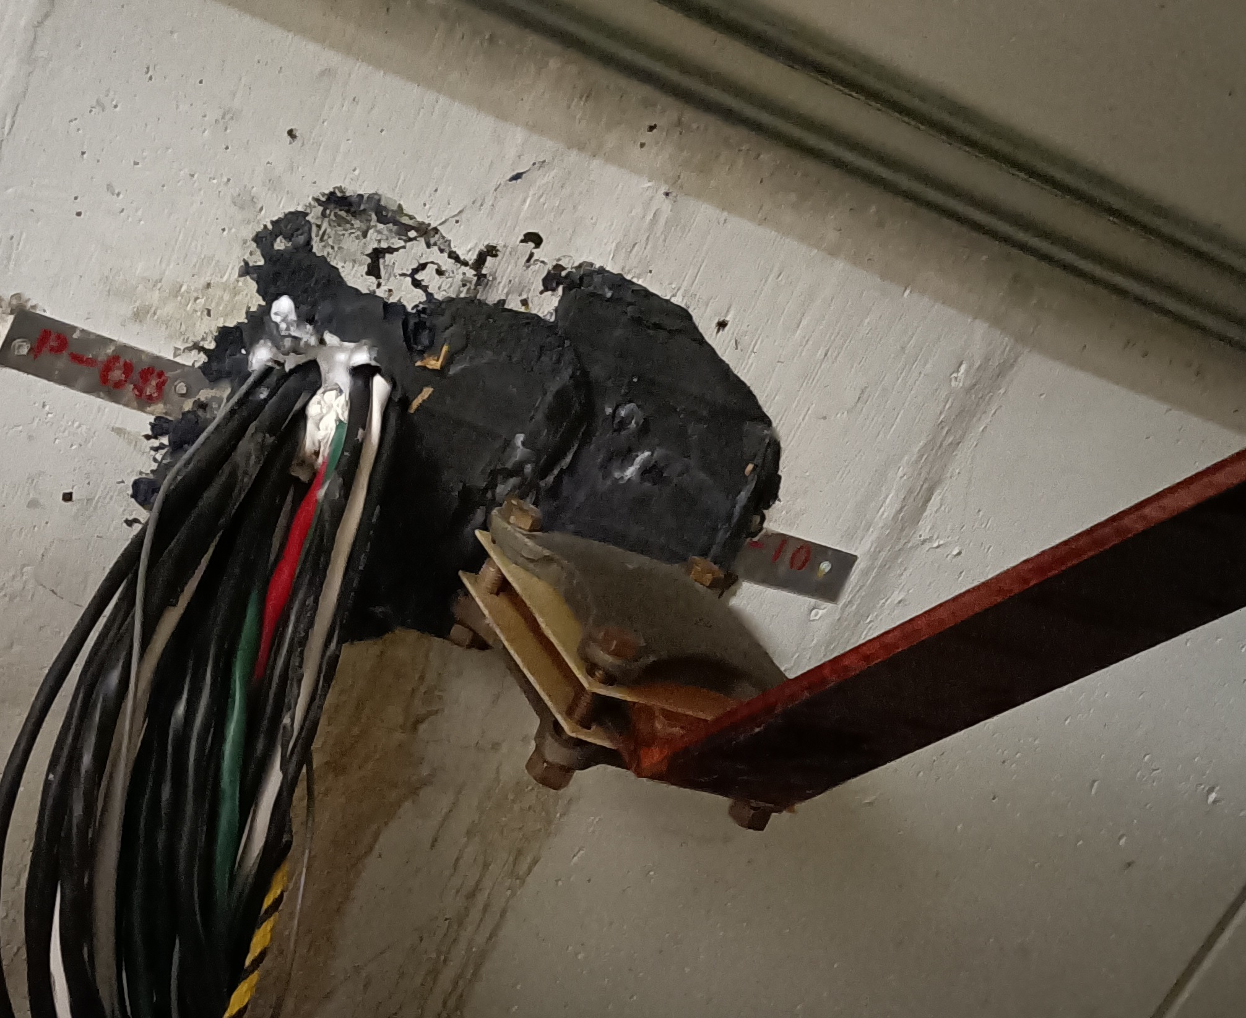
The bus bars
Bus bars behind the bias supply
Bus bars as seen from the gallery
Bus bars as seen from the tunnel

Slide 8
Presentation Outline
Introduction
COMSOL thermal simulations for present conditions - Results - Validation
COMSOL thermal simulations for PIP-II conditions
Proposed changes - New busbars section - Results
Peak temperature tables
Conclusions

Slide 9
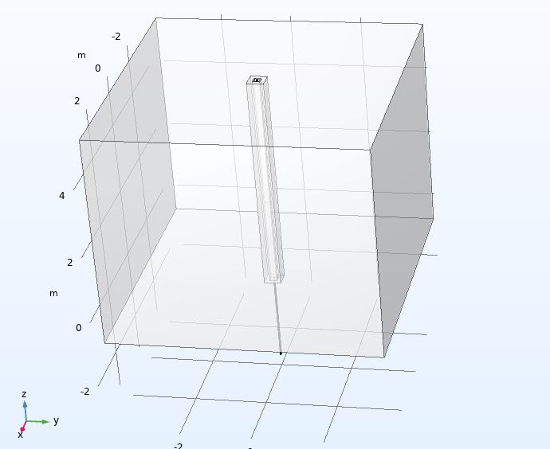
COMSOL 3D simulation – geometry
Surface (gallery)
10ft exposed to air
thermocouples
Penetration
20ft
upper
upper
10ft wrapped in poly beads
lower
lower
2ft exposed to air (tunnel)
Booster station layout
Simulation geometry
Notes:
Underline how the different materials surrounding the busbars allow to predict how the temperature curve will be, qualitatively Clarify that the 2 feet at the bottom are useful for modeling forced convection in the tunnel

Slide 10
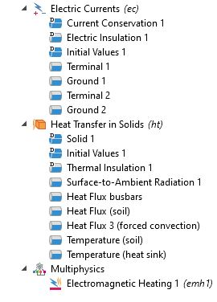
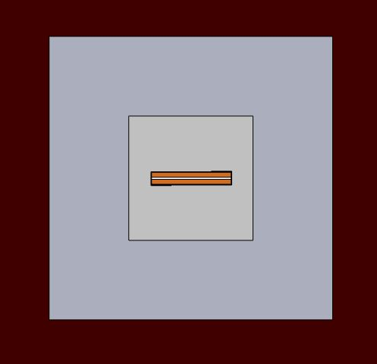
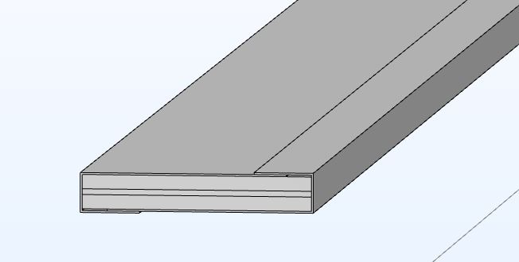
COMSOL 3D simulation – boundary conditions and materials
Polyethylene
(neutron shield)
Cross section
Assembly
Concrete
Soil
Boundary conditions
Materials
Notes:
Underline how the k of soil and concrete is 1) unknown and 2) variabile with time. Hence, a parametric sweep has been performed in order to choose the value that gives the best results according to experimental data, of course among the sensible values. Also due to this uncertainty, it is not possible to compare directly the point where the thermocouple that took the values is to the same exact point in the simulation. Rather, an interval will be evaluated.

Slide 11
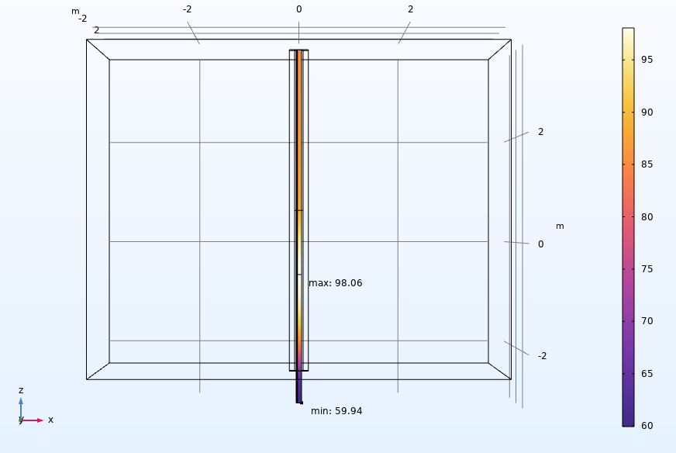
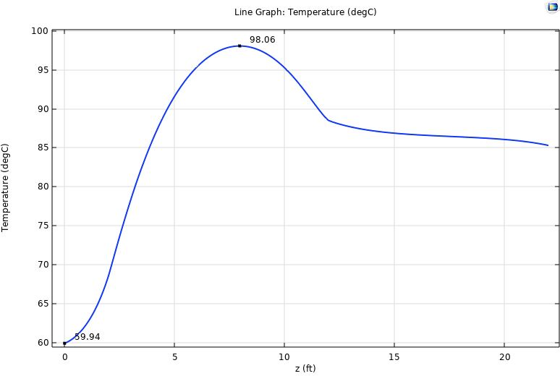
COMSOL 3D simulation – present conditions
Simulations results for 15Hz, 1354A RMS
22 ft
12 ft
upper
10 ft
polybeads
lower
4 ft
2 ft
0 ft
Temperature gradient of the assembly
Temperature along the surface of a clampshell

Slide 12
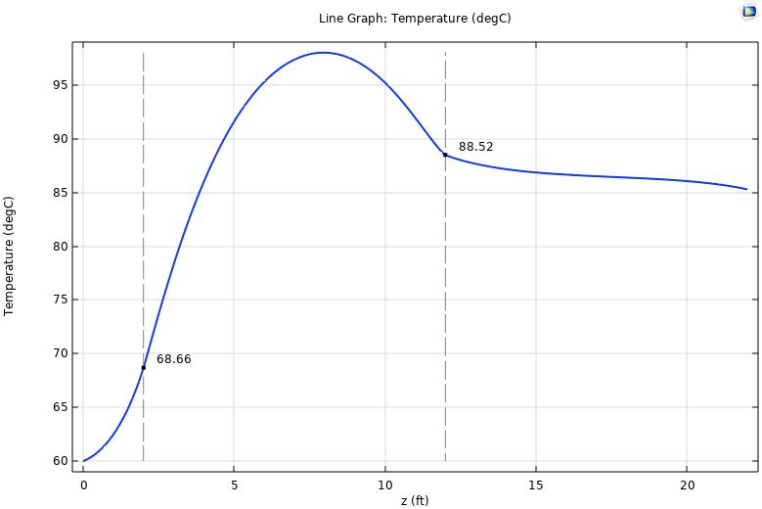
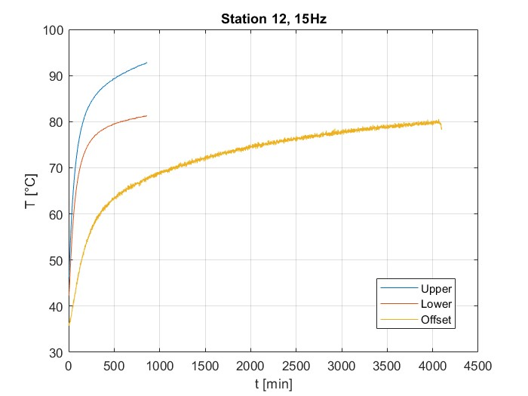
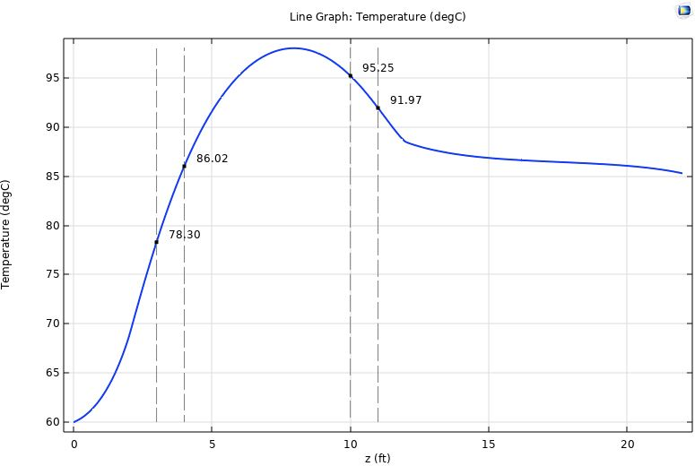
COMSOL 3D simulation – present conditions
Validation of the results: comparison with thermocouples readings
upper
upper
lower
lower
upper (offset)
Experimental data
Temperature along the surface of a clampshell

Slide 13
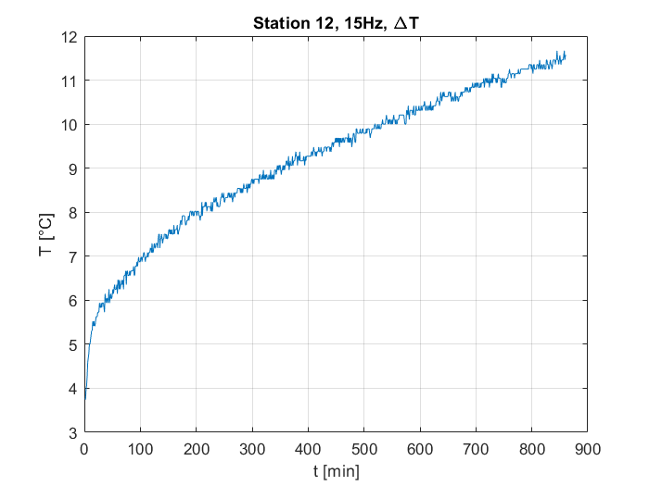
COMSOL 3D simulation – present conditions
Validation of the results: comparison with thermocouples readings
upper
lower
Experimental data
Temperature along the surface of a clampshell

Slide 14
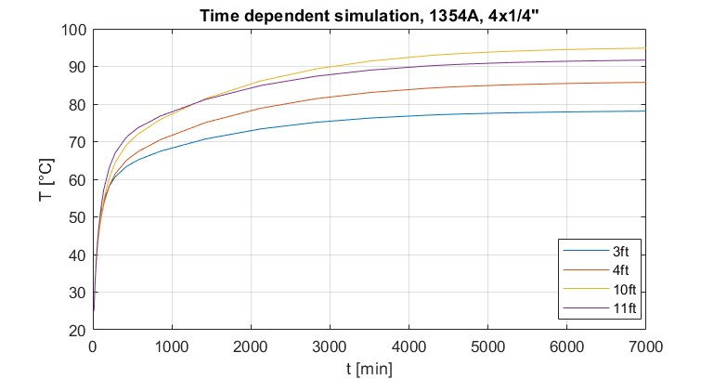
COMSOL 3D simulation – present conditions
Transient simulation
upper
lower
Experimental data
Temperature along the surface of a clampshell

Slide 15
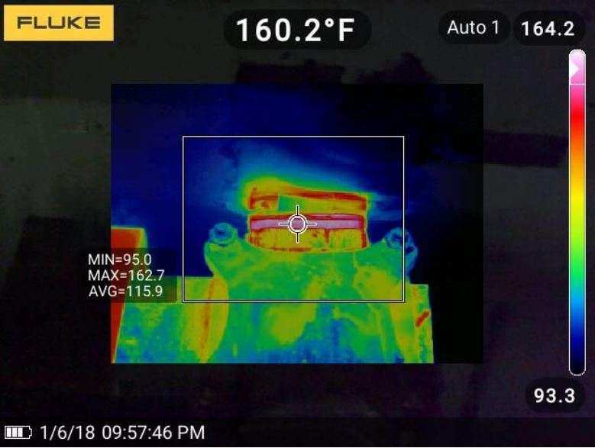
COMSOL 3D simulation – present conditions
Validation of the results: comparison with IR camera images
(71.2°C)
IR camera image of the bottom of the penetration
Temperature simulated value at the bottom of the penetration

Slide 16
Presentation Outline
Last episode recap
COMSOL thermal simulations for present conditions - Results - Validation
COMSOL thermal simulations for PIP-II conditions
Proposed changes - New busbars section - Results
Peak temperature tables
Conclusions

Slide 17
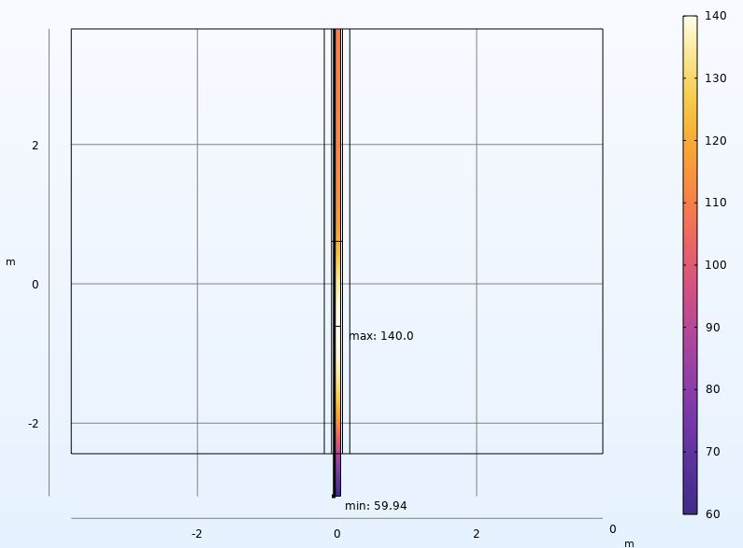
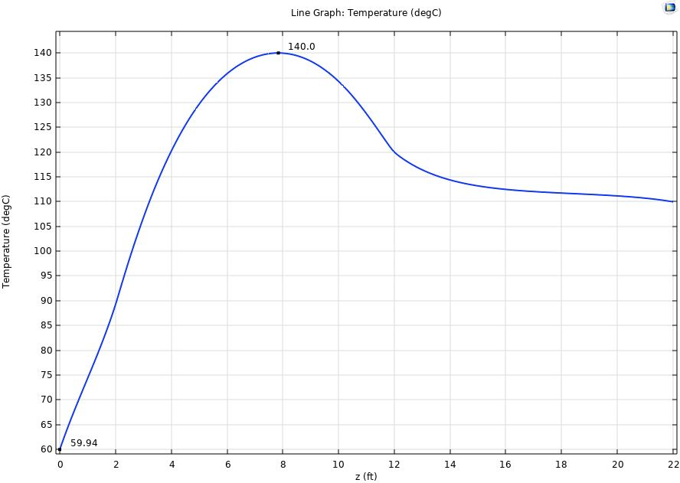
COMSOL 3D simulation – PIP-II conditions
Simulations results for 20Hz, 1695A RMS
22 ft
12 ft
10 ft
4 ft
2 ft
0 ft
Temperature gradient of the assembly
Temperature along the surface of a clampshell

Slide 18
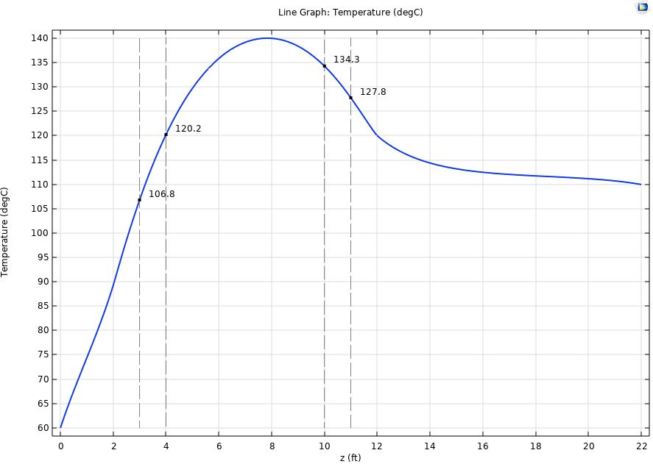
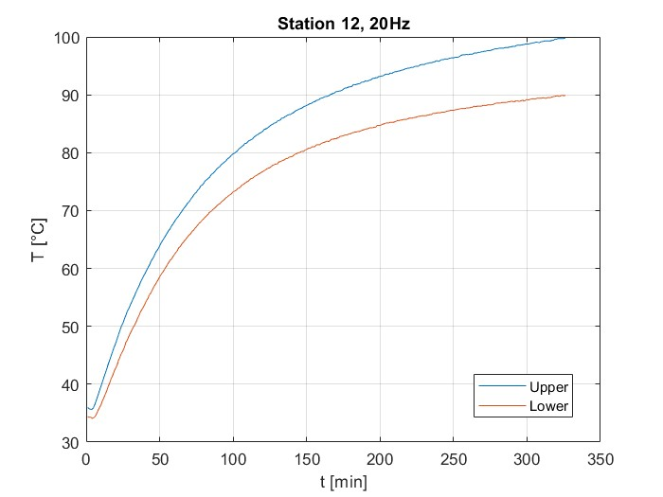
COMSOL 3D simulation – PIP-II conditions
Comparison with experimental data (steady-state)
upper
lower
Experimental data
Temperature along the surface of a clampshell

Slide 19
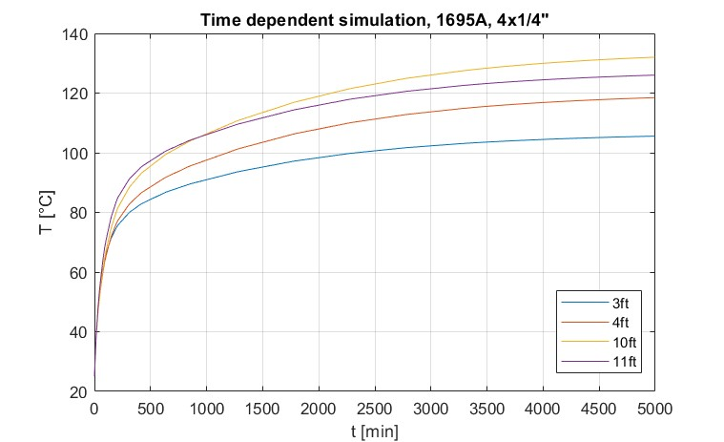
COMSOL 3D simulation – PIP-II conditions
Transient simulation
upper
lower
Experimental data
Temperature along the surface of a clampshell

Slide 20
Presentation Outline
Last episode recap
COMSOL thermal simulations for present conditions - Results - Validation
COMSOL thermal simulations for PIP-II conditions
Proposed changes - New busbars section - Results
Peak temperature tables
Conclusions

Slide 21
Proposed change: increasing the cross section
One of the many possible solutions to the thermal problem would be increasing the cross section of the bus bars. A bigger cross section would mean:
Smaller resistance: $R=ρ\frac{L}{A}$ , hence less power generation
Bigger heat capacity, hence more heat stored in the mass of the bars
Taking into consideration a simple, lumped parameter equation that could describe the system:
$$− hA\left(T−T_{∞}\right)−εσA\left(T^{4}−T_{∞}^{4}\right)+{\dot{Q}}_{joule}=ρcV\frac{dT}{dt}$$
Decrease in power
generation
(about -50% power generation)
Increase in heat capacity
(about +85% volume)

Slide 22
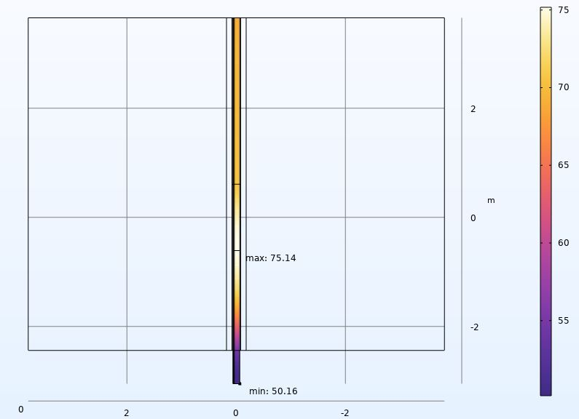
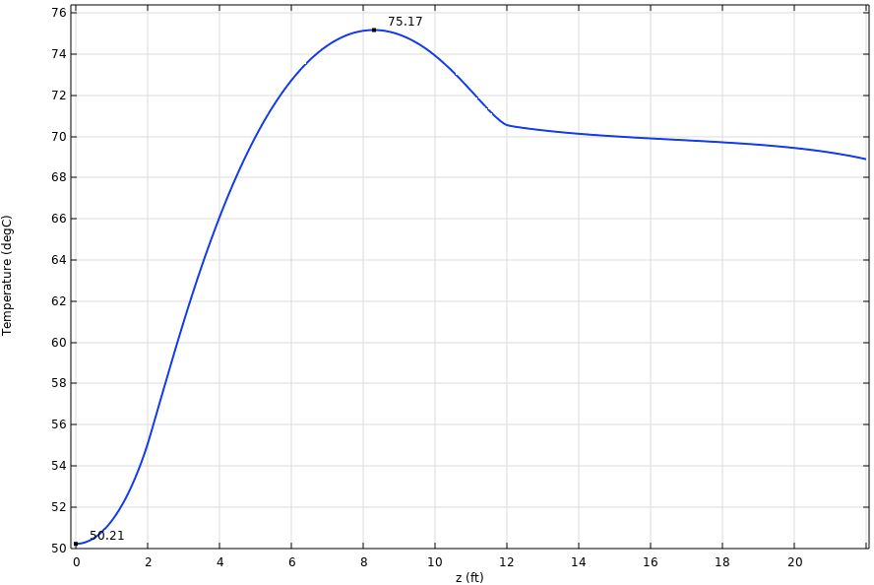
COMSOL 3D simulation – PIP-II conditions + new assembly
Simulations results for 20Hz, 1695A RMS, 5x3/8’’ cross section
22 ft
12 ft
10 ft
4 ft
2 ft
0 ft
Temperature gradient of the assembly
Temperature along the surface of a clampshell

Slide 23
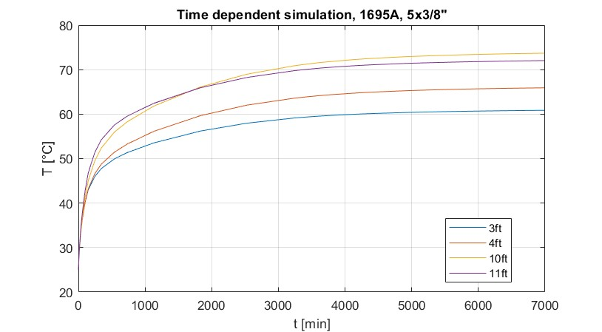
COMSOL 3D simulation – PIP-II conditions + new assembly
Simulations results for 20Hz, 1695A RMS, 5x3/8’’ cross section
Temperature gradient of the assembly
Temperature along the surface of a clampshell

Slide 24
Presentation Outline
Last episode recap
COMSOL thermal simulations for present conditions - Results - Validation
COMSOL thermal simulations for PIP-II conditions
Proposed changes - New busbars section - Results
Peak temperature tables
Conclusions

Slide 25
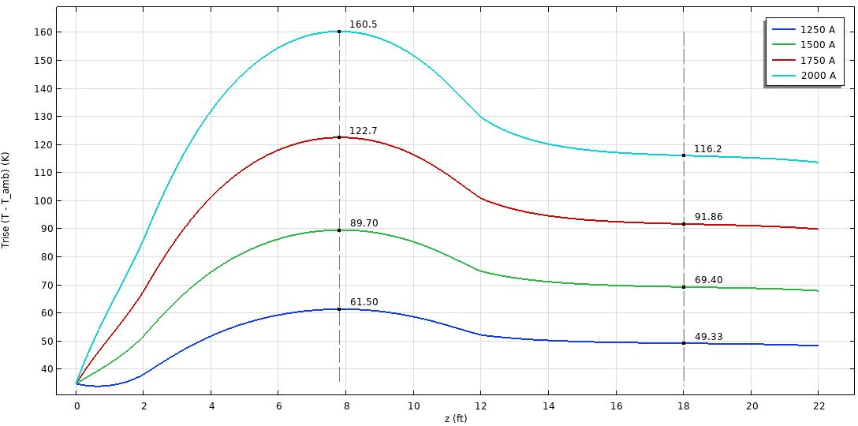
Data evaluation – current sweep

Slide 26
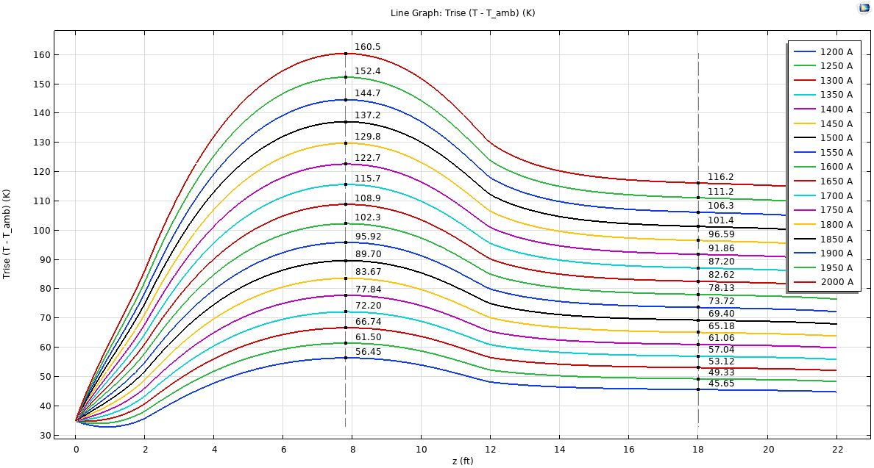
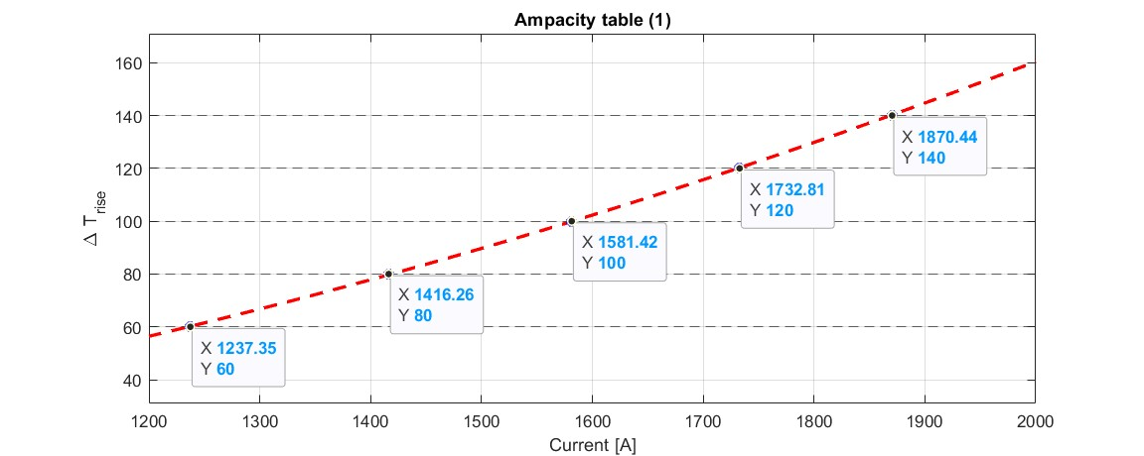
Data evaluation – current sweep
In order to gather the data to build a reference table, the simulation has been computed for several different RMS values of the bias current.
The goal is to be able to evaluate the temperature rise as a function of the amount of RMS current carried by the bus bar.
The $ΔT_{rise}$ is defined as the difference bet-ween the maximum temperature and the ambient temperature, since for this kind of problem the maximum temperature is the most significant data:
$$ΔT_{rise}=T_{max}−T_{amb}$$

Slide 27
Data evaluation
After gathering a discrete number of $\left(I, ΔT_{rise}\right)$ points it is possible to fit the data and obtain the necessary RMS current to get a specific temperature rise.

Slide 28
Peak temperatures table
Notes:
Peak temperatures in poly-beads as a function of current

Slide 29
Presentation Outline
Last episode recap
COMSOL thermal simulations for present conditions - Results - Validation
COMSOL thermal simulations for PIP-II conditions
Proposed changes - New busbars section - Results
Peak temperature tables
Conclusions!

Slide 30
Conclusions
It has been proved that in the new working conditions the polyethylene shield will melt
It has been obtained a reliable model of the assembly, that can be useful for future evaluations prior to experiments/tests
An ampacity table has been made for quick consultation in case of future change in operational conditions
A solution to the problem has been proposed

Slide 31
References
Victor Grzelak, “THE FERMILAB BOOSTER RF MODIFICATIONS FOR THE 800MEV INJECTION ERA”
Fermilab Accelerator Division. “Concepts book
Matther Domeier. “Booster Bus Bar Replacement”
Taylor Electronics Services. “Ampacity table for copper busbars”
Engineering toolbox
John H. Lienhard IV and John H. Lienhard V. “A heat transfer textbook”.

Slide 32
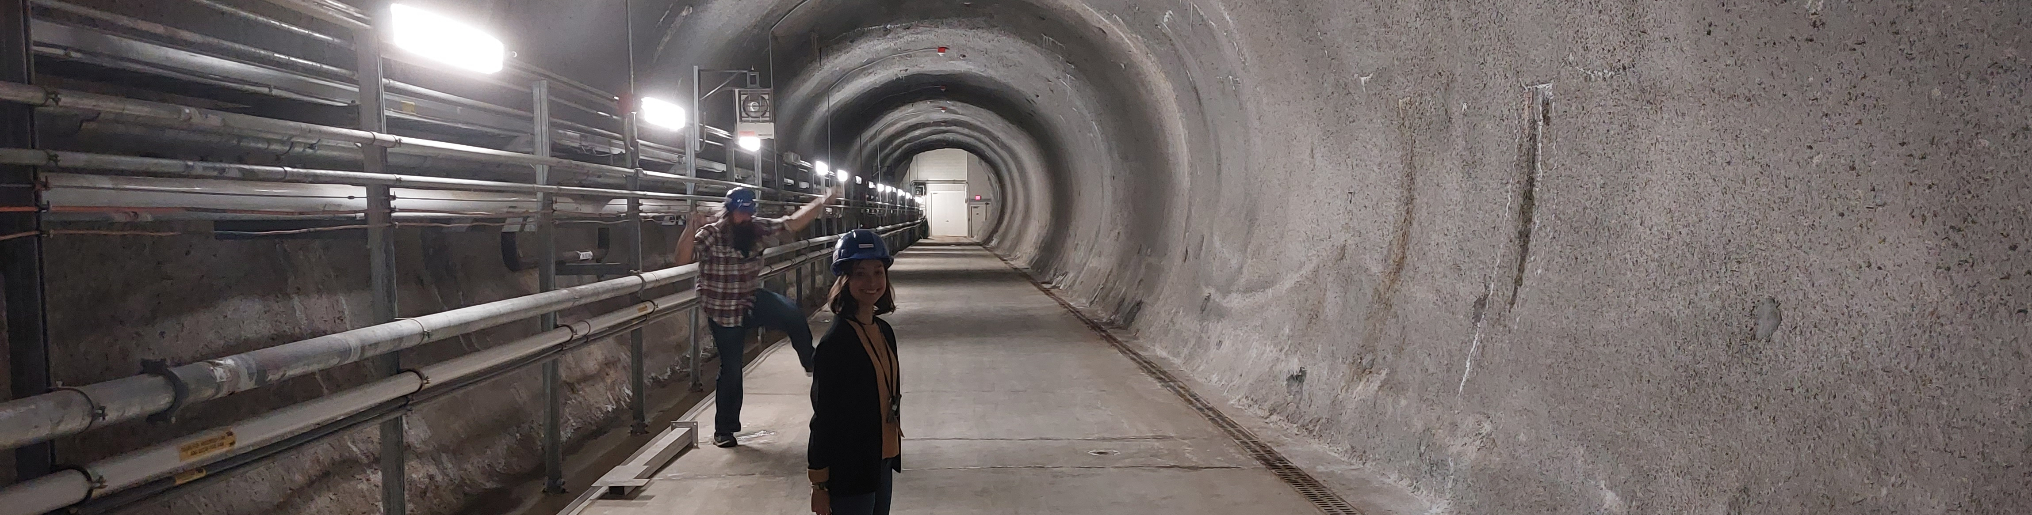
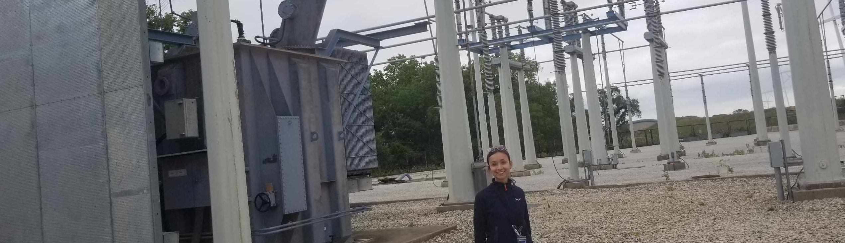
Figure: me and Victor during a visual inspection
Thank you for your attention!
Silvia Picchi, Victor Grzelak
Thermal Analysis of the Bus Bars
09/27/2023

Slide 33
Backup

Slide 34
Lumped capacity analysis
Hypothesis: the temperature gradients are small, $T\left(\vec{x},t\right)=T(t)$ (true if $Bi=\frac{hL}{k}≪1$)
Energy balance:
$$− hA\left(T−T_{∞}\right)−εσA\left(T^{4}−T_{∞}^{4}\right)+Q_{joule}=ρcV\frac{dT}{dt}$$
Solving this non-linear equation gives an approximation of the temperature variation of the busbars, from ambient temperature to steady-state.
Temperature T(t) for the 4x1/4” cross section, in open air.
IRMS = 1354A (current operating conditions)
Tsteady = 67.4°C
Temperature T(t) for the 4x1/4” cross section, in open air.
IRMS = 1695A (PIP-II operating conditions)
Tsteady = 87.9°C
Notes:
First step would be a simple lumped capacity analysis. Since the biot numer is significantly lower than 1 for both the cross sections it is possible to neglect the variations of temperature inside the body, which is the whole mass of the busbars, and write this thermal energy balance Solving this equation it is possible to understand what the steady-state temperature of the bus bars in oper air in going to be. And I underline, that these results are couples of bus bars in open air. Because the actual working condition are much more complex than that. Now you could think, ‘why should I trust these super simple calculation that neglect basically everything?’

Slide 35
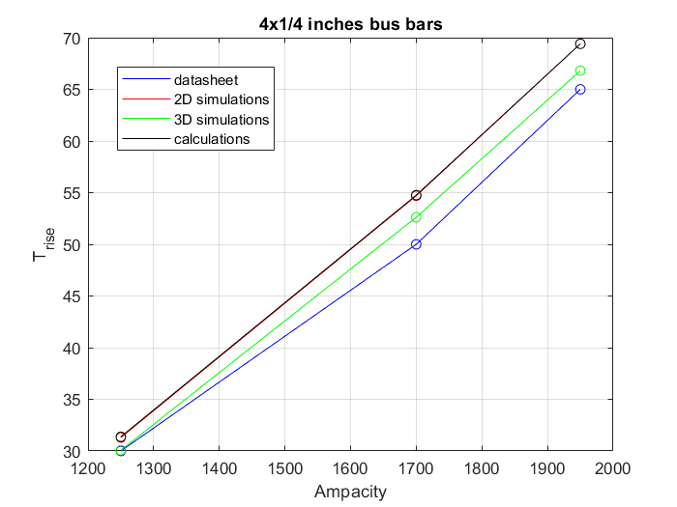
Preliminary analysis
Preliminary evaluations have been made:
Investigating possible solutions to the problem
Analytical lumped model of the busbars assembly
2D COMSOL simulations of single bus bars
3D COMSOL simulations of single bus bars
$$− hA\left(T−T_{∞}\right)−εσA\left(T^{4}−T_{∞}^{4}\right)+{\dot{Q}}_{joule}=ρcV\frac{dT}{dt}$$
Comparison of different datasets

Slide 36
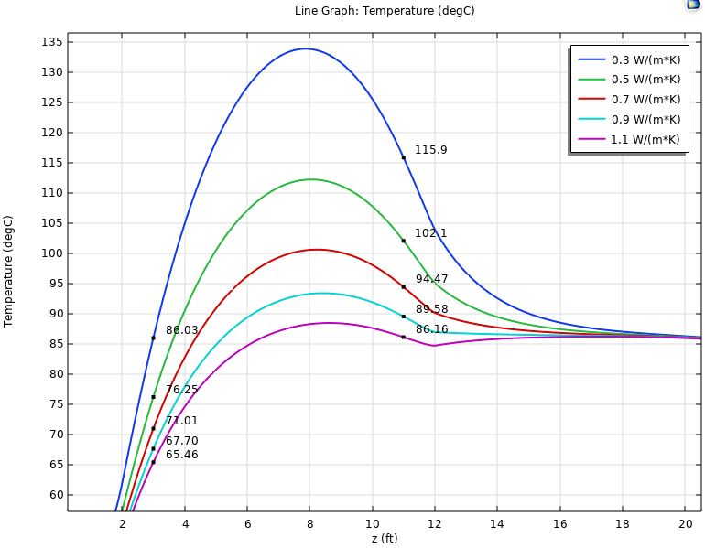
Parametric sweep
Soil thermal conductivity
Changes with the time of the years and the weather conditions
Affects greatly the results of the simulations
Finally, a value of 0.7W/mK has been chosen.

Slide 37
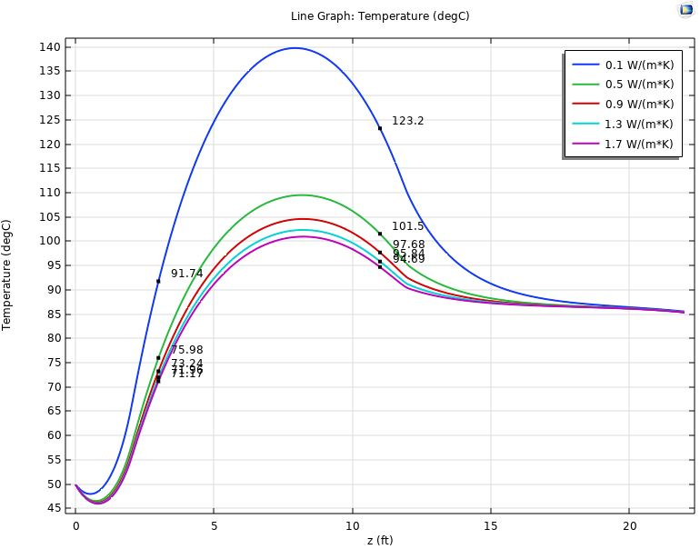
Parametric sweep
Concrete thermal conductivity
Not specified in literature
Affects greatly the results of the simulations
Finally, a value of 1.7W/mK has been chosen.

Slide 38
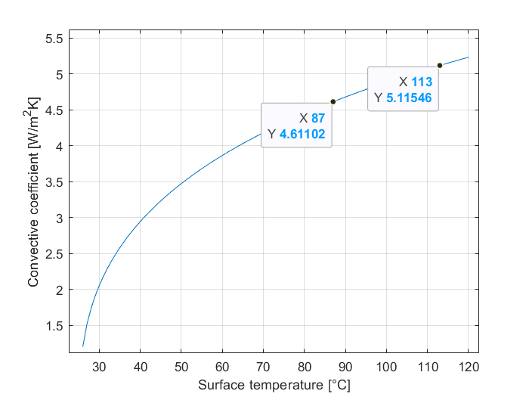
Natural convection calculations
Natural convection coefficient h can be evaluated from adimensional number of Nusselt, $Nu=hδ/k$.
Grashof number:
$$Gr= \frac{g ΔT βδ^{3}}{ν^{3}}$$
Prandtl number:
$$\operatorname{Pr}{=\frac{α}{ν}}$$
Rayleigh number:
$$Ra=\operatorname{Pr}{⋅Gr}$$
And from the Ra number it is possible to use experimental correlations to calculate $Nu$.

Slide 39
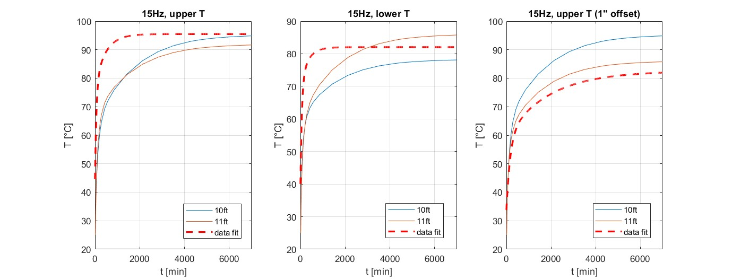
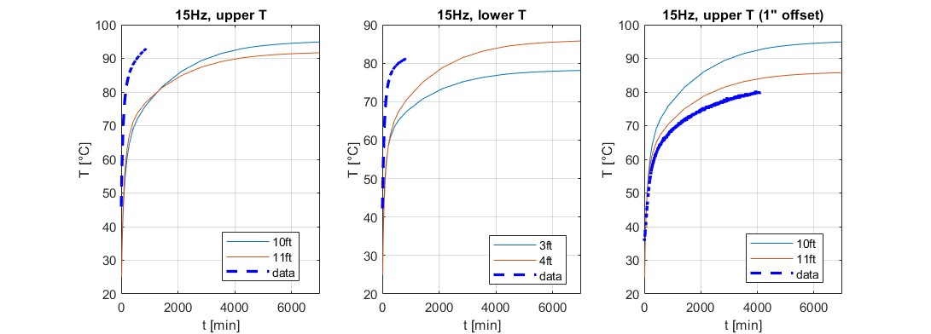
Transient comparison (4x1/4”, present conditions)
Test
4ft
3ft

Slide 40
Transient comparison (4x1/4”, present conditions)
Test
4ft
3ft

Slide 41
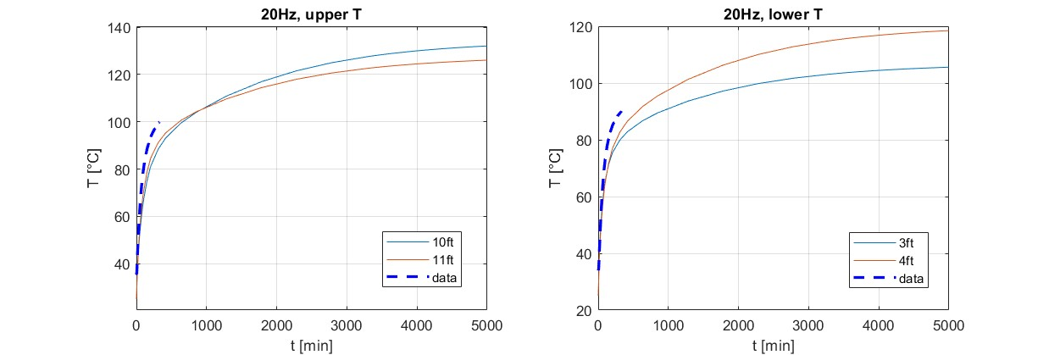
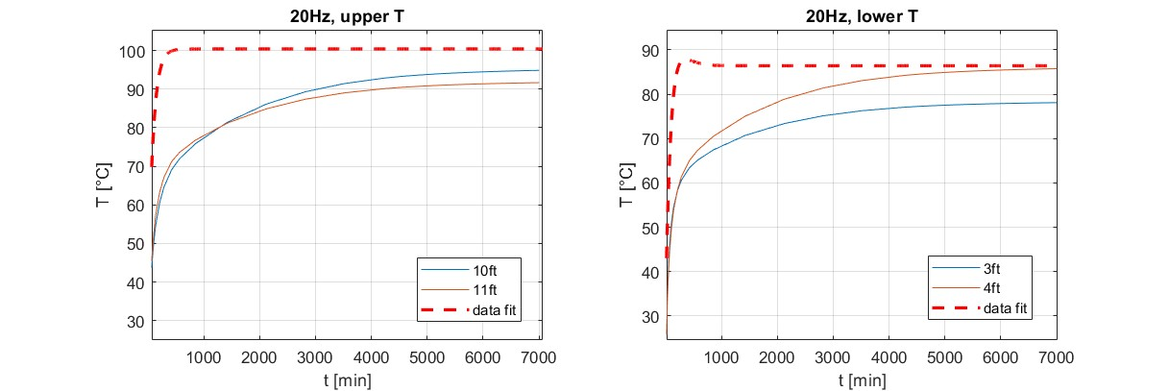
Transient comparison (4x1/4”, PIP-II conditions)

Slide 42
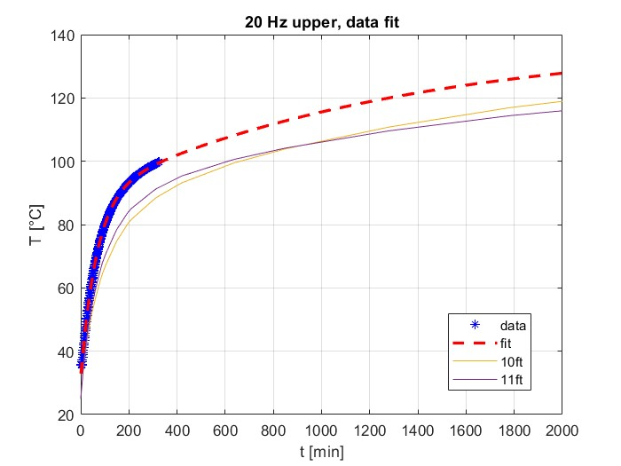
Transient comparison (4x1/4”, PIP-II conditions)

Slide 43
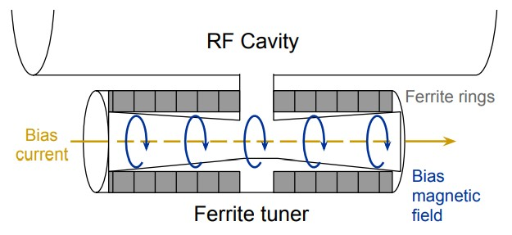
Biasing ferrite tuners
- Modern high-energy accelerators use conducting structures known as RF cavities
RF cavities are electromagnetically resonant
Synchrotrons require the RF frequency to increase with the beam energy- so the resonant frequency of the cavities must be changed. This is accomplished using ferrite tuners.
The ferrite of the tuners changes the inductance of the system, thus altering the resonant frequency of the cavity. This happens when a large amount of current is applied to the tuner- it creates a biasing field that changes the magnetic permeability of the tuner itself.
Applying a large current causes a decrease in magnetic permeability.
RF cavity with ferrite tuner
© FERMILAB Accelerator division –
operations department

Slide 44
Another way around the problem
Instead of focusing on reducing the temperature, another effective way to solve the problem would be reducing the current needed by the ferrite tuners.
This can be done in different ways, such as changing the harmonic number of the accelerator or redesigning the ferrite tuners.
The harmonic number is defined as $h=\frac{f_{RF}}{f_{rev}}$. It is the number of RF oscillations completed in the time it takes a particle to traverse one orbit.
RF cavities resonate in a range of frequencies, as the current changes the magnetic permeability of the ferrite tuners (and therefore the resonant frequency).
RF cavity with ferrite tuner
© FERMILAB Accelerator division –
operations department
Notes:
Now, the solution that has been discussed until now has potential but it doesn’t address the root of the problem. Another way to look at the problem would be finding a way to reduce the current, which can be done in many ways. Some of the ways would be changing the harmonic number of the accelerator, or redesigning the ferrite tuners. The goal of this section is finding a transfer function from RF frequency to bias current.
As the current increase the permeability decreases, which increases the Q and changes the resonant frequency.

Slide 45
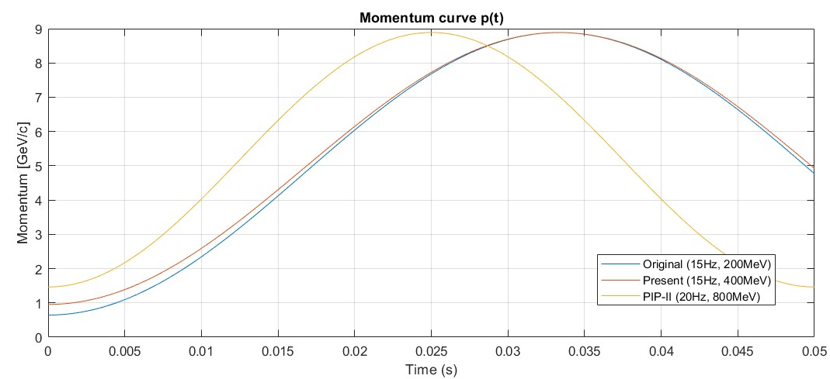
Calculating RF frequency curves
Momentum curves
$$p\left(t\right)=\frac{p_{f}+p_{i}}{2}−\frac{p_{f}−p_{i}}{2}cos⁡(ωt)$$
Total energy
$$E_{TOT}\left(t\right)=m_{p}^{2}c^{4}+p^{2}\left(t\right)c^{2}$$
$$γ\left(t\right)=\frac{E_{TOT}(t)}{m_{p}}$$
$$ω=2πf$$ $f →$ machine frequency
$$p_{i}=\sqrt{{\left(\frac{KEi+m_{p}c^{2}}{c}\right)}^{2}−m_{p}^{2}c^{4}}$$
$$p_{f}=\sqrt{{\left(\frac{KE_{f}+m_{p}c^{2}}{c}\right)}^{2}−m_{p}^{2}c^{4}}$$
$$β\left(t\right)= \sqrt{1−1/γ^{2}(t)}$$
Revolution frequency
$$f_{rev}\left(t\right)=\frac{βc}{C}$$
RF frequency
$$f_{RF}\left(t\right)=h⋅f_{rev}(t)$$
$$C →Booster circumference$$
Notes:
Without going too much into details, this is the path that has been followed to obtain the RF frequency as a function of time. As you can see, it is a function of many fixed values (rev. frequency inj-ext is fixed), while the harmonic number can be, in theory, changed.

Slide 46
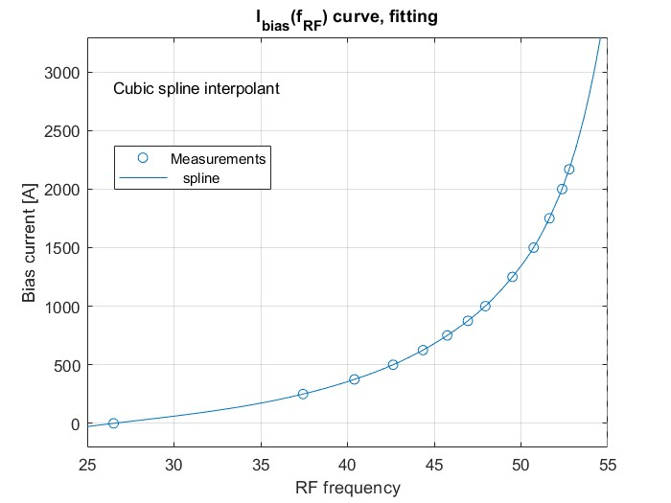
RF frequency – Bias current transfer function
Fitting experimental data:
Calculating new $I_{RMS}$:
Harmonic number
h = 84
RMS current
IRMS = 1695A
h = 75
IRMS = 770.1A
Spline interpolation of experimental data
Current ranges for different h
Notes:
Using a spline interpolation, it is possible to obtain the current range for each fRF curve obtained for the different harmonic numbers. It can be seen clearly how this is going to lower the RMS current and therefore solve the problem and, last but not least, save a lot of energy.

