Slide 1
New jet tagging techniques in Vector Boson Scattering (VBS) WV analysis in the semi-leptonic channel with the CMS experiment
Raffaele Delli Gatti, Irene Zoi, Jennifer Ngadiuba
Final reports – Summer Trainings
27 September 2023

Slide 2
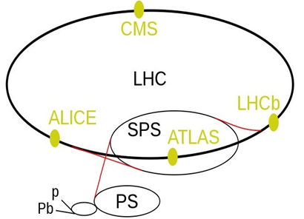
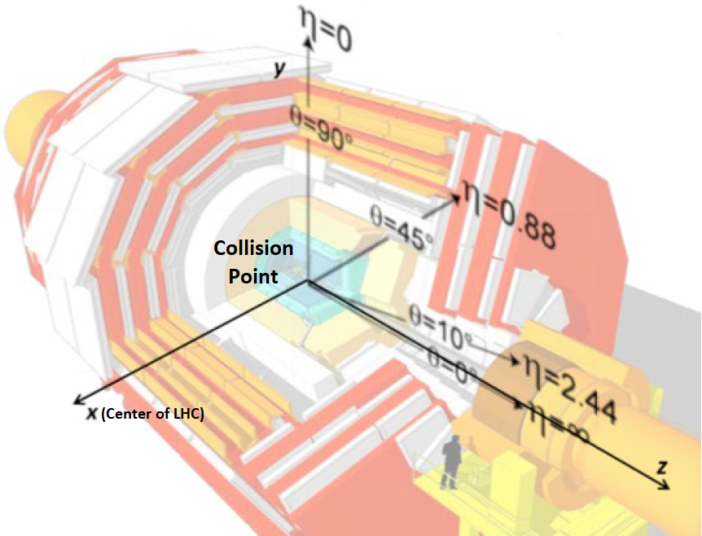
The Compact Muon Solenoid at the LHC
Carthesian $(x,y,z)$ and cylindrical $\left(r,η,\text{φ}\right)$coordinates
$$r$$
$$φ$$
Run I (2010-2012)
Run II (2015-2018)
Run III (2022-)
Pseudorapidity $η=−ln$ $tanθ/2$
Angular distance $∆R=\sqrt{{∆η}^{2}+{∆\text{φ}}^{2}}$
Momentum, energy measured in the transverse plane:
$$p_{T}=\sqrt{p_{x}^{2}+p_{y}^{2}}, E_{T}=\sqrt{m^{2}+p_{T}^{2}}$$
Missing Transverse Energy (MET): $E_{T}=\left|−\sum_{i}{{\overline{p}}_{T_{i}}}\right|$
CMS Detector

Slide 3
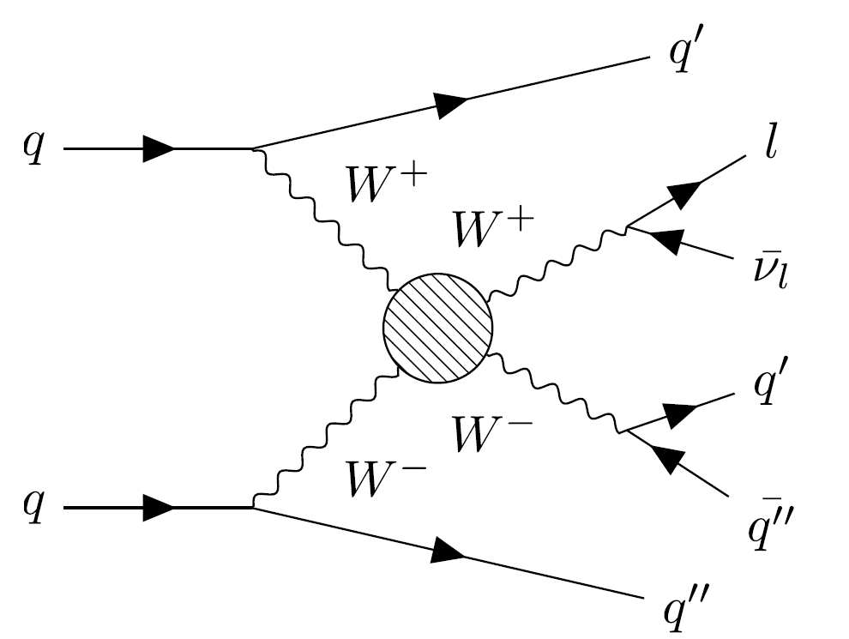
Introduction and motivation
WV(V=Z,W) VBS scattering in the semileptonic channel
The W boson decaying leptonically and the other boson hadronically
Two high energetic jets in the forward regions and reduced jet activity in the central region
Purely EWK rare process at LO with 6 fermions in the final state and large background contamination
First evidence of the SM process at the LHC in 2021 [PLB 834 (2022) 137438] using full Run II
Signal significance of 4.4 standard deviations, to be increased for $5σ$ observation
Also Important for BSM searches, such as anomalous Quartic Gauge Couplings

Slide 4
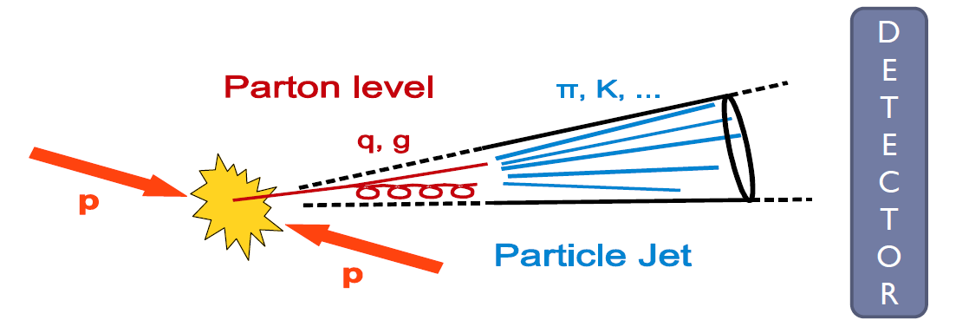
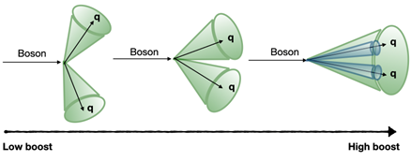
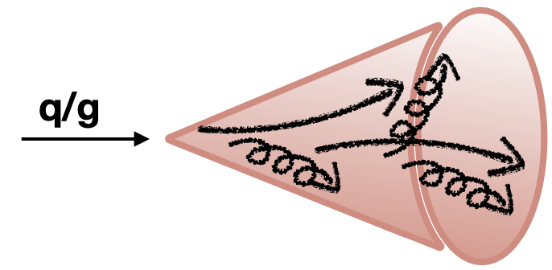
Jet clustering and tagging
Jets are signatures of quarks and gluons
Parton Showering $→$ Hadronization $→$ Jets of colorless particles
Jet tagging: identify the particle that initiated a jet
Boosted hadronic objects have a different energy pattern than background jets of comparable invariant mass
Boosted W boson jet
Boosted background jet

Slide 5
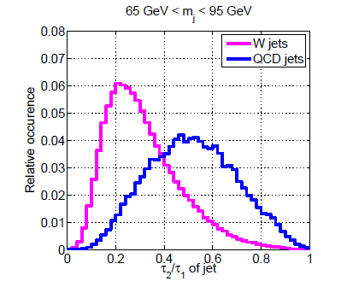
N-subjettiness
Traditional tagging method [JHEP 03 (2011) 015]
Effective discriminating variable for tagging boosted objects (at high Lorentz boost) and rejecting the background of QCD jets with large invariant mass
For a large enough boost factor, the decay and fragmentation yields a collimated spray of hadrons which a standard jet algorithm would reconstruct as a single jet
Jet shape variable (it tells how likely a jet has N subjets): $τ_{N}$
$τ_{2}/τ_{1}$ is an effective discriminating variable to identify two-prong objects like boosted W, Z, and Higgs bosons

Slide 6
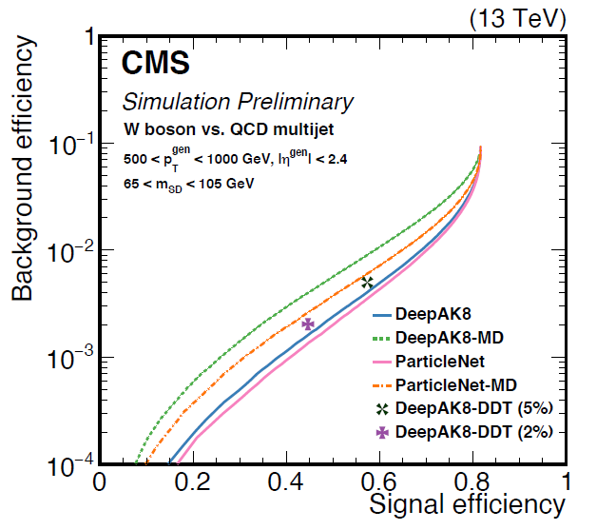
ParticleNET
Improving boosted top, W, Z or Higgs tagging techniques by using machine learning, most notably deep neural networks (DNNs) [PRD 101 (2020) 056019]
$$Signal efficiency =\frac{\# selected signal events}{\# signal events}$$
$$Background efficiency =\frac{\# selected bkg events}{\# bkg events}$$

Slide 7
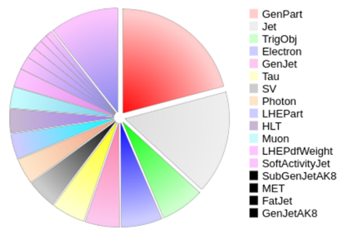
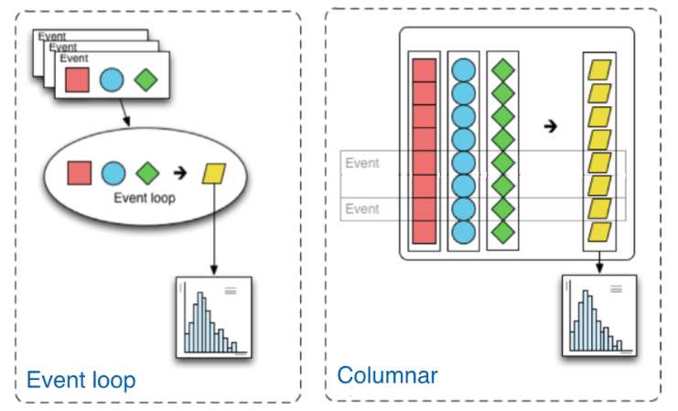
NANOAOD and Coffea
NANOAOD composition
NANOAOD: a new event data format by CMS
ntuples with per event information ($\sim 1$kB per event)
A factor of 20 smaller than the MINIAOD
Only top-level information and physics objects used in the last steps of the analysis
Columnar Analysis with Coffea Framework
The columnar approach has no explicit event loops: 100 times faster
The fields of data are treated as awkward arrays: array of subarrays of arbitrary length
[[Muon, Muon], [Muon], [], [Muon, ... [Muon]]

Slide 8
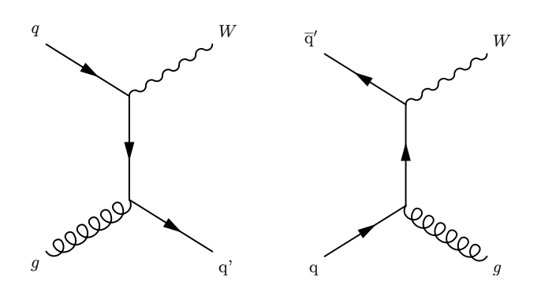
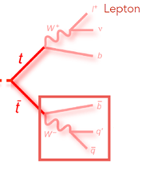
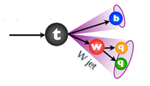
Backgrounds contributions
Main sources
W + jets
Top: $t\overline{t}$, single $t$, $tW$, $tZ$

Slide 9
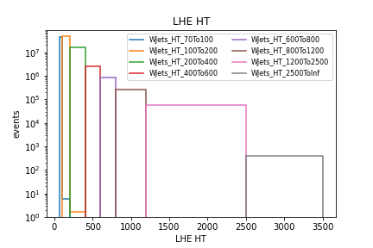
W + jets background
W+jets HT-binned samples
$HT=\sum_{i=1}^{N_{jet}}{E_{T}}$
Variable characterizing the visible energy in the transverse plane
Increased statistic in ensured at different scales of energy with respect to inclusive LO generation

Slide 10
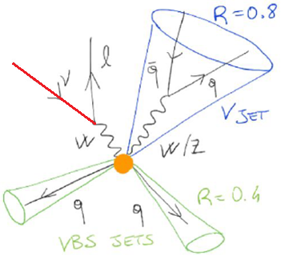
Characterization of the phase space
Kinematic cuts to define the electron signal region
Boosted category
One isolated lepton ($electron$) in the final state, moderate Missing Transverse Energy
1 FatJet (anti-kt $R=0.8$ jet) from hadronic decay of W boson
Invariant mass cut on the hadronically decaying W: $70 GeV<m_{SD}<115 GeV$
At least 2 jets (anti-kt R=0.4) tagged as VBS jets (max invariant mass pair)
$$E_{T}=\left|−\sum_{i}{{\overline{p}}_{T_{i}}}\right|$$

Slide 11
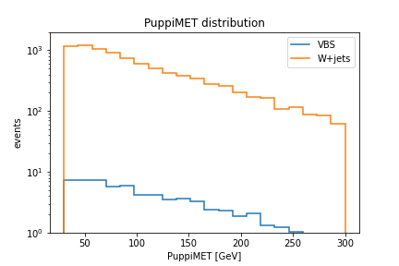
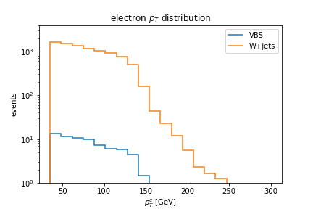
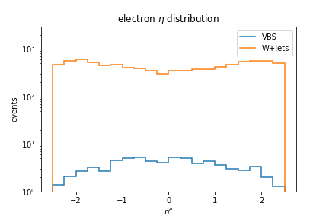
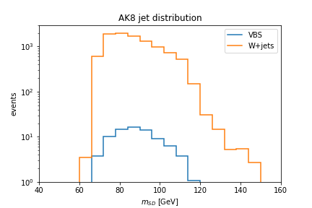
Kinematic distributions
$$p_{T}=\sqrt{p_{x}^{2}+p_{y}^{2}}$$
Pseudorapidity $η=−ln$ $tanθ/2$

Slide 12
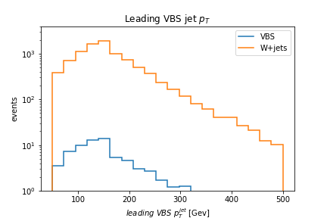
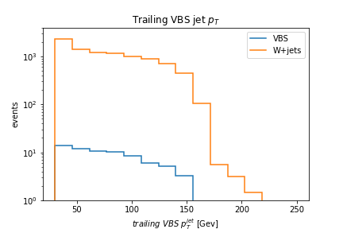
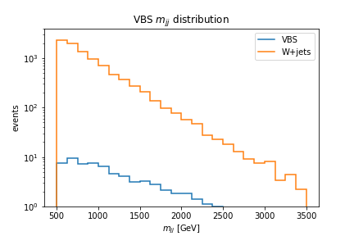
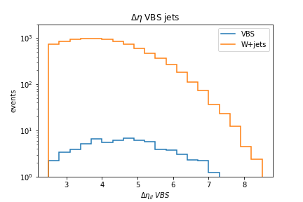
Kinematic distributions

Slide 13
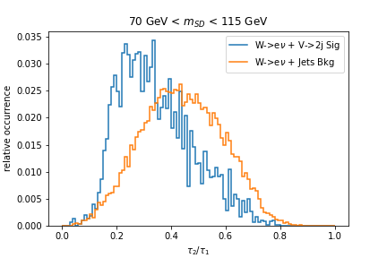
Working point of the official analysis
N-subjettiness
$$Signal efficiency=78\%$$
$$Background efficiency=53\%$$
$τ_{2}/$ $τ_{1}<0.45$

Slide 14
Efficiency studies for different working points
N-subjettiness
$$Signal efficiency=95\%$$
$$Background efficiency=85\%$$
$τ_{2}/$ $τ_{1}<0.$6

Slide 15
Efficiency studies for different working points
N-subjettiness
$$Signal efficiency=43\%$$
$$Background efficiency=18\%$$
$τ_{2}/$ $τ_{1}<0.3$

Slide 16
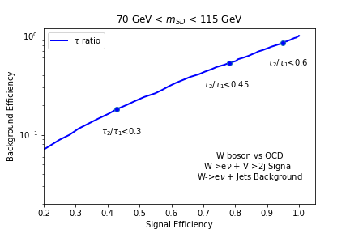
Tagging Efficiency
N-subjettiness
WP

Slide 17
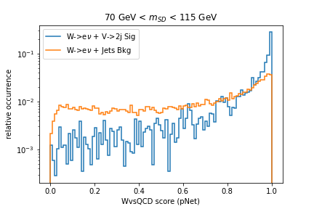
Efficiency studies for different working points
ParticleNET
$$Score>X\%$$

Slide 18
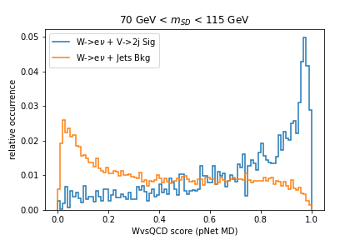
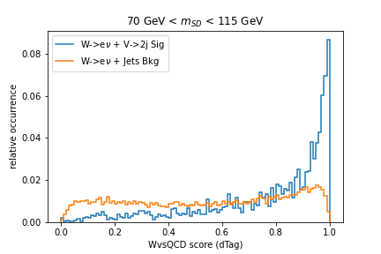
Jet tagging variables
N-subjettiness
ParticleNET
pNET MD
DeepTag

Slide 19
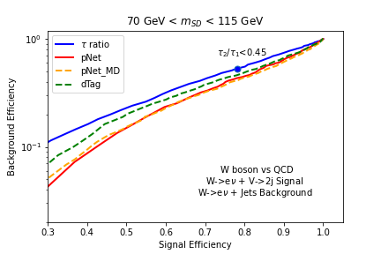
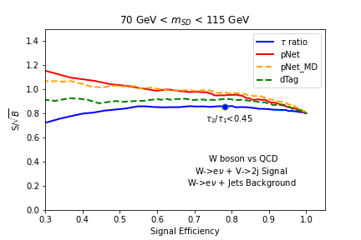
Efficiency and sensitivity studies
Background efficiency reduction $\sim 20\%$, sensitivity gain $\sim 11\%$ for a signal efficiency of $78\%$

Slide 20
Conclusions
$WV(V=Z,W)$ Vector Boson Scattering in the semi-leptonic $lνq\overline{q}$ channel
Coffea Framework to analyze NANOAOD data version 9
Electron signal region, W + jets background
Latest developments in ML-based identification algorithms of highly Lorentz boosted heavy particles in CMS
Compared to N-subjettiness, ParticleNet shows background efficiency reduction $\sim 20\%$ and sensitivity gain $\sim 11\%$, for a signal efficiency of $78\%$, in the context of the VBS WV analysis
Further studies:
Tagging efficiency and sensitivity also in the muon signal region
Z vs QCD score
Study of the top background
Include full Run II statistics

Slide 21
Thank you for your attention

Slide 22
Backup

Slide 23
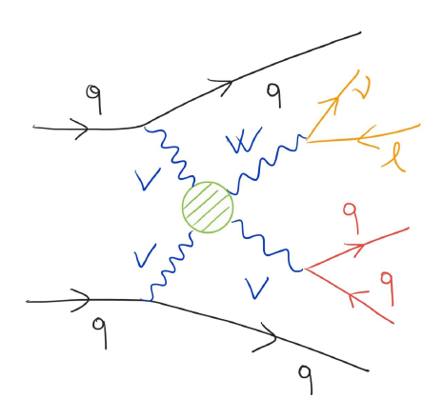
Outline
The Compact Muon Solenoid at the Large Hadron Collider
$WV(V=Z,W)$ Vector Boson Scattering in the semi-leptonic $lνq\overline{q}$ channel
Jet tagging techniques
N-subjettiness and ParticleNet
NANOAOD and Coffea Framework
Phase space and distributions
Efficiency and sensitivity gain

Slide 24
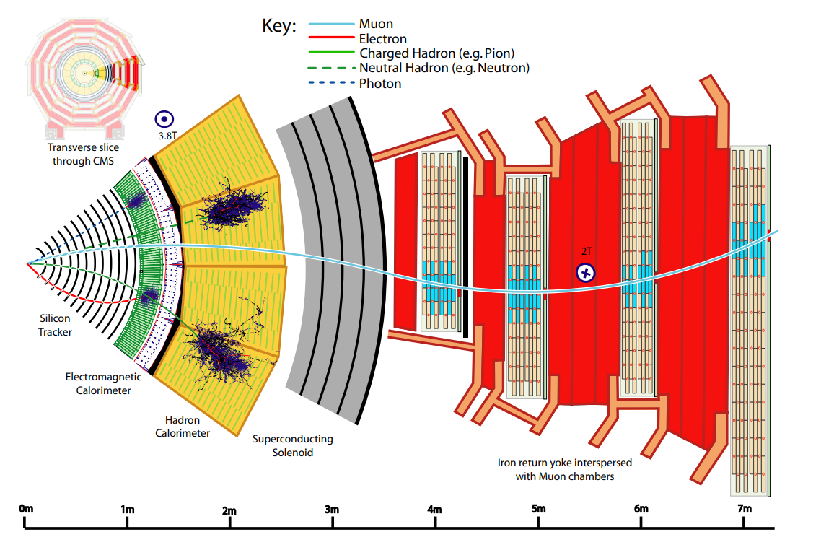
The Compact Muon Solenoid
Multi-purpose detector (Cessy, France)
Cylindrical structure, around the interaction point
Sub-detectors
Superconducting solenoid magnet, $3.8 T$
Barrel and endcap regions
Particle flow (PF) algorithm to reconstruct final state particles

Slide 25
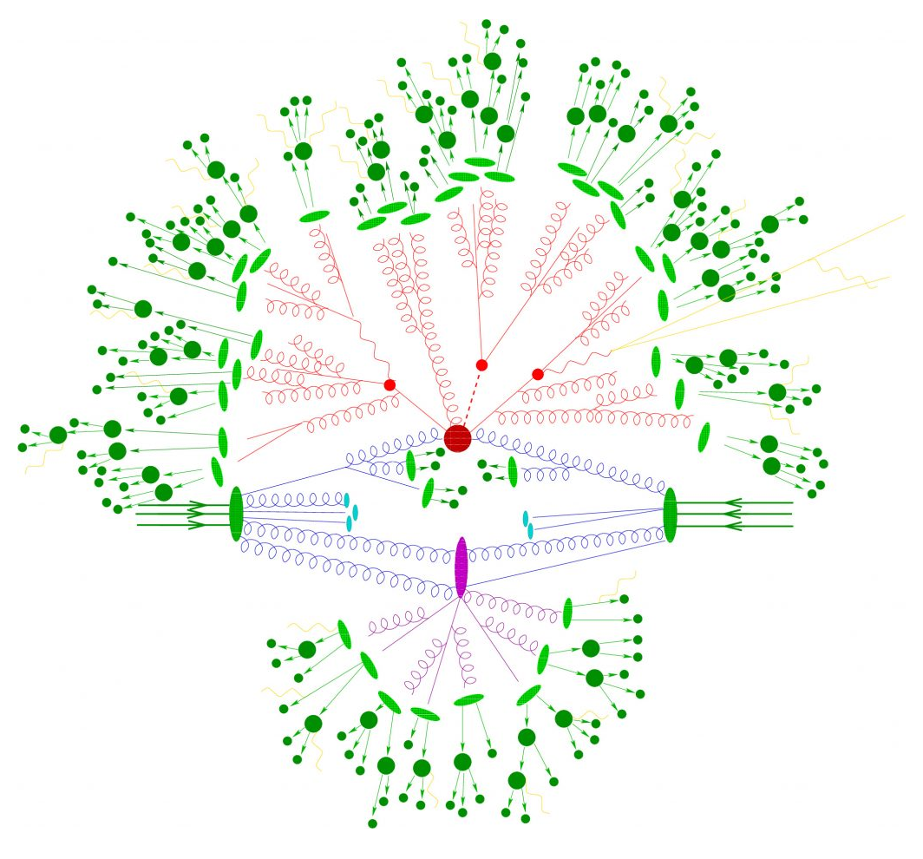
Structure of a proton-proton collision at LHC
Structure of a proton-proton collision
Hadronization
Particle decays
Hard subprocess
Parton showers
Valence quarks
Valence quarks
Incoming proton
Incoming proton
Initial partons
(quarks or gluons)
Underlying event

Slide 26
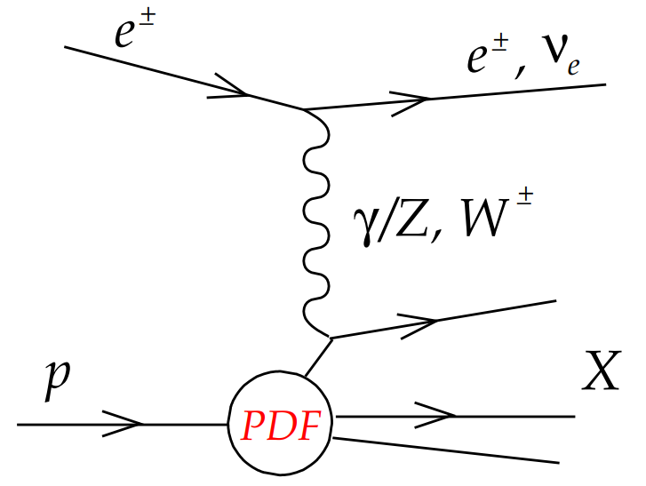
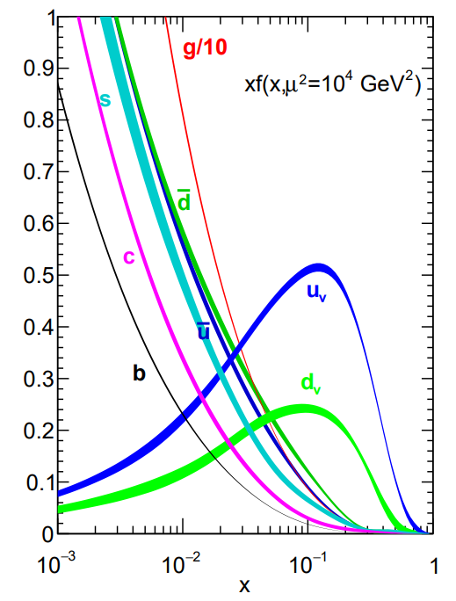
Monte Carlo generation
PARTON DISTRIBUTION FUNCTIONS (PDFs)
In hadron collisions at the LHC, the colliding protons presents an internal structure: valence quarks interact via gluons, from which virtual quark-antiquark pairs arise (sea quarks)
Dynamics of the systems resulting in a distribution of the parton momenta, to be determined by experiments (non-perturbative QCD), such as electron-proton deep inelastic scattering
$$p_{1}$$
$$q^{2}$$
$$p_{2}$$
Each parton carries an unknown fraction $ξ$ of the proton momentum: statistical distribution $f\left(ξ\right).$ There are two independents variables:
Bjorken scaling $x≡\frac{Q^{2}}{2p_{2}∙q}$ with $Q^{2}=−q^{2}$, $0≤x≤1$
Inelasticity $y≡\frac{p_{2}∙q}{p_{2}∙p_{1}}≈\frac{Q^{2}}{x∙s},$ $s={\left(p_{1}+p_{2}\right)}^{2}≈2p_{1}∙p_{2}$, $0≤y≤1$
At high energies $E≫m_{p}, x≡ξ→$ PDF: f$\left(x,Q^{2}\right)$.

Slide 27
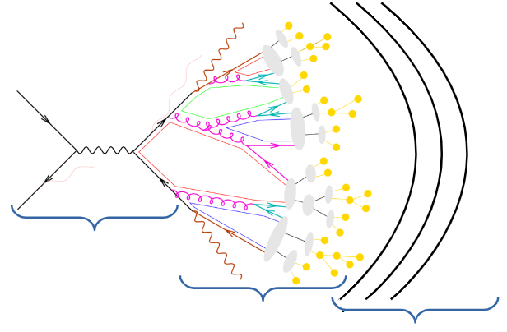
Simulated Monte Carlo sample of the signal
Process: $WlepWhadjj_EW$, $WlepZhadjj_EW$
Production campaign: Run II 2018
Collisions: proton-proton
Center-of-mass energy: 13 TeV
PDF: NNPDF3.1
Tuning: CP5 MC Tune
Format: NANOAODSIMv9
Matrix element
Generators: Madgraph (perturbative QCD and QED) interfaced with Pythia8 (non-perturbative QCD)
Parton Shower
Hadronization
Decays
Detector effects

Slide 28
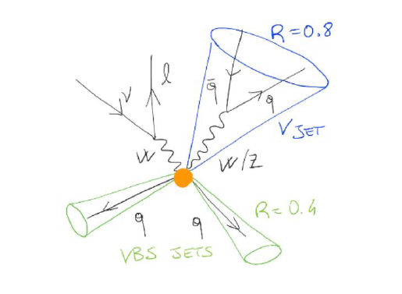
Characterization of the phase space
Kinematic cuts to define the signal region
Only one isolated tight lepton ($e, μ$) in the final state: $p_{T}^{e}>35 GeV$, $p_{T}^{μ}>30 GeV$
Events containing a second loosely identified lepton with $p_{T}>10 GeV$ are vetoed
Lepton pseudorapidity : $\left|η^{e}\right|<2.5$, $\left|η^{μ}\right|<2.4$
Moderate Missing Transverse Energy : $E_{T}>30 GeV$
1 FatJet (anti-kt $R=0.8$ jet) from hadronic decay of W boson: $p_{T}>200 GeV$, $η<4.7$
At least 2 jets (anti-kt R=0.4) tagged as VBS jets (max invariant mass pair): leading $p_{T}>50 GeV$, trailing $p_{T}>30 GeV$, $η<2.4$, ${∆η}_{VBS}>2.5$, $m_{jj}^{VBS}>500 GeV$
Boosted category

Slide 29
Characterization of the phase space
Reconstructed jet no overlapping with isolated leptons: $ΔR(j_{AK4},l)>0.4$, $ΔR(j_{AK8},l)>0.8$
AK4 jets no overlapping with AK8 jets: $ΔR(j_{AK4},j_{AK8})>0.8$
Transverse mass of the leptonically decaying W: $m_{W}^{T}<185 GeV$
Invariant mass of the hadronically decaying W:
$${70 GeV<m}_{W}<115 GeV$$
bVeto (no b jets)
Boosted category

Slide 30
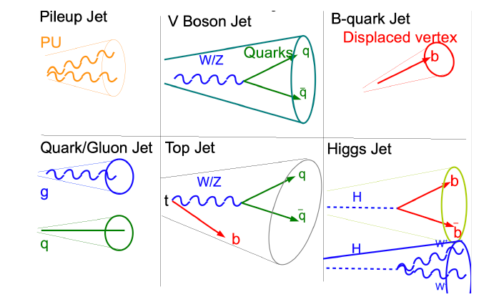
Jet clustering and tagging
Jets are signatures of quarks and gluons
Parton Showering $→$ Hadronization $→$ Jets of colorless particles
Jet algorithm allows to collect iteratively the particles belonging to a jet
Different types of jets
Larger cone: top jet
Smaller cone: W jet
Much smaller: b jet
Cone radius: $∆R=\frac{2m}{p_{T}}$
Jet tagging: identify the particle that initiated a jet
AK8: $R=0.8$
AK4: $R=0.4$

Slide 31
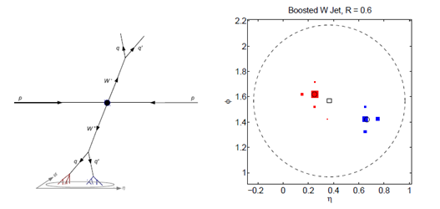
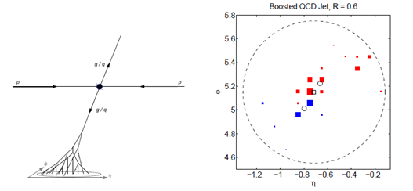
Boosted objects
Boosted hadronic objects have a different energy pattern than QCD jets of comparable invariant mass
A jet containing a boosted W boson should be composed of two distinct hard subjets, with invariant mass of $80$ GeV
A Boosted QCD jet of 80 GeV originates from a hard parton, it gains mass through large angle soft splittings
Boosted W jet, $R=0.6$
Boosted QCD jet, $R=0.6$

Slide 32
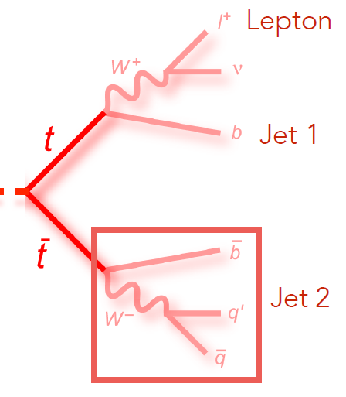
Background contributions
Main sources
Other contributions
W + jets
Top: ttbar, single top, tW, tZ
QCD-VV
Non-prompt: data-driven estimation with fakable object technique
VBF-V: single V boson EWK production
Drell-Yan
ggWW, VVV, Vgamma: very small contribution

Slide 33
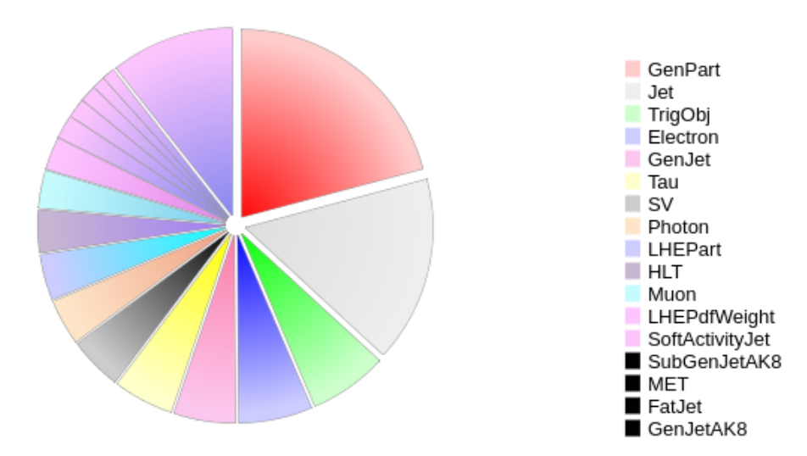
NANOAOD data format
A new event data format designed by the CMS collaboration
Satisfy the needs of a large fraction of physics analyses (at least 50%) with a per event size of order 1 kB.
More than a factor of 20 smaller than the MINIAOD format
Only top level information and physics objects typically used in the last steps of the analysis
Typical format of user ntuples, containing per event information
NANOAOD composition

Slide 34
Coffea Framework
Columnar Analysis with Coffea Framework
While the traditional way of analyzing data in HEP involves the event loop, the columnar approach has no explicit loops: 100 times faster
The fields of data are treated as arrays and analysis is done by way of numpy-like array operations.
Coffea builds upon awkward arrays with a variety of features that better enable us to do analyses
Array of subarrays, which have arbitrary length (they can even be empty)!
[[Muon, Muon], [], [Muon], [], [Muon, ... [Muon]]

