Slide 1
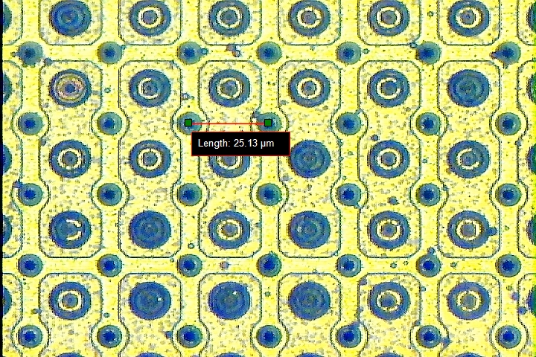
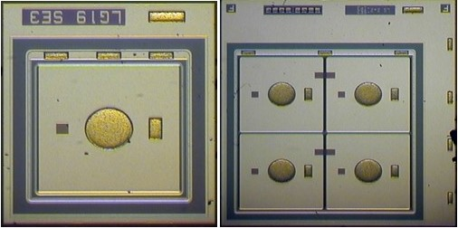
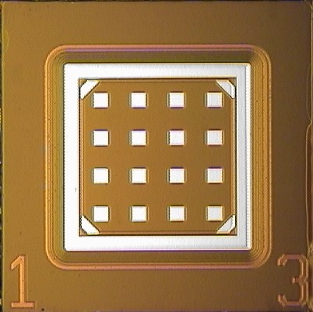
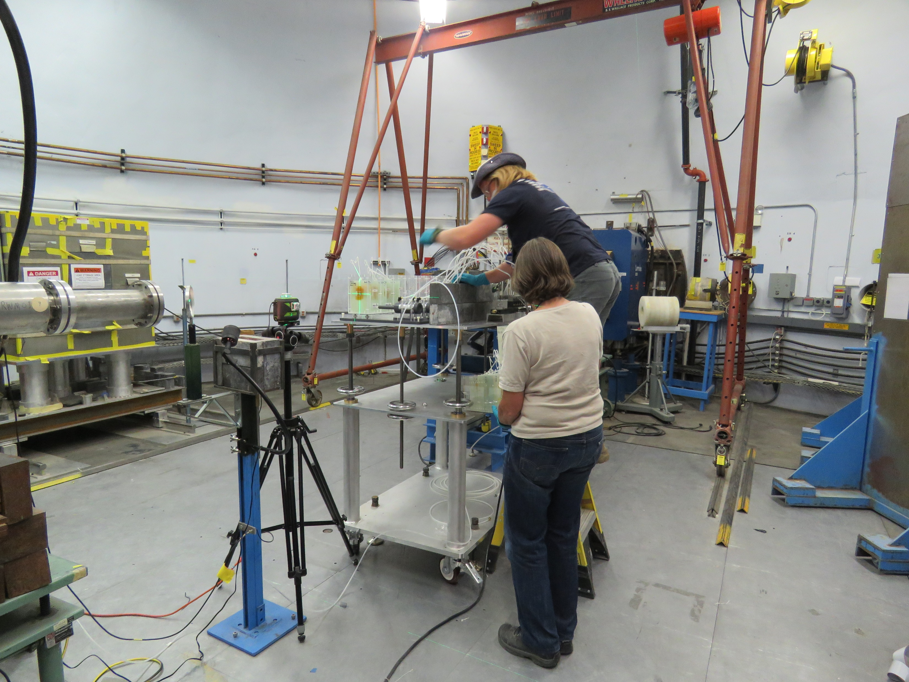
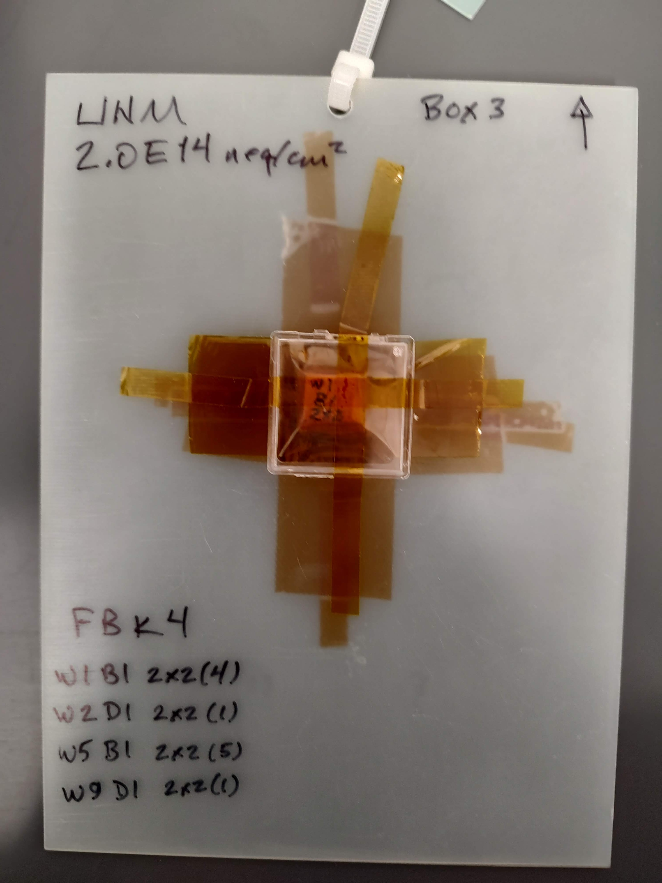
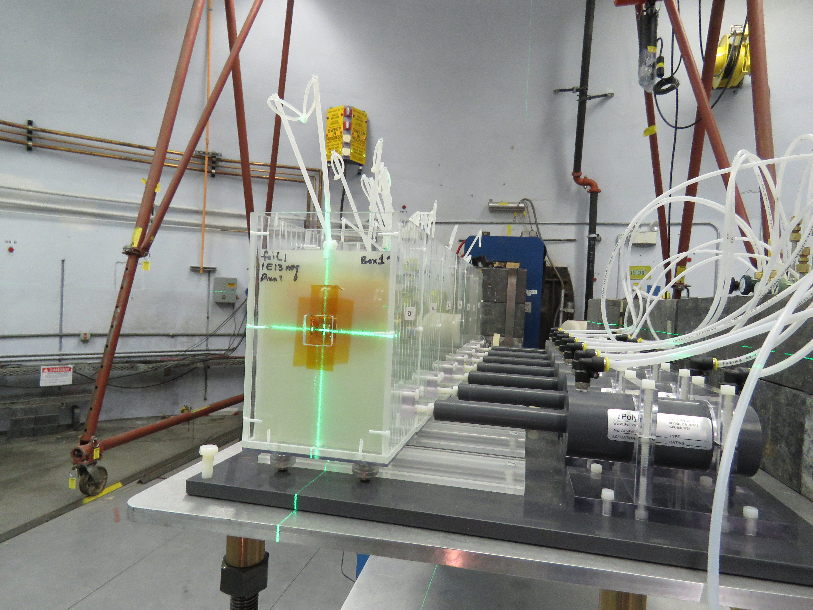
People: Sally Seidel (Professor), Jiahe Si (Electrical Engineer), Martin Hoeferkamp(retired Electrical Engineer, still actively contributing), Radek Novotny (Postdoc), Josef Sorenson (Grad), Easwar Narayanan (Grad), Andrew Gentry (Grad), Hijas Farook (Grad), Jordan Hernandez (undergrad)
We are currently studying 3D, LGADs, and AC-LGADs
We irradiate samples using protons, neutrons, and gammas using facilities at LANSCE, FNAL, and Sandia and evaluate the changes in characteristics that these induce.

Slide 2
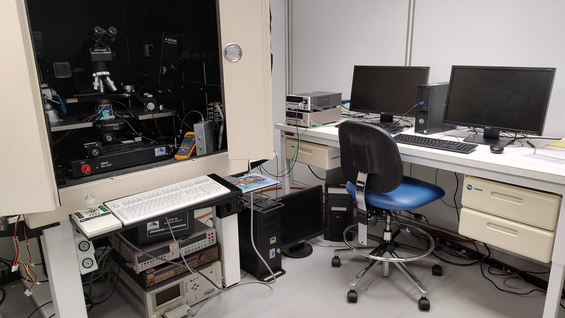
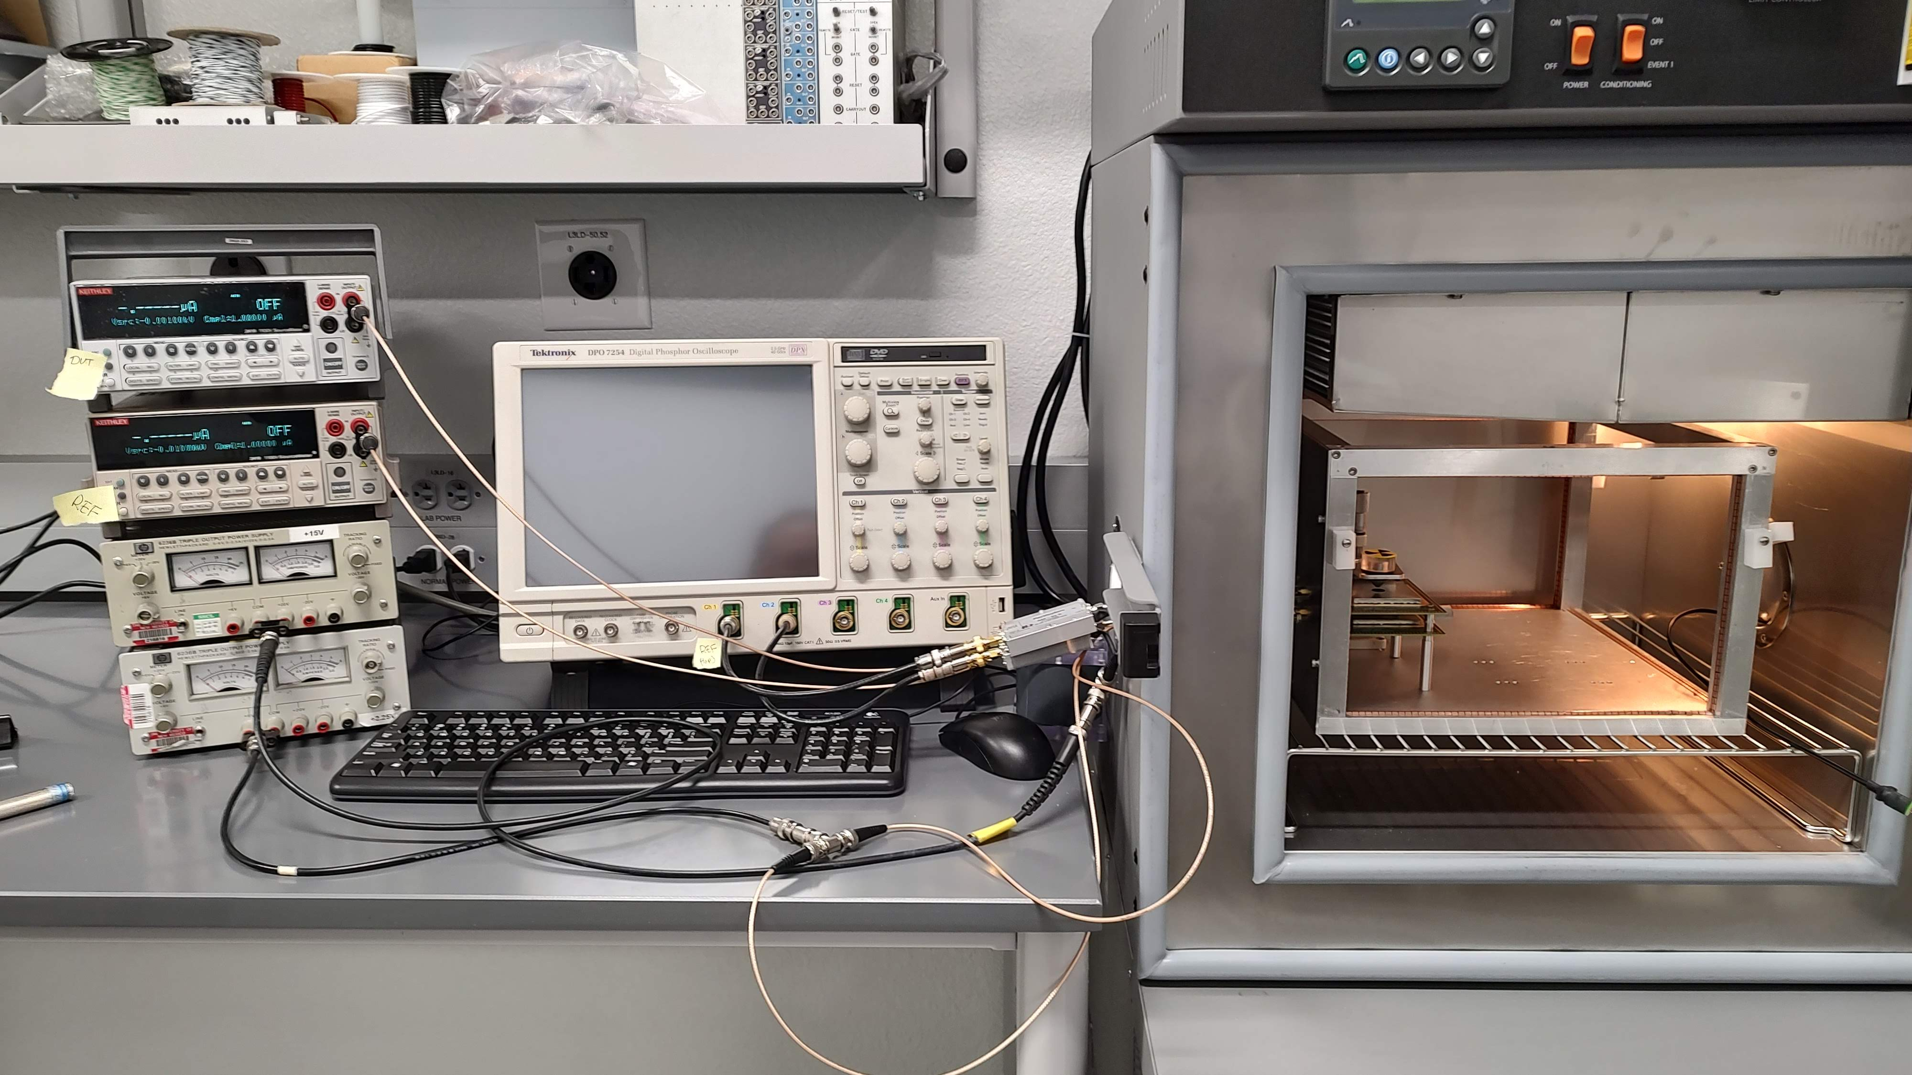
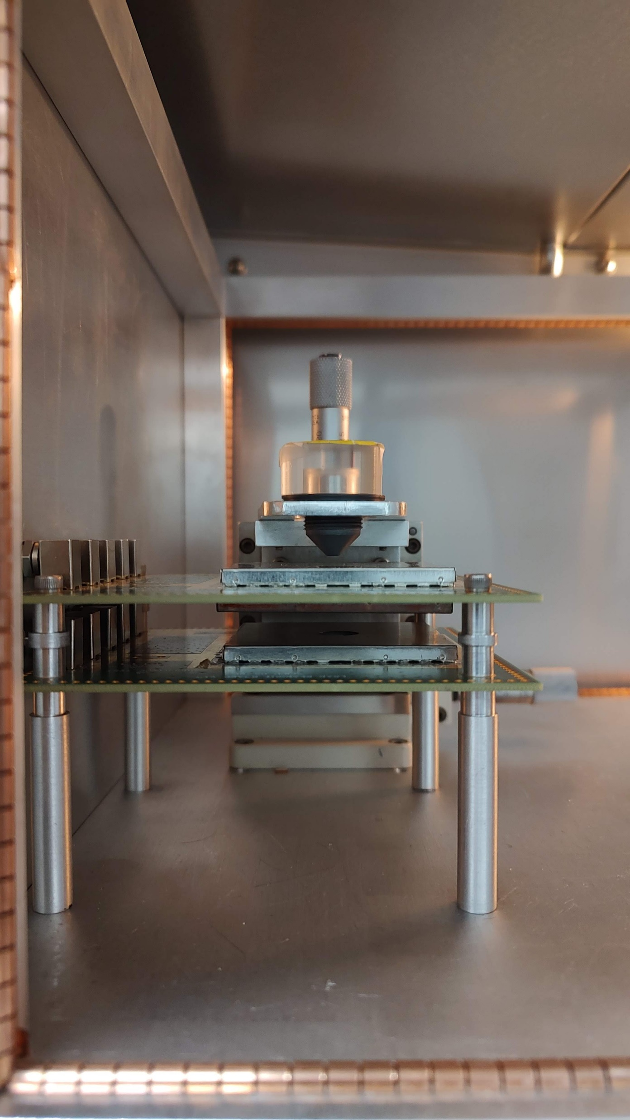
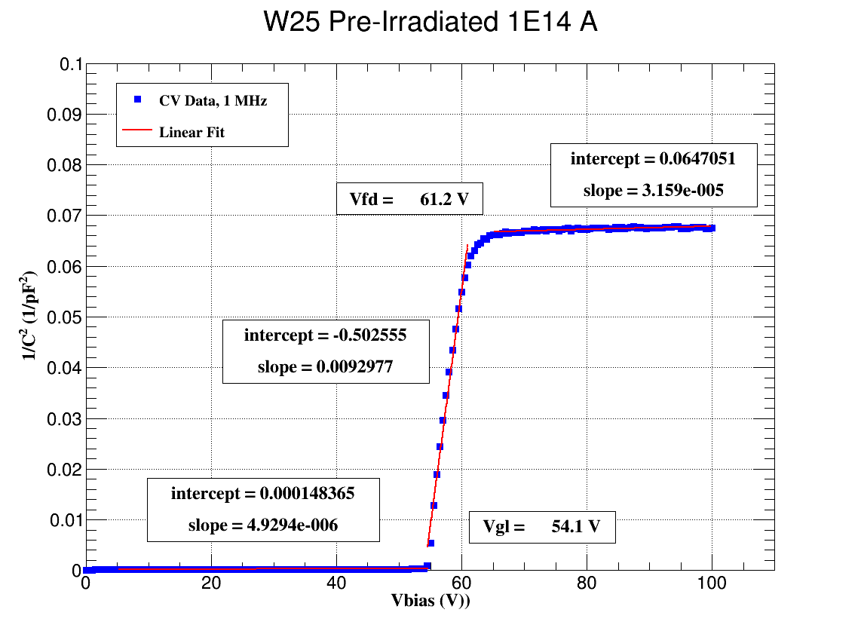
We study the sensors by measuring IV and CV characteristics.
We study the sensors’ timing and charge collection characteristics.
We are acquiring a TCT system, and we also develop software and hardware tools for particle sensor study.
Recent activities
J. Si, et al, Hadron damage investigation of FBK and HPK Low Gain Avalanche Detectors, CPAD Workshop 2022
A. Gentry, et al, Characterization Measurements of Small-Pitch 3D Silicon Sensors for Particle Physics Applications, CPAD Workshop 2022
M.R. Hoeferkamp, et al. Characteristics of Low Gain Avalanche Detectors Prototypes’ Response to Gamma Radiation, Front. Phys. 10.3389 (2022)
J. Sorenson, et al. Investigation of low gain avalanche detectors exposed to proton fluences beyond 10¹⁵ neq/cm² (prepared for submission to JINST)

