Slide 1
RDC3: solid state tracking Interests at Argonne
Jessica Metcalfe, Christine MClean

Slide 2
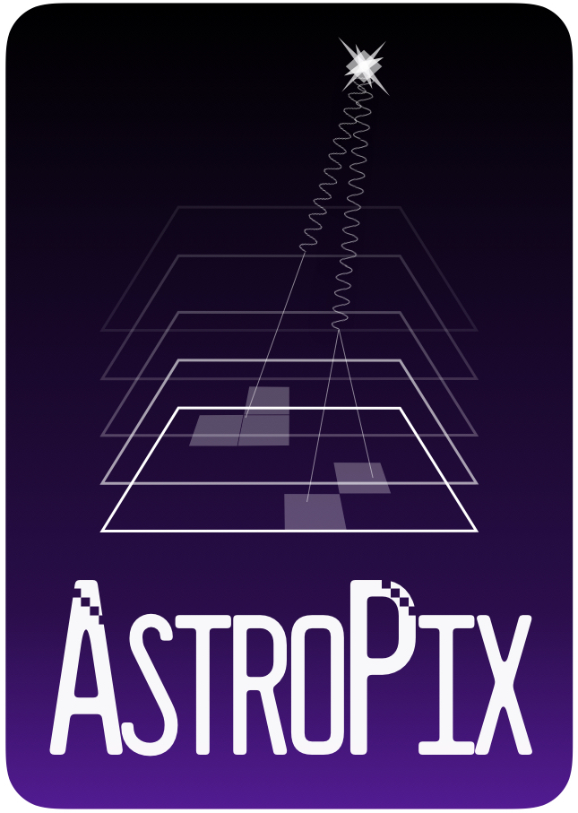
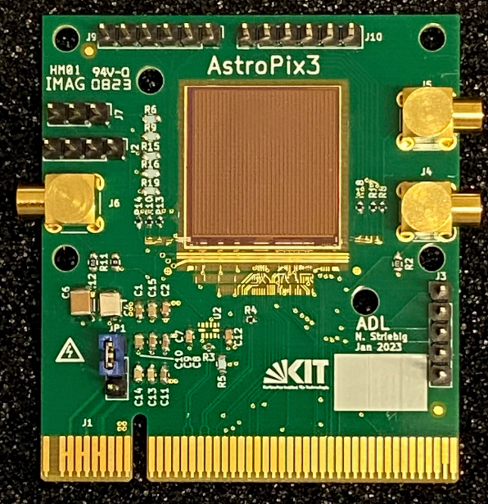
Current/past projects
ATLAS Pixels
Building 1,000+ modules @ANL
Inner System cooling & mechanics
Thin Film Detectors
novel approach to solid state tracking
Crystalline InP
JINST 18 P07047, July 2023
CMOS: AstroPix
Leverage ATLASPix
Large pixel 500 um pitch
Low power <1 mW/cm²
AMEGO-X (proposed)
EIC barrel Ecal
~100 m^2 silicon
https://arxiv.org/abs/2101.02665
https://arxiv.org/abs/2109.13409
https://arxiv.org/abs/2209.02631
https://arxiv.org/abs/2302.00101
https://pos.sissa.it/444/644/pdf
https://pos.sissa.it/444/579/pdf
LGADS
With UCSC/BNL
Test beam measurements
Aimed at EIC
CMOS sensor design in TCAD
2021 JINST 16 P06008

Slide 3
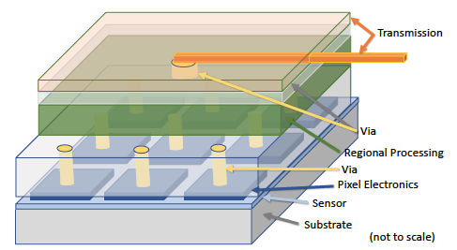
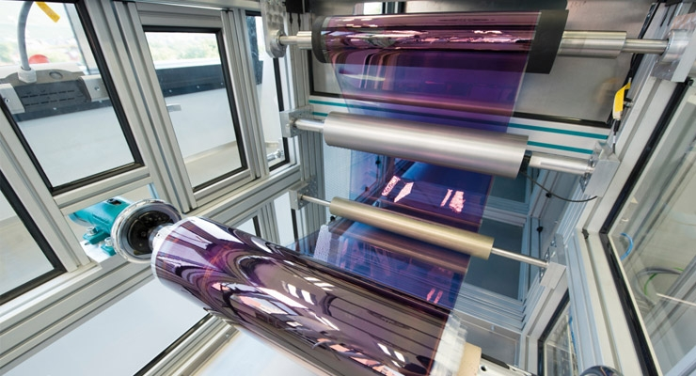
Interests
Thin Film Detectors
Low mass
Integrated vertical designs
Printable ‘roll-to-roll’ technologies
Fast Timing CMOS
LGAD sensor implemented in a CMOS process
Integrated Mechanics
Synergy with RDC3
Low mass cooling designs
Additive manufacturing or printing of complex objects—services integrated into carbon fiber supports

