Slide 1


QXFA237 Coil Review
Jesse Schmalzle
October 6, 2023

Slide 2
Outline
Coil Fab DRs
Additional Info
  Coil length, Pole gaps
  Reaction plots
  Electrical Data
Notes:
  Series coil.
  After to change for B6 adjustment.

Slide 3
QXFA237 - DRs
DRs posted to interface traveler.
Critical = Affecting Form, Fit or Function
(as found)

Slide 4
-
Additional Info…

Slide 5
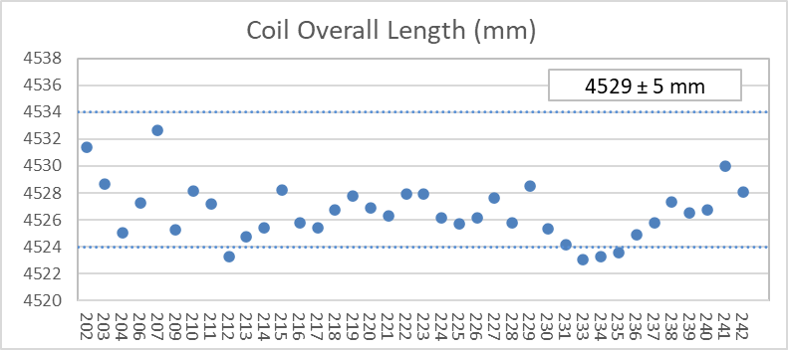
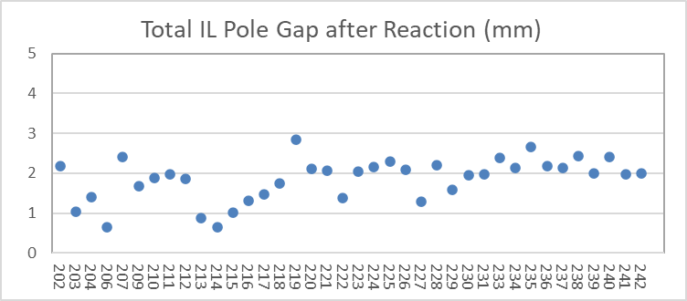
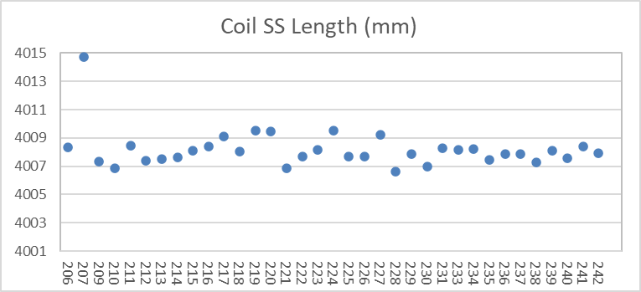
QXFA237 – Length, Gaps
Coil length within spec.
(207 error in initial pole gap setting)

Slide 6
QXFA237 - Reaction
No Data
Temperatures and dwell times all within spec.

Slide 7
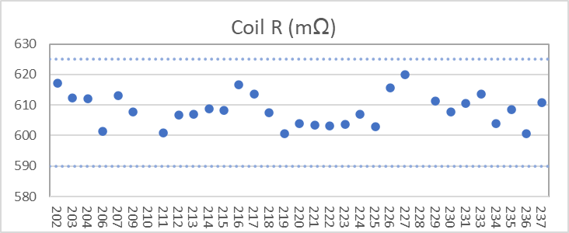
QXFA237 - Electrical
Final electrical checks – all passed

Slide 8
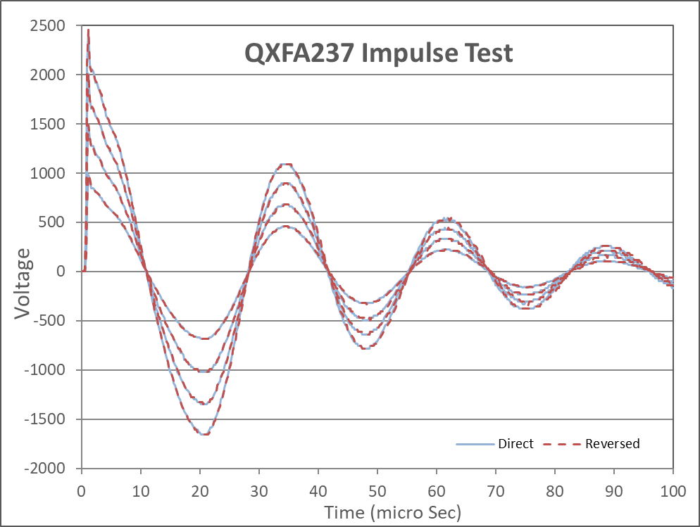
QXFA237 - Electrical

Slide 9
QXFA239 Coil Review
Jesse Schmalzle
October 6, 2023

Slide 10
Outline
Coil Fab DRs
Additional Info
  Coil length, Pole gaps
  Reaction plots
  Electrical Data
Notes:
  Series coil.
  After to change for B6 adjustment.

Slide 11
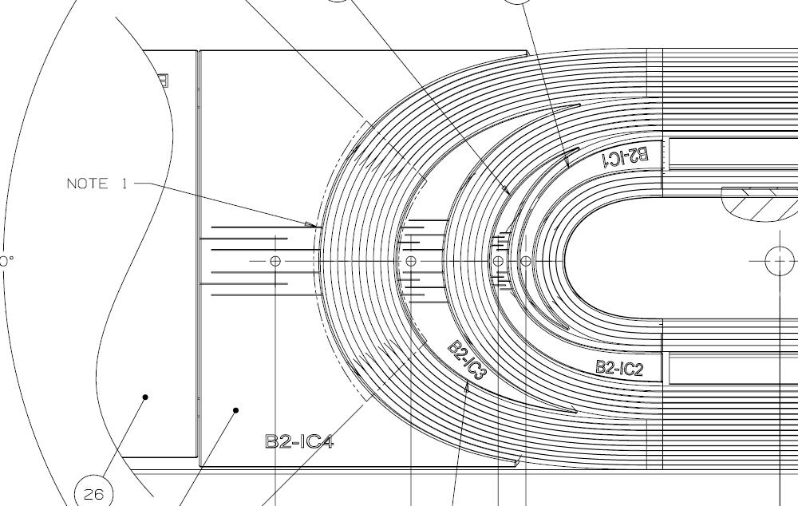
QXFA239 - DRs
DRs posted to interface traveler.
Critical = Affecting Form, Fit or Function
(as found)

Slide 12
-
Additional Info…

Slide 13
QXFA239 – Length, Gaps
Coil length within spec.
(207 error in initial pole gap setting)

Slide 14
QXFA239 - Reaction
Temperatures and dwell times all within spec.

Slide 15
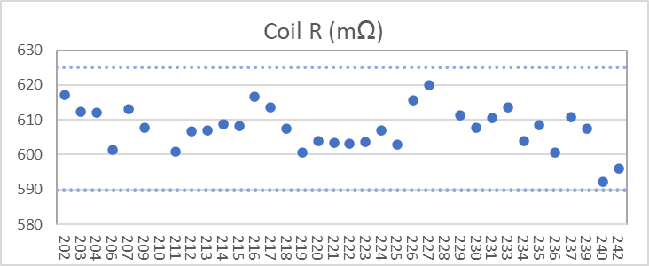
QXFA239 - Electrical
Final electrical checks – all passed

Slide 16
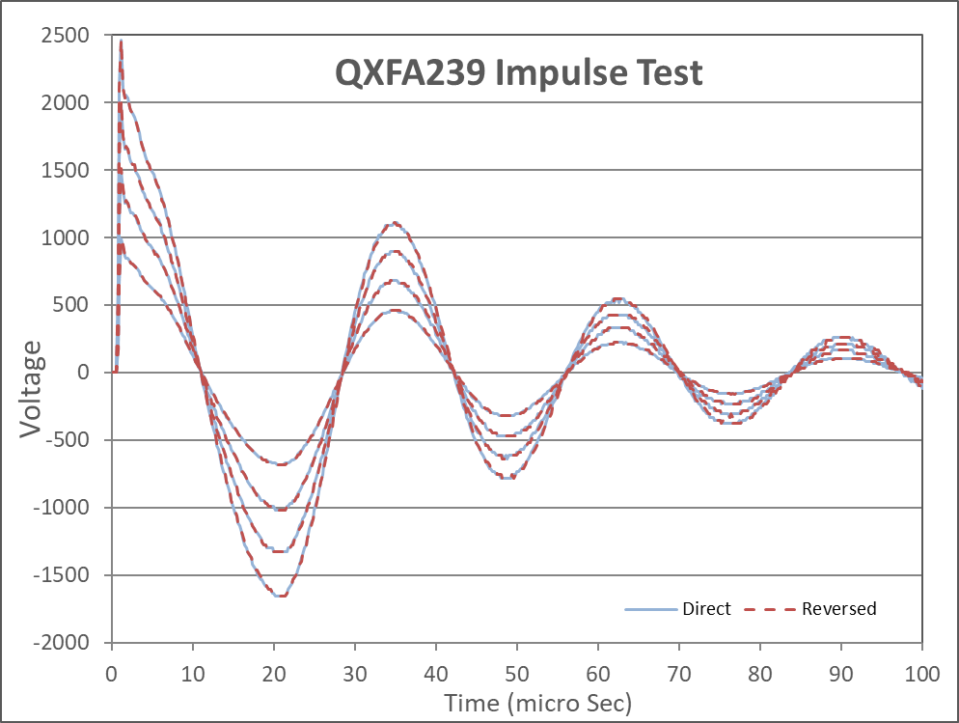
QXFA239 - Electrical

Slide 17
QXFA242 Coil Review
Jesse Schmalzle
October 6, 2023

Slide 18
Outline
Coil Fab DRs
Additional Info
  Coil length, Pole gaps
  Reaction plots
  Electrical Data
Notes:
  Series coil.
  After to change for B6 adjustment.

Slide 19
QXFA242 - DRs
DRs posted to interface traveler.
Critical = Affecting Form, Fit or Function
(as found)

Slide 20
-
Additional Info…

Slide 21
QXFA242 – Length, Gaps
Coil length within spec.
(207 error in initial pole gap setting)

Slide 22
QXFA242 - Reaction
Temperatures and dwell times all within spec.

Slide 23
QXFA242 - Electrical
Final electrical checks – all passed

Slide 24

QXFA242 - Electrical

