Slide 1


MQXFA17 Coils Acceptance Review
QXFA150, QXFA151, and QXFA152
Fred Nobrega, L3/CAM, Coil Fabrication at FNAL
Miao Yu, Deputy L3
Vittorio Marinozzi, Electrical Measurements & Testing
MQXFA17 Coils Acceptance Review
October 6, 2023

Slide 2
Overview
A prerequisite for coils selected for MQXFA17 is that they have no critical DR’s.
DR’s written against specific step in traveler which conforms to the following documents:
  QXFA Series Coil Production Specification, US-HiLumi-doc-2986
  MQXFA Final Design Report, US-HiLumi-doc-948
  QXFA Series Coil Fabrication Electrical QC Plan, US-HiLumi-doc-521
Appendix
  Coil data for the magnet fabrication report

Slide 3
DR Summary
Legend
Noncritical DR
Critical DR
Critical DR – affects form/fit/function and needs L2 review
Coil # | W&C Prep | React | Impreg | CMM Interface | Electrical | Total DR’s | Critical DR’s
QXFA150 | 0 | 0 | 2 | 0 | 1 | 3 | 0
QXFA151 | 0 | 0 | 0 | 0 | 1 | 1 | 0
QXFA152 | 0 | 0 | 2 | 0 | 1 | 3 | 0
Links to all DR’s: (FNAL services account required)
Discrepancy Reports – QXFA150
Discrepancy Reports – QXFA151
Discrepancy Reports – QXFA152

Slide 4
QXFA150 DR’s
Legend
Minor DR
Critical DR
Critical DR – affects form/fit/function and needs L2 review
DR Number | Description | Disposition | Impact/Corrective Action
12979 Electrical Testing | Hipot failure of trace 221-49-20-3 due to a pin hole. | Replace failed trace with trace number 221-49-32-2 | No impact to coil. No corrective action
13001 Splice / Epoxy Impreg | A glass bead was found on the LE transition side under 2nd heater over an end part. | As a precaution, lightly sand the bead surface with 600 grit sandpaper. | Impact none. The bead is in a non-critical area of the coil. Corrective action: inspect for beads on the end filler S2 parts before installation.
13194 Splice / Epoxy Impreg | While doing the pre-shipment inspection, we noticed that there were beads underneath the trace at 3 locations. 240 mm from the LE of the coil T side 182 mm from the LE of the coil NT side 4410 mm from the LE of the coil NT side | Use small Dremel bit and cut relief above the bead into the S2 glass above the trace. | Repair impact none. Corrective action: inspect for beads on the end filler S2 parts before installation.

Slide 5
QXFA151 DR’s
Legend
Minor DR
Critical DR
Critical DR – affects form/fit/function and needs L2 review
DR Number | Description | Disposition | Impact/Corrective Action
13159 Electrical Testing | Q @ 20 Hz is 0.9, minimum acceptance is 1.1 | Continue production, check Q is conform in following steps. | Impact none. No corrective action.

Slide 6
QXFA152 DR’s
Legend
Minor DR
Critical DR
Critical DR – affects form/fit/function and needs L2 review
DR Number | Description | Disposition | Impact/Corrective Action
13020 Splice / Epoxy Impreg | While inspecting the coil after reaction, we noticed 2 dark spots on the OD of the coil. | Verify that R, Ls, and Q are within range. Continue to process coil following the traveler. | Impact none. No corrective action.
13063 Splice / Epoxy Impreg | Fibers of the outer layer blanket got trapped between the midplane and midplane shim. | The outer layer S2 glass insulation folded onto the G11 midplane shim during the stainless steel midplane shim installation. | Impact none. CMM of the midplane showed no increase in size.
13344 Electrical Testing | Electrical tests performed at a temperature of 74 F, while max temperature is 73 F. | Proceed with production following the traveler. | Impact none. No corrective action.

Slide 7
Appendix
Backup slides
Coil data for magnet fabrication report
  Reaction temperature plots
  Electrical measurements & tests
  Coil lengths
  Cable parameters
  Wedge lengths & gaps
  Pole gaps

Slide 8
Backup Slides

Slide 9
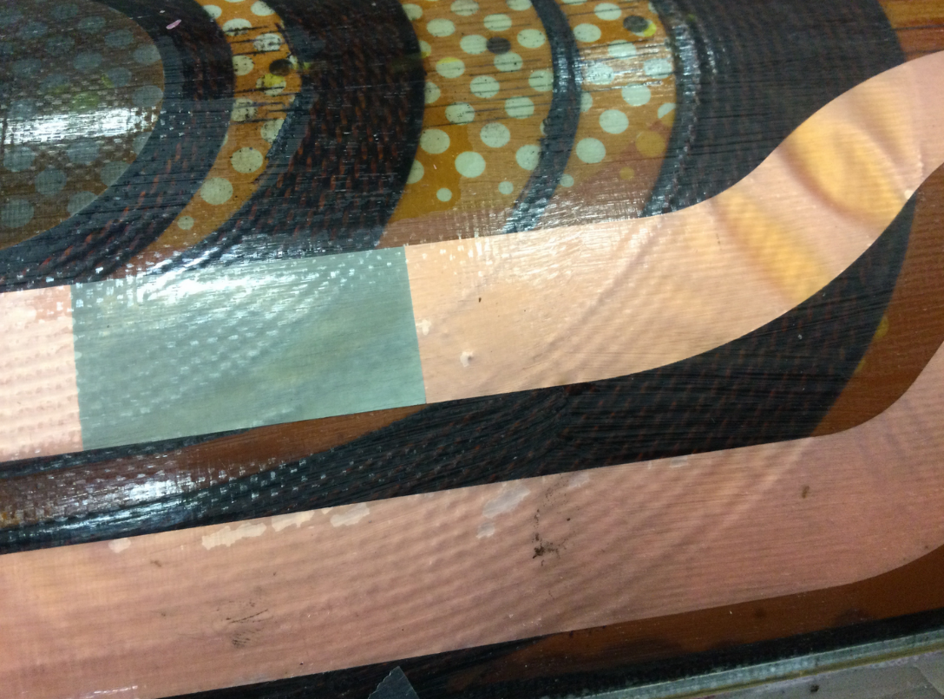
QXFA150, DR13001

Slide 10
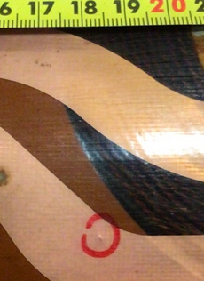
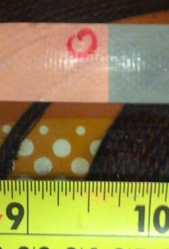
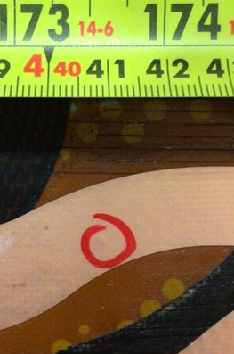
QXFA150, DR13194

Slide 11
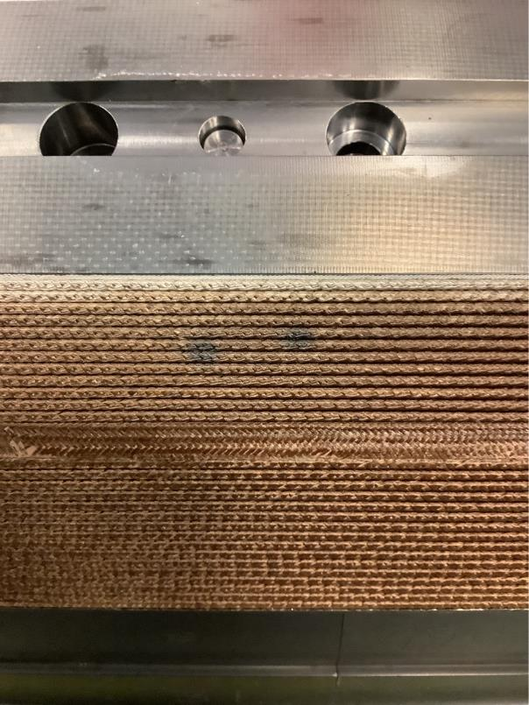
QXFA152, DR13020

Slide 12
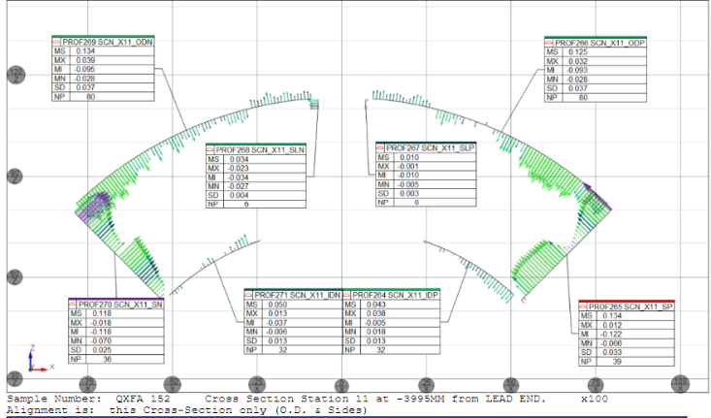
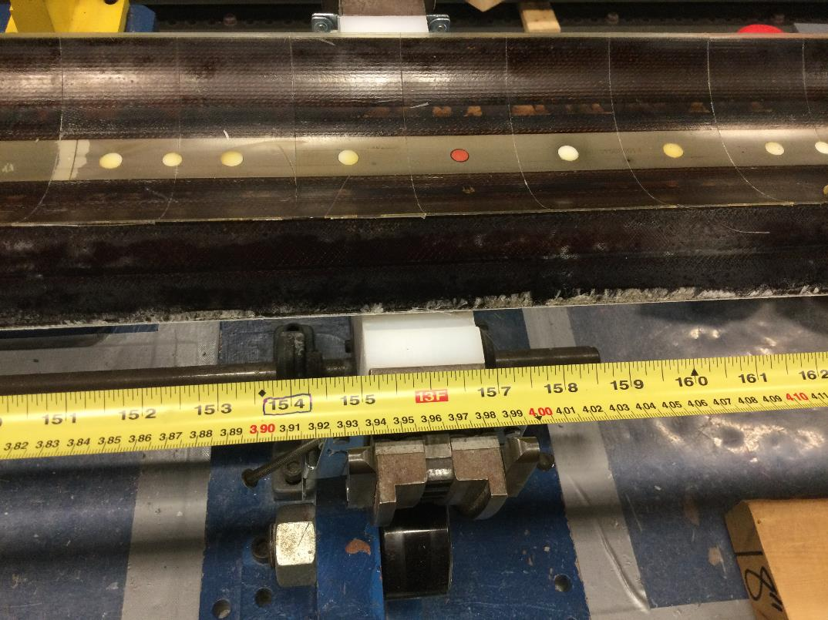
QXFA152, DR13063

Slide 13
Coil Data for Magnet Fabrication Report

Slide 14
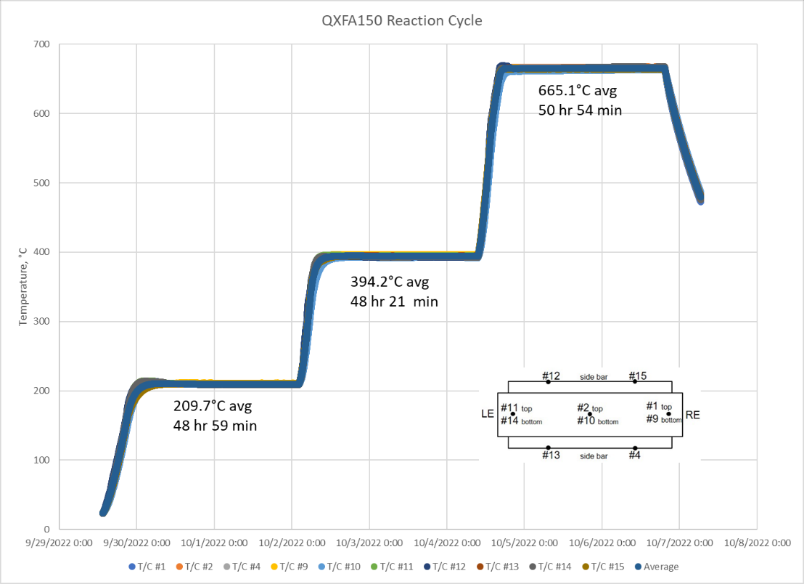
QXFA150 Average Temperature & Dwell Time

Slide 15
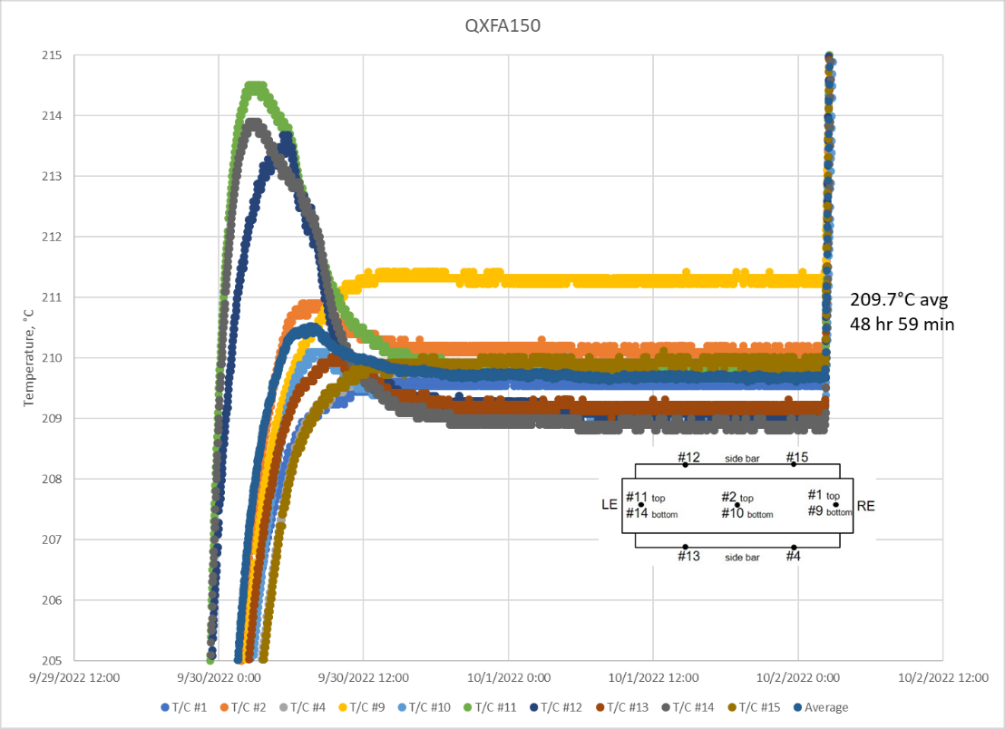
QXFA150 210° C Plateau

Slide 16
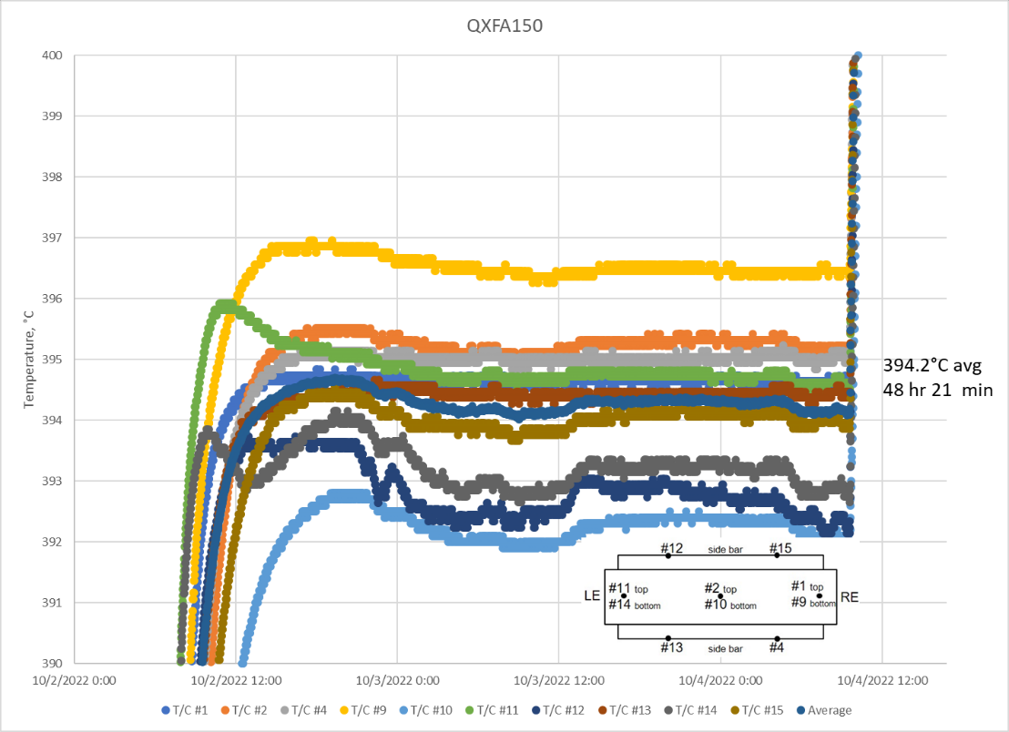
QXFA150 395° C Plateau

Slide 17
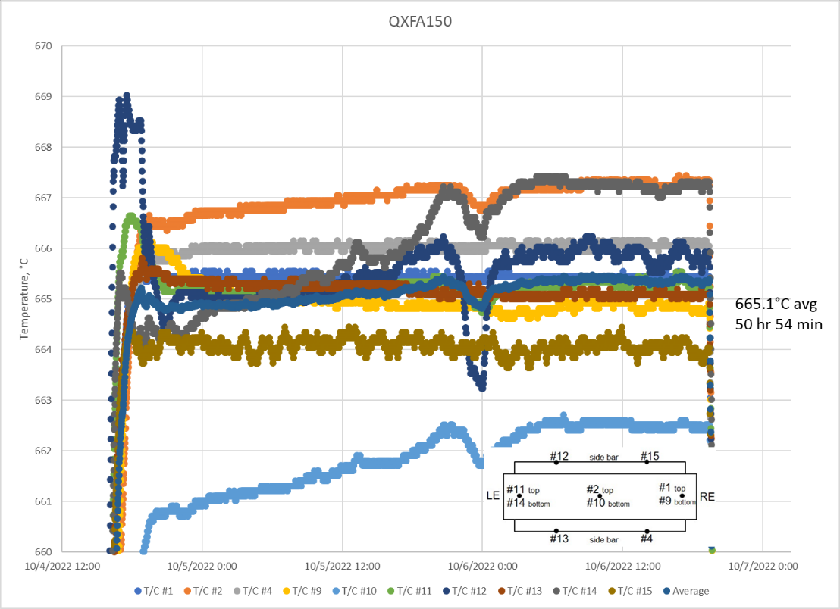
QXFA150 665° C Plateau

Slide 18
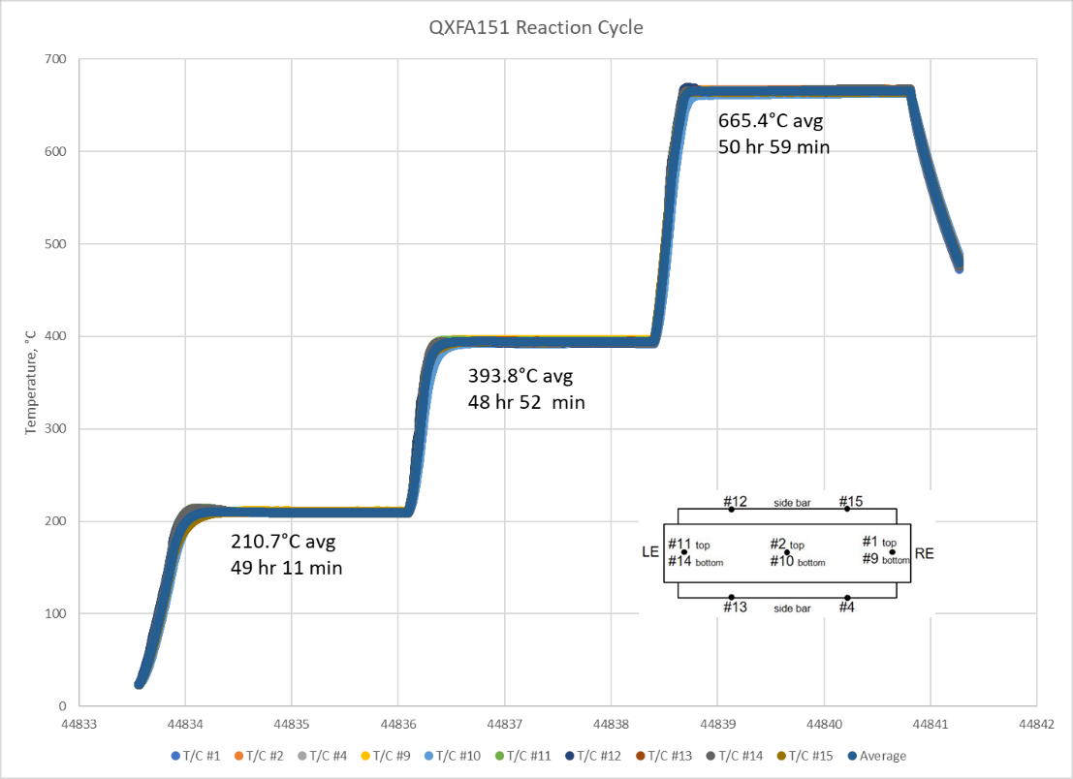
QXFA151 Average Temperature & Dwell Time

Slide 19
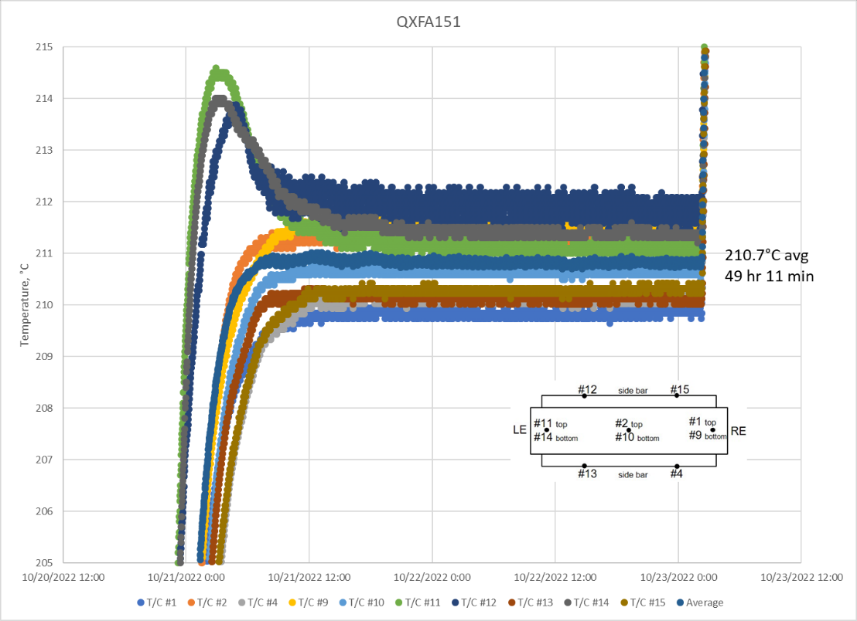
QXFA151 210° C Plateau

Slide 20
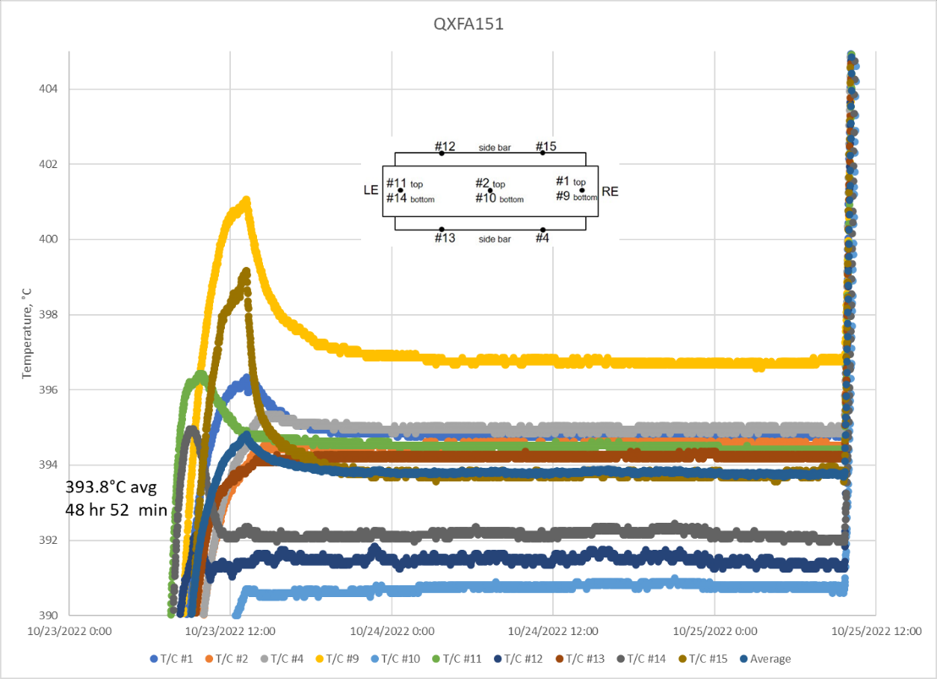
QXFA151 395° C Plateau
T/C #4

Slide 21
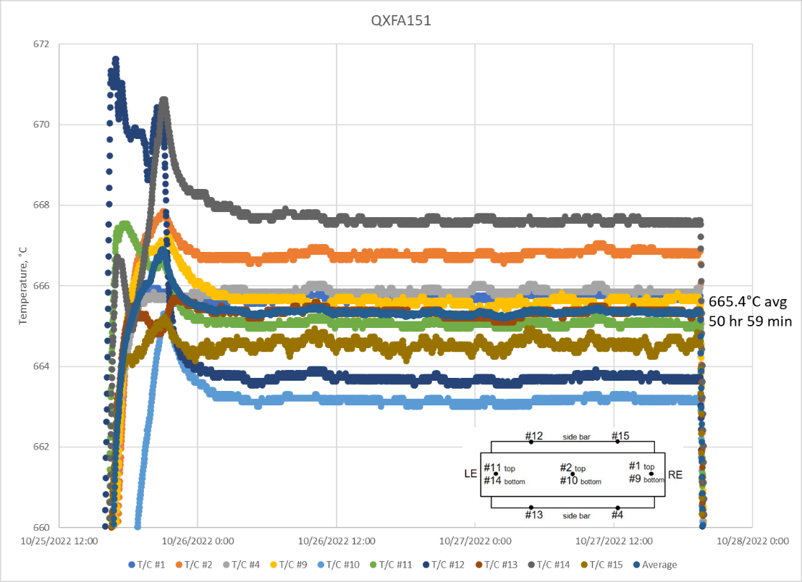
QXFA151 665° C Plateau

Slide 22
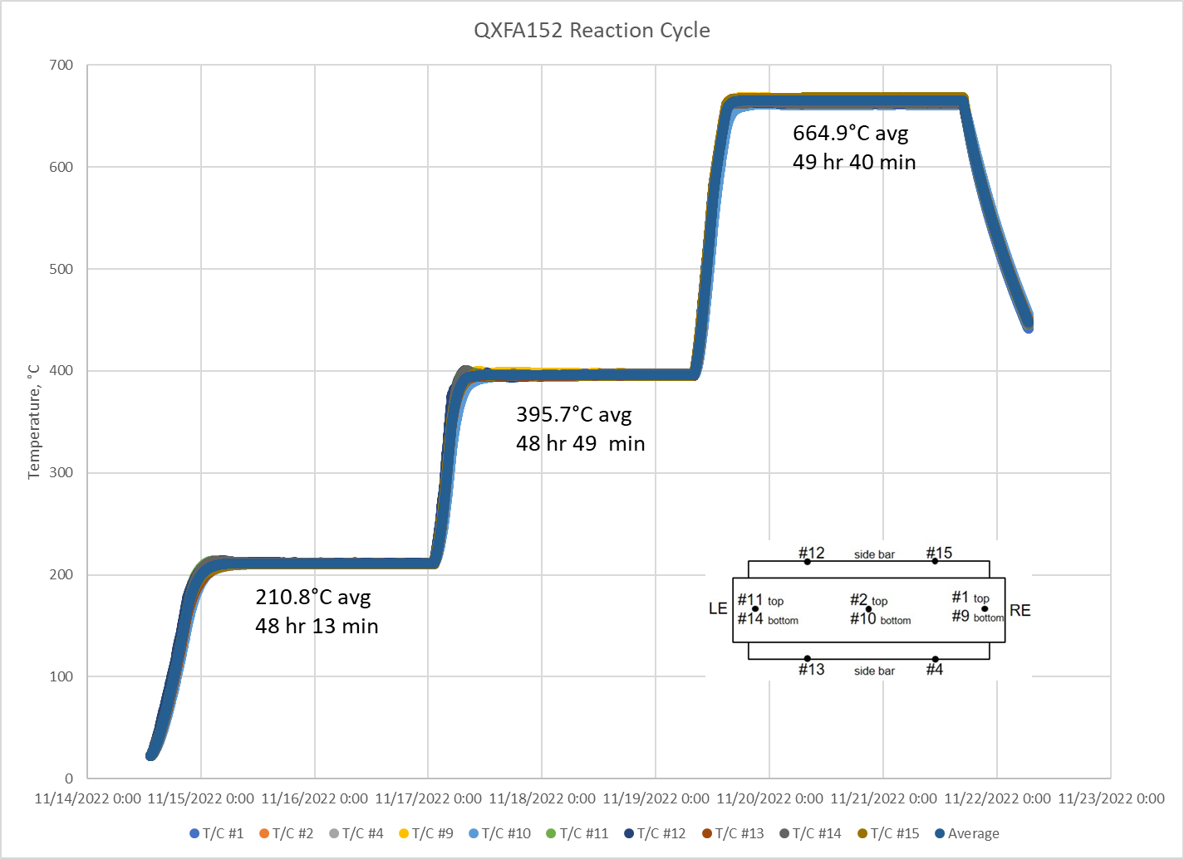
QXFA152 Average Temperature & Dwell Time

Slide 23
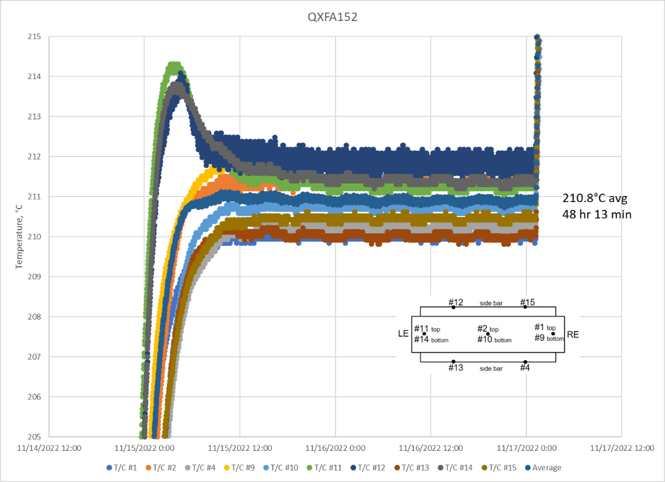
QXFA152 210° C Plateau

Slide 24
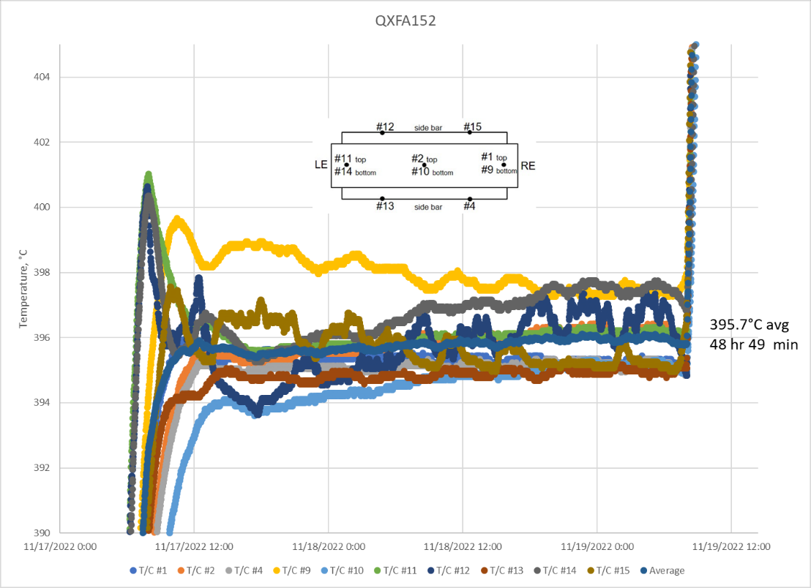
QXFA152 395° C Plateau
T/C #4

Slide 25
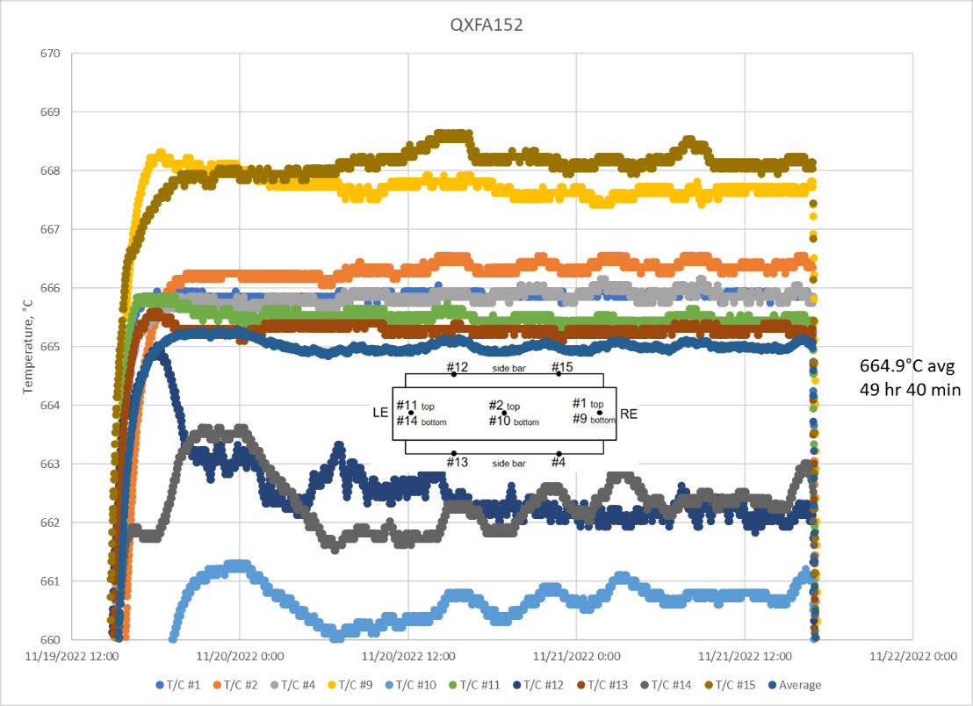
QXFA152 665° C Plateau

Slide 26
QXFA150 Hi-pot & Electrical Checks
Hipot: | Final Test Voltage [V] | Max Leakage (µA) | Final Leakage (µA)
Coil to Pole | 100 | 0.1 | 0.0
PHB01 to Coil | 3680 | 0.7 | 0.0
PHB02 to Coil | 3680 | 0.8 | 0.0
PHB03 to Coil | 3680 | 0.7 | 0.0
PHB04 to Coil | 3680 | 1.0 | 0.0
LE IL Endshoe to Coil | 1000 | 0.0 | 0.0
LE OL Endshoe to Coil | 1000 | 0.1 | 0.0
RE IL Endshoe to Coil | 1000 | 0.0 | 0.0
RE OL Endshoe to Coil | 1000 | 0.0 | 0.0
LE OL Endshoe to PHB01 | 2500 | 0.1 | 0.0
LE OL Endshoe to PHB02 | 2500 | 0.1 | 0.0
LE OL Endshoe to PHB03 | 2500 | 0.0 | 0.0
LE OL Endshoe to PHB04 | 2500 | 0.1 | 0.0
RE OL Endshoe to PHB01 | 2500 | 0.0 | 0.0
RE OL Endshoe to PHB02 | 2500 | 0.0 | 0.0
RE OL Endshoe to PHB03 | 2500 | 0.0 | 0.0
RE OL Endshoe to PHB04 | 2500 | 0.0 | 0.0
LE IL Endshoe to LE OL Endshoe | 1000 | 0.0 | 0.0
RE IL Endshoe to RE OL Endshoe | 1000 | 0.0 | 0.0
Measurement | QXFA 150 | Average | STD | STD/AVG | Min | MAX
Coil R @1 A (mΩ) | 604.4 | 605.90 | 4.55 | 0.01 | 595.73 | 614.75
Ls @ 20 Hz (mH) | 5.04 | 4.86 | 0.31 | 0.06 | 4.56 | 6.29
Q | 0.83 | 0.79 | 0.10 | 0.13 | 0.73 | 1.28
Ls @ 100 Hz (mH) | 3.56 | 3.43 | 0.61 | 0.18 | 3.17 | 6.24
Q | 1.66 | 1.76 | 0.78 | 0.44 | 1.55 | 5.44
Ls @ 1 kHz (mH) | 1.92 | 2.06 | 0.79 | 0.38 | 1.85 | 5.75
Q | 1.97 | 2.32 | 1.30 | 0.56 | 1.95 | 8.41
VTA1 (mΩ) | 0.69 | 0.32 | 0.28 | 0.87 | 0.02 | 0.98
VTA2 | 0.70 | 0.38 | 0.29 | 0.76 | 0.04 | 1.00
VTB2 | 604.32 | 604.94 | 4.96 | 0.01 | 593.70 | 614.70
VTB1 | 604.36 | 605.54 | 4.33 | 0.01 | 595.61 | 614.80
VTA01 – VTA02 | 0.01 | 0.19 | 0.31 | 1.64 | 0.00 | 0.80
VTB02 – VTB01 | 0.04 | 0.09 | 0.05 | 0.51 | 0.02 | 0.15
VTB01-VTA01 | 603.67 | 607.76 | 1.86 | 0.00 | 605.52 | 610.22
QHB1 | 2.12 | 1.96 | 0.15 | 0.08 | 1.61 | 2.20
QHB2 | 2.08 | 1.98 | 0.14 | 0.07 | 1.65 | 2.21
QHB3 | 1.95 | 1.98 | 0.13 | 0.07 | 1.62 | 2.22
QHB4 | 1.89 | 1.97 | 0.14 | 0.07 | 1.61 | 2.23
Test Time | 05/15/23 2 pm
Room Temperature [F] : | 71.36
Relative Humidity [%]: | 30.7

Slide 27
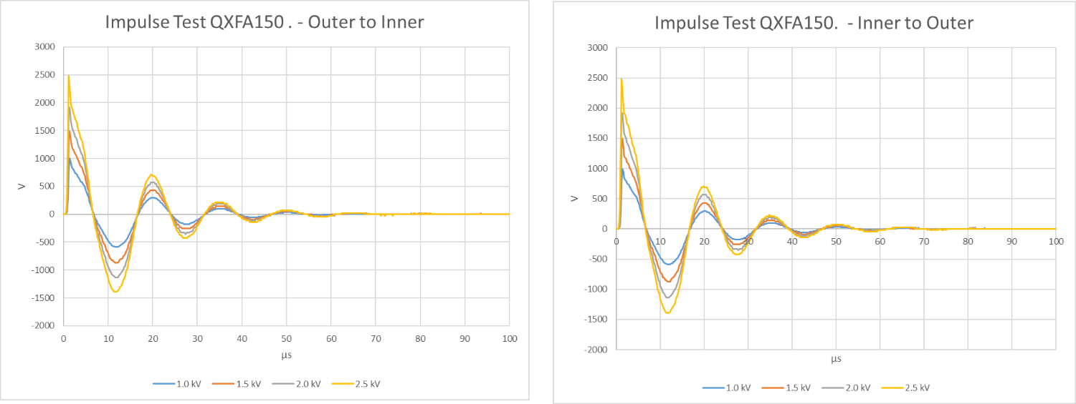
QXFA150 Impulse Test

Slide 28
QXFA151 Hi-pot & Electrical Checks
Hipot: | Final Test Voltage [V] | Max Leakage (µA) | Final Leakage (µA)
Pole to Coil | 100 | 0.2 | 0.0
PHB01 to Coil | 3680 | 1.0 | 0.0
PHB02 to Coil | 3680 | 0.6 | 0.0
PHB03 to Coil | 3680 | 0.7 | 0.0
PHB04 to Coil | 3680 | 0.6 | 0.0
LE IL Endshoe to Coil | 1000 | 0.0 | 0.0
LE OL Endshoe to Coil | 1000 | 0.1 | 0.0
RE IL Endshoe to Coil | 1000 | 0.0 | 0.0
RE OL Endshoe to Coil | 1000 | 0.0 | 0.0
LE OL Endshoe to PHB01 | 2500 | 0.1 | 0.0
LE OL Endshoe to PHB02 | 2500 | 0.0 | 0.0
LE OL Endshoe to PHB03 | 2500 | 0.0 | 0.0
LE OL Endshoe to PHB04 | 2500 | 0.1 | 0.0
RE OL Endshoe to PHB01 | 2500 | 0.0 | 0.0
RE OL Endshoe to PHB02 | 2500 | 0.0 | 0.0
RE OL Endshoe to PHB03 | 2500 | 0.0 | 0.0
RE OL Endshoe to PHB04 | 2500 | 0.0 | 0.0
LE IL Endshoe to LE OL Endshoe | 1000 | 0.0 | 0.0
RE IL Endshoe to RE OL Endshoe | 1000 | 0.0 | 0.0
Measurement | QXFA 151 | Average | STD | STD/AVG | Min | MAX
Coil R @1 A (mΩ) | 604.5 | 605.90 | 4.55 | 0.01 | 595.73 | 614.75
Ls @ 20 Hz (mH) | 4.7 | 4.86 | 0.31 | 0.06 | 4.56 | 6.29
Q | 0.75 | 0.79 | 0.10 | 0.13 | 0.73 | 1.28
Ls @ 100 Hz (mH) | 3.2 | 3.43 | 0.61 | 0.18 | 3.17 | 6.24
Q | 1.58 | 1.76 | 0.78 | 0.44 | 1.55 | 5.44
Ls @ 1 kHz (mH) | 1.86 | 2.06 | 0.79 | 0.38 | 1.85 | 5.75
Q | 2.1 | 2.32 | 1.30 | 0.56 | 1.95 | 8.41
VTA1 (mΩ) | 0.14 | 0.32 | 0.28 | 0.87 | 0.02 | 0.98
VTA2 | 0.16 | 0.38 | 0.29 | 0.76 | 0.04 | 1.00
VTB2 | 605.63 | 604.94 | 4.96 | 0.01 | 593.70 | 614.70
VTB1 | 605.75 | 605.54 | 4.33 | 0.01 | 595.61 | 614.80
VTA01 – VTA02 | 0.02 | 0.19 | 0.31 | 1.64 | 0.00 | 0.80
VTB02 – VTB01 | 0.12 | 0.09 | 0.05 | 0.51 | 0.02 | 0.15
VTB01-VTA01 | 605.61 | 607.76 | 1.86 | 0.00 | 605.52 | 610.22
QHB1 | 1.88 | 1.96 | 0.15 | 0.08 | 1.61 | 2.20
QHB2 | 1.95 | 1.98 | 0.14 | 0.07 | 1.65 | 2.21
QHB3 | 1.90 | 1.98 | 0.13 | 0.07 | 1.62 | 2.22
QHB4 | 1.90 | 1.97 | 0.14 | 0.07 | 1.61 | 2.23
Test Time | 08/08/23 10 am
Room Temperature [F] : | 72.18
Relative Humidity [%]: | 51.0

Slide 29
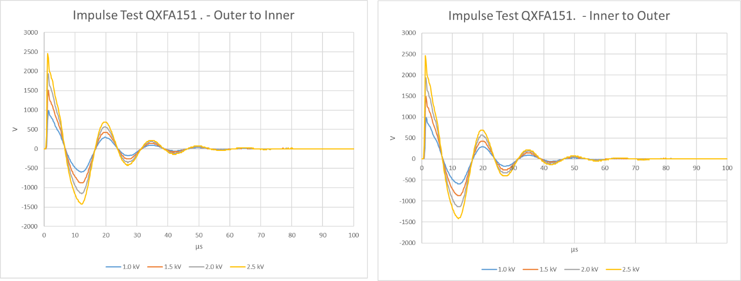
QXFA151 Impulse Test

Slide 30
QXFA152 Hi-pot & Electrical Checks
Hipot: | Final Test Voltage [V] | Max Leakage (µA) | Final Leakage (µA)
Pole to Coil | 100 | 0.2 | 0.0
PHB01 to Coil | 3680 | 0.9 | 0.0
PHB02 to Coil | 3680 | 0.6 | 0.0
PHB03 to Coil | 3680 | 0.7 | 0.0
PHB04 to Coil | 3680 | 0.7 | 0.0
LE IL Endshoe to Coil | 1000 | 0.0 | 0.0
LE OL Endshoe to Coil | 1000 | 0.1 | 0.0
RE IL Endshoe to Coil | 1000 | 0.0 | 0.0
RE OL Endshoe to Coil | 1000 | 0.0 | 0.0
LE OL Endshoe to PHB01 | 2500 | 0.0 | 0.0
LE OL Endshoe to PHB02 | 2500 | 0.0 | 0.0
LE OL Endshoe to PHB03 | 2500 | 0.1 | 0.0
LE OL Endshoe to PHB04 | 2500 | 0.0 | 0.0
RE OL Endshoe to PHB01 | 2500 | 0.0 | 0.0
RE OL Endshoe to PHB02 | 2500 | 0.0 | 0.0
RE OL Endshoe to PHB03 | 2500 | 0.0 | 0.0
RE OL Endshoe to PHB04 | 2500 | 0.0 | 0.0
LE IL Endshoe to LE OL Endshoe | 1000 | 0.0 | 0.0
RE IL Endshoe to RE OL Endshoe | 1000 | 0.0 | 0.0
Measurement | QXFA 152 | Average | STD | STD/AVG | Min | MAX
Coil R @1 A (mΩ) | 603.7 | 605.90 | 4.55 | 0.01 | 595.73 | 614.75
Ls @ 20 Hz (mH) | 4.9 | 4.86 | 0.31 | 0.06 | 4.56 | 6.29
Q | 0.8 | 0.79 | 0.10 | 0.13 | 0.73 | 1.28
Ls @ 100 Hz (mH) | 3.41 | 3.43 | 0.61 | 0.18 | 3.17 | 6.24
Q | 1.62 | 1.76 | 0.78 | 0.44 | 1.55 | 5.44
Ls @ 1 kHz (mH) | 1.9 | 2.06 | 0.79 | 0.38 | 1.85 | 5.75
Q | 2.03 | 2.32 | 1.30 | 0.56 | 1.95 | 8.41
VTA1 (mΩ) | 0.67 | 0.32 | 0.28 | 0.87 | 0.02 | 0.98
VTA2 | 0.71 | 0.38 | 0.29 | 0.76 | 0.04 | 1.00
VTB2 | 604.2 | 604.94 | 4.96 | 0.01 | 593.70 | 614.70
VTB1 | 604.3 | 605.54 | 4.33 | 0.01 | 595.61 | 614.80
VTA01 – VTA02 | 0.04 | 0.19 | 0.31 | 1.64 | 0.00 | 0.80
VTB02 – VTB01 | 0.1 | 0.09 | 0.05 | 0.51 | 0.02 | 0.15
VTB01-VTA01 | 603.63 | 607.76 | 1.86 | 0.00 | 605.52 | 610.22
QHB1 | 2.05 | 1.96 | 0.15 | 0.08 | 1.61 | 2.20
QHB2 | 2.06 | 1.98 | 0.14 | 0.07 | 1.65 | 2.21
QHB3 | 2.06 | 1.98 | 0.13 | 0.07 | 1.62 | 2.22
QHB4 | 2.03 | 1.97 | 0.14 | 0.07 | 1.61 | 2.23
Test Time | 08/10/23 2 pm
Room Temperature [F] : | 72.31
Relative Humidity [%]: | 51.1

Slide 31
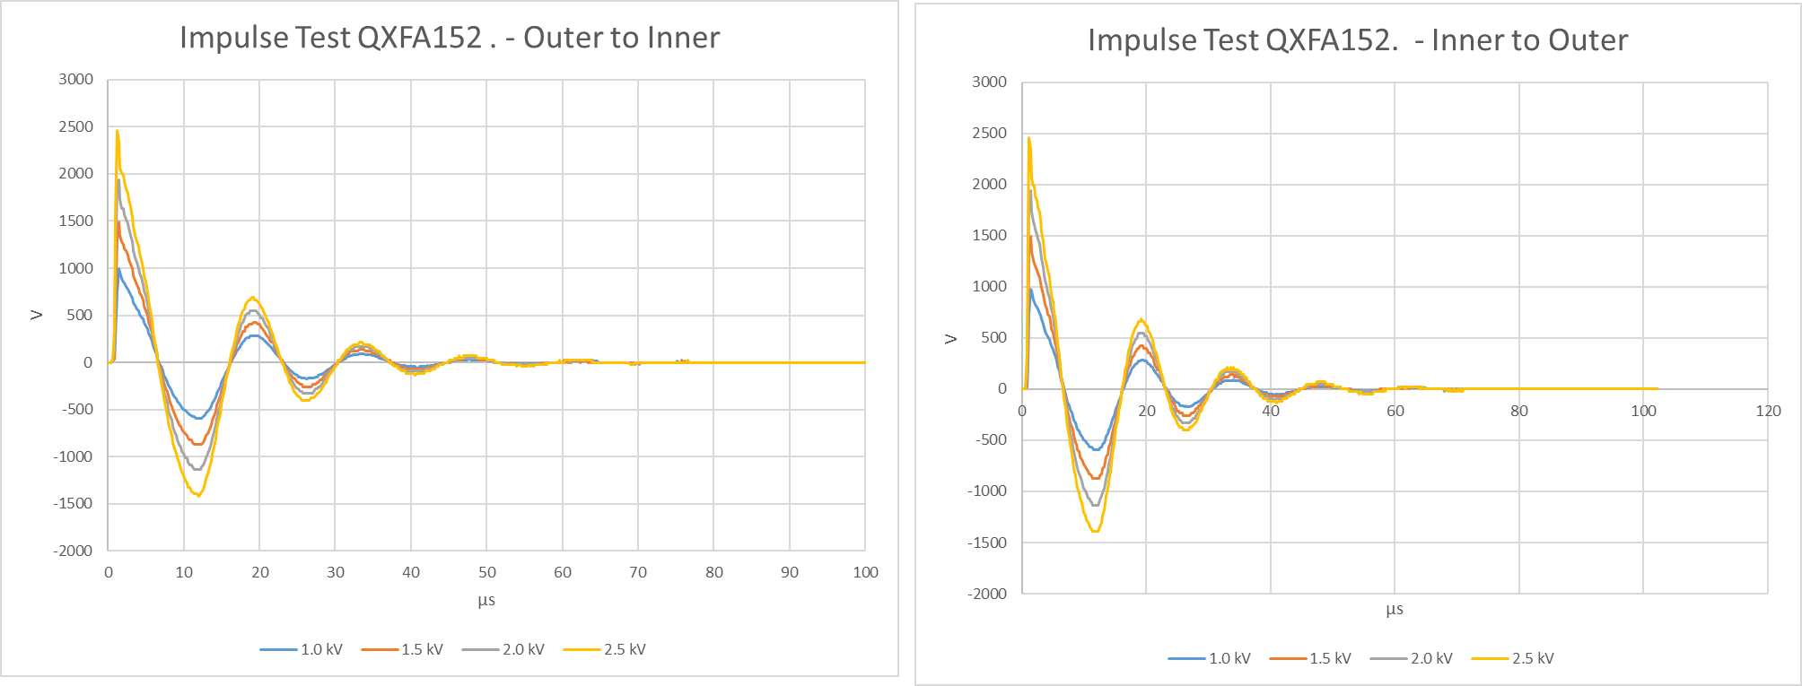
QXFA152 Impulse Test

Slide 32
Coil Length
 | Overall Coil Length (mm)
Pre-Series Requirement | 4532 ± 5.0
Series Requirement | 4529 ± 5.0
QXFA 150 | 4530.2
QXFA 151 | 4530.6
QXFA 152 | 4529.5

Slide 33
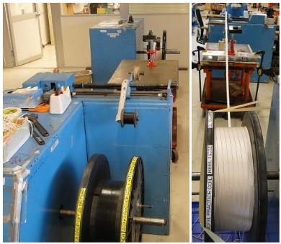
Cable Preparation
Re-spool the insulated cable to verify the total length (min. 441 m including the winding lead).
Split into two reels for L1 coil (min. 195 m) and L2 coil (min. 246 m).
Cable respooling
 | Cable ID | Total (m) | L1 (m) | L2 (m)
QXFA 150 | 1186 | 451.1 | 196.1 | 255
QXFA 151 | 1190 | 448.3 | 202.3 | 246
QXFA 152 | 1193 | 446.7 | 200.7 | 246
Cable length in coil
 | Cable ID | Total (m) | L1 (m) | L2 (m)
Average (QXFA 104-160) |  | 426.9 | 187.6 | 239.3
QXFA 150 | 1186 | 427.4 | 187.8 | 239.6
QXFA 151 | 1190 | 427.2 | 188.0 | 239.2
QXFA 152 | 1193 | 427.2 | 187.9 | 239.3

Slide 34
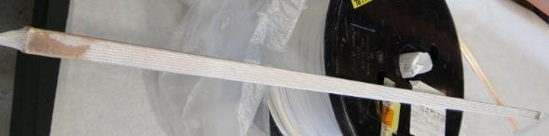
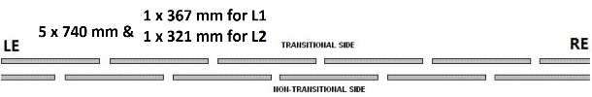
Wedge Length and Gap
QXFA 150, 151 & 152
Wedge gap: 2 mm 3.75 mm 3.75 mm 3.75 mm 3.75 mm 3.75 mm 2 mm

Slide 35
Pole Gap

