Slide 1


MQXFA17 & 13b
Magnets 302.2.02 and 03 –
• Strand Procurement & Testing
• Cable Fabrication & Testing
Lance Cooley – NHMFL/ASC (302.2.02 L3)
Vito Lombardo – FNAL (302.2.02 CAM)
Ian Pong – LBNL (302.2.03 L3 & CAM)
Mike Naus – LBNL (302.2.03 L3 Deputy & CAM Deputy)
Elizabeth Lee – LBNL
Jonathan Lee – LBNL Intern Student (now Grad Student at NHMFL)

Slide 2
Cable & Coil Overview
Coil # | Cable #
150 | P43OL1186
151 | P43OL1190
152 | P43OL1193
237 | P43OL1182
239 | P43OL1184
242 | P43OL1189
All cables are 2nd generation QXF cables produced under AUP

Slide 3
Cable QC Summary
All cables passed the required quality control testing per US-HiLumi-Doc 74
There were No Critical DRs

Slide 4
Cable 1186 (Coil 150)
DR Detail: 3 DRs

Slide 5
QXFA-150 / P43OL1186: RRR Heat Treat
DR #12736 (1 of 3)
Issue: Range across all 7 sample TCs outside ±1°C window at 210°C
  Measured Range: 2.3°C Allowed Range: 2.0°C
Cause: TCs calibrated at/between 400°C & 665°C.
  Not expected to be fully accurate at 210°C
Acceptance Justification
  Heat Treatment witness wires’ RRR values were within historical norms (both encapsulated & unencapsulated samples)
  Averaged plateau temperature was within ±1°C of target
  210°C the least impactful to RRR of all plateaus

Slide 6
QXFA-150 / P43OL1186: Insulation Mfg Data
DR #12749 (2 of 3)
Issue: Insulation run-log data missing for last 85 m of cable
Cause: Operator unplugged computer; could not restart logging function
Acceptance Justification
  Vision system continued to run normally
    No defects seen
    No automatic process stops
  No visible defects noted by operator(s)

Slide 7
QXFA-150 / P43OL1186: Cabling Machine Stopped
DR #12753 (3 of 3)
Issue: Cabling machine was momentarily stopped at 7th meter
Cause: Difficulty feeding cable starting end through CME measurement head.
Acceptance Justification
  7th meter will be in the discarded “cable drop” section

Slide 8
Cable 1190 (Coil 151)
DR Detail: 3 DRs

Slide 9
QXFA-151/ P43OL1190: In-Process Thickness
DR #12910 (1 of 3)
Issue: One in-process thickness measurement above spec (CME) within 1st meter of cable
Cause:
  Cables often started on the thick side in order to be on target for most of run
  Measurement noise is greater close to cut end of cable
Acceptance Justification
  OOS value in to-be-discarded “cable drop” section

Slide 10
QXFA-151/ P43OL1190: I_{c} Measurement Issue
DR #12922 (2 of 3)
Issue: 1 of 3 primary I_{c} strands was not able to be measured.
Cause: Unknown. Believed to be sample mounting issue.
Acceptance Justification
  Back-up sample successfully measured and acceptable, thus meeting the requirement

Slide 11
QXFA-151/ P43OL1190: Bad Accelerometer Data
DR #12904 (3 of 3)
Issue: Shipping accelerometers had data integrity issues
  Accelerometer-1 only recorded data LBNL-NEWT, not NEWT‑FNAL
  Accelerometer-1 had higher tilt & vibration instances than normal
  Accelerometer-2 didn’t record any data
Cause: Believed to be…
  Memories not cleared before shipment
  Rough handling from shipping company
Acceptance Justification
  Use as-is. Low probability of issues.
  Cables will be inspected during winding
[Same issue and DR as Cable 1189]

Slide 12
Cable 1193 (Coil 152)
DR Detail: 2 DRs

Slide 13
QXFA-152/ P43OL1193: RRR Heat Treat TCs
DR #12896 (1 of 2)
Issue: Incorrect temperature measurement for first 33 hours of 210°C plateau
Cause:
  Thermocouples plugged into incorrect data logger ports/jacks
Acceptance Justification
  Valid data from last 15 hours was within spec
  No unusual temperature excursions during entirety of 210C run
  Total during confirmed to be 48.2 h [Spec: 48 h ± 2 h]
  Same furnace setpoints from previous run, which was within spec
  210°C plateau the least impactful of the 3 HT plateaus

Slide 14
QXFA-152/ P43OL1193: No Core Detector
DR #12912 (2 of 2)
Issue: Core detector inoperable during cable manufacture
Cause: PCB failure within core detector box
Acceptance Justification
  Difference in core spool weight pre- and post-run is consistent with that expected
  Core was visually monitored sporadically during the run

Slide 15
Cable 1182 (Coil 237)
DR Detail: 4 DRs

Slide 16
QXFA-237/ P43OL1182: RRR Heat Treatment
DR #12618 (1 of 4)
Issue: Range across all 7 sample TCs outside ±1°C window at 210°C
  Measured Range: 2.1°C Allowed Range: 2.0°C
Cause: TCs calibrated at/between 400°C & 665°C.
  Not expected to be fully accurate at 210°C
Acceptance Justification
  Heat Treatment witness wires’ RRR values were within historical norms (both encapsulated & unencapsulated samples)
  Averaged plateau temperature was within ±1°C of target
  210°C the least impactful to RRR of all plateaus
[Same HT and DR as cable (1184)]

Slide 17
QXFA-237/ P43OL1182: Thin Insulation
DR #12651 (2 of 4)
Issue: Insulation verification 10-stack below spec by 1.4µm at 5 MPa
Cause: Suspect excessive verification sample coiling for shipment to LBNL created extra tension on insulation
Acceptance Justification: Vendor’s data is passing

Slide 18
QXFA-237/ P43OL1182: Excess Lubricant
DR #12564 (3 of 4)
Issue: Excess residual 4BR cabling lubricant within cable
Cause: Changes to lubrication equipment and intentional increased 4BR usage rate
  Attempt to mitigate facet divergence
Acceptance Justification:
  4BR is not known to adversely affect cable quality
  4BR is expected to volatilize away eventually

Slide 19
QXFA-237/ P43OL1182: No Core Detector
DR #12608 (4 of 4)
Issue: Core detector inoperable during cable manufacture e
Cause: Battery had died. Unable to replace.
Acceptance Justification:
  Difference in core spool weight pre- and post-run is consistent with that expected
  Core was visually monitored sporadically during the run

Slide 20
Cable 1184 (Coil 239)
DR Detail: 2 DRs

Slide 21
QXFA-239/ P43OL1184: In-Process Thickness
DR #12609 (1 of 2)
Issue: One in-process thickness measurement above spec (CME) within first 2 meters of cable
Cause:
  Cables often started on the thick side in order to be on target for most of run
  Measurement noise is greater close to cut end of cable
Acceptance Justification
  OOS value in to-be-discarded “cable drop” section

Slide 22
QXFA-239/ P43OL1184: RRR Heat Treatment
DR #12618 (2 of 2)
Issue: Range across all 7 sample TCs outside ±1°C window at 210°C
  Measured Range: 2.1°C Allowed Range: 2.0°C
Cause: TCs calibrated at/between 400°C & 665°C.
  Not expected to be fully accurate at 210°C
Acceptance Justification
  Heat Treatment witness wires’ RRR values were within historical norms (both encapsulated & unencapsulated samples)
  Averaged plateau temperature was within ±1°C of target
  210°C the least impactful to RRR of all plateaus
[Same HT and DR as previous cable (1182)]

Slide 23
Cable 1189 (Coil 242)
DR Detail: 1 DR

Slide 24
QXFA-242/ P43OL1189: Bad Accelerometer Data
DR #12904 (1 of 1)
Issue: Shipping accelerometers had data integrity issues
  Accelerometer-1 only recorded data LBNL-NEWT, not NEWT‑FNAL.
  Accelerometer-1 had higher tilt & vibration instances than normal
  Accelerometer-2 didn’t record any data.
Cause: Believed to be…
  Memories not cleared before shipment
  Rough handling from shipping company
Acceptance Justification
  Use as-is. Low probability of issues.
  Cables will be inspected during winding
[Same issue and DR as previous Cable 1190]

Slide 25
END
[Back-Up Slides Below]

Slide 26
Strand Summary
All strands ordered per the “HiLumi” specification under the AUP program, per the following POs:
  FNAL PO 646116 SA1 Shipment E
  FNAL PO 667037 Shipments: A, B1, B2, C, and D
Conductor Description:
  Ø0.85 mm, 108/127 stack, Ti-doped, Reduced-Sn core

Slide 27
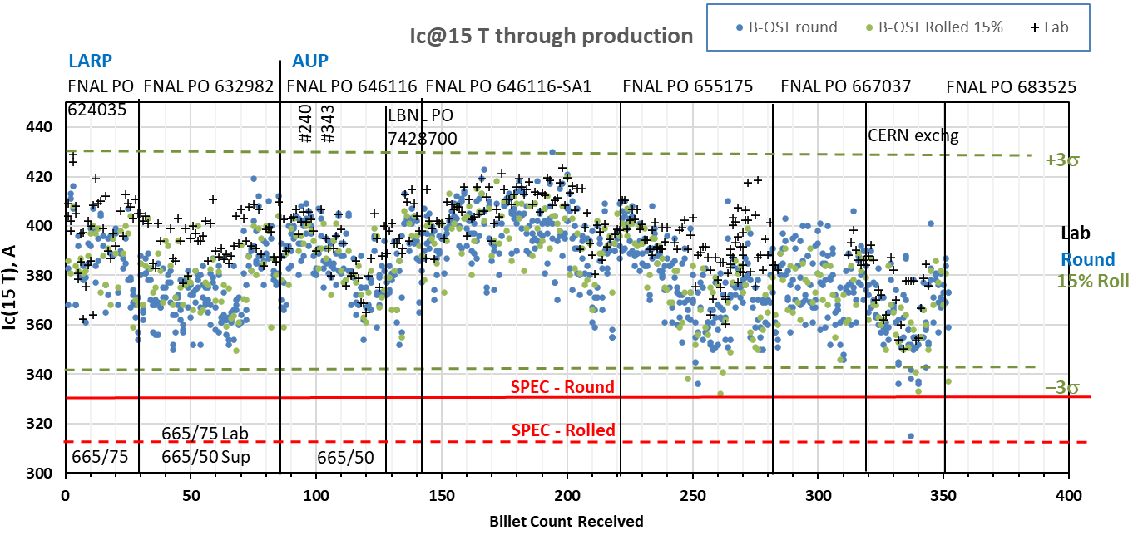
Strand Production Data – I_{c, 15T}
Yellow boxes indicate strand data for these cables
Both 665°C/75h
S: 665°C/50h
V: 665°/75h
Both 665°C/50h

Slide 28
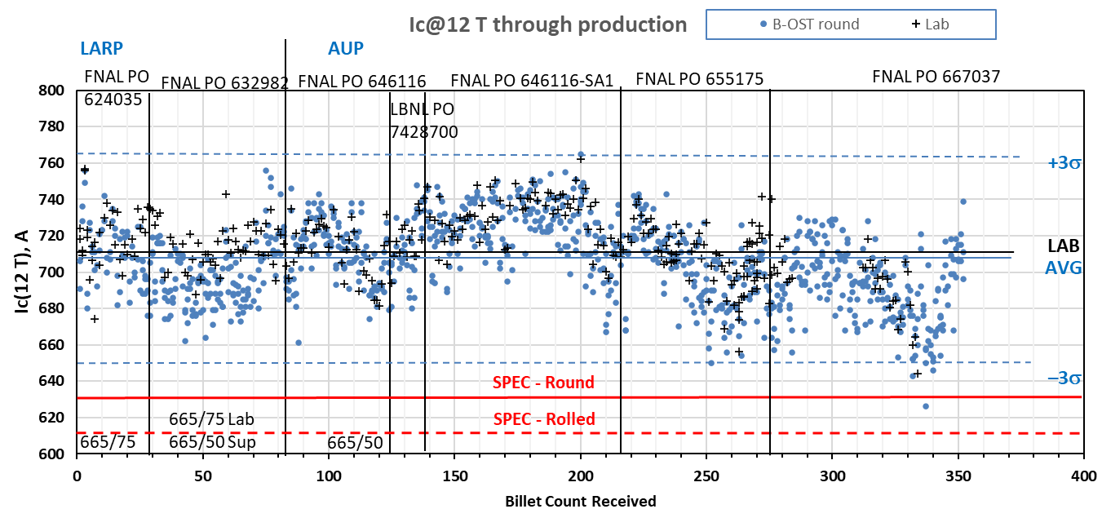
Strand Production Data – I_{c, 12T}
Yellow boxes indicate strand data for these cables
Both 665°C/50h
Both 665°C/75h
S: 665°C/50h
V: 665°/75h

Slide 29
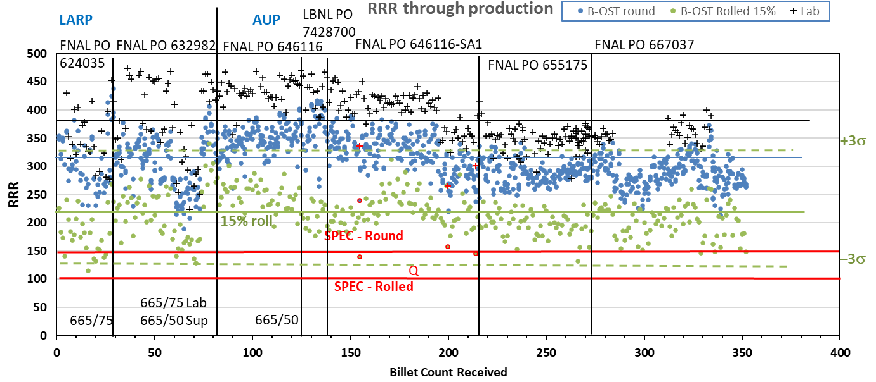
Strand Production Data - RRR
Data for 15% rolled strand predicts the RRR at cable sharp bend
Lab: IEC method, Supplier: 20K method
Inter-lab comparisons have validated approaches (see QP)
Yellow boxes indicate strand data for these cables

Slide 30
QXFA-150 / P43OL1186

Slide 31
P43OL1186 – Cable Date, Lengths
Cable Manufacture Date
  03 Feb 2022 (Production run)
Cable Length:
  464 m (LBNL, fabricated, including LBNL samples)

Slide 32
P43OL1186 – Strand and SS Core ID
Spool:
  PO08S00516A04U x 5 ULs
  PO08S00673A03U x 1 ULs
  PO08S00673A01U x 4 ULs
  PO08S00673A02U x 11 ULs
  PO08S00674A01U x 19 ULs
Core:
  120L37A7400804
    Heat: 850858. Lot: 17-521
    Material: 316L
    Chemical Properties CoT/CoC #172660-1: 0.16 wt% Co
    Core width: 12.0 mm
From 3 billets

Slide 33
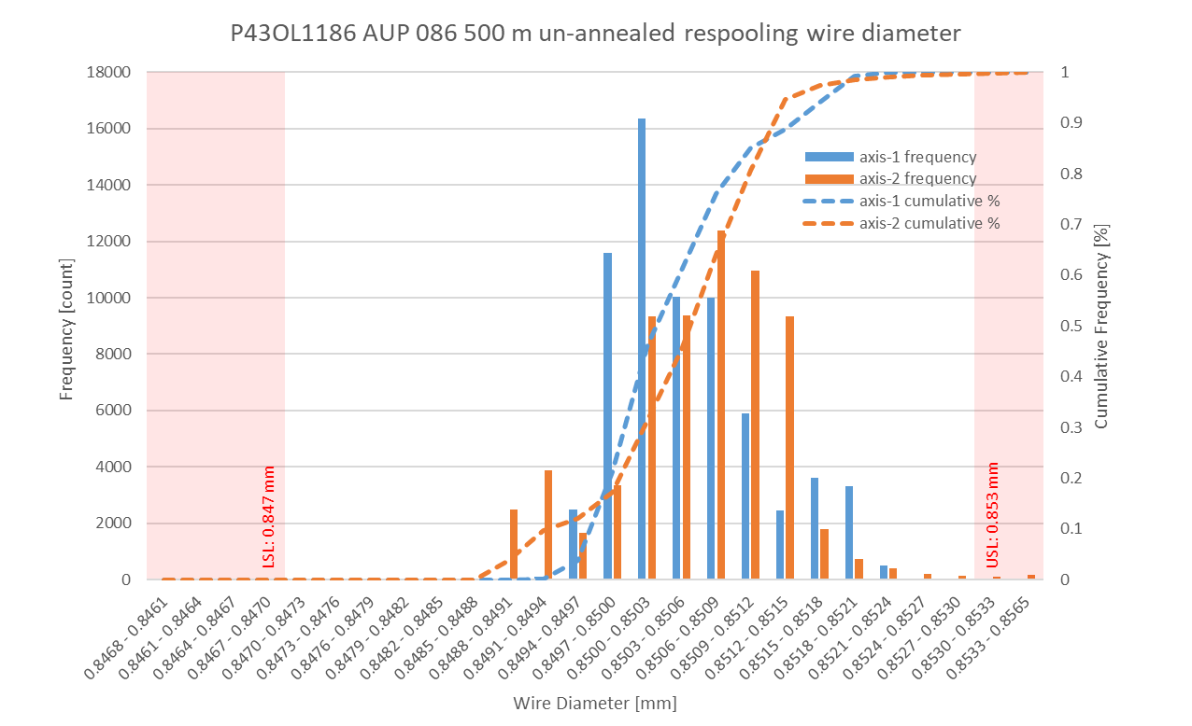
P43OL1186 Respooling Wire Diameter
Below LSL: 0.001%
Above USL: 0.139%

Slide 34
P43OL1186 – Cable QC Data Summary
CME:
Residual Twist: 145°
10-stack:
  Qualification: 1.537 mm
  Production tail end: 1.528 mm
 | Pressure (MPa) | Angle (°) | Width (mm) | Thickness (mm)
Maximum | 17.0 | 0.394 | 18.177 | 1.533
Average | 17.0 | 0.367 | 18.144 | 1.522
Minimum | 16.9 | 0.328 | 18.138 | 1.517
Sigma | 0.01 | 0.011 | 0.004 | 0.002

Slide 35
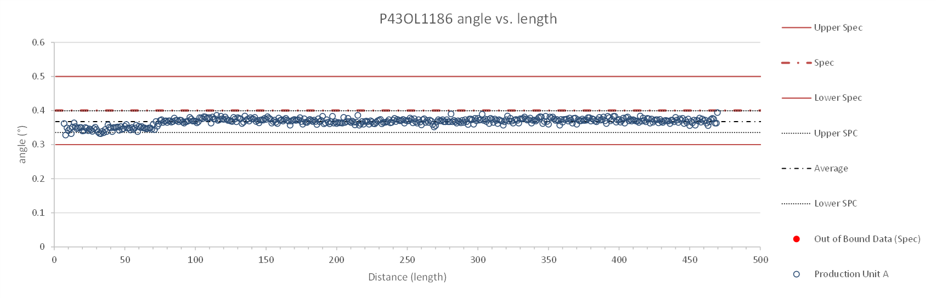
Rollers: P-93 (2021-08-09) & P-94 (2021-08-09)

Slide 36
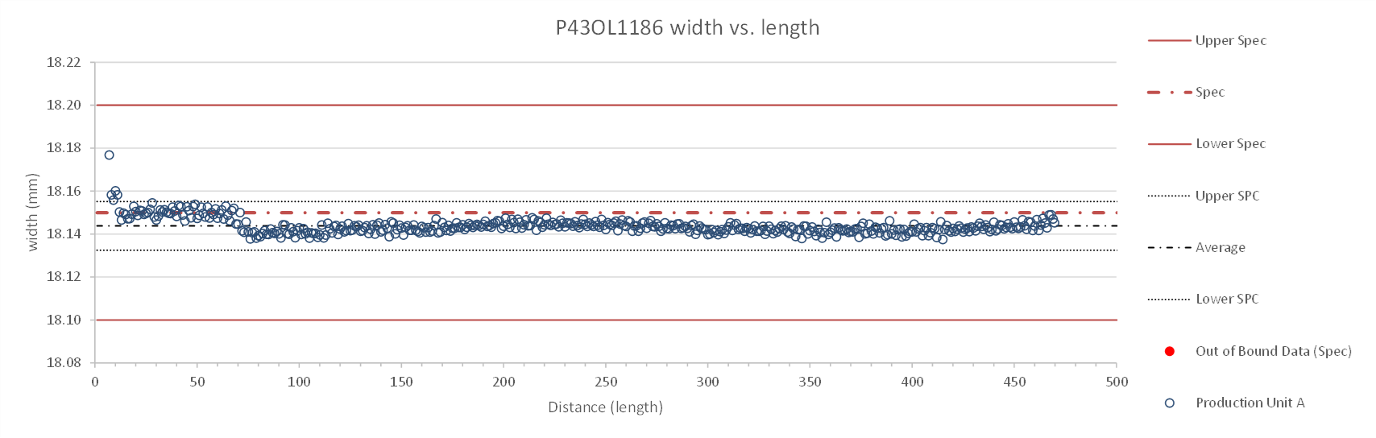
Rollers: P-93 (2021-08-09) & P-94 (2021-08-09)

Slide 37
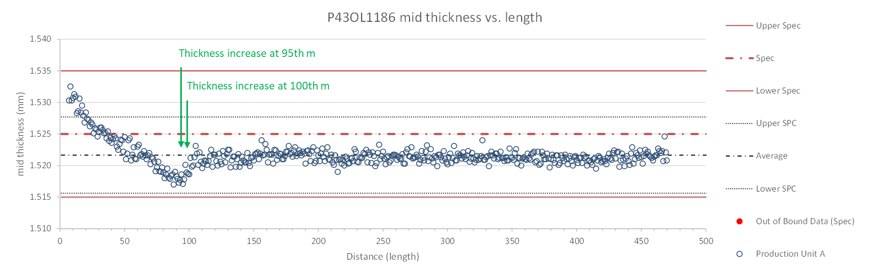
Rollers: P-93 (2021-08-09) & P-94 (2021-08-09)

Slide 38
P43OL1186 – Braiding
Fiberglass Lot: #RCV0011562
P/I: 18.9
Spool tension: 10 lbs. @ payoff. 20 lbs. @ takeup (12 lbs min)
Bobbin payoff tension: 0.125 lbs. ≤ T ≤ 0.250 lbs.
Insulation Thickness (at 5 MPa)
Site | Cycle #1 (mm) | Cycle #2 (mm) | Cycle #3 (mm) | Average (mm)
NEWT | 0.147 | 0.145 | 0.144 | 0.145
LBNL Verification | 0.148 | 0.146 | 0.145 | 0.146

Slide 39
P43OL1186 – Wire Parameters
Properties | Inspected Average
Wire Diameter | 0.8506 ± 0.0006 mm (LBNL)¹
Cu ratio ª | 54.19% (BOST)
Strand twist pitch ª | 18.9 mm (BOST)
RRR (RW) ª | 301 (BOST)
RRR (15% rolled) ª | 188 (BOST)
I_{C} (4.2 K, 15 T) ª | 379 A (BOST)
I_{C} (4.2 K, 14 T) ª | 474 A (BOST)
I_{C} (4.2 K, 13 T) ª | 580 A (BOST)
I_{C} (4.2 K, 12 T) ª | 702 A (BOST)
ª First billet averaged, then weighted average according
to the spool distribution in the cable
¹ As-received. LBNL respooling data. Mean ± 1 sigma

Slide 40
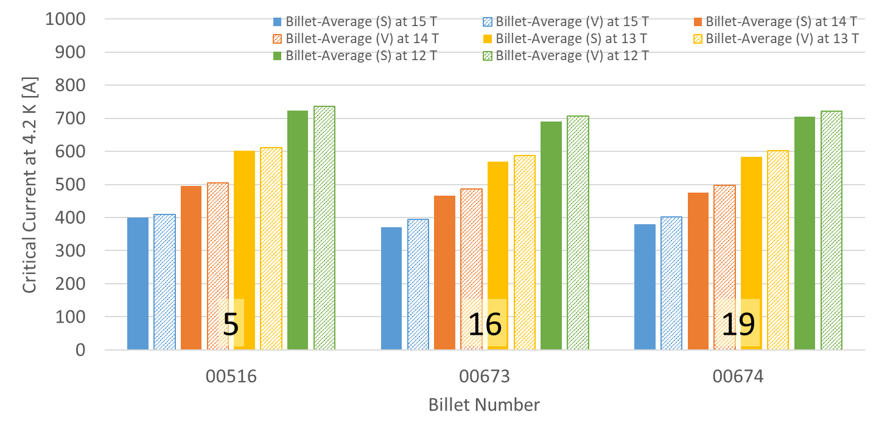
P43OL1186 – Wire Parameters
Supplier (S) and Verification (V) I_{C} Data
Number of spools from that billet used in the cable

Slide 41
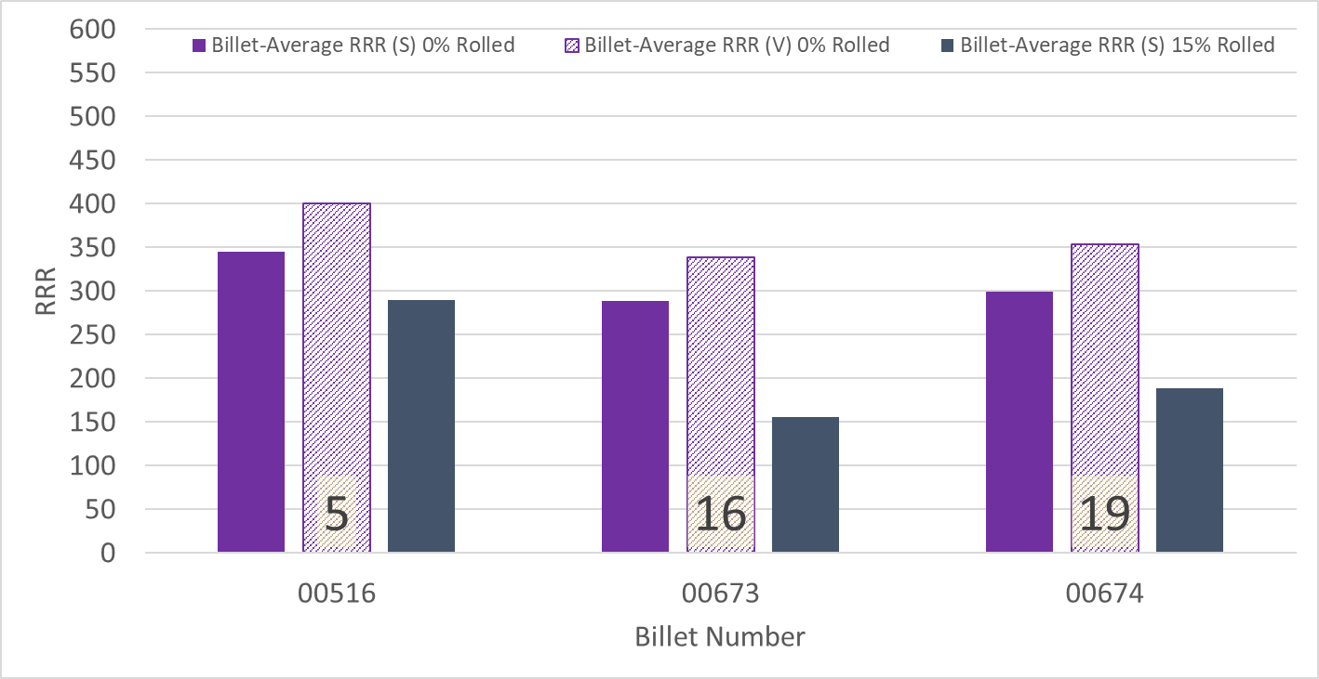
P43OL1186 – Wire Parameters
Supplier (S) and Verification (V) RRR Data
Number of spools from that billet used in the cable

Slide 42
P43OL1186 – Extracted Strand RRR
Cable ID | No. of Units from Billet (spool) | Heat Treat/ Sample ID | Major Edge RRR | Minor Edge RRR | Straight 1 RRR | Straight 2 RRR
PO08S00516A04U P43OL1186AE05E | 5 (5) | LRLK220208ALC1 | 305 | 296 | 390 | 407
PO08S00673A01U P43OL1186AE11E | 16 (4) | LRLK220208ALC1 | 277 | 267 | 331 | 340
PO08S00673A02U P43OL1186AE17E | 16 (11) | LRLK220208ALC1 | 260 | 259 | 330 | 321
PO08S00674A01U P43OL1186AE33E | 19 (19) | LRLK220208ALC1 | 245 | 220 | 295 | 308
PO08S00674A01U P43OL1186AE35E | 19 (19) | LRLK220208ALC1 | 273 | 257 | 321 | 344

Slide 43
P43OL1186 – I_{c}, Cable Qual Samples
Wire/ Cable Strand | I_{c}(A) at Field (T)
 | 12 T | 13 T | 14 T | 15 T
PO08S00674A01U P43OL1186AE33E | 693 | 577 | 474 | 381
PO08S00673A02U P43OL1186AE17E | 679 | 566 | 460 | 367
PO08S00516A04U P43OL1186AE03E | 710 | 591 | 485 | 392

Slide 44
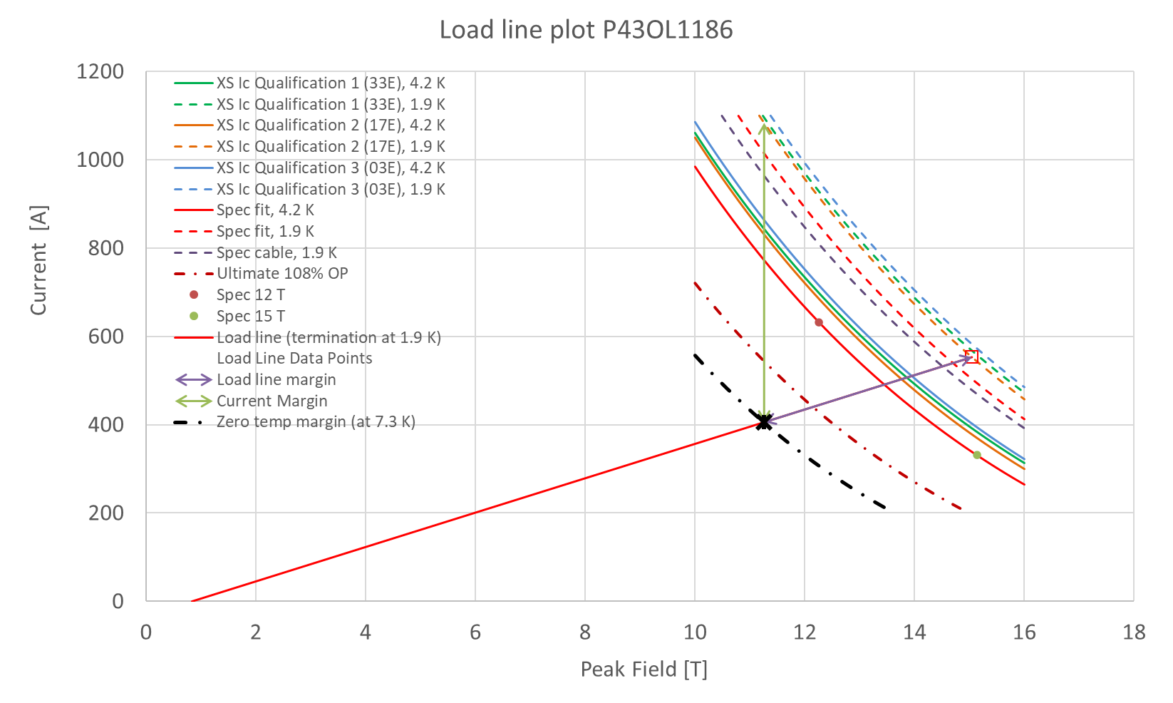
P43OL1186 – SSL Plot, Cable Qual Samples

Slide 45
P43OL1186 – SSL Margins, Qual Samples
Strand from which Margin is Calculated: | Strand # 17E @ 1.9 K
Margins | Margin | Operating Point (X)
Load Line Margin (Purple Arrow) | 26.6% | 73.4%
Current Margin (Green Arrow) | 62.6% | 37.4%
Temperature Margin (K) | 5.4 | 7.3
Limits | Strand | Strand x 40
Selected Strand Current (A) at Margin-Calculation Field | 1083.7 | 43348.2
Selected Strand Current (A) at 100% SSL | 553.1 | 22125.0
Selected Strand Field (T) at 100% SSL | 15.04

Slide 46
QXFA-151 / P43OL1190

Slide 47
P43OL1190 – Cable Date, Lengths
Cable Manufacture Date
  31 Mar 2022(Production run)
Cable Length:
  468 m (LBNL, fabricated, including LBNL samples)

Slide 48
P43OL1190 – Strand and SS Core ID
Spool:
  PO08S00657A01U x 6 ULs
  PO08S00657A03U x 5 ULs
  PO08S00660A02U x 11 ULs
  PO08S00661A01U x 2 ULs
  PO08S00661A02U x 7 ULs
  PO08S00661A03U x 9 ULs
Core:
  120L41A7400804
    Heat: 850858. Lot: 17-521
    Material: 316L
    Chemical Properties CoT/CoC #172660-1: 0.16 wt% Co
    Core width: 12.0 mm
From 3 billets

Slide 49
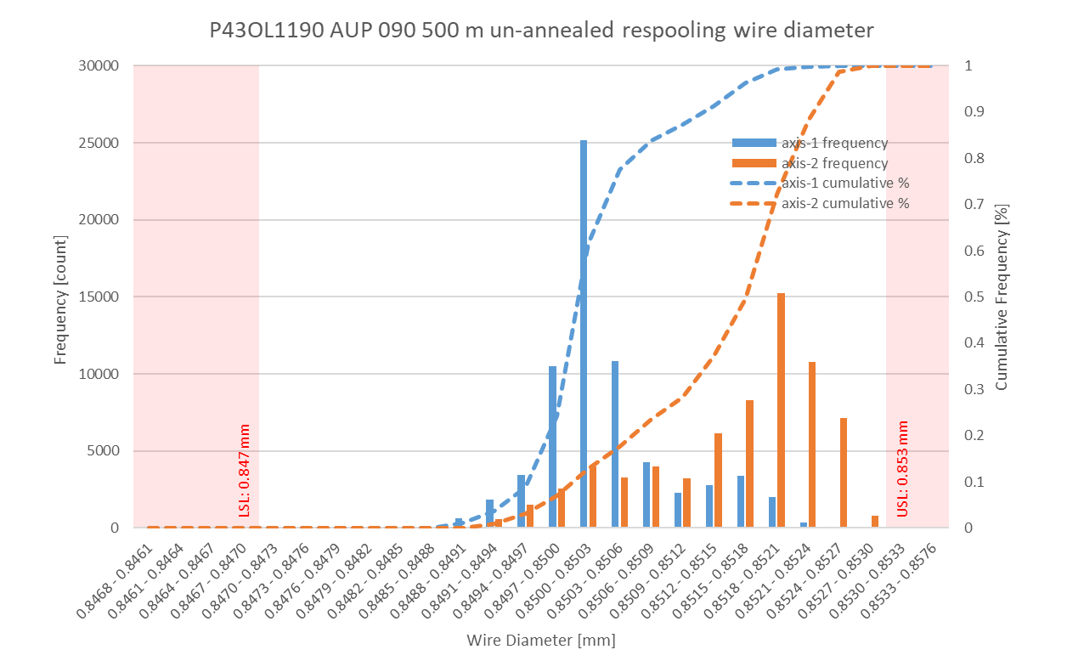
P43OL1190 Respooling Wire Diameter
Below LSL: 0.001%
Above USL: 0.008%

Slide 50
P43OL1190 – Cable QC Data Summary
CME:
Residual Twist: 125°
10-stack:
  Qualification: 1.540 mm
  Production tail end: 1.529 mm
 | Pressure (MPa) | Angle (°) | Width (mm) | Thickness (mm)
Maximum | 17.4 | 0.392 | 18.146 | 1.536
Average | 16.7 | 0.359 | 18.133 | 1.524
Minimum | 16.7 | 0.341 | 18.128 | 1.520
Sigma | 0.10 | 0.006 | 0.003 | 0.002

Slide 51
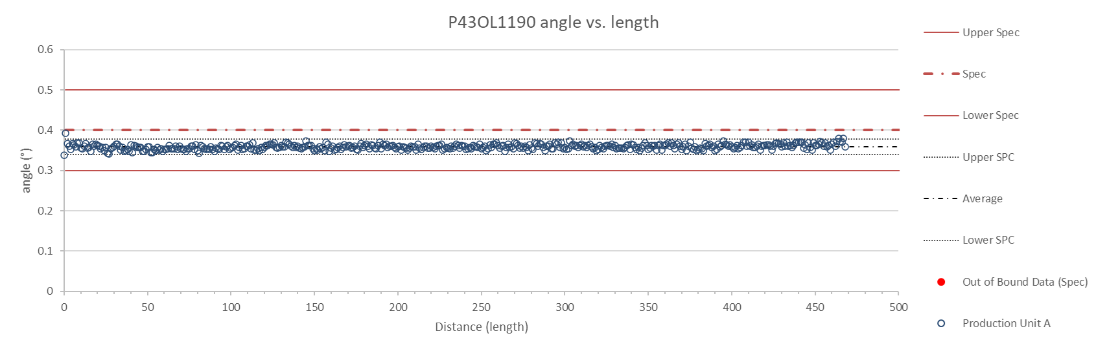
Rollers: P-93 (2021-08-09) & P-94 (2021-08-09)

Slide 52
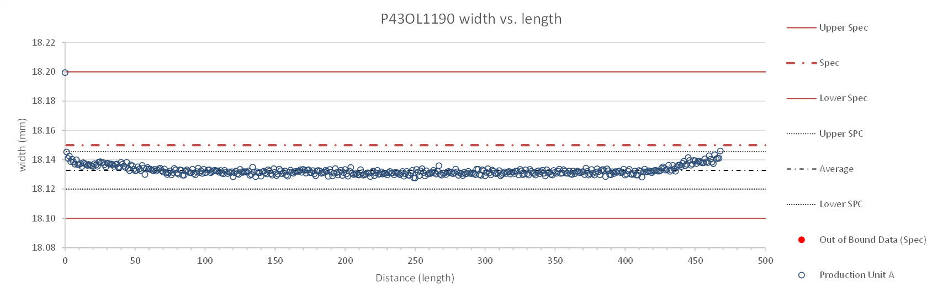
Rollers: P-93 (2021-08-09) & P-94 (2021-08-09)

Slide 53
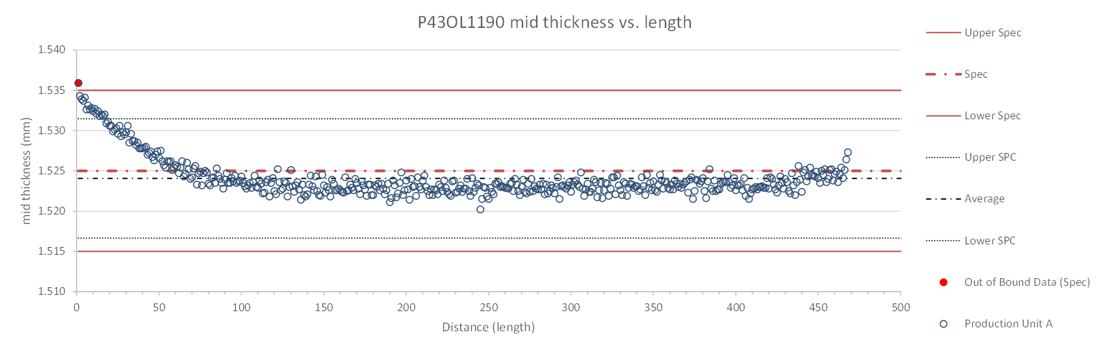
Rollers: P-93 (2021-08-09) & P-94 (2021-08-09)

Slide 54
P43OL1190 – Braiding
Fiberglass Lot: #RCV0011562
P/I: 18.9
Spool tension: 10 lbs. @ payoff. 20 lbs. @ takeup (12 lbs min)
Bobbin payoff tension: 0.125 lbs. ≤ T ≤ 0.250 lbs.
Insulation Thickness (at 5 MPa)
Site | Cycle #1 (mm) | Cycle #2 (mm) | Cycle #3 (mm) | Average (mm)
NEWT | 0.151 | 0.148 | 0.146 | 0.148
LBNL Verification | 0.151 | 0.148 | 0.146 | 0.148

Slide 55
P43OL1190 – Wire Parameters
Properties | Inspected Average
Wire Diameter | 0.8509 ± 0.001 mm (LBNL)¹
Cu ratio ª | 54.32% (BOST)
Strand twist pitch ª | 19.7 mm (BOST)
RRR (RW) ª | 292 (BOST)
RRR (15% rolled) ª | 192 (BOST)
I_{C} (4.2 K, 15 T) ª | 366 A (BOST)
I_{C} (4.2 K, 14 T) ª | 458 A (BOST)
I_{C} (4.2 K, 13 T) ª | 563 A (BOST)
I_{C} (4.2 K, 12 T) ª | 683 A (BOST)
ª First billet averaged, then weighted average according
to the spool distribution in the cable
¹ As-received. LBNL respooling data. Mean ± 1 sigma

Slide 56
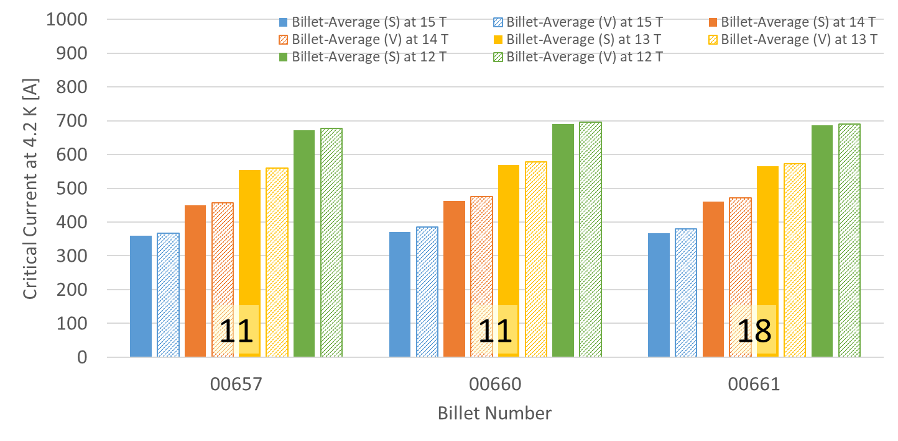
P43OL1190 – Wire Parameters
Supplier (S) and Verification (V) I_{C} Data
Number of spools from that billet used in the cable

Slide 57
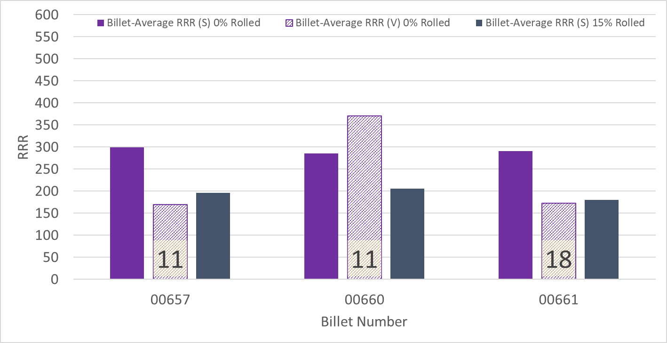
P43OL1190 – Wire Parameters
Supplier (S) and Verification (V) RRR Data
Number of spools from that billet used in the cable

Slide 58
P43OL1190 – Extracted Strand RRR
Cable ID | No. of Units from Billet (spool) | Heat Treat/ Sample ID | Major Edge RRR | Minor Edge RRR | Straight 1 RRR | Straight 2 RRR
PO08S00657A01U P43OL1190AE03E | 11 (6) | LRLK220420ALC1 | 234 | 232 | 296 | 308
PO08S00657A03U P43OL1190AE11E | 11 (5) | LRLK220420ALC1 | 283 | 267 | 328 | 354
PO08S00660A02U P43OL1190AE18E | 11 (11) | LRLK220420ALC1 | 283 | 287 | 353 | 368
PO08S00661A02U P43OL1190AE37E | 18 (7) | LRLK220420ALC1 | 242 | 231 | 271 | 278
PO08S00661A03U P43OL1190AE48E | #N/A | LRLK220420ALC1 | 247 | 245 | 310 | 312

Slide 59
P43OL1190 – I_{c}, Cable Qual Samples
Wire/ Cable Strand | I_{c}(A) at Field (T)
 | 12 T | 13 T | 14 T | 15 T
PO08S00661A03U P43OL1190AE48E | 665 | 552 | 449 | 361
PO08S00661A02U P43OL1190AE37E | 663 | 549 | 447 | 358
PO08S00660A02U P43OL1190AE19E | 639 | 523 | 425 | 338

Slide 60
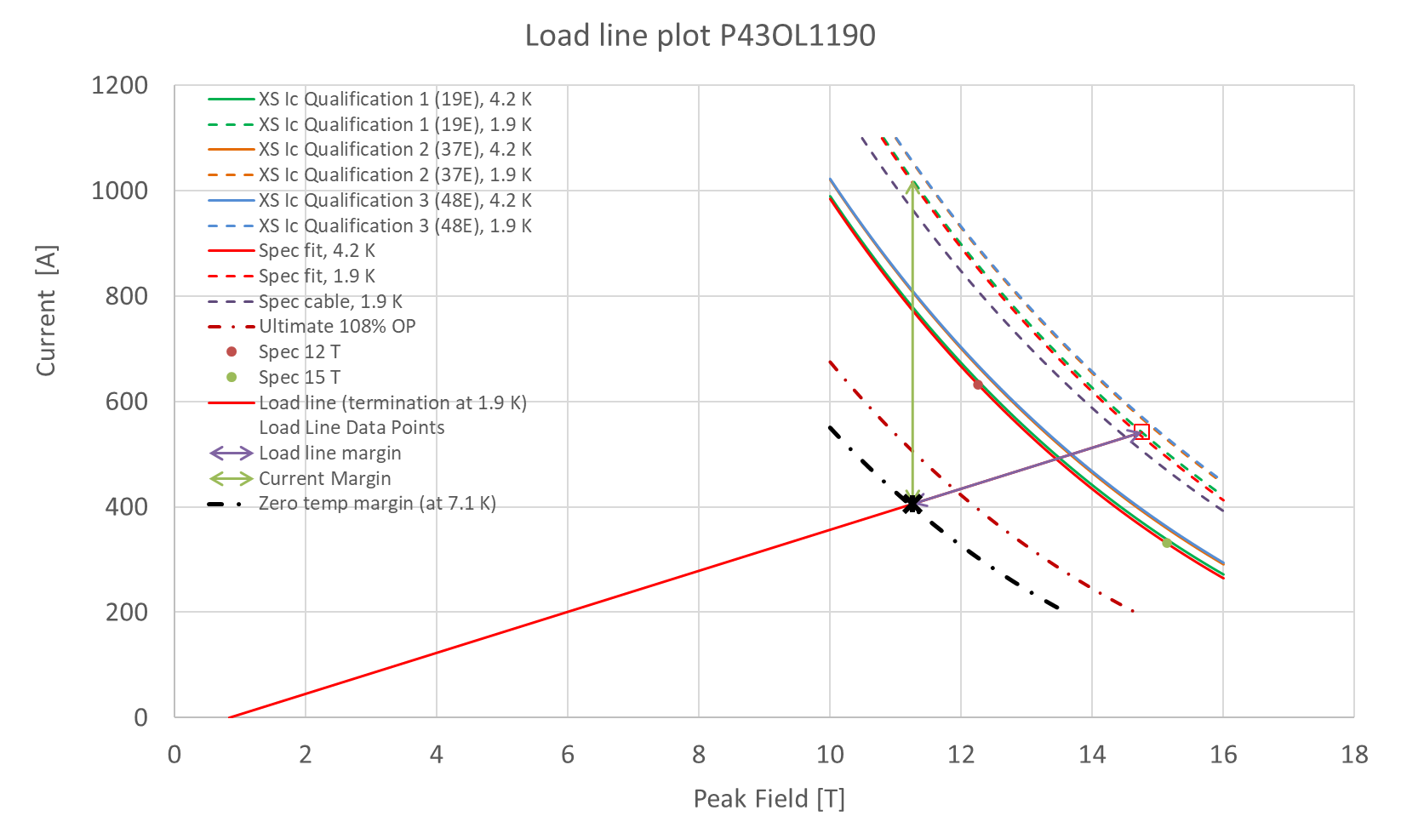
P43OL1190 – SSL Plot, Cable Qual Samples

Slide 61
P43OL1190 – SSL Margins, Qual Samples
Strand from which Margin is Calculated: | Strand # 19E @ 1.9 K
Margins | Margin | Operating Point (X)
Load Line Margin (Purple Arrow) | 25.1% | 74.9%
Current Margin (Green Arrow) | 60.2% | 39.8%
Temperature Margin (K) | 5.2 | 7.1
Limits | Strand | Strand x 40
Selected Strand Current (A) at Margin-Calculation Field | 1020.3 | 40811.6
Selected Strand Current (A) at 100% SSL | 541.7 | 21669.5
Selected Strand Field (T) at 100% SSL | 14.75

Slide 62
QXFA-152 / P43OL1193

Slide 63
P43OL1193 – Cable Date, Lengths
Cable Manufacture Date
  03 May 2022(Production run)
Cable Length:
  468 m (LBNL, fabricated, including LBNL samples)

Slide 64
P43OL1193 – Strand and SS Core ID
Spool:
  PO08S00641A01U x 17 ULs
  PO08S00675A02U x 9 ULs
  PO08S00688A01U x 14 ULs
Core:
  120L44A7400804
    Heat: 850858. Lot: 17-521
    Material: 316L
    Chemical Properties CoT/CoC #187781-1: 0.16 wt% Co
    Core width: 12.0 mm
From 3 billets

Slide 65
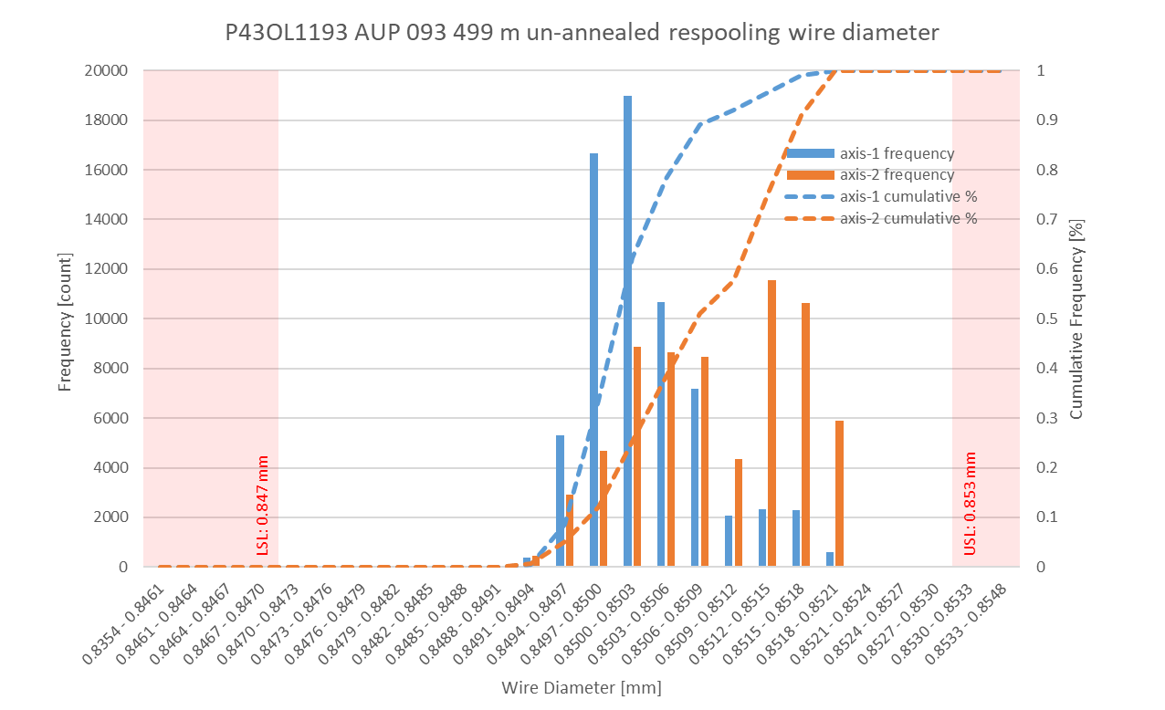
P43OL1193 Respooling Wire Diameter
Below LSL: 0.007%
Above USL: 0.008%

Slide 66
P43OL1193 – Cable QC Data Summary
CME:
Residual Twist: 140°
10-stack:
  Qualification: 1.541 mm
  Production tail end: 1.527 mm
 | Pressure (MPa) | Angle (°) | Width (mm) | Thickness (mm)
Maximum | 17.2 | 0.388 | 18.160 | 1.532
Average | 16.8 | 0.367 | 18.140 | 1.522
Minimum | 16.7 | 0.339 | 18.136 | 1.518
Sigma | 0.06 | 0.007 | 0.002 | 0.002

Slide 67
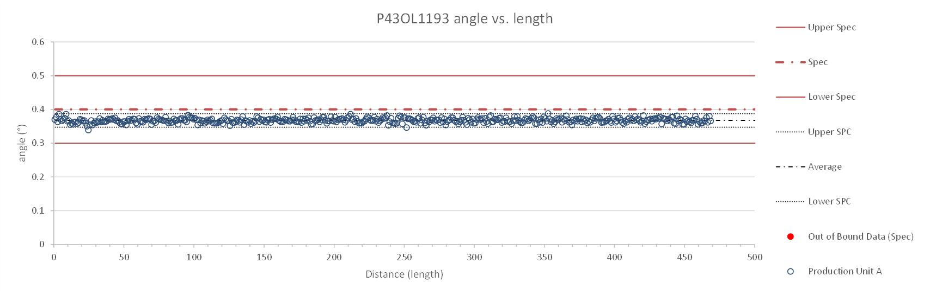
Rollers: P-93 (2021-08-09) & P-94 (2021-08-09)

Slide 68
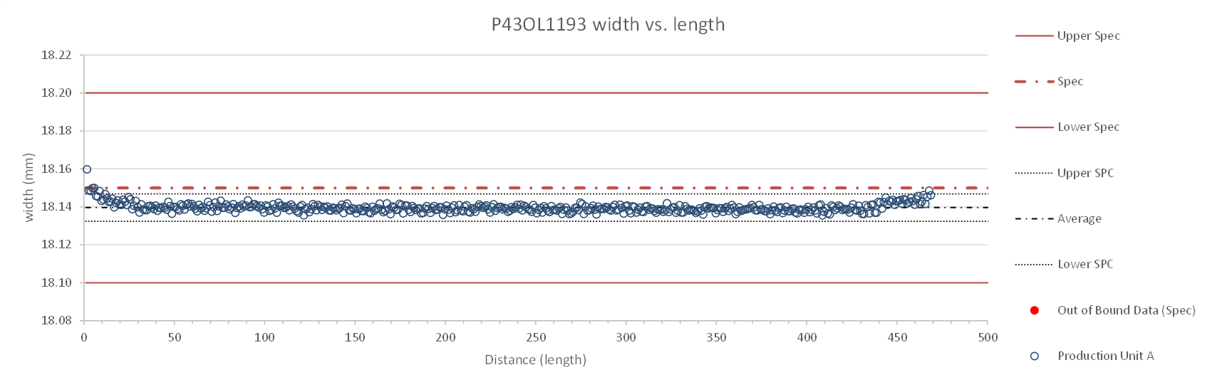
Rollers: P-93 (2021-08-09) & P-94 (2021-08-09)

Slide 69
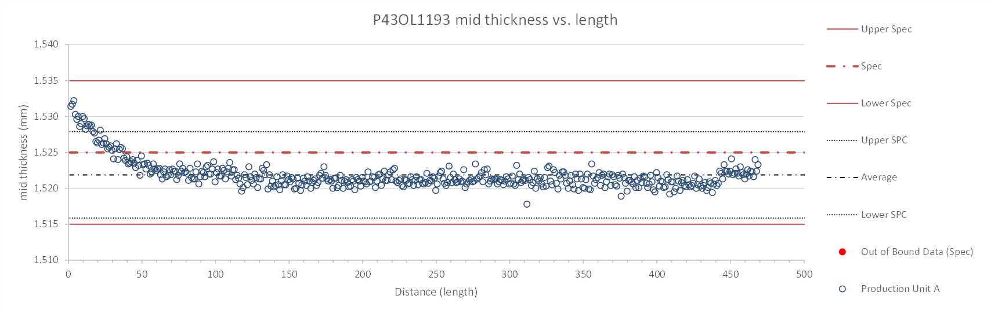
Rollers: P-93 (2021-08-09) & P-94 (2021-08-09)

Slide 70
P43OL1193 – Braiding
Fiberglass Lot: #11562
P/I: 18.9
Spool tension: 10 lbs. @ payoff. 20 lbs. @ takeup (12 lbs min)
Bobbin payoff tension: 0.125 lbs. ≤ T ≤ 0.250 lbs.
Insulation Thickness (at 5 MPa)
Site | Cycle #1 (mm) | Cycle #2 (mm) | Cycle #3 (mm) | Average (mm)
NEWT | 0.149 | 0.147 | 0.146 | 0.148
LBNL Verification | 0.150 | 0.147 | 0.145 | 0.147

Slide 71
P43OL1193 – Wire Parameters
Properties | Inspected Average
Wire Diameter | 0.8506 ± 0.0007 (LBNL)¹
Cu ratio ª | 53.86% (BOST)
Strand twist pitch ª | 19.5mm (BOST)
RRR (RW) ª | 306 (BOST)
RRR (15% rolled) ª | 229 (BOST)
I_{C} (4.2 K, 15 T) ª | 366 A (BOST)
I_{C} (4.2 K, 14 T) ª | 459 A (BOST)
I_{C} (4.2 K, 13 T) ª | 563 A (BOST)
I_{C} (4.2 K, 12 T) ª | 685 A (BOST)
ª First billet averaged, then weighted average according
to the spool distribution in the cable
¹ As-received. LBNL respooling data. Mean ± 1 sigma

Slide 72
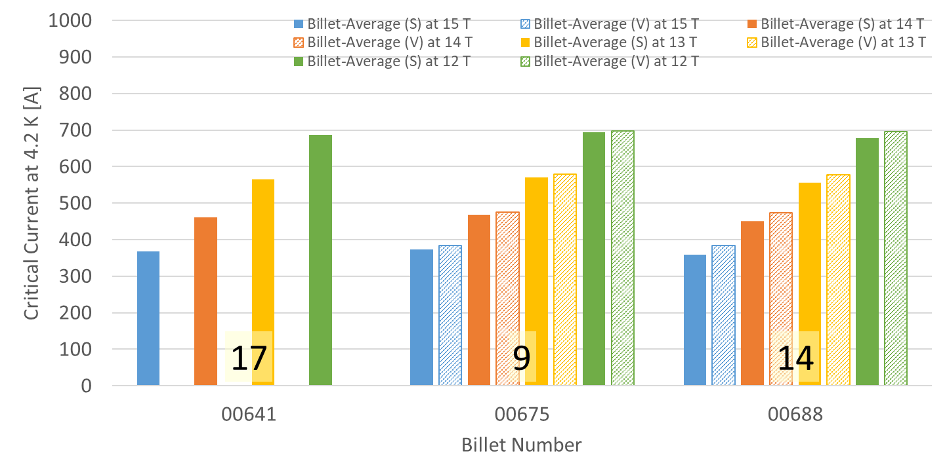
P43OL1193 – Wire Parameters
Supplier (S) and Verification (V) I_{C} Data
Number of spools from that billet used in the cable
Some verification data not available

Slide 73
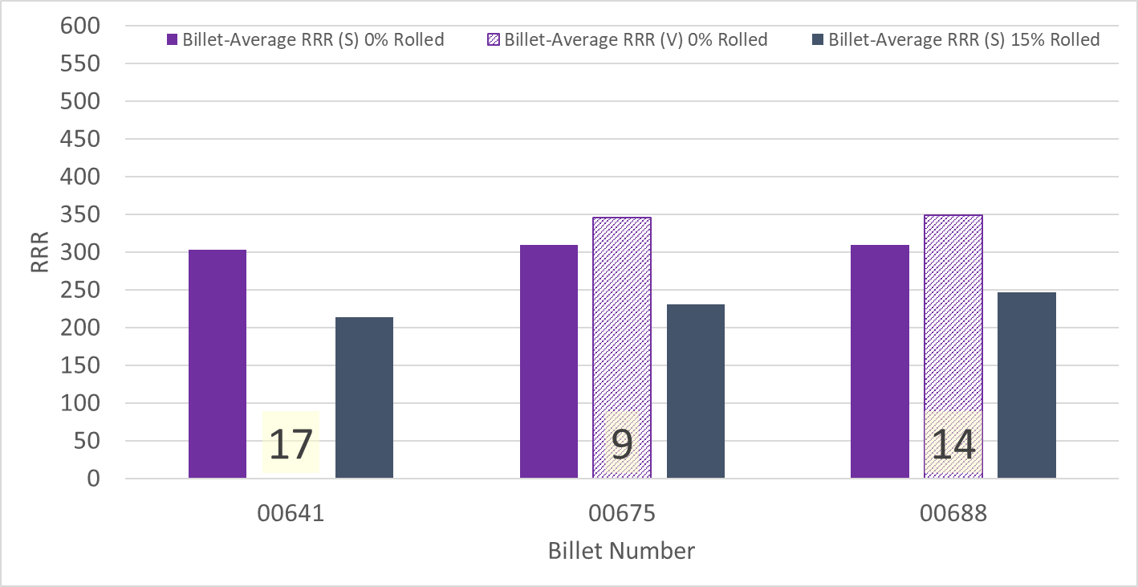
P43OL1193 – Wire Parameters
Supplier (S) and Verification (V) RRR Data
Number of spools from that billet used in the cable
Some verification data not available

Slide 74
P43OL1193 – Extracted Strand RRR
Cable ID | No. of Units from Billet (spool) | Heat Treat/ Sample ID | Major Edge RRR | Minor Edge RRR | Straight 1 RRR | Straight 2 RRR
PO08S00641A01U P43OL1193AE03E | 17 (17) | LRLK220523ALC1 | 277 | 251 | 315 | 321
PO08S00641A01U P43OL1193AE05E | 17 (17) | LRLK220523ALC1 | 287 | 280 | 347 | 355
PO08S00675A02U P43OL1193AE27E | 9 (9) | LRLK220523ALC1 | 261 | 251 | 320 | 324
PO08S00688A01U P43OL1193AE41E | 14 (14) | LRLK220523ALC1 | 291 | 270 | 338 | 339
PO08S00688A01U P43OL1193AE42E | 14 (14) | LRLK220523ALC1 | 276 | 283 | 341 | 331

Slide 75
P43OL1193 – I_{c}, Cable Qual Samples
Wire/ Cable Strand | I_{c}(A) at Field (T)
 | 12 T | 13 T | 14 T | 15 T
PO08S00641A01U P43OL1193AE01E | 652 | 535 | 430 | 341
PO08S00688A01U P43OL1193AE41E | 669 | 554 | 449 | 363
PO08S00675A02U P43OL1193AE27E | 660 | 549 | 444 | 360
PO08S00641A01U P43OL1193AE03E | 672 | 555 | 451 | 359

Slide 76
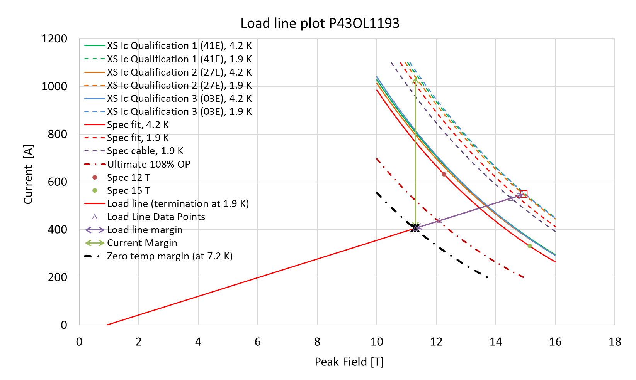
P43OL1193 – SSL Plot, Cable Qual Samples

Slide 77
P43OL1193 – SSL Margins, Qual Samples
Strand from which Margin is Calculated: | Strand # 27E @ 1.9 K
Margins | Margin | Operating Point (X)
Load Line Margin (Purple Arrow) | 26.0% | 74.0%
Current Margin (Green Arrow) | 61.2% | 38.8%
Temperature Margin (K) | 5.3 | 7.2
Limits | Strand | Strand x 40
Selected Strand Current (A) at Margin-Calculation Field | 1045.4 | 41817.0
Selected Strand Current (A) at 100% SSL | 548.5 | 21941.9
Selected Strand Field (T) at 100% SSL | 14.93

Slide 78
QXFA-237 / P43OL1182

Slide 79
P43OL1182 – Cable Date, Lengths
Cable Manufacture Date
  22 Sept 2021 (Production run)
Cable Length:
  467 m (LBNL, fabricated, including LBNL samples)

Slide 80
P43OL1182 – Strand and SS Core ID
Spool:
  PO08S00649A03U x 9 ULs
  PO08S00656A01U x 2 ULs
  PO08S00656A02U x 15 Uls
  PO08S00659A02U x 14 ULs
Core:
  120L33A7400804
    Heat: 85058. Lot: 17-521
    Material: 316L
    Chemical Properties CoT/CoC #187781-1: 0.158 wt% Co
    Core width: 12.0 mm
From 3 billets

Slide 81
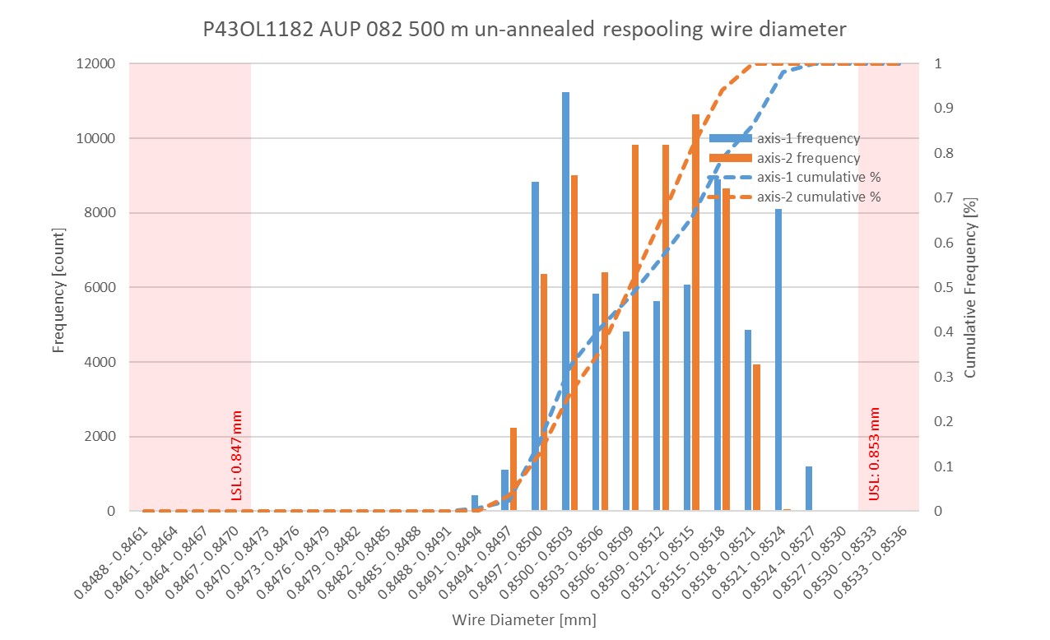
P43OL1182 Respooling Wire Diameter
Below LSL: 0.000%
Above USL: 0.001%

Slide 82
P43OL1182 – Cable QC Data Summary
CME:
Residual Twist: 125°
10-stack:
  Qualification: 1.537 mm
  Production tail end: 1.526 mm
 | Pressure (MPa) | Angle (°) | Width (mm) | Thickness (mm)
Maximum | 17.0 | 0.375 | 18.154 | 1.535
Average | 17.0 | 0.359 | 18.144 | 1.523
Minimum | 17.0 | 0.337 | 18.139 | 1.518
Sigma | 0.01 | 0.007 | 0.002 | 0.003

Slide 83
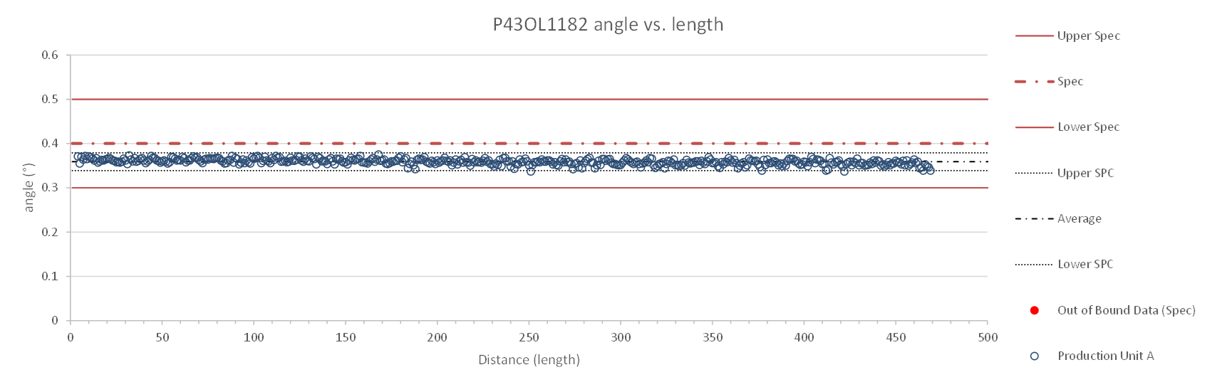
Rollers: P-93 (2021-08-09) & P-94 (2021-08-09)

Slide 84
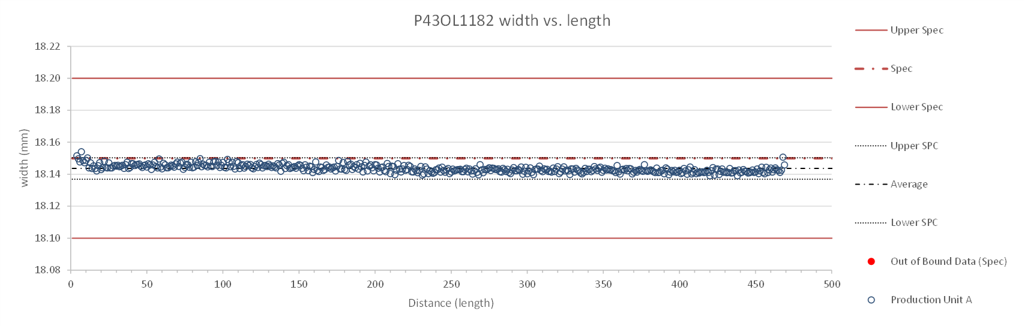
Rollers: P-93 (2021-08-09) & P-94 (2021-08-09)

Slide 85
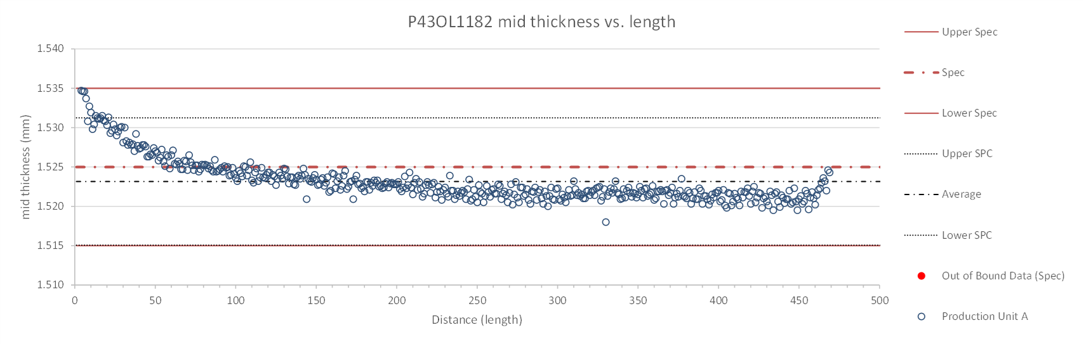
Rollers: P-93 (2021-08-09) & P-94 (2021-08-09)

Slide 86
P43OL1182 – Braiding
Fiberglass Lot: #111154
P/I: 18.9
Spool tension: 10 lbs. @ payoff. 20 lbs. @ takeup (12 lbs min)
Bobbin payoff tension: 0.125 lbs. ≤ T ≤ 0.250 lbs.
Insulation Thickness (at 5 MPa)
Site | Cycle #1 (mm) | Cycle #2 (mm) | Cycle #3 (mm) | Average (mm)
NEWT | 0.150 | 0.147 | 0.146 | 0.147
LBNL Verification | 0.140 | 0.138 | 0.137 | 0.139
Vector #464342

Slide 87
P43OL1182 – Wire Parameters
Properties | Inspected Average
Wire Diameter | 0.8509 ± 0.0007 mm (LBNL)¹
Cu ratio ª | 53.59% (BOST)
Strand twist pitch ª | 19.8mm (BOST)
RRR (RW) ª | 283 (BOST)
RRR (15% rolled) ª | 202 (BOST)
I_{C} (4.2 K, 15 T) ª | 363 A (BOST)
I_{C} (4.2 K, 14 T) ª | 455 A (BOST)
I_{C} (4.2 K, 13 T) ª | 561 A (BOST)
I_{C} (4.2 K, 12 T) ª | 682 A (BOST)
ª First billet averaged, then weighted average according
to the spool distribution in the cable
¹ As-received. LBNL respooling data. Mean ± 1 sigma

Slide 88
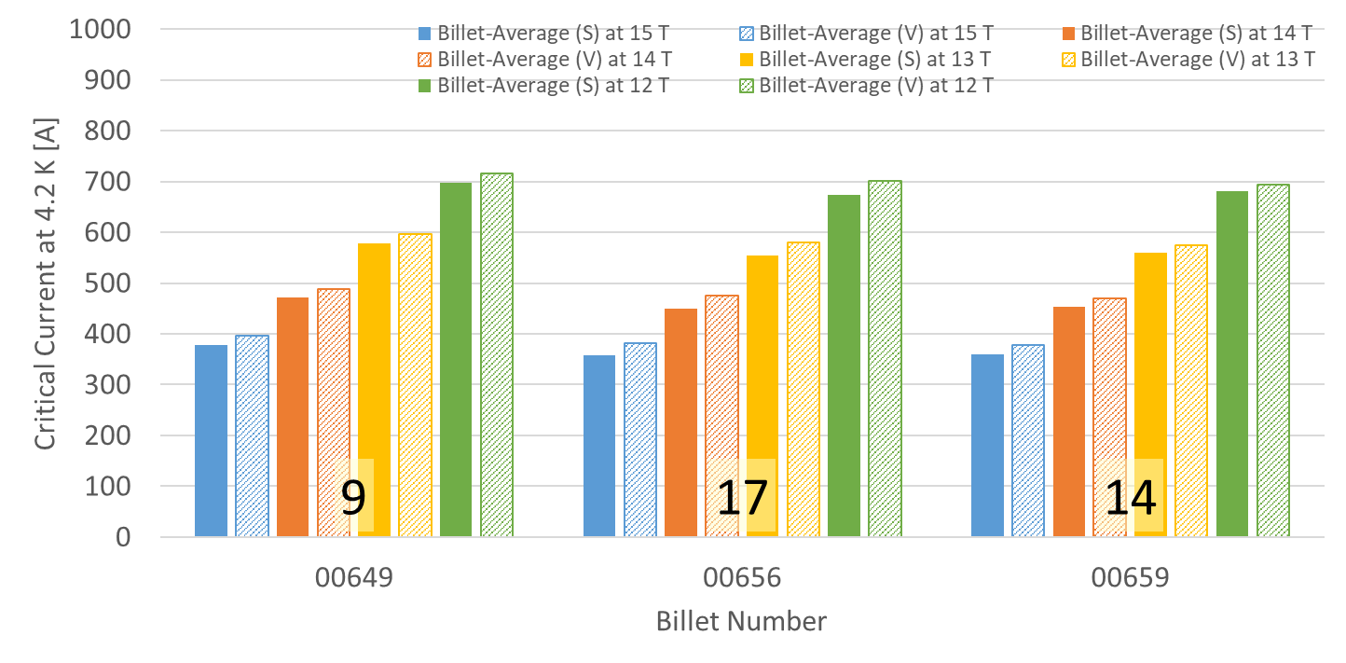
P43OL1182 – Wire Parameters
Supplier (S) and Verification (V) I_{C} Data
Number of spools from that billet used in the cable

Slide 89
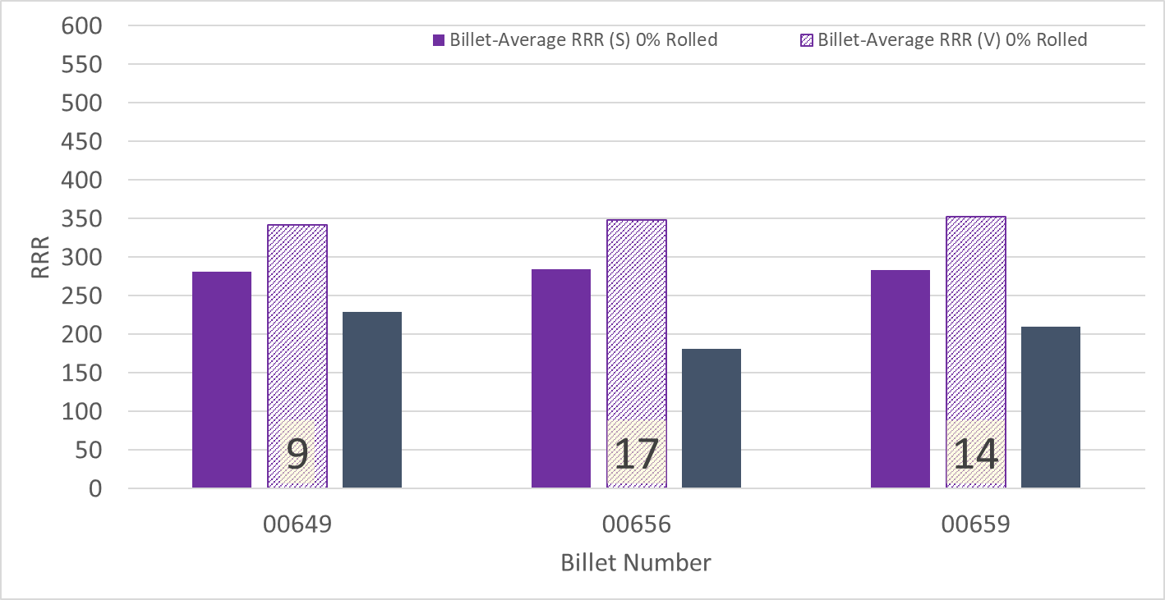
P43OL1182 – Wire Parameters
Supplier (S) and Verification (V) RRR Data
Number of spools from that billet used in the cable

Slide 90
P43OL1182 – Extracted Strand RRR
 | Cable ID | No. of Units from Billet (spool) | HT/sample ID | Major edge RRR | Minor edge RRR | Straight section 1 RRR | Straight section 2 RRR
ID #1 | PO08S00659A02U P43OL1182AE03E | 14 (14) | LRLK211021ALC1 | 268 | 269 | 332 | 358
ID #2 | PO08S00659A02U P43OL1182AE05E | 14 (14) | LRLK211021ALC1 | 252 | 263 | 319 | 348
ID #3 | PO08S00649A03U P43OL1182AE23E | 9 (9) | LRLK211021ALC1 | 217 | 226 | 269 | 292
ID #4 | PO08S00656A02U P43OL1182AE39E | 17 (15) | LRLK211021ALC1 | 236 | 227 | 281 | 324
ID #5 | PO08S00656A02U P43OL1182AE41E | 17 (15) | LRLK211021ALC1 | 235 | 251 | 300 | 326
Vector #464342

Slide 91
P43OL1182 – I_{c} , Cable Qual Samples
Wire/ Cable Strand | I_{c}(A) at Field (T)
 | 12 T | 13 T | 14 T | 15 T
PO08S00656A02U P43OL1182AE39E | 693 | 574 | 470 | 377
PO08S00659A02U P43OL1182AE01E | 666 | 547 | 445 | 355
PO08S00649A03U P43OL1182AE23E | 690 | 573 | 470 | 377

Slide 92
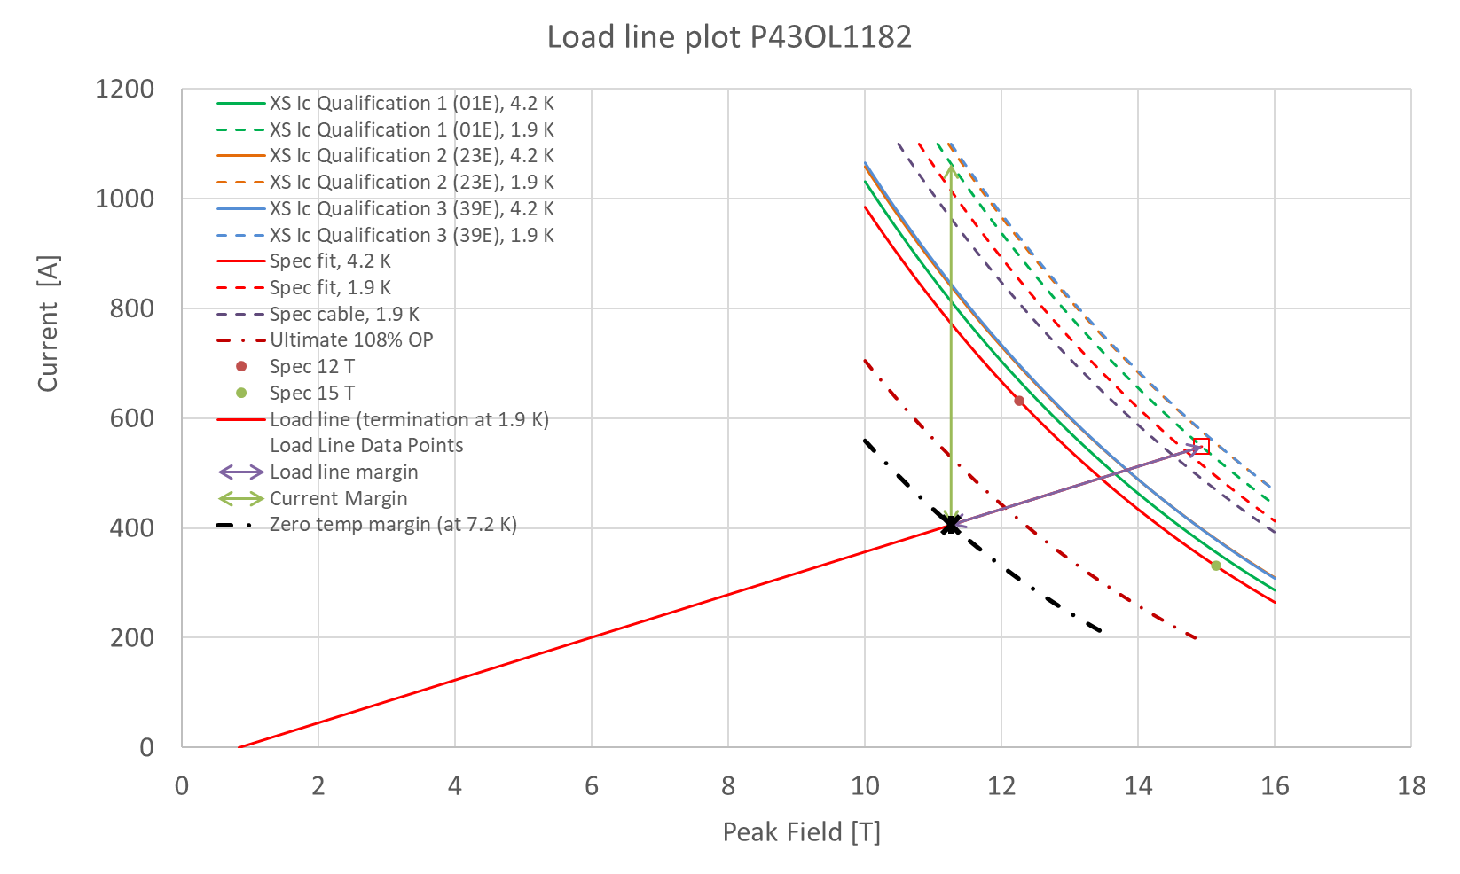
P43OL1182 – SSL Plot, Cable Qual Samples

Slide 93
P43OL1182 – SSL Margins, Qual Samples
Strand from which Margin is Calculated: | Strand # 01E @ 1.9 K
Margins | Margin | Operating Point (X)
Load Line Margin (Purple Arrow) | 26.0% | 74.0%
Current Margin (Green Arrow) | 61.8% | 38.2%
Temperature Margin (K) | 5.3 | 7.2
Limits | Strand | Strand x 40
Selected Strand Current (A) at Margin-Calculation Field | 1063.4 | 42534.8
Selected Strand Current (A) at 100% SSL | 548.5 | 21941.8
Selected Strand Field (T) at 100% SSL | 14.93

Slide 94
QXFA-239 / P43OL1184

Slide 95
P43OL1184 – Cable Date, Lengths
Cable Manufacture Date
  12 Oct 2021 (Production run)
Cable Length:
  467 m (LBNL, fabricated, including LBNL samples)

Slide 96
P43OL1184 – Strand and SS Core ID
Spool:
  PO08S00646A02U x 5 ULs
  PO08S00651A01U x 11 ULs
  PO08S00651A02U x 7 ULs
  PO08S00652A01U x 7 ULs
  PO08S00652A02U x 10 ULs
Core:
  120L35A7400804
    Heat: 85058. Lot: 17-521
    Material: 316L
    Chemical Properties CoT/CoC #187781-1: 0.158 wt% Co
    Core width: 12.0 mm
From 3 billets

Slide 97
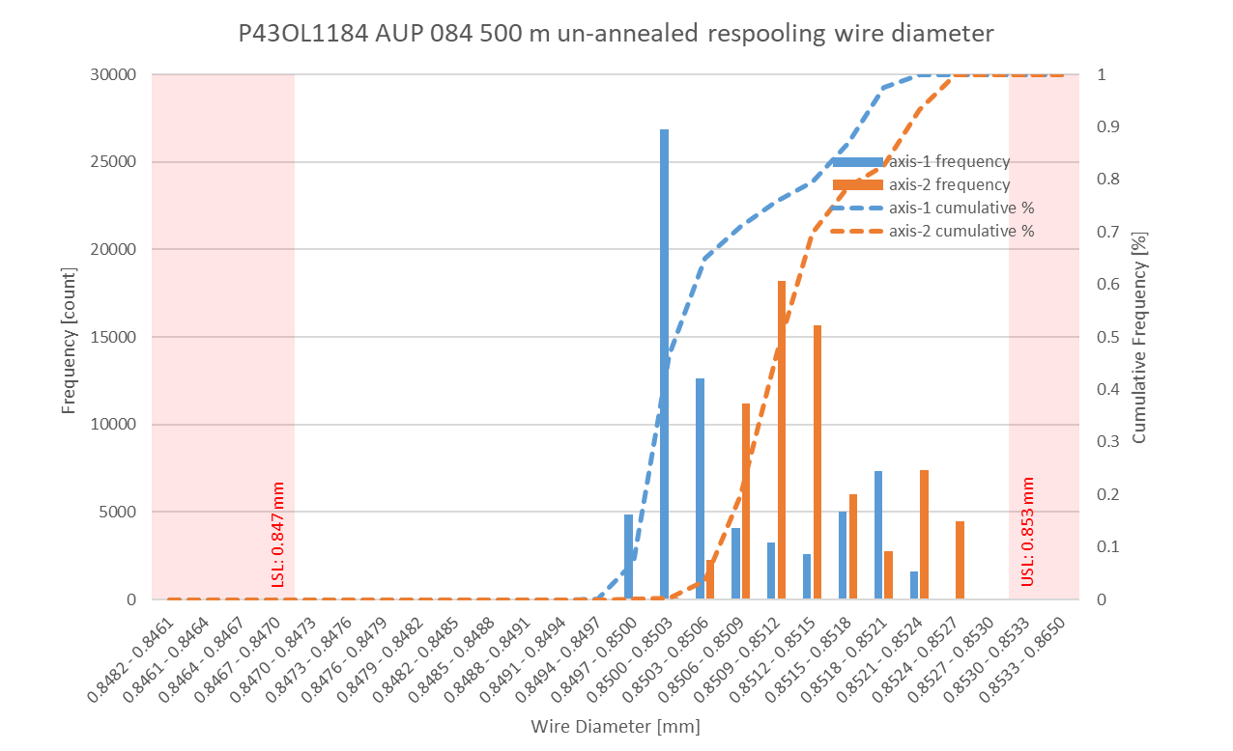
P43OL1184 Respooling Wire Diameter
Below LSL: 0.000%
Above USL: 0.006%

Slide 98
P43OL1184 – Cable QC Data Summary
CME:
Residual Twist: 140°
10-stack:
  Qualification: 1.536 mm
  Production tail end: 1.530 mm
 | Pressure (MPa) | Angle (°) | Width (mm) | Thickness (mm)
Maximum | 17.1 | 0.381 | 18.160 | 1.536
Average | 17.0 | 0.357 | 18.140 | 1.525
Minimum | 17.0 | 0.339 | 18.133 | 1.520
Sigma | 0.01 | 0.007 | 0.002 | 0.002

Slide 99
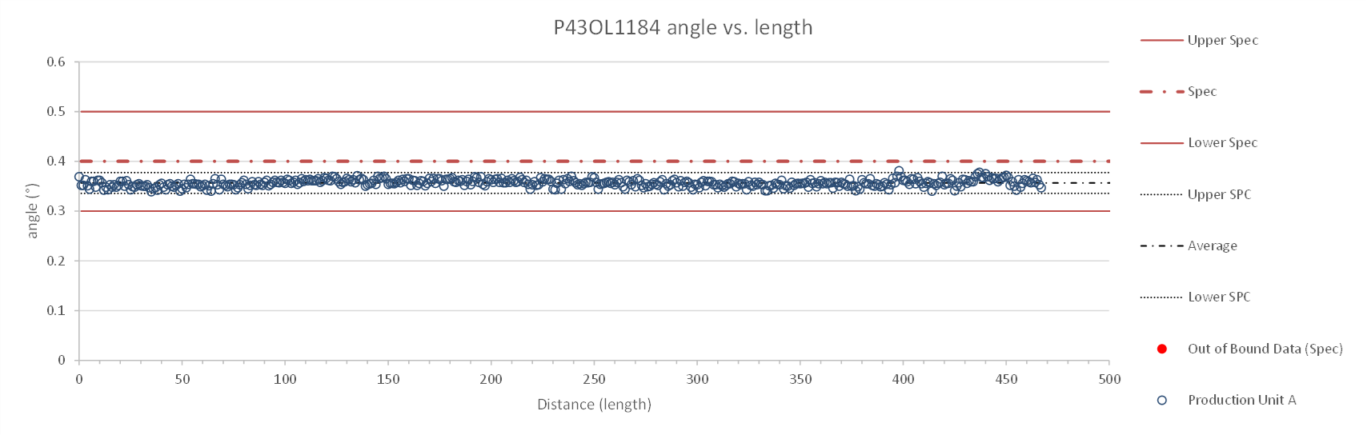
Rollers: P-93 (2021-08-09) & P-94 (2021-08-09)

Slide 100
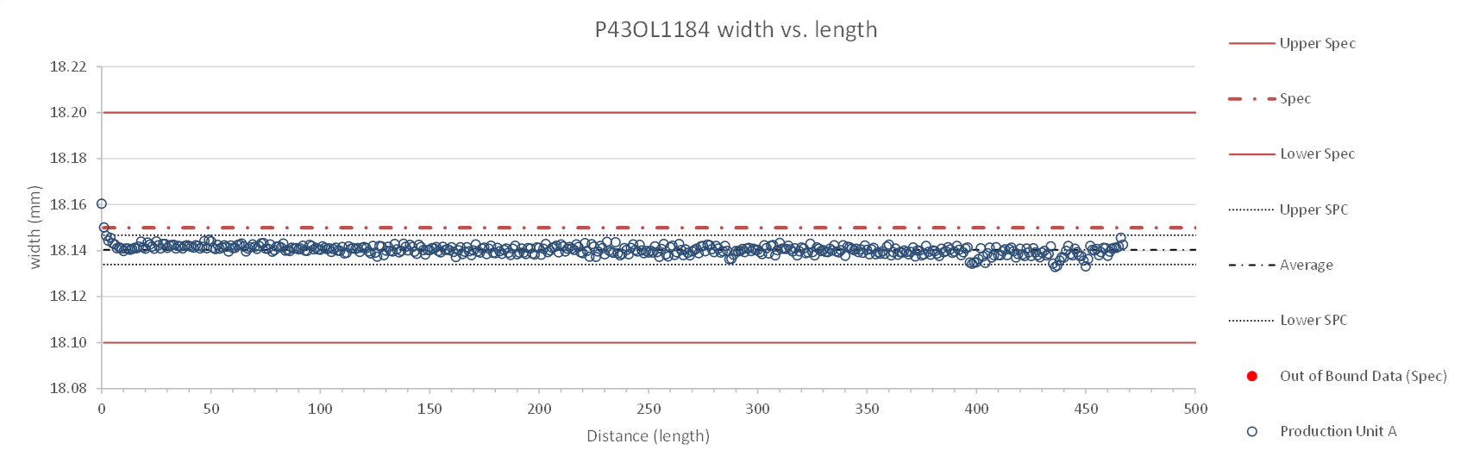
Rollers: P-93 (2021-08-09) & P-94 (2021-08-09)

Slide 101
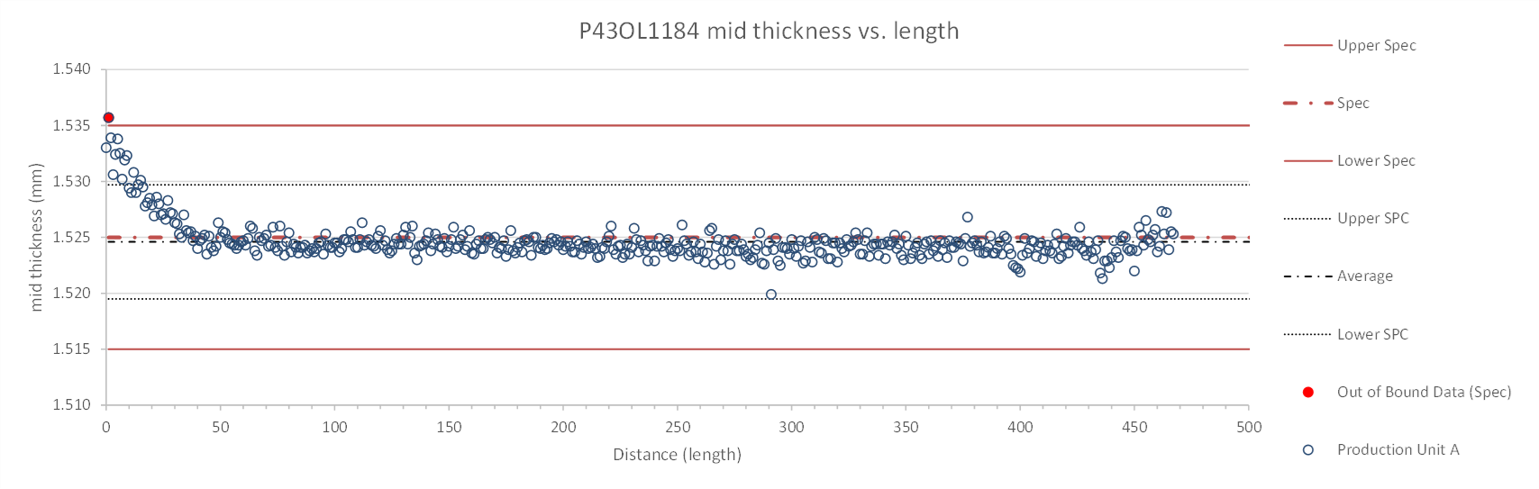
Rollers: P-93 (2021-08-09) & P-94 (2021-08-09)

Slide 102
P43OL1184 – Braiding
Fiberglass Lot: #111154
P/I: 18.9
Spool tension: 10 lbs. @ payoff. 20 lbs. @ takeup (12 lbs min)
Bobbin payoff tension: 0.125 lbs. ≤ T ≤ 0.250 lbs.
Insulation Thickness (at 5 MPa)
Site | Cycle #1 (mm) | Cycle #2 (mm) | Cycle #3 (mm) | Average (mm)
NEWT | 0.148 | 0.147 | 0.146 | 0.147
LBNL Verification | 0.143 | 0.141 | 0.140 | 0.141
Vector #464342

Slide 103
P43OL1184 – Wire Parameters
Properties | Inspected Average
Wire Diameter | 0.8520 ± 0.0007 mm (LBNL)¹
Cu ratio ª | 54.32% (BOST)
Strand twist pitch ª | 19.2mm (BOST)
RRR (RW) ª | 269 (BOST)
RRR (15% rolled) ª | 182 (BOST)
I_{C} (4.2 K, 15 T) ª | 356 A (BOST)
I_{C} (4.2 K, 14 T) ª | 448 A (BOST)
I_{C} (4.2 K, 13 T) ª | 554 A (BOST)
I_{C} (4.2 K, 12 T) ª | 673 A (BOST)
ª First billet averaged, then weighted average according
to the spool distribution in the cable
¹ As-received. LBNL respooling data. Mean ± 1 sigma

Slide 104
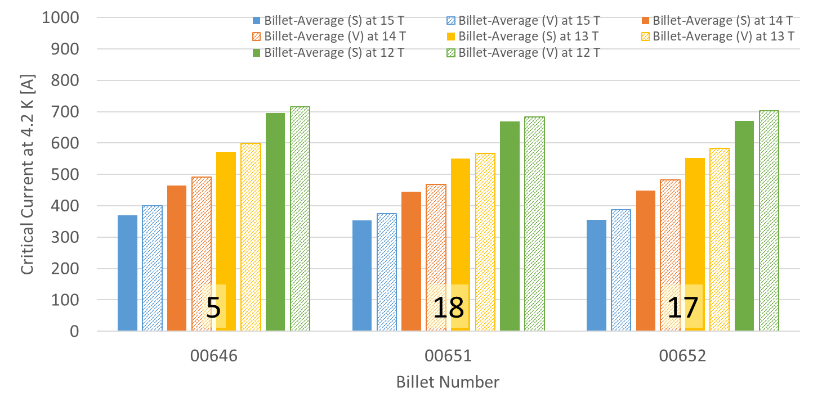
P43OL1184 – Wire Parameters
Supplier (S) and Verification (V) I_{C} Data
Number of spools from that billet used in the cable

Slide 105
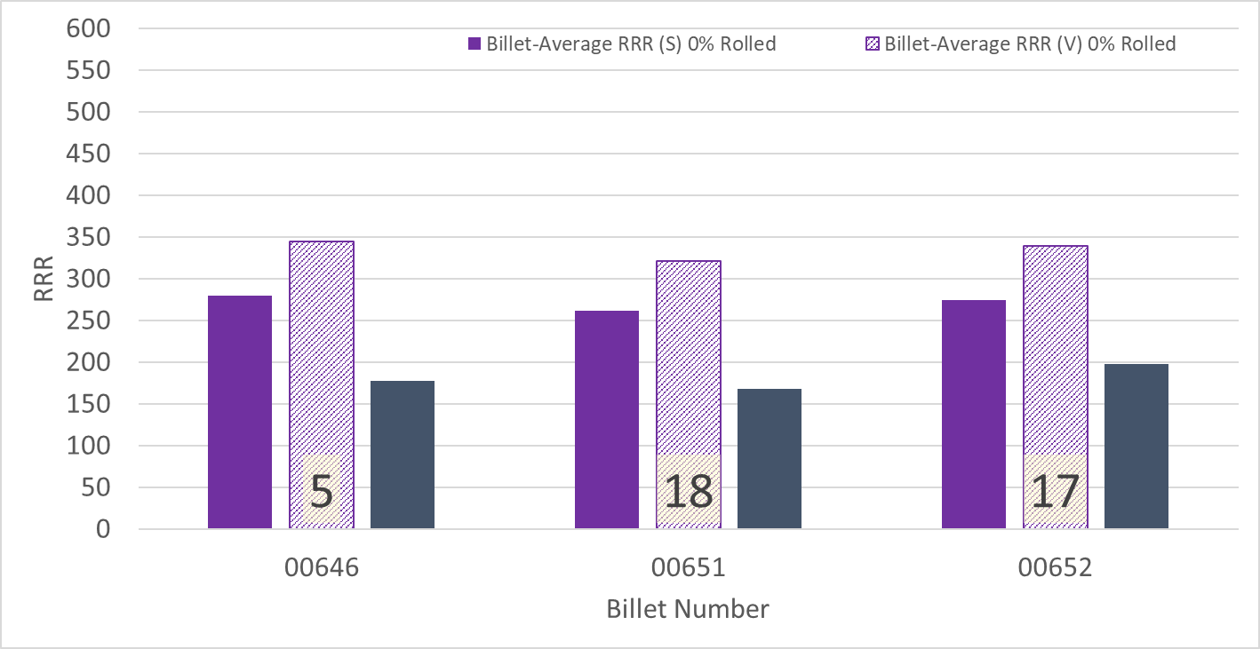
P43OL1184 – Wire Parameters
Supplier (S) and Verification (V) RRR Data
Number of spools from that billet used in the cable

Slide 106
P43OL1184 – Extracted Strand RRR
 | Cable ID | No. of Units from Billet (spool) | HT/sample ID | Major edge RRR | Minor edge RRR | Straight section 1 RRR | Straight section 2 RRR
ID #1 | PO08S00646A02U P43OL1184AE03E | 5 (5) | LRLK211021ALC1 | 287 | 265 | 324 | 348
ID #2 | PO08S00651A01U P43OL1184AE09E | 18 (11) | LRLK211021ALC1 | 241 | 230 | 285 | 297
ID #3 | PO08S00651A02U P43OL1184AE25E | 18 (7) | LRLK211021ALC1 | 254 | 225 | 293 | 310
ID #4 | PO08S00652A01U P43OL1184AE36E | 17 (7) | LRLK211021ALC1 | 283 | 269 | 310 | 326
ID #5 | PO08S00652A02U P43OL1184AE47E | 17 (10) | LRLK211021ALC1 | 234 | 235 | 302 | 305
Vector #464342

Slide 107
P43OL1184 – I_{c} , Cable Qual Samples
Wire/ Cable Strand | I_{c}(A) at Field (T)
 | 12 T | 13 T | 14 T | 15 T
PO08S00651A01U P43OL1184AE09E | 664 | 551 | 452 | 364
PO08S00652A02U P43OL1184AE47E | 671 | 555 | 453 | 362
PO08S00651A02U P43OL1184AE25E | 651 | 537 | 435 | 347
PO08S00651A01U P43OL1184AE11E | 665 | 552 | 452 | 364

Slide 108
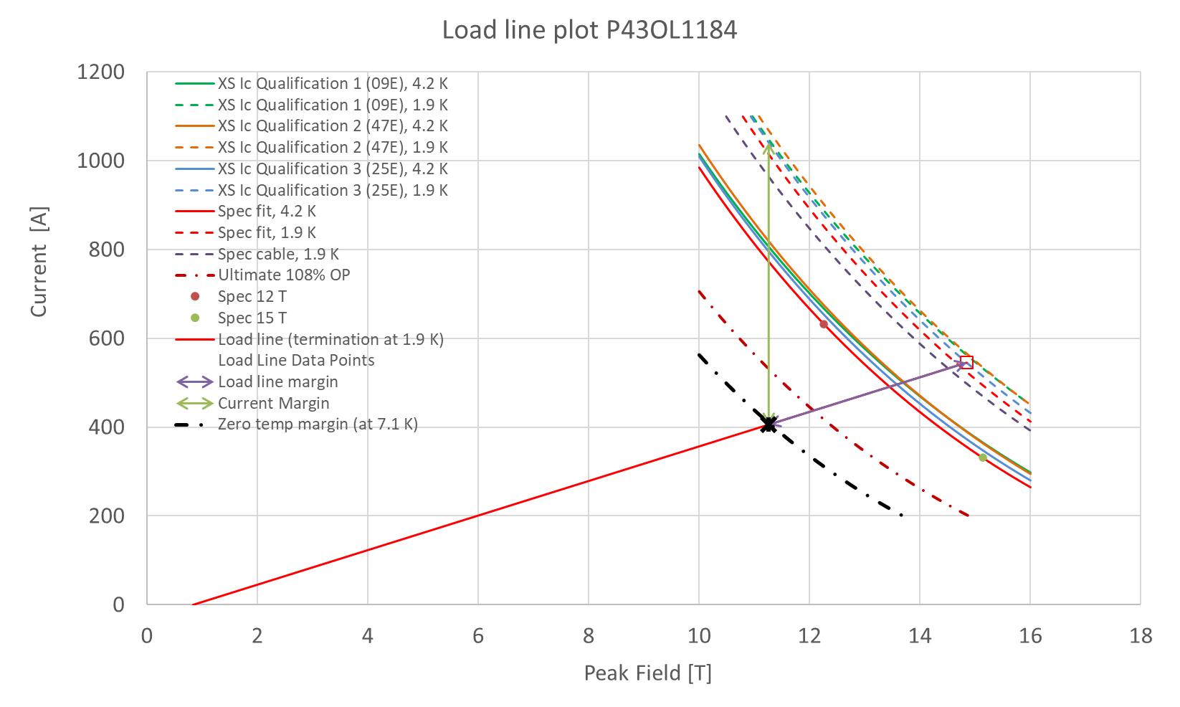
P43OL1184 – SSL Plot, Cable Qual Samples

Slide 109
P43OL1184 – SSL Margins, Qual Samples
Strand from which Margin is Calculated: | Strand # 25E @ 1.9 K
Margins | Margin | Operating Point (X)
Load Line Margin (Purple Arrow) | 25.6% | 74.4%
Current Margin (Green Arrow) | 61.0% | 39.0%
Temperature Margin (K) | 5.2 | 7.1
Limits | Strand | Strand x 40
Selected Strand Current (A) at Margin-Calculation Field | 1040.9 | 41636.4
Selected Strand Current (A) at 100% SSL | 545.4 | 21814.5
Selected Strand Field (T) at 100% SSL | 14.84

Slide 110
QXFA-242 / P43OL1189

Slide 111
P43OL1189 – Cable Date, Lengths
Cable Manufacture Date
  22 Mar 2022 (Production run)
Cable Length:
  466 m (LBNL, fabricated, including LBNL samples)

Slide 112
P43OL1189 – Strand and SS Core ID
Spool:
  PO08S00523A03U x 15 ULs
  PO08S00671A02U x 11 ULs
  PO08S00681A01U x 12 ULs
  PO08S00681A02U x 2 ULs
Core:
  120L40A7400804
    Heat: 850858. Lot: 17-521
    Material: 316L
    Chemical Properties CoT/CoC #172660-1: 0.16 wt% Co
    Core width: 12.0 mm
From 3 billets

Slide 113
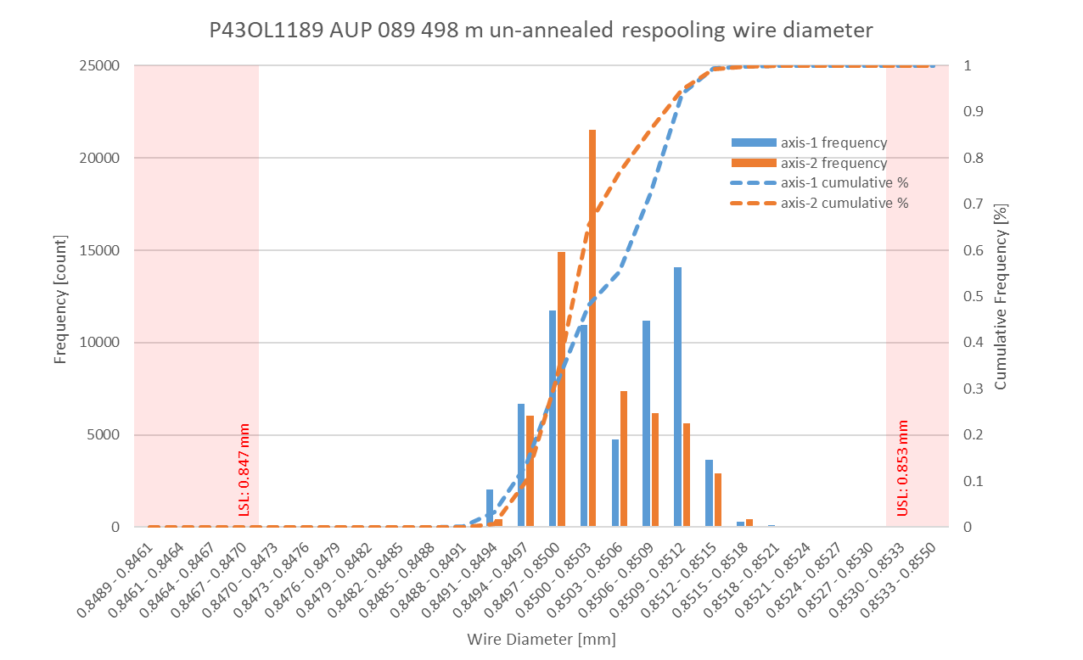
P43OL1189 Respooling Wire Diameter
Below LSL: 0.000%
Above USL: 0.004%

Slide 114
P43OL1189 – Cable QC Data Summary
CME:
Residual Twist: 135°
10-stack:
  Qualification: 1.531 mm
  Production tail end: 1.530 mm
 | Pressure (MPa) | Angle (°) | Width (mm) | Thickness (mm)
Maximum | 17.1 | 0.390 | 18.159 | 1.529
Average | 17.0 | 0.374 | 18.134 | 1.525
Minimum | 16.9 | 0.350 | 18.126 | 1.517
Sigma | 0.02 | 0.007 | 0.004 | 0.002

Slide 115
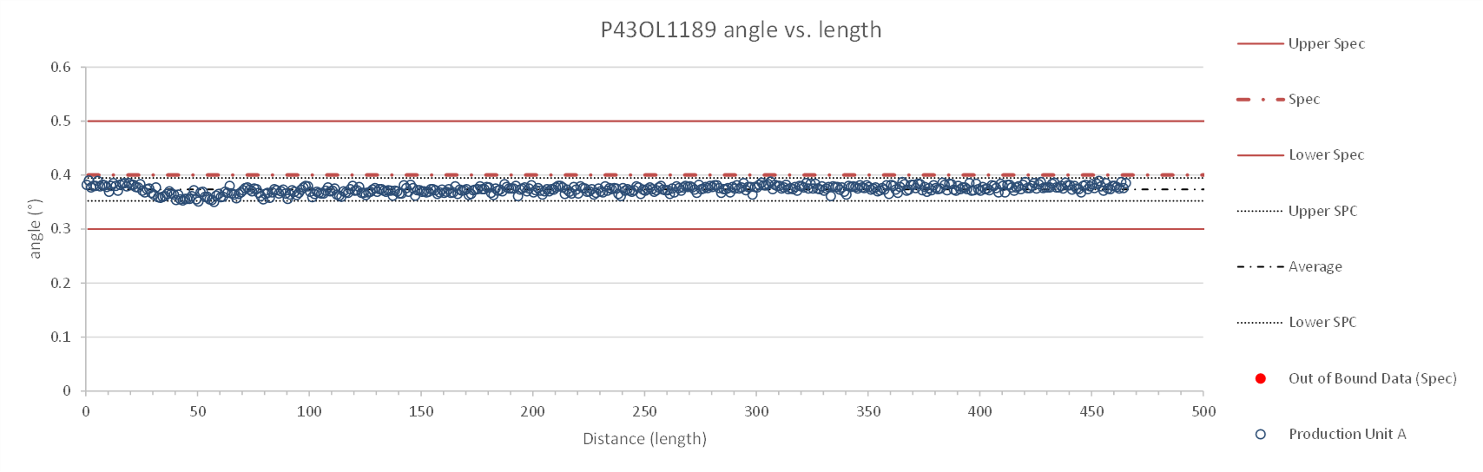
Rollers: P-93 (2021-08-09) & P-94 (2021-08-09)

Slide 116
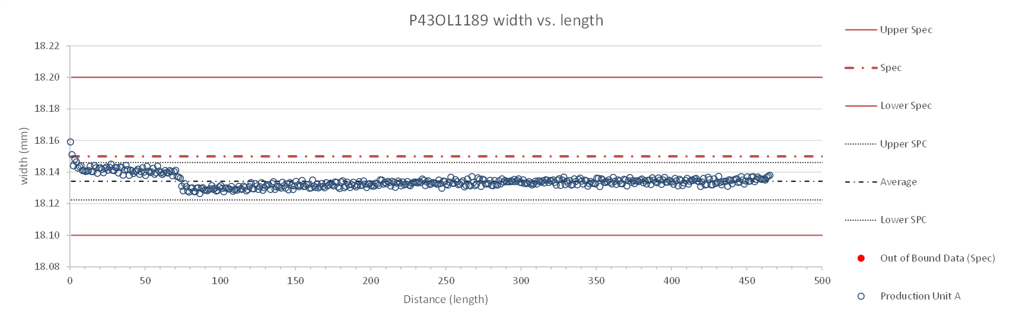
Rollers: P-93 (2021-08-09) & P-94 (2021-08-09)

Slide 117
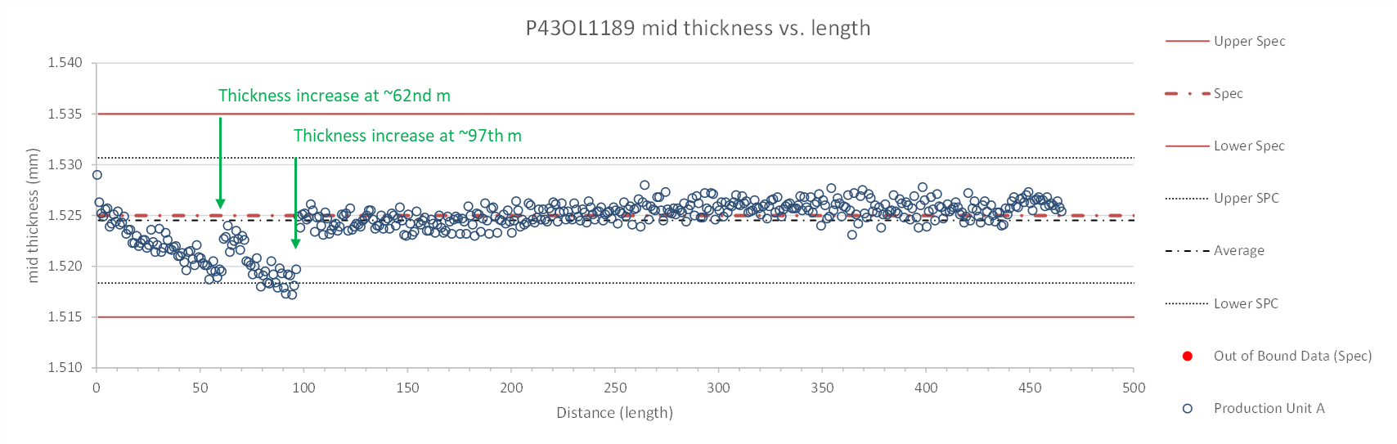
Rollers: P-93 (2021-08-09) & P-94 (2021-08-09)

Slide 118
P43OL1189 – Braiding
Fiberglass Lot: #RCV0011562
P/I: 18.9
Spool tension: 10 lbs. @ payoff. 20 lbs. @ takeup (12 lbs min)
Bobbin payoff tension: 0.125 lbs. ≤ T ≤ 0.250 lbs.
Insulation Thickness (at 5 MPa)
Site | Cycle #1 (mm) | Cycle #2 (mm) | Cycle #3 (mm) | Average (mm)
NEWT | 0.151 | 0.149 | 0.148 | 0.149
LBNL Verification | 0.146 | 0.144 | 0.142 | 0.144

Slide 119
P43OL1189 – Wire Parameters
Properties | Inspected Average
Wire Diameter | 0.8503 ± 0.001 mm (LBNL)¹
Cu ratio ª | 54.15% (BOST)
Strand twist pitch ª | 18.7 mm (BOST)
RRR (RW) ª | 314 (BOST)
RRR (15% rolled) ª | 220 (BOST)
I_{C} (4.2 K, 15 T) ª | 380 A (BOST)
I_{C} (4.2 K, 14 T) ª | 475 A (BOST)
I_{C} (4.2 K, 13 T) ª | 580 A (BOST)
I_{C} (4.2 K, 12 T) ª | 703 A (BOST)
ª First billet averaged, then weighted average according
to the spool distribution in the cable
¹ As-received. LBNL respooling data. Mean ± 1 sigma

Slide 120
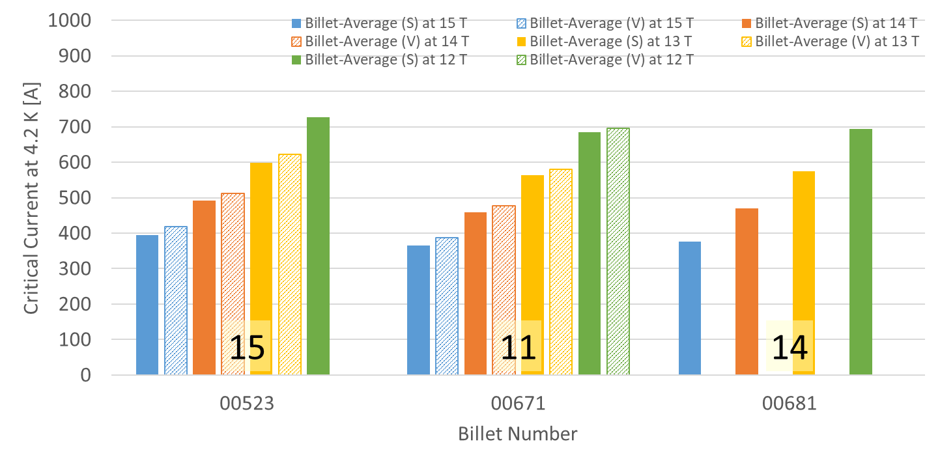
P43OL1189 – Wire Parameters
Supplier (S) and Verification (V) I_{C} Data
Number of spools from that billet used in the cable

Slide 121
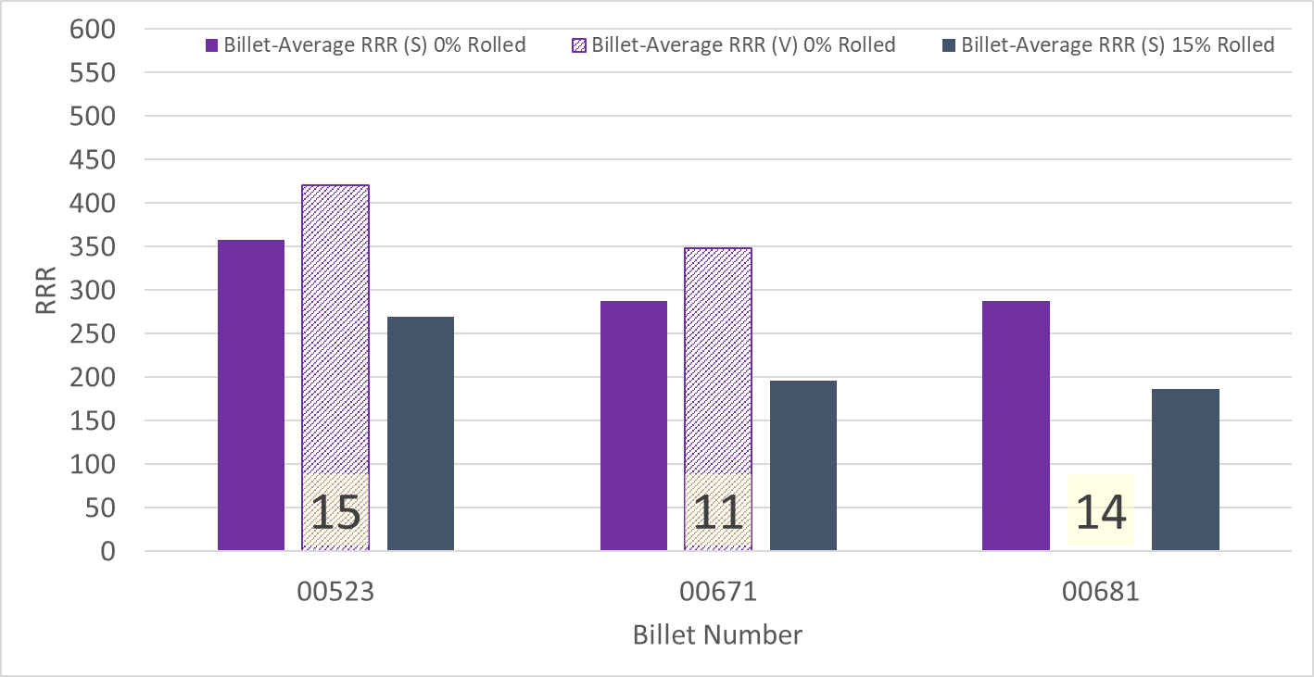
P43OL1189 – Wire Parameters
Supplier (S) and Verification (V) RRR Data
Number of spools from that billet used in the cable

Slide 122
P43OL1189 – Extracted Strand RRR
Cable ID | No. of Units from Billet (spool) | Heat Treat/ Sample ID | Major Edge RRR | Minor Edge RRR | Straight 1 RRR | Straight 2 RRR
PO08S00523A03U P43OL1189AE03E | 15 (15) | LRLK220420ALC1 | 314 | 238 | 361 | 366
PO08S00523A03U P43OL1189AE05E | 15 (15) | LRLK220420ALC1 | 337 | 270 | 386 | 386
PO08S00671A02U P43OL1189AE24E | 11 (11) | LRLK220420ALC1 | 276 | 246 | 311 | 303
PO08S00681A01U P43OL1189AE41E | 14 (12) | LRLK220420ALC1 | 320 | 266 | 353 | 357
PO08S00681A01U P43OL1189AE42E | 14 (12) | LRLK220420ALC1 | 300 | 270 | 359 | 362

Slide 123
P43OL1189 – I_{c}, Cable Qual Samples
Wire/ Cable Strand | I_{c}(A) at Field (T)
 | 12 T | 13 T | 14 T | 15 T
PO08S00523A03U P43OL1189AE01E | 704 | 587 | 480 | 384
PO08S00681A01U P43OL1189AE41E | 664 | 549 | 449 | 360
PO08S00671A02U P43OL1189AE24E | 665 | 552 | 453 | 365

Slide 124
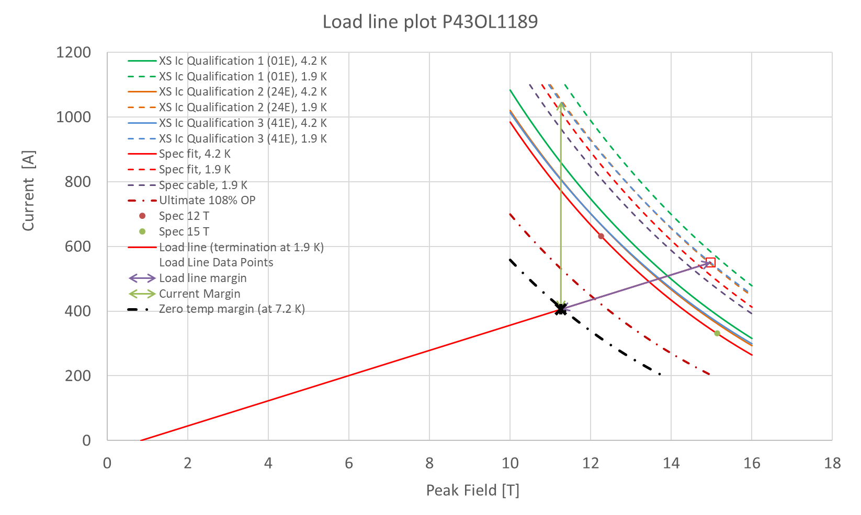
P43OL1189 – SSL Plot, Cable Qual Samples

Slide 125
P43OL1189 – SSL Margins, Qual Samples
Strand from which Margin is Calculated: | Strand # 41E @ 1.9 K
Margins | Margin | Operating Point (X)
Load Line Margin (Purple Arrow) | 26.3% | 73.8%
Current Margin (Green Arrow) | 61.3% | 38.7%
Temperature Margin (K) | 5.3 | 7.2
Limits | Strand | Strand x 40
Selected Strand Current (A) at Margin-Calculation Field | 1047.2 | 41887.8
Selected Strand Current (A) at 100% SSL | 550.1 | 22005.4
Selected Strand Field (T) at 100% SSL | 14.97

