Slide 1


Coil ordering in MQXFA17 based on conductor properties
Maria Baldini, Vittorio Marinozzi

Slide 2
MQXFA17 cables: RRR estimations
Maximum coil to ground voltage at quench with ordering: 353 V (EDMS 1963398, Us-HiLumi Docdb 879)
COIL | CABLE
150 | P43OL1186
151 | P43OL1190
237 | P43OL1182
239 | P43OL1184
152 | P43OL1193
242 | P43OL1189
Rolled and minor edge extracted samples used to estimate RRR of the coil
Each cable: 40 strands in parallels coming from several spools
Spools come from different billets.
There is one rolled sample value per billet.
If the Cu/NCu value of the spool used for the cable is not present, the Cu/NCu of a particular spool is estimated averaging data from spools belonging to the same billet.
A weighted mean (weight= # of strands) is used to estimate cable RRR rolled samples and Cu/NCu values.
Minor and Major edge extracted samples are collected only from the most represented billets. Values are averaged
Witness sample RRR are also collected on representative billets. Data are not measured anymore starting from cable 1134

Slide 3
MQXFA17 coils
COIL | RRR rolled | RRR minor edge | RRR major edge
150 | 188.4 | 259.8 | 272
151 | 191.55 | 252.4 | 257.8
237 | 201.95 | 247.2 | 241.6
239 | 181.875 | 244.8 | 259.8
152 | 220.1 | 267 | 278.4
242 | 220.25 | 258 | 309.4
COIL | Cu/nCu
150 | 1.18
151 | 1.19275
237 | 1.15355
239 | 1.189125
152 | 1.188
242 | 1.183125

Slide 4
RRR estimate values

Slide 5
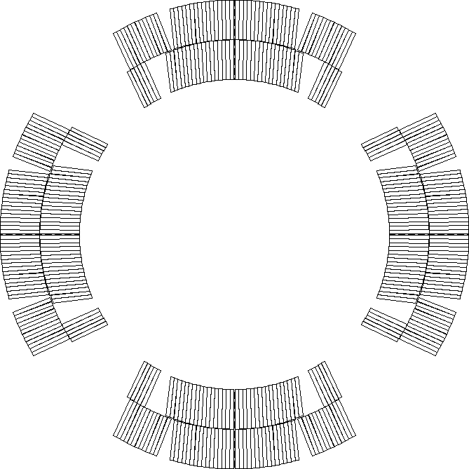
Peak voltages assumptions
Current: 16470
  Old nominal, since electrical design criteria are based on old nominal current
Nominal protection (CLIQ 600 V - 40 mF, OL QH 300 V – 7.05 mF)
Coils are reported in mechanical ordering
Peak voltages have been computed using rolled and minor edge RRR values. All coil orderings resulting in peak voltage to ground less than 353 V with both assumptions and for all failure cases have been identified
Peak voltages computed using STEAM-LEDET app provided by CERN
  All possible combinations of coils are considered
  For each combination, nominal scenario plus 3 failure scenarios are considered
P2
P1
P3
P4
Notes:
Need to be u

Slide 6
Acceptable coil ordering (150 spare)
Coils are reported in mechanical order
There are 74 (with coil 152) acceptable coil orderings with voltage < 353 V that are common for both rolled and minor edge RRR values (values reported for rolled RRR)
  11 combinations without 150
P1 | P2 | P3 | P4 | Volt
239 | 237 | 151 | 152 | 329
239 | 150 | 151 | 152 | 329
150 | 239 | 151 | 152 | 330
239 | 150 | 151 | 237 | 331
151 | 239 | 152 | 150 | 331
151 | 150 | 152 | 239 | 331
150 | 237 | 151 | 152 | 331
239 | 237 | 151 | 150 | 332
239 | 237 | 150 | 151 | 332
239 | 151 | 150 | 237 | 332
237 | 239 | 151 | 152 | 332
237 | 150 | 151 | 152 | 332
151 | 237 | 152 | 239 | 332
150 | 239 | 151 | 237 | 332
150 | 237 | 239 | 151 | 332
150 | 151 | 239 | 237 | 332
151 | 237 | 152 | 150 | 333
150 | 237 | 152 | 151 | 333
150 | 237 | 151 | 239 | 333
239 | 237 | 152 | 151 | 334
237 | 239 | 150 | 151 | 334
237 | 150 | 239 | 151 | 334
151 | 239 | 152 | 237 | 334
151 | 239 | 150 | 237 | 334
151 | 237 | 239 | 150 | 334
P1 | P2 | P3 | P4 | Volt
151 | 237 | 150 | 239 | 334
151 | 150 | 239 | 237 | 334
151 | 150 | 152 | 237 | 335
150 | 239 | 152 | 151 | 335
239 | 150 | 152 | 151 | 337
150 | 237 | 152 | 239 | 337
239 | 237 | 152 | 150 | 339
239 | 237 | 150 | 152 | 341
237 | 239 | 150 | 152 | 341
237 | 150 | 239 | 152 | 341
150 | 237 | 239 | 152 | 341
152 | 150 | 151 | 239 | 342
152 | 239 | 151 | 150 | 343
151 | 152 | 239 | 237 | 343
152 | 237 | 151 | 239 | 344
239 | 152 | 150 | 151 | 344
237 | 151 | 239 | 152 | 344
151 | 152 | 239 | 150 | 344
151 | 152 | 150 | 239 | 344
151 | 152 | 150 | 237 | 344
150 | 152 | 239 | 151 | 344
152 | 237 | 151 | 150 | 345
151 | 237 | 239 | 152 | 345
239 | 151 | 150 | 152 | 346
151 | 237 | 150 | 152 | 346
P1 | P2 | P3 | P4 | Volt
150 | 239 | 152 | 237 | 346
150 | 151 | 239 | 152 | 346
152 | 237 | 239 | 151 | 347
152 | 151 | 239 | 150 | 347
152 | 151 | 150 | 239 | 347
151 | 239 | 150 | 152 | 347
151 | 150 | 239 | 152 | 347
150 | 152 | 239 | 237 | 347
152 | 239 | 151 | 237 | 348
152 | 239 | 150 | 151 | 348
152 | 237 | 150 | 151 | 348
152 | 150 | 239 | 151 | 348
152 | 150 | 151 | 237 | 348
152 | 151 | 239 | 237 | 349
152 | 151 | 150 | 237 | 349
239 | 150 | 152 | 237 | 349
152 | 237 | 150 | 239 | 350
239 | 152 | 150 | 237 | 350
150 | 152 | 151 | 239 | 350
150 | 151 | 152 | 239 | 350
152 | 237 | 239 | 150 | 351
239 | 152 | 151 | 150 | 352
239 | 151 | 152 | 150 | 352
152 | 150 | 239 | 237 | 353

Slide 7
Acceptable coil ordering (242 spare)
Coils are reported in mechanical order
There are 76 (with coil 242) acceptable coil orderings with voltage < 353 V that are common for both rolled and minor edge RRR values (values reported for rolled RRR)
  12 combinations without 150
P1 | P2 | P3 | P4 | Volt
242 | 237 | 150 | 151 | 345
242 | 150 | 151 | 237 | 345
239 | 151 | 150 | 242 | 345
237 | 242 | 239 | 150 | 345
151 | 237 | 150 | 242 | 345
150 | 242 | 239 | 237 | 345
150 | 239 | 242 | 237 | 345
150 | 151 | 239 | 242 | 345
242 | 151 | 239 | 237 | 346
242 | 151 | 239 | 150 | 346
242 | 151 | 150 | 239 | 346
242 | 151 | 150 | 237 | 346
242 | 150 | 239 | 151 | 346
151 | 239 | 150 | 242 | 346
151 | 150 | 239 | 242 | 346
242 | 239 | 150 | 151 | 347
242 | 237 | 150 | 239 | 347
239 | 242 | 150 | 237 | 347
239 | 150 | 242 | 237 | 347
242 | 237 | 239 | 150 | 348
150 | 242 | 151 | 239 | 348
150 | 151 | 242 | 239 | 348
242 | 150 | 239 | 237 | 350
239 | 242 | 151 | 150 | 350
239 | 151 | 242 | 150 | 350
242 | 239 | 150 | 237 | 351
P1 | P2 | P3 | P4 | Volt
239 | 150 | 151 | 242 | 329
239 | 237 | 151 | 242 | 330
150 | 239 | 151 | 242 | 330
239 | 150 | 151 | 237 | 331
150 | 237 | 242 | 151 | 331
150 | 237 | 151 | 242 | 331
239 | 237 | 242 | 151 | 332
239 | 237 | 151 | 150 | 332
239 | 237 | 150 | 151 | 332
239 | 151 | 150 | 237 | 332
151 | 239 | 242 | 237 | 332
151 | 239 | 242 | 150 | 332
151 | 150 | 242 | 239 | 332
150 | 239 | 151 | 237 | 332
150 | 237 | 239 | 151 | 332
150 | 151 | 239 | 237 | 332
151 | 237 | 242 | 239 | 333
151 | 237 | 242 | 150 | 333
151 | 150 | 242 | 237 | 333
150 | 239 | 242 | 151 | 333
150 | 237 | 151 | 239 | 333
237 | 239 | 150 | 151 | 334
237 | 150 | 239 | 151 | 334
151 | 239 | 150 | 237 | 334
151 | 237 | 239 | 150 | 334
P1 | P2 | P3 | P4 | Volt
151 | 237 | 150 | 239 | 334
151 | 150 | 239 | 237 | 334
239 | 150 | 242 | 151 | 335
150 | 237 | 242 | 239 | 335
239 | 237 | 242 | 150 | 337
242 | 150 | 151 | 239 | 339
242 | 239 | 151 | 150 | 340
239 | 237 | 150 | 242 | 340
237 | 239 | 242 | 151 | 340
237 | 239 | 150 | 242 | 340
237 | 150 | 239 | 242 | 340
150 | 237 | 239 | 242 | 340
242 | 237 | 151 | 239 | 341
237 | 150 | 242 | 151 | 341
242 | 237 | 151 | 150 | 342
237 | 242 | 239 | 151 | 342
151 | 242 | 239 | 237 | 342
239 | 242 | 150 | 151 | 343
151 | 242 | 239 | 150 | 343
151 | 242 | 150 | 239 | 343
151 | 242 | 150 | 237 | 343
150 | 242 | 239 | 151 | 343
151 | 237 | 239 | 242 | 344
242 | 239 | 151 | 237 | 345
242 | 237 | 239 | 151 | 345

Slide 8
Backup slides

Slide 9
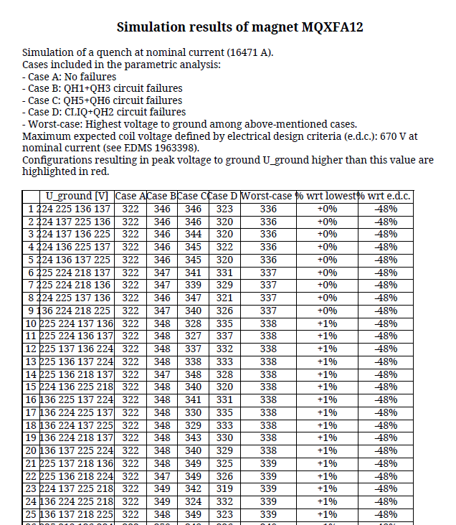
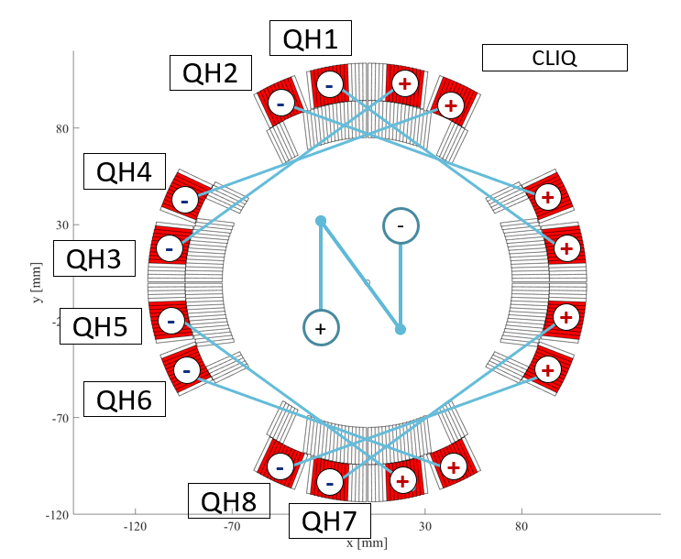
Peak voltages report
Old value, since design criteria are based on old nominal current

