Slide 1


Electrical QC Measurements
Coils 150, 151, 152, 237, 239, 242
MQXFA17 and MQXFA13b Coil Selection Review
Bob Memmo, Dan Cheng for the AUP Team
Data compiled Sep 22, 2023
LBNL

Slide 2
Overview
New Coils reported on will be
  Coils 150, 151, 152, 237, 239, 242
  MQXFA17 and spares, one of which will be chosen for MQXFA13b
LBNL EQC Acceptance Data
  Will be summarized in following slides
  Now includes acceptance values reviewed by V. Marinozzi
  Uploaded to this Indico page

Slide 3
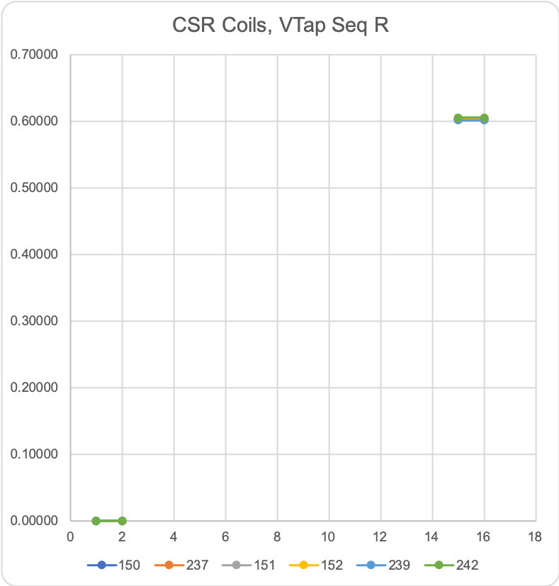
Coil Data
 |  |  | 150 | 237 | 151 | 152 | 239 | 242
See DocDB #956 / SU-1010-1903
RLQ |  |  |  |  |  |  |  |  | Acceptance Range
 | R | (mΩ) | 602 | 605 | 603 | 603 | 602 | 606 | 590-625
 | L_{s} (mH) | 20 Hz | 9.97 | 10 | 9.99 | 9.97 | 9.98 | 10.03 | 9.9-10.3
 |  | 100 Hz | 6.41 | 6.42 | 6.41 | 6.4 | 6.43 | 6.43 | 6.2-6.6
 |  | 1 kHz | 5.81 | 5.85 | 5.8 | 5.79 | 5.82 | 5.82 | 5.5-6
 | Q | 20 Hz | 1.3 | 1.29 | 1.29 | 1.29 | 1.3 | 1.29 | 1.2-1.4
 |  | 100 Hz | 5.51 | 5.65 | 5.45 | 5.47 | 5.56 | 5.5 | 5.2-5.8
 |  | 1 kHz | 8.6 | 8.32 | 8.52 | 8.53 | 8.36 | 8.55 | 5.8-10.7
QH R (Ω)
 | NT | A01 | N/A | N/A | N/A | N/A | N/A | N/A
 | T | A02 | N/A | N/A | N/A | N/A | N/A | N/A
 | T-P | B01 | 1.9 | 2 | 2.2 | 2.1 | 1.8 | 2.2 | 1.4-2.7
 | NT-P | B02 | 1.9 | 2.1 | 1.9 | 2.1 | 1.7 | 2.1 | 1.4-2.7
 | T-M | B03 | 1.7 | 2 | 1.9 | 2 | 1.8 | 2 | 1.4-2.7
 | NT-M | B04 | 1.7 | 2 | 1.7 | 2 | 1.8 | 2 | 1.4-2.7
VT R (mΩ) Individual coils
@1 Amp |  | A1 | 0.00019 | 0.00023 | 0.00038 | 0.00030 | 0.00034 | 0.00032
 |  | A2 | 0.00026 | 0.00028 | 0.00042 | 0.00035 | 0.00039 | 0.00040
 |  | A3
 |  | A4
 |  | A5
 |  | A6
 |  | A7
 |  | A8
 |  | B8
 |  | B7
 |  | B6
 |  | B5
 |  | B4
 |  | B3
 |  | B2 | 0.60180 | 0.60460 | 0.60450 | 0.60240 | 0.60190 | 0.60550
 |  | B1 | 0.60190 | 0.60470 | 0.60360 | 0.60250 | 0.60200 | 0.60560
HIPOT |  |  | OK | OK | OK | OK | OK | OK
IMPULSE |  |  | OK | OK | OK | OK | OK | OK
All coils are Series coils, with limited voltage taps

Slide 4
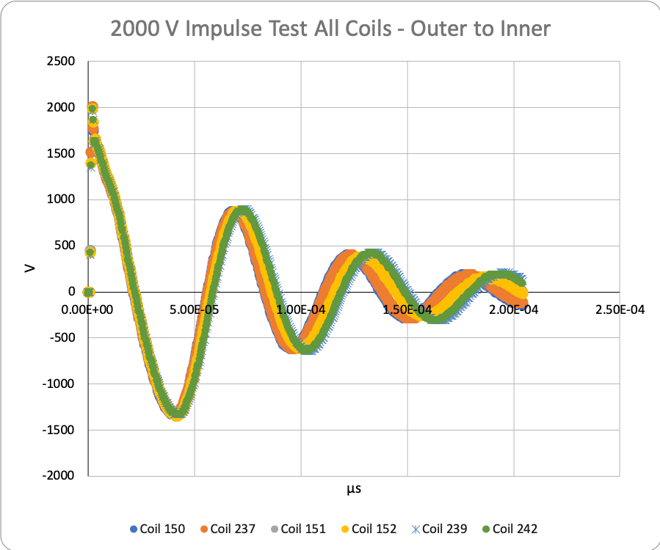
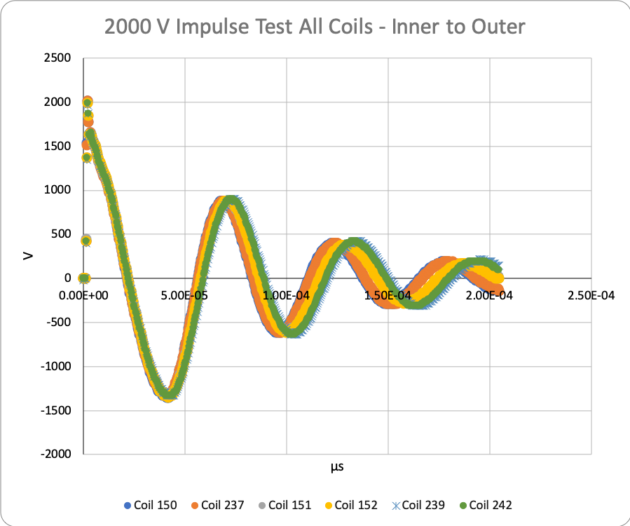
Hipot and Impulse tests
Hipot tests passed for coils
  See Coil EQC data workbook on Indico Page
Impulse tests at 2000V shown below

Slide 5
Summary
Coil acceptance EQC tests are complete
No critical issues observed

Slide 6
Appendix

