Slide 1
MQXFA17-13b coil dimensions
P. Ferracin, Dan Cheng, Jennifer Doyle, Katherine Ray, Michael Solis
on behalf of the MQXF collaboration
MQXFA17-13b Coils Acceptance Review
October 10th, 2023
LBNL, Berkeley, CA, USA

Slide 2
Outline
Data taking and processing
Impregnated coil dimensional tolerances
Results (straight section)
  Arc length excess
  Outer radius profile deviation
  Inner radial deviations (coil blocks)
  Inner radial deviations (pole)
  Key slot deviations
  Best-fit outer radius
Appendix

Slide 3
Outline
Data taking and processing
Impregnated coil dimensional tolerances
Results (straight section)
  Arc length excess
  Outer radius profile deviation
  Inner radial deviations (coil blocks)
  Inner radial deviations (pole)
  Key slot deviations
  Best-fit outer radius
Appendix

Slide 4
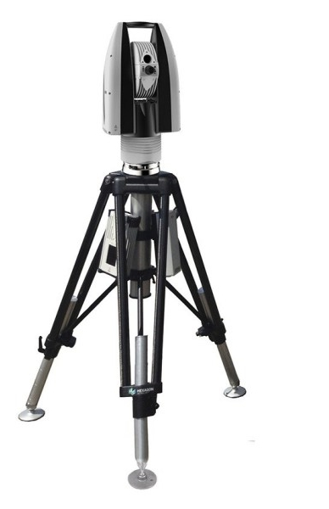
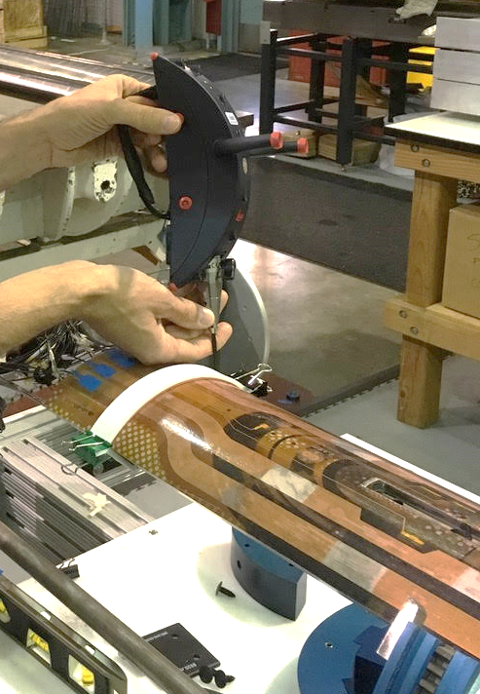
Data taking and processing
Leica System
  AT960 with T-Probe
Data processed using
  Spatial Analyzer

Slide 5
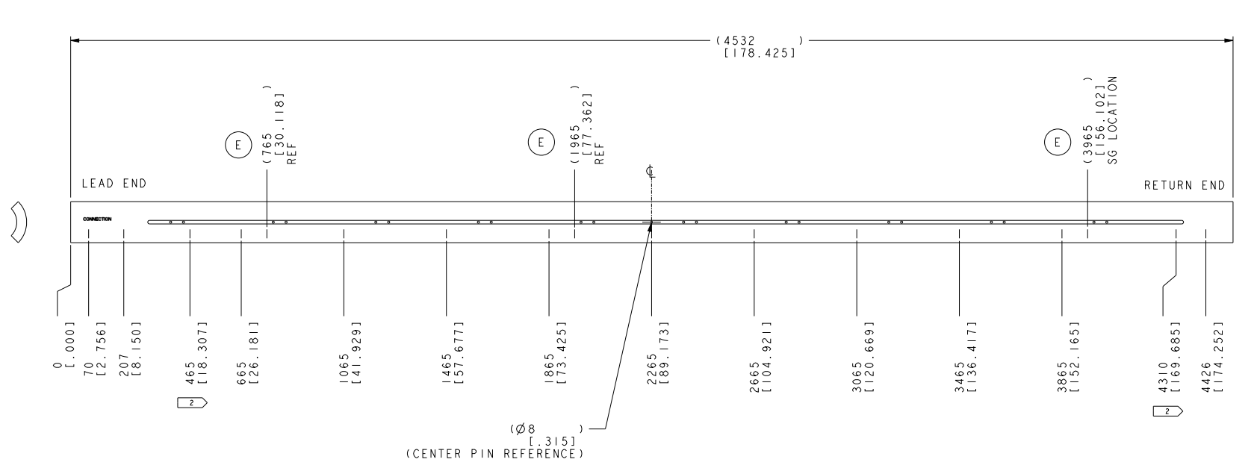
Post processing
Each cross section is treated separately.
  Coils cross-sections are measured in 15 different locations along the coil length, from 70 mm close to the lead end to 4426 mm close to the return end.
  The 12 so-called straight section locations, where the pole key slot is present, are from 465 mm close to the lead end to 4310 mm close to the return end.
  The strain gauge is at location 3965 mm.

Slide 6
Outline
Data taking and processing
Impregnated coil dimensional tolerances
Results (straight section)
  Arc length excess
  Outer radius profile deviation
  Inner radial deviations (coil blocks)
  Inner radial deviations (pole)
  Key slot deviations
  Best-fit outer radius
Appendix

Slide 7
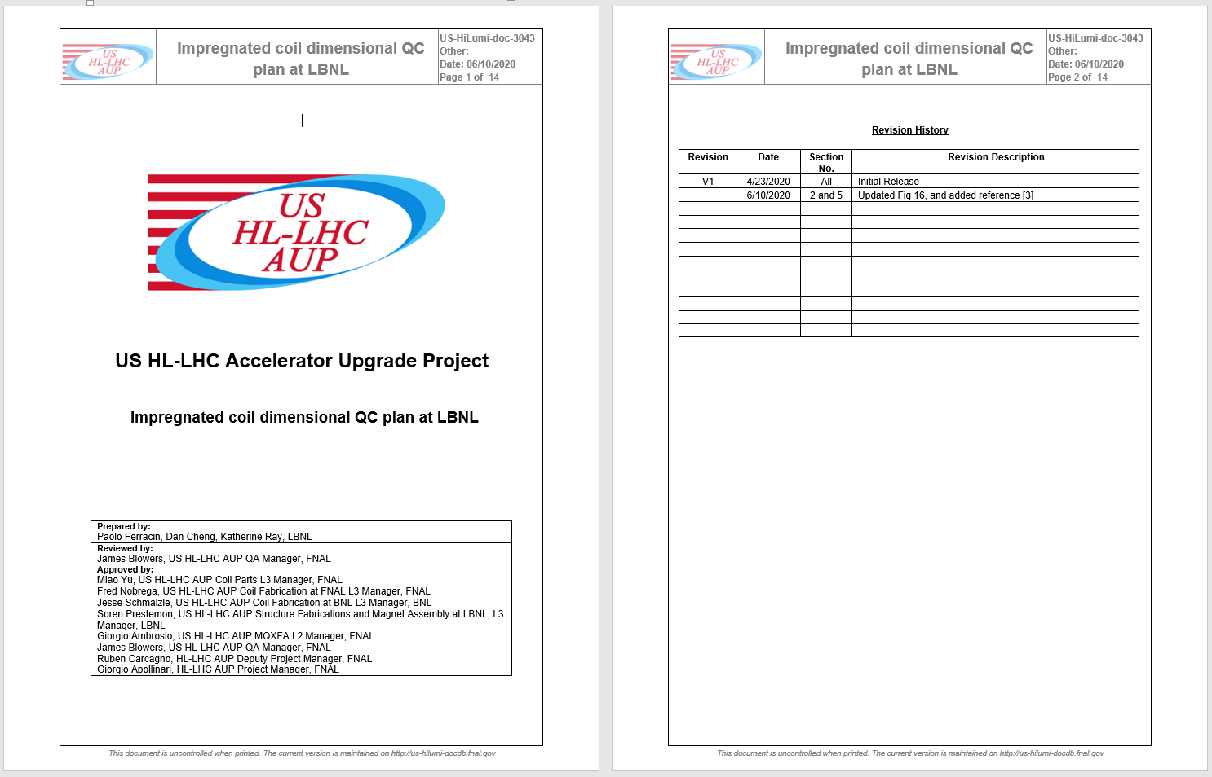
Impregnated coil dimensional tolerances
(for series coils)

Slide 8
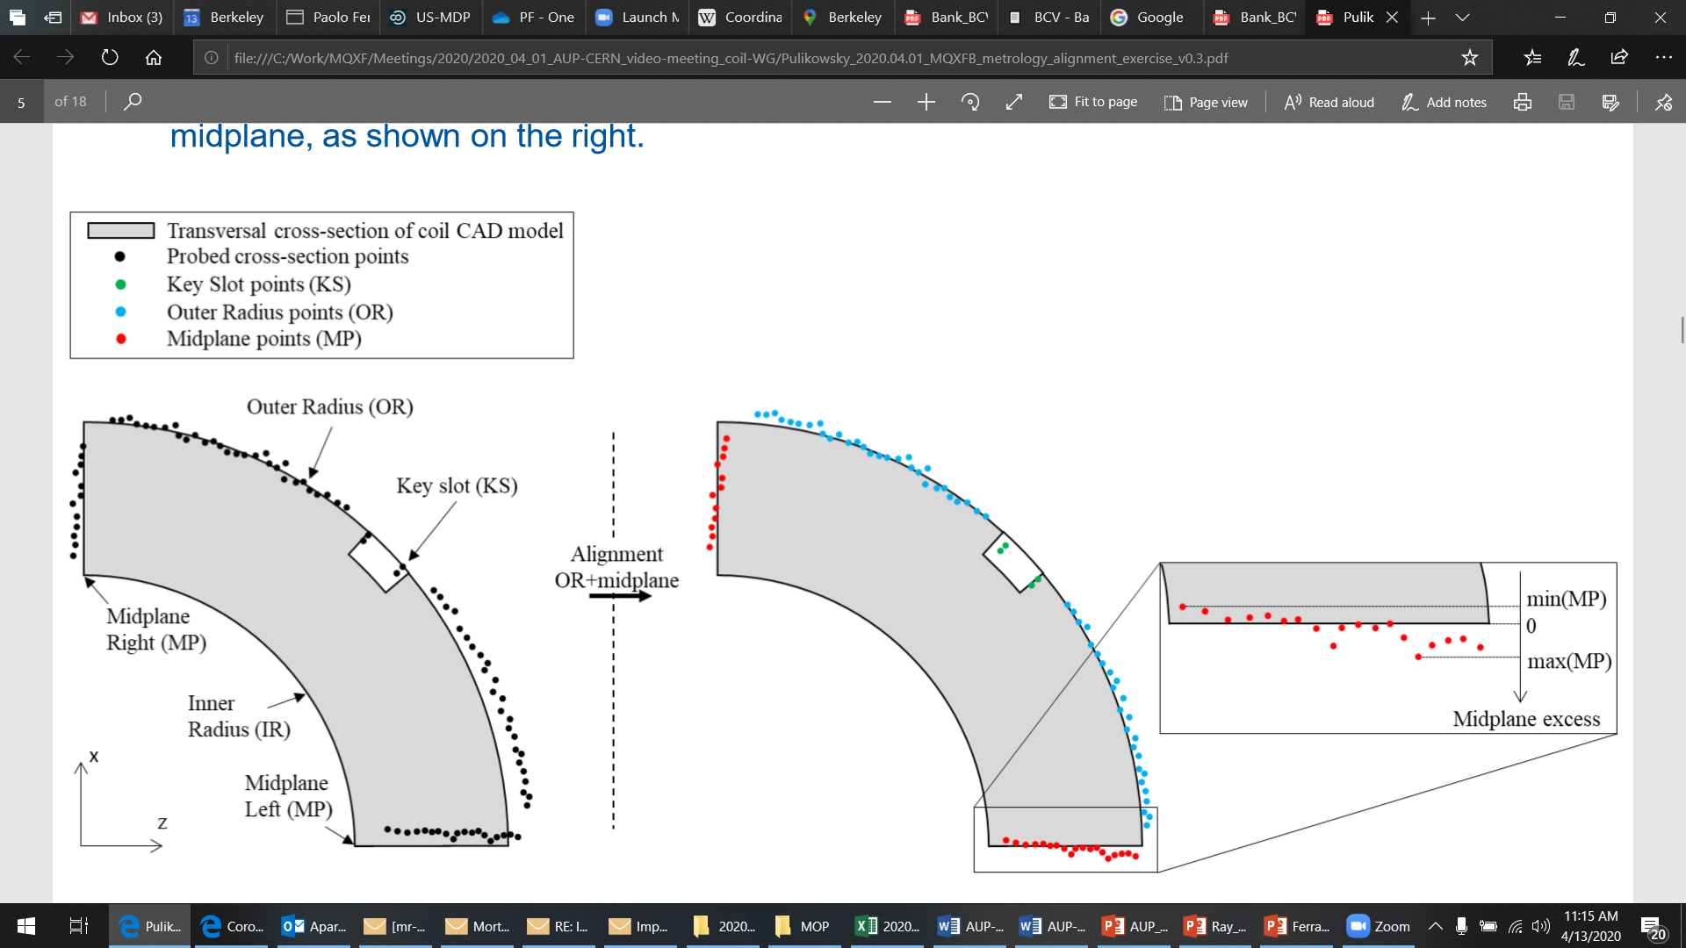
Impregnated coil dimensional tolerances
Arc length excess
The impregnated coil is accepted for use in MQXFA if its arc length excesses along the straight section are within the following tolerances: +0.150/-0.250 mm
The arc length excess, which is difference between the measured coil arc length and the nominal one, is determined by fitting outer radius and mid-planes points with the nominal profile, with equal weighting and imposing as symmetrical the two mid-planes offsets. The sum of the two measured mid-plane offsets provides the arc length excess

Slide 9
Impregnated coil dimensional tolerances
Outer radius profile deviation
The impregnated coil is accepted for use in MQXFA if its outer radius profile deviations along the straight section are within the following tolerances: +0.200/-0.250 mm
The outer radius profile deviation, which is given by the variation of each point on the outer radius with respect to the nominal outer radius, is determined by fitting outer radius and mid-planes points with the nominal profile, with equal weighting and imposing as symmetrical the two mid-planes offsets. Positive deviation indicates more material than nominal, negative indicates less material than nominal.

Slide 10
Impregnated coil dimensional tolerances
“Coil blocks” inner radius profile deviation
The impregnated coil is accepted for use in MQXFA if its “coil blocks” inner radius profile deviations (E-F in next slide) along the straight section are within the following tolerances: +0.150/-0.250 mm
The “coil blocks” inner radius profile deviations, which is given by the variation of each point on the inner radius with respect to the nominal radius, is determined by fitting outer radius and mid-planes points with the nominal profile, with equal weighting and imposing as symmetrical the two mid-planes offsets. Positive deviation indicates more material than nominal, negative indicates less material than nominal.

Slide 11
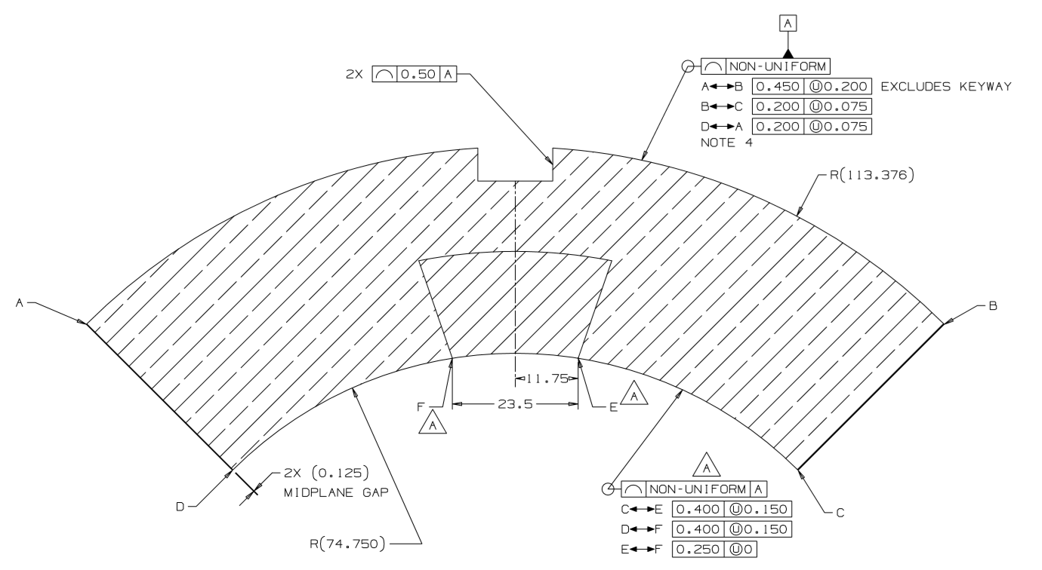
Impregnated coil dimensional tolerances

Slide 12
Impregnated coil dimensional tolerances
“Pole” inner radius profile deviation
The impregnated coil is accepted for use in MQXFA if its “pole” inner radius profile deviations (C-E and D-F in next slide) along the straight section are within the following tolerances: +0.000/-0.250 mm*
The “pole” inner radius profile deviations, which is given by the variation of each point on the inner radius with respect to the nominal radius, is determined by fitting outer radius and mid-planes points with the nominal profile, with equal weighting and imposing as symmetrical the two mid-planes offsets. Positive deviation indicates more material than nominal, negative indicates less material than nominal.

Slide 13
Impregnated coil dimensional tolerances
* Cross-section measurements shall be taken close to all possible bumper locations. In addition, data shall be taken on the surface surrounding the pole holes where bumpers are inserted and projected on the closest measured cross-section.

Slide 14
Impregnated coil dimensional tolerances
Pole key slot mis-alignment
The impregnated coil is accepted for use in MQXFA if its pole key slot mis-alignment along the straight section are within the following tolerances: +0.250/-0.250 mm
The pole key slot mis-alignment, which is the misalignment of the center of the pole key slot with respect to the nominal position, is determined by fitting outer radius and mid-planes points with the nominal profile, with equal weighting and imposing as symmetrical the two mid-planes offsets.
  View from LE, positive shift towards left

Slide 15
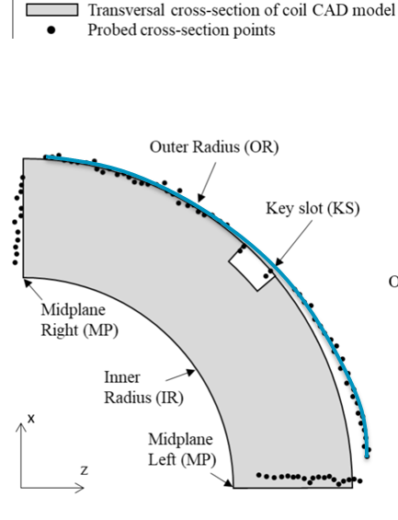
Best-fit outer radius
The best-fit outer radius is determined by best-fitting only the outer radius points.
No tolerance is specified
  Used to monitor coil-to-collar contact surfaces (“LQ effect”)

Slide 16
Outline
Data taking and processing
Impregnated coil dimensional tolerances
Results (straight section)
  Arc length excess
  Outer radius profile deviation
  Inner radial deviations (coil blocks)
  Inner radial deviations (pole)
  Key slot deviations
  Best-fit outer radius
Appendix

Slide 17
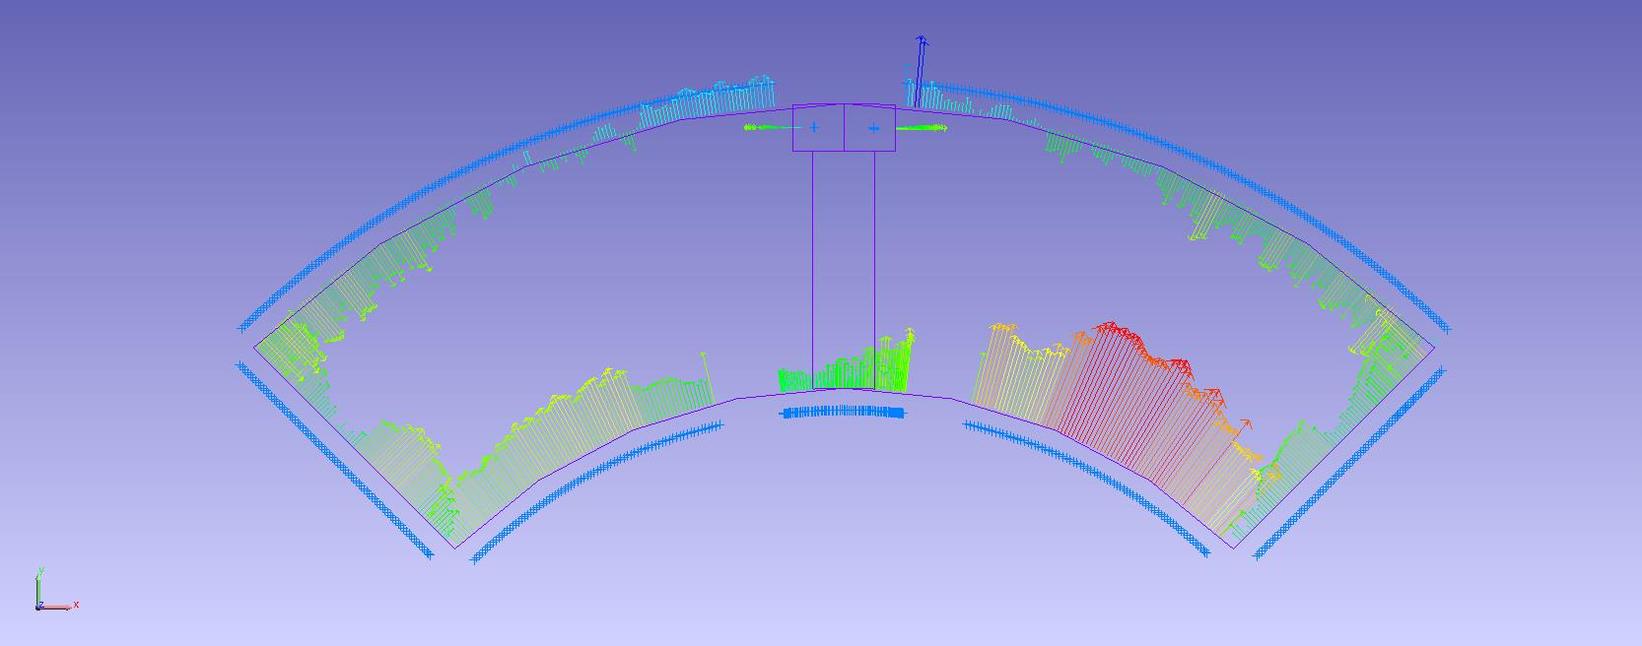
Arc length excess

Slide 18
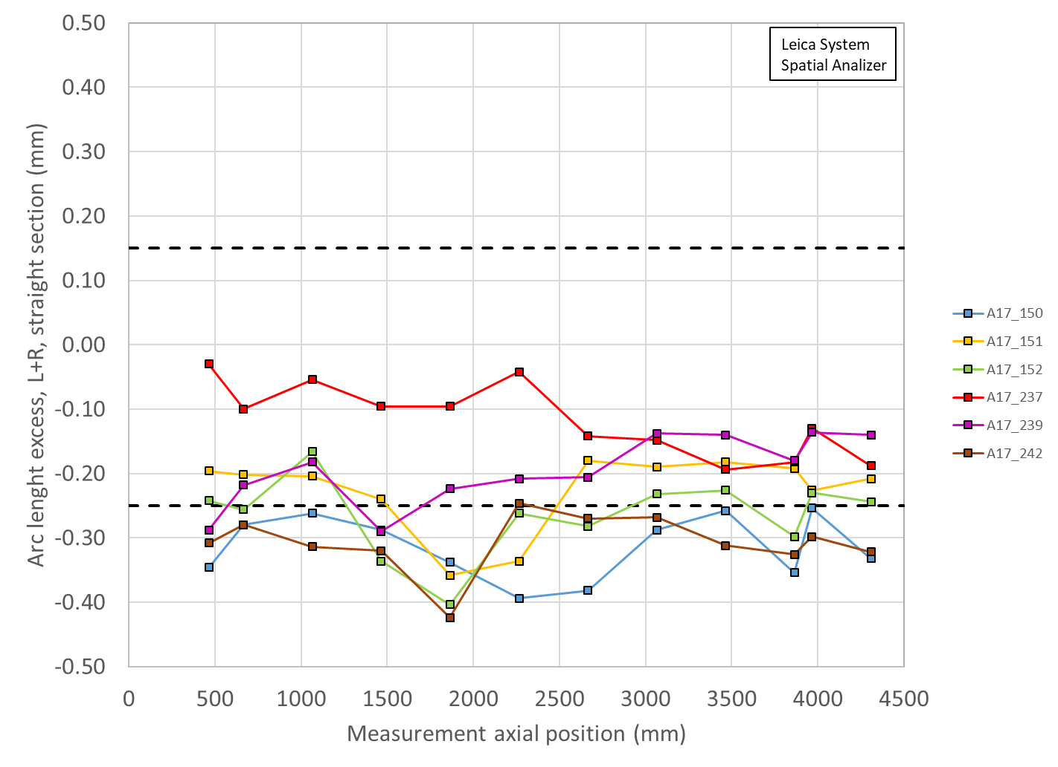
Arc length excess straight section

Slide 19
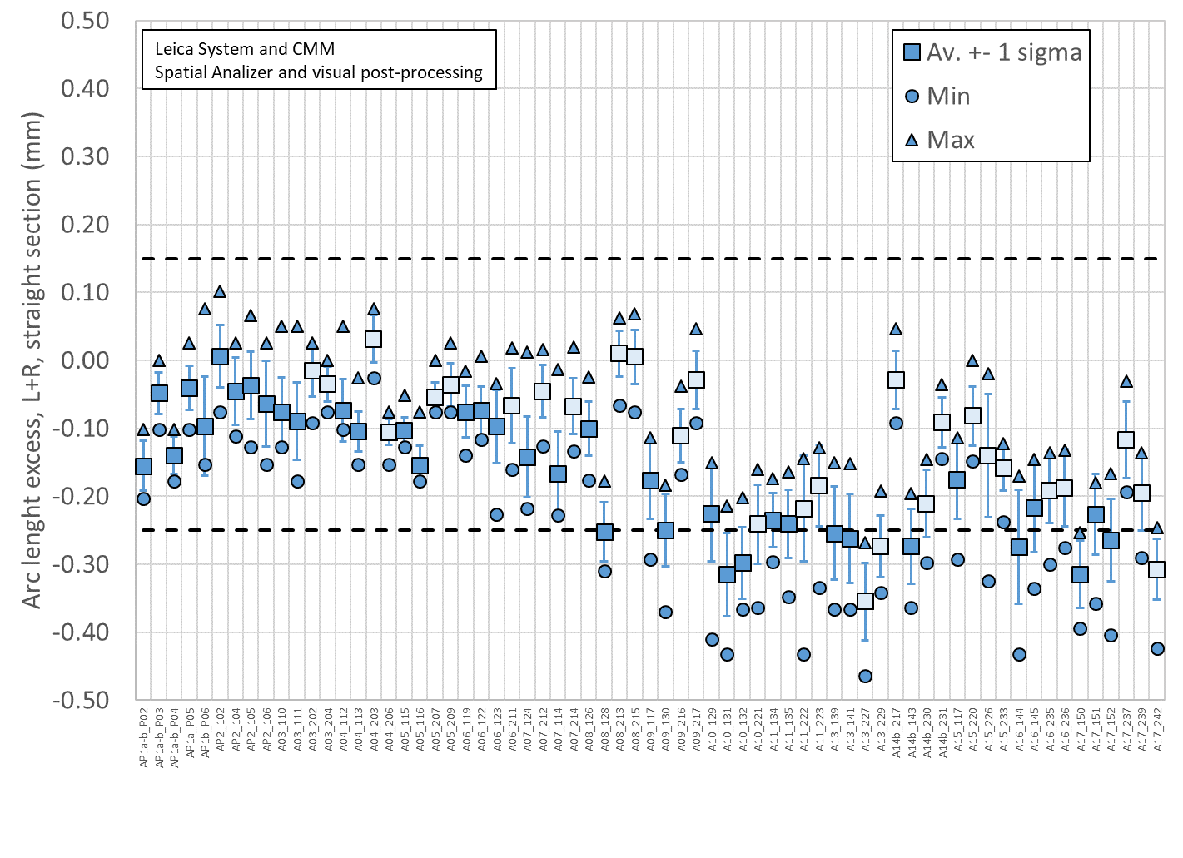
Arc length excess straight section

Slide 20
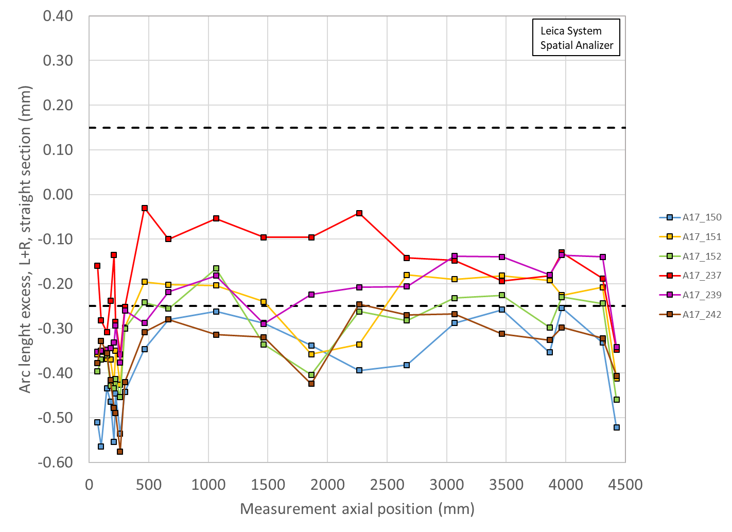
Arc length excess full length

Slide 21
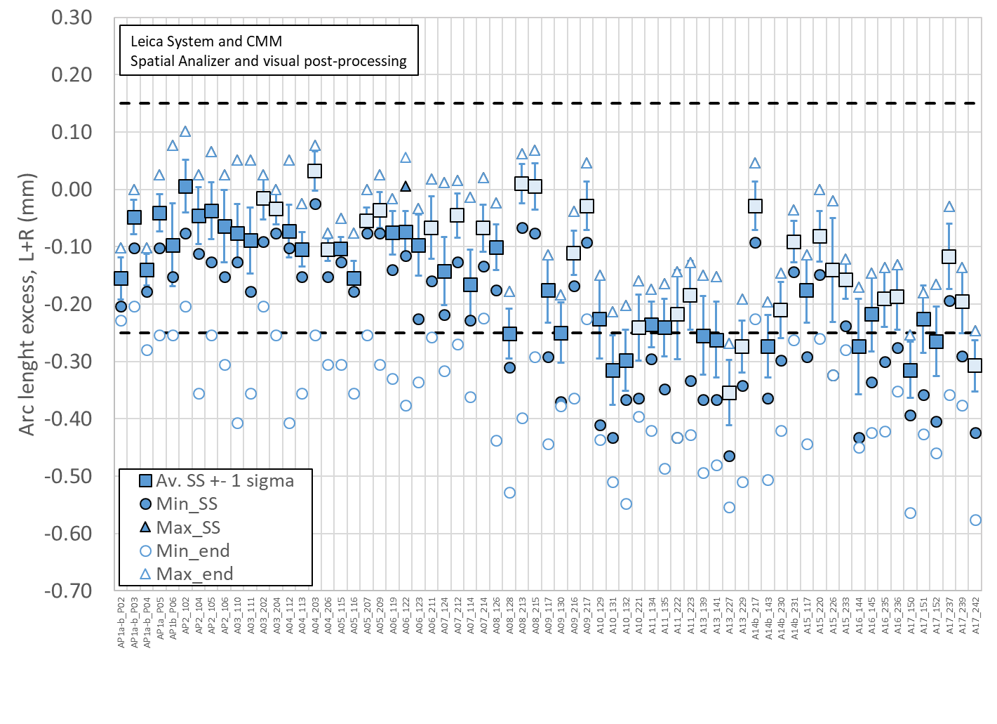
Arc length excess straight section
(with min/max straight sect and full length)

Slide 22
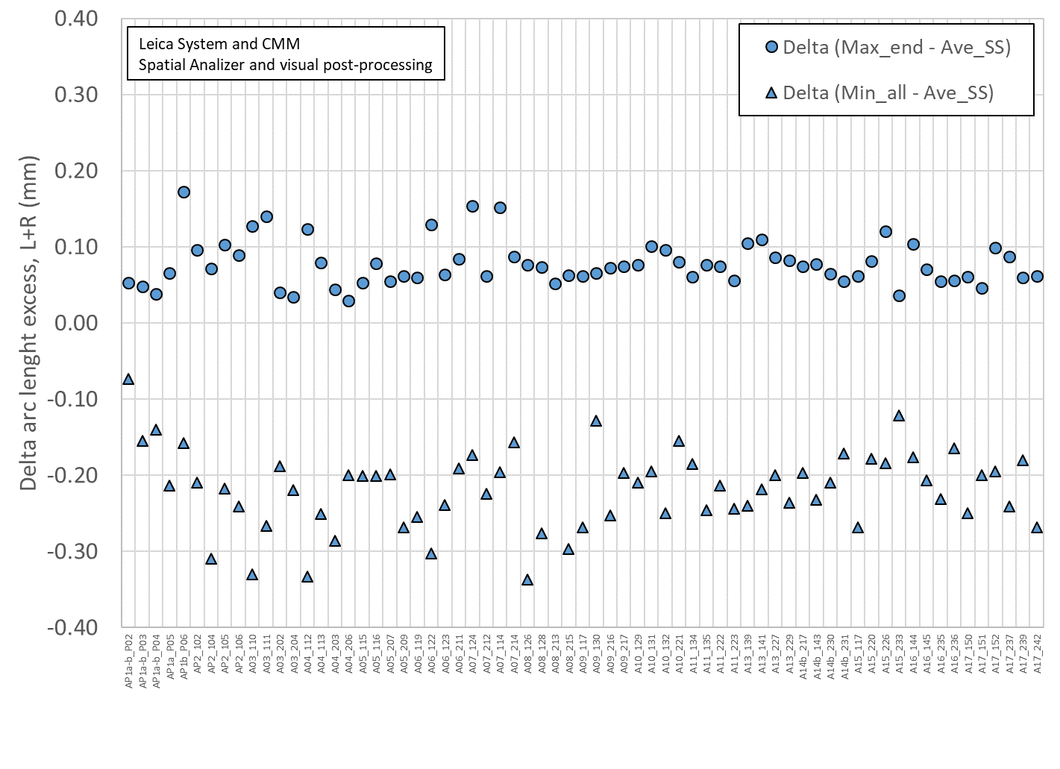
Delta between arc length excess straight section and min/max full length

Slide 23
Arc length excess straight section
Conclusions
  All coils except 237 with several points out of spec
Action items
  The coils will be shimmed on the mid-plane to compensate

Slide 24
Outline
Data taking and processing
Impregnated coil dimensional tolerances
Results (straight section)
  Arc length excess
  Outer radius profile deviation
  Inner radial deviations (coil blocks)
  Inner radial deviations (pole)
  Key slot deviations
  Best-fit outer radius
Appendix

Slide 25
Outer radius profile deviation

Slide 26
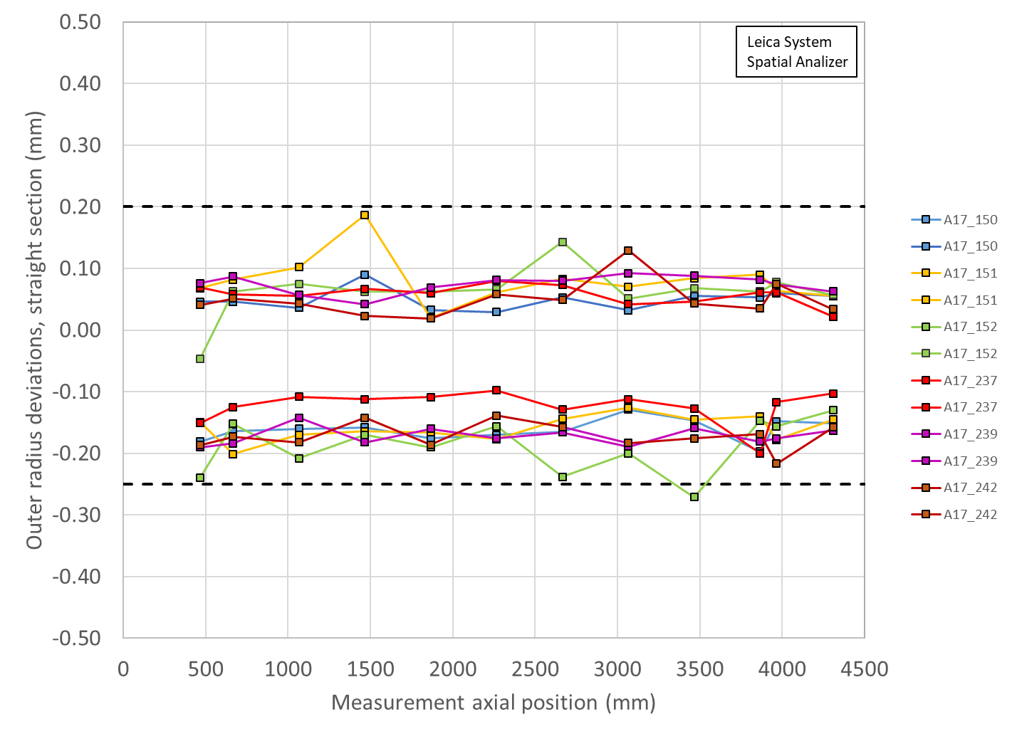
Outer radius profile deviations straight section (min-max)

Slide 27
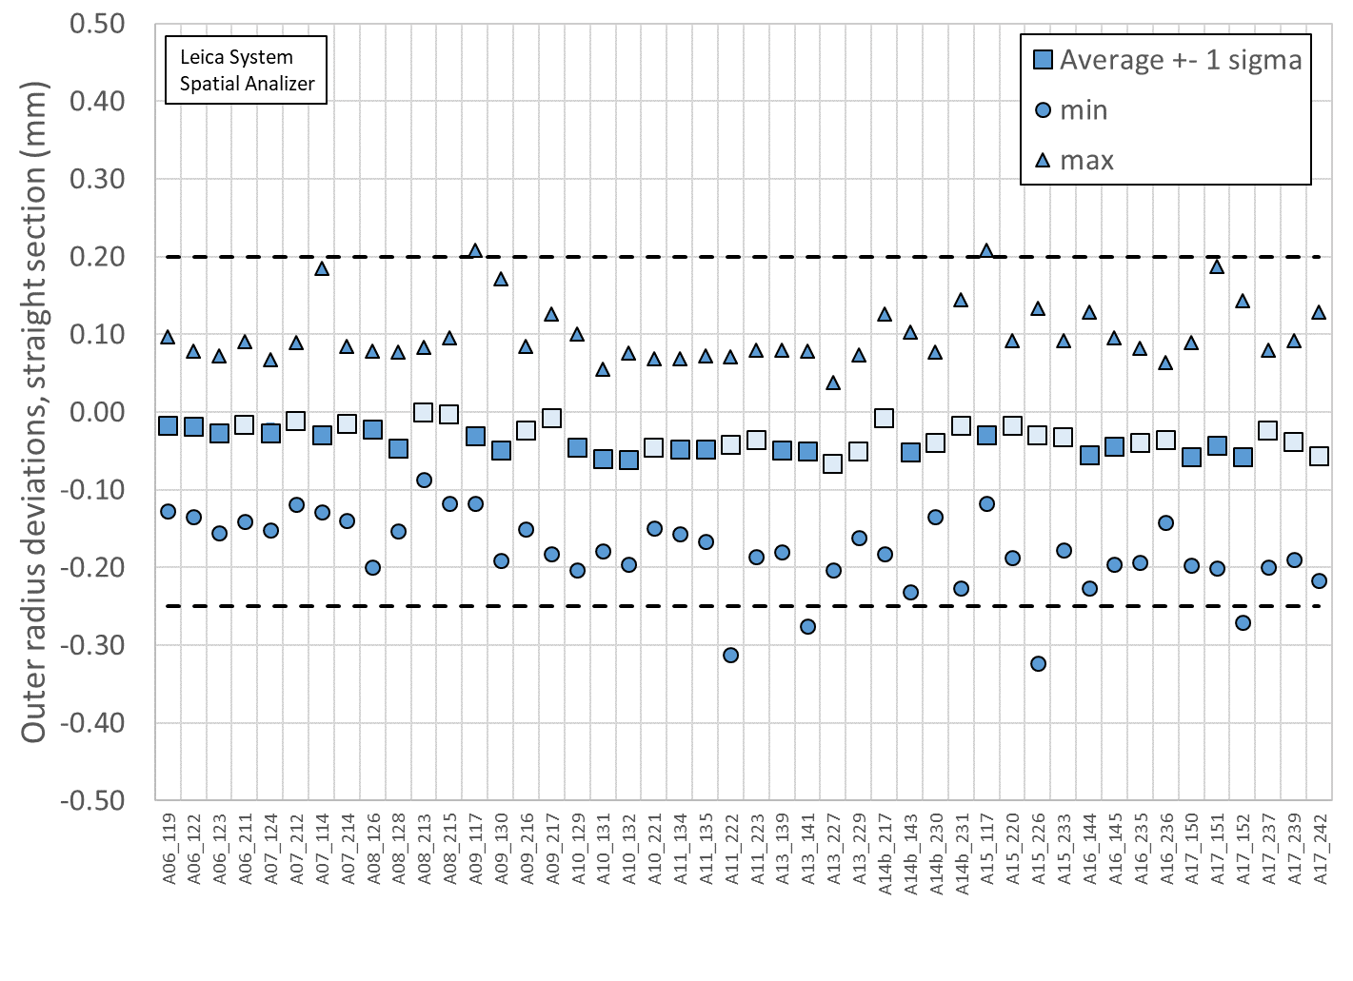
Outer radius profile deviations straight section

Slide 28
Outer radius profile deviations straight section
Conclusions
  One data in coil 152 points marginally out of spec
Action items
  No action items

Slide 29
Outline
Data taking and processing
Impregnated coil dimensional tolerances
Results (straight section)
  Arc length excess
  Outer radius profile deviation
  Inner radial deviations (coil blocks)
  Inner radial deviations (pole)
  Key slot deviations
  Best-fit outer radius
Appendix

Slide 30
Inner radial deviations (coil blocks)

Slide 31
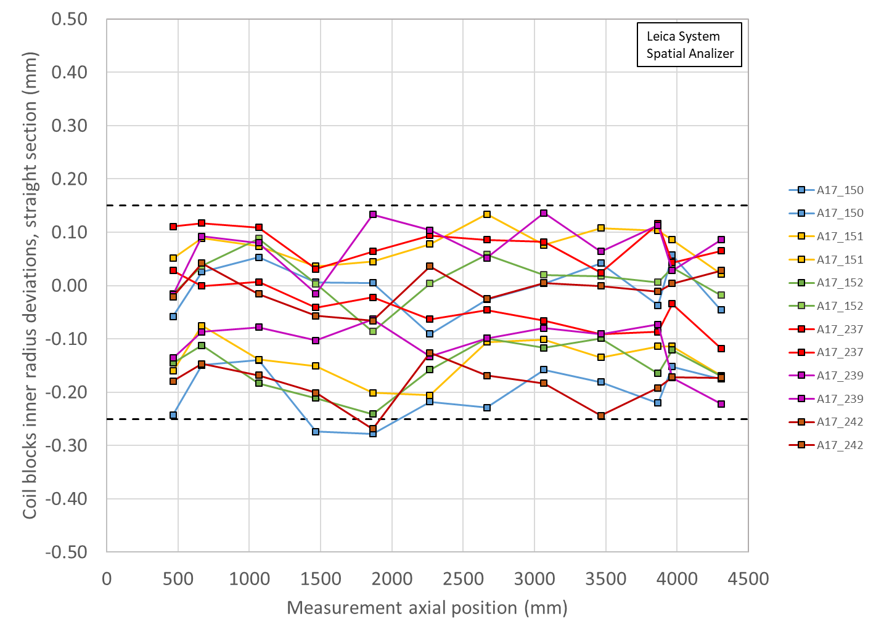
Coil blocks inner radial deviations straight section (min-max)

Slide 32
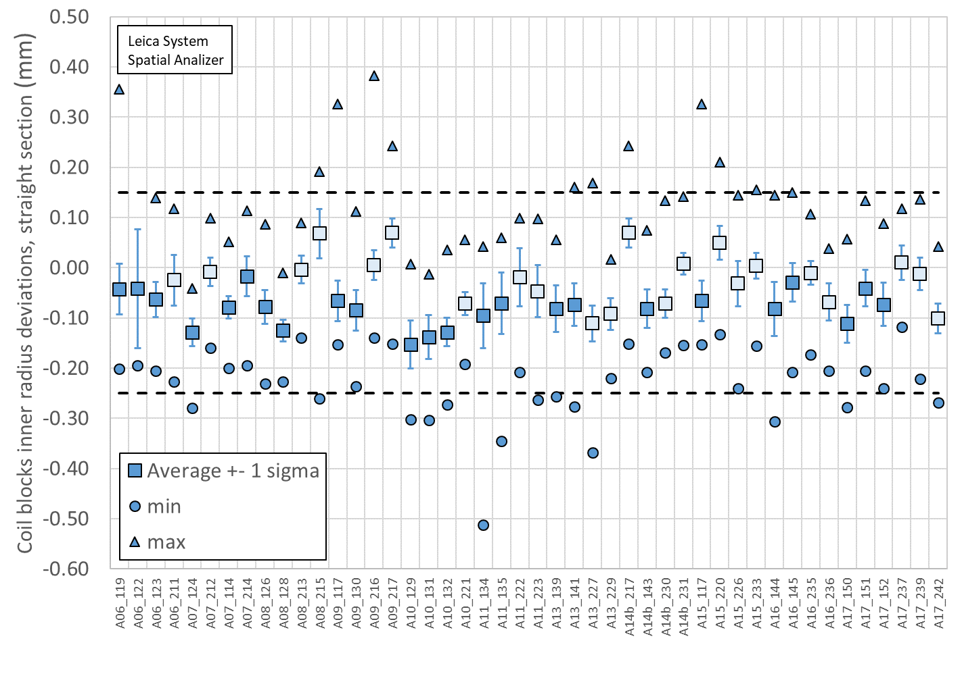
Coil blocks inner radial deviations straight section

Slide 33
Coil blocks inner radial deviations straight section
Conclusions
  Coil 150 and 242 marginally out of spec in few positions
Action items
  Non critical non conformity
    Increase of LHe space between cold bore and inner coil in one location

Slide 34
Outline
Data taking and processing
Impregnated coil dimensional tolerances
Results (straight section)
  Arc length excess
  Outer radius profile deviation
  Inner radial deviations (coil blocks)
  Inner radial deviations (pole)
  Key slot deviations
  Best-fit outer radius
Appendix

Slide 35
Inner radial deviations (pole)

Slide 36
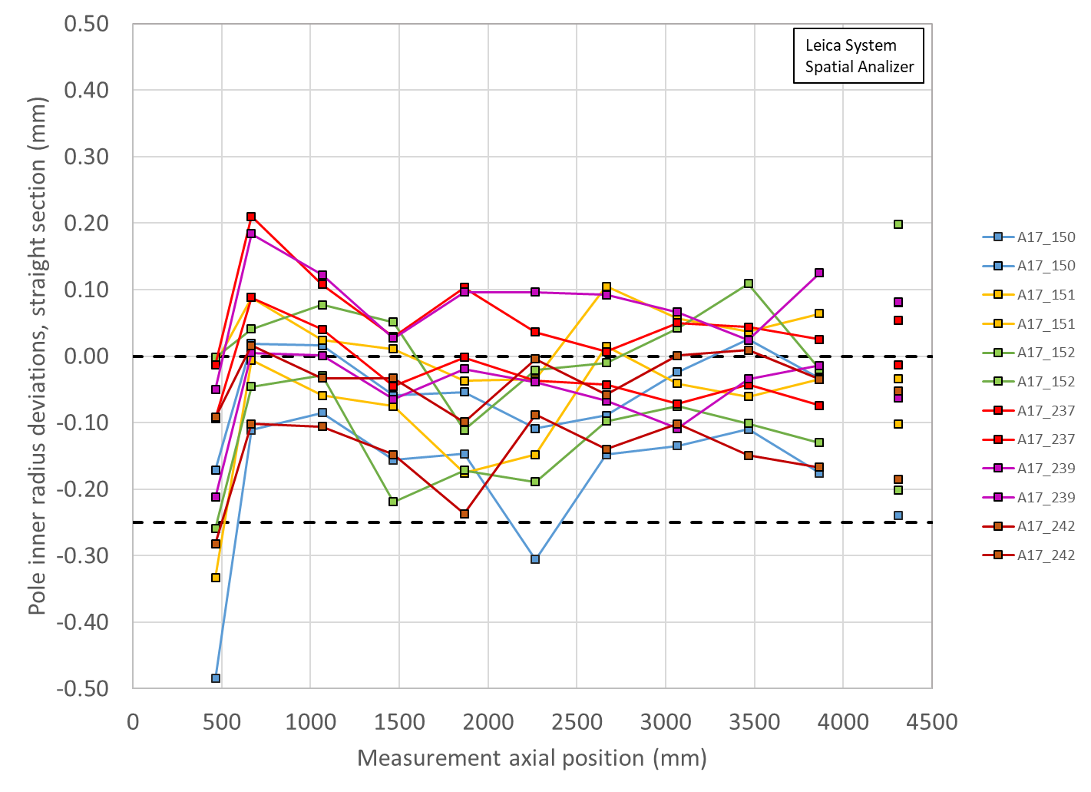
Pole inner radial deviations straight section
(min-max)

Slide 37
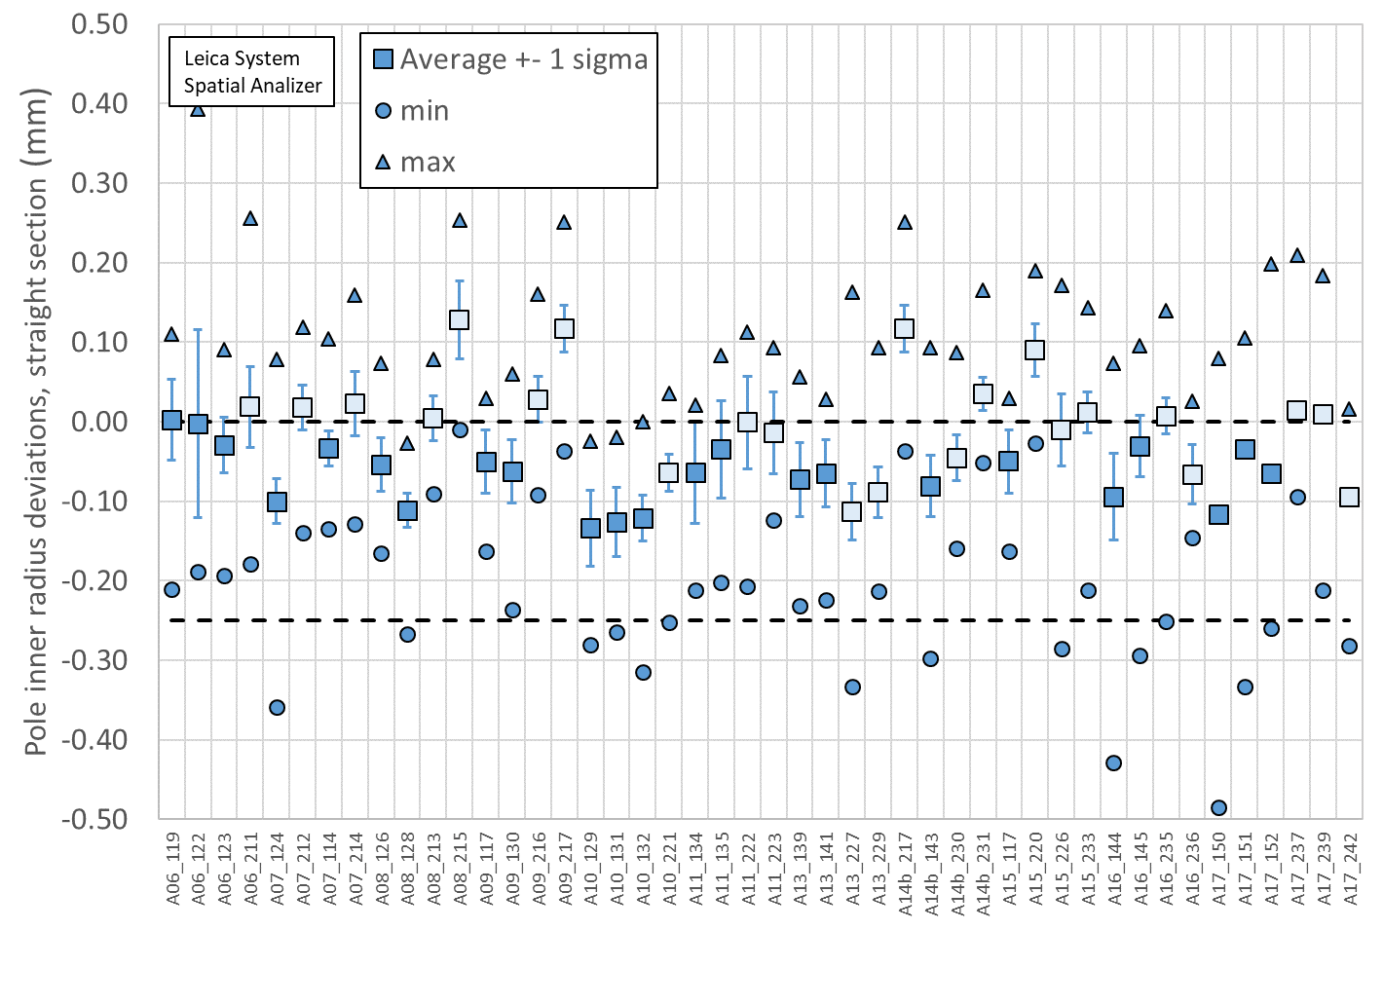
Pole inner radial deviations straight section

Slide 38
Pole inner radial deviations straight section
Conclusions
  Several out of spec positions, in all coils,
    Coil bumper thickness to be corrected to compensate
Action items
    Coil bumper thickness to be corrected to compensate

Slide 39
Outline
Data taking and processing
Impregnated coil dimensional tolerances
Results (straight section)
  Arc length excess
  Outer radius profile deviation
  Inner radial deviations (coil blocks)
  Inner radial deviations (pole)
  Key slot deviations
  Best-fit outer radius
Appendix

Slide 40
Key slot deviations*
  *View from LE, positive shift towards left

Slide 41
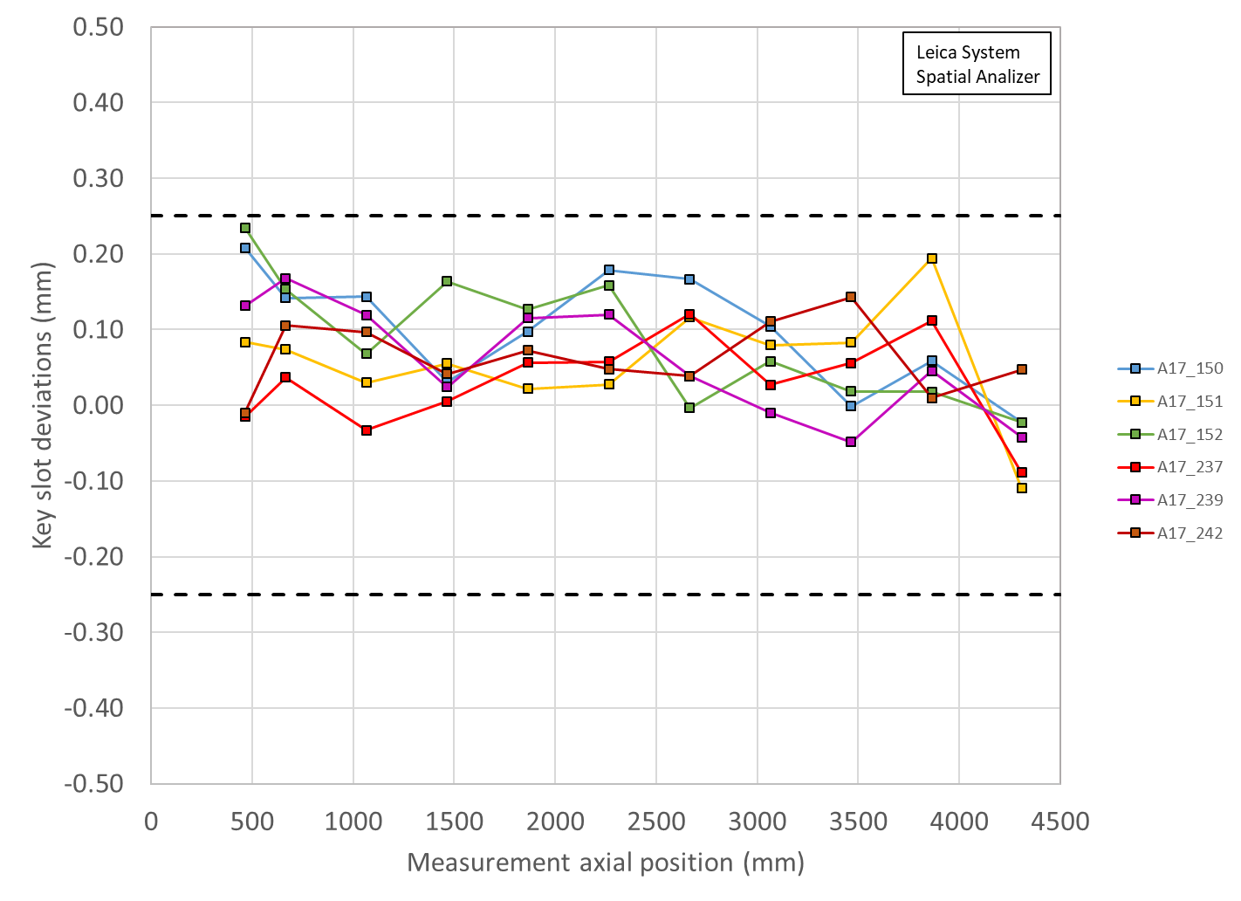
Key slot deviations

Slide 42
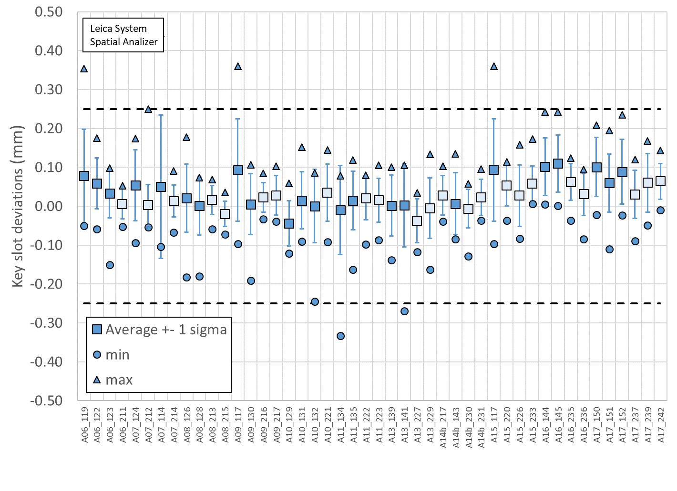
Key slot deviations

Slide 43
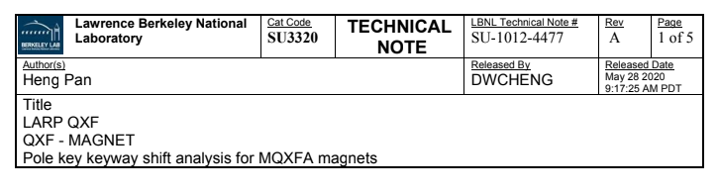
Key slot deviations
Conclusions
  No data out of spec
*See LBNL note and Record of Decision in Docdb-2844

Slide 44
Outline
Data taking and processing
Impregnated coil dimensional tolerances
Results (straight section)
  Arc length excess
  Outer radius profile deviation
  Inner radial deviations (coil blocks)
  Inner radial deviations (pole)
  Key slot deviations
  Best-fit outer radius
Appendix

Slide 45
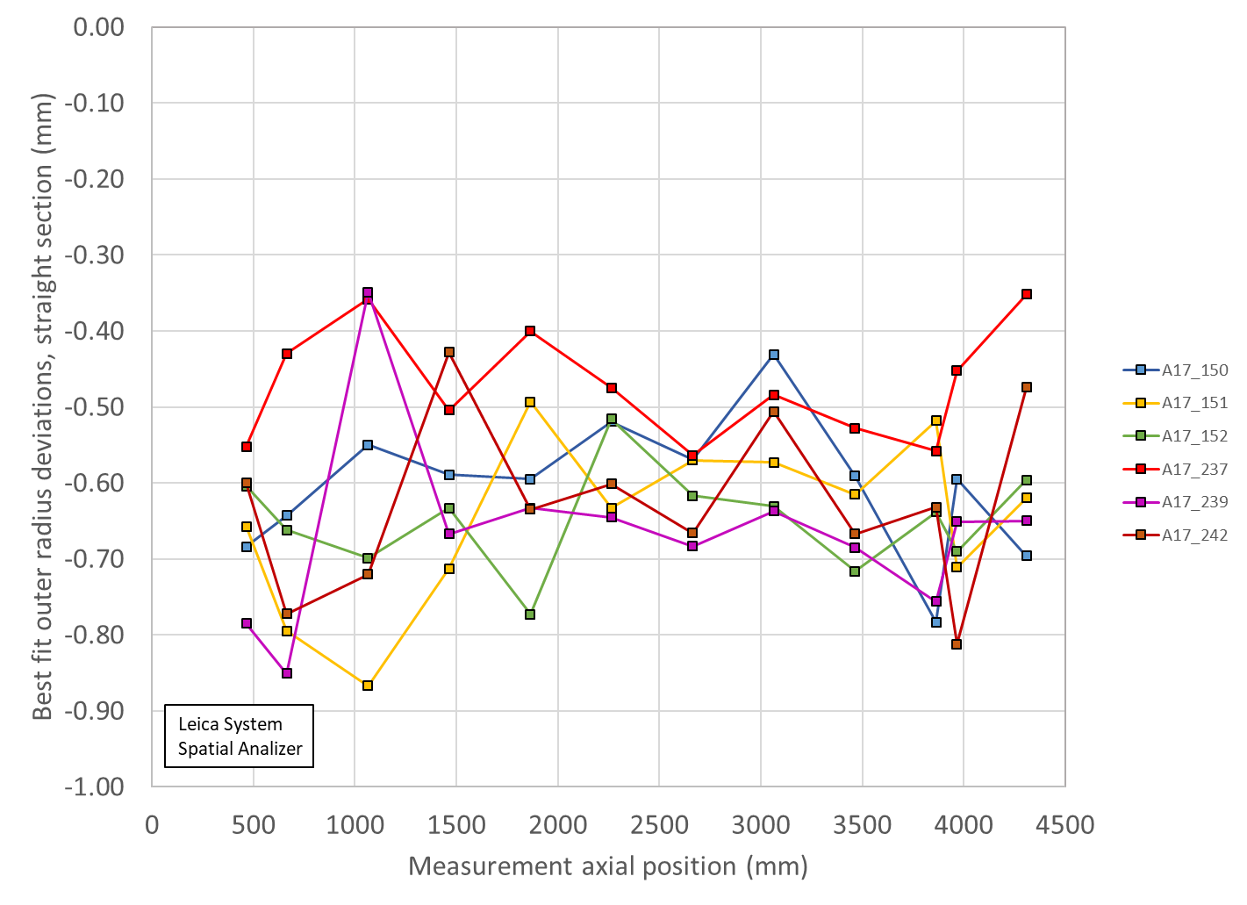
Best-fit outer radius deviations

Slide 46
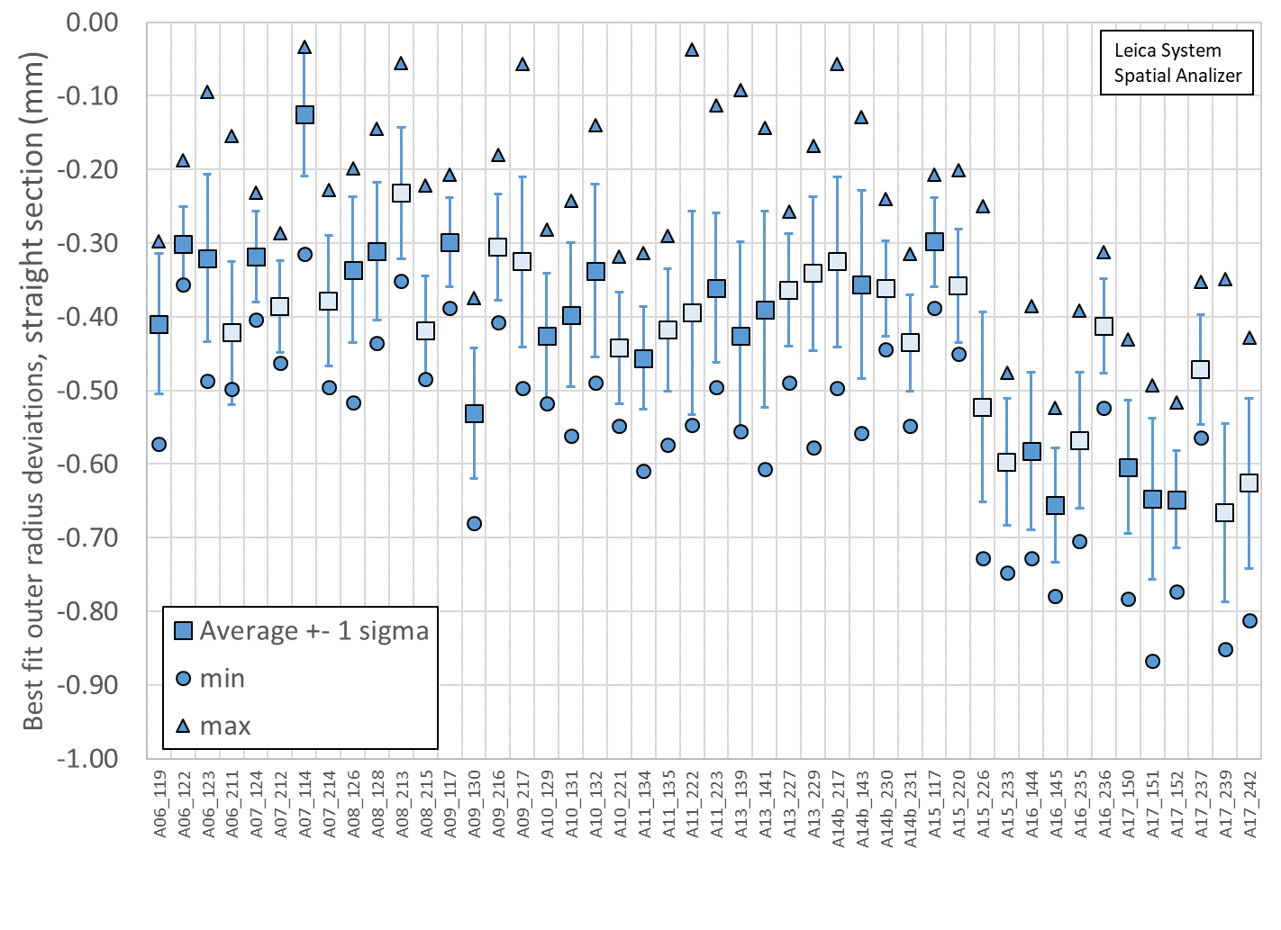
Best-fit outer radius deviations

Slide 47
Best-fit outer radius deviations
Conclusions
  Data consistent with A15 and A16 coils, but smaller than coils in previous magnets

Slide 48
Out of specs
Arc length excess
  All coils except 237 with several points out of spec
    The coils will be shimmed on the mid-plane to compensate
Outer radius profile deviation
  One data in coil 152 points marginally out of spec
    No action items
Inner radial deviations (coil blocks)
  Coil 150 and 242 marginally out of spec in few positions
    Non critical non conformity
      Increase of LHe space between cold bore and inner coil in one location
Inner radial deviations (pole)
  Several out of spec positions, in all coils,
    Coil bumper thickness to be corrected to compensate
Key slot deviations
  No data out of spec
Best-fit outer radius deviations
  Data consistent with A15 and A16 coils, but smaller than coils in previous magnets

Slide 49
Outline
Data taking and processing
Impregnated coil dimensional tolerances
Results (straight section)
  Arc length excess
  Outer radius profile deviation
  Inner radial deviations (coil blocks)
  Inner radial deviations (pole)
  Key slot deviations
  Best-fit outer radius
Appendix

Slide 50
Appendix

