Slide 1
MQXFA17 and MQXFA13b Coils Acceptance Review
Introduction & Charge
Giorgio Ambrosio
Magnets L2
U.S. HL-LHC Accelerator Upgrade Project
MQXFA17 and MQXFA13b Coil Acceptance Review
October 6, 2023

Slide 2
Committee
Arup Ghosh (chairperson), BNL retired
Helene Felice, CEA
Susana Izquierdo Bermudez, CERN
Date and Time
October 6, 2023.
Start time is 7/9/10/16 (LBNL/FNAL/BNL-FSU/CEA-CERN)
Location/Connection
Video-link by Zoom, info by email.
Link to agenda with talks and other documents
https://indico.fnal.gov/event/61535/

Slide 3
Review Goals I
The HL-LHC AUP project is planning to start assembly of MQXFA17. This is the 10th series low-beta quadrupole magnet (MQXFA) for the Inner Triplet of the High Luminosity LHC. If MQXFA17 meets MQXFA requirements [1] it will be used in a Q1/Q3 cryo-assembly to be installed in the HL-LHC.
For MQXFA17 assembly AUP is planning to use these QXFA coils (including two spare coils): 150, 151, 152, 237, 239 and 242.
A spare coil may be used in MQXFA13b after MQXFA17 assembly.
Conductor and series coil specifications are presented in [2-6]. Discrepancy or Non-conformity Reports are generated whenever a component does not meet specifications. Magnet MQXFA17 is planned for use in Cold Mass 05 without previous vertical test. Therefore, the coils presented at this review were selected because they do not have critical Discrepancies/Non-conformities.
The reviewers are requested to review discrepancies and non-conformities in strands, cables, and coils for the following coils: 150 (P43OL1186), 151 (1190), 152 (1193), 237 (1182), 239 (1184), 242 (1189).

Slide 4
CHARGE Questions
The committee is requested to answer the following questions:
Have all recommendations from previous reviews [7] been adequately addressed?
Have Discrepancies and Non-conformities been adequately documented and processed?
Is there any critical Discrepancy/Non-conformity?
Is there any coil that you recommend not to use in MQXFA17?
Do you have any other comment or recommendation regarding these coils and their conductor for allowing MQXFA17 to meet MQXFA requirements [1]?

Slide 5
References
MQXFA Functional Requirements Specification, US-HiLumi-doc-36
Specification for Quadrupole Magnet Conductor, US-HiLumi-doc-40
Cable Specification, US-HiLumi-doc-74
Quadrupole Magnet Cable Insulation, US-HiLumi-doc-75
QXFA Series Coil Production Specification, US-HiLumi-doc-2986
QXFA Series Coil Fabrication Electrical QC plan, US-HiLumi-doc-521
MQXFA16 Coils Acceptance Review, US-HiLumi-doc-4900
All docs are on the Review Indico page
Coil CMM measurements for acceptance are performed at LBNL
Coil CMM at BNL and FNAL are used for feedback to L3s

Slide 6
Critical DR/NCR:
Critical nonconformance: a nonconformance which meets at least one of the following:
  affects form, fit, or function in the as-found condition
  involves damage, or suspected damage, to the coil conductor
  is likely to trigger yellow or red schedule or cost variance reporting thresholds
  meets the requirements of “Moderate” or higher per the CERN Impact Matrix (for collaborations) in EDMS 1863763
Handling of Discrepancies and Nonconformances
US-HiLumi-doc-2484

Slide 7
Coil Ordering
The use of coils with different conductor properties (RRR and Cu/NCu) may increase Coil-Ground voltages
Since CLIQ is introducing an asymmetric behavior, coil ordering may be used to compensate for different conductor properties
Therefore, starting from MQXFA03, AUP is checking peak Coil-Ground voltages for any possible coil ordering
  All options with peak voltage above spec will be forbidden
  Voltages of other options will be taken into account together with other data, when deciding coil ordering
➔ talk “Coil Ordering based on Conductor Properties”

Slide 8
Traveler status on MTF
We added this topic following a request from Susana

Slide 9
Recommendations from MQXFA16 Coil Acceptance Review
Pending further analysis and assessment of the corrective actions for coil compensation at the ends, use coils 144, 145, 235 and 236 for magnet MQXFA16. The other two coils have smaller coil ends, so they can be designated as spares for the moment. There is no limitation to coil ordering if these coils are used
Recommendation was accepted by AUP and coils 144, 145, 235 and 236 are in magnet MQXFA16.

Slide 10
Recommendations from MQXFA16 Coil Acceptance Review
Currently, LBNL measures only two cross sections in the LE end (70 mm and 207 mm) and one in the RE end (4426 mm). In order to have a better picture of the coil size in the end region, it would be useful to measure one coil with higher longitudinal definition (one section every ≈ 50 mm). It will also help to improve the FE analysis if this information is fed into the model
Done. See next slide

Slide 11
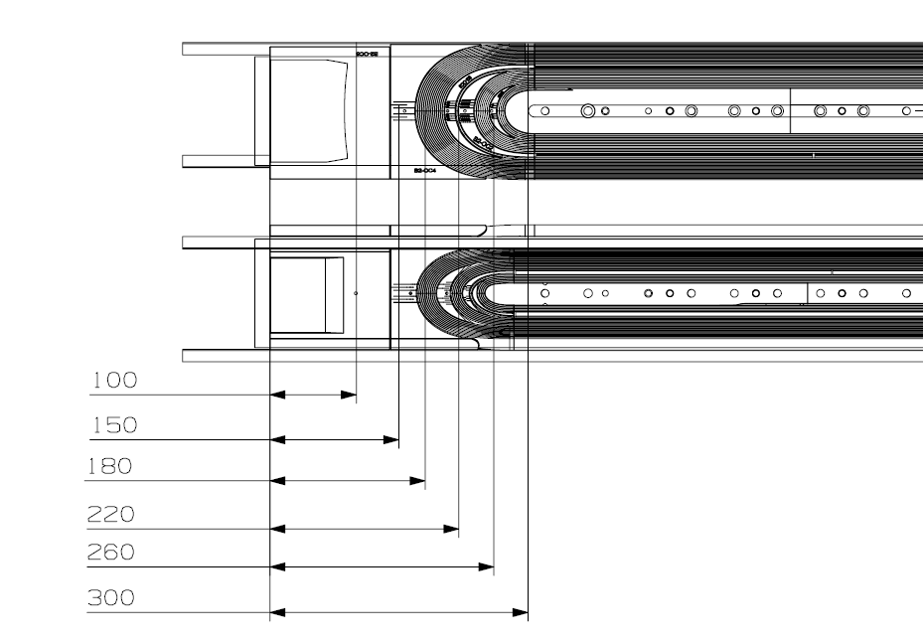
Coil 157 - Additional Locations
X-sections in addition to 70, 207, 465 (standard locations)

Slide 12
Average of Midplanes – Coil 157 LE
Average of MN on transition and non-transition sides
X-sections in addition to 70, 207 and 465 (standard locations)
Distance from LE | NT side | T side | Average
mm | um | um | um
70 | -121 | -117 | -119
100 | -125 | -121 | -123
150 | -140 | -134 | -137
180 | -155 | -148 | -151.5
207 | -179 | -167 | -173
220 | -171 | -155 | -163
260 | -139 | -136 | -137.5
300 | -102 | -96 | -99
465 | -65 | -61 | -63

Slide 13
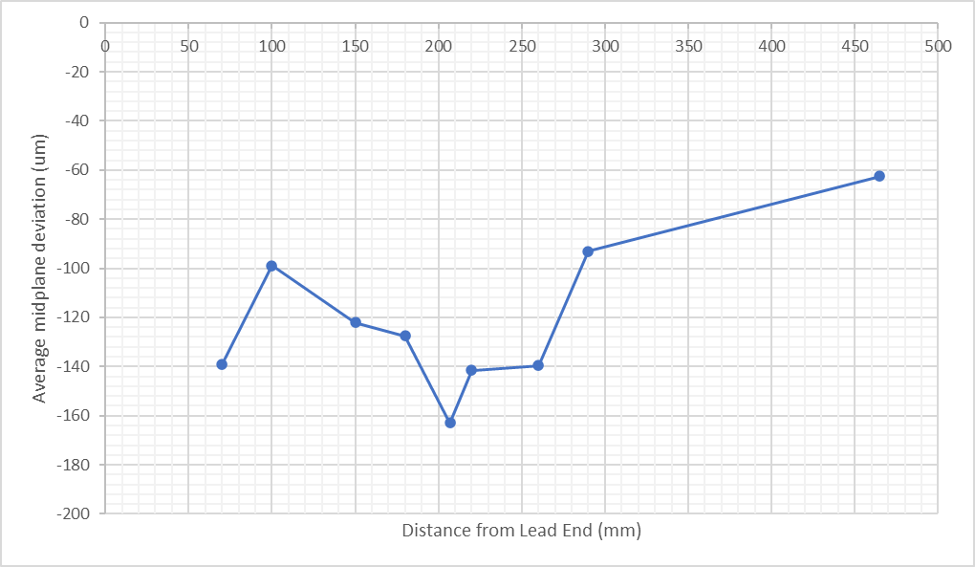
Coil 158 LE
Average of MN on transition and non-transition sides
Distance from LE | NT side | T side | Average
mm | um | um | um
70 | -145 | -133 | -139
100 | -103 | -95 | -99
150 | -126 | -118 | -122
180 | -132 | -123 | -127.5
207 | -169 | -157 | -163
220 | -147 | -136 | -141.5
260 | -143 | -136 | -139.5
290 | -96 | -90 | -93
465 | -64 | -61 | -62.5

Slide 14
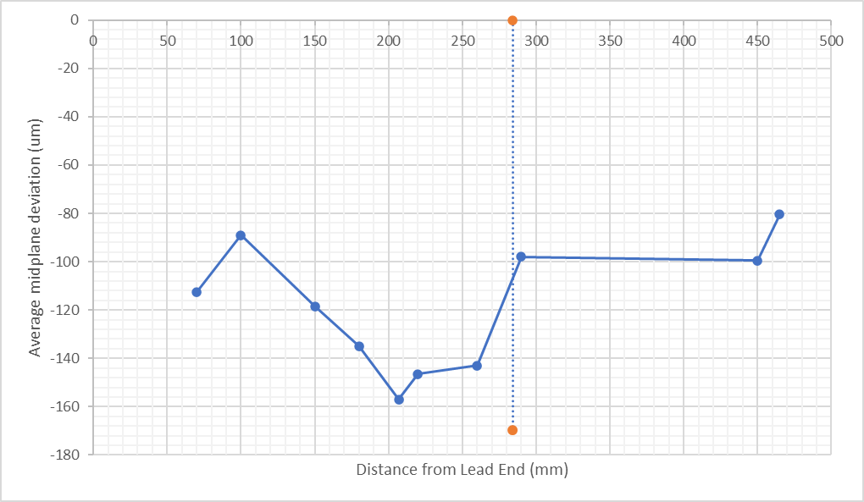
Coil 159 LE
Average of MN on transition and non-transition sides
Distance from LE | NT side | T side | Average
mm | um | um | um
70 | -88 | -137 | -112.5
100 | -90 | -88 | -89
150 | -121 | -116 | -118.5
180 | -140 | -130 | -135
207 | -161 | -153 | -157
220 | -151 | -142 | -146.5
260 | -145 | -141 | -143
290 | -100 | -96 | -98
450 | -100 | -99 | -99.5
465 | -82 | -79 | -80.5
Wedge-spacer transition on Inner Layer

Slide 15
See slides about CMM at LBNL for data about QXFA17 and MQXFA13b coils

Slide 16
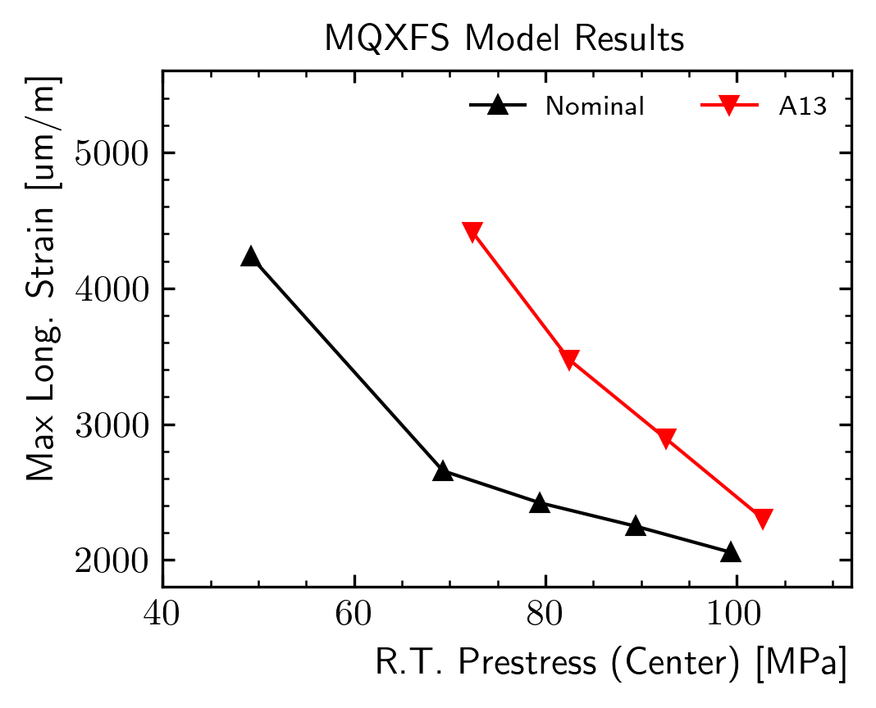
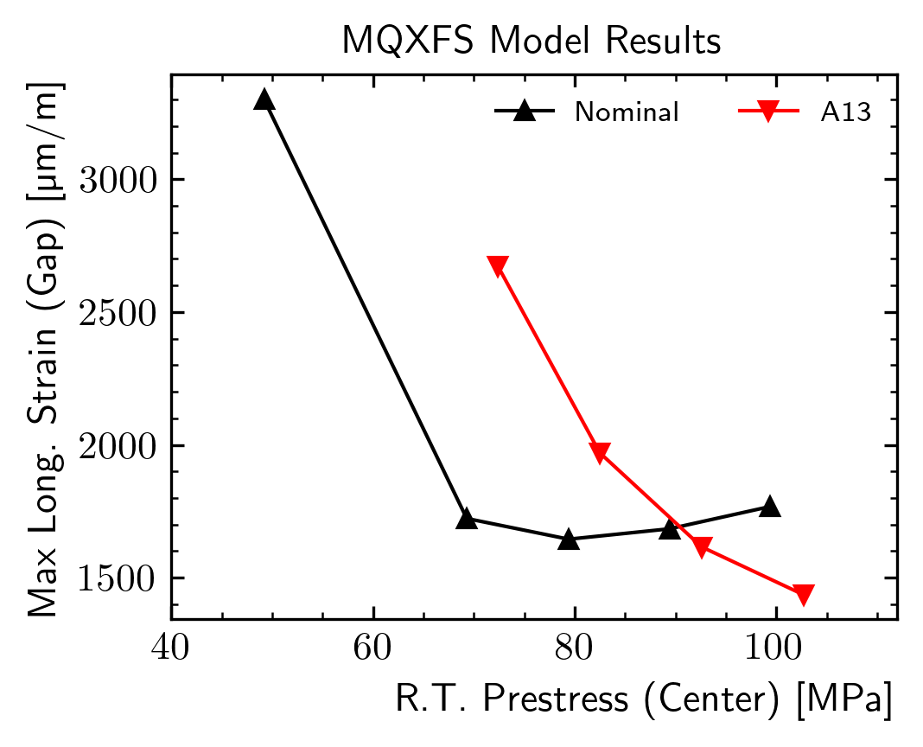
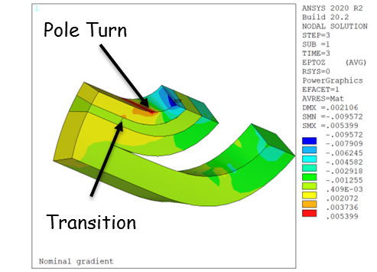
Peak Strain as a Function of the Prestress
The peak strain is a function of the applied prestress
  Clearly the distance between the red and black line will be different for each coil pack shape
Effect on max strain on the transition seems similar:
  A13 requires higher room temperature prestress to keep the strain below the ‘knee’

Slide 17
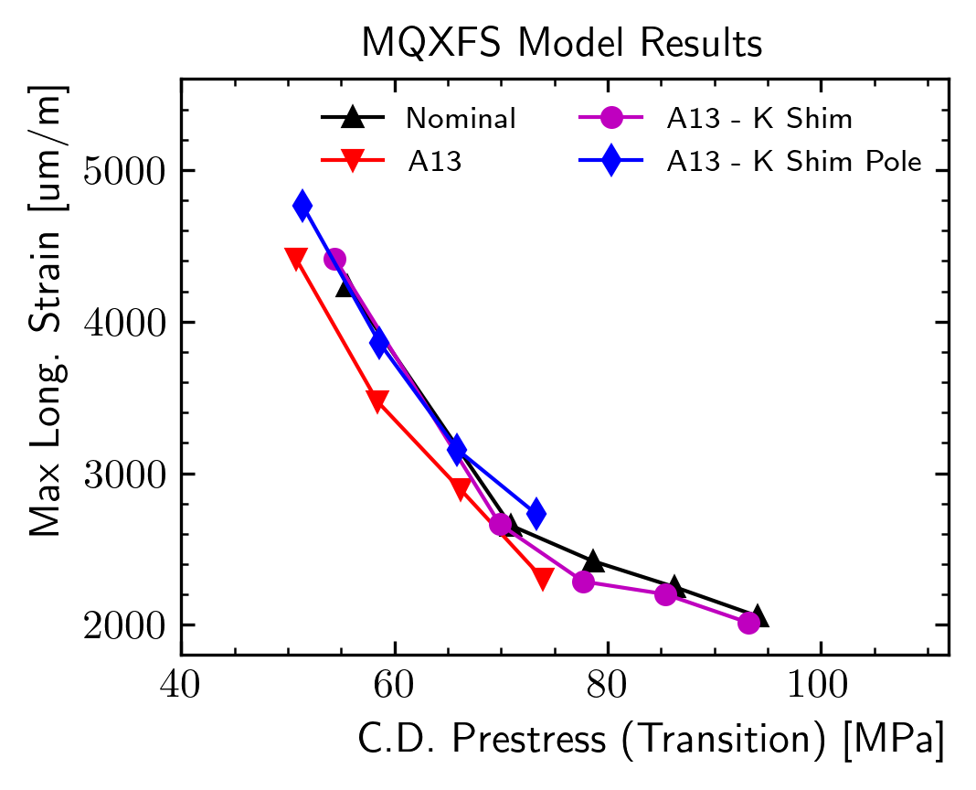
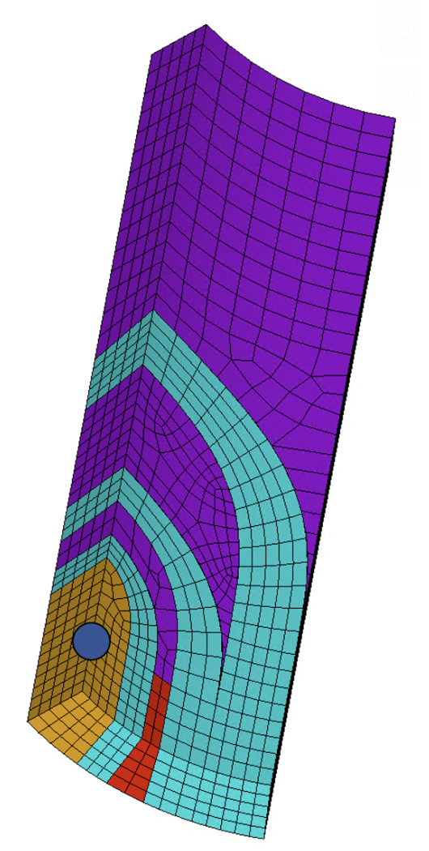
Why the strain increases?
Pole stress at cold computed on the same z location of the wedge/end-spacer transition
  Blue/magenta lines represent end-region modifications
  All the points are on the same lines!
The effect seems to be controlled by a local prestress loss

Slide 18
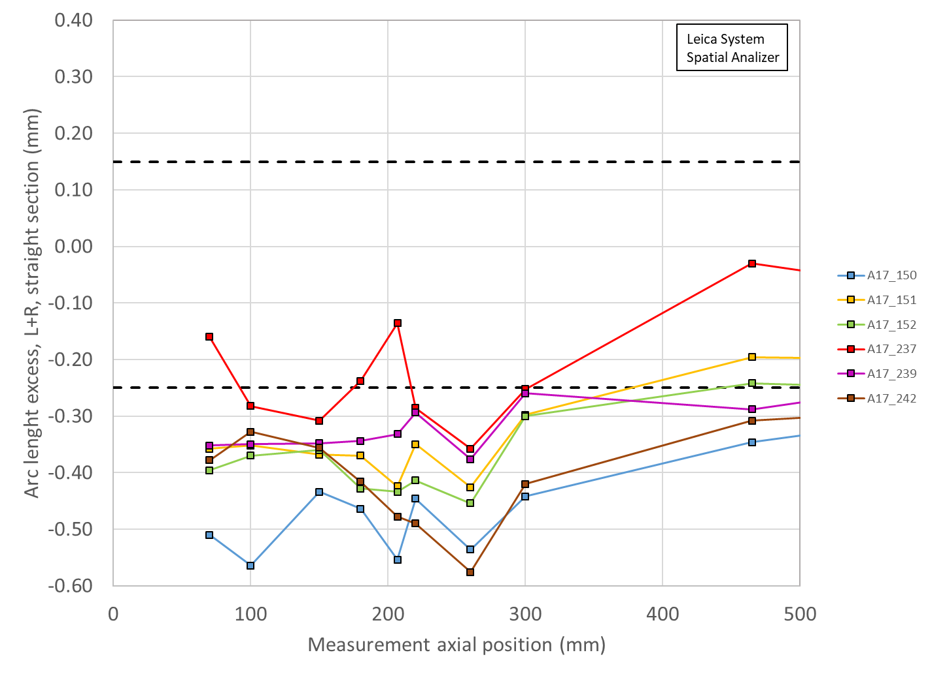
Coils for MQXFA17 in Lead End
Baseline coils for MQXFA17:
151, 152, 237 and 239
And preload will be done with updated specs & targets
Spare coils

Slide 19
Recommendations from MQXFA16 Coil Acceptance Review
Include the end regions in the coil dimensional requirements with a minimum threshold below which a critical discrepancy/non conformity would be triggered.
Very good point! We are working on it, not yet ready to set threshold

Slide 20
Schedule
Today:
  Talks
  Q&A
Following days:
  Closed session(s)
  Possibly Q&A by email
Report by email or Zoom mtg in ~2 weeks

