Slide 1
Main Injector Shutdown Status
D. Morris, M. Murphy
Friday 09:00 AD Scheduling Meeting
October 6th, 2023

Slide 2
General
ISD work requiring significant MI power outages is complete.
HVAC installation finishing up with punch-list items. A few internal sensors need to
be installed.
E:V108 cabling at MI-62 is finished.
Dual PA cabling for 4 RF stations is finished
Work on MI-50 PS cables done. LAM61 cables and Recycler 620 sextupoles next.
MI VCB maintenance is complete. All VCB Over-Current relays are being replaced.
RF maintenance continues.
Trying to get one cavity water path rework completed so we can pull another
cavity to rework before the next shutdown.
MI-60 Test Cave anode PS transformer replacement is delayed.
2
MI Department Meeting | D. Morris
10/5/23

Slide 3
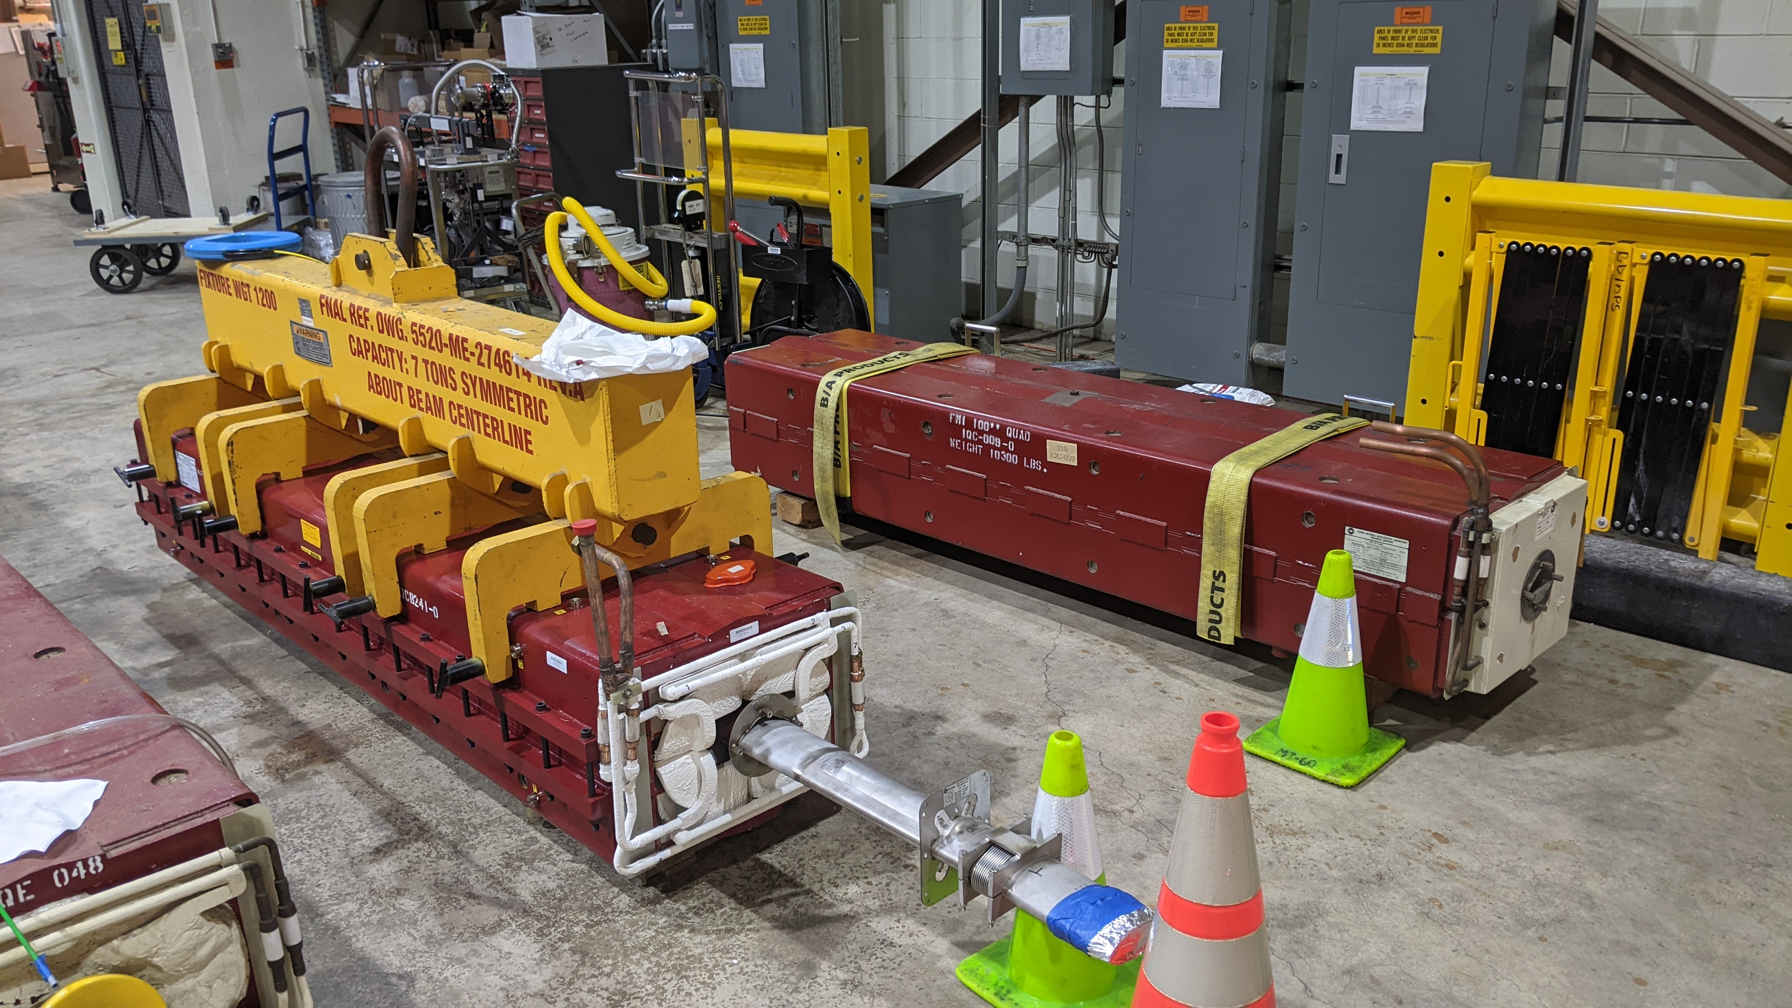
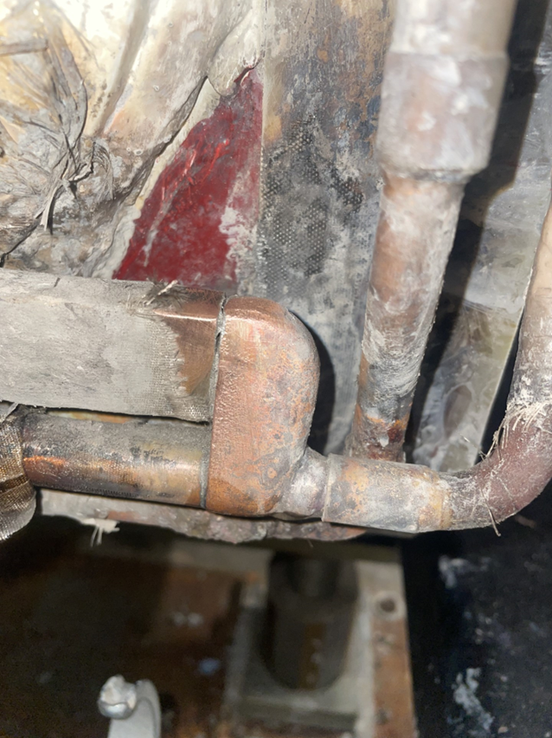
Tunnel Work
Q319 faulted quad replacement finishing up.
EE Support/Instrumentation connections
Work in completed on MI and
RR IPM micro-channel plates.
Q333 (IQB-067) LCW leak.
Repair completed
EE Support/Instrumentation connections
3
MI Department Meeting | D. Morris
10/5/23

