Slide 1
Planning
Schedule & Milestones
E. Jensen (CERN) – just reporting, the work is done by many!
April 8 – April 10, 2013

Slide 2
Master Schedule – unchanged!
now
Global scheme with elliptical CC is plan B.
Test in LHC IR4 is not yet decided.
NB (from my experience): things left of the blue line don’t move, but those right of the blue line tend to move further to the right; … except for the years!
NB (rumour – against my experience): Maybe detectors need interruption earlier, i.e. an advanced LS2…

Slide 3
Long-term goals
Hi-Lumi Beam Commissioning/“Operation”: 2024+
Hi-Lumi Installation: 2022+
CC Commissioning: 2021+
CC production: 2017-2021
CC Validation run in SPS: 2016-2017
I’ll concentrate on the planning up to here
The following was prepared by Alick Macpherson, who is leading the coordination/integration effort towards the LHC CC SPS Validation.
To this end, Alick chairs the “Crab Cavity Technical Coordination working group”.

Slide 4
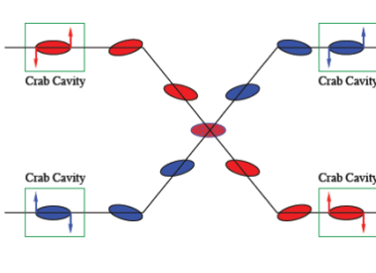
Crab cavities - Why we want them in the LHC
Crab Cavities: Transverse deflecting cavities that rotate bunches to optimize the geometrical reduction factor in luminosity for colliding beams with a non-zero crossing angle.
Motivation for HL-LHC
  Can optimize luminosity production
    Gives a factor ~2 in Luminosity reach
  Can be used for luminosity leveling
  Can moderate longitudinal vertex density
LHC Prerequisites
  Show that crab cavities can work effectively in LHC environment
  Ensure machine protection aspects are compatible with LHC operation
Demonstration of feasibility with proton machines: SPS validation is essential

Slide 5
Crab Cavities in the SPS:
SPS Validation program - Objectives
  Validate Crab cavity design for proton beams
  Validate operational functionality & Machine protection mechanisms
  Overall goal => set inputs for final design
SPS tests considered essential to finalize design + operational scenarios
  SPS crab cavity tests not foreseen before 2016
Crab cavity prototypes:
  Compact superconducting transverse deflecting cavities
    complicated geometry, compact, made from solid Niobium sheets.
Operational Constraint: Cavities must not block normal SPS operation
  Must be possible to remove from beam line on short time scale.

Slide 6
SPS Crab Cavity Validation Program
Stand alone validation
  Full characterization of cryomodule & cavities prior to installation in SPS
Invisibility Tests
  Crab Cavities must be transparent to operation when detuned
Beam loaded measurements
  Cavity performance with beam: cavity response, heat loads, RF noise etc.
Validation of cavity operational cycle with beam
  LLRF permits cycling multiple cavities through operational states
Crabbing functionality:
  Validation of crabbing, performance analysis vs. beam parameters
Machine Protection Aspects
  Detection of failure modes and mitigations/interlocks associated with LLRF

Slide 7
Crab Cavity layout
LHC: Local crabbing scheme: 3 cavities per beam on each side of the IP
LHC
Q4
D2
IP
D2
Q4
11 m
SPS
3 m
Beam
SPS: Possible to test of both local or global crabbing schemes
2 identical cavities per cryomodule, 1 RF amplifier per cavity
Cavities can only stay in beam line if superconducting state maintained
SPS tests: Only horizontal crabbing (LHC: crabbing in both H & V)

Slide 8
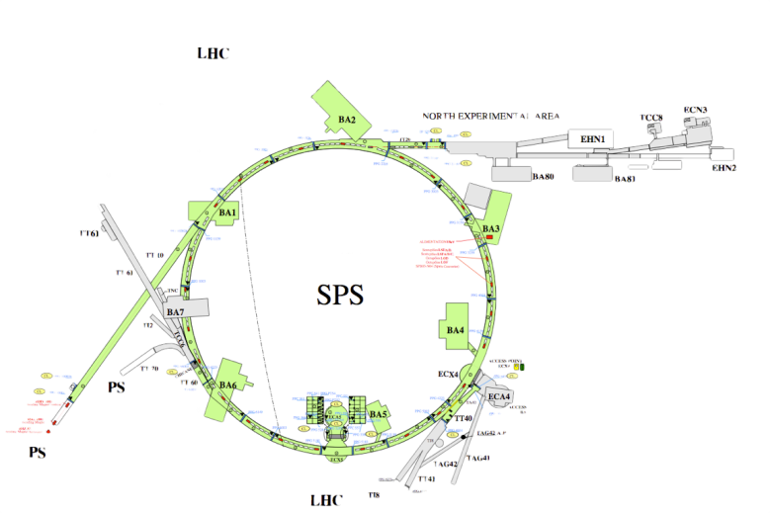
SPS crab cavity location
SPS Location: LSS4
  Cryogenics Infrastructure
    Only SPS Pt 4 is feasible
  LLRF can be close (35 m)
    Experimental cavern (ECX4)
  Facility for switching cavities in/out
  Crab Cavity space not free till 2015
  Limited access to SPS zone after SPS long shutdown (2013-2014)
  SPS Extraction pt for LHC beam 2
8

Slide 9
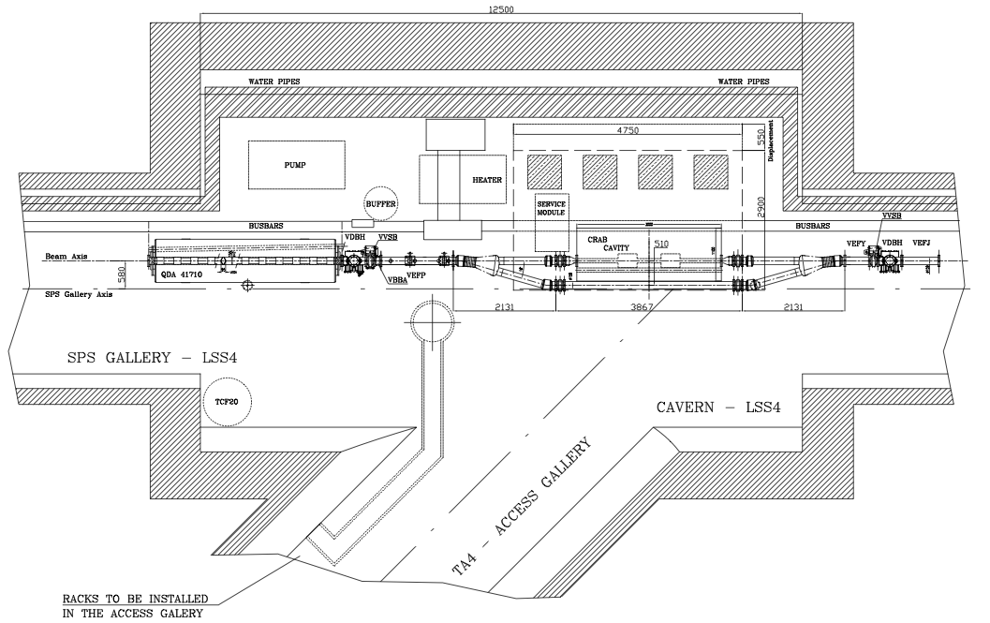
SPS LSS4 Layout
LLRF
ECX4(35 m)
CC CM

Slide 10
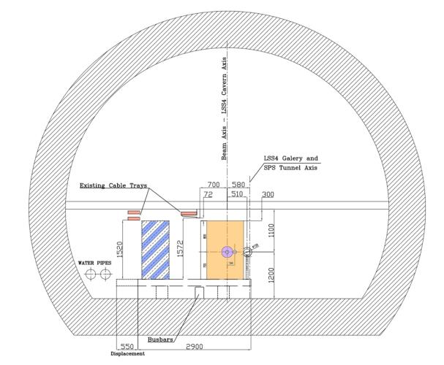
SPS Integration - Space available
Integration Issues
Transport Lane respected
Support table: size ~5 m x 3 m
  Transverse motion = 510 mm
Constrained cryomodule volume
RF amplifiers mounted on support table
  Rigid connections between RF amplifiers and cryomodule
Rigid cryo lines onto cryomodule to minimize heat load
Support
Infrastructure
Crab Cavity
RF Amplifiers
& Circulators
Cryomodule
Envelope
Support Table
Based on 3D model built from
Dec 2012 scans of as-installed geometry

Slide 11
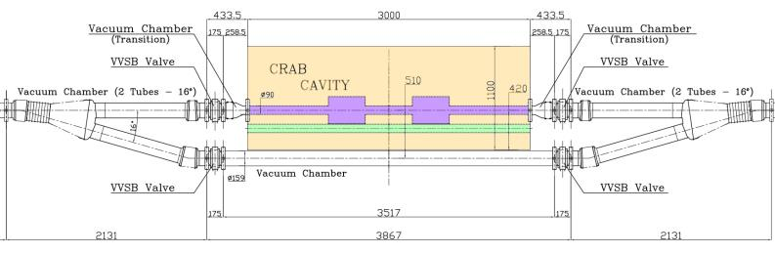
Integration in the SPS – operational aspects
SPS operation must be independent of crab cavity operational availability
Crab Cavity module switchable from in-beam to out-of-beam position
  → Mechanical Y-Chamber, CC mounted on support table
Y-chamber movement: reproducible 0.51 m transverse movement in < 1hr
  Must be remote controlled (i.e. no access required) and allow
      Safety incorporated into support structure design
      Mechanical movement of helium vessels, cryo-lines etc.
3000 mm
510 mm
Dummy LHC Beam Pipe

Slide 12
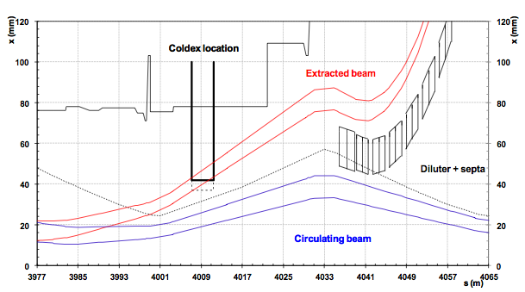
SPS Operational Constraints
SPS Extraction bump prohibits CC in beam when filling LHC
  CCs in beam: Blocks LHC filling. Aperture bottleneck for normal SPS operation
  → Y-Chamber needed so cavities can be bypassed when not under test
Crab Cavity
SPS LSS4: LHC Extraction bump (Q20 optics)

Slide 13
SPS Cryogenic Issues
Cryo infrastructure for 2 K operation
  Existing 4.5 K cryo station, but concerns over liquefaction capacity
Predicted Liquefaction capacity line [g/s]
0.7
0.85
1.2
    Helium Liquefaction capacity measurement mandatory
    Static and dynamic heat loads to be reviewed (cavities + infrastructure)
Static heat load -> 0.55-0.65 g/s
MS: June 2013!
Equipment | Heat load @ 2K | Source of capacity
cryostat -static | ~ 7W @ 2K | TCF20 -> 0.35 g/s
cryostat -dynamic | ~ 5-10 W @2K | TCF20/Buffer tank
Service module | ~1-2 W @ 2K | TCF20 -> 0.1 g/s
Buffer tank | ~1-2 W @ 4.5 K | TCF20 -> 0.1 g/s
Transfer lines | ~2 W @ 4.5 K | TCF20 -> 0.1 g/s
  Install 200 l LHe buffer tank: ensures > 8 h MD operation with beam @ 2 K

Slide 14
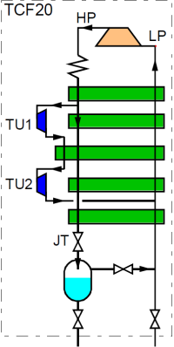
Crab Cavity Cryogenics in the SPS
Cold Box
black –> existing [4.5 K]
red –> to be built/installed [2 K]
Buffer tank
Service module
R
EH
TT
From LN2
pre-cooler
JT
Screen
CC cryostat
PT
LT
Coupler intercept
End cone intercept
End cone intercept
CC x 2
Screen
EH
TT

Slide 15
Cryogenics Layout
LLRF
ECX4( 35m)
Pump
Heater
Buffer
SM
CC
TCF20
Electrical
equipment

Slide 16
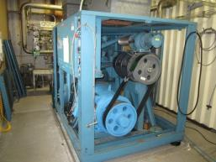
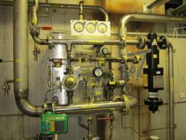
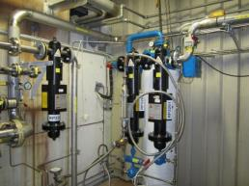
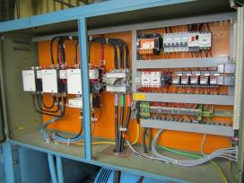
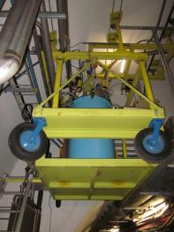
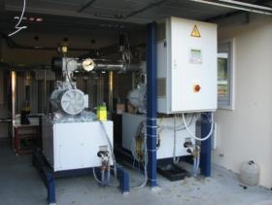
Cryogenics - infrastructure for real
SPS BA4 4.5 K cryogenics last used 8 years ago (COLDEX). Refurbishment + upgrade for 2 K – is underway
Renovated compressor + elec. motor
Revised, labeled and qualified pressure control system / oil removal system
Cold box TCF20
New power supply panel for compressor station
2 K pumping groups recovered from AMS
TCF20 Cold box

Slide 17
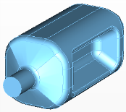
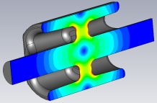
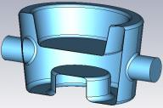
Cavity Tuners – concepts
Up/down motion
± 2μm → 1 kHz
Push/pull on cavity body
Scissor jack type mechanism
  Detuning range: LHC = ±5.5 kHz (half frev). Lorentz Detuning ~O(1 MHz)
SM
SM
SM
Double lever
(Saclay type)
Modified screw/nut
(SOLEIL type)
CEBAF Tuner

Slide 18

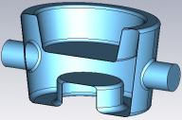
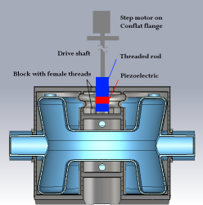
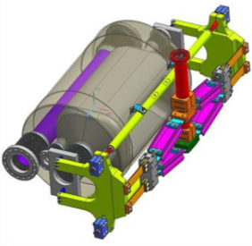
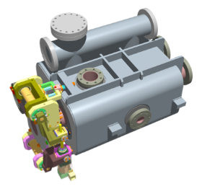
Cavity Tuners - Implementation
Up/down motion
± 2μm → 1 kHz
Push/pull on cavity body
Scissor jack type mechanism
→each cavity prototype requires its own cryomodule design

Slide 19
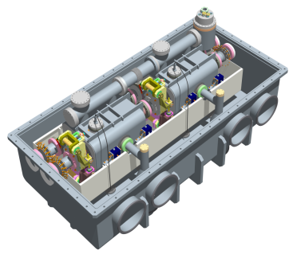
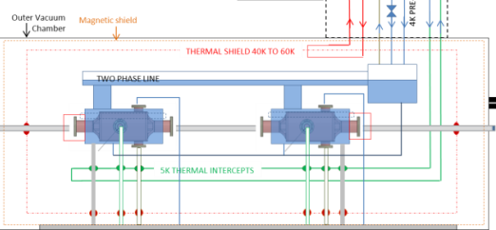
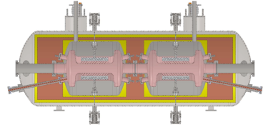
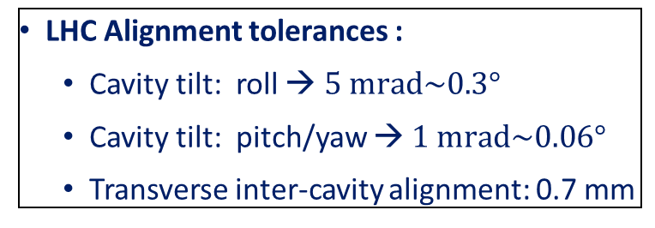
Cryomodule Design
SPS tests: 2 identical cavities in 1 cryomodule
SPS tests: 2 identical cavities per cryomodule
Cryo modules for SPS not final LHC design
Cryogenic and power coupler ports to be top mounted
SPS integration imposes design restrictions
1000mm
2160mm
LHC Alignment tolerances :
  Cavity tilt: roll → $5 \text{mrad}\sim 0.3°$
  Cavity tilt: pitch/yaw → $1 \text{mrad}\sim 0.06°$
  Transverse inter-cavity alignment: 0.7 mm
to be x-checked
~3000mm

Slide 20
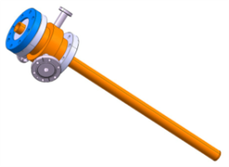
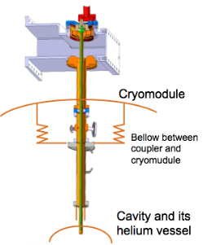
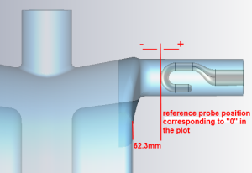
Fundamental Power coupler
Fundamental power coupler: Design nearing completion
  2 Cavity types with E-field coupling, 1 with B-field coupling
Power coupler fabrication and testing take time
  Not expected before Q2 of 2015
Interface to cryo module still being resolved
Assembly constraint:
connection from top
→Cavity must be able to support coupler weight (with WG) [ ~35 kg]

Slide 21
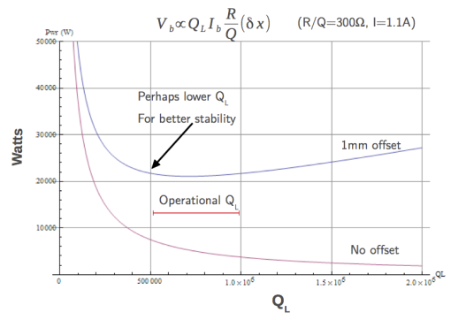
RF Power
RF amplifier: One 400 MHz - 50 kW SPS Tetrode per cavity.
TX power vs. QEXT
50 kW
Blue trace → 1 mm offset
Red Trace → 0 mm offset
    1 mm offset: power is “flat” at ~QEXT in 25 kW range for QEXT in [4x10⁶, 1.5 x10⁶]
Inter Cavity Alignment
1 mm tolerance is OK for power converter in a reasonable QEXT range
10⁶
  Machine protection
If QEXT = 10⁶ → τVoltage ~800 μs while TBeam dump = ~ 3 LHC turns ~ 270 μs
→ Most failure modes slow (due to QL) => OK for LHC beam dump system
→ For fast failure, look to nested feed back loops to mitigate failure!

Slide 22
Multiple Cavity Control and MP algorithms: LLRF
LHC
Cavity Controller: Strong feedback to regulate individual cavities
  Feedback loop delay < 1µs
Global Feedback: regulates crabbing-uncrabbing & MPS mitigations
  Feedback loop delay ~5 µs << 1 LHC turn
LHC Control loops and MPS algorithms to be developed and tested in SPS

Slide 23
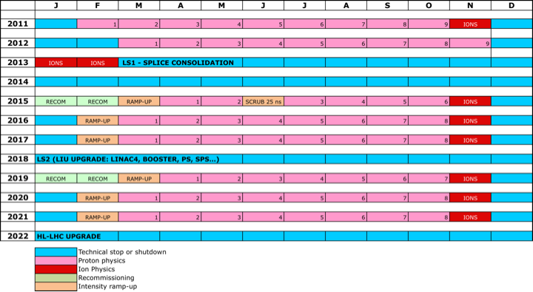
Schedule - Longer term view
SPS validation run
2016 & 2017?
Final Design and production

Slide 24
Schedule up to Installation in the SPS
~ Now
2013
2014
2015
2016
Coupler
Designed
Cavity
Testing
Cryostat
Design
Cryo
Installed
Couplers
Ready
SM18
Cold Test
Crab Cavity
Validation Run
Installation
Power coupler design completed: Q1 of 2013
SM18 - Vertical tests of prototype cavities: start Q2 of 2013
Verification He liquefaction capacity: June 2013
Cryostat design ready: Q4 of 2013
Cryogenic infrastructure installed in SPS LSS4 : End of SPS LS1 (June 2014)
Cabling infrastructure in SPS: Q1 of 2014
Power Couplers available for cryostat: Q2 of 2015
Cryomodule fully dressed: Q2 of 2015
Cryomodule fully tested in SM18: Q3 of 2015
Cryomodule installed in SPS: 2015-2016 Christmas stop.
Crab Cavity validation MDs: SPS Run 2016 and maybe 2017

Slide 25
Thank you for your attention!
… and special thanks to Alick Macpherson and Rama Calaga for preparing this!

