Slide 1
HQ02
Assembly summary and Next steps
Helene Felice
Joint LARP CM20 / Hilumi Meeting
April 8th to 10th 2013
Napa, CA, USA

Slide 2
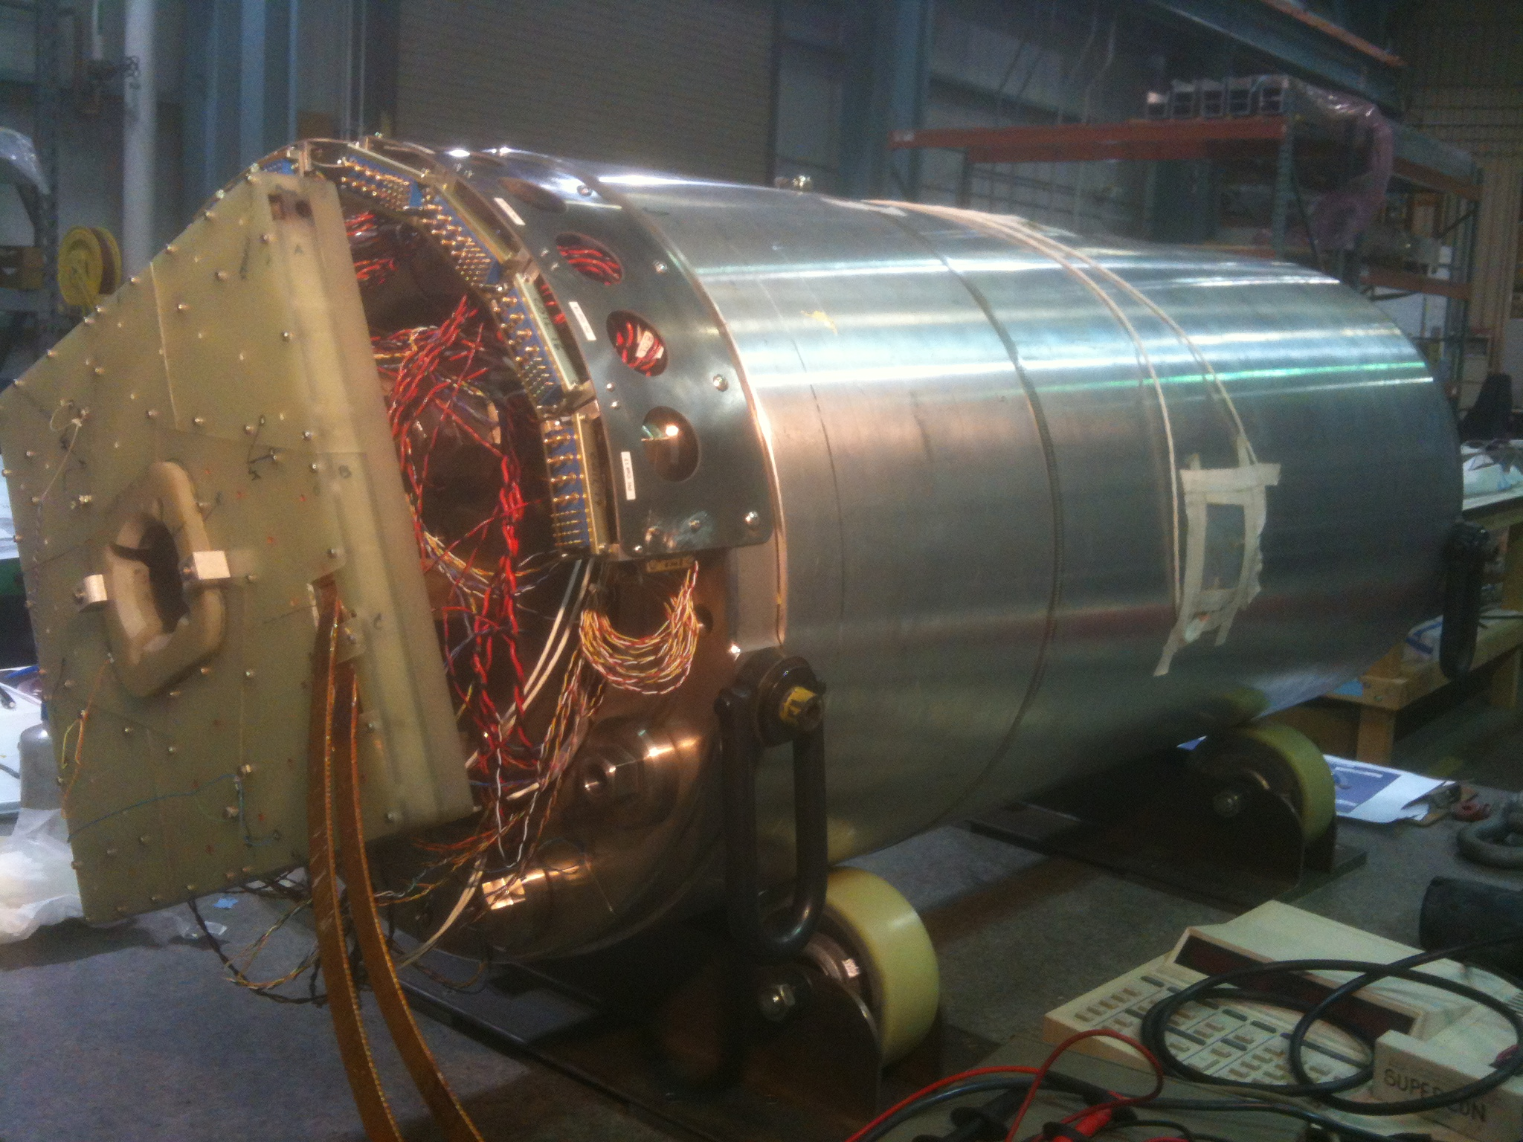
The HQ02 Team
Franck Borgnolutti, Rodger Bossert, Drew Carleton, Dan Cheng, Guram Chlachidze, Dan Dietderich, Helene Felice, Arup Ghosh, Arno Godeke, Ray Hafalia, Hugh Higley, Daryl Horler, Chip Kozy, Toby Levine, Tom Lipton, Nate Liggins, Maxim Marchevsky, Matt Reynolds, Jesse Schmalzle, James Swanson, Prabir Roy, Gianluca Sabbi, Abdi Salehi, Tiina Salmi, Xiaorong Wang…

Slide 3
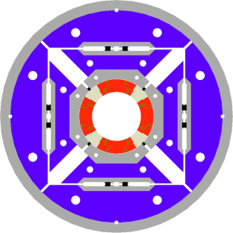
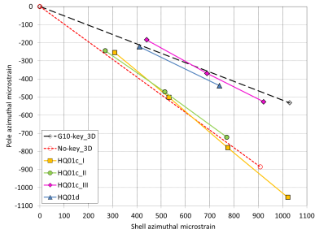
Outline
Magnet Overview
HQ02 Assembly Summary
Next steps

Slide 4
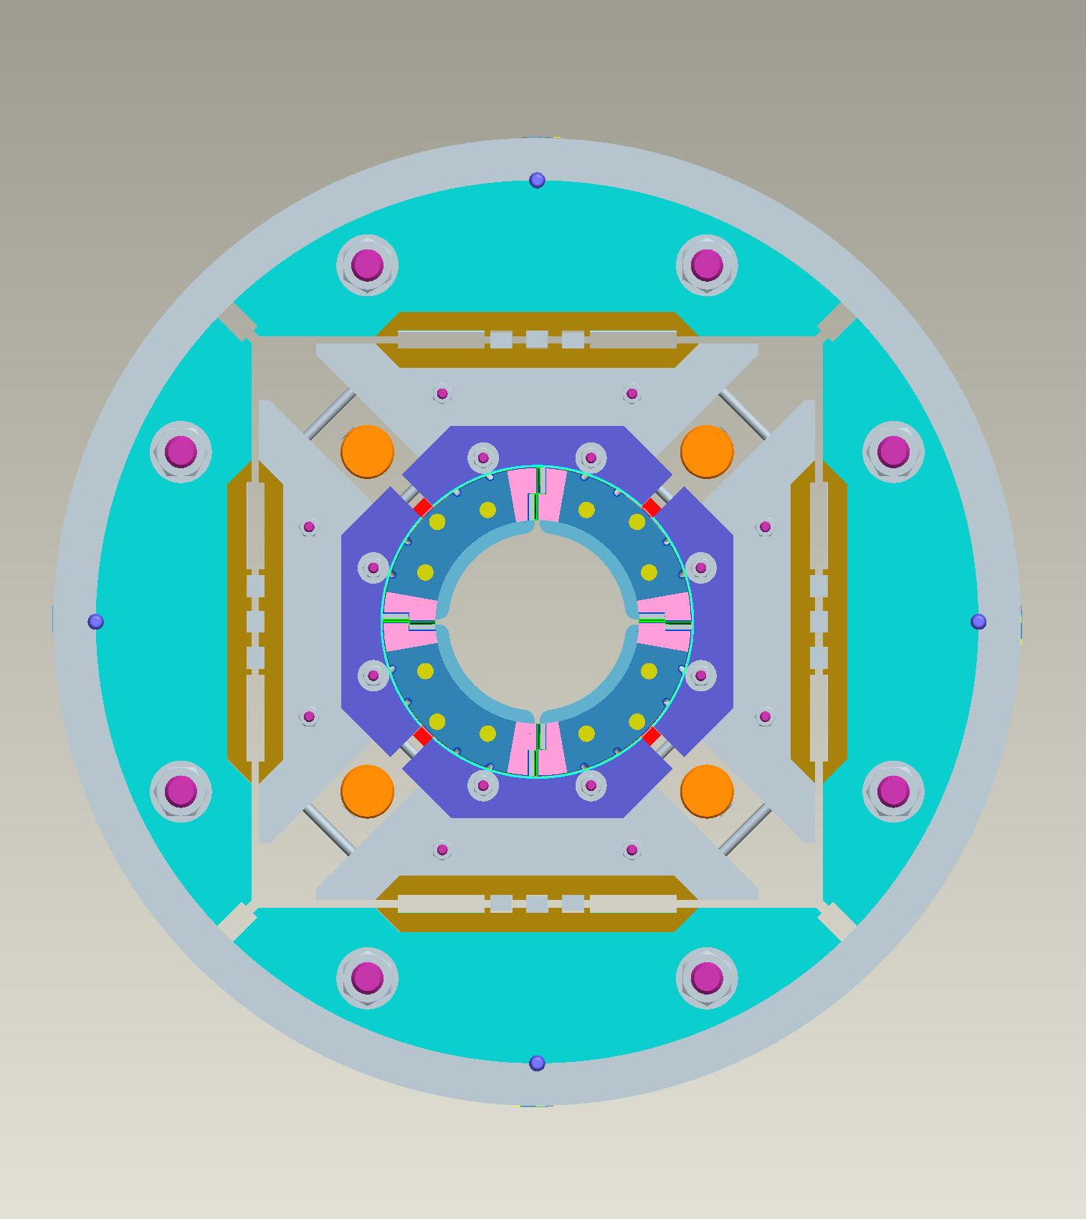
HQ02 layout
VIEW LOOKING AT
LEAD END
“New” generation of HQ coils:
  Coil 15, 16, 17 and 20
  108/127 conductor
  SS core
  14.77 mm x 1.376 mm smaller cable
  1 spare coil in fabrication: coil 21
See Franck Borgnolutti’s talk about HQ coil fabrication experience
Electrical sequence:
  (-) 16 – 17 – 15 – 20 – (+)
A
Sector D
Sector A
COIL 17
COIL 20
D
B
COIL 16
COIL 15
Sector C
Sector B
C

Slide 5
HQ02 magnet parameters
Based on extracted strands measurements from BNL and LBNL
Coil 15, 16, 17 and 20 => 17 is the limiting coil
Jc values at 12 T and 4.2 K with SF correction range from 2914 to 3098 A/mm²
 | HQ01e |  | HQ02
 | 4.3 K | 1.9 K | 4.5 K | 1.9 K
Typical I_{ss} | 17.3 kA | 19 kA | 16.5 kA | 18.26 kA
Gradient at I_{ss} | 195 T/m | 213 T/m | 186 T/m | 205 T/m
Peak Field at I_{ss} | 13.6 T | 14.8 T | 13 T | 14.2 T
Stored energy at I_{ss} | 0.9 MJ | 1.1 MJ | 0.8 MJ | 1 MJ
Fx per octant per unit length at I_{ss} | 2.7 MN/m | 3.15 MN/m | 2.4 MN/m | 2.9 MN/m
Fy per octant per unit length at I_{ss} | -3.9 MN/m | -4.7 MN/m | -3.5 MN/m | -4.3 MN/m
Fz per magnet end at I_{ss} | 1.06 MN | 1.28 MN | 0.96 MN | 1.18 MN

Slide 6
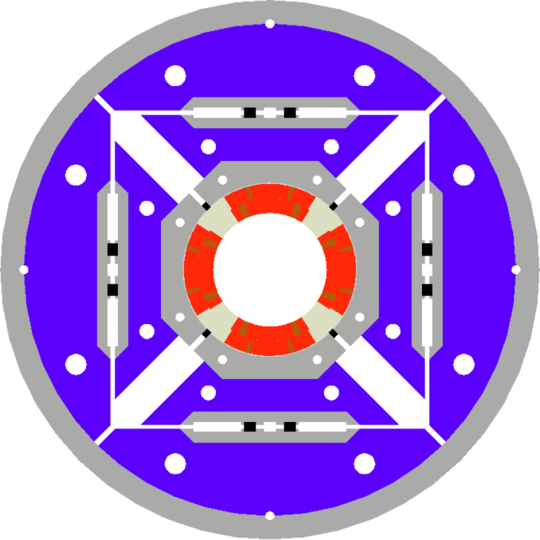
Structure and assembly steps overview
Collar-pack assembly
4 collars bolted against the full length G10 keys
Shimming of the alignment key to ensure contact between collar and keys
Coil-pack assembly
4 pads bolted around the collars
Final assembly and loading
Master/bladders and Keys stack is prepared based on coil-pack assembly
Insertion of the coil-pack in the yoke shell sub-assembly by sliding on the bottom masters
Insertion of the side and top masters
Masters include load keys and bladders + pull shims
Key parameters we watched
Preload distribution
Alignment: collar and key must be in contact
Preload uniformity among coils
Coil-pack assembly
Collar pack assembly
Bladder slot
Master

Slide 7
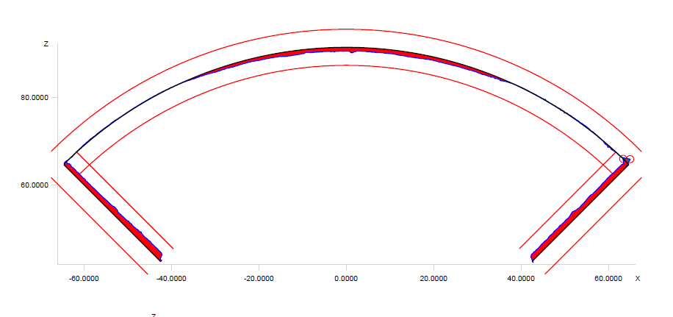
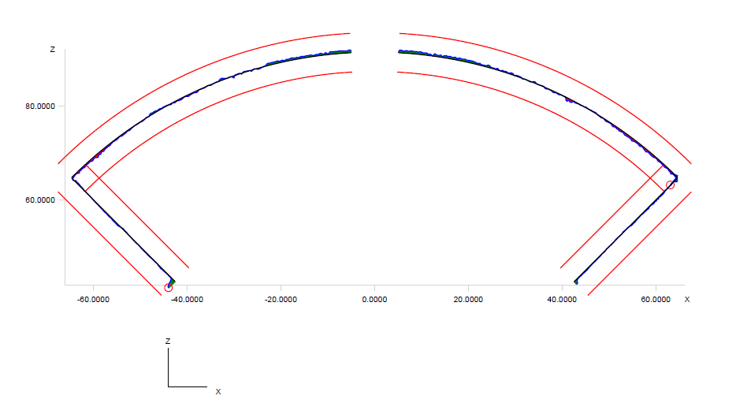
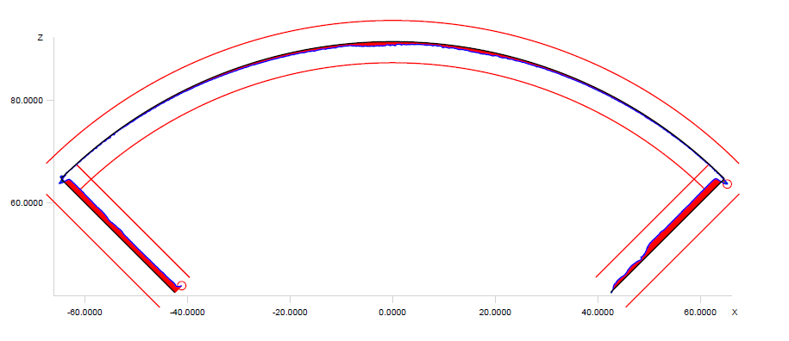
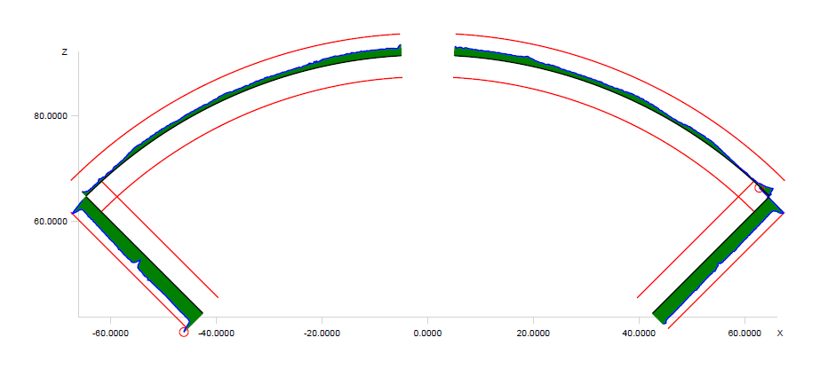
Preload uniformity
Coil Dimensions (LBNL CMM)
Example of HQ 17 “new generation”
+250 μm
~ 0.010”
C17 LE
C17 660 mm from LE
New coils much closer to nominal size
End-shoe shows same dimension
Example of HQ 11 “old generation”
C11 LE
C11 660 mm from LE

Slide 8
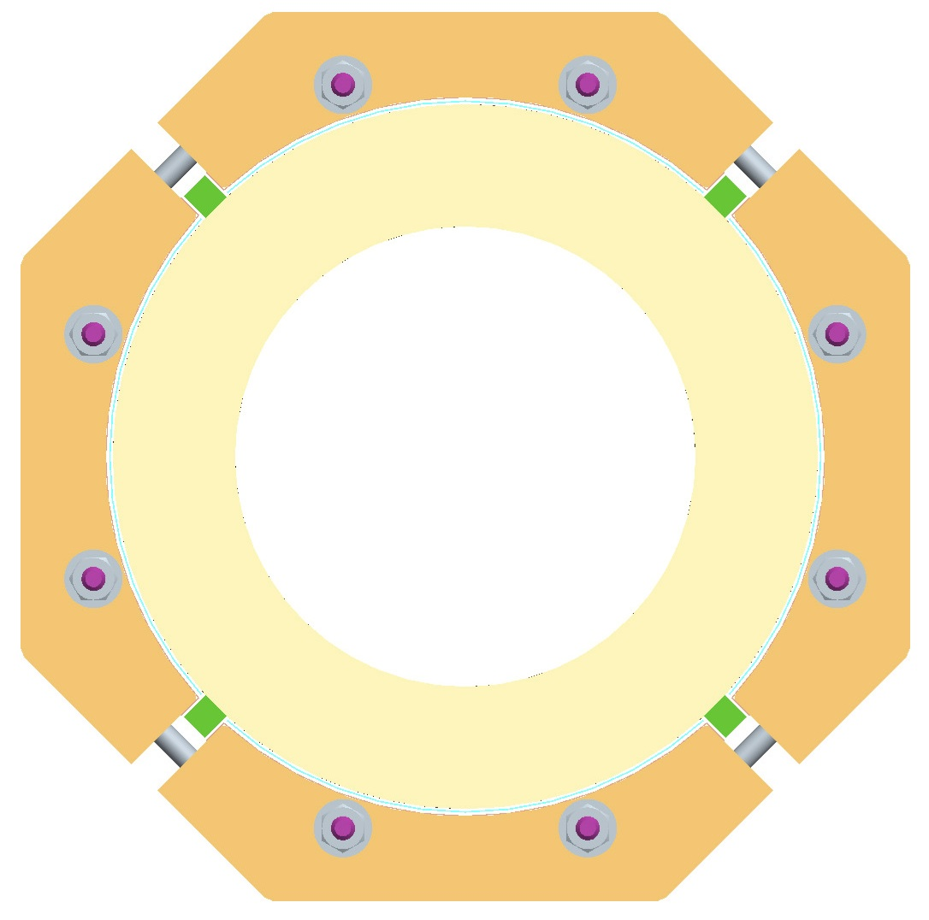
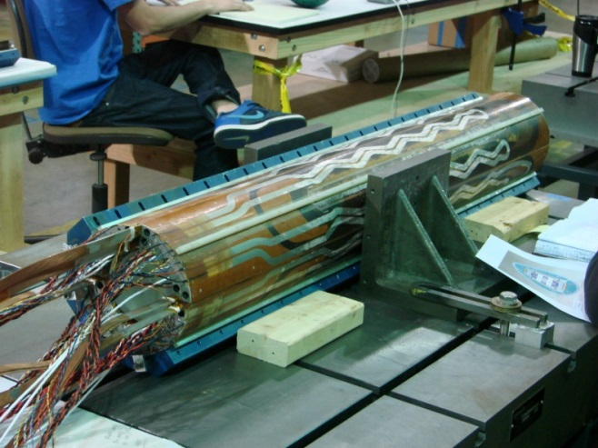
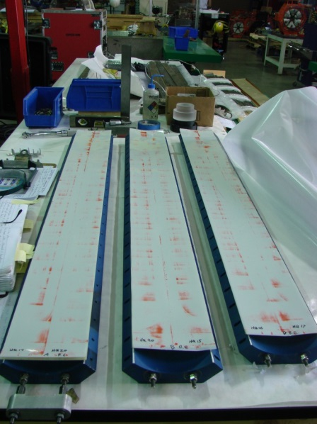
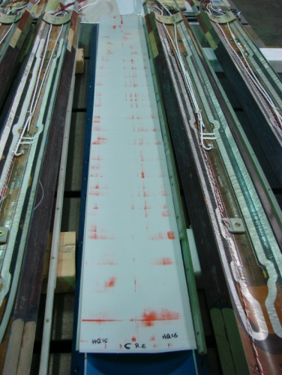
Preload uniformity
Fuji paper test
Collar-pack #1 used to assess radial shimming
A
Radial shims chosen based
on coil CMM measurements
Fuji paper positioned radially
Strain Gauge monitoring
C17
C20
D
B
C16
C15
C
B
D
C
A
Led to ground plane insulation scheme
  G10: 500 μm
  Kapton: 250 μm
  Effective stack: 700 μm

Slide 9
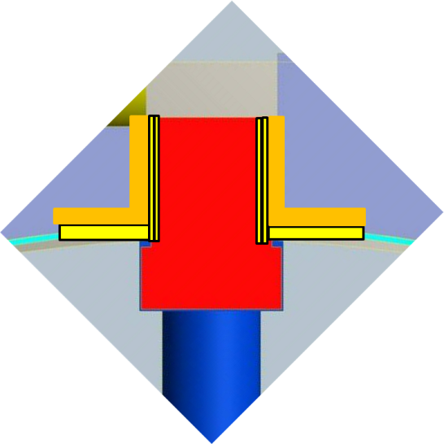
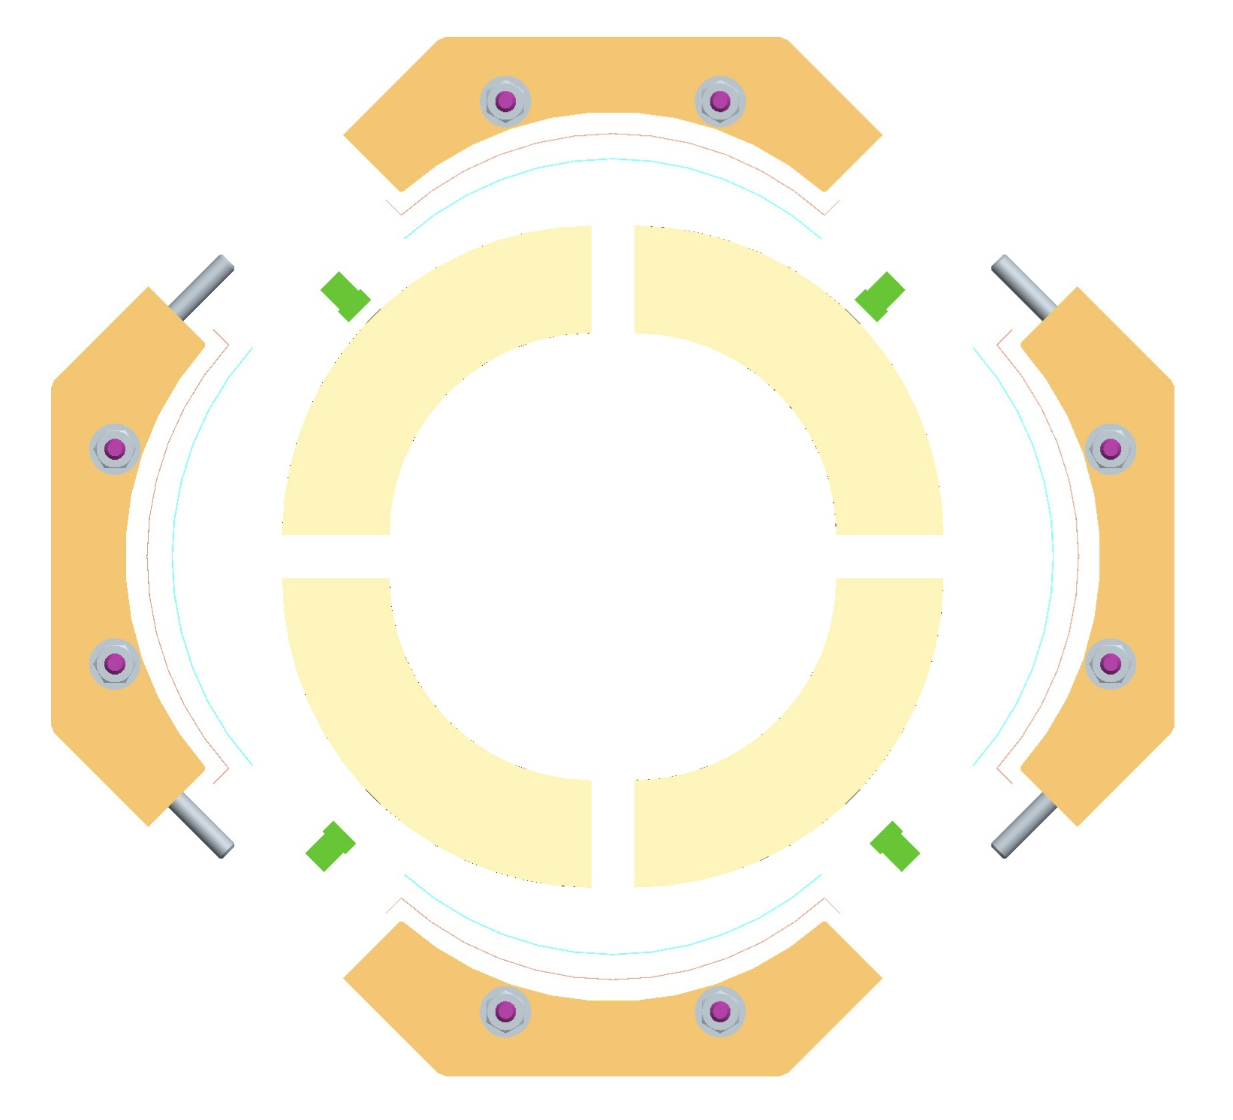
Alignment
A
Collar-pack #2 and 3# used to assess pole key shimming
G10 shims and Kapton wrap
C17
C20
D
B
C16
C15
C
Measurements with pins and feeler gauges to insure contact between keys and collars

Slide 10
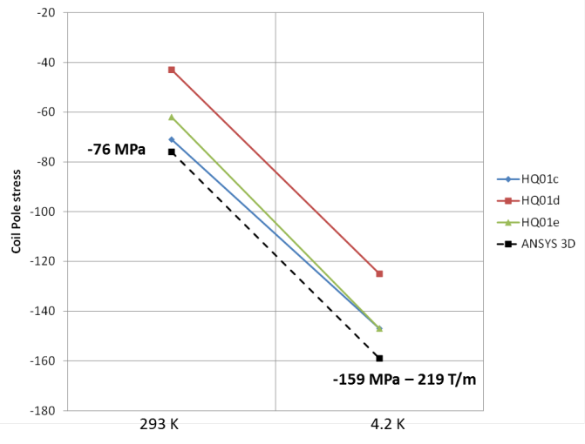
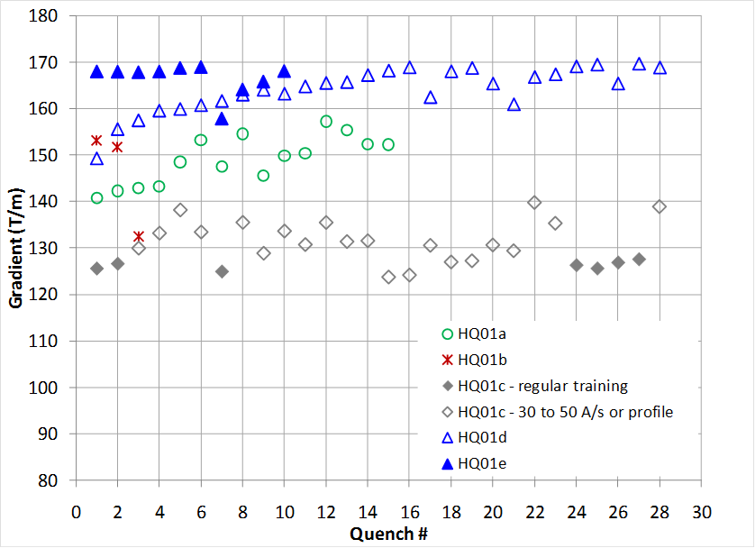
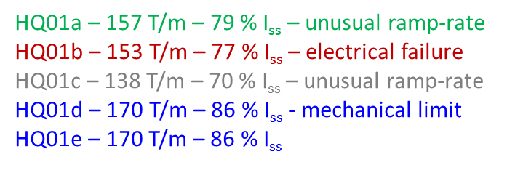
Preload
Motivation for conservative targets
Azimuthal preload
Preload for ~ 200 T/m
Target Preload at 300 K:
εθ shell / pole = 863 με / -450 με
σθ shell / pole = 66 /-63 MPa
Target Preload at 4.2 K:
εθ shell / pole = 1905 με / -720 με
σθ shell / pole = 169 / -147 MPa
 | 4.5 K | 1.9 K
Fz | 0.96 MN | 1.18 MN
Axial preload
Axial preload target:
~ 560 kN of axial preload
~ 58% of Fz at 4.5 K
~ 47 % of Fz at 1.9 K
~ 70 % of Fz at 15 kA
From Modeling point of view
Layer 1 (35 % of the total end force):
Contact pressure maintained >0 up to 219 T/m
Layer 2 (65 % of the total end force):
Contact pressure maintained >0 up to 180 T/m

Slide 11
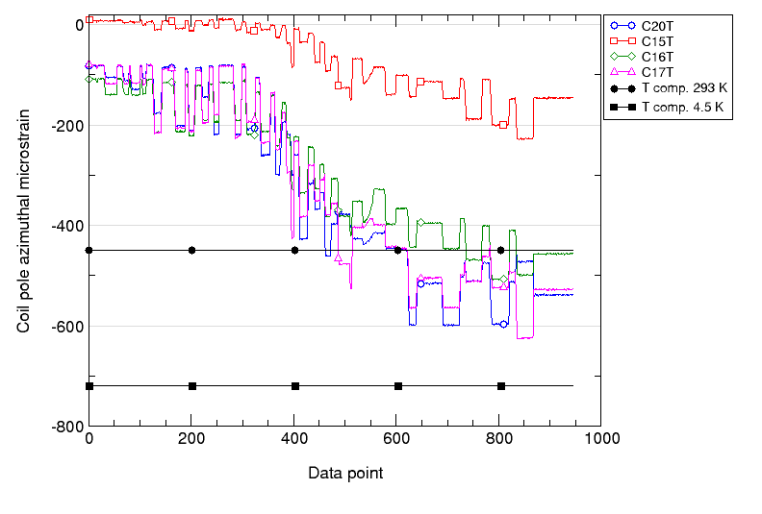
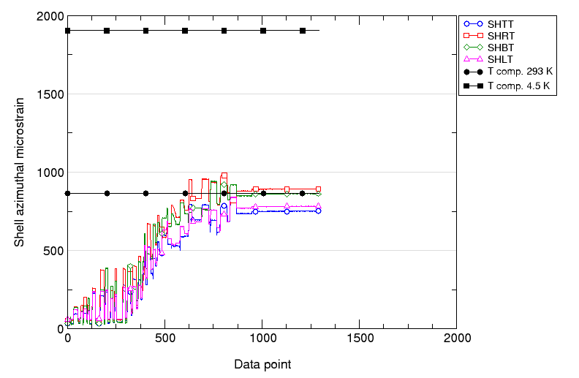
Preload
Strain gauge data – Coil Pole and Shell
Coil pole
Target: -450 με
Avg: -403 με
sigma: 181 με
Target: -63 MPa
Avg: -54 MPa
Sigma: 25 MPa
Coil 15 already tested
Shell
Target: 860 με
Avg: 822 με
sigma: 66 με
Target: 66 MPa
Avg: 68 MPa
Sigma: 6.6 MPa

Slide 12
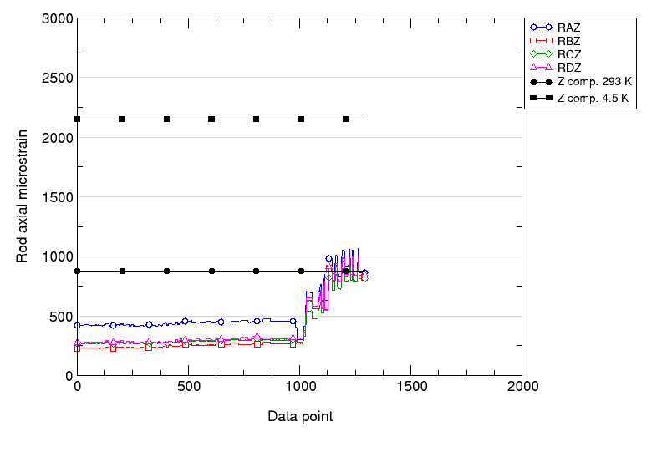
Preload
Strain gauge data - Rods
Rods
Target: 880 με
Avg: 833 με
sigma: 23 με
Target: 60 MPa
Avg: 58.5 Mpa
Sigma: 1.5 MPa

Slide 13
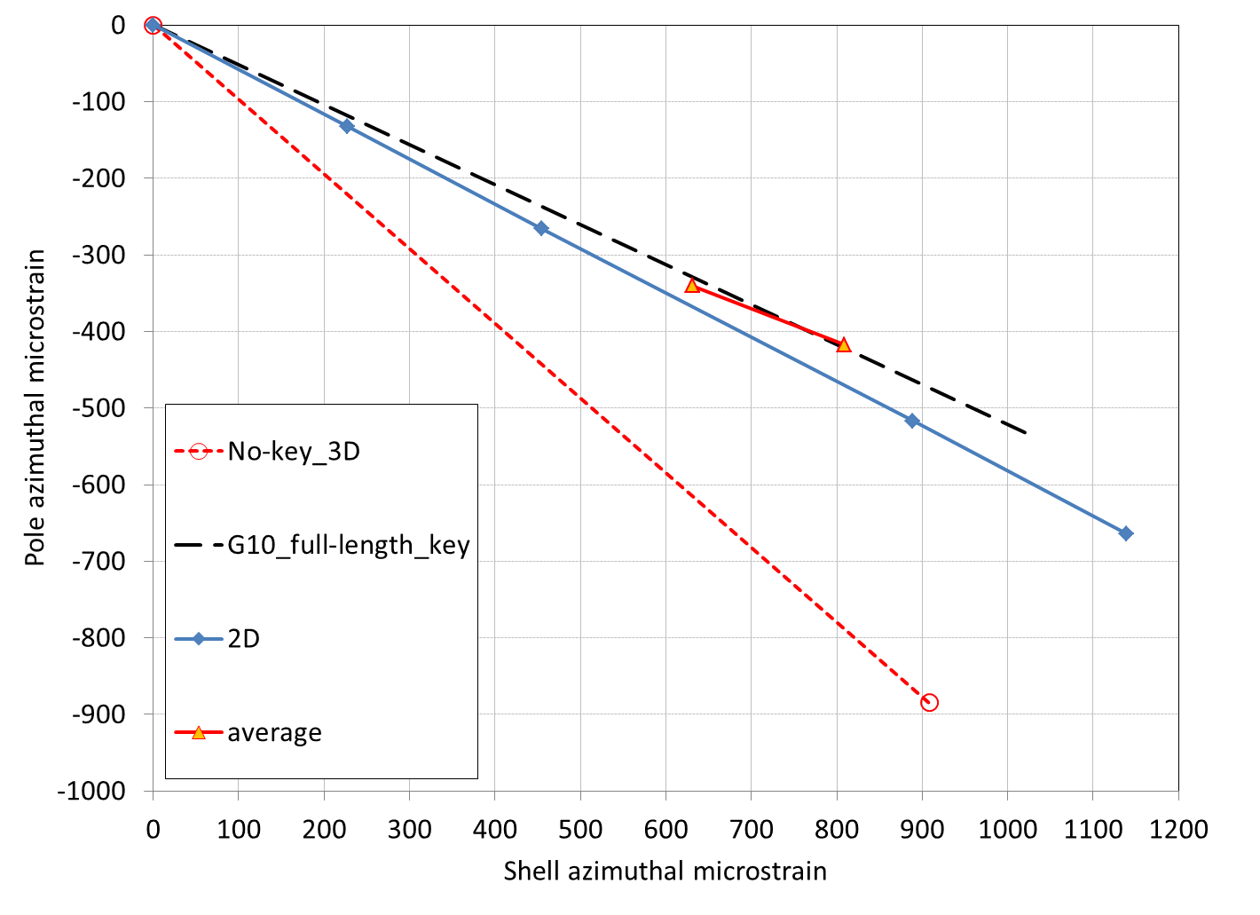
Comparison with Model

Slide 14
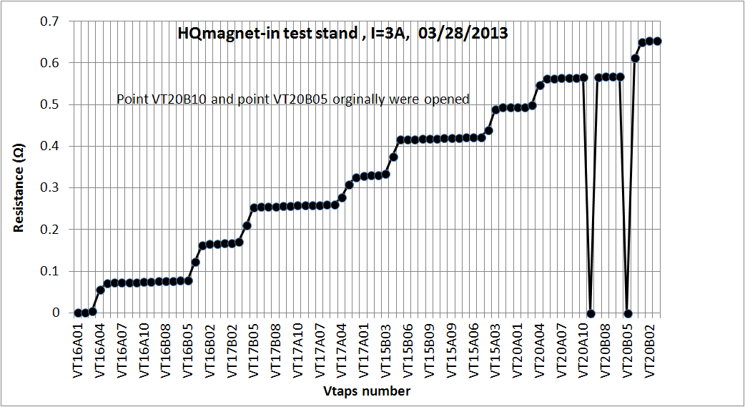
Electrical QA
Electrical QA performed at various steps of the assembly
Final Electrical QA before shipping to FNAL
Sequential R measurements
Hipot
  1000V coil to components
  500 V components to components
  All coils good to target except
    HQ17 LE IL endshoe to IL PH
    HQ16 LE IL / OL endshoe
Impulse test to 1000 V

Slide 15
Next steps
HQ02 test
Timeline
HQ02 delivered at FNAL April 2nd 2013
Strain gauges reading check April 4th 2013
Magnet delivery to MTF April 9th 2013
Tentative date for cool-down start Mid April 2013
Test set-up
1.9 K – 15 kA header will be used to give priority to 1.9 K testing
  90 % of I_{ss} at 4.5 K
  82 % of I_{ss} at 1.9 K
  169 T/m
  Consistent with conservative preload approach
Test plan
Under discussion
Will include: magnetic measurements, training, conservative protection study

Slide 16
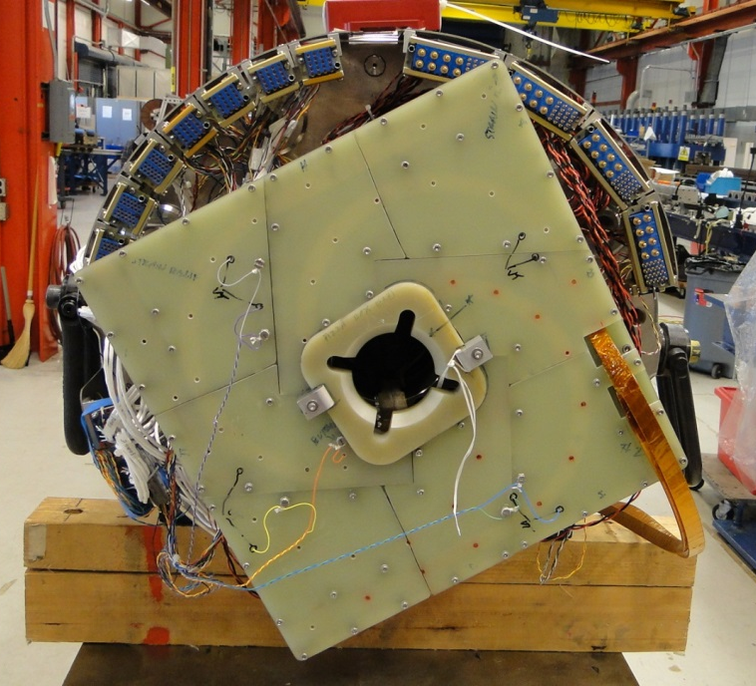
Post HQ02a test
Thermal cycle or HQ02b
If preload looks appropriate => thermal cycle
If preload too low or asymmetric
  Preload adjustment at LBNL => HQ02b
  New test at FNAL
More aggressive protection study
Spare coil 21 is also an option
HQ03:
Decision to be taken in 1 to 2 months regarding new series of coils
  Would implement last coil fabrication improvement (toward QXF)
    See Franck Borgnolutti’s talk
  Would test reproducibility in performance and field quality

Slide 17
For discussion…

Slide 18
HQ01 series Overview
HQ01a
HQ01b
HQ01c
HQ01d
HQ01e
Coils
Alignment
Test
1-2-3-4
No
April 2010
1- 4 -5-6
Yes
June 2010
1 -5-7-8
Yes
Oct. 2010
5-7-8-9
Yes
April 2011
5-7-8-9
Yes
July 2011
Summer 2012
Fall 2012
9 coils (54/61 or 108/127 RRP)
5 tests at 4.4 K at LBNL
HQ01a – 157 T/m – 79 % I_{ss} – unusual ramp-rate
HQ01b – 153 T/m – 77 % I_{ss} – electrical failure
HQ01c – 138 T/m – 70 % I_{ss} – unusual ramp-rate
HQ01d – 170 T/m – 86 % I_{ss} - mechanical limit
HQ01e – 170 T/m – 86 % I_{ss}

Slide 19
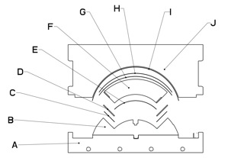
Accounting for azimuthal and radial changes: test coils
0.25 mm glass
0.25 mm Mica
Reaction Liner
Increase of the azimuthal space in the cavity
Still high radial compaction
0.25 mm glass
Reaction block
Coil 12 – 54/61 – cored cable
By adjusting mid-plane shimming
average of 3 % per turn of additional space
assembled and tested in HQM01
Limited by mid-plane turn
Improved performance at 150 A/s => 82 % Iss
1.5 mm
SS shim
0.125 mm mica shim
Reaction Mandrel block
Rodger Bossert - Poster - 4AP2-4
Coil 13 – 54/61
By removing the mid-plane turn in both layers
Average of 5 % per turn of additional space
Assembled in HQM02
91% Iss 4.6 K
89% Iss at 1.9 K

Slide 20
New series of coils
Coil 10 => reaction issue – broken strand
Coil 11 => ok but not tested
Coil 12 = > special coils
Coil13 => special coils
New generation with smaller cable
Coil 14 => rejected for electrical reason
Coil 15 => HQM04 (97 % Iss at 4.6 K) and HQ02
Coil 16 => HQ02
Coil 17 => HQ02
Coil 18 => aborted at the winding stage
Coil 19 => aborted at the winding stage
Coil 20 => HQ02
Total coils to consider: 20 coil – 2 special coils = 18 coils
Effectively rejected without test: 4 coils (#10,14)
Coil with electrical issues: 1 coil (#6)
Rate of true rejection = 17 %
Improvements made along the way

