Slide 1
3D magnetic analysis and coil end design
Susana Izquierdo Bermudez
Joint LARP CM20/Hi-Lumi Annual Meeting
Napa Valley, 8-10 April 2013

Slide 2
Outline
Design objectives & variables
Strain energy minimization
Peak field minimization
Field quality
Summary
OPERA model
SQXF baseline design

Slide 3
Outline
Design objectives & variables
Strain energy minimization
Peak field minimization
Field quality
Summary
OPERA model
SQXF baseline design

Slide 4
1. Design objectives
Minimize the strain energy on the cable
Minimize the peak field
Minimize the multipole content of the integrated field
First optimization of parameters that mainly affect to the strain energy on the cable
Optimization of parameters that mainly affect to peak field and field harmonics
Re-optimization of parameters that mainly affect to the strain energy on the cable
Ellipticity, β , H_{order}
Number of blocks, distribution of the conductors, z
Ellipticity, β , H_{order}
General remark: Study performed based on MQXF CERN cross-section
4

Slide 5
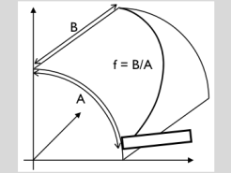
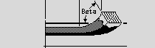
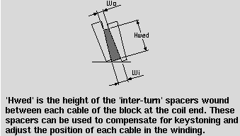
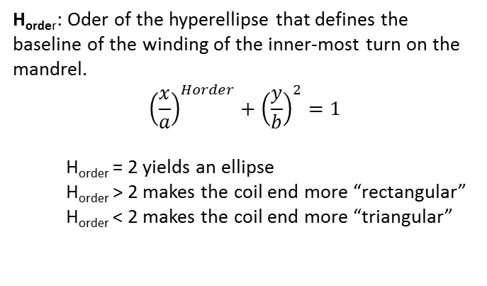
1. Design variables: ROXIE input parameters
Mechanical optimization by differential geometry methods
β : turn’s inclination angle at the nose of the bend (in the yz-plane)
f: ellipticity of the coil-end baseline
z_{o}: z position of the first conductor on the free edge curve
z_{o}
Inter-turn spacers to simulate the deformation of the cable on the ends
H_{order}: Oder of the hyperellipse that defines the baseline of the winding of the inner-most turn on the mandrel.
$${\left(\frac{x}{a}\right)}^{Horder}+{\left(\frac{y}{b}\right)}^{2}=1$$
  H_{order} = 2 yields an ellipse
  H_{order} > 2 makes the coil end more “rectangular”
  H_{order} < 2 makes the coil end more “triangular”
(taking as reference values used for MQXC, to be updated after winding tests)

Slide 6
Outline
Design objectives & variables
Strain energy minimization
Peak field minimization
Field quality
Summary
OPERA model
SQXF baseline design

Slide 7


2. Strain energy minimization (1/2)
Strain energy in a block is defined as
where fτ,fn,fg, are the flexural rigidities, and τ, κn, κg are the torsion, normal curvature and geodesic curvature.
Normal curvature = easy-way bend (inverse of bending radius).
Geodesic curvature = hard-way bend (inverse of bending radius).
Main objective: minimize hard-way bend squared over entire block
Ref: Coil end design of superconducting magnets applying differential geometry methods.
Bernhard Auchmann & Stephan Russenschuck

Slide 8
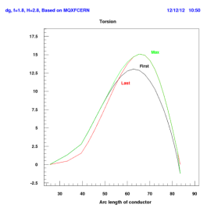
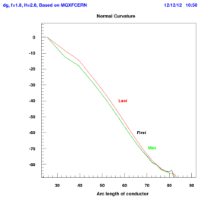
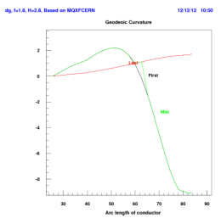
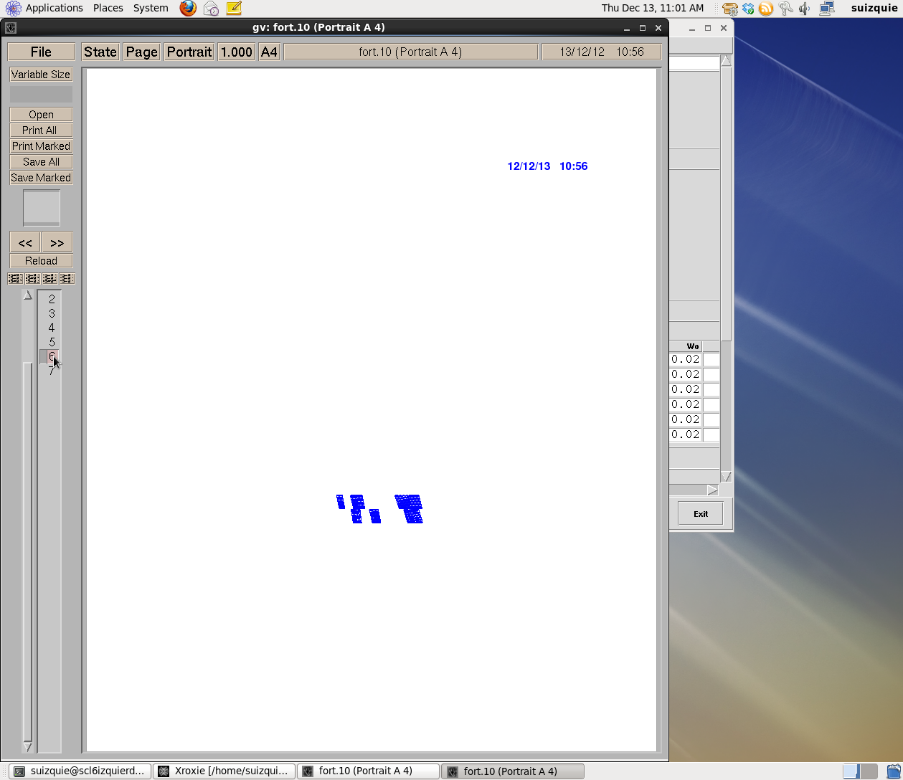
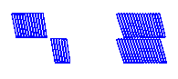
2. Strain energy minimization (2/2)
Variables to optimize: ellipticity, β, H_{order} and additional torsion
Example of the torsion, normal curvature (soft-way bend) and geodesic curvature (hard-way bend) for the first block to wind in the inner layer.
Selected parameters:
4
3
4.b
4.a
3
2
1
2
1.b
1.a
 | Inner |  | Outer
Block # | 2 | 1 | 4 | 3
β | 80 | 72 | 78 | 72
f | 1.8 | 1.9 | 1.8 | 2
Horder | 3 | 2.8 | 3 | 2.8
 | inner |  |  | Outer
Block # | 2 | 1.b | 1.a | 4.b | 4.a | 3
β | 81 | 77 | 72 | 78 | 77 | 72
f | 1.8 | 1.9 | 2 | 1.8 | 1.9 | 2
Horder | 2.8 | 2.8 | 2.8 | 2.8 | 2.8 | 2.8

Slide 9
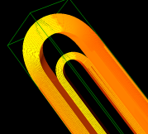
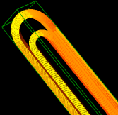
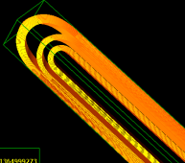
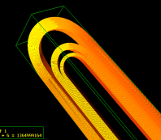
2. Strain energy minimization (3/3)
4
3
4.b
4.a
3
2
1
2
1.b
1.a
Block | Max. Hard-Way Bending (κ_{g})(1/m) | Int .κ_{g}² over Block
1.a | 8.7 | 8.4
1.b | 8.5 | 7
2 | 11.3 | 2.2
3 | 10.3 | 15.1
4.a | 7 | 1.8
4.b | 8.7 | 0.2
Block | Max. Hard-Way Bending (κ_{g})(1/m) | Int .κ_{g}² over Block
1 | 13.6 | 22.5
2 | 9.1 | 1.2
3 | 9.8 | 17.7
4 | 12.6 | 6.4

Slide 10
Outline
Design objectives & variables
Strain energy minimization
Peak field minimization
Field quality
Summary
OPERA model
SQXF baseline design

Slide 11
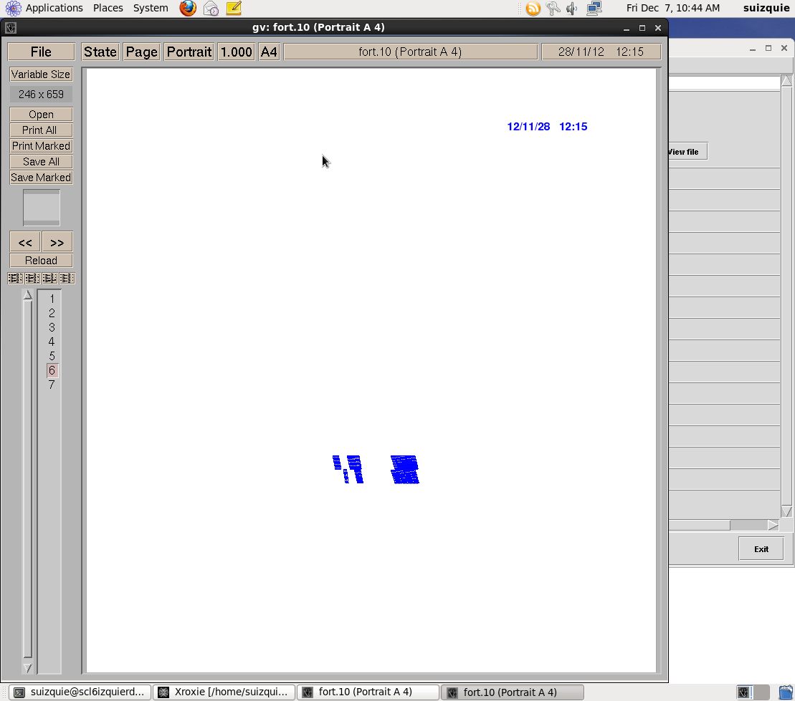
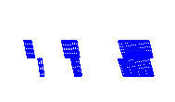
3. Peak field minimization (1/3)
Divide the blocks to minimize the peak field
4 Blocks
6 Blocks
117 mm
117 mm
vs10
vs5
Influence of the iron not considered
ΔBp = +5%
ΔBp = +2%
Increase the length of the ends
117 mm
135 mm
vs5
vs11
ΔBp = +2%
ΔBp = +1%
Influence of the iron not considered

Slide 12
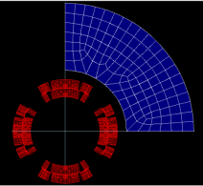
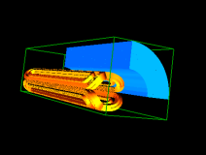
3. Peak field minimization (2/3)
Remove magnetic iron at the ends
  Yoke simplified by a ring
  Rin = 133 mm; Rout = 279 mm
  Cable simplified (1x4 strands, instead of 2x20)
Peak field straight section = 12.13 T
Yoke extension
Magnetic yoke extension: z = 500

Slide 13
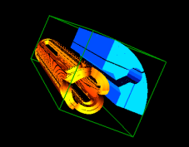
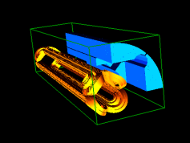
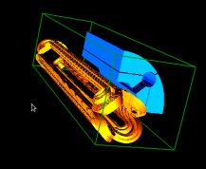
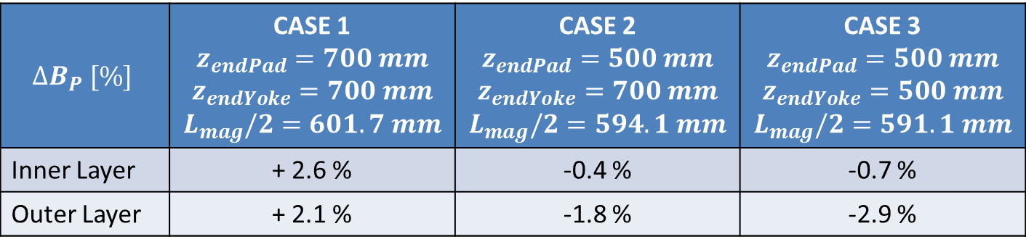
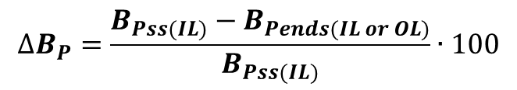
Impact of the yoke cutback on the peak field (6 Blocks case)
3. Peak field minimization (3/3)
$$∆B_{P} [\%]$$ | CASE 1 $$z_{endPad}=700 mm$$ $$z_{endYoke}=700 mm$$ $$L_{mag}/2=601.7 mm$$ | CASE 2 $$z_{endPad}=500 mm$$ $$z_{endYoke}=700 mm$$ $$L_{mag}/2=594.1 mm$$ | CASE 3 $$z_{endPad}=500 mm$$ $$z_{endYoke}=500 mm$$ $$L_{mag}/2=591.1 mm$$
Inner Layer | + 2.6 % | -0.4 % | -0.7 %
Outer Layer | + 2.1 % | -1.8 % | -2.9 %
$$∆B_{P}=\frac{B_{Pss(IL)}−B_{Pends(IL or OL)}}{B_{Pss(IL)}}∙100$$

Slide 14
Outline
Design objectives & variables
Strain energy minimization
Peak field minimization
Field quality
Summary
OPERA model
SQXF baseline design

Slide 15
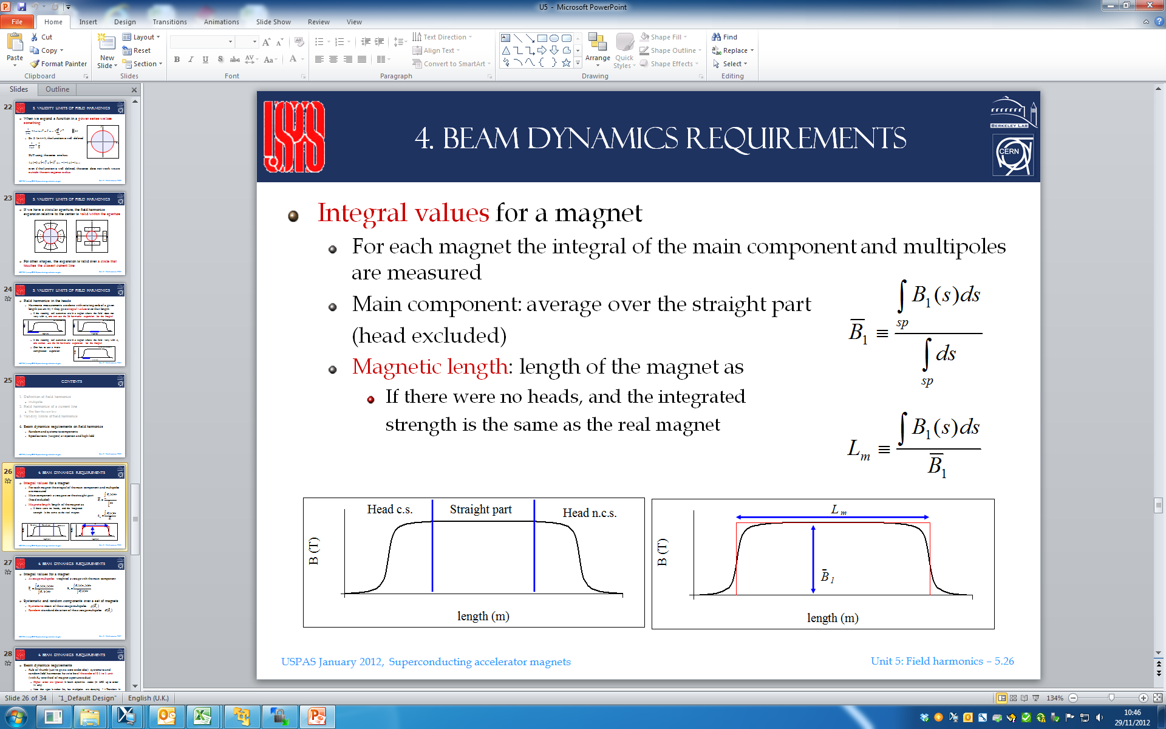
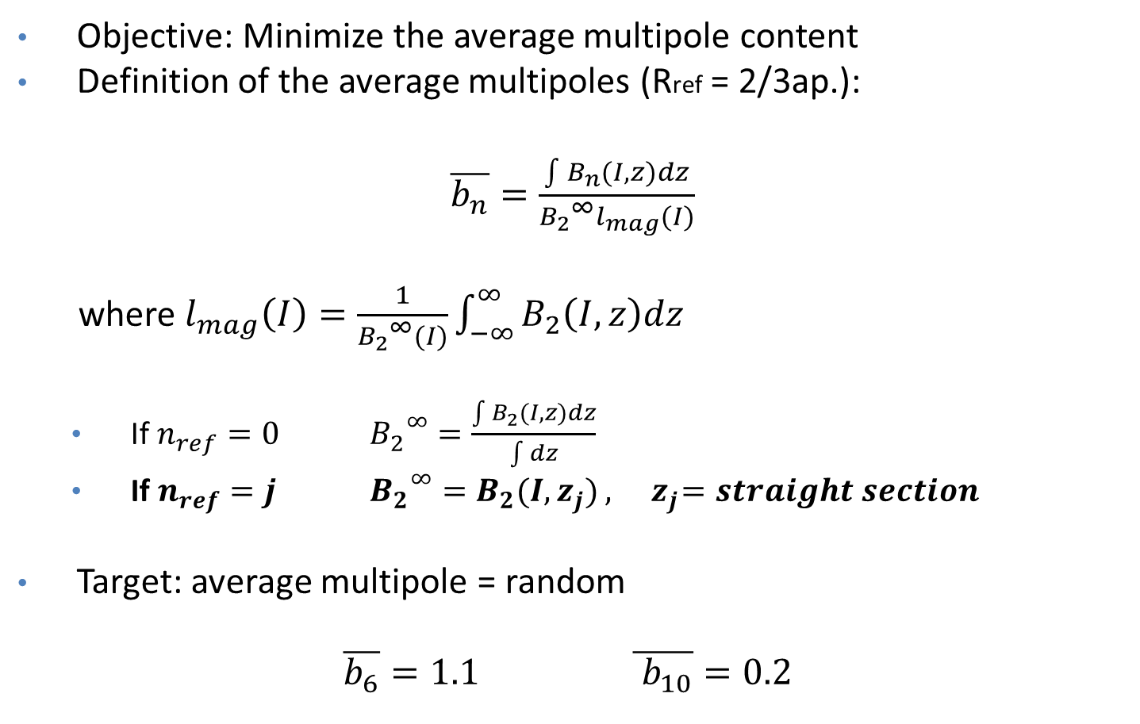
4. Field quality (1/3)
Objective: Minimize the average multipole content
Definition of the average multipoles (Rref = 2/3ap.):
$\overline{b_{n}}=\frac{\int{B_{n}(I,z)dz}}{{B_{2}}^{∞}l_{mag}(I)}$
where $l_{mag}\left(I\right)=\frac{1}{{B_{2}}^{∞}(I)}\int_{−∞}^{∞}{B_{2}\left(I,z\right)dz}$
  If $n_{ref}=0$ ${B_{2}}^{∞}=\frac{\int{B_{2}(I,z)dz}}{\int{dz}}$
  If $n_{ref}=j$ ${B_{2}}^{∞}=B_{2}(I,z_{j})$ $,{ z}_{j}=straight section$
Target: average multipole = random
$$\overline{b_{6}}=1.1 \overline{{ b}_{10}}=0.2$$
zj
z

Slide 16
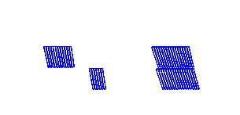
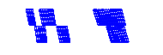
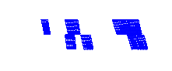
4. Field quality (2/3)
Influence of the iron not considered
4 Blocks
6 Blocks
117 mm
135 mm
vs10
vs3
b6 = -1.27; b10=-0.55
b6 = 0.19; b10=-0.61
118 mm
135 mm
vs13
vs8
b6 = 0.26; b10=-0.07
b6 = 0.07; b10=-0.03
*Assuming a magnetic length of 4m

Slide 17

4. Field quality (3/3)
 |  |  | Harmonic Analysis 3D |  |  | Harmonic Analysis 2D
 |  |  | Lm | b6 | b10 | b6 | b10
Cable simplified (1x4 strands) | Impact of the coil end z=[400-700] mm | 4 Blocks | 194 | -10.59 | -4.94 | 0.14 | 0.46
 |  | 6 Blocks |  | -9.70 | -1.52
 | SQXF | 4 Blocks | 1188 | -3.17 | -1.29
 |  | 6 Blocks |  | -2.88 | -0.18
 | LQXF | 4 Blocks | 4000 | -0.68 | -0.12
 |  | 6 Blocks |  | -0.60 | 0.21
Real strand (2x20) |  |  |  |  |  | -0.37 | 0.36
Configuration
Magnetic yoke z = [0-700] mm
Magnetic pad z = [0-500] mm
Non-magnetic pad z = [500-700] mm
Remarks:
b6 can be “easily” tuned for the 4-Blocks and 6-Blocks options
b10 can be “easily” tuned only for the 6-Blocks option

Slide 18
Outline
Design objectives & variables
Strain energy minimization
Peak field minimization
Field quality
Summary
OPERA model
SQXF baseline design

Slide 19

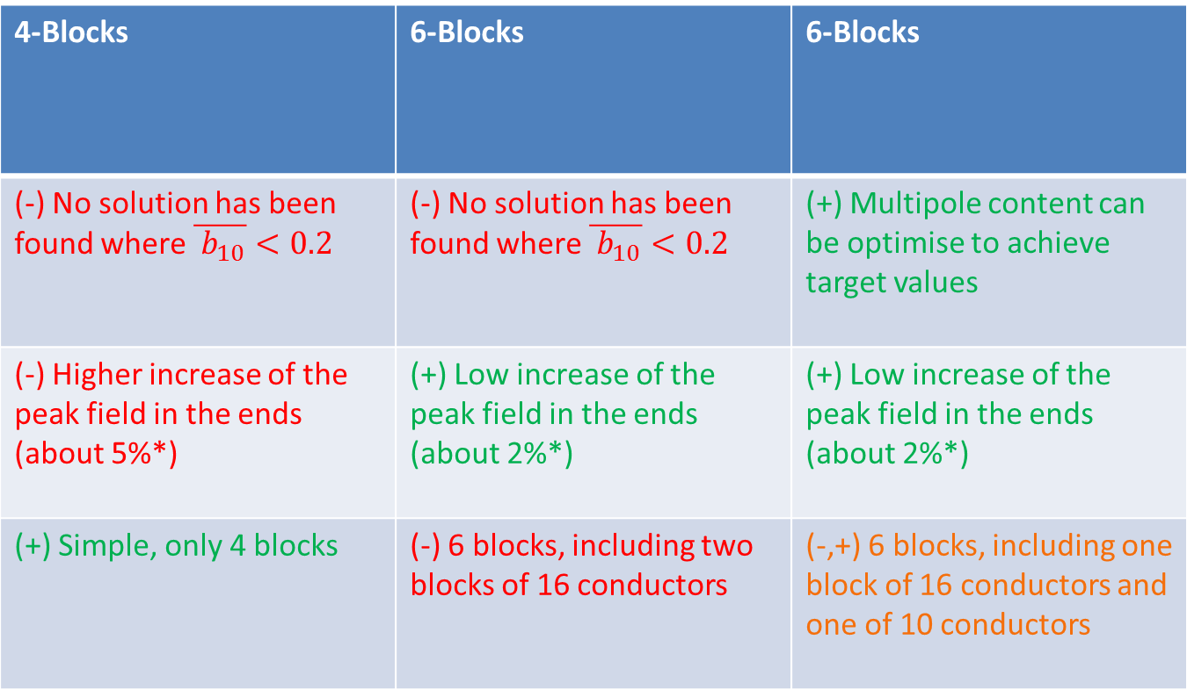
5. Summary
4-Blocks | 6-Blocks | 6-Blocks
(-) No solution has been found where $\overline{{ b}_{10}}<0.2$ | (-) No solution has been found where $\overline{{ b}_{10}}<0.2$ | (+) Multipole content can be optimise to achieve target values
(-) Higher increase of the peak field in the ends (about 5%*) | (+) Low increase of the peak field in the ends (about 2%*) | (+) Low increase of the peak field in the ends (about 2%*)
(+) Simple, only 4 blocks | (-) 6 blocks, including two blocks of 16 conductors | (-,+) 6 blocks, including one block of 16 conductors and one of 10 conductors
*without considering the reduction when removing magnetic pad/yoke at the ends

Slide 20
Outline
Design objectives & Variables
Strain energy minimization
Peak field minimization
Field quality
Summary
OPERA Model
SQXF baseline design

Slide 21
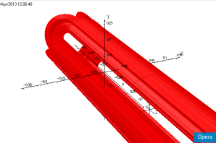
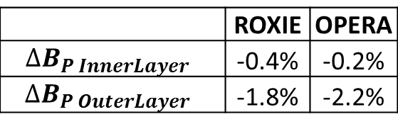

6. OPERA model
Good agreement between OPERA and ROXIE model
Differences on peak field ≈ 0.2 T
For the baseline design…
 | ROXIE | OPERA
$$∆B_{P InnerLayer }$$ | -0.4% | -0.2%
$$∆B_{P OuterLayer }$$ | -1.8% | -2.2%
$$∆B_{P(IL or OL)}=\frac{B_{Pss(IL)}−B_{Pends(IL or OL)}}{B_{Pss(IL)}}∙100$$
Average multipole content:

Slide 22
Outline
Design objectives & Variables
Strain energy minimization
Peak field minimization
Field quality
Summary
OPERA Model
SQXF baseline design

Slide 23
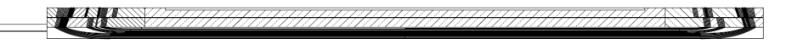
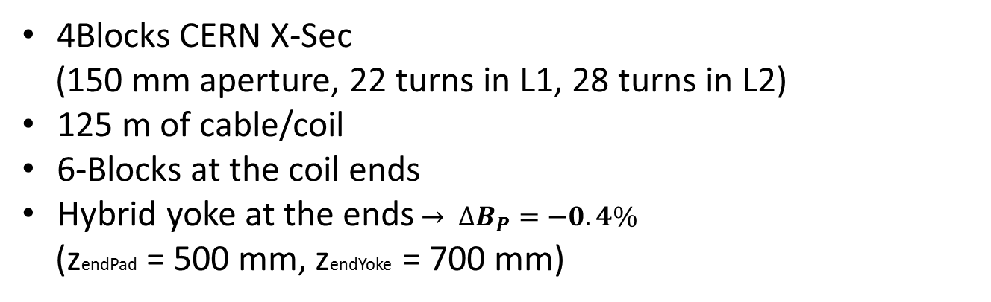
7. SQXF baseline design
4Blocks CERN X-Sec
(150 mm aperture, 22 turns in L1, 28 turns in L2)
125 m of cable/coil
6-Blocks at the coil ends
Hybrid yoke at the ends$→ ∆B_{P}=−0.4\%$
(zendPad = 500 mm, zendYoke = 700 mm)
End of the conductor: 651 mm
Magnetic length: 594 mm
Good Field Region: 400 mm
118 mm
57mm
251 mm

Slide 24
Additional slides

Slide 25
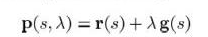
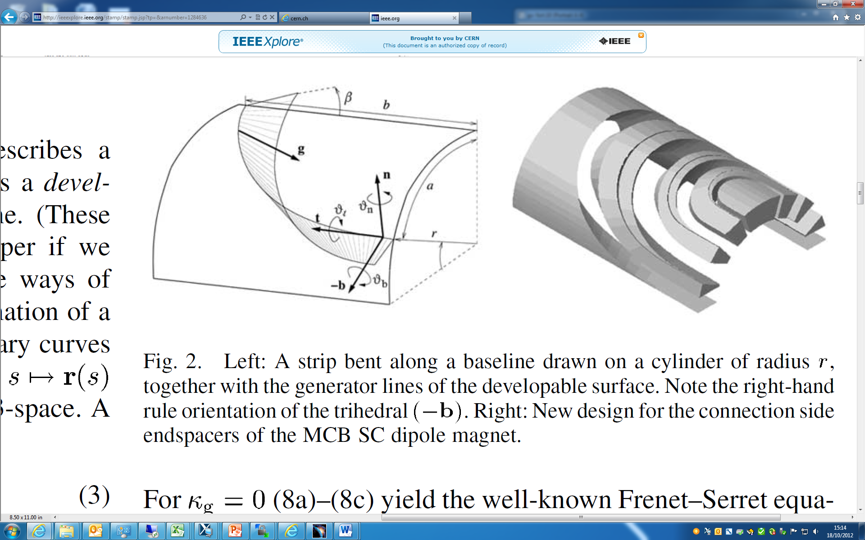
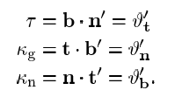
Differential geometry ends
g: Generator vectors (ruling)
t: Tangent vector
n: Normal vector
b: bi-normal vector
Trihedral
Curvature parameters:

Slide 26
“Equivalent” BEND parameters
Selected parameters:
vs10
 |  | ROXIE INPUT |  |  |  | BEND INPUT
Block | # conductors | z (mm) | beta | f | Horder | A-lenght (mm) | Straight part (mm) | angle
2 | 6 | 557 | 80 | 1.8 | 3 | 23.9 | 533.1 | 10
1 | 16 | 607 | 72 | 1.9 | 2.8 | 51.8 | 555.2 | 18
4 | 12 | 527 | 78 | 1.8 | 3 | 34.8 | 492.2 | 12
3 | 16 | 607 | 72 | 1.9 | 2.8 | 80.9 | 526.1 | 18
4
3
2
1
vs12
 |  | ROXIE INPUT |  |  |  | BEND INPUT
Block | # conductors | z (mm) | beta | f | Horder | A-lenght (mm) | Straight part (mm) | angle
2 | 6 | 553 | 81 | 1.8 | 2.8 | 24.5 | 528.5 | 9
1.b | 6 | 578 | 77 | 1.9 | 2.8 | 53.6 | 524.4 | 13
1.a | 10 | 625 | 72 | 2 | 2.8 | 76.1 | 548.9 | 18
4.b | 4 | 533 | 78 | 1.8 | 2.8 | 34.8 | 498.2 | 12
4.a | 8 | 552 | 77 | 1.9 | 2.8 | 50.0 | 502.0 | 13
3 | 16 | 613 | 72 | 2 | 2.8 | 85.5 | 527.5 | 18
4.b
4.a
3
2
1.b
1.a

Slide 27
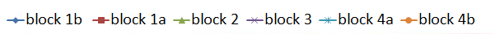
Sensibility analysis: impact of the block position on the average field harmonic (6 Blocks, vs12)
Lm = 194 mm

Slide 28
Impact of the yoke cutback on the peak field (6 Blocks, vs12)

Slide 29
Study of MQXF shimming
Per Hagen for the CERN MQXF team
(TE/MSC/MDT)
April 2013
Acknowledgement:
The study is using the basic ideas from shimming implemented in MQXC

Slide 30
Motivation
Shimming is a passive technique to reduce undesired field harmonics present in a magnet “as built”
Introducing geometric asymmetry in the material permeability around the coils, allows for correcting certain combinations of multipoles
The MQXC magnet uses two kinds of shimming for this purpose
  rods in the collars
  shims (small pieces removed from the iron yoke)
This MQXF study follows the MQXC ideas
ROXIE was used for the magnetic studies, and ANSYS was used for assessing side-effects on the mechanical structure (not part of this presentation)
Note! In this presentation, field harmonics are expressed with European notation.
That is, the main field of the quadrupole is B2

Slide 31
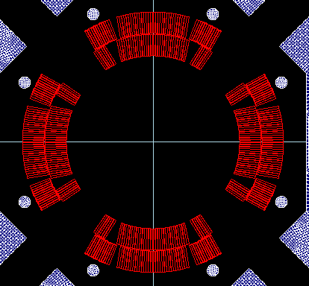
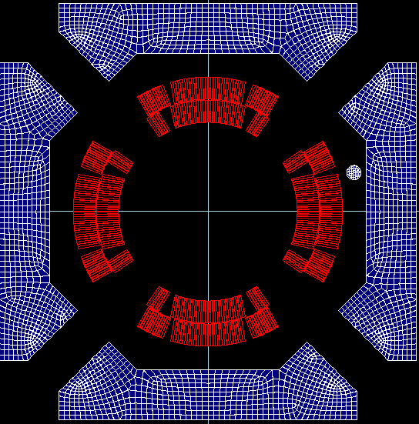
Rods
7
8
6
1
1
rrod
rodang
5
2
4
3
8 identical iron rods positioned symmetrically around the four poles
Parametric study of variation in multipoles as function of rod angle (rodang), radius (rrod) and current

Slide 32
Study of excitation current
Rod diameter 10 mm, angle 25 degrees, radius 123 mm
Correction strongly dependent upon excitation current
The relative permeability in the rods approach 1 at high current and the rods become transparent
Conclusion: Because of the stronger field in the MQXF coils, compared to MQXC, rods are not an interesting option (large field errors at low field, small corrections at nominal)

Slide 33
Shims
8 identical rectangular shims positioned symmetrically around the four poles
Parametric study of variation in multipoles as function of size and current
Note: The iron yoke in this study has fewer details compared to the today’s design. Since the effect of the shims are expressed as derivative (“effect with” minus “effect without”), this approximation is still good.

Slide 34
Study of excitation current
μ_{r,} B_{shim}
4000, 0.1 T
40, 0.35 T
15, 1.6 T
2, 2.0 T
1.4 > 2.5 T
Shim width 10 mm x 60 height mm
Nominal Gradient 140 T/m (17320 A)
  Harmonics expressed at Rref = 50 mm
Conclusion
The shim effect is small at low current, reaches a maximum and then fades away as the iron becomes transparent (behavior most pronounced in b3 and b4)

Slide 35
Interesting shims combinations
Notation: (+b5) means small b5
We assume that the most interesting shim combinations are the ones which correct as few multipoles as possible. That is, one or at most two.
We used a numeric code to try all combinations and the results is given in the table
It turns out that only a small subset of combinations of 4 shims (12 out of 70) gives the desired result
Example: Check that ROXIE agrees with linear combinations
We forgot to mention that for some 4 shims
combinations, there is a non-negligible dipole!

Slide 36
Conclusions
The shimming technique seems feasible for correcting one or two low-order multipoles (order 3 to 5)
The “rod in collar” technique used in MQXC does not seems interesting due to the stronger field
The study did not address the issue how to correct a given value of a multipole
The size of the shim sets upper limit on how much a given multipole can be corrected
Some shim combinations generate 25 units of dipole component (should be possible to correct using the nearest orbit corrector in the triplet)

Slide 37
Backup slides

Slide 38
Study of rod angle
Rod angle from 5 to 30 degrees in step of 1 degree
Parameters constant:
  Nominal Gradient 140 T/m (17320 A)
  Harmonics expressed at Rref = 50 mm
  Rod diameter 10 mm (equal MQXC)
  Rod radius 123 mm
  ROXIE: Use same BH-curve for rods as for yoke (BHiron1)
Field quality most important @ 7 TeV
Conclusions: Can essentially correct harmonics of order 3 to 5, depending upon sign. b3 and b4 correction weakly dependent upon rod angle

Slide 39
Study of rod radius
Rod radius from 122 to 125 mm in step of 1 mm
Parameters constant
  Nominal Gradient 140 T/m (17320 A)
  Harmonics expressed at Rref = 50 mm
  Rod diameter 10 mm (equal MQXC)
  Rod angle 25 degrees
  ROXIE: Use same BH-curve for rods as for yoke (BHiron1)
Conclusion: Correction weakly dependent on rod radius

Slide 40
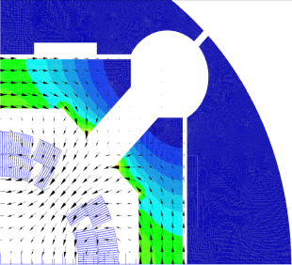
Study of shim size
Shim width x height
w
h
Shim position:
w “left”, h “centered”
Example: Results for b3 scan (sextupole)
Shim height from 30 to 90 mm in step of 10 mm
Shim width from 5 to 20 mm in step of 5 mm
Parameters constant
  Nominal Gradient 140 T/m (17320 A)
  Harmonics expressed at Rref = 50 mm
  ROXIE: Use same BH-curve for shims as for yoke (BHiron1)
Conclusion: Effect scales approximately with size (as expected intuitively)
Decided to use shim with size 10 x 60 mm for further studies!

Slide 41
Study of shims combinations
The effect of shims can be expressed using a set of unsigned coefficients
The difference between two shims (due to symmetry) are the sign and exchange |bn| ↔ |an|
We expect (analytically) that we can use any subset of the 8 shims, and that the global effect should be the linear combination of the individuals
We see from the table that b6 (allowed multipole) always has the same sign and magnitude

