Slide 1
QXF Reaction / Impregnation Fixtures
J. Schmalzle
4/9/13

Slide 2
QXF Reaction / Impregnation Fixtures
Fixture design follows scheme used for LQ, HQ and LHQ coils:
Material – 304 stainless steel.
Full length base plate, top plate and side rails.
Form blocks and mandrel pieces are short blocks (~2” / 50 mm).
Thin stainless steel liner inside form blocks (.020” / .5mm).
Alignment pins into keyway of coil pole.
Longitudinal seal between liner and baseplate.
Fixture length ~172” / 4.4 m
Weight ~5000 lbs / 2300 kg
Individual form block weight 22 lbs / 10 kg.
Some open questions:
Coil overall length?
Final cable / coil cross section?
Nominal Coil Dimensions:
Inner Radius = 2.953” / 75 mm
Outer radius = 4.464” / 113.38 mm
Room in Cavity for additional material (ie: trace, fiberglass, mica, mylar):
Inner Radius = .010” / .25 mm
Outer Radius = .020” / .50 mm

Slide 3
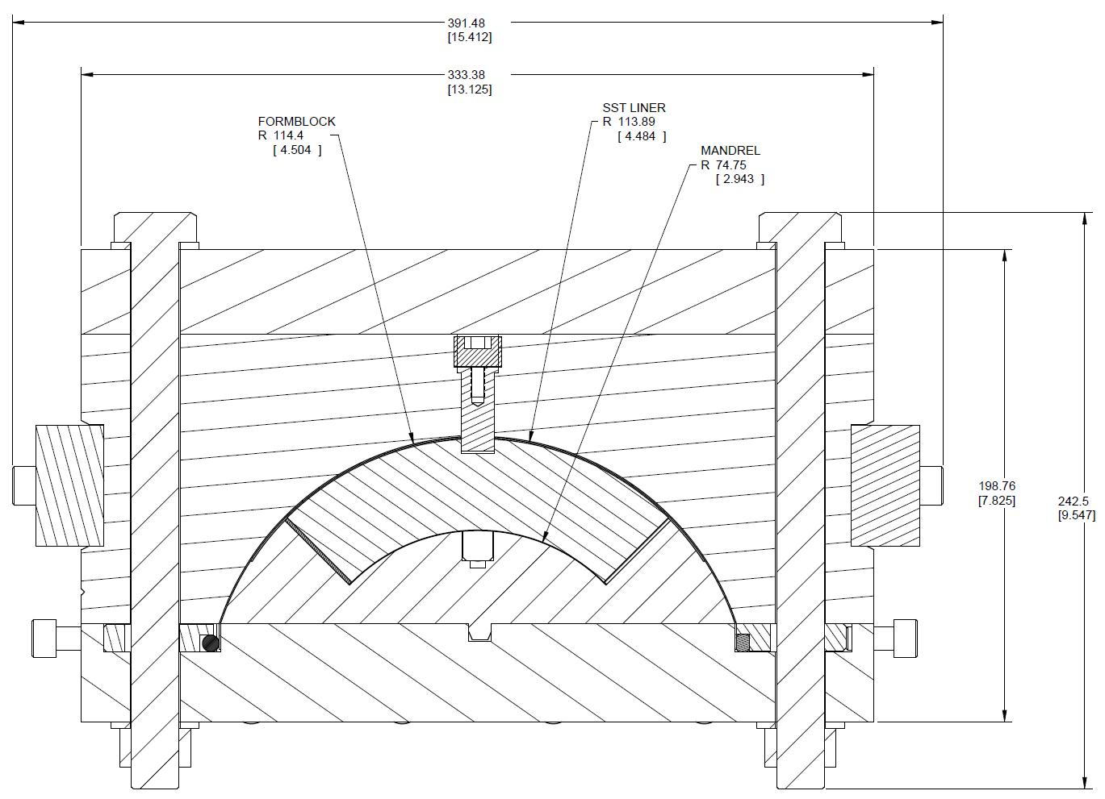
QXF Reaction Fixture Cross Section
Top Plate
Form block
Coil
Side Rail
Mandrel
Base Plate
Longitudinal Seal

Slide 4
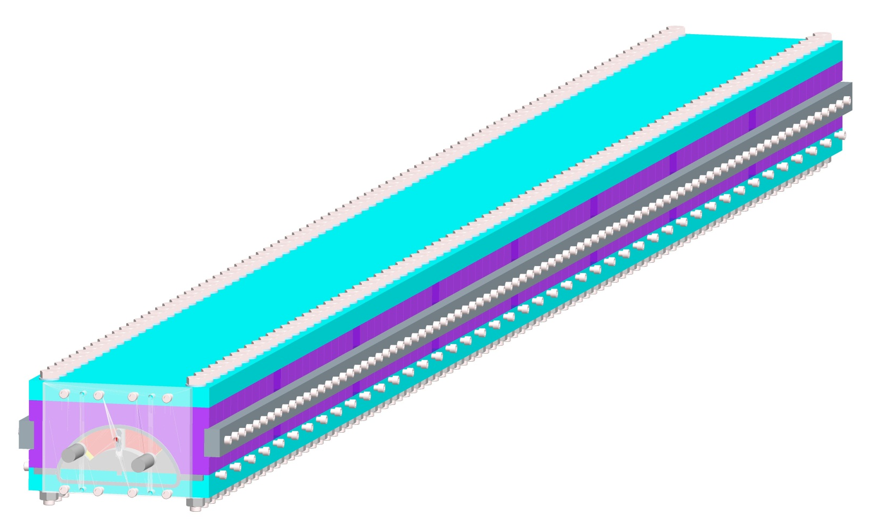
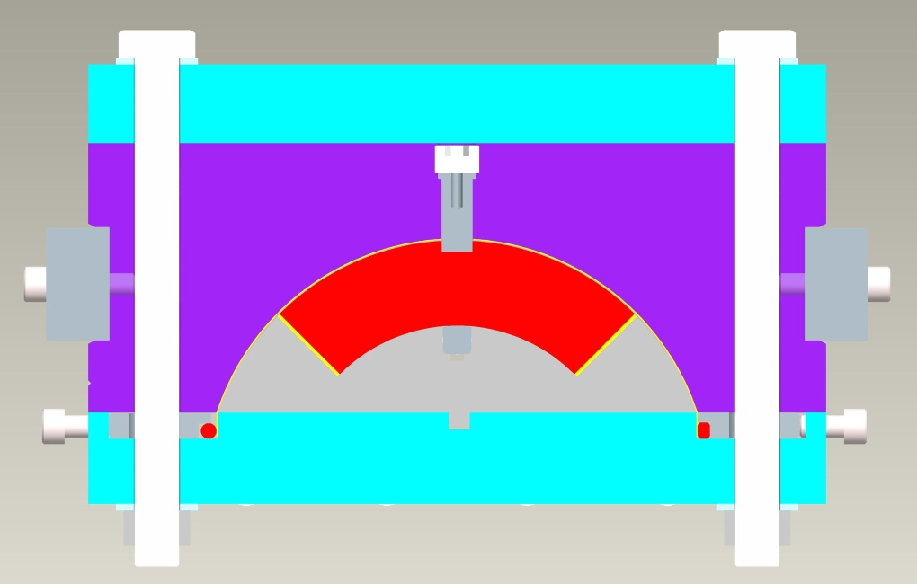
QXF Reaction Fixture
Alignment pins through form block into keyway of coil pole.
7 locations, approx 21“ / 540 mm spacing.
Set screw
Alignment Pin

Slide 5
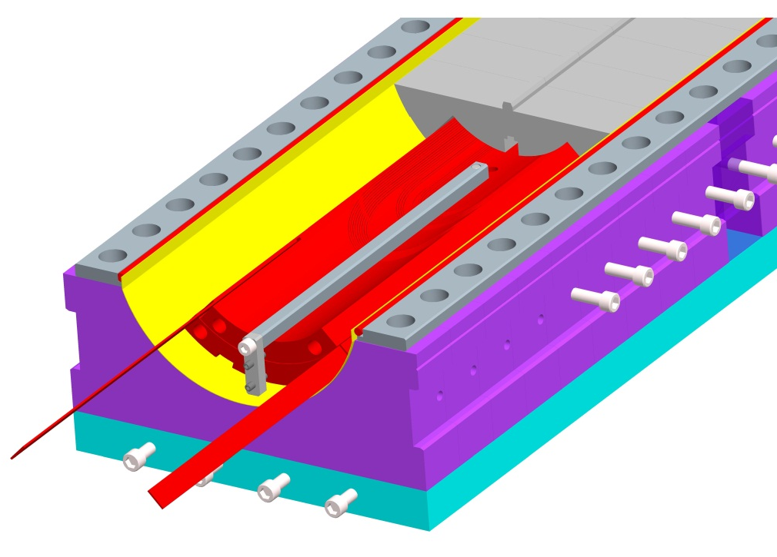
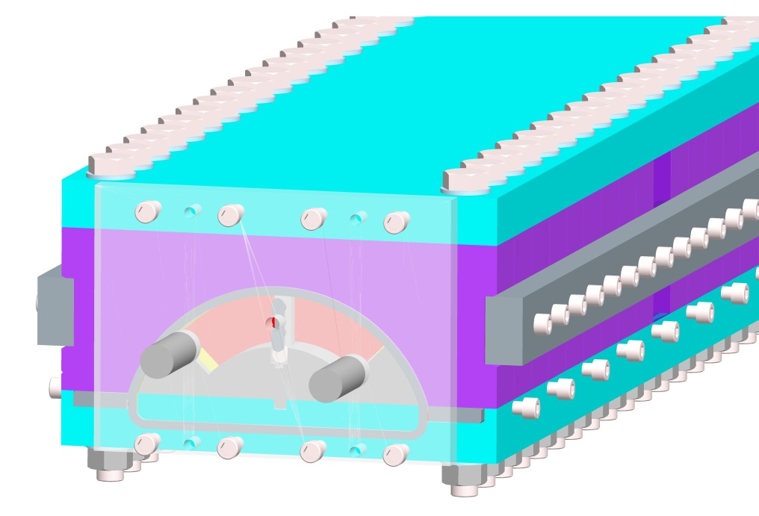
QXF Reaction Fixture
End saddle links, fit in slot in mandrel blocks, keep saddles in contact with coil turns during reaction.
Endplates at both ends to close and seal the fixture, seals made from copper tubing.
Short coil leads contained within fixture.

Slide 6
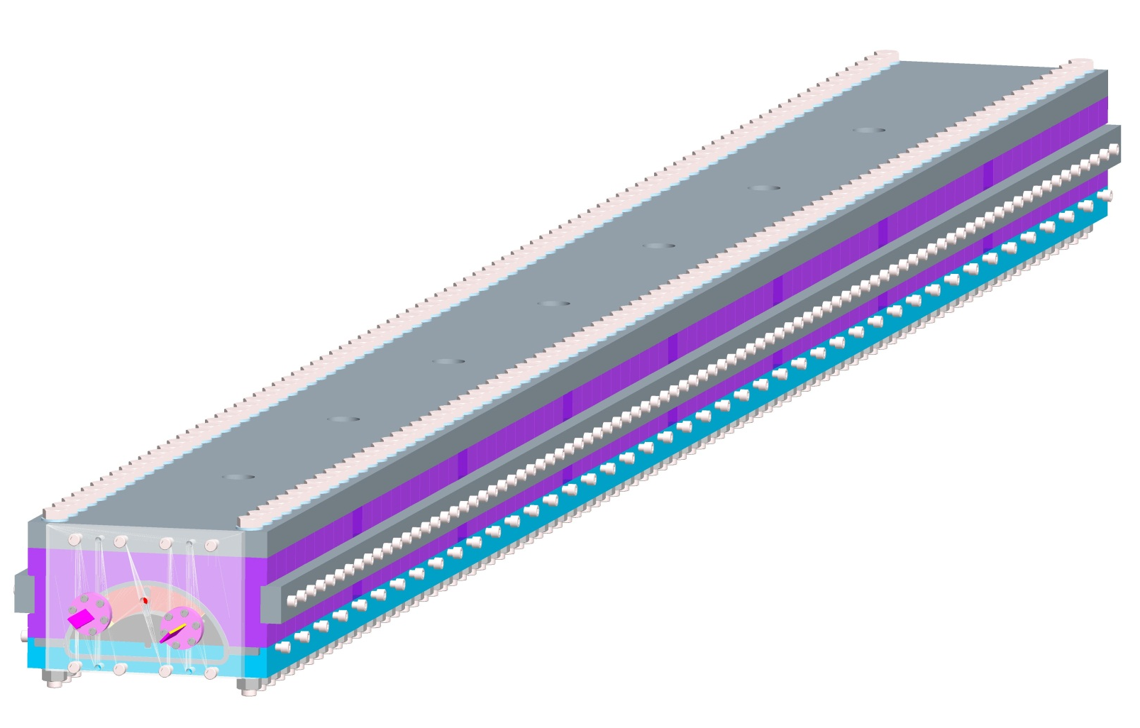
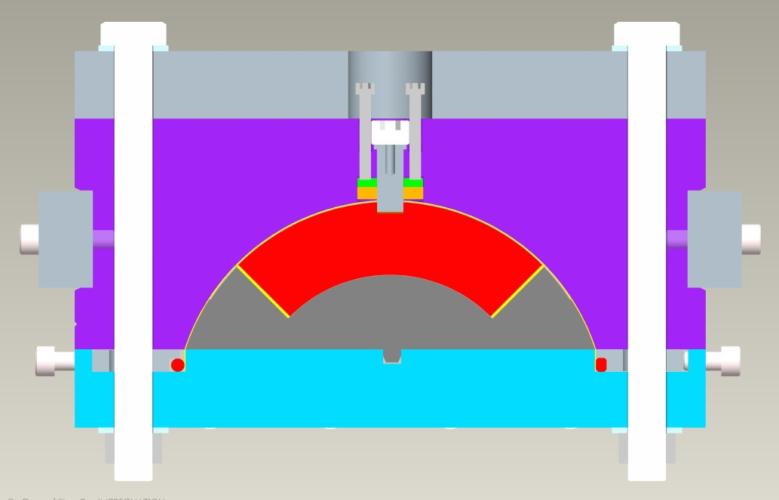
QXF Impregnation Fixture
Fixture nearly identical to reaction fixture.
Additional features to create epoxy tight seals.
Sealing Gaskets around alignment pins.
Access holes through top plate.
Bolts to compress seal.
Alignment Pins
Bolts
Compression Disc
Gasket
Seals against liner

Slide 7
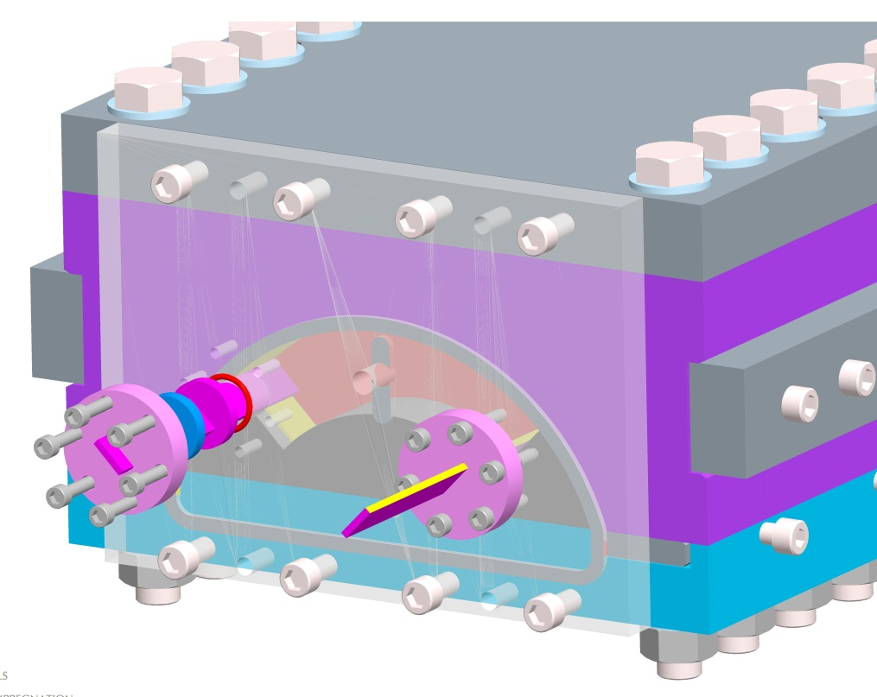
QXF Impregnation Fixture
Coil leads exit through end plate.
Rubber gaskets to seal around solder filled coil leads.
O-Ring
Compression Disc
Gasket

Slide 8
Summary
Preliminary design of long tooling underway.
Need final coil cross section and length.
Short tooling will utilize same fixture cross section.
Detailed drawings to be competed.

