Slide 1
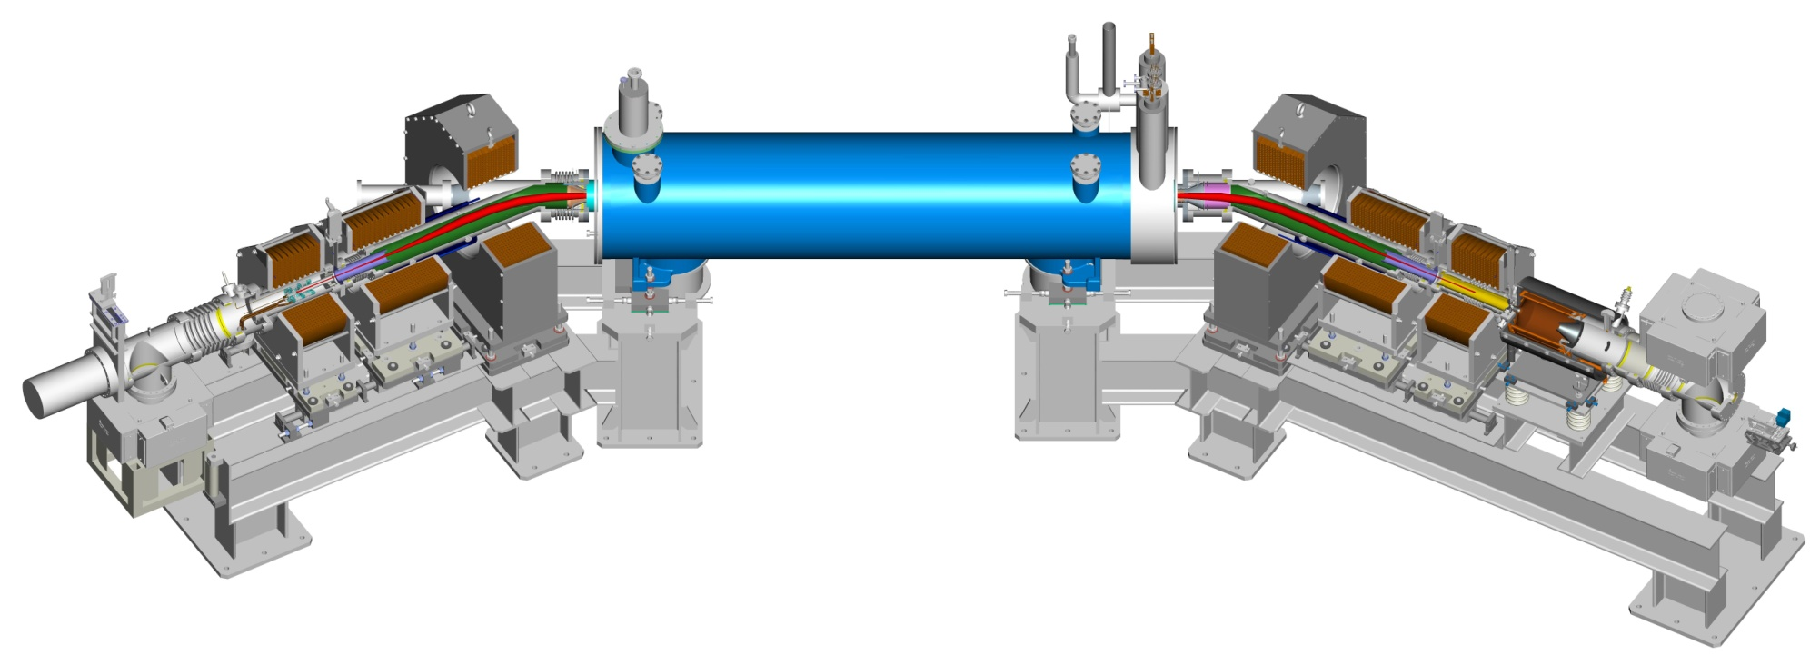
RHIC electron-lens status and test plan options Wolfram Fischer, BNL LARP CM20, 8-10 April 2013, Napa
Notes:
30 min

Slide 2
Co-authors and Acknowledgements
Co-authors
Z. Altinbas, M. Anerella, D. Bruno, C.D. Dawson, A.K. Drees, D.M. Gassner, X. Gu, R.C. Gupta, P. Joshi, J. Hock, L. Hoff, A.K. Jain, P. Kovach, R. Lambiase, Y. Luo, M. Mapes, A. Marone, A. Marusic, R. Michnoff, T. Miller, R. Michnoff, M. Minty, C. Montag, S. Nemesure, S. Plate, A.I. Pikin, L. Snydstrup, Y. Tan, S. Tepikian, R. Than, C.W. Theisen, P. Thieberger, J. Tuozzolo, P. Wanderer, S. White, W. Zhang
Acknowledgments – Institutions
FNAL: TEL experience, beam-beam experiments and simulations US LARP: beam-beam simulation CERN: beam-beam experiments and simulations
Acknowledgments – Individuals FNAL: H.-J. Kim, V. Shiltsev, T. Sen, G. Stancari, A. Valishev, G. Kuznezov BINP: G. Kuznezov CERN: X. Buffat, R. DeMaria, J.-P. Koutchouk, T. Pieloni, F. Schmidt, F. Zimmermann FZJ: V. Kamerdziev SLAC: A. Kabel

Slide 3
Outline – head-on beam-beam compensation
RHIC goals, Historical survey DCI experience, proposals for other machines
Head-on beam-beam compensation ideal, deviations from ideal
Technology developments for hadron beams Tevatron electron lenses, Electron Beam Ion Sources
RHIC electron lenses design, simulations, lattice, hardware, test bench, commissioning

Slide 4
RHIC electron lenses Motivation
Bunch intensity in 2012 polarized proton physics store
Goal:
Compensate for 1 of 2 beam-beam interactions with electron lenses
Then increase bunch intensity
up to 2× luminosity
Need new polarized proton source − under commissioning in 2013, A. Zelenski
bunches with 1 collision
bunches with 2 collisions

Slide 5
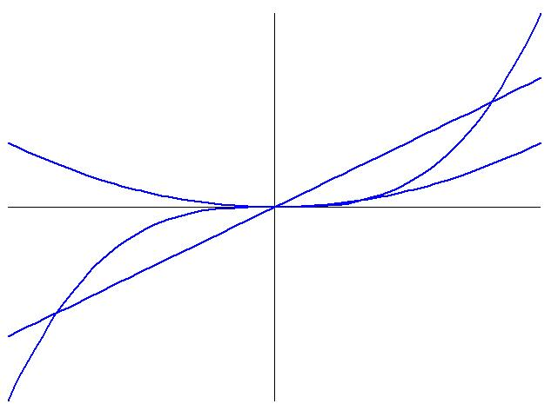
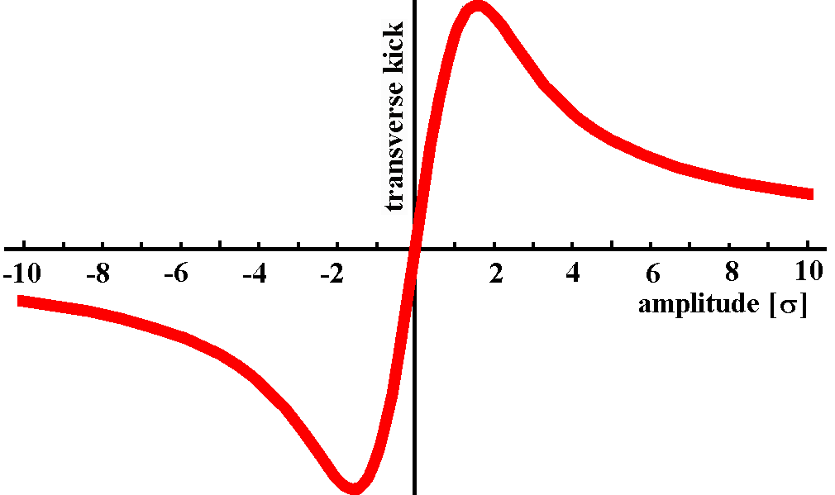
Head-on beam-beam compensation
beam-beam kick
magnet kicks
Amplitude dependence of beam-beam kick fundamentally different from magnets (strength not monotonically increasing in BB)
Another beam can produce same kick of opposite sign

Slide 6
History of head-on beam-beam compensation (HOBBC)
Compensation schemes (S. Peggs, Handbook):
Direct space charge compensation (4 beams)
Indirect space charge compensation (electron lenses)
Betatron phase cancellation between neighboring IPs (for certain order resonances only)
Proposals/studies of head-on beam-beam compensation to date:
COPPELIA ➔4-beam (J.E. Augustine, HEACC, 1969)
DCI ➔ 4-beam (G. Arzelia et al., HEACC, 1971) ➔ only real attempt so far
CESR ➔ e-lens (R. Talman, unpublished, 1976)
SSC ➔ e-lens (E. Tsyganov et al., SSCL-PREPRINT-519 ,1993)
LHC ➔ e-lens (E. Tsyganov et al., CERN SL-Note-95-116-AP, 1995)
Tevatron ➔ e-lens (Shiltsev et al., PRST-AB, 1999)
e⁺e⁻ collider ➔ 4-beam (Y. Ohnishi and K. Ohmi, Beam-Beam’03, 2003)
considered for RHIC

Slide 7
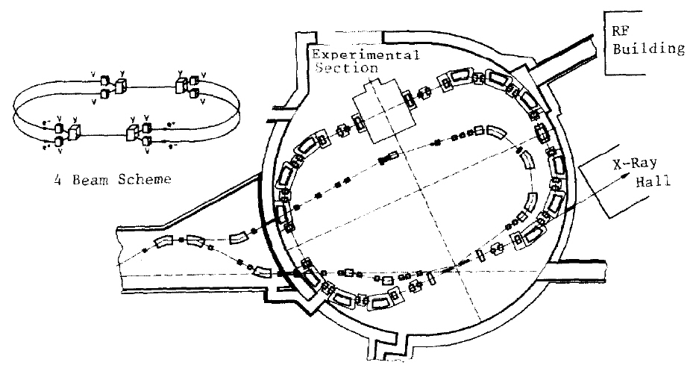
Head-on beam-beam compensation in DCI
Head-on beam-beam compensation was only tested in DCI (starting in 1976)
4-beam collider (e⁺e⁻e⁺e⁻) for complete space charge compensation
Main parameters:
Circumference 94.6 m
Energy 1.8 GeV
Beam-beam ξ ~0.05-0.1
Luminosity (design) ~10³² cm⁻²s⁻¹
Luminosity fell short by ~100x compared to expectations (2-, 3-, and 4-beam L about the same)
The Orsay Storage Ring Group, “Status report on D.C.I.”, PAC77
The Orsay Storage Ring Group, “Status report on D.C.I.”, PAC79
Notes:
References: Derbenev, Siemann; have Simon’s experiments for reference later

Slide 8
Coherent beam motion in DCI
Luminosity shortfall in DCI attributed to coherent instabilities (Derbenev, Chau, Potau – later Podobedov and Siemann)
Considered tune-split and feedback
from Podobedov & Siemann:
beam-size increase at even-order resonances of high order
regions of stability in simulations 3-5 times wider than observed
- Ya. S. Derbenev, “Collective instability of compensated colliding beams”, Nuclear Physics Institute, Siberian Division, Academy of Sciences USSR, Novosibirsk, Report No IYAF 70-72, in Russian (1972), SLAC-TRANS 151 in English.
- N.N. Chau and D. Potau, “Stabilité des oscillations transverse dans un anneau à charge d’espace compensée”, LAL Orsay (1974 and 1975).
- B. Podobedov and R.H. Siemann, “Coherent beam-beam interaction with four colliding beams”, Phys. Rev. E 52, No 3, pp. 3066-3073 (1995).

Slide 9
Beam-beam compensation with electron lens
2-beam coherent instabilities not an issue with electron lenses:
No feedback loop with compensating electron beam (single pass effects – require sufficient rigidity of electron beam required, see S. White)
Also: beam-beam parameter ξ in hadron colliders order of magnitude smaller than in lepton colliders
RHIC electron lens

Slide 10
HOBBC with electron lens – beam line view
p-beam lens defocuses
e-beam lens focuses
p-beam
lenses characterized by intensity and size
Single-pass compensation:
exact if x₃(N₁,N₂) = x₃(0,0) and x’₃(N₁,N₂) = x’₃(0,0) :
Same amplitude dependent force in p-beam and e-beam lens, and
Phase advance between p-beam and e-beam lens is ΔΨ = kπ, and
No nonlinearities between p-beam and e-beam lens
Notes:
Have phase space picture

Slide 11
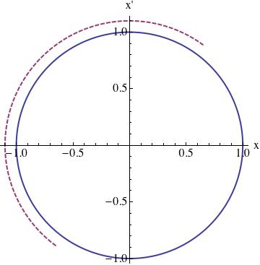
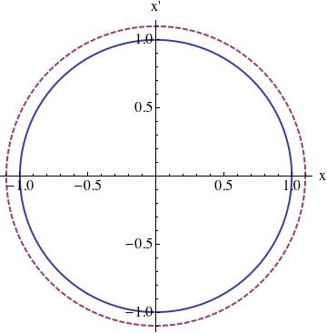
HOBBC with electron lens – phase space view
p-beam lens defocuses
e-beam lens focuses
Exact compensation if:
Same amplitude dependent force in p-beam and e-beam lens, and
Phase advance between p-beam and e-beam lens is ΔΨ = kπ, and
No nonlinearities between p-beam and e-beam lens
Notes:
Have phase space picture

Slide 12
HOBBC with electron lens – Hamiltonian view
(1-D only)
if:
Same amplitude dependent force in p-beam and e-beam lens
Phase advance between p-beam and e-beam lens is ΔΨ = kπ, and
No nonlinearities between p-beam and e-beam lens
and
Y. Luo et al, “Six-dimensional weak-strong simulations of head-on beam-beam compensation in the Relativistic Heavy Ion Collider”, Phys. Rev. ST – Accel. Beams 15, 051004 (2012).

Slide 13
Deviations from ideal head-on compensation
Deviations from: Same amplitude dependent force in p-beam and e-beam lens
e-beam current does not match p-beam intensity
e-beam profile not Gaussian
e-beam size ≠ p-beam size
time-dependence (noise) of e-beam and p-beam parameters
Deviations from: Phase advance between p-beam and e-beam lens is ΔΨ = kπ
linear phase error in lattice
long bunches (σ_{s} > β*)
Deviations from: No nonlinearities between p-beam and e-beam lens
sextupoles, octupoles, magnetic triplet errors between p-p and e-p
=> technology and instrumentation
=> lattice design => choice of β* (not too small)
=> need to be able to tolerate
Studied all tolerances with simulations [Y. Luo et al, PRSTAB 15, 041001 (2012)]

Slide 14
Phase advance and resonance driving terms
E-lens profile and current => reduces tune spread
Δψ = kπ phase advance => minimizes resonance driving terms
Δψ_{x,y}=(8.5π,11.1π)
Installed additional power supplies in all planes (B+Y; hor+ver) that allow for shifting phase between IP8 (p-p) and IP10 (p-e)
Also required change of integer tunes B: (28,29) => (27,29) Y: (28,29) => (29,30)
C. Montag
Δψ_{x,y}=(0.0π,0.0π)
Y. Luo et al, Phys. Rev. ST – Accel. Beams 15, 051004 (2012).

Slide 15
Effect of long bunches on HOBB
short bunch, σ_{s}=0
long bunch, σ_{s}=0.2 m, β*=0.5 m
significant deviations from short-bunch case (~30%) for r ≈ σ and large r’

Slide 16
Effect of long – bunches on HOBBC
no HOBBC, RHIC case
HOBBC, -10 deg phase error
significant part uncompensated (~60%) for r ≈ 0 and large r’

Slide 17
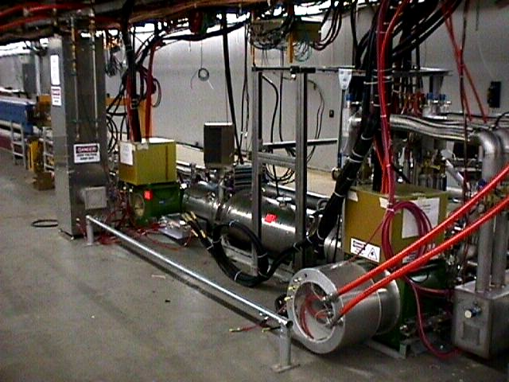
E-lenses technology – Tevatron electron lenses
V. Shiltsev, A. Burov, A. Valishev, G. Stancari, X.-L. Zhang, et al.
2 lenses in Tevatron:
Energy: 5/10 kV
Current: 0.6/3 A
pulsed, 200 ns rise time [RHIC: also DC]
Length: 2 m
e-beam radius: 2.3 mm [RHIC: 0.3 mm]
TEL-1
Operationally used as gap cleaner (very reliable)
Shown to have increased beam lifetime of pbar bunches affected by PACMAN effect (by factor 2 at beginning of store, mostly tune shift)
Have learned sensitivity to parameters (relative beam position – important, e-beam shape – important, current – 10⁻³ variations ok)
Experiments with Gaussian gun (Sep. 2009, Jul 2010) (alignment and losses, tune shifts, coherent modes, tune space scan with e-lens)
[V. Shiltsev et al., PRST-AB 2, 071001 (1999); PRL 99, 244801 (2007); PRSTAB 11, 103501 (2008); New J. Phys. 10, 043042 (2008)]

Slide 18
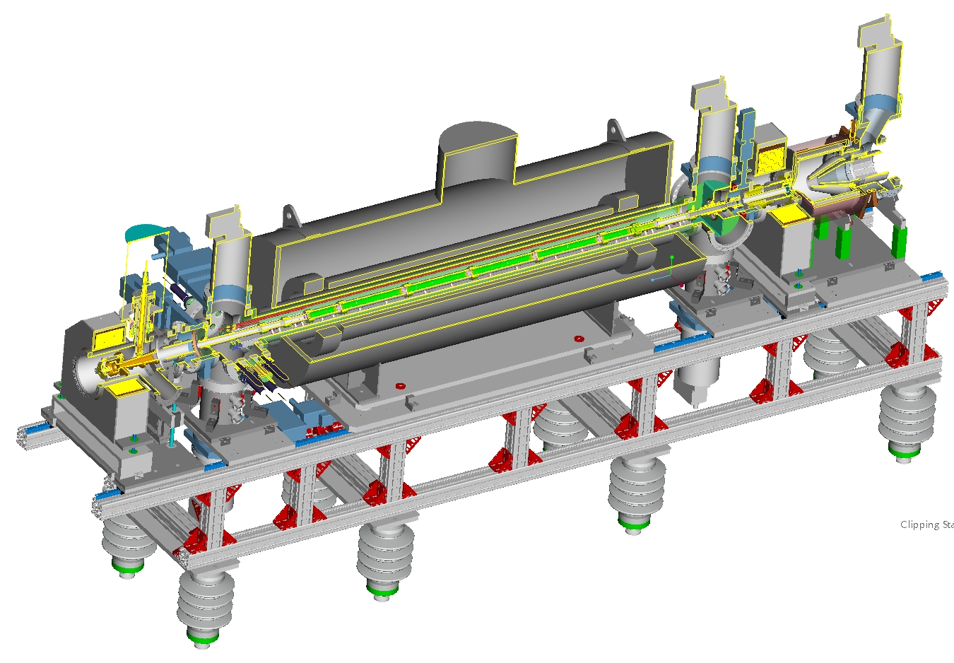
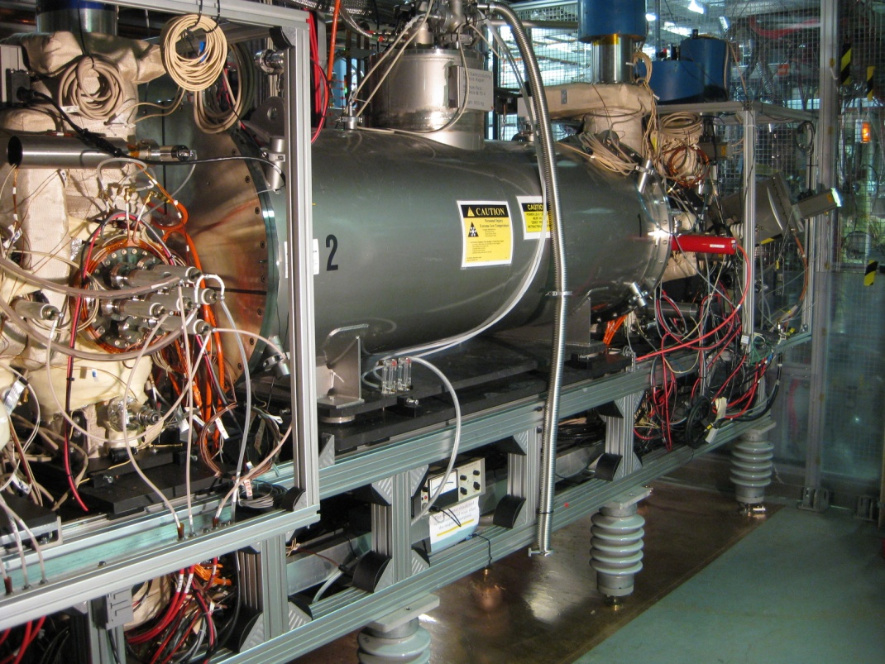
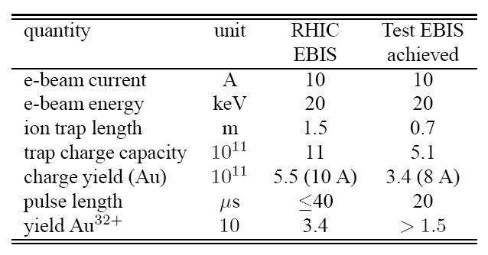
E-lens technology – BNL Electron Beam Ion Source
Superconducting Solenoid (5 T)
Electron Collector
J. Alessi, E. Beebe, S. Pikin, D. Raparia, M. Okamura,
L. Snydstrup, J. Ritter, R. Lambiase et al.
Drift Tube Structure (P=10⁻¹⁰ Torr)
E-Gun
(10 A)
Operated for NASA Space Radiation Laboratory in 2011-12 with
He⁺, He²⁺, Ne⁵⁺, Ne⁸⁺, Ar¹⁰⁺, Kr¹⁸⁺, Ti¹⁸⁺, Fe²⁰⁺, Xe²⁷⁺, Ta³³⁺, Ta³⁸⁺
Operated for RHIC in 2012 with
U³⁹⁺ (not possible previously), Cu¹¹⁺, Au³¹⁺

Slide 19
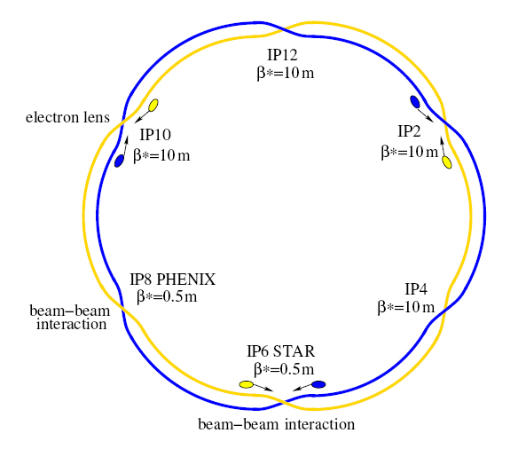
RHIC electron lenses – Basic design decisions
Electron lenses in IR10 smallest distance to IP8 head-on beam-beam interaction (nonlinearities), available space
Both lenses in common area main solenoids compensate each other for coupling and spin, β_{x} = β_{y} at e-lens locations drawback: β-functions relatively small (<= 10 m)
DC beam for compensation avoids noise introduced with HV switching (have pulsed operation for set-up and diagnostics)
Superconducting main solenoid need high field to match electron and proton beam size
Field straightness correctors incorporated in sc main solenoid compact solenoid
Transport solenoids and orbit correctors warm capital cost lower than for sc (sc transport solenoids with break-even time 5-10 years)
Diagnostics basic diagnostic consists of BPMs and RHIC instrumentation (BTF, lifetime), e-bam profile monitors, backscattered electron monitor, halo detection

Slide 20
RHIC electron lenses Compensation overview
GS1 warm solenoid
SC main solenoid B = 6 T, I = 440 A + 16 more magnets (fringe fields, correctors)
CSB = GSB
GS2 warm solenoid
CS2 = GS2
GSB warm solenoid
CS1 = GS1
p
p
e⁻
e⁻
e⁻
GSX/Y
CSX/Y = GSX/Y
Electron collector
Electron gun

Slide 21
Requirement for electron lens
1. Electron beam size in the main solenoid
RMS beam size: 0.3 mm - 0.8 mm (issue: relatively small)
2. Gaussian shape of electron beam
good fit to 3 σ (issue: cathodes have limited size)
3. Straightness of magnetic field in main solenoid target of ± 50 μm after correction (issue: good overlap of e and p beam)
4. Steering electron beam in e-lens
maximum shifting : ± 5 mm in X and Y planes
maximum angle : 0.1 mrad
5. Stability in electron current
power supplies stability better than 10⁻³
6. Overlap of electron and proton beams
robust real-time measurement with resolution better than 100 μm

Slide 22
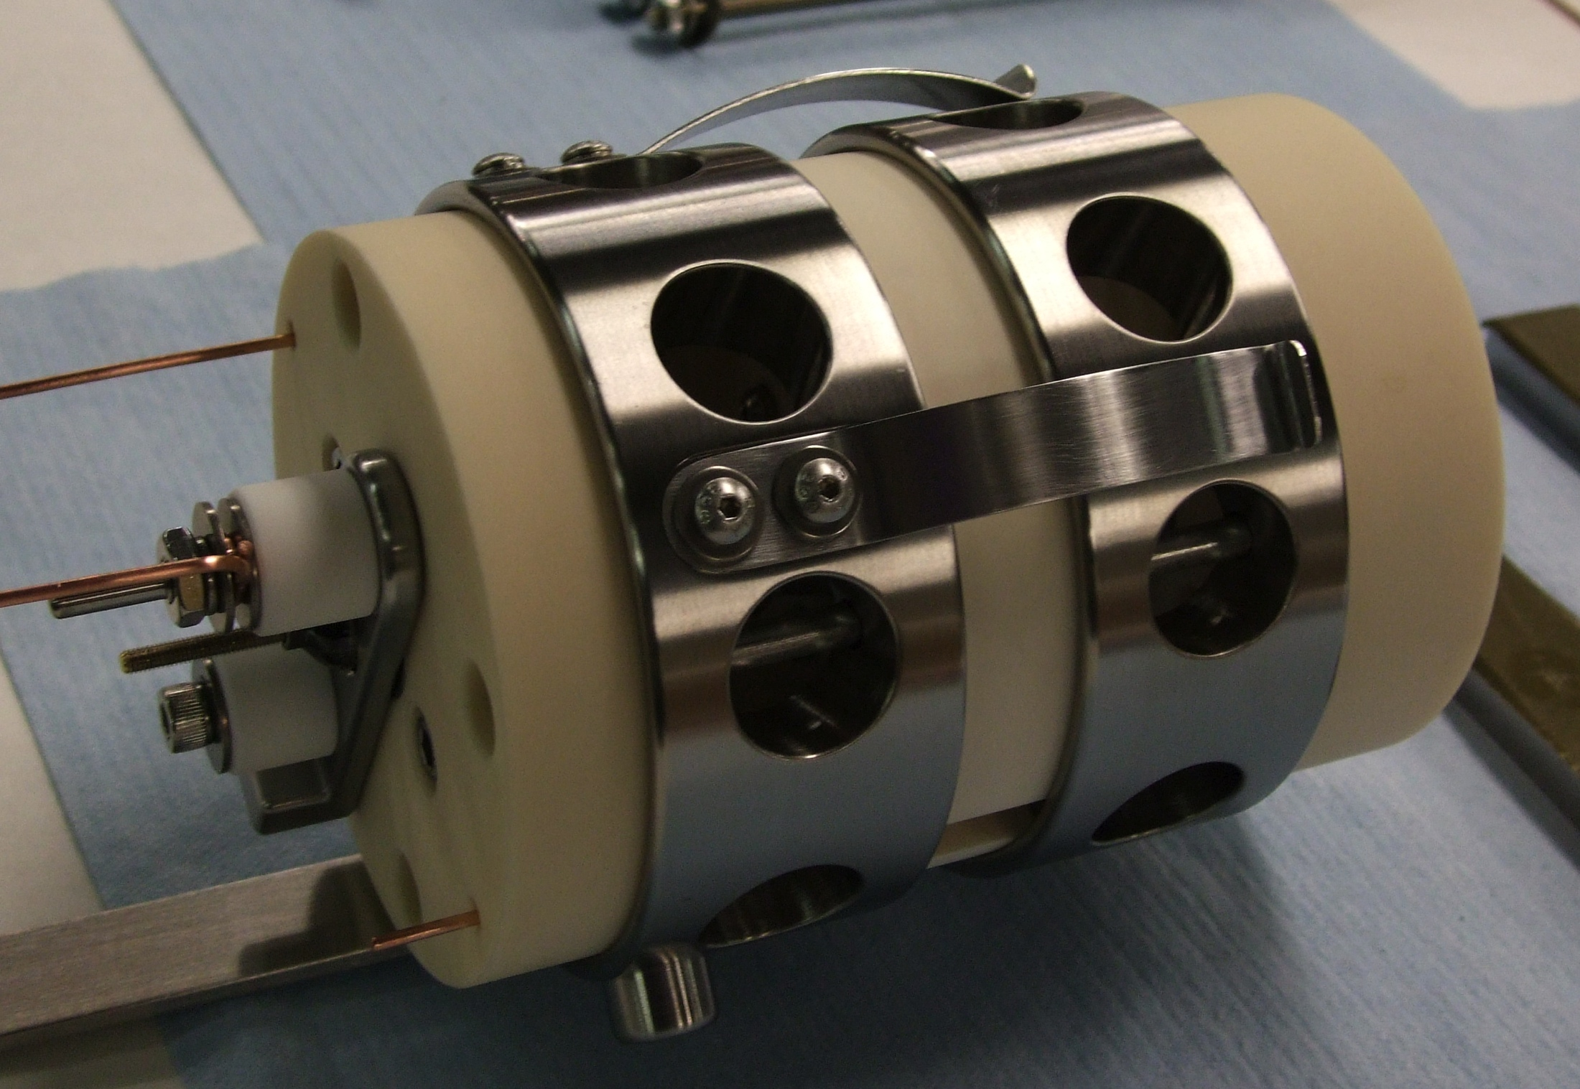
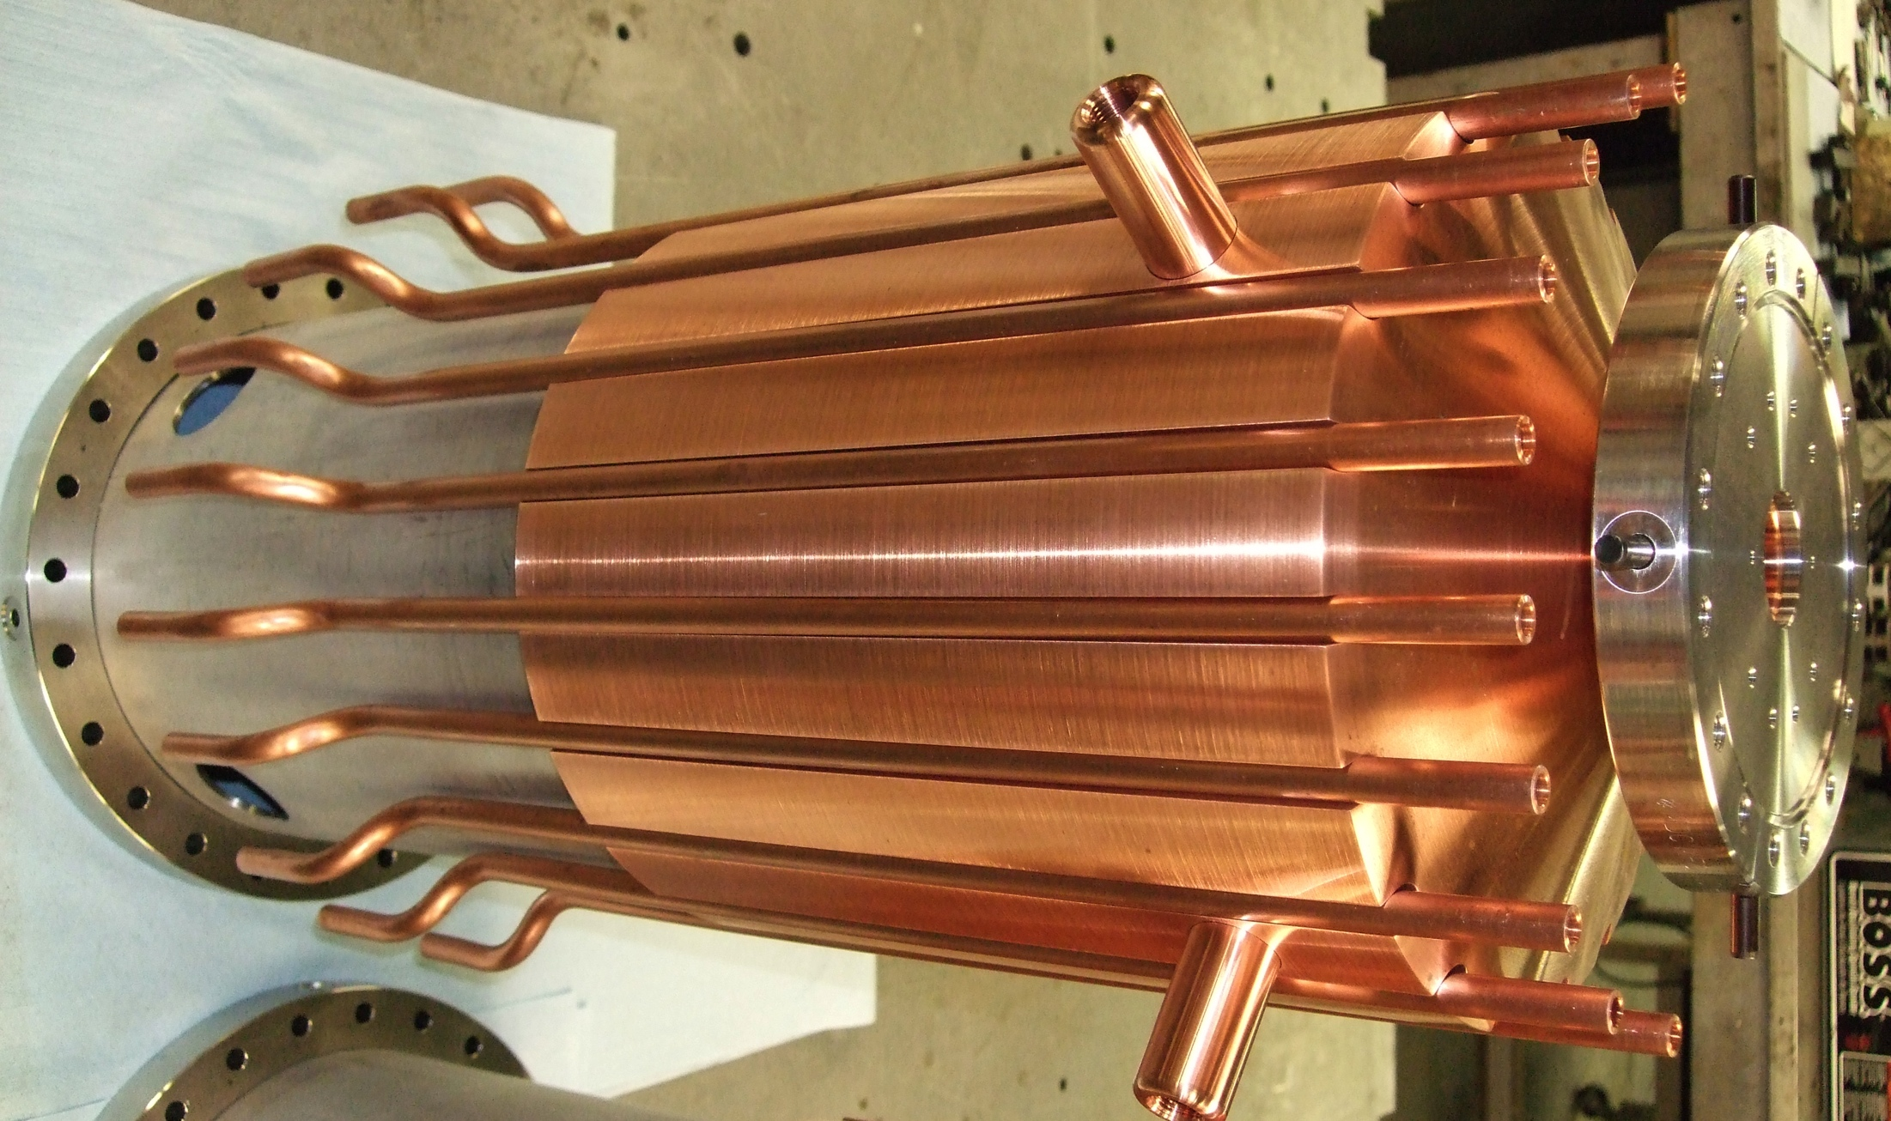
RHIC electron lenses Gun and collector (A. Pikin)
Gun
Designed for: current density, profile
3 modes: DC (full compensation) 100 Hz (positioning) 78 kHz (single bunch compensation) V_{max} = 10 kV, I_{max} = 1 A, P = 1×10⁻⁶ AV^{-3/2}
Cathodes: LaB₆ and IrCe (from Budker), 4.1 mm radius, Gaussian profile (2.8 σ)
Collector Designed for: Reliability
Water cooled, can take 4x nominal load of 15 kW
ρ_{P} < 50 W/cm², T < 125°C

Slide 23
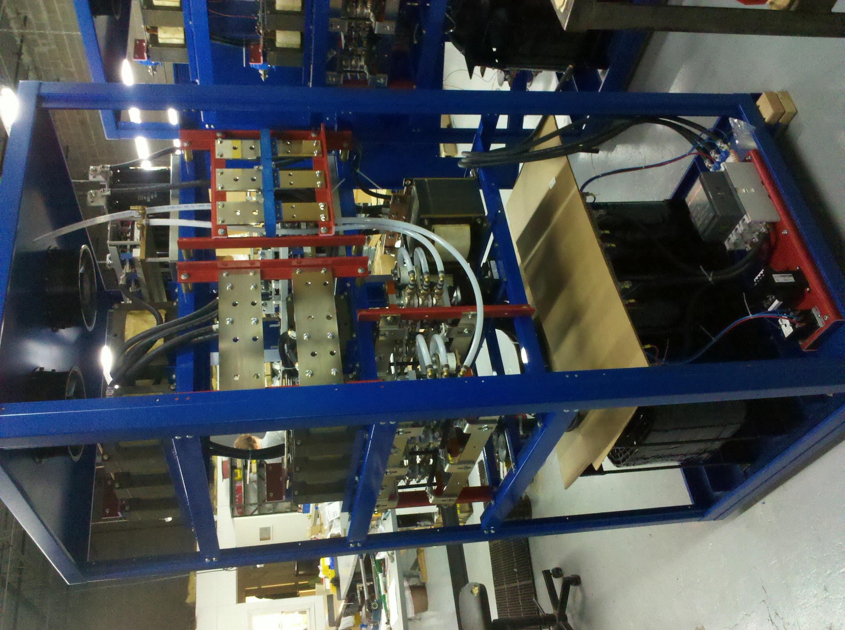
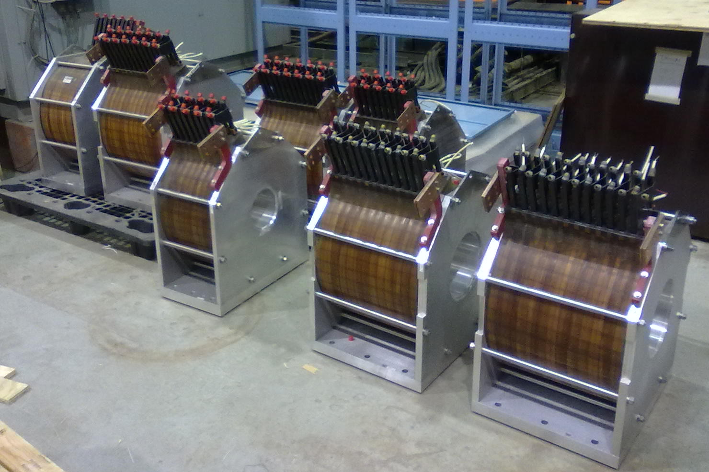
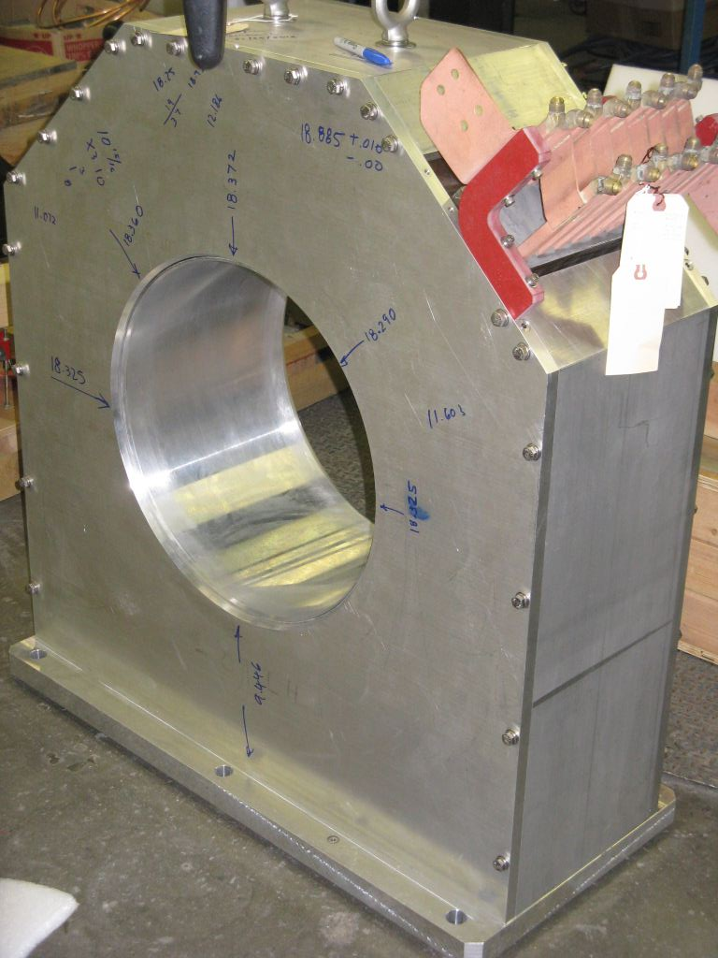
RHIC electron lenses Warm magnets (A. Pikin, X. Gu)
4 types: GS1, GS2, GSB, GSX/Y Designed for: 0.3 T min transport field, power consumption (total < 0.5 MW)
GS1 (gun, collector)
B = 0.8 T, I = 1200 A, P = 58 kW
PS in assembly (1 each for GS1-CS1,
GS2-CS2, GSB-CSB)
GSB (bend) B = 0.3 T, I = 770 A, P = 45 kW
GS2 B = 0.5 T, I = 730 A, P = 25 kW

Slide 24
RHIC electron lenses Superconducting magnets (R. Gupta)
Designed for: solenoid field strength (6T), field straightness (±50 μm)
Stabilizes e-beam Magnetic compression (need 310 μm rms beam size)
Maximize overlap of p- and e-beams
17 magnets total
To correct for straightness
5 hor + 5 ver
0.3 T with reduced B_{main}
maintain field quality with reduced B_{main}

Slide 25
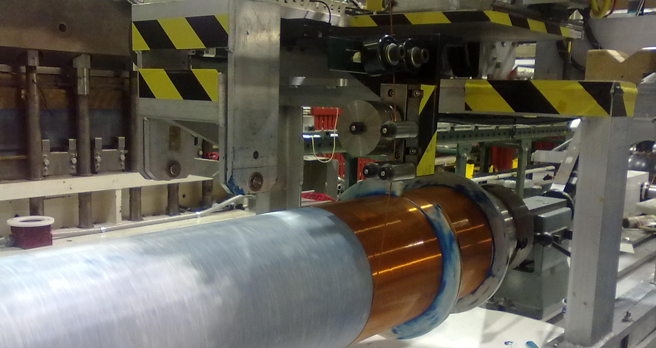
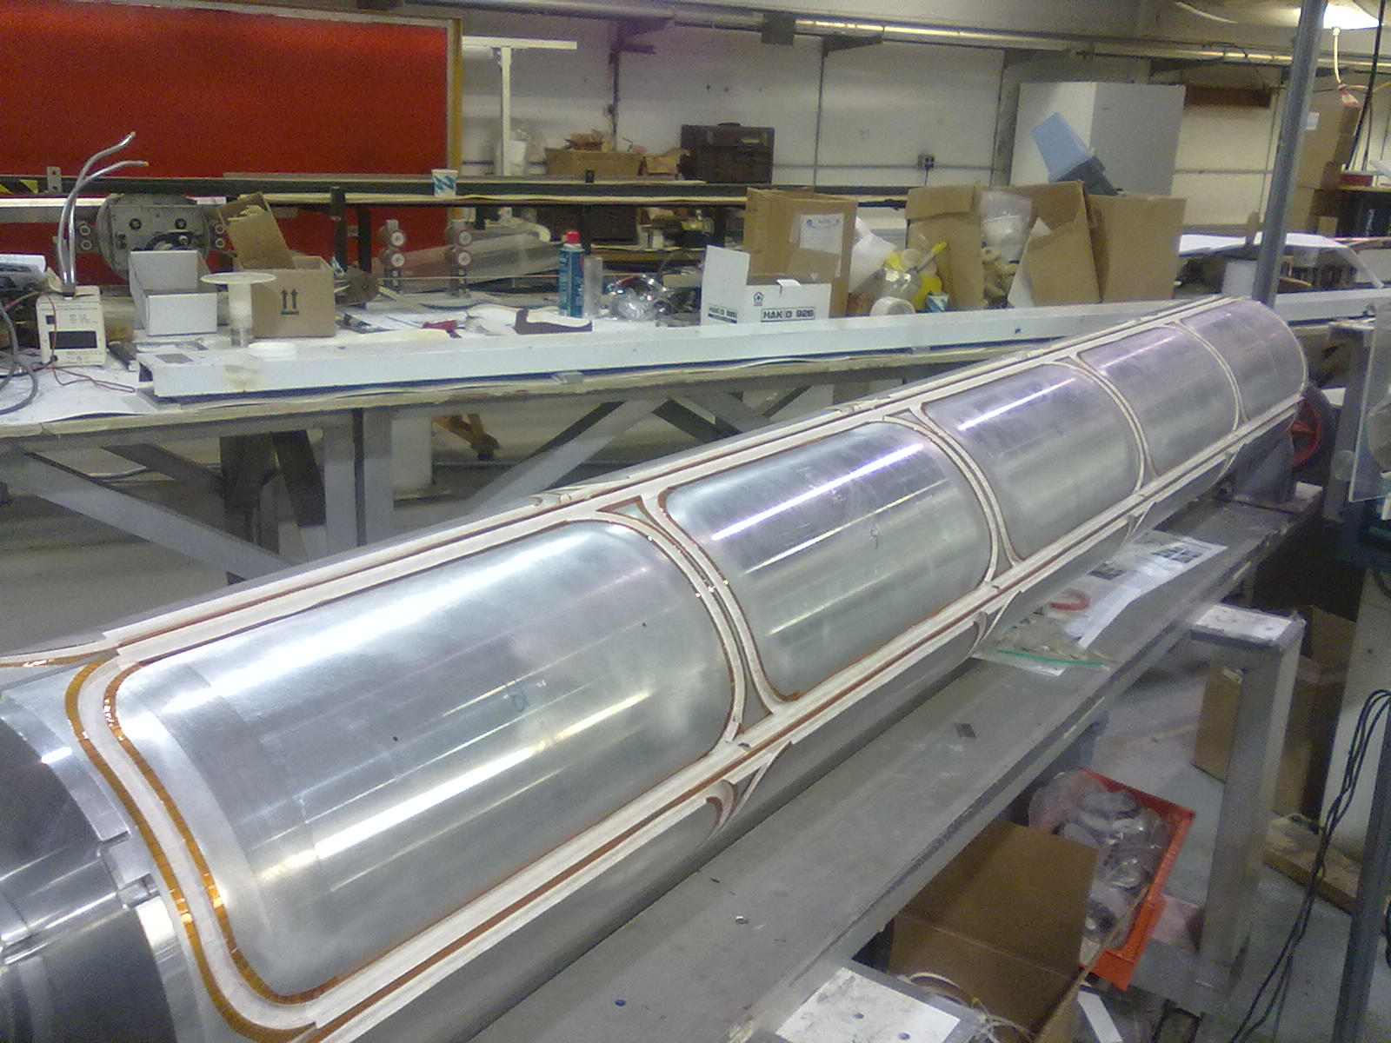
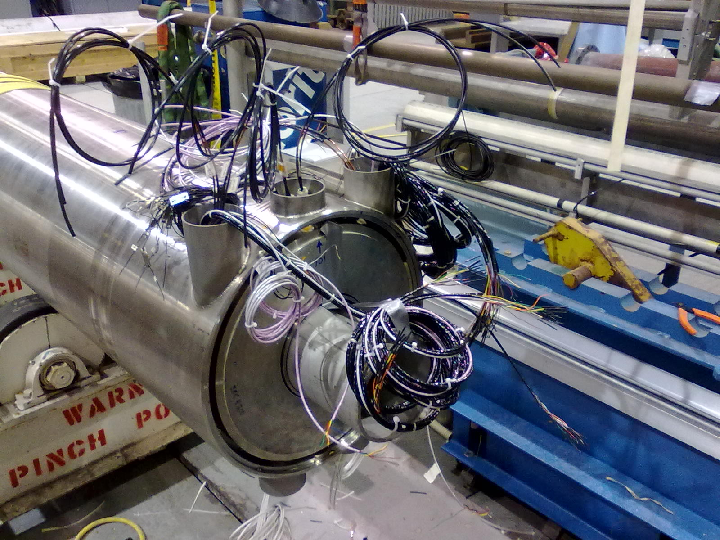
RHIC electron lenses Superconducting magnets
winding at BNL 22 layers, ~25000 turns
shell with correctors
end with cables
1st solenoid tested cold:
end preparation
2nd solenoid also reached 6 T (all layers good)
Ground fault developed in layer 1, decided to disable layers 1&2

Slide 26
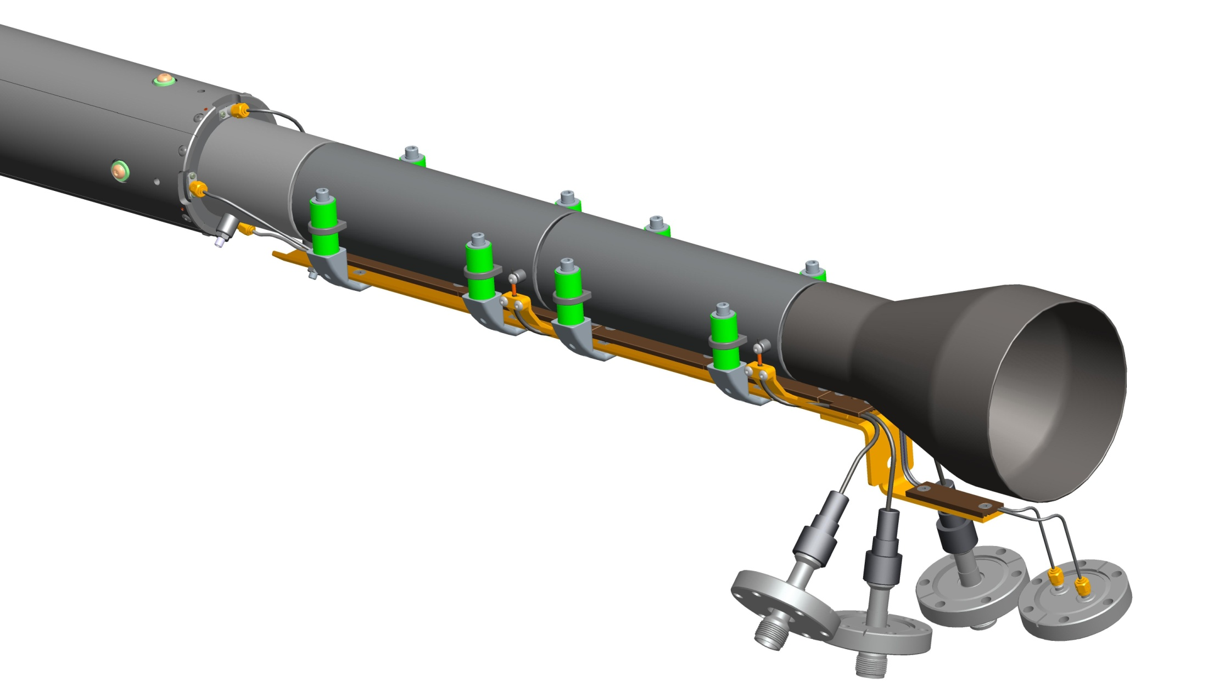
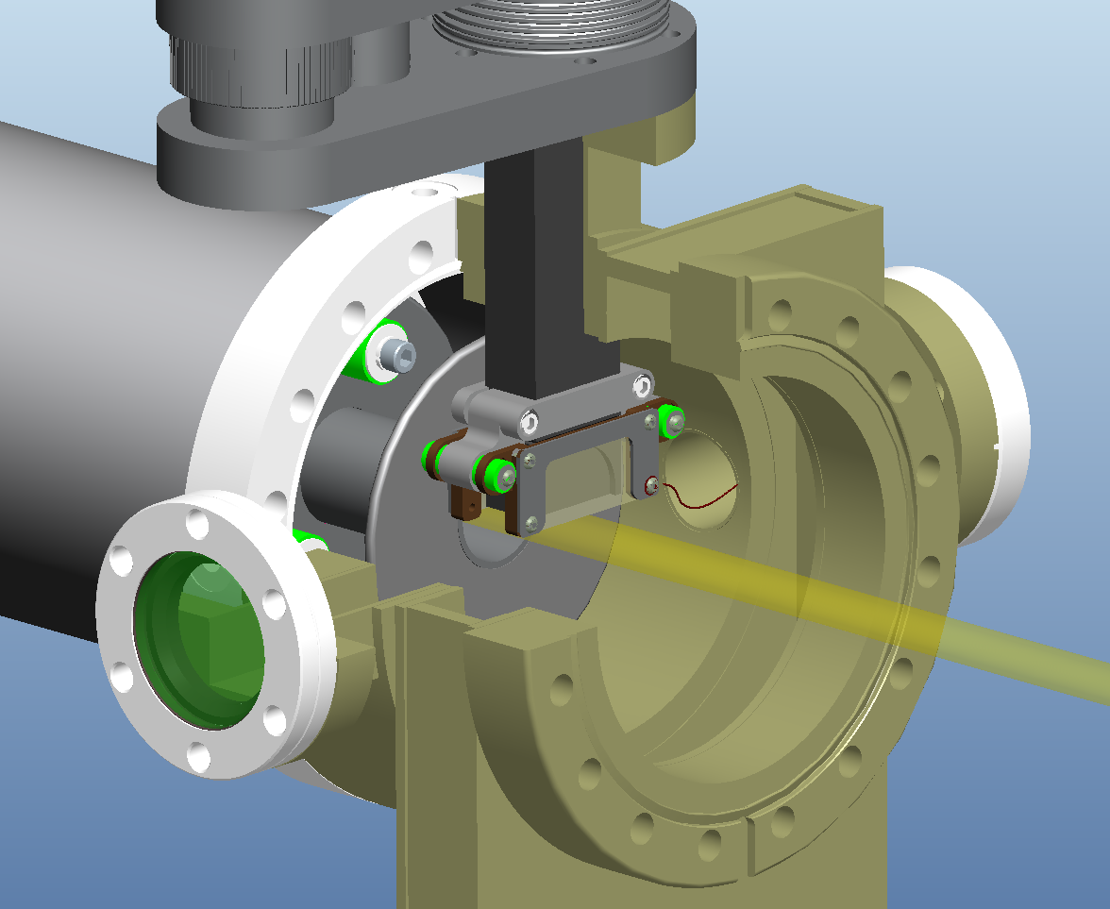
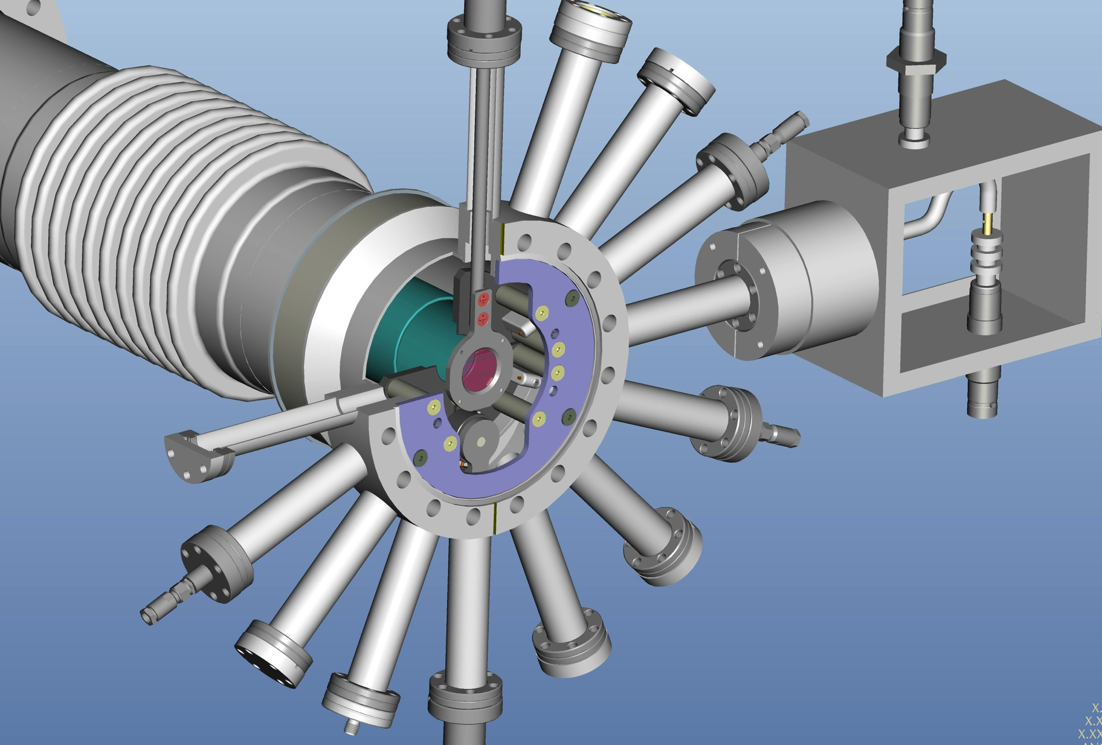
RHIC electron lenses Instrumentation
Designed for:
e-beam position
e-current and losses halo monitor
Drift tubes ion extraction with DC e-beam
e-beam profiles pin-hole detector, YAG screen
Overlap of p- and e-beam
BPM
drift tube
overlap detector
instrument holder

Slide 27
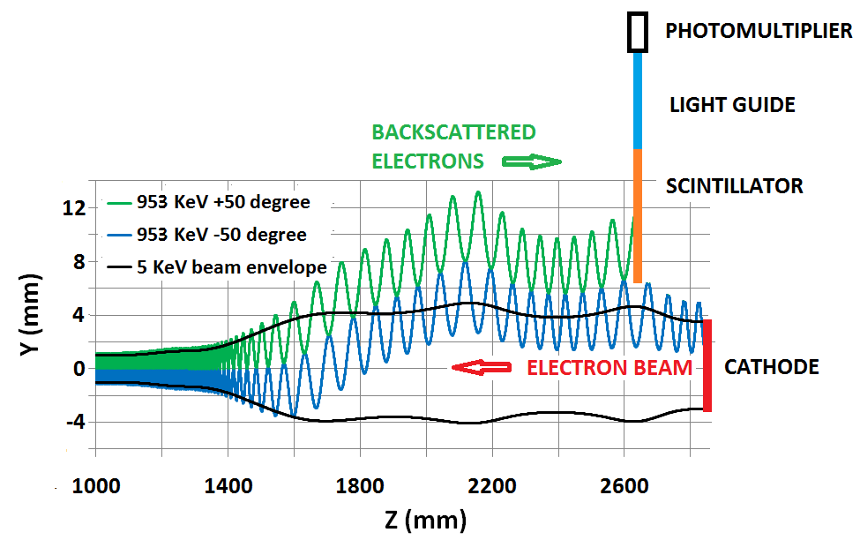
RHIC electron lenses Instrumentation
Beam overlap monitor (P. Thieberger):
p-e beam interaction creates bremsstrahlung (photons) and backscattered electrons
Backscattered electrons can be detected near gun (above e-beam)

Slide 28
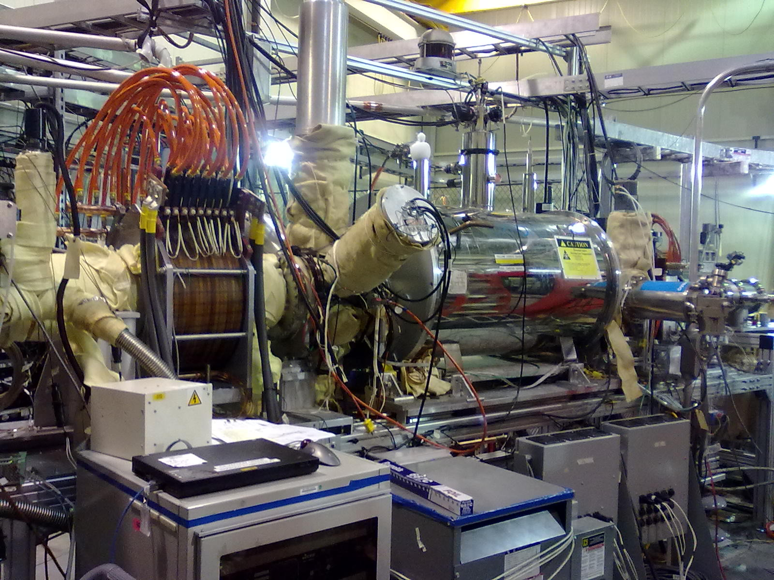
RHIC electron lenses Test bench 2012
collector
instrument holder
pin hole detector
YAG screen
halo monitor
e-gun
GS1 solenoid
More details: X. Gu et al., IPAC12, paper in preparation

Slide 29
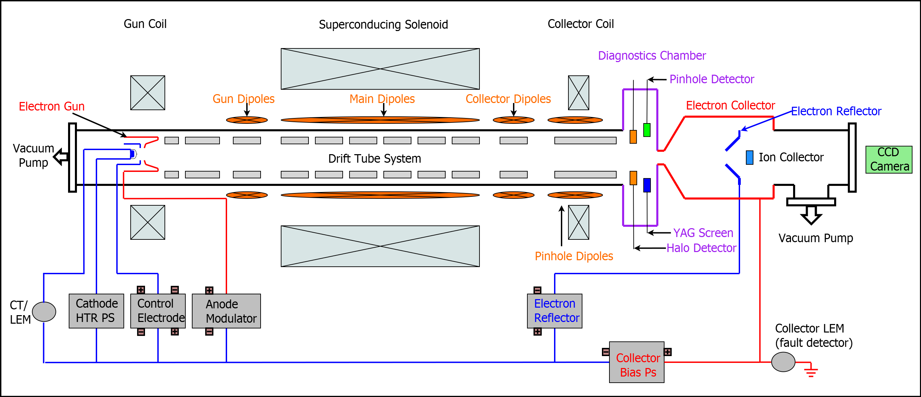
RHIC electron lenses Test bench results 2012
Gun operation in all modes (100 Hz, 78 kHz, DC) – 1 A, ΔI/I_{rnd} = 0.075% OK
Measured gun perveance (I vs. U): 0.93 μAV^{-3/2} OK
Measured collector temperature and pressure with high load OK
Commissioning of pin hole detector and YAG screen done
Verified transverse Gaussian profile OK
Prototype of machine protection system done
Test of software controls done
More details: X. Gu et al., IPAC12, paper in preparation

Slide 30
Installation for 2013
Electron lens main solenoid #1
straight beam pipe (Y-pipes not ready)
allows for commissioning of all solenoid magnets
does not allow for electron beam commissioning
IP10
outside ring
inside ring
EBIS spare solenoid
allows for electron transport from gun to collector with 2 Tm integrated strength
does not allow for beam-beam compensation (field lines not straight enough)

Slide 31
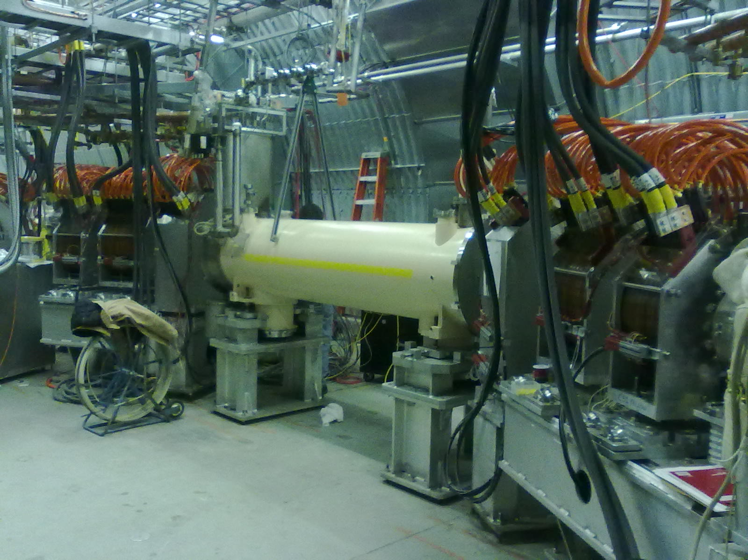
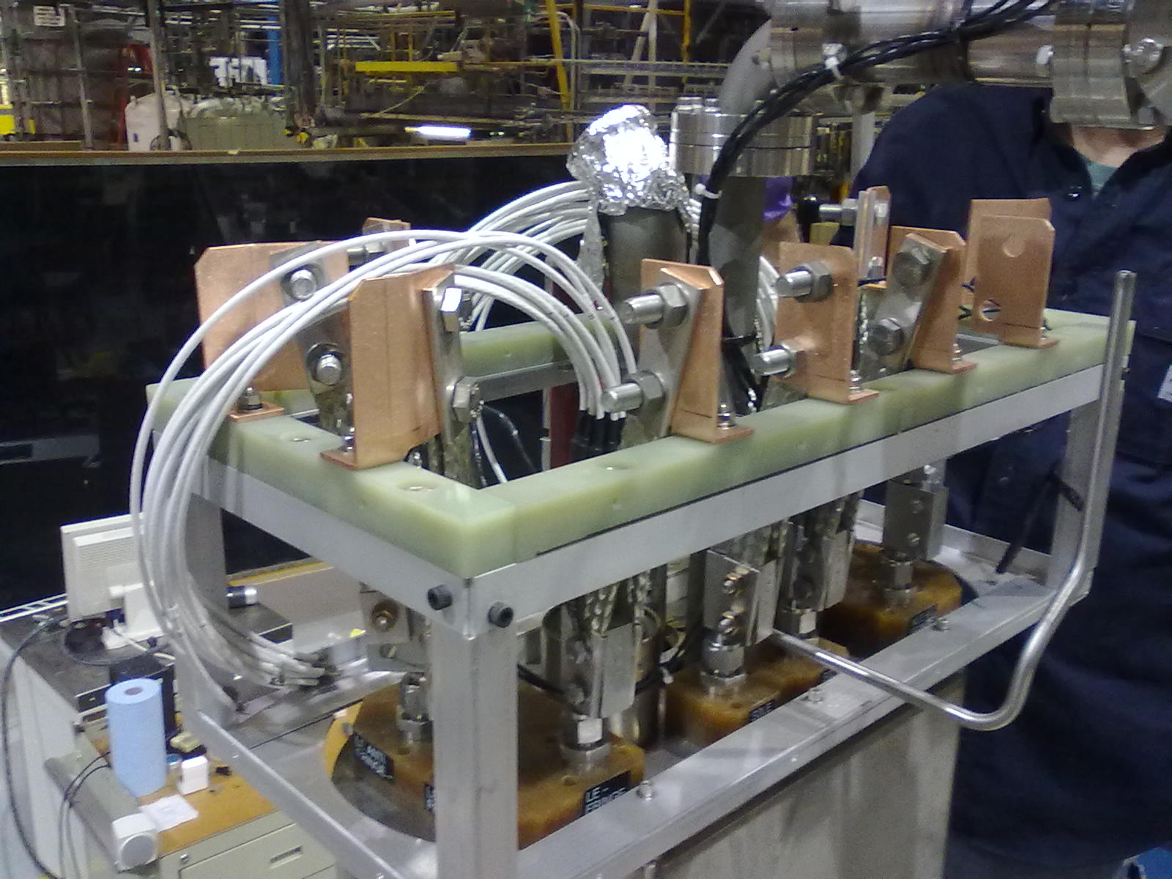
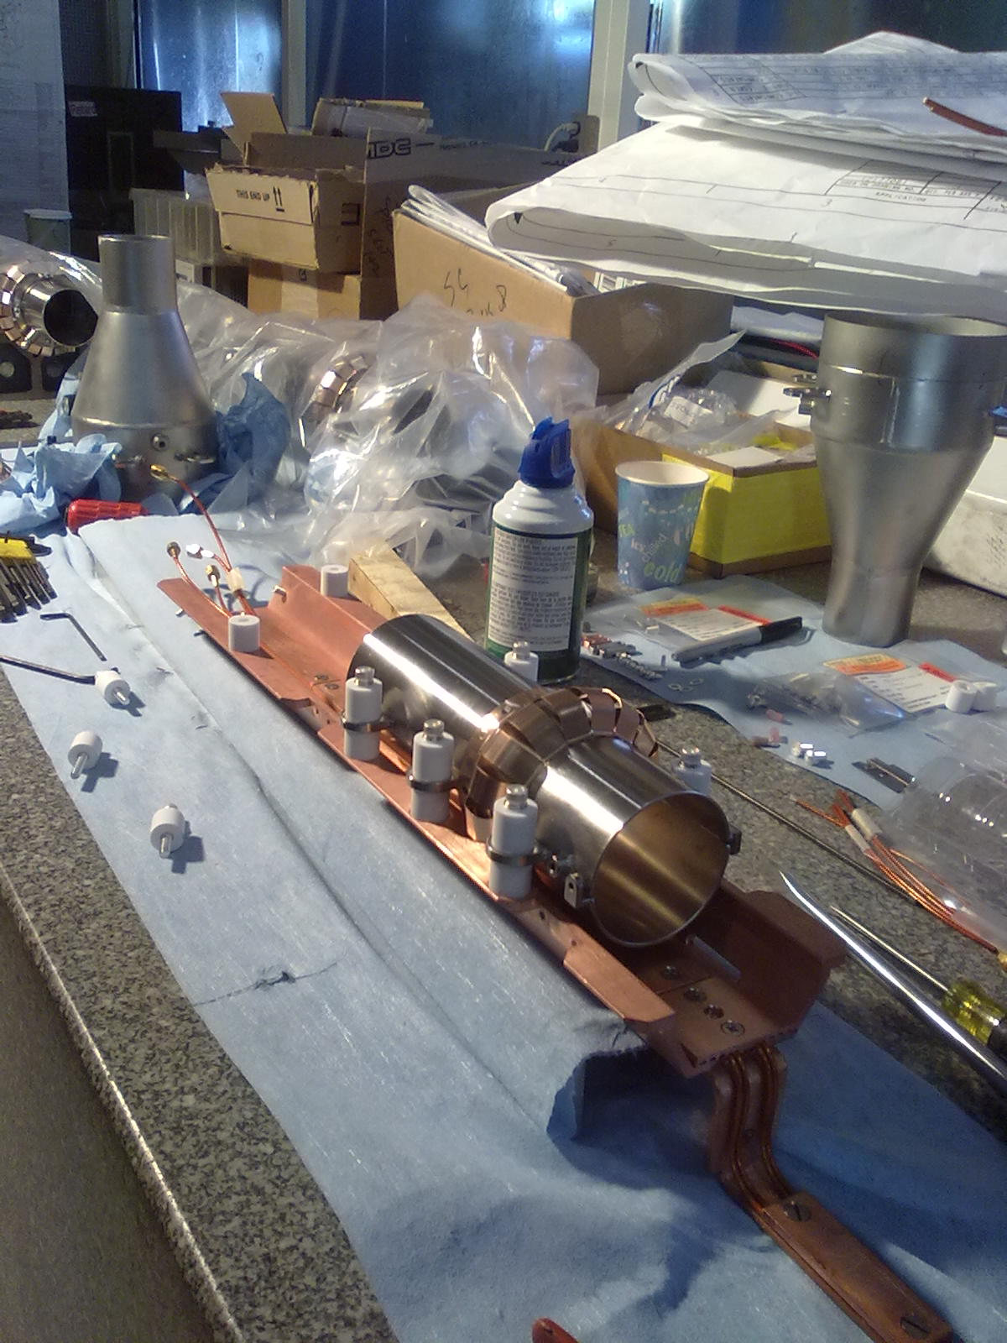
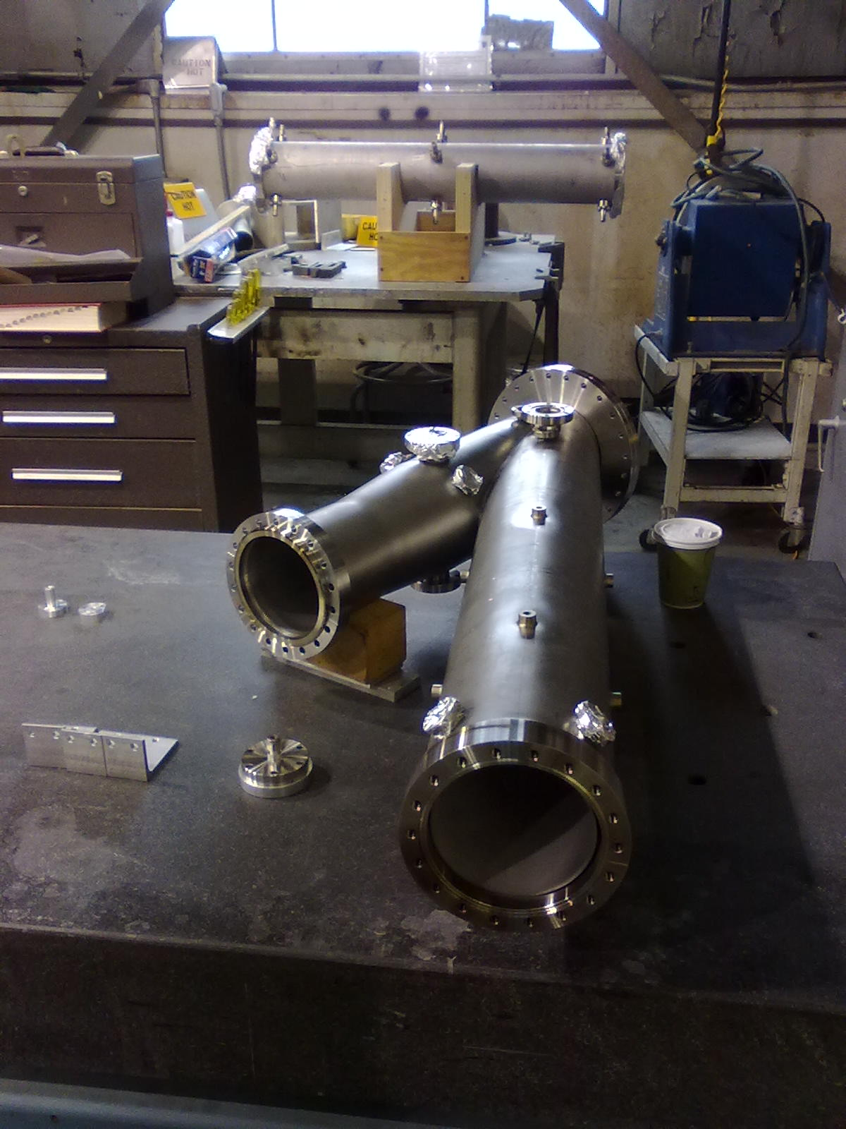
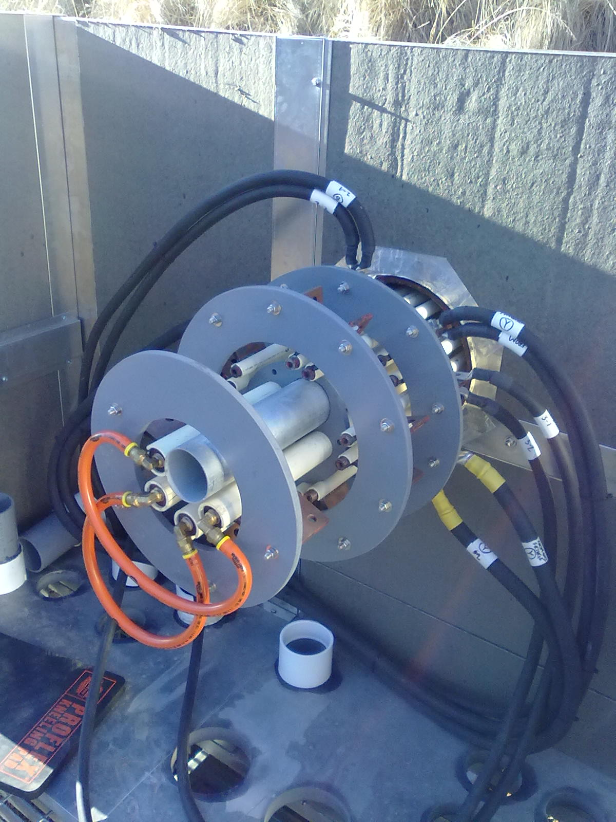
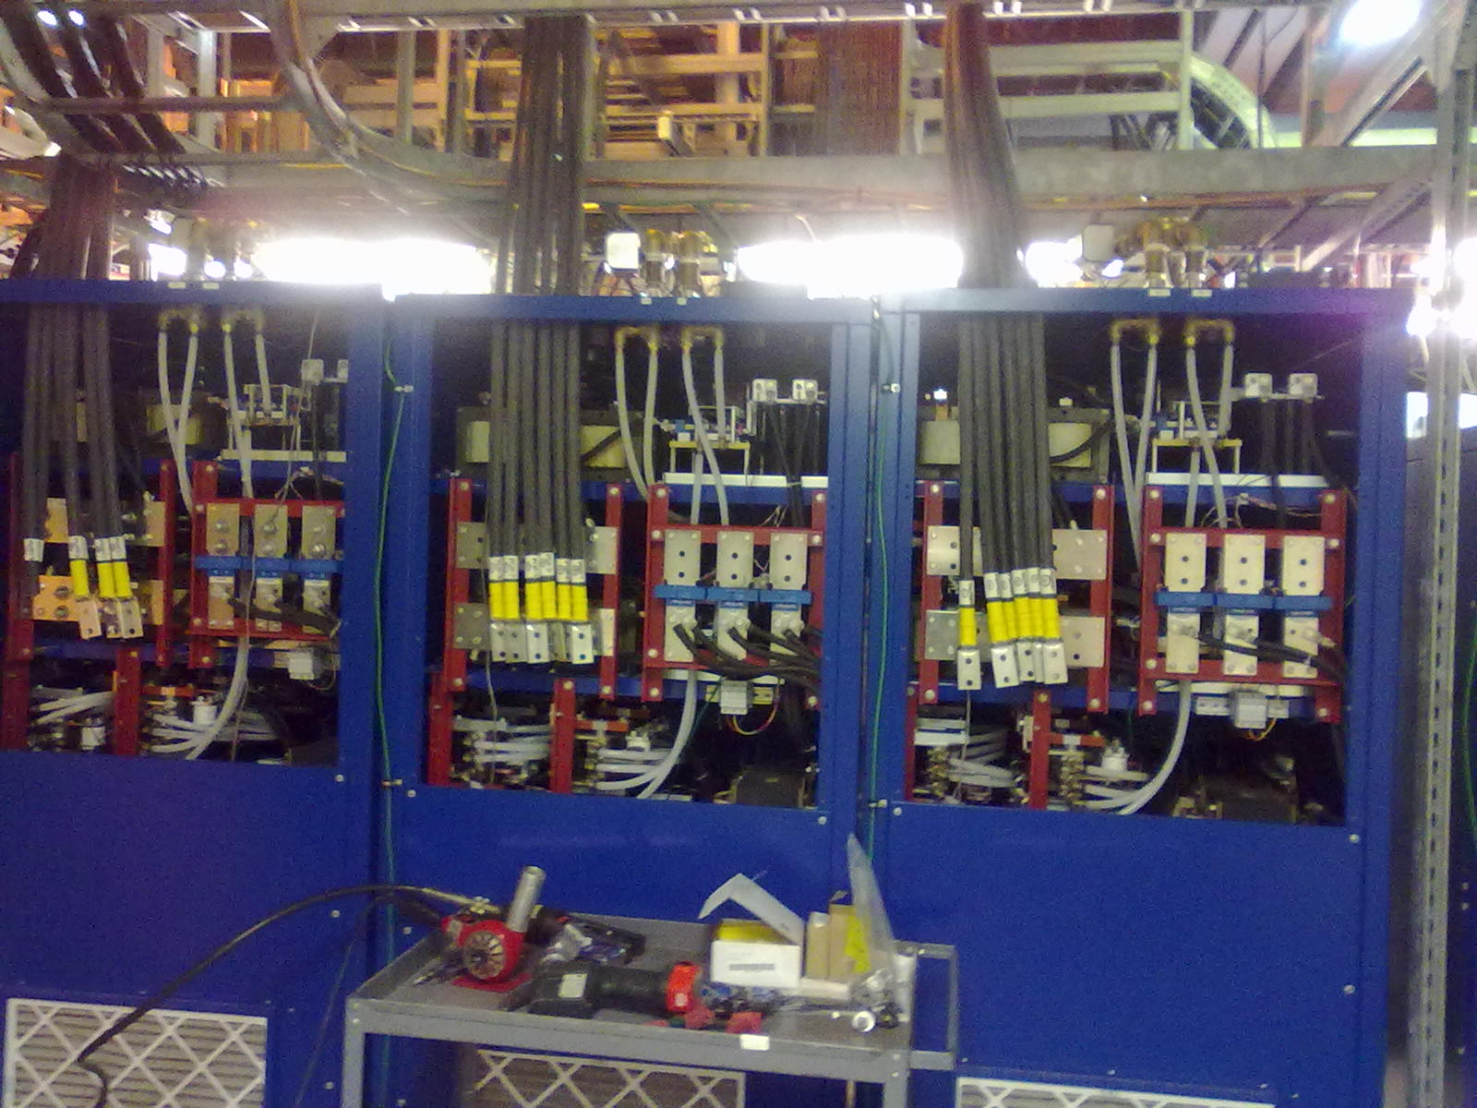
RHIC Electron lenses
Yellow e-lens in RHIC tunnel
leads of sc solenoid
drift tube
Y-pipe
water-cooled bus for warm solenoids
ps for warm solenoids

Slide 32
RHIC electron lenses - commissioning
2013 polarized proton run
Commission new lattice (Δψ_{x,y} = kπ) Commission new p-beam diagnostics (single bunch BTF, single bunch beam loss rates)
Commission Yellow lens superconducing solenoid
Commission Blue and Yellow lens warm magnets
Commission Blue lens electron beam and instrumentation
Summer 2013 shut-down
Install Blue superconducting solenoid
Measure/correct Blue and Yellow field straightness in tunnel
Complete installation (Yellow vacuum system, backscattered electron detectors)
2014 run
Commission both lenses with ion/proton beams

Slide 33
Options for tests with electron lenses in RHIC
Electron lenses can be used for test beyond HOBBC
Electron lenses are built for polarized proton operation ➔ test compatible with pp setup (Gaussian profile) are easy to accommodate ➔ can be done as soon as electron beams and interaction with hadron beam is commissioned (as early as 2014)
Test that require hollow lens are easier with heavy ion operation ➔ hollow gun needs to be manufactured ➔ ion collimation (break-up in primary) is different from proton collimation (scatter in primary) ➔ likely have to wait until 2015 and an ion run
Need support for simulations that accompany experiments

Slide 34
Summary – RHIC head-on beam-beam compensation
Simple principle – reverse beam-beam kick with beam of opposite charge
Need to control deviation from ideal compensation scheme – phase advance, lattice nonlinearities, bunch length, e-beam position and shape, noise in all parameters
To date one attempt at DCI (unsuccessful because of coherent modes), and a number of proposals (including hadron colliders SSC, Tevatron, RHIC, and LHC)
Electron lens technology well established today Tevatron electron lenses, EBIS and similar devices
RHIC electron lens test bench demonstrated required e-beam, lenses mostly installed, hardware under commissioning
Notes:
Have background picture of RHIC electron lens – in contrast to DCI picture

