Slide 1
Proof of Principle Cavity Preparation and Testing: BNL Double Quarter Wave Design
Binping Xiao
On behalf of the DQWCC team
04/09/2013

Slide 2
Outline
Cavity Design and Fabrication
Cavity Post-processing Status
Cavity Test Status
Summary and Reference

Slide 3
Outline
Cavity Design and Fabrication
Cavity Post-processing Status
Cavity Test Status
Summary and Reference

Slide 4
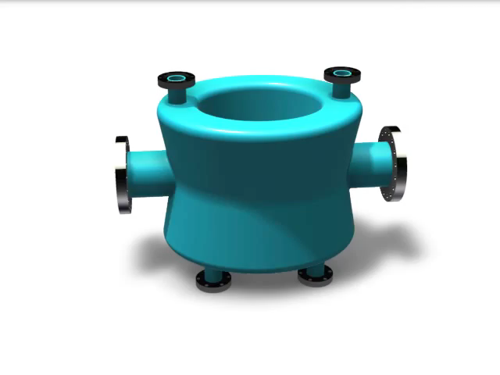
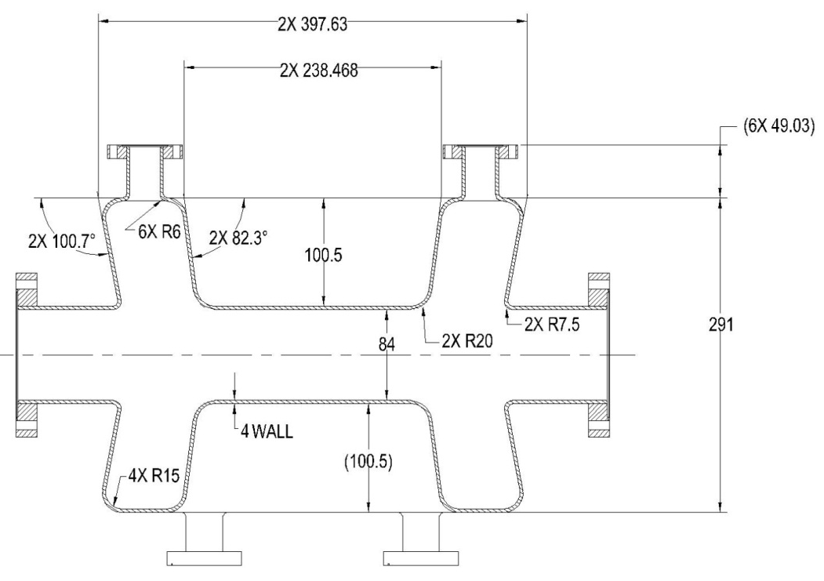
The Double Quarter Wave Cavity
390
296
362
 | Crabbing (fundamental) mode freq. | Cavity length | Cavity width | Beam pipe diameter | Deflecting voltage | Bpeak
Unit | MHz | mm | mm | mm | MV | mT
DQW crab cavity | 400 | 390 | 148 | 84 | 3 | 60**
** Might have some decrease in electric field on the cavity and increase of magnetic field at the port opening (ACE3P)

Slide 5
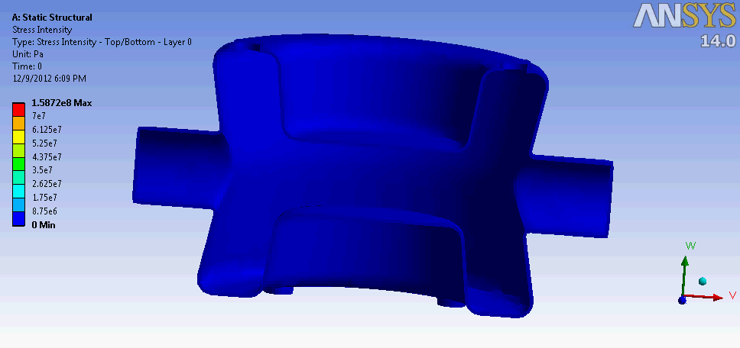
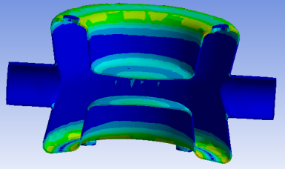
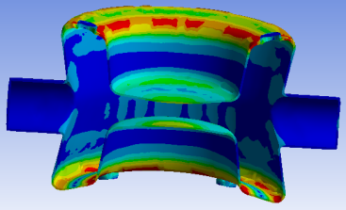
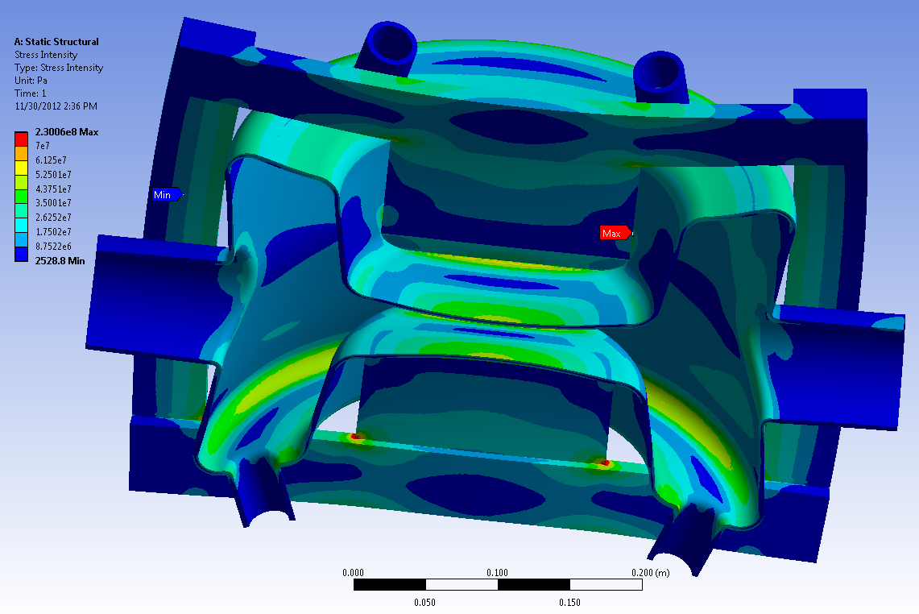
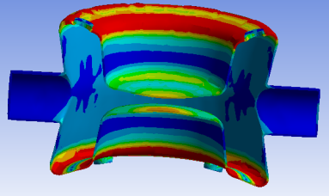
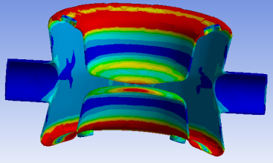
Cavity Stress Analysis
Pressure: 2e5 Pa (2 bar) outside, vacuum inside.
Fixed Support: One side of beam port.
Stiffening plates and frames are added to the cavity for vertical cold tests.
The material for stiffening components can be either Nb or Ti.
Bare cavity without stiffening frame
Cavity stress with stiffening frame

Slide 6
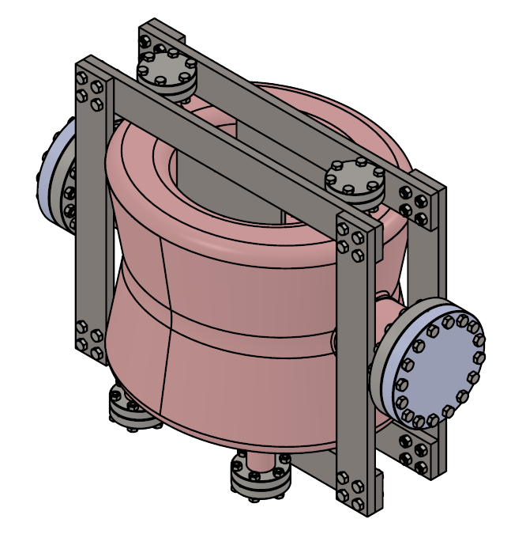
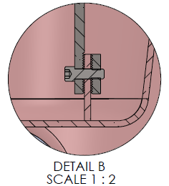
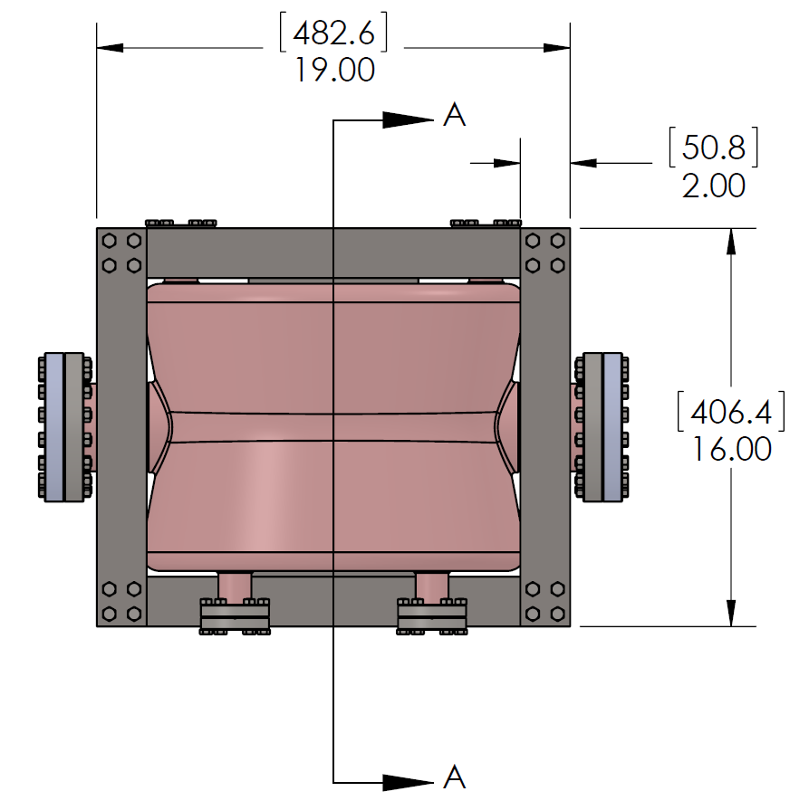
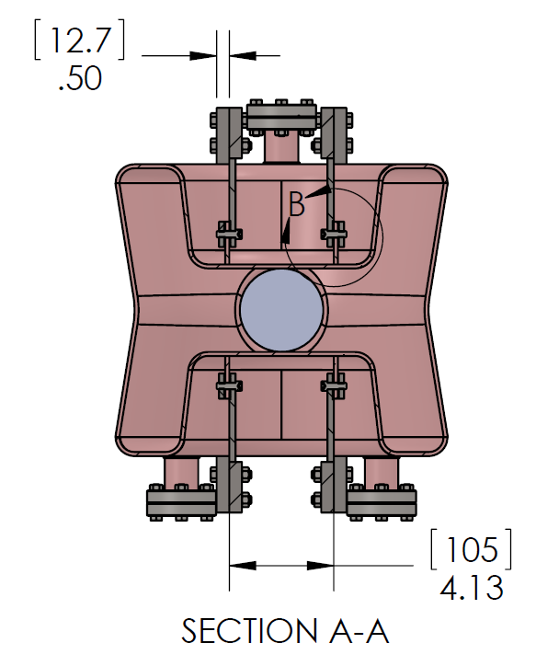
Design of PoP Cavity Stiffening
Stiffening material: Ti
Nb to Ti transition by serrated surface plus SS bolts
SS bolts and pins at frame connections

Slide 7
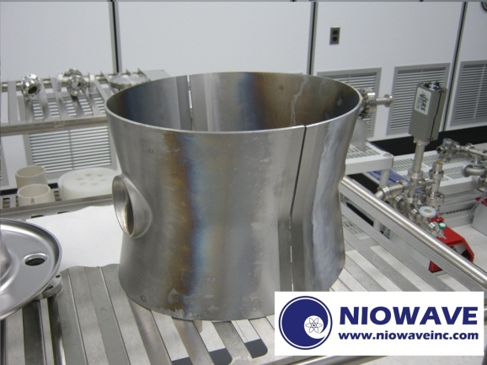
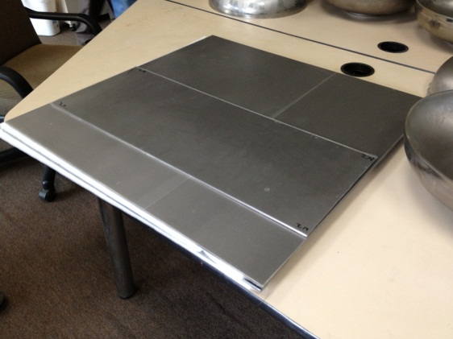
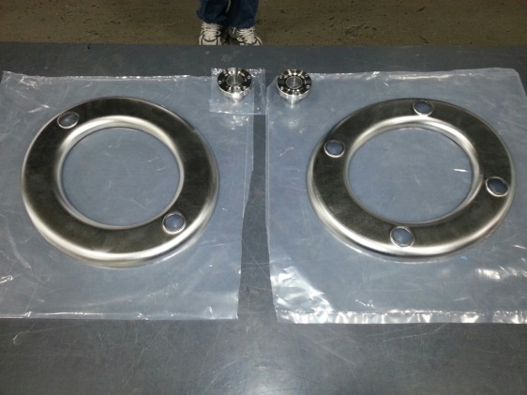
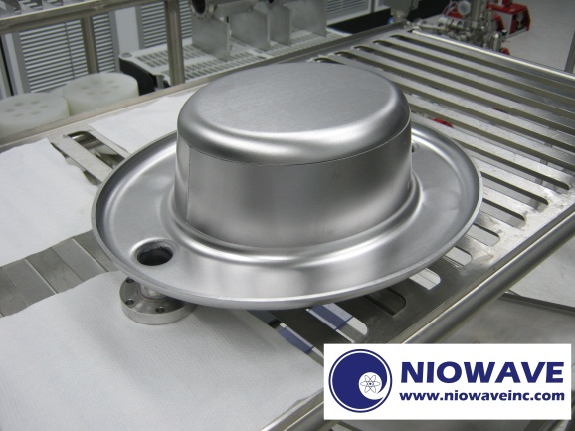
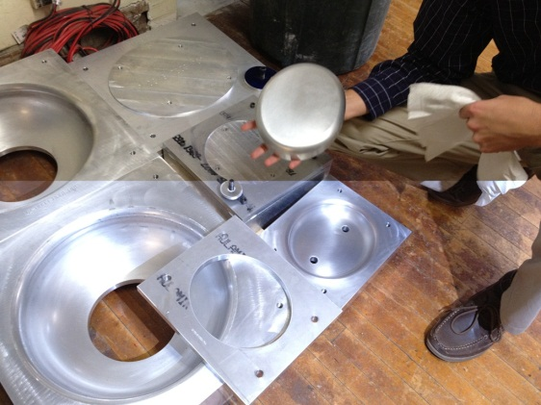
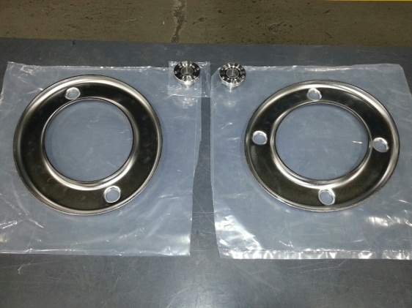
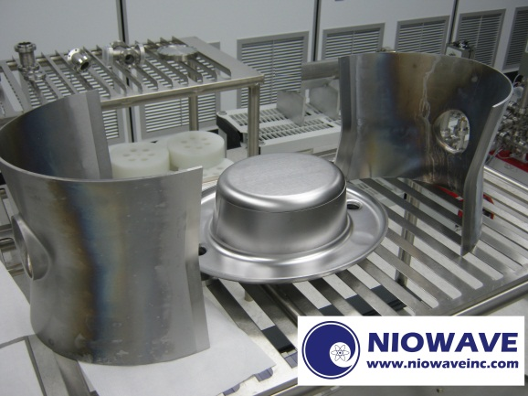
Fabrication of the PoP Cavity
Courtesy of Niowave Inc.

Slide 8
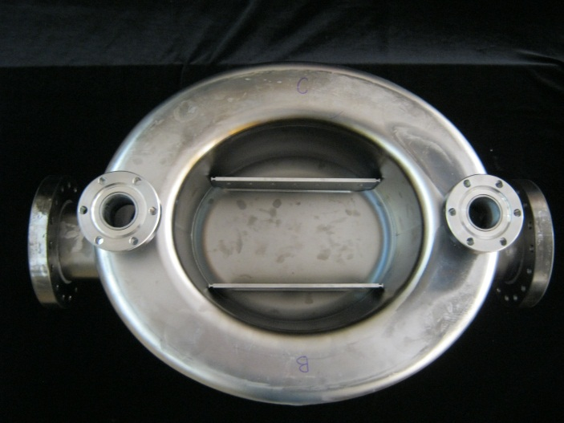
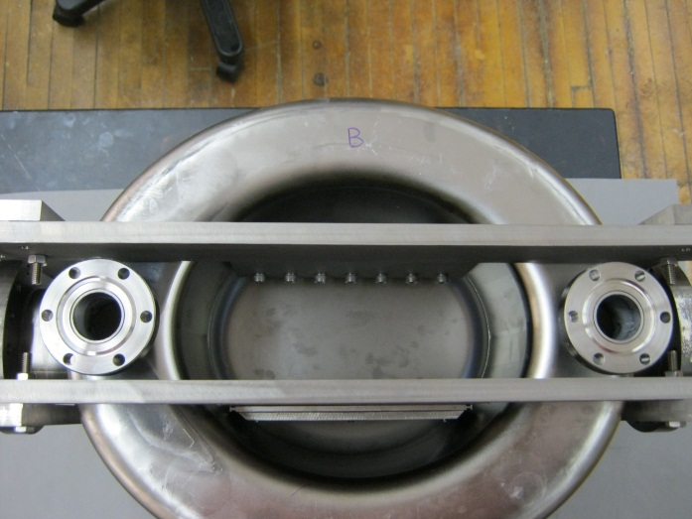
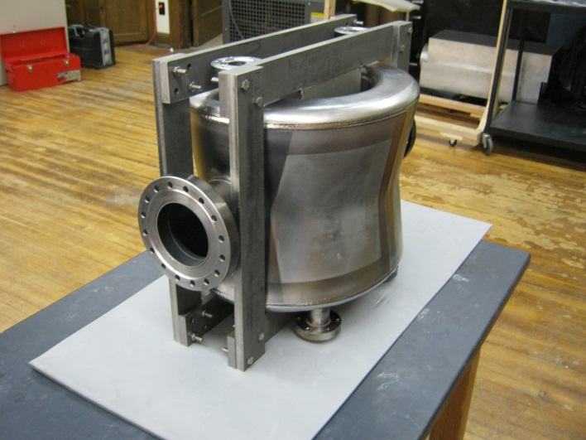
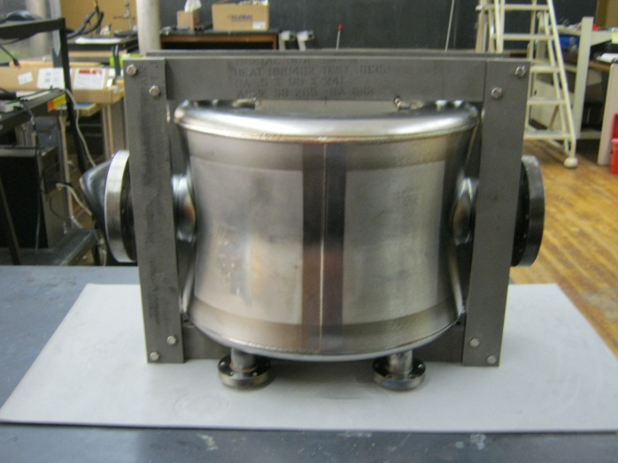
Fabrication of the PoP Cavity (2)
Courtesy of Niowave Inc.

Slide 9
Outline
Cavity Design and Fabrication
Cavity Post-processing Status
Cavity Test Status
Summary and Reference

Slide 10

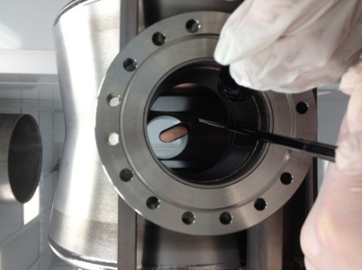
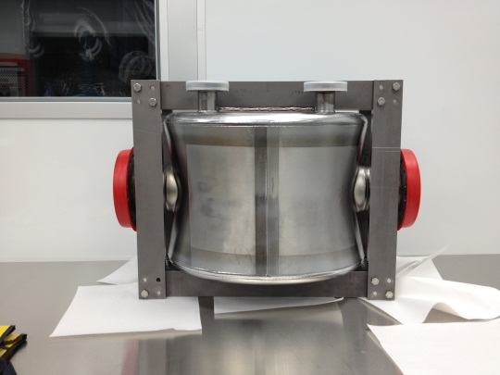
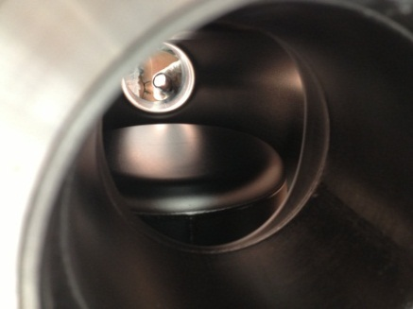
Post-processing of the PoP Cavity
shipped to BNL
machining, welding, buffer chemical polishing (BCP, 150 um) and assembling
Inspection upon receiving on Feb 25

Slide 11
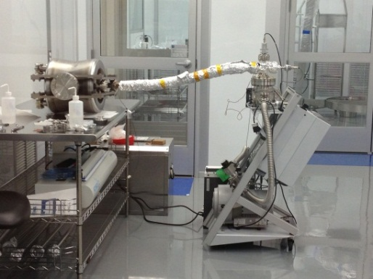
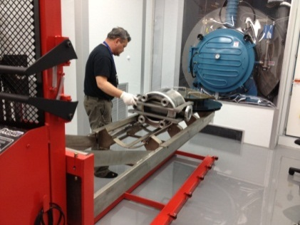
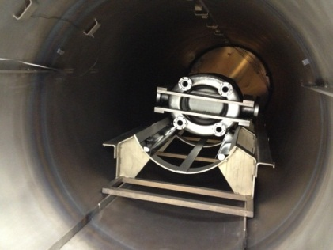
Post-processing of the PoP Cavity
Leak checking
10h 600°C vacuum baking. After baking, center resonant frequency is 403.3117 MHz, with room temperature unloaded Q at 5,400
Shipped back to Niowave on March 8 for light BCP and HPR, which are scheduled on April 8-12
Ship back to BNL for vertical test

Slide 12
Outline
Cavity Design and Fabrication
Cavity Post-processing Status
Cavity Test Status
Summary and Reference

Slide 13
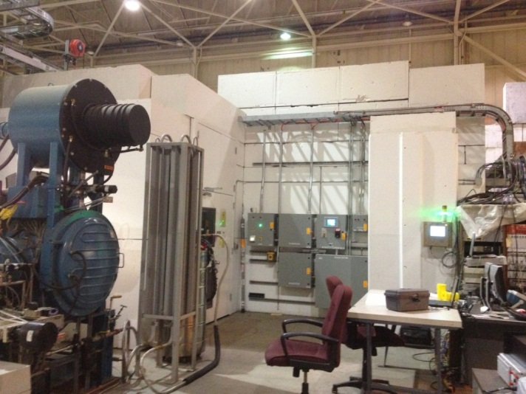
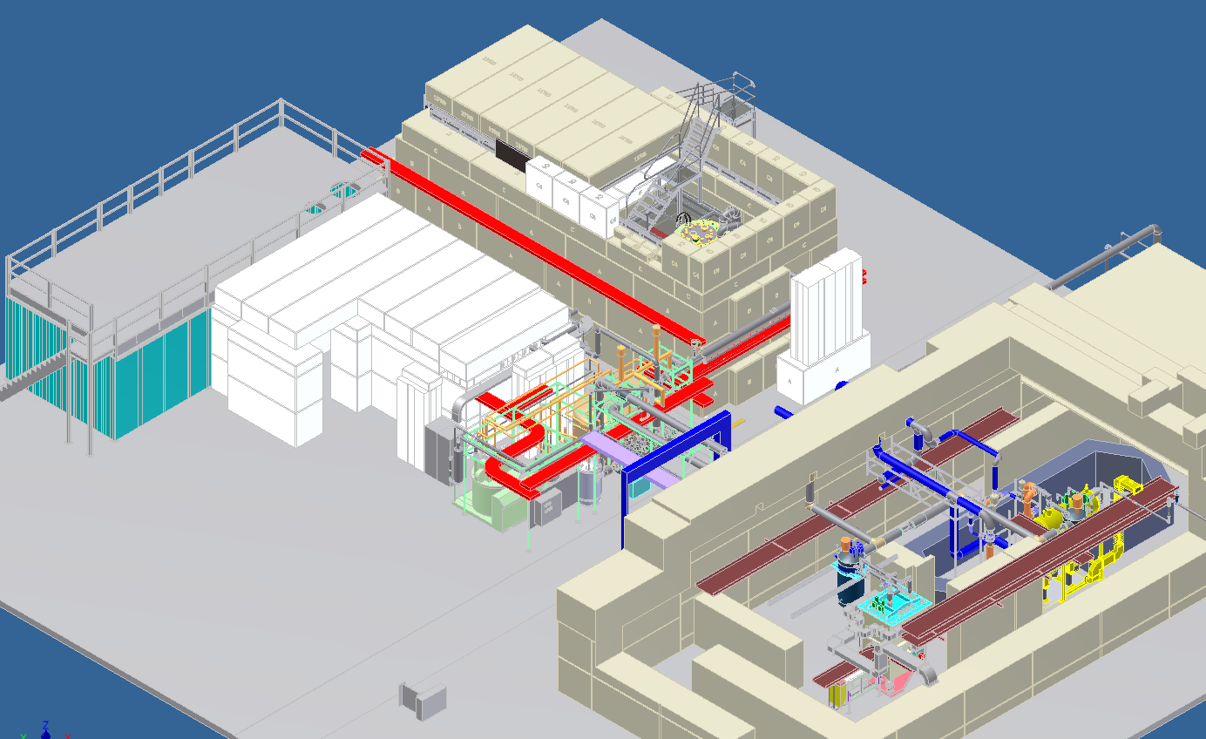
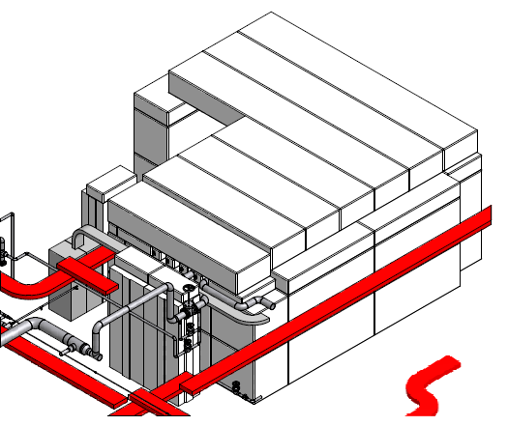
Vertical Test – Small VTF
Large Vertical Test Facility
Mezzanine clean room
ERL
Small VTF
Small VTF
ERL / VTF cryogenic system
SRF test facility in building 912

Slide 14
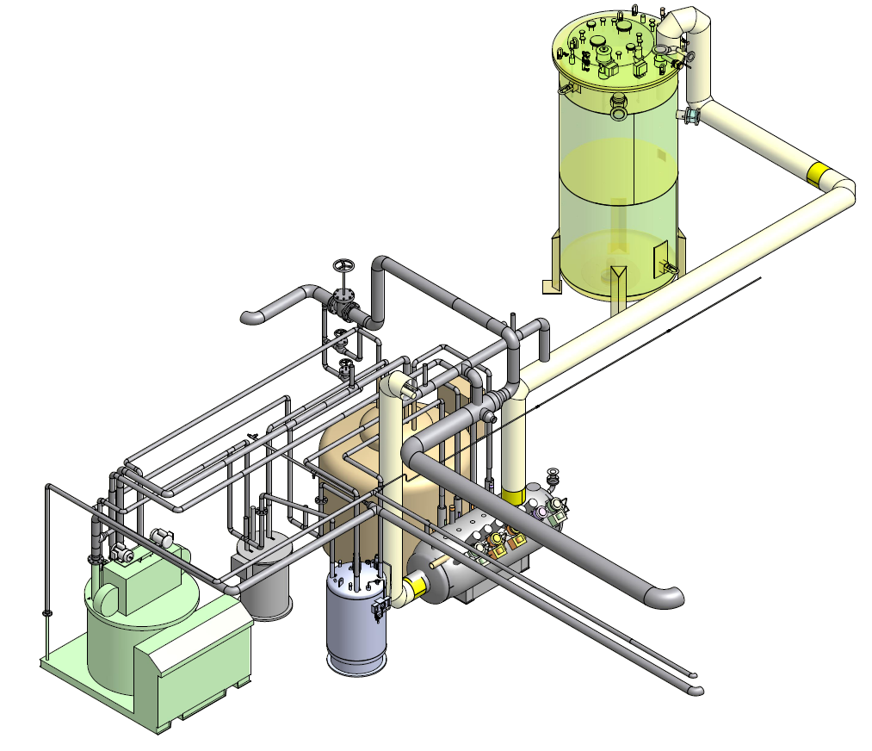
Vertical Test – Cryogenic System
360 W 4 K refrigerator.
A liquid ring pump is used to reach 2 K operation, capable of handling a 100 watt heat load.
1000 gallon LHe storage dewar.
38,000 gallon warm helium gas storage tank (outside the building).
VTF dewar
LHe storage dewar
Wet expander
1660 plant
Valve box
Sub-cooler

Slide 15
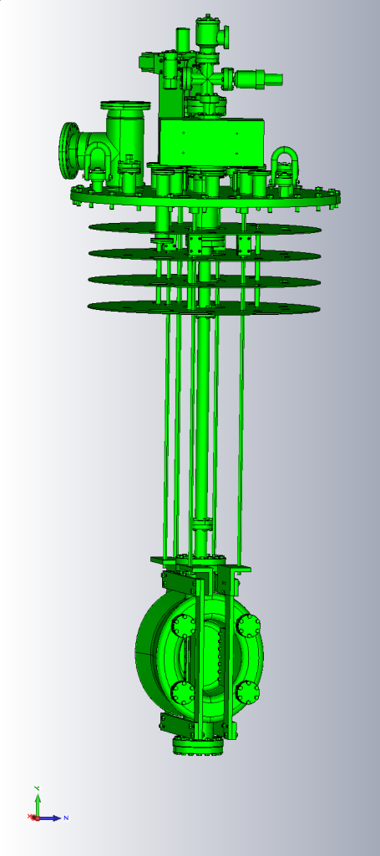
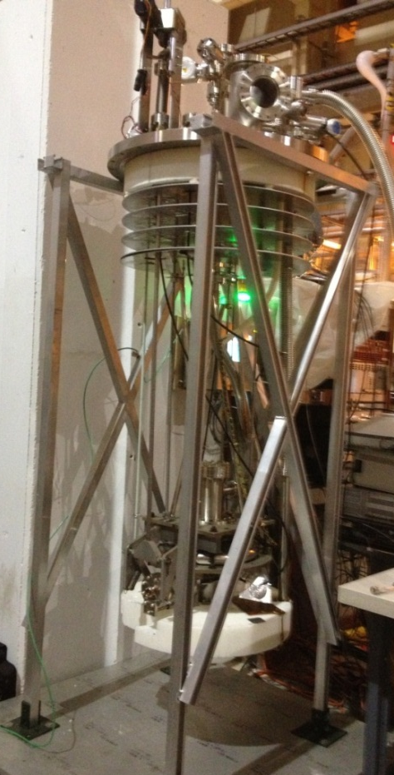
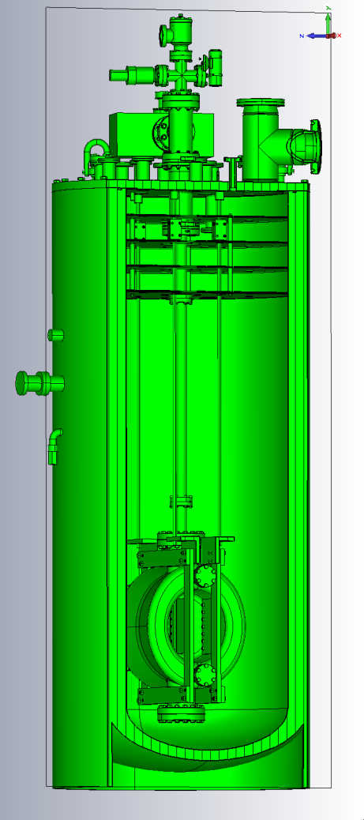
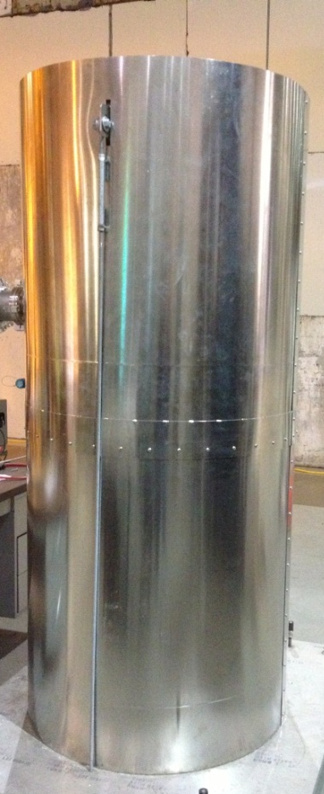
Vertical Test – Test Stand
Crab cavity in the SVTF Cryostat
Crab cavity mounted on the insert
Vertical cryostat insert
28” diameter vertical cryostat

Slide 16
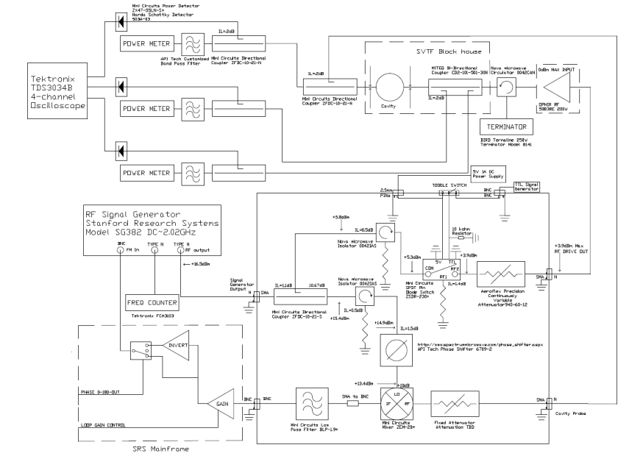
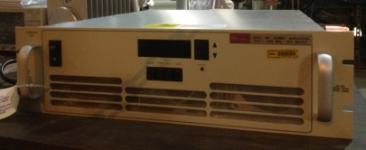
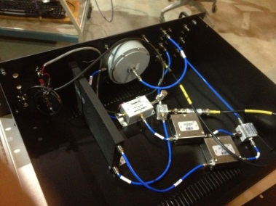
Vertical Test – RF System
200W max power
with 56±0.5dB gain

Slide 17
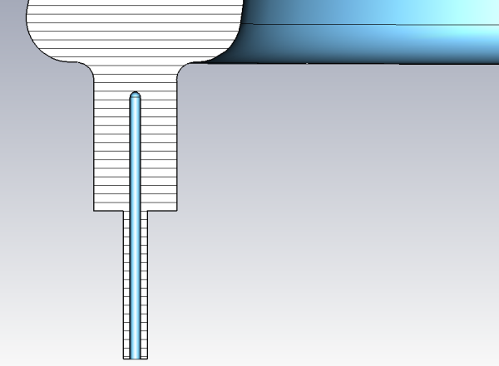
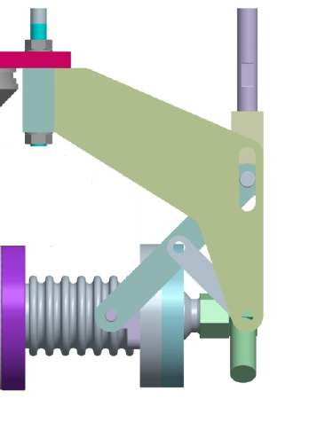
Vertical Test – FPC and PU Couplers
Mounting Rods (x4)
Drive Shaft
Probe position,
from 0 to 50mm
Actuator Drive & Linkage
Bellow with conflat flanges

Slide 18
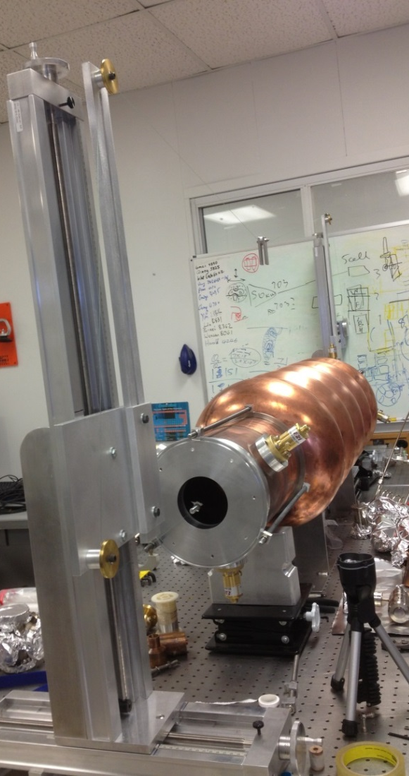
Automated Acquisition Bead Pulling System
Bead
Perturbation factors
Thread
Computer Driven Motor
Frequency shift calculated from S21 phase shift
Bead pull can be used for
HOM mode identification
Fundamental mode field flatness study

Slide 19
Outline
Cavity Design and Fabrication
Cavity Post-processing Status
Cavity Test Status
Summary and Reference

Slide 20
Summary
The DQWCC can provide high deflection voltage in a very compact dimension.
The peak surface field of the cavity is in a safe level at the target deflecting voltage.
Fabrication of the cavity with stiffening frame is complete.
Heavy BCP and baking are done, light BCP and HPR will be followed.
Vertical testing, first without HOM couplers then with HOM couplers will be carried out soon.
The vertical testing will be focused on deflection voltage, Peak fields and possible multipacting.
Bead pulling testing will be focused on the fundamental mode field flatness and HOM identification.
We are looking forward to testing the PoP Nb cavity.

Slide 21
Reference
S. Belomestnykh, Q. Wu, B. P. Xiao, presentations, LHC Crab Cavity Engineering Meeting, Fermi Lab, Dec 13-14, 2012
Q. Wu, R. Calaga & A. Macpherson, K. Brodzinski & L. Tavian, presentations, 2nd Joint HiLumi LHC-LARP Annual Meeting, INFN Frascati, Nov 14-16, 2012
R. Calaga, et. al., A Quarter Wave Design for Crab Crossing in the LHC, Proceedings of IPAC12, New Orleans, LA, May 20-25, 2012
Q. Wu, presentation, LARP CM18/HiLumi LHC Meeting, Fermi Lab, May 7-9, 2012
Q. Wu, S. Belomestnykh, I. Ben-Zvi, Novel deflecting Cavity Design and Fabrication for eRHIC, Proceedings of SRF11, Chicago, IL, July 25-29, 2011
R. Calaga, presentation, LHC-CC11, CERN, Nov 14-15, 2011
I. Ben-Zvi, presentation, LHC-CC10, CERN, Dec 15-17, 2010

Slide 22
Thank you!

