Slide 1
11 T Dipole Fabrication and Test Results
F. Nobrega
Fermilab
LARP CM20
April 8, 2013

Slide 2
Outline
Overview of the 11T program
Test results of the 1st two magnets
Near term plans
Conclusions

Slide 3
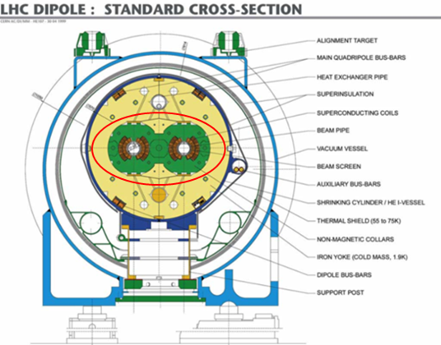
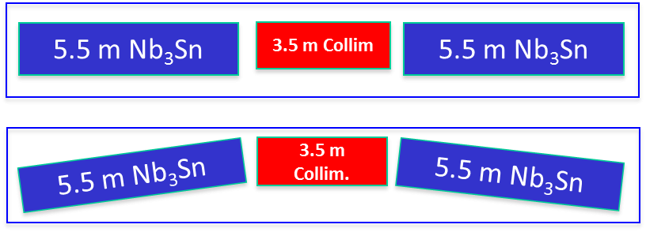
Nb₃Sn Dipole R&D (a.k.a.11 T Program)
Joint R&D program with CERN since FY2011 – main present activity
Goal: to demonstrate feasibility and build a twin-aperture 11 T, 5.5 m long Nb₃Sn dipole prototype by 2015
  Synergy of FNAL HFM program goals and LHC needs
  11 T dipole magnet must be compatible with the LHC lattice and main systems
Challenges and approaches
  First 2-in-1 Nb₃Sn magnet
  Larger aperture - 56 mm => 60 mm
  Long length ~11m => two 5.5-m long cold masses
  Accelerator field quality
  Larger Lorentz forces
  Large stored energy
A.V. Zlobin et al., PAC2011, March 2011

Slide 4
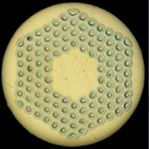
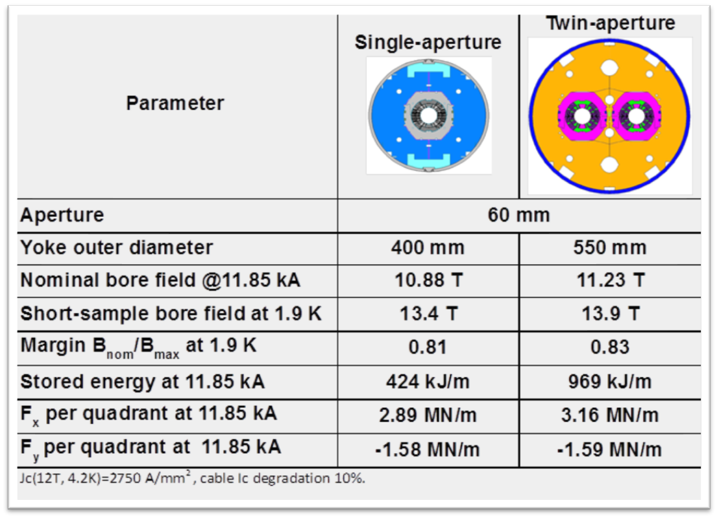

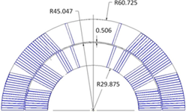
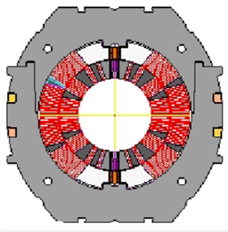
Magnet Design and Parameters
0.7 mm RRP-108/127
Nb₃Sn strand
40-strand cable
60-mm 2-layer 6-block coil
Two configurations: single-aperture and twin-aperture
Stainless steel collar

Slide 5
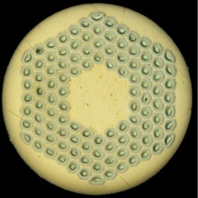
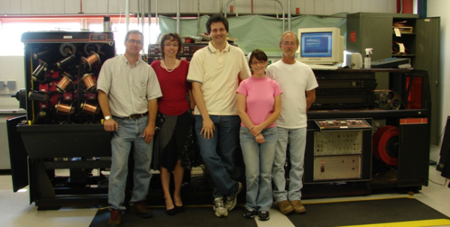

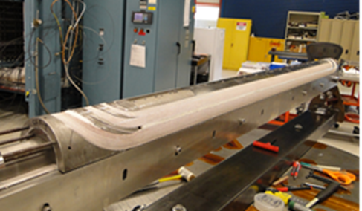
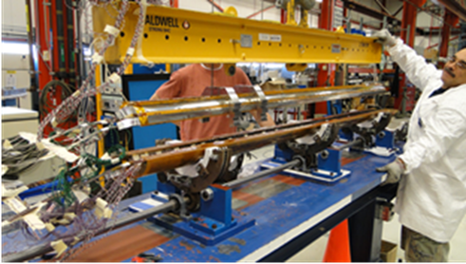
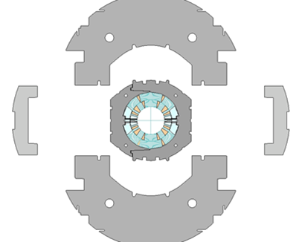
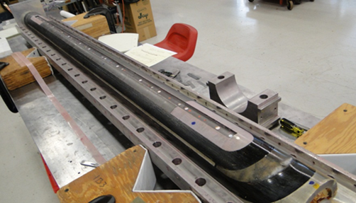
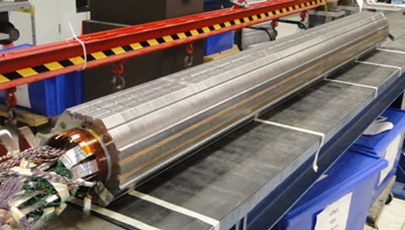
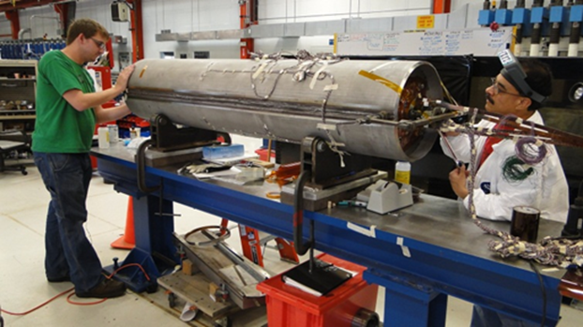
MBHSP01 - 2 m Long Demonstrator Fabrication
A.V. Zlobin et al., IPAC2012, May 2012
40-strand cable fabricated using FNAL cabling machine
Coil fabrication
Collared coil assembly
Cold mass assembly
Magnet development and fabrication was done in record time – 18 months (magnet assembly in 8 months)!

Slide 6
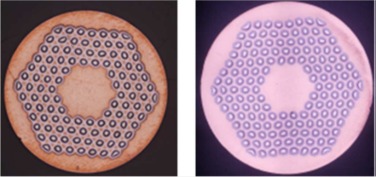
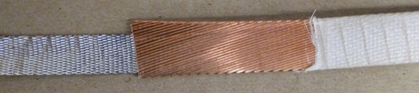
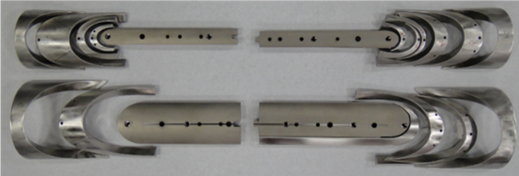
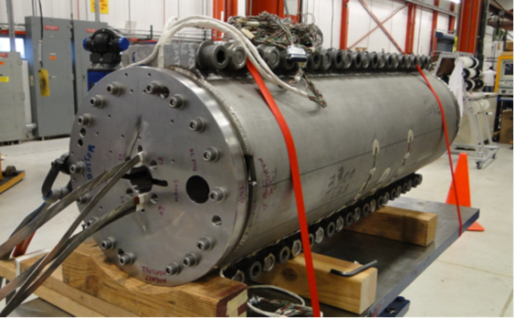
MBHSP02-04 - 1 m Versions of MBHSP01
Goals: demonstrate new R&D strand, cored cable, improved process and reproducibility
Strand:
  MBHSP02 – R&D RRP-150/169 strand
  MBHSP03 – baseline RRP-108/127
    Both strands were developed by OST and FNAL
Cable: both models use 40-strand cable with 12 mm wide and 0.025 mm thick stainless steel core
  Cored cable was developed at FNAL in FY12
Coil: optimized end parts and process
Structure:
  MBHSP02 – modified MBHSP01 collar
  MBHSP03 – mirror magnet (with bolt on skin)
  MBHSP04 – new collar (with bolt on skin)
MBHSP02 fabrication - 6 months!
MBHSP03 coil fabrication is in progress
40-strand cored cable
RRP 108/127 RRP150/169
Optimized end parts
MBHSP02 cold mass
MBHSP03 coil winding

Slide 7
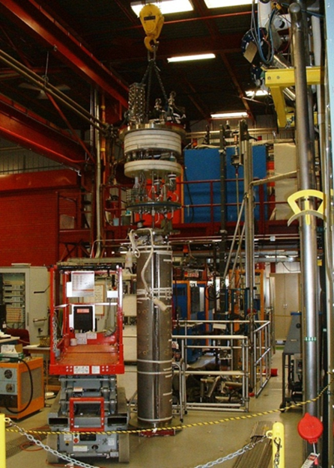
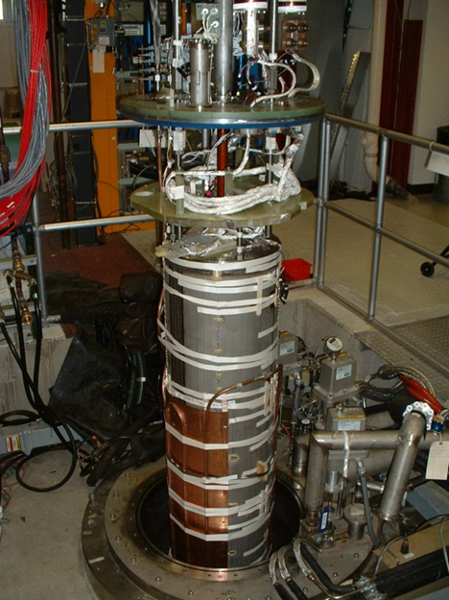
Magnet Test Preparation and Test Plan
Vertical Magnet Test Facility (FNAL)
Test plan:
Temperature range 1.9-4.6 K
Quench performance, margin*
Field quality*
Quench protection*
AC losses, splice resistance, coil RRR, etc.
Test status:
MBHSP01 – was tested in June 2012
MBHSP02 – test completed April 2013
*Accelerator quality parameters
Magnet installation in vertical dewar
(VMTF)
MBHSP01 mechanical and electrical connection to the Top Heat in IB1 (FNAL MTF)

Slide 8
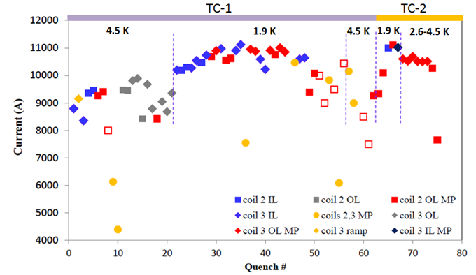
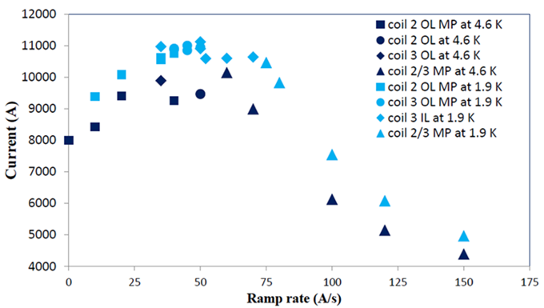
MBHSP01 Quench Performance
Design goal:
  B_{nom}=11 T with 20% margin
Limited quench performance
  B_{max}=10.4 T at 1.9 K and 50 A/s (78% of SSL)
  long training
  conductor degradation
  irregular ramp rate dependence
Quench performance was limited by conductor degradation in coil OL mid-plane blocks and leads
  lead damage during reaction - confirmed by autopsy
Appropriate improvements implemented in MBHSP02
A.V. Zlobin et al., ASC2012, Sept 2012
Quench history
Ramp rate dependence

Slide 9
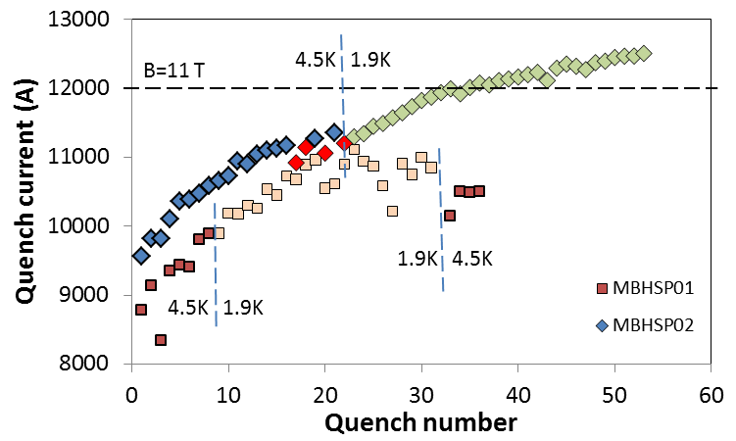
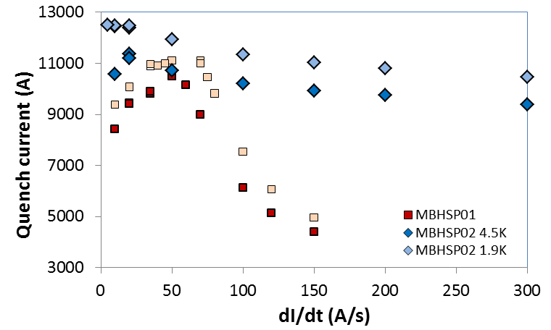
MBHSP02 Quench Performance
Test completed last week
  B_{max}= 11.5 T - 96% of design field B=12 T (78% of SSL at 1.9 K)
Improved quench performance
Issues to be addressed
  Long training
  Some conductor degradation
  Negative ramp rate dependence at dI/dt<20 A/s and 4.5 K
Next steps
  Assemble-test mirror MBHSP03 with new coil (Test if cable degradation is a coil fabrication issue or a magnet assy issue.)
  Assemble-test dipole MBHSP004 with larger pre-load, implement lessons from MBHSP02-03, improve performance, show reproducibility
  Assemble-test 1st 2-in-1 dipole model
Magnet training
Ramp rate dependence

Slide 10
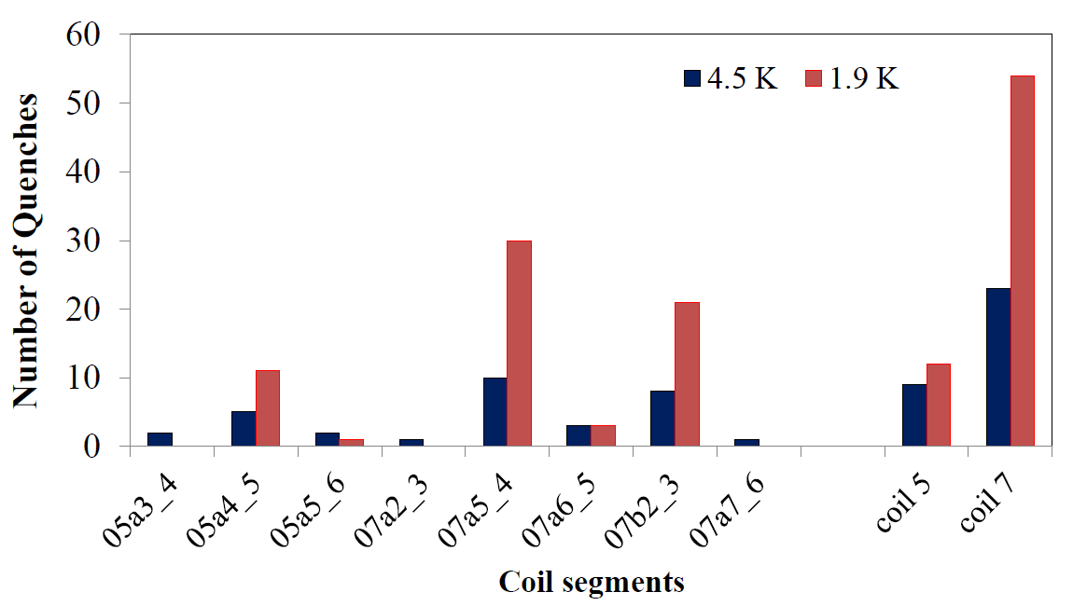
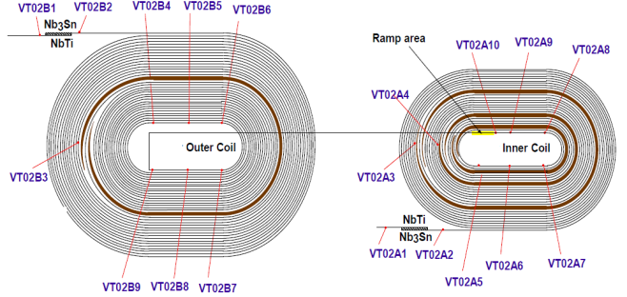
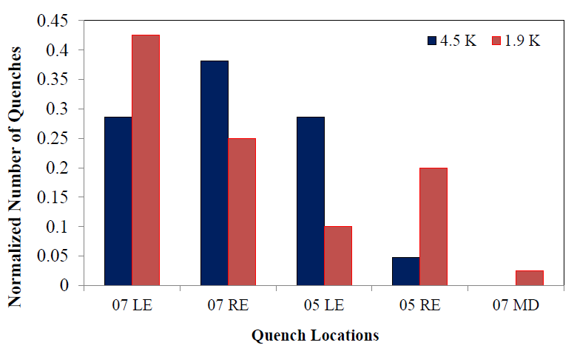
MBHSP02 Quench Performance
Most training quenches in a4_a5 and a3_a4 segments of coils #5 and #7 both at 1.9 K and 4.5 K
Quench locations moved to the mid-plane area of coil #7, segment b2_b3, at the end of 4.5 K training
All holding quenches in L2 MP segment b2_b3 of coil #7
Guram Chlachidze, HFM Mtg, April 2013
Multiplicity of the 1st quenching segments
Quench Antenna
Voltage tap location

Slide 11
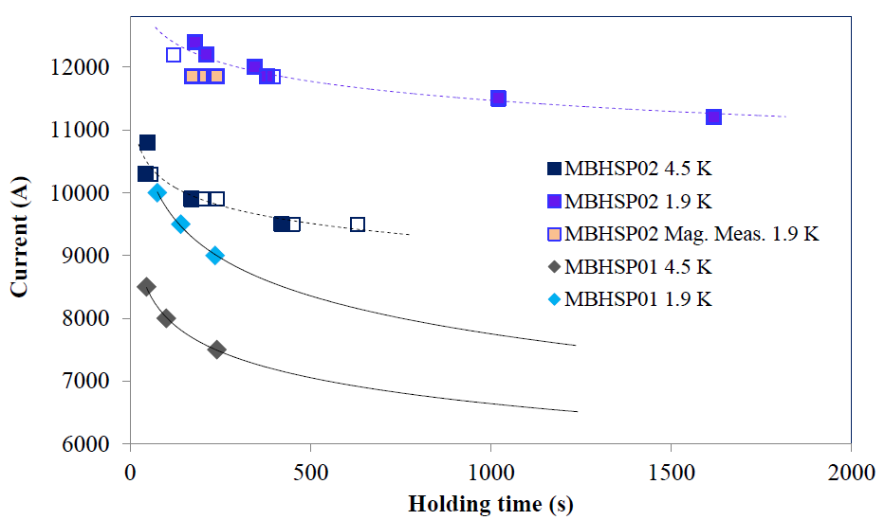
MBHSP02 Holding Quenches
Hold-to-quench tests were done both at 4.5 K and 1.9 K
All holding quenches developed in the outer mid-plane area of coil #7, segment b2_b3
Few spontaneous quenches developed during the 1.9 K magnetic measurements at 11850 A
Reproducibility of holding time checked at 1.9 K and 4.5 K; clear correlation found between the holding time and ramping pre-history (high vs. low)
Holding time and quench current was lower in MBHSP01
MBHSP01 holding quenches also developed in the mid-plane area: b2_b3 segment of coil #2
Guram Chlachidze, HFM Mtg, April 2012
After 1.9 K test

Slide 12
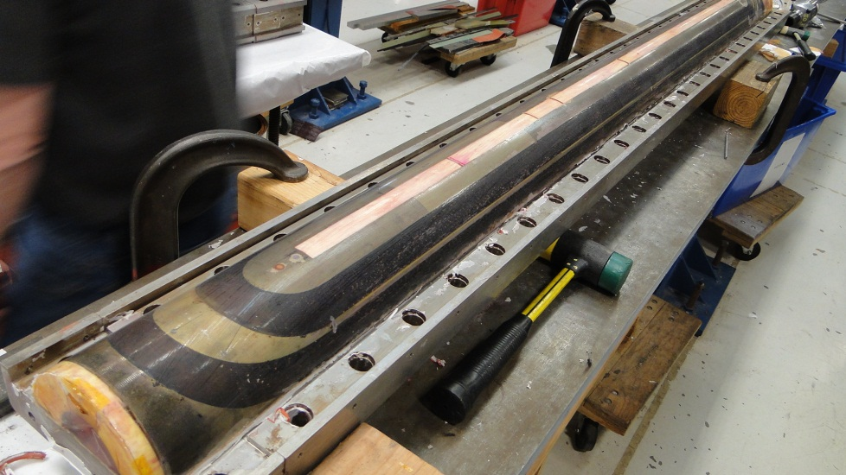
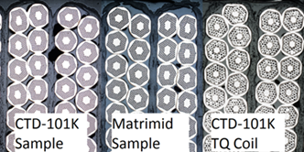
MATRIMID Coil – Next Steps
Technology scale up
  2-m long 11T dipole coil was
  successfully potted with
  MATRIMID
  Coil inspection is in progress
When resources allow make:
  5.5 m long 11 T dipole practice coil potted with MATRIMID
  2 m dipole MATRIMID coil tested a in dipole mirror structure
Cable test stack program to be completed
  mechanical, thermal and electrical testing of stacks at room temperature and 4.5 K using cables of various types
Radiation testing of MATRIMID coil samples is also planned in collaboration with LARP and CERN
R.C Bossert et al., ASC2012, Sept 2012

Slide 13
Conclusion
FNAL High Field Magnet R&D Program is well defined with present focus on Nb₃Sn magnets and technologies
Several advances have been made:
  The 1st single-aperture 2 m long 11 T demonstrator dipole has been developed and fabricated in record time (<18 months), tested in June 2012
  1 m dipole model with R&D strand, cored cable and optimized process was fabricated in 6 months, testing completed last week.
    B_{nom}=11 T was achieved and performance improvement demonstrated
  MATRIMID as a potting material for future Nb₃Sn accelerator magnets exposed to severe radiation environments has been demonstrated
  Nb₃Sn strands and cables suitable for high-field accelerator magnets have been developed and demonstrated
Issues of long training, reaching SSL, and negative ramp rate dependence are being addressed in next mirror magnet MBHSP03.
Program provides support and contributes to success of LARP

