Slide 1


IR Quadrupole Magnet Project
GianLuca Sabbi
LARP/Hi-Lumi Collaboration Meeting 20
April 8, 2013

Slide 2
Outline
Project plans: progress since CM19
  Magnet project in the LARP “scope selection” proposal
    Deliverables, contributions, milestones, funding profile
    DOE feedback and revisions for the next iteration
  IR Quadrupole requirements and interfaces (HiLumi DS)
Magnet development: current status and key issues
  QXF IR Quadrupole design and development
  HQ02, LHQ and additional R&D in support of QXF
Summary: main goals and discussion topics for CM20

Slide 3
Construction Project Proposal
Prepared in response to DOE request following the 2012 review
Funding envelope: 200 M$ construction + 4 more years of LARP at constant funding level
Planning group formed with contributors from all Labs
“Scope selection” proposal submitted to DOE in December
Magnet plan includes:
  Completion of R&D on 120 mm aperture models
  Development of 150 mm “QXF” prototypes (with CERN)
  Infrastructure upgrades for magnet production
  Fabrication of cold masses for Q1 and Q3 elements:
    4 m long; 2 pre-series, 16 cold masses and 2 spares
    2 production lines for coils and assembly
    All magnets tested in the US before shipping to CERN

Slide 4
Project schedule
Main project phases:
Prototype
development
Construction
start
Production
units
Spare
units

Slide 5
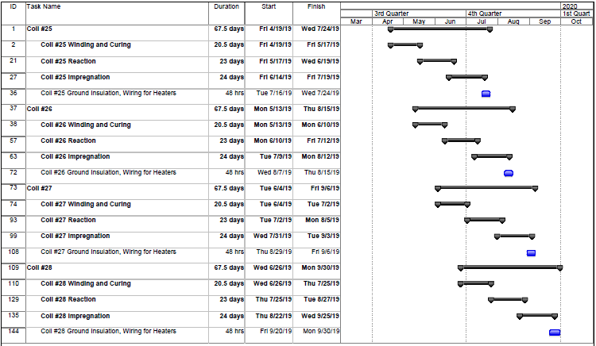
Coil production details
Production plan assumed two facilities working in parallel
Studies by BNL and FNAL with generally consistent results
Coil fabrication building block
Initial rate
(coil 1-10 at
each facility)
Coil production
at maximum rate

Slide 6
Funding Profile
Total IR Quad development and construction: 180M$
Includes 30% contingency (on construction only)
Project management not included (18M$ with 11% contingency)
Additional R&D not included (proposed as a GARD contribution)

Slide 7
DOE feedback on LARP proposal
Strong support for the magnet project – first priority – but:
  Formal project approval (Critical Decision process) will not start for the next several years
  Contingent on prototype results and a robust construction plan
  Still ok to assume CD-3 in 2017 for planning purposes
  Meanwhile, “project-like” approach with “CD-like” reviews
For the near term: update plan and budget assuming:
  Flat funding until 2015 - only option to augment LARP resources in 13-14 is through GARD contributions
  Additional “pre-project” funds may be available from FY15 to support construction infrastructure and long term procurements

Slide 8
Project plan updates
To date: incorporated most recent information
  Agreed on project funding profiles within DOE guidance
  Preliminary schedule assessment: additional 6-12 months
At CM20:
  Refine QXF development plan, taking “project” approach
  Continue discussion on GARD contributions
After CM20:
  Obtain formal commitments from contributing parties
  Look for possible improvements in production plan
    Error bars on magnet portion may have significant effect on the other two projects
Project reviews will follow

Slide 9
Magnet Specifications & Interfaces
Significant progress by the Design Study in the last months
  Details will be presented in Monday PM plenary session
Critical new information is being provided:
  Baseline layout with magnet position, gradient, length
  Cooling options and corresponding channel sizes
  Shielding options and corresponding radiation doses
  Field quality tables and limits on individual effects
Good news: it appears that we have sufficient flexibility in the overall design to find solutions compatible with available magnet technology in critical areas such as conductor, epoxy resins and mechanical structure design
  Further improvements are desirable but not a precondition for successful implementation of Nb₃Sn IR Quadrupoles

Slide 10
QXF Design Priorities
Three components are presently on the critical path:
  Superconducting cable (required for coil design)
  Cable insulation (required for coil design)
  Coil fabrication tooling (long procurement time)
In parallel, comparatively large effort on other aspects
  Magnetic, mechanical, quench protection, integration…
Need to optimize this investment:
  (+) Ensure compatibility of key choices with all requirements
  (+) Prepare to move forward rapidly
  (−) Avoid detailed optimizations using preliminary specs
    May have to be repeated, or worse,
    May prematurely “lock” sub-optimal design choices

Slide 11
Cable Optimization
Constraints Goals | Compaction | Keystone angle | Width (# strands) | Thickness (wire diam.)
Minimal degradation | Low | Low
No barrier damage | Low | Low
Mechanical stability | High |  | Low
Tight winding radii | High |  | Low | Low
Small filament diam. |  |  |  | Low
High field reach | High |  | High
Minimize peak stress |  |  | High
Low inductance |  |  | High | High
Low quench temperature |  |  | High | High
Few wedges/spacers |  | High | Low | High
Coil stress uniformity |  | High | Low | High
Conflicting objectives result in a complex optimization process

Slide 12
Quadrupole cables from TQ to QXF
Parameter | Unit | TQ/LQ | HQ1 | HQ2-LHQ | QXF(*)
Winding radius | mm | 90 | 120 | 120 | 150
Strand diameter | mm | 0.7 | 0.8 | 0.778 | 0.85
Number of strands |  | 27 | 35 | 35 | 40
Cable width | mm | 10.08 | 15.15 | 14.8 | 18.27
Cable thickness | mm | 1.26 | 1.44 | 1.375 | 1.50
Aspect ratio |  | 8.0 | 10.5 | 10.8 | 12.2
Keystone angle |  | 1.0 | 0.75 | 0.75 | 0.65
Core |  | No | No | 60% | 80%
(*)
prelim.
target
values
Larger aperture, energy and forces drive up cable width and aspect ratio
Winding remains challenging: aspect ratio, low keystone, thicker cable
Introduction of core is an additional challenge requiring process changes

Slide 13
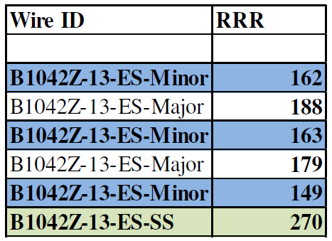
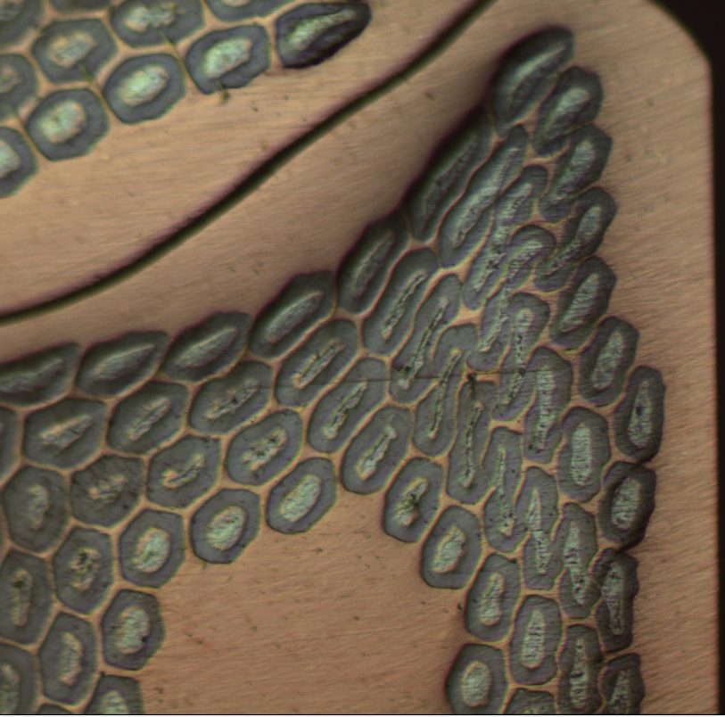
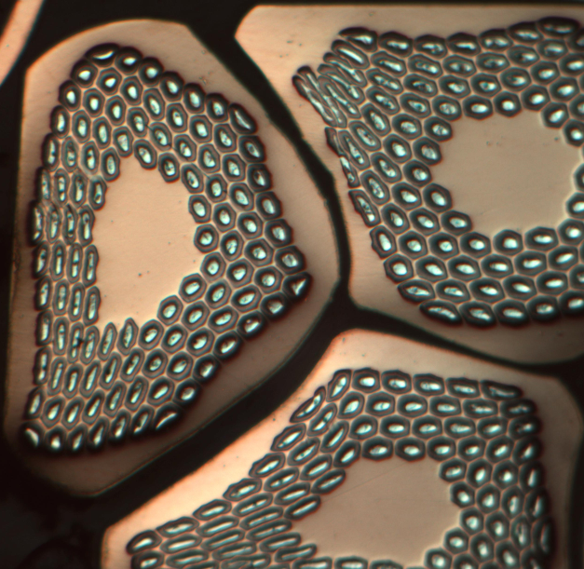
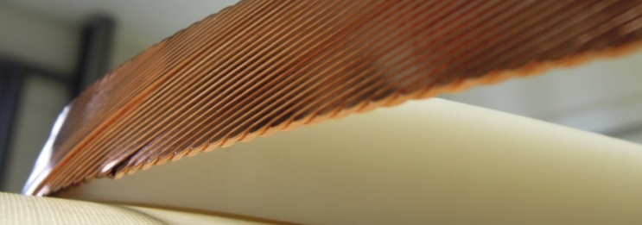
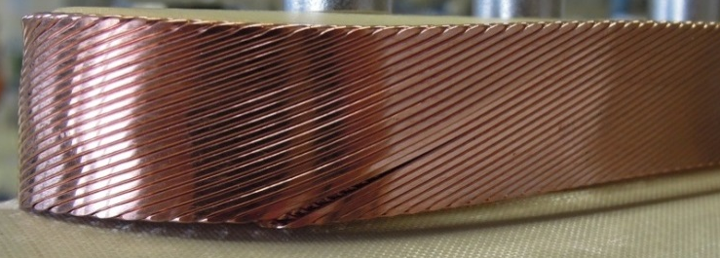
QXF cable development status
Cable design & fabrication – Dan Dietderich
Local RRR– A. Ghosh
Cable cross-section micrographs – Dan Dietderich
Winding tests – S. Izquierdo Bermudez

Slide 14
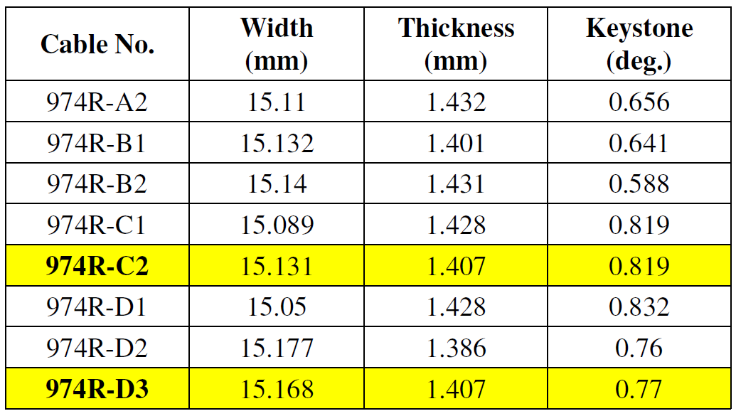
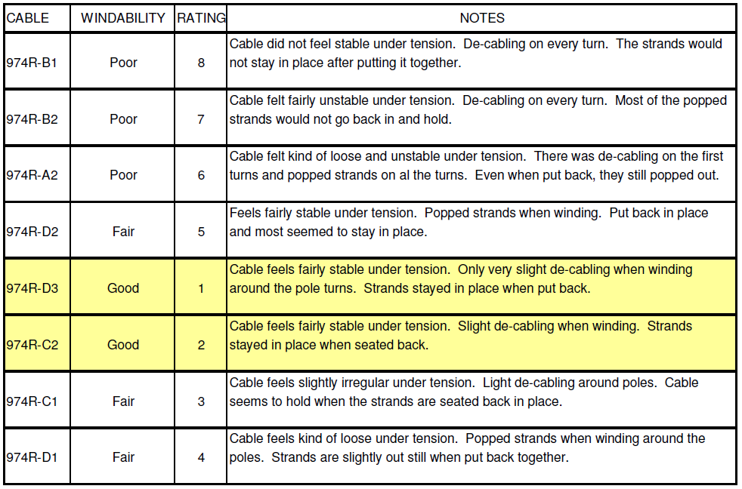
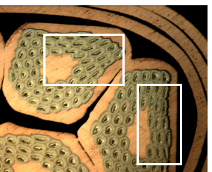
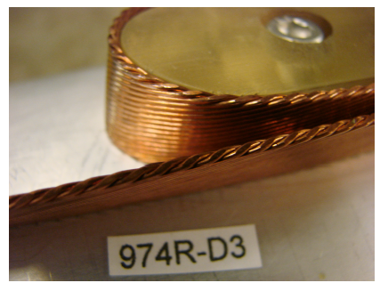
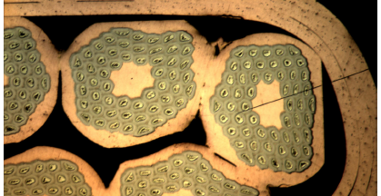
Comparison with HQ Cable
974R-C2
974R-D3
D. Dietderich, H. Higley, N. Liggins, J. Swanson (2008)

Slide 15
QXF Cable Development Strategy
We are raising the bar in both difficulty and expectations
  QXF requirements more challenging than TQ/LQ, HQ/LHQ
  …while demanding production-level robustness and margins
Most critical building block for the magnet
Progressively more difficult to make changes as program proceeds
It was agreed to invest additional effort in cable development
  Limited delay if tooling design/procurement can proceed
Strategy: perform additional optimization, but in parallel establish clear priorities to enable a decision
Challenges are not only technical
  Large and “new” multi-Lab team with different experiences
  First benchmark – see what lessons can be learned
High priority for CM20 - Details in Tuesday morning session

Slide 16
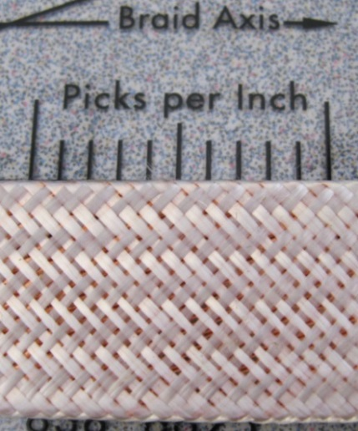
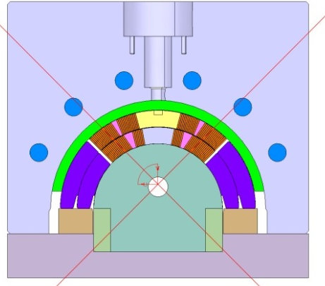
Cable insulation and coil tooling
Cable insulation spec also required for coil design
Initial baseline was a braid of 150 μm thickness
Need sample fabrication to confirm dimensions
125 μm option may be easier to produce
  Also attractive in terms of magnetic efficiency
Confirm electrical requirements/trade-offs
Coil tooling is currently on the critical path
Traditionally procured after final coil design
Add features to accommodate expected range
  Overall a better approach for first models
In both cases, it should be possible to resolve remaining questions during CM20

Slide 17
Recent progress on HQ/LHQ
HQ02 coil series completed:
  Reduced compaction, improved insulation, cored cable
  (presentation by F. Borgnolutti, Monday PM)
HQ02a model assembled:
  Achieved pre-load targets and contact with alignment keys
  Clear benefits from improvements in coil fabrication
  Improved coil uniformity and electrical QA
    (presentation by H. Felice, Monday PM)
HQ02 test preparations underway at Fermilab
Positive feedback from mechanical model of HQ alternate structure
    (presentation by J. Schmaltzle, Monday PM)
First LHQ coil wound and cured
    (presentation by Miao Yu, Monday PM)

Slide 18
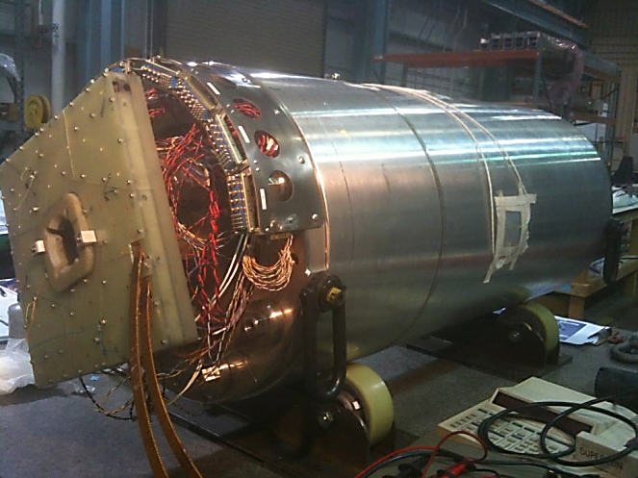
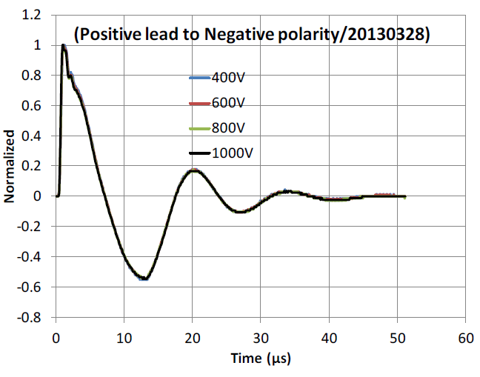
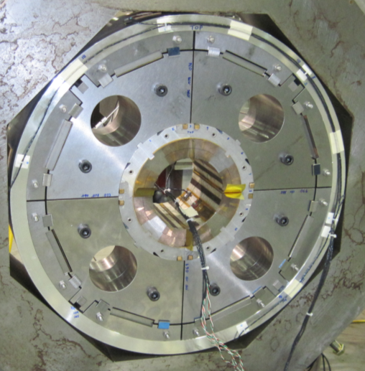
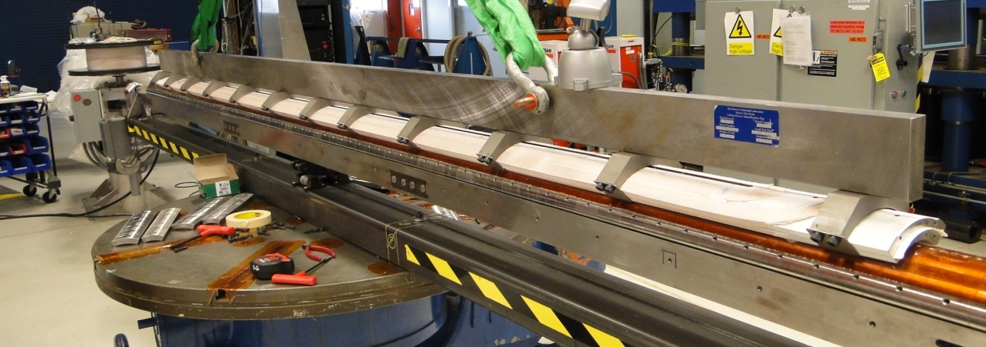
HQ and LHQ status
Assembled HQ02a magnet
HQ02a pre-load
HQ02a impulse test
Alt. structure model
Fabrication of first LHQ practice coil

Slide 19
Future R&D in support of QXF
Available platforms can efficiently support QXF and HiLumi DS
  Details were covered in CM19 presentation
Current plan includes HQ02 and LHQ mirror
No firm plans to carry out additional R&D beyond that
Leaves 1-2 year gap:
  HQ02 testing complete in 2013, first SQXF test in mid-2015
  LHQ complete by mid-2014, first LQXF test in early 2016
We need to find the optimal balance:
  Provide needed resources for QXF to move forward quickly
  Provide experimental feedback on key issues in the interim
Important topic for CM20 discussion and recommendations
Significant opportunities for GARD contributions in this area

Slide 20
Summary and CM20 topics
Discuss project plan updates/refinements and prepare reviews
QXF - technical
  Cable assessment, next optimization steps, design selection criteria
  Resolve remaining questions on cable insulation & tooling design
QXF - planning and schedule:
  Efficiency: use of infrastructure, avoid duplications of effort etc.
  Balance/priority between short and long models
    Technical: initial focus on short models, then scale-up
    DOE review: emphasis on long prototypes to enable project start
  How to formalize and manage contributions from different parties
R&D in support of QXF and the HiLumi design study:
  Evaluation of HQ/LHQ results and next steps
  Future needs and optimal resource balance
  Continue discussion on GARD contributions

