Slide 1
Studies of Electron Cloud Growth and Mitigation at CESR-TA
J. Calvey
Cornell University

Slide 2
Outline
Overview electron cloud
The CESR-TA program
  Overview
  EC buildup studies
  Retarding Field Analyzers
Cloud measurements and mitigation tests at
CESR-TA
Simulations
  Detector modeling
  Fitting data

Slide 3
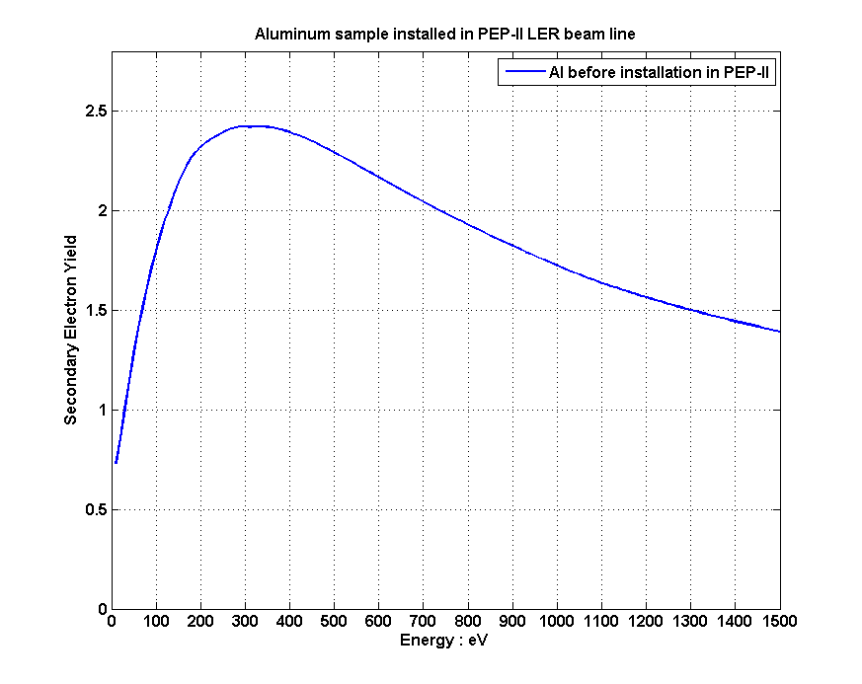
What is electron cloud?
F. Ruggiero
Buildup of low energy electrons inside vacuum chamber
  Typical density ~ 10¹¹ - 10¹² e- / m³
  Typical energy ~< 200 eV
Generated by photoelectrons produced by synchrotron radiation
  Or ionization of residual gas, beam particle loss, etc
Electrons gain energy from beam kicks
Additional (low energy) electrons from secondary emission
  Determined by the secondary emission yield (SEY) function δ(E)
  If average SEY > 1, exponential cloud growth
  Low energy yield determines cloud lifetime during train gap (~100 ns)
Cloud growth ultimately limited by space charge
Causes emittance growth, instabilities, gas desorption…
  Especially from positively charged, high intensity, low emittance beams
Aluminum

Slide 4
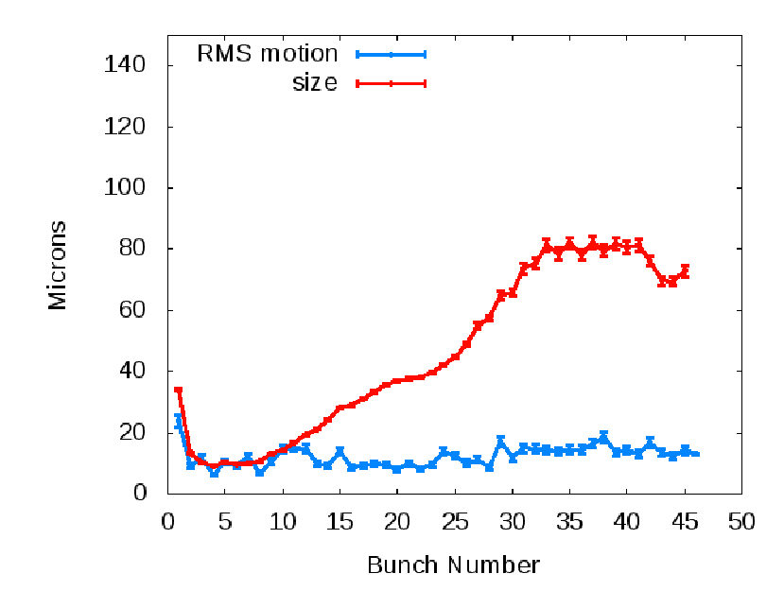
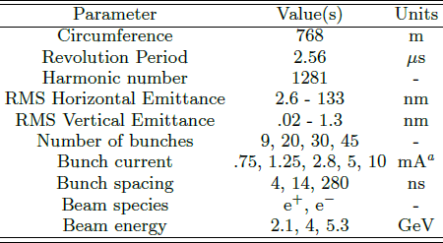
What is CESR-TA?
In mid 2008 CESR was converted from a e+/e- collider to a “damping ring” configuration, to study issues related to the ILC damping ring
Areas of research:
  Low emittance tuning
    Improved BPMs, XBSM…
    Typical vertical emittance: ~10 pm
  Studies of electron cloud growth and mitigation
  Studies of electron cloud induced emittance growth
  and instabilities
CESR is well suited to accelerator
physics studies
  Similar parameters to
  ILC damping ring
  Very flexible
Collaborators: APS, SLAC, KEK,
CERN, LBL
Emittance growth
CESR Parameters

Slide 5
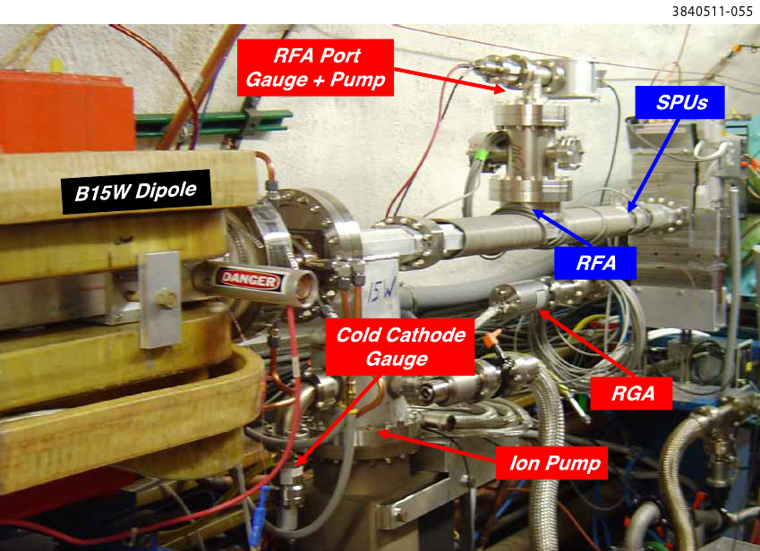
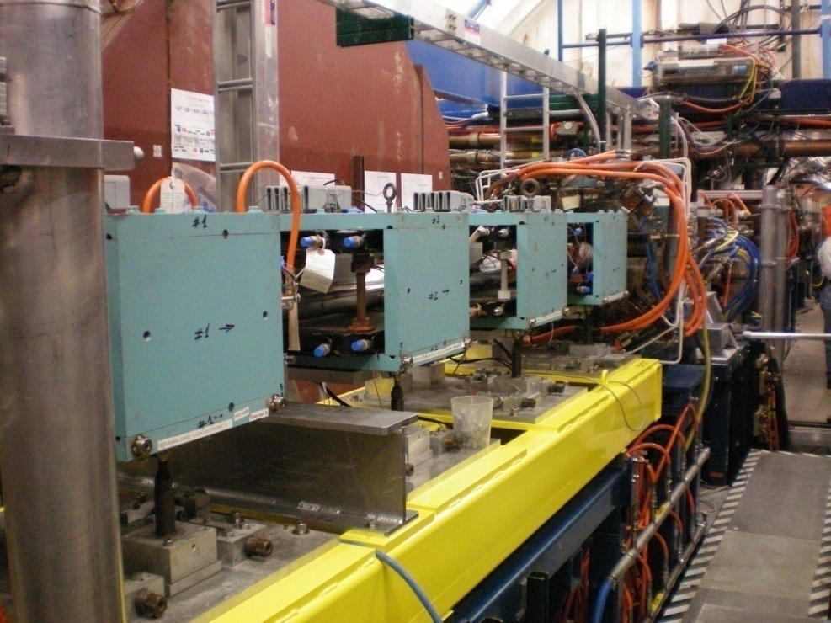
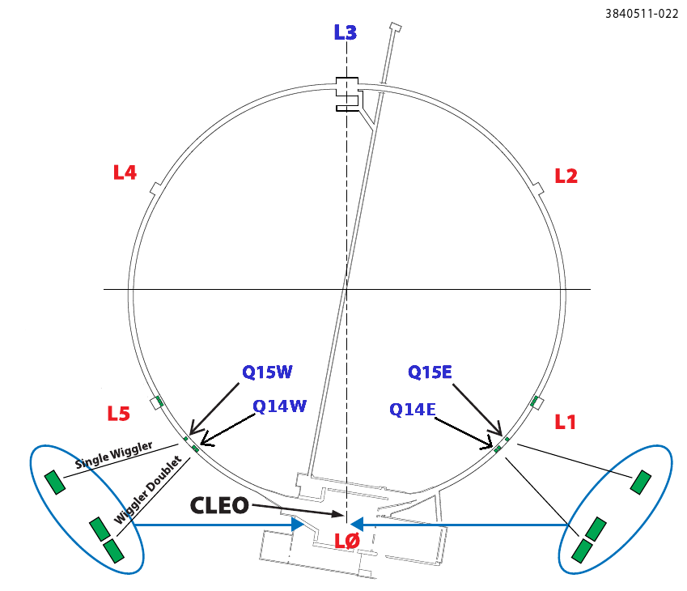
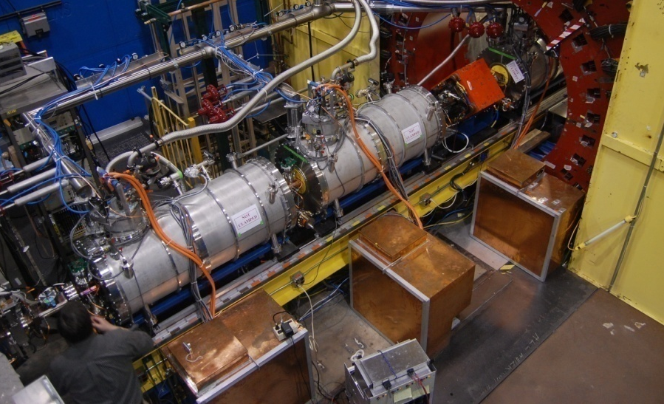
EC Buildup Studies at CESR-TA
Retarding field analyzers
  Measure electron cloud wall flux, with transverse and energy resolution
  Many RFAs (~30) deployed in CESR
  In different environments: drift (field free), dipole, quadrupole, wiggler
  Designs for insertion in confined spaces
  Dedicated RFA measurements
    Under different beam conditions
    In vacuum chambers with different mitigations
    Over time, to observe beam conditioning
    In combination with other EC diagnostics
      Shielded pickups
      Microwave propagation
  Large data set, 4+ years of measurements
  Proportionally large simulation program
Main electron cloud experimental regions
  Q15 E/W: drift mitigation experiments
  L3: chicane dipoles, NEG section,
  quadrupole
  L0: wigglers
4/9/2013
5

Slide 6
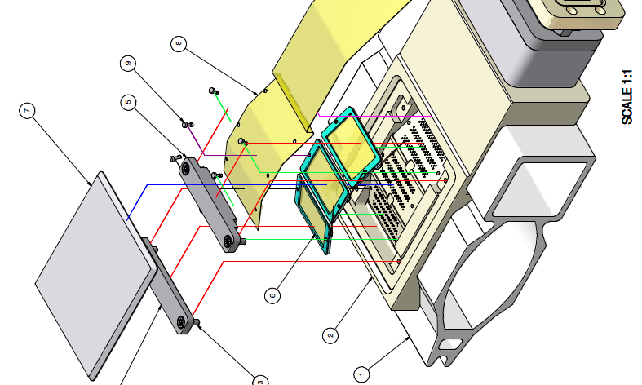
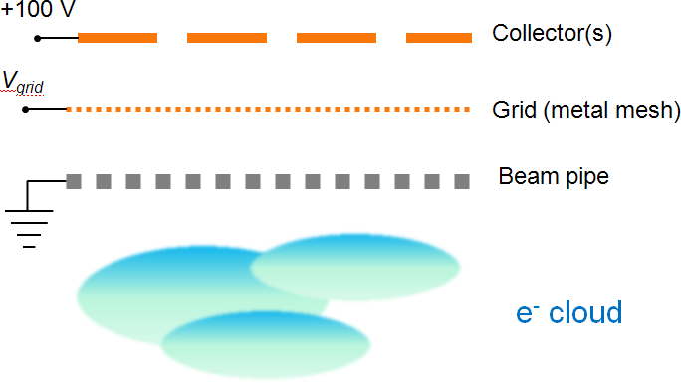
Retarding Field Analyzers
A method to measure the local electron cloud wall flux, and infer the cloud density, energy, and transverse distribution. They consist of:
  Holes drilled in vacuum chamber wall
    Allow electrons to enter device
  Retarding grid
    Reject electrons with E < V_{grid}
    Scan retarding voltage -> integrated energy spectrum
    Additional grounded grids optional
  One or more collectors
    Segmented transversely to study spatial distribution

Slide 7
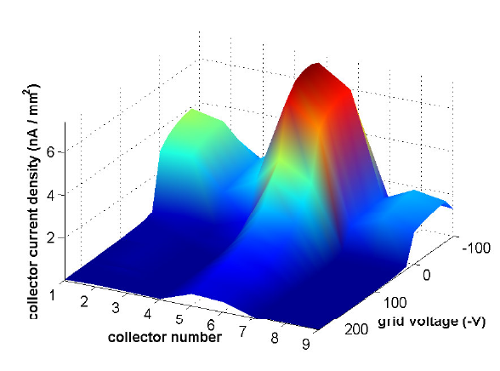
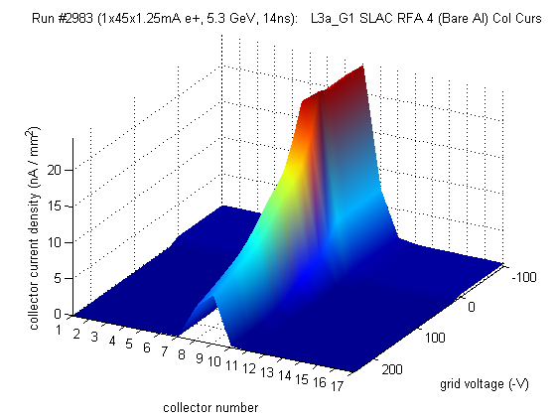
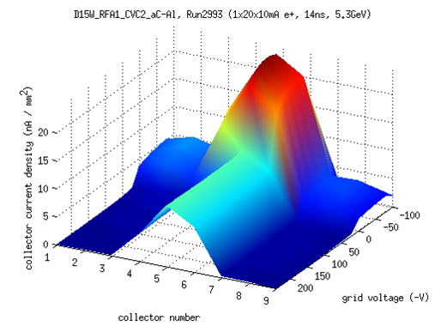
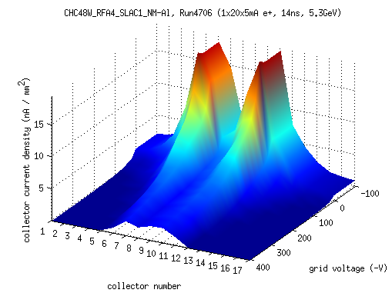
RFA Measurements
Plots shows voltage scan done with 45 bunches, 14ns spacing, 5.3 GeV
  Collector signal vs retarding voltage (~integral of energy) and collector number (~transverse position)
  Drift: broad signal across collectors, peaked at center (beam location)
    Low current: high flux of low-energy electrons
    High current: more signal especially at high energy
  Dipole: central peak more pronounced
    Electrons pinned to field lines
    High current: peak bifurcates
8x10¹⁰ e⁺/bunch
2x10¹⁰ e⁺/bunch

Slide 8
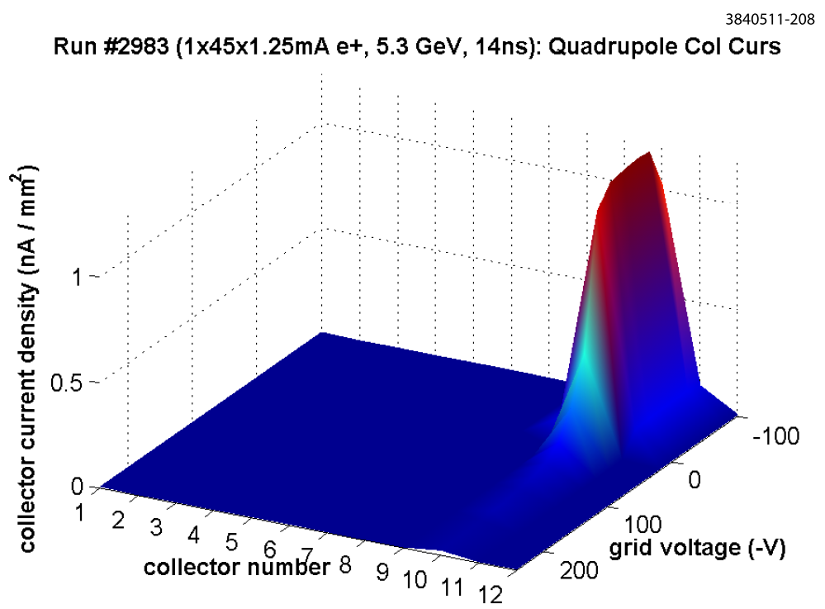
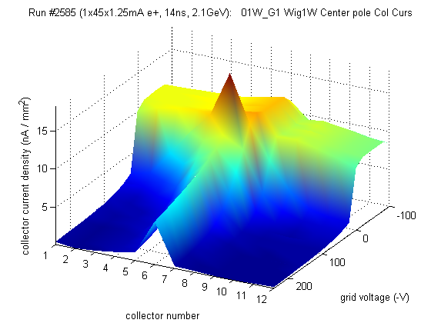
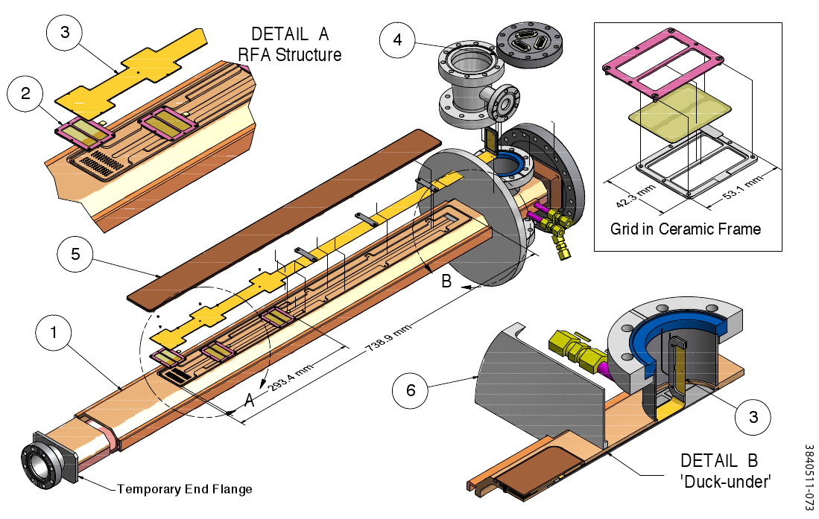
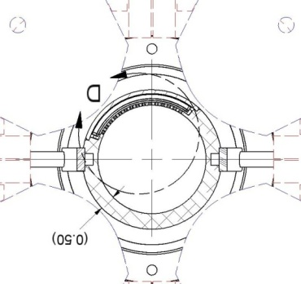
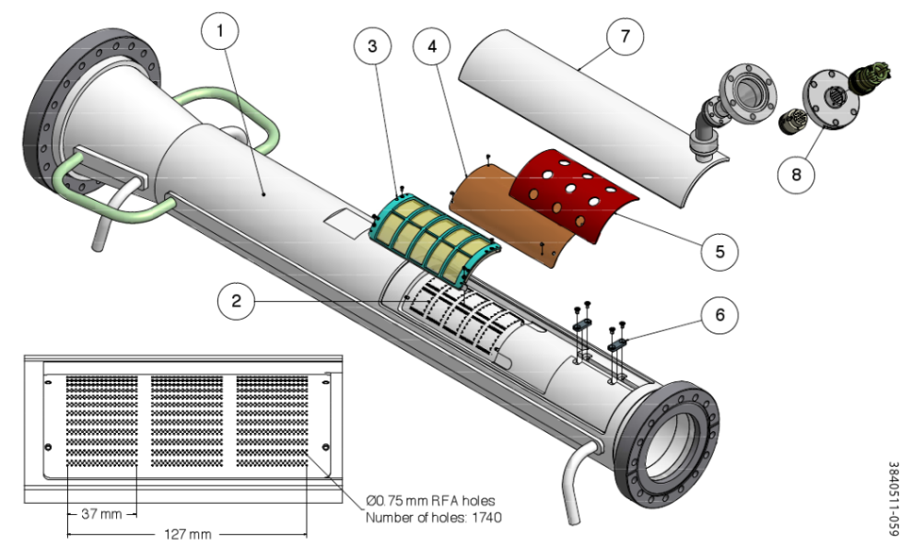
RFA Measurements II
Plots shows voltage scan done with 45 bunches, 14ns spacing, 2x10^10 positrons/bunch, 5.3 GeV beam energy
  Quadrupole: detector wraps azimuthally around chamber
    Sharp peak in a single collector aligned with quad pole tip
  Wiggler: three RFAs per wiggler, in different fields
    Center pole: signal is fairly broad, though peaked in the center at high energy
    Spike at low (but nonzero) retarding voltage

Slide 9
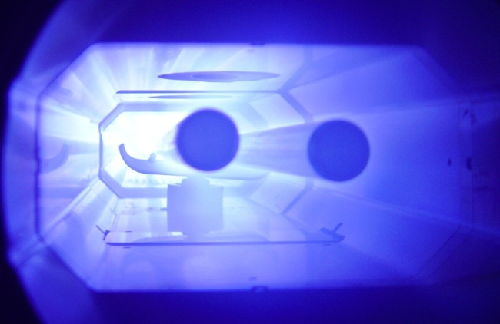
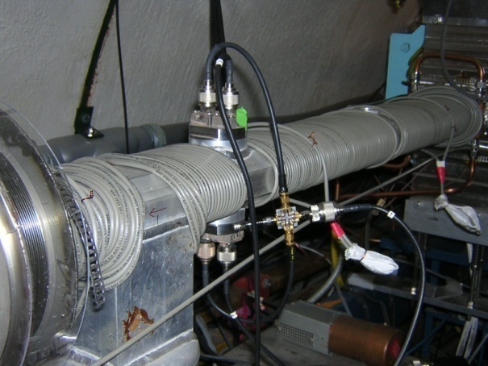
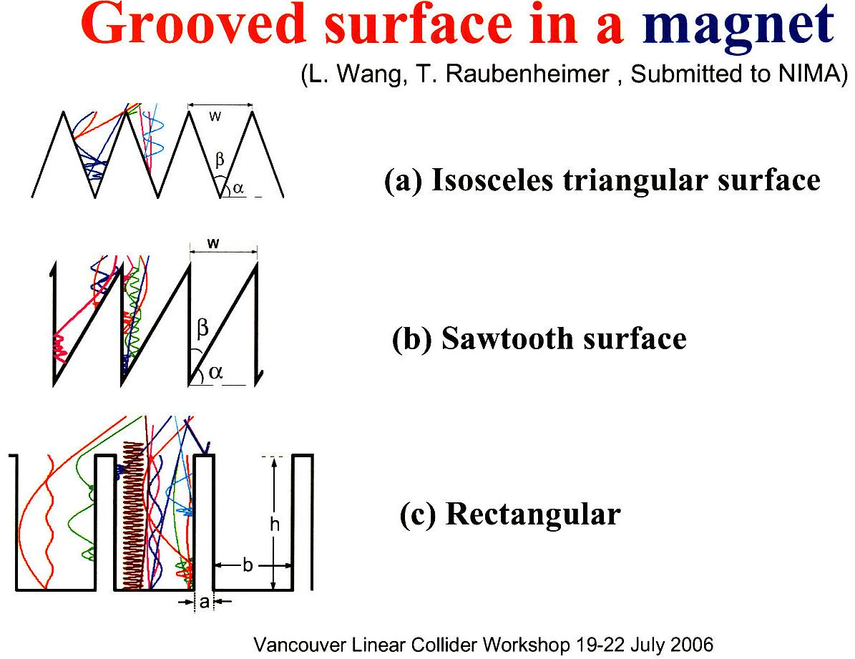
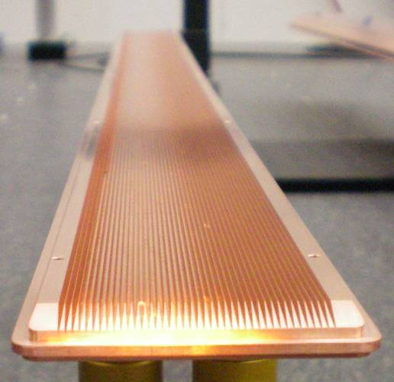
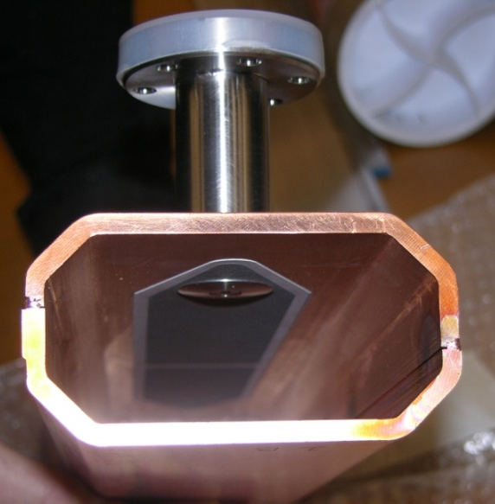
Cloud Mitigation at CESR-TA
TiN Coating
Beam pipe coatings
  Reduce SEY
  Useful in any field element
  TiN, aC, DLC, TiZrV
Solenoid windings (~20 G)
  Trap electrons near chamber wall
  Useful in field free regions
Longitudinal grooves
  Reduce effective SEY in a dipole field
Clearing electrode
  Push electrons out of the way
  Tested in a wiggler
  Need ~400 V
Solenoid Windings
  R_{t}
  (Roundness)
B
  d
  by L. Wang et al.
Grooved Insert for
CesrTA Wiggler
Clearing Electrode

Slide 10
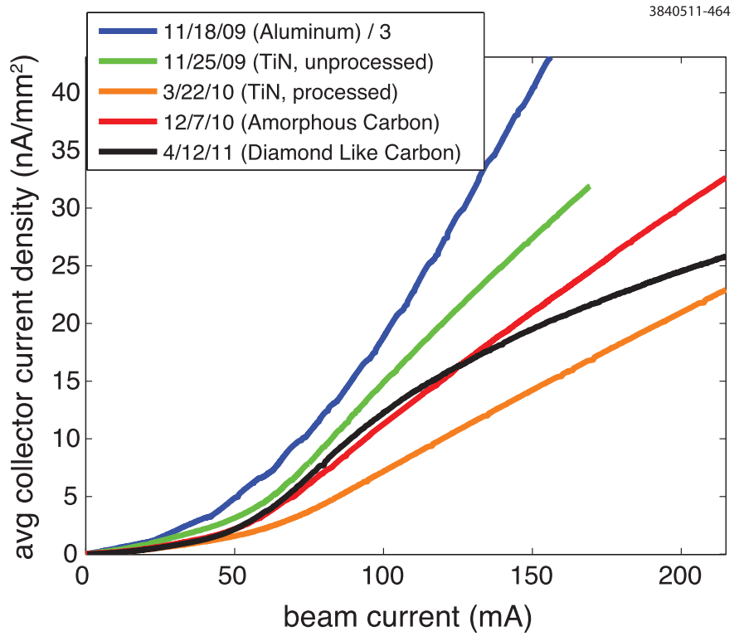
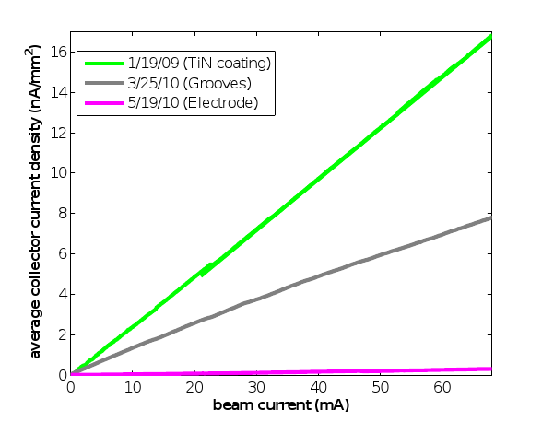
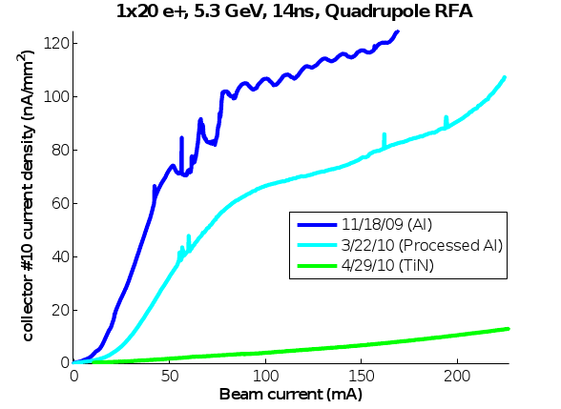
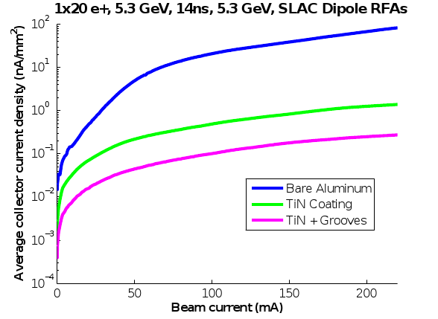
Mitigation Comparisons
Plots show average collector signal vs beam current for 20 bunches e+, 14ns spacing, 5.3GeV
  Drift: Cycling different chambers at the same locations in CESR allows for direct comparison of their effectiveness
    All coated chambers show significant improvement relative to aluminum
    Conditioned TiN shows lowest signal in this case
  Dipole: each chicane magnet has different mitigation
    Coating good, grooves + coating better
  Quadrupole: TiN coating effective
  Wiggler: mitigations cycled through the same two locations in L0 straight
    TiN coating relatively ineffective, clearing electrode clear winner
Quad
Dipole
Drift
Wiggler

Slide 11
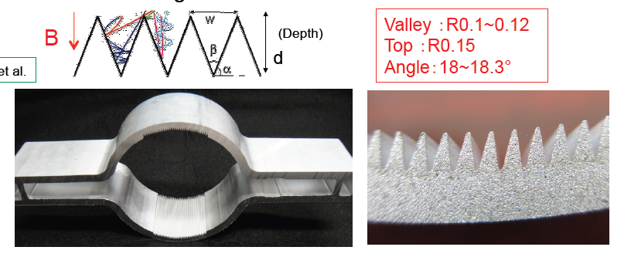
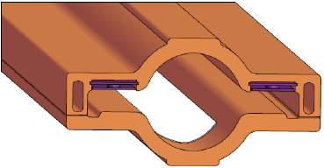
ILC Baseline Mitigation Plan (G. Dugan)
Mitigation Evaluation conducted at satellite meeting of ECLOUD`10
(October 13, 2010, Cornell University)
EC Working Group Baseline Mitigation Recommendation
 | Drift* | Dipole | Wiggler | Quadrupole*
Baseline Mitigation | TiN Coating+ Solenoid Windings | Grooves with TiN coating | Clearing Electrodes | TiN Coating
SuperKEKB Dipole Chamber Extrusion
DR Wiggler chamber concept with thermal spray clearing electrode – 1 VC for each wiggler pair.
Conway/Li
Y. Suetsugu

Slide 12
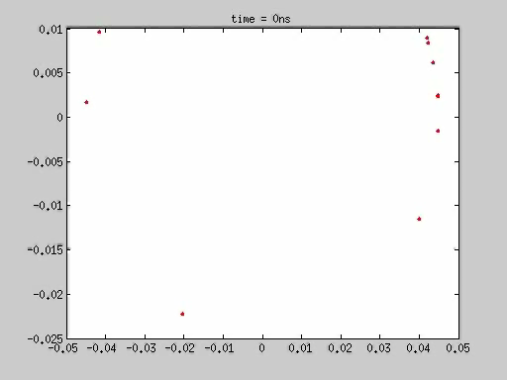
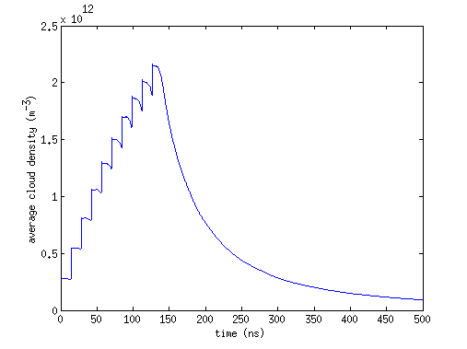
EC Simulations
Most simulations in this talk were done with POSINST (M. Furman & M. Pivi)
  Electrons represented by macroparticles, tracked under action of beam and space charge
  Primary and secondary electrons generated via probabilistic process
    Photoemission parameters: photon flux and azimuthal distribution, quantum efficiency, photoelectron energy and angular distribution
    Secondary emission parameters: SEY vs incident energy and angle δ(E,θ), secondary electron energy and angular distribution
  Dipole, solenoid, or quadrupole fields
  Well travelled (LBL, ANL, SLAC, LANL, Cornell…)
  Example movie: field free, 10 bunches, positrons, 14 ns spacing
Average cloud density

Slide 13
RFA Simulations
Goal: obtain simulated RFA signals via specially modified cloud buildup code, adjust simulations to match data
  Provide constraints on the surface parameters of the instrumented chambers
  Understand cloud dynamics on a more fundamental level
  Validate primary and secondary emission models
Requires cloud simulation program (e.g. POSINST)
  Photon flux and azimuthal distribution determined by a 3 dimensional simulation of photon production and reflection (SYNRAD3D)
  SEY parameters taken from in-situ measurements done at CESR
Also need a model of the RFA itself
  Method 1: Analytical model
    Special function in POSINST, called when particle collides in RFA region
    Maps incident particle position, energy, and angle into collector signals
    Binned by energy and transverse position to simulate a “voltage scan”
  Method 2: full particle tracking model
    Track electron in RFA, using native POSINST routines
    More self-consistent, can model effects of the RFA on the development of the cloud
    Need to do a separate simulation for each retarding voltage

Slide 14
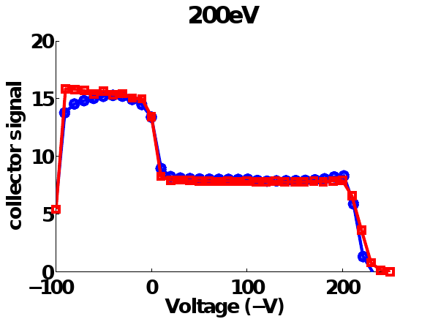
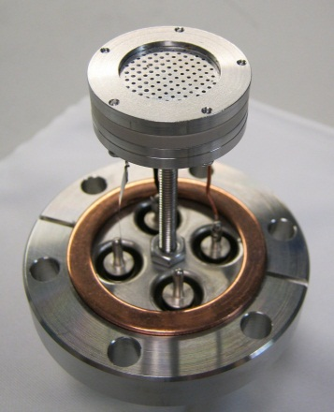
Field Free RFA Simulations
Using the “analytical” method, a large quantity of data can be simultaneously fit, using a chi squared minimization procedure
  Choose several different voltage scans, done under a wide variety of beam conditions
  Choose ~3, parameters which have significant /independent effects on the simulations
    Peak SEY determined by data with moderately high current, short spacing
    Low energy yield determined by high bunch spacing data
    Quantum efficiency determined by low current data
RFA model features:
  Cross checked with bench measurements done with a test RFA and electron gun
    Measurement: blue, model: red
  Model of secondary electron production in beam pipe holes, and grid
    Results in enhancement of signal at low/positive voltage
  Realistic fields
    Results in non-ideal energy cutoff
RFA used
for bench
measurements

Slide 15
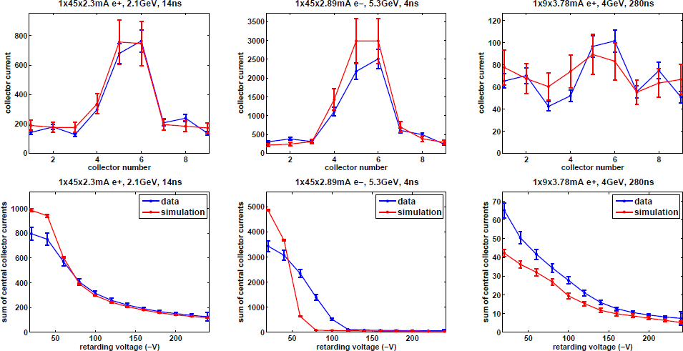
Fit Results I
Top plots show transverse distribution, bottom plots show retarding voltage scan (Aluminum chamber, field free)
  Data in blue, simulation in red

Slide 16
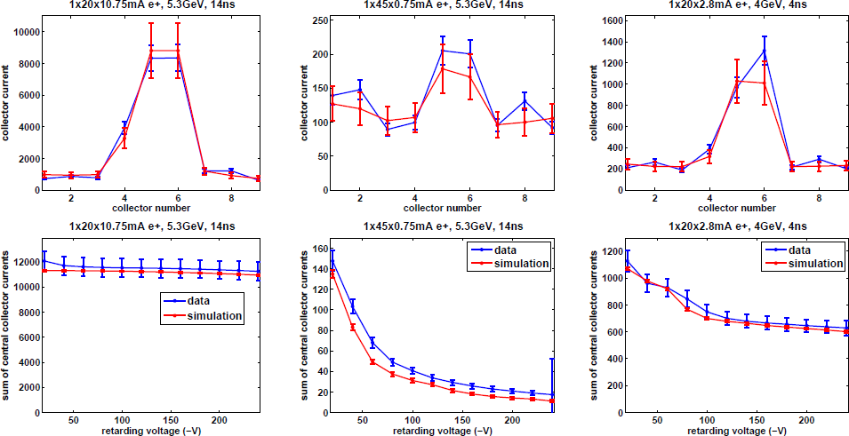
Fit Results II
Top plots show transverse distribution, bottom plots show retarding voltage scan (Aluminum chamber, field free)
  Data in blue, simulation in red

Slide 17
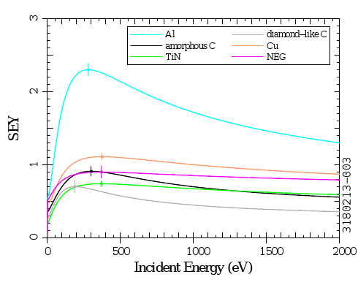
Best Fit Parameters
Have obtained best fit primary and secondary emission parameters for all instrumented surfaces
  Table shows results for Al chamber
  Plot shows best fit SEY curves
  TiN and DLC have lowest SEY
    Some question about effect of charging in DLC
  aC has lowest quantum
  efficiency
  Errors on parameters
  derived from covariance
  matrix of fits
Parameter | Base | Best Fit
True secondary yield (δ_{ts}) | 1.37 | 2.08 ± .09
Elastic yield (δ₀) | .5 | .36 ± .03
Rediffused yield (δ_{red}) | .2 | .2
Peak yield energy (E_{ts}) | 280 eV | 280 eV
Quantum efficiency, 5.3 GeV | .1 | .11 ± .01
Quantum efficiency, 2.1 GeV | .1 | .08 ± .01

Slide 18
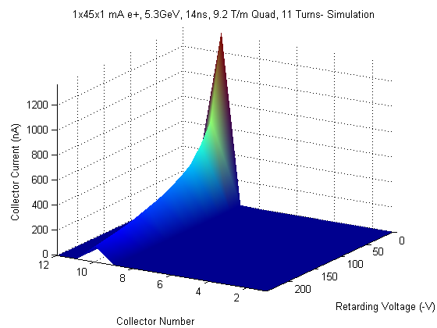
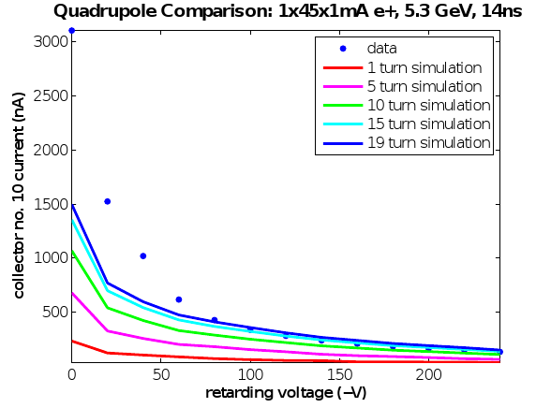
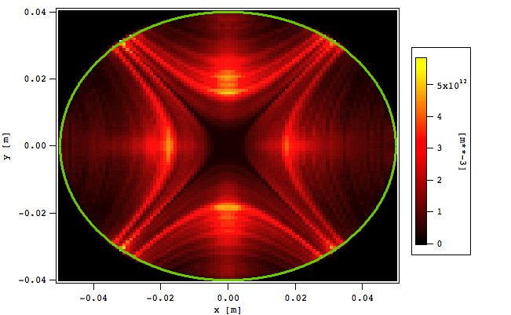
Quadrupole Simulations
Cloud particles follow field lines
Also predict most signal will be in collector 10
Suggest long term trapping of cloud
  Multi-turn simulation needed to reach equilibrium
M. Furman

Slide 19
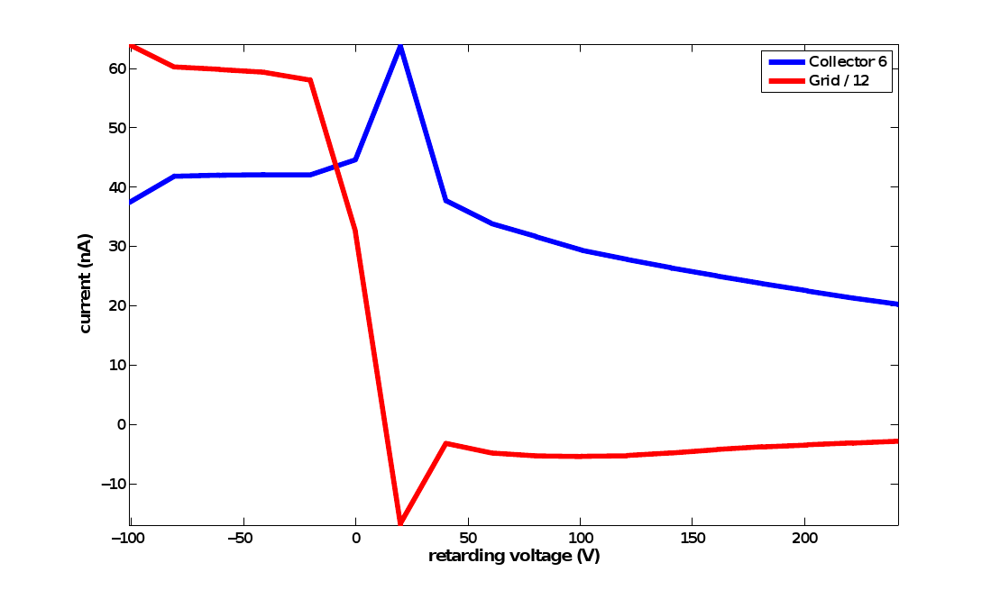
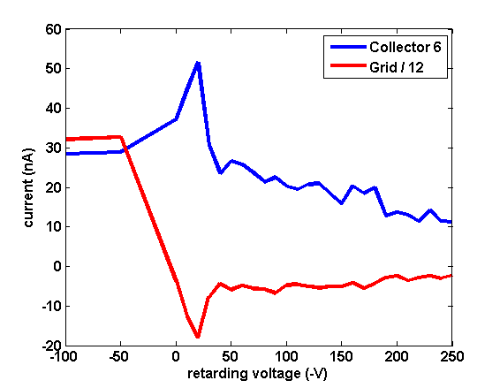
Full Particle Tracking Model
Analytical model assumes no significant interaction between RFA and cloud
  Misses some features of the data in high magnetic fields
  Ex: In the wiggler data, we observe an anomalous spike in current at low (but nonzero) retarding voltage
    Due to a resonance between the voltage and bunch spacing
    Extra signal comes from secondaries produced on the retarding grid
  Need full particle tracking model to observe this in simulation
Data
Simulation

Slide 20
Conclusions
Electron cloud is ubiquitous in accelerators (especially for positively charged beams)
  Always bad, often a limiting factor
  Major issue for next generation machines
CESR-TA is (among other things) the most extensive investigation of electron cloud in a single machine to date
Many RFAs have been installed in CESR
  Drifts, dipoles, quadrupole, wigglers
  Different mitigations: coatings, grooves, clearing electrode…
  Measurements taken under a wide variety of beam conditions
    Helps for pinning down different SEY and PEY parameters
Quantitative analysis is challenging, requires detailed model of the RFA
  For drift data, fits generally successful across wide variety of beam conditions
    Result: best fit parameters for different materials
  In field regions, qualitative phenomena reproduced
    Interaction between cloud and RFA significant
Main accomplishments
  Deeper understanding of the electron cloud
  Detailed evaluation of different materials/mitigations
  Validation of buildup codes
  Input for future machines

Slide 21
About Me
Undergrad: University of Illinois Champaign-Urbana
  Studied acoustic detection of breakdown of NC accelerating structures
  Worked on fast kicker design for ILC at A0 photoinjector at FNAL
Graduate: Cornell University
  CESR-TA
    Hands on experience with an accelerator
    International collaboration
    RFA studies: input to design, data acquisition system, running bench tests, planning and running beam experiments, data analysis, simulations, data fitting…
  Current affiliate at LBNL
Future: LARP?
  Work on the world’s most powerful accelerator
    ~1000 times energy of CESR!
  EC at LHC (25 ns operation)
  Beam dynamics studies
    Beam-beam effect at IP
    Space charge in injector chain
  Fast feedback system

Slide 22
Thanks!
M. Furman
G. Dugan, M. Palmer, D. Rubin
CESR-TA group: L. Bartnik, M.G. Billing, J.V. Conway, J.A. Crittenden, M. Forster, S. Greenwald, W. Hartung, Y. Li, X. Liu, J. Livezey, J. Makita, R.E. Meller, S. Roy, S. Santos, R.M. Schwartz, J. Sikora, and C.R. Strohman
Collaborators:
  LBL: C.M. Celata, M. Venturini
  SLAC: M. Pivi, L. Wang
  APS: K. Harkay
  CERN: S. Calatroni, G. Rumolo
  KEK: K. Kanazawa, S. Kato, Y. Suetsugu
You, for your attention

Slide 23
Backup Slides

Slide 24
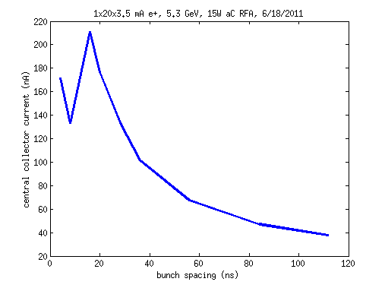
Beam-induced multipacting (BIM)
Low energy electrons near chamber wall kicked by positron beam, given energy E
Reach opposite wall in time Δt, generate secondaries determined by δ(E)
Resonant buildup if Δt = bunch spacing and δ(E) > 1
Has been observed in RFA data

Slide 25
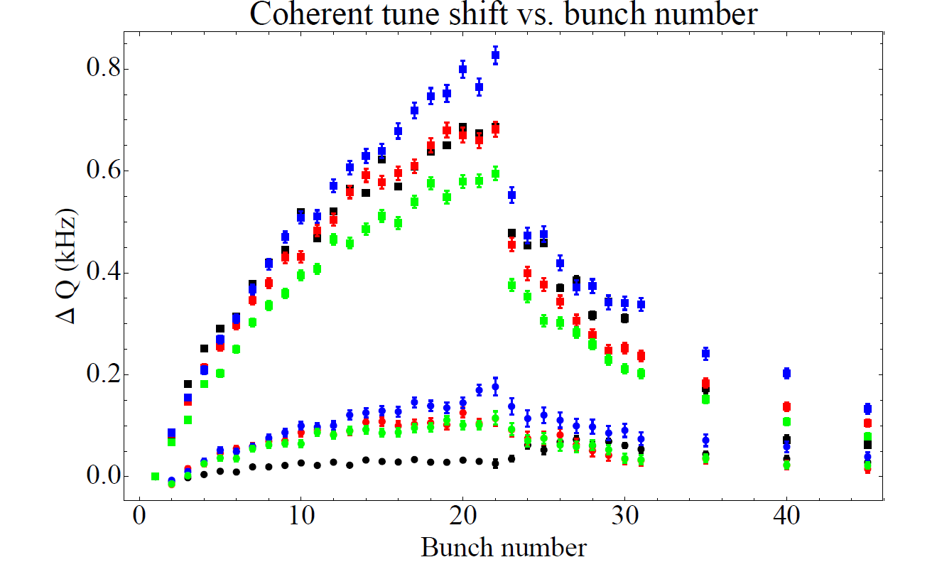
Coherent tune measurements (G. Dugan)
A large variety of bunch-by-bunch coherent tune measurements have been made, using one or more gated BPM’s, in which a whole train of bunches is coherently excited, or in which individual bunches are excited.
These data cover a wide range of beam and machine conditions.
The change in tune along the train due to the buildup of the electron cloud has been compared with predictions based on the electron cloud simulation codes (POSINST and ECLOUD).
Quite good agreement has been found between the measurements and the computed tune shifts. The details have been reported in previous papers and conferences.
The agreement constrains many of the model parameters used in the buildup codes and gives confidence that the codes do in fact predict accurately the average density of the electron cloud measured in CesrTA.
Vertical
Horizontal
2.1 GeV positrons, 0.5 mA/bunch
Black: data
Blue, red, green: from POSINST simulations, varying total SEY by +/-10%

Slide 26
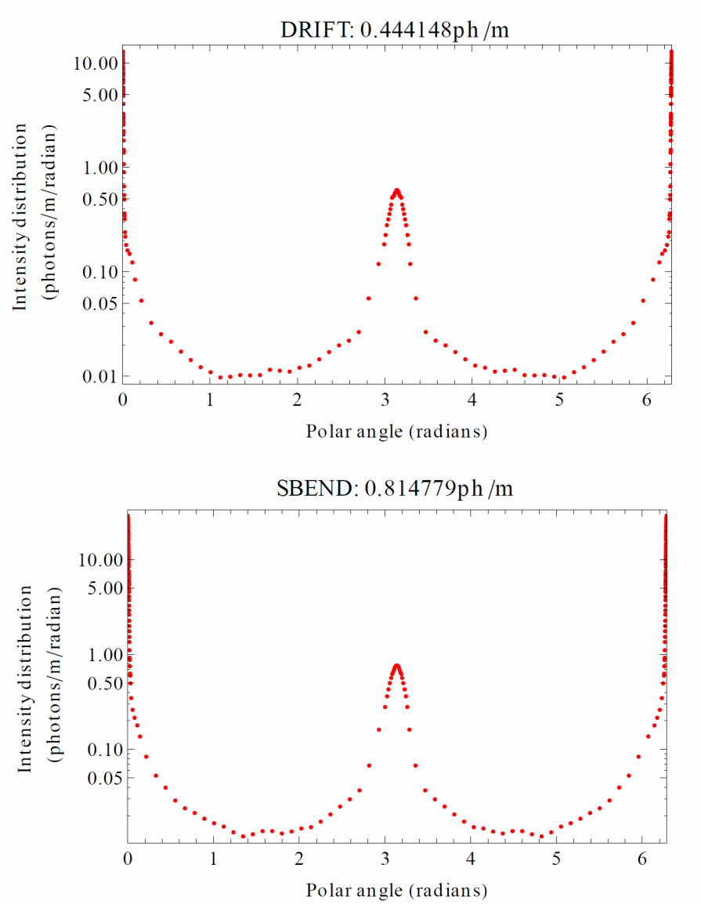
Photon reflectivity simulations (G. Dugan)
Since synchrotron radiation photons generate the photoelectrons which seed the cloud, the model predictions depend sensitively on the details of the radiation environment in the vacuum chamber. To better characterize this environment, a new simulation program, SYNRAD3D, has been developed.
This program predicts the distribution and energy of absorbed synchrotron radiation photons around the ring, including specular and diffuse scattering in three dimensions, for a realistic vacuum chamber geometry.
The output from this program can be used as input to the cloud buildup codes, thereby eliminating the need for any additional free parameters to model the scattered photons.
SYNRAD3D predictions for distributions of absorbed photons on the CesrTA vacuum chamber wall for drift and dipole regions, at 5.3 GeV.
polar angle
chamber wall
Direct radiation
Direct radiation

Slide 27
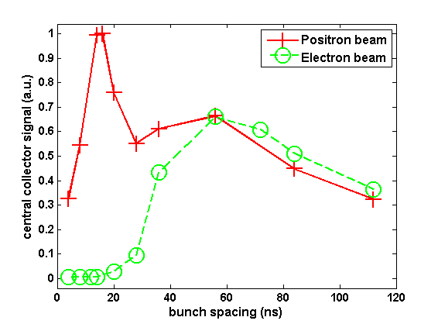
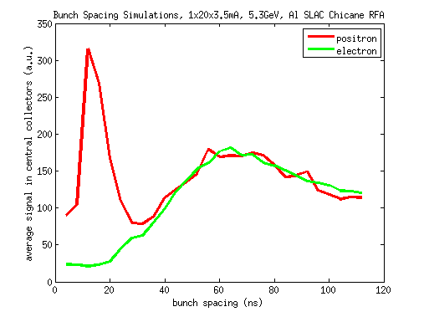
Multipacting Simulations
Looking at data taken vs bunch spacing, 1x20x3.5mA, 5.3GeV
  Aluminum SLAC chicane RFA
Both data and simulation show:
  strong peak at ~12ns in positron data
  Broader peak at ~60ns in both electron and positron data
Theory:
  60ns is time for secondary electron to drift into the center of the chamber
  12ns is an n=2 resonance
Simulation
Data

Slide 28
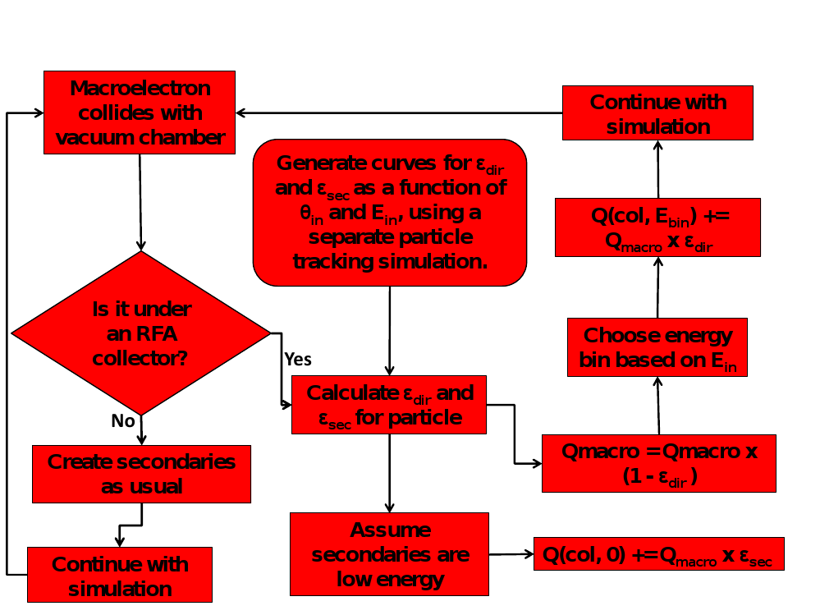
Analytical RFA Model

Slide 29
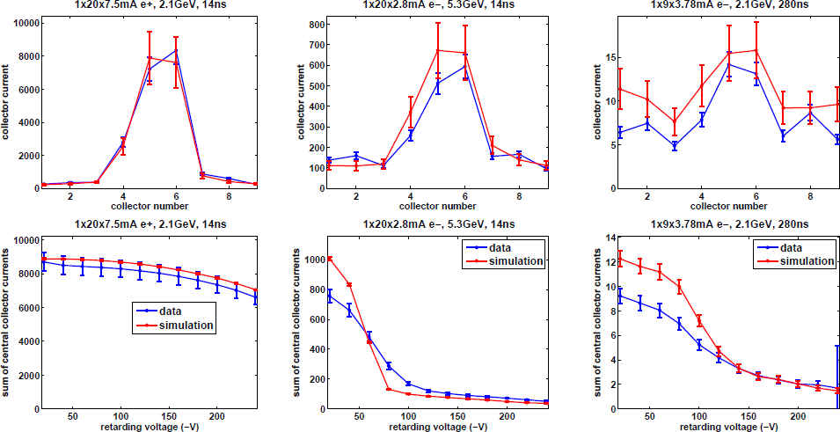
Fit Results III
Top plots show transverse distribution, bottom plots show retarding voltage scan

Slide 30
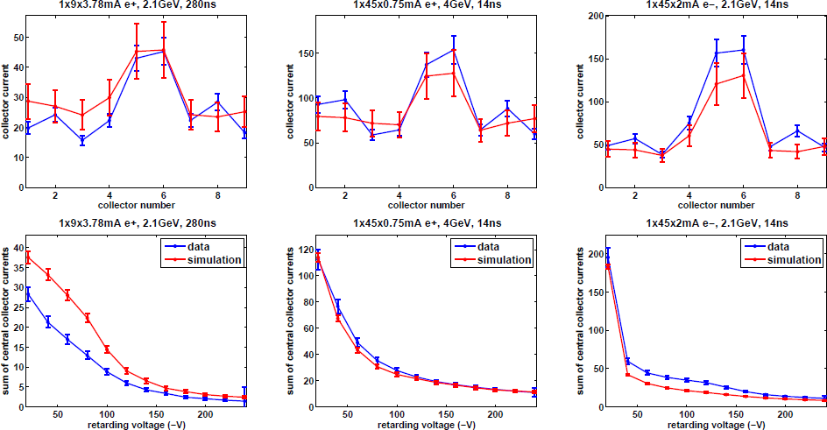
Fit Results IV
Top plots show transverse distribution, bottom plots show retarding voltage scan

Slide 31
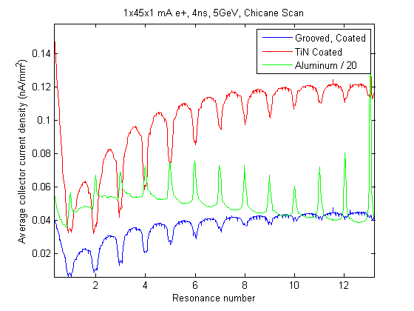

Chicane Field Scan
1x45x1 mA, 4ns, 5GeV, positrons
Plots show sum of all collectors in each RFA
  Note that Aluminum RFA signal is divided by 20
  In terms of absolute current, Al >> TiN > Grooved + TiN
On resonance, there are peaks in the Al chamber and dips in the TiN and grooved chambers
  Both dips and peaks are exactly on resonance

Slide 32


Wiggler Ramp
Data taken during wiggler ramp on 12/18/2010
  Plots show signal in RFA and TEW detectors as a function of wiggler field
    RFAs = solid lines, Resonant TEW = dotted lines, Transmission TEW = dashed lines
    Red = further downstream, violet = further upstream
    All signals normalized to 1 at peak wiggler field
  Further downstream detectors turn on first
    TEW 2W-2W ~= TEW 0W-2W ~= RFA 2WB < RFA 2WA < RFA 1W ~= TEW 0W-0W < TEW 0W-2E
    RFA and TEW turn on points are roughly consistent

Slide 33


Secondary Electron Yield
Generation of secondaries is determined by the secondary emission yield (SEY) function δ(E):
  Characterized by peak value δ_{max} at E = E_{max}
  Low energy yield δ(0): determines survival time of cloud during train gap
    Typical lifetime ~100 ns
  Typically, δ_{max}~1–3, and E_{max}~200-400 eV, δ(0) ~ .5
Many materials “condition” with electron cloud bombardment
  Results in lower δ_{max}, higher E_{max}
N. Hilleret et al, PAC99
δ_{max}
total
secondary
electrons
photo-
electrons
Ε_{max}

Slide 34

Consequences of EC
KEK Photon Factory
Coherent tune shifts
Multi-bunch instability
  Cloud couples motion of successive bunches
Single bunch instability
  e.g. Head-tail
  Happens above “threshold” cloud density
Emittance growth
  Below threshold
  Luminostiy reduction at PEP-II, KEKB
Gas desorption, vacuum pressure rise
Excessive energy deposition
on the chamber walls
  important for superconducting
  machines, eg. LHC
Particle losses, interference
with diagnostics,…
LHC: currently limits 25 ns operation
Concern for future machines
  LHC upgrade, ILC DR’s, MI upgrade,…
Emittance growth (CESR)

