Slide 1
Beam-beam Studies for HL-LHC
A.Valishev (Fermilab/US LARP) for WP2 Task 2.5
Joint LARP CM20 – HiLumi Meeting
April 8-10, 2013
Contributors: D.Banfi, A.Burov, S.Fartoukh, B.Muratori, K.Ohmi, S.Paret, T.Pieloni, J.Qiang, D.Shatilov, S.White, F.Zimmermann

Slide 2
ICFA Mini-Workshop on Beam-Beam Effects in Hadron Colliders. CERN Mar. 18-22 2013
http://indico.cern.ch/event/beam-beam-2013
Program – 4 ½ days, 52 talks 58 registered participants
Beam-beam experience in hadron colliders
Beam-beam experience in lepton colliders
Single Particle Effects I - head-on beam-beam effects
Single Particle Effects II - parasitic beam-beam effects
Beam-beam compensation schemes
Strong-strong beam-beam effects
Theory and simulations
Operational aspects of beam-beam effects
Studies for future Projects

Slide 3
HL-LHC Beam-Beam Study
Evaluate beam-beam for HL-LHC scenarios, identify minimum requirements – β*, crossing scheme
Evaluate limitations
Luminosity leveling techniques
Develop self-consistent simulations of beam-beam with other dynamical effects
Interplay with machine impedance (A.Burov)
Crab cavity, noise, offset, etc. (S.Paret)
Support new ideas

Slide 4
Methods
Analytical calculations, where possible
Weak-strong
Tune footprint (very fast)
Dynamic Aperture (fast)
Full-scale multi-particle simulation of intensity and emittance life time (slow)
Strong-strong
Self-consistent multi-effect simulation (short reach as far as the number of turns, slowest)

Slide 5
Simulation Tools
Weak-strong
SixTrack. Well-tested code, the backbone of tracking studies for LHC design.
Lifetrac. Many years of use for electron machines and Tevatron. Well-tested 6D beam-beam with crossing angle and crab cavity.
Strong-Strong
BeamBeam3D. Many users – LBNL, FNAL, BNL
COMBI. Good for multi-bunch simulations

Slide 6
Study Topics
Evaluate the options for HL-LHC
Choice of basic options – β*, crossing scheme
Luminosity leveling techniques
Imperfections, mitigation of beam-beam
Develop self-consistent simulations of the beam-beam phenomena with other dynamical effects
Interplay with machine impedance
Crab cavity, noise, offset, etc.
Support new ideas

Slide 8
HL-LHC Base Beam-Beam Parameters
N_{p}=2.2x10¹¹, ε=2.5 μm
θ=590 μrad = const
β*=15cm = const
ξ ~= 0.02 (3 IPs)
A/σ = 12.5
Level with crab only

Slide 9
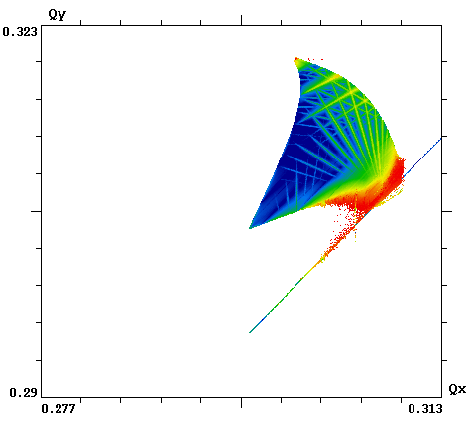
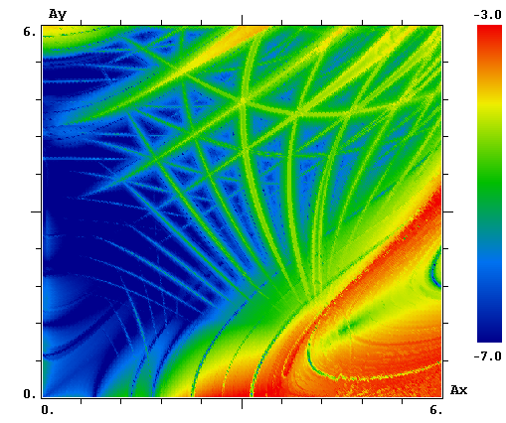
Frequency Map Analysis
β*=15 cm, N_{p}=2.2×10¹¹
θ=590 μrad
Δp/p=0
Lifetrac: full HL-LHC lattice (element-by-element, sextupoles)
+ beam-beam (head-on & long-range), 2¹¹ turns

Slide 10
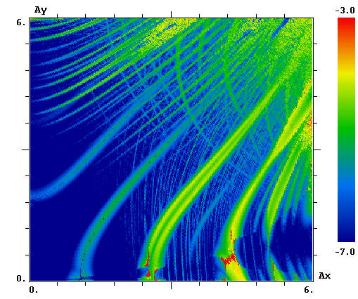
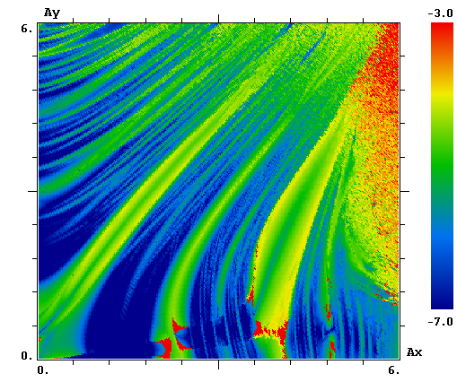
Frequency Map Analysis of HL-LHC options
β*=15cm θ=590μrad Δp/p=1.1e-4
β*=15cm θ=590μrad Δp/p=2.2e-4
D.Shatilov, A.Valishev

Slide 11
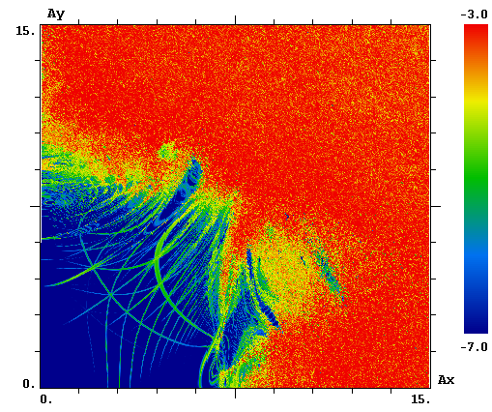
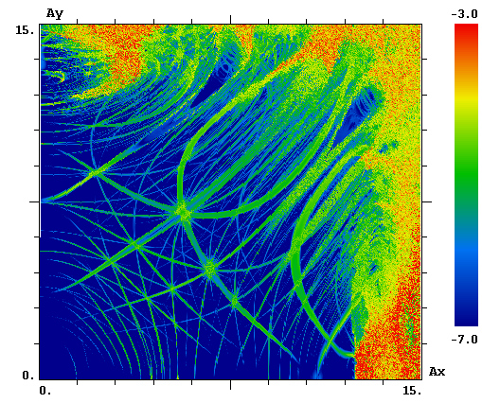
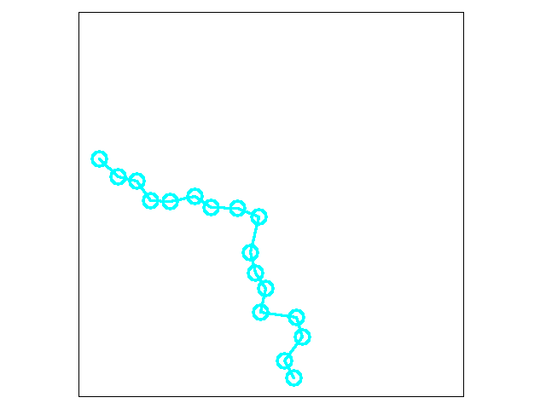
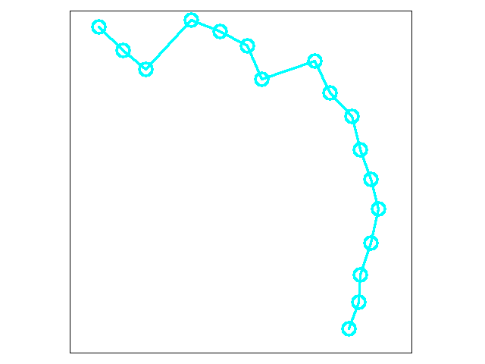
From FMA to Dynamical Aperture
β*=15cm θ=590μrad Δp/p=0
σ_{z}=7.5cm
β*=33cm θ=590μrad Δp/p=0
σ_{z}=4cm
Linear HL-LHC lattice (no sextupoles) + beam-beam (head-on & long-range)
DA based on 10⁶ tracking turns, FMA – 2¹³ turns
D.Shatilov, A.Valishev

Slide 12
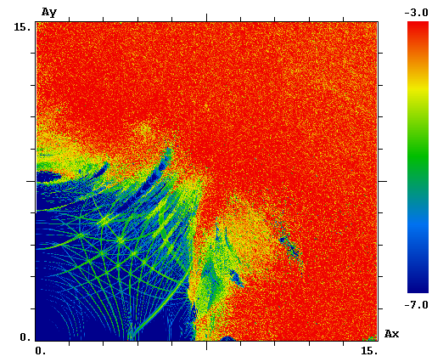
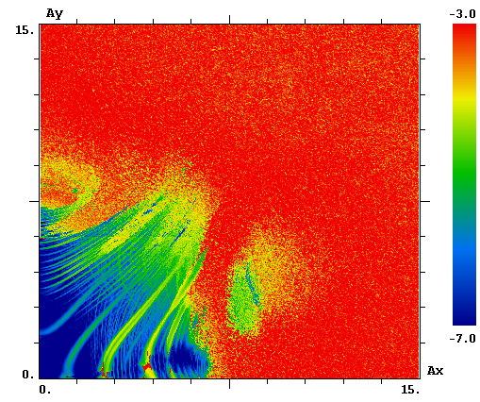
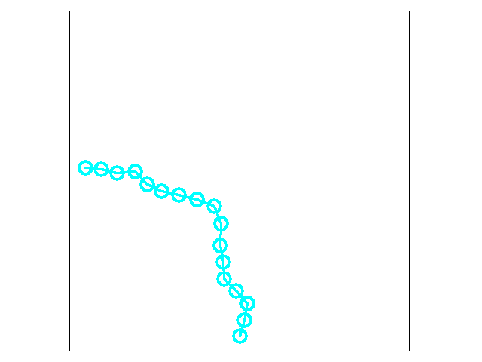
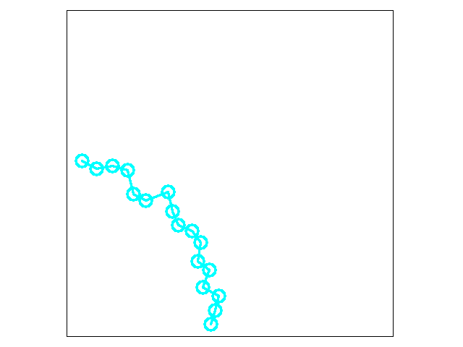
From FMA to Dynamical Aperture
β*=40cm θ=360μrad Δp/p=0
σ_{z}=4cm
β*=15cm θ=590μrad Δp/p=1.1e-4
σ_{z}=7.5cm
Linear HL-LHC lattice (no sextupoles) + beam-beam (head-on & long-range)
DA based on 10⁶ tracking turns, FMA – 2¹³ turns
D.Shatilov, A.Valishev

Slide 13
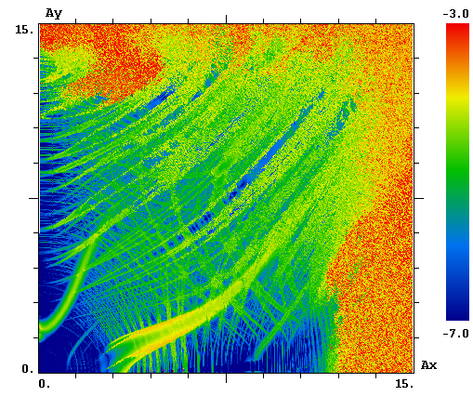
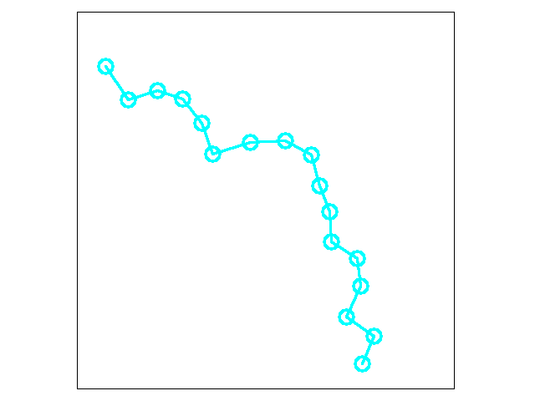
From FMA to Dynamical Aperture
β*=40cm θ=360μrad Δp/p=0
σ_{z}=4cm
β*=33cm θ=590μrad Δp/p=1.1e-4
σ_{z}=4cm
Linear HL-LHC lattice (no sextupoles) + beam-beam (head-on & long-range)
DA based on 10⁶ tracking turns, FMA – 2¹³ turns
D.Shatilov, A.Valishev

Slide 14
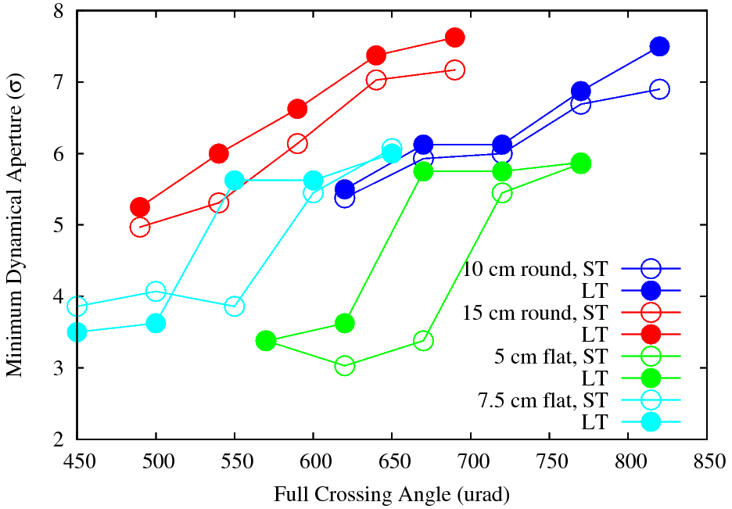
DA Studies Sixtrack vs. Lifetrac
HL-LHC lattice without magnetic errors (only chroma sextupoles)
DA based on 10⁶ tracking turns. N_{p}=2×10¹¹, ε=2.5μm
S.White, A.Valishev

Slide 15
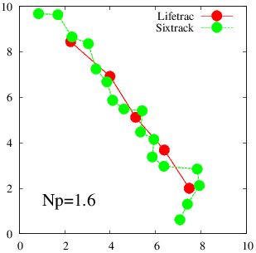
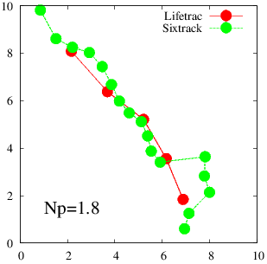
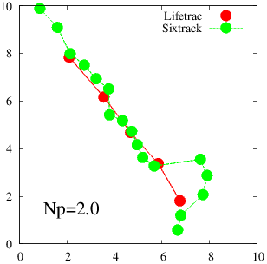
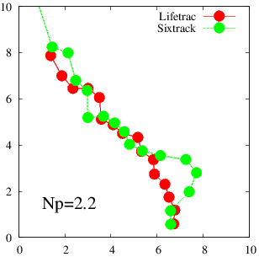
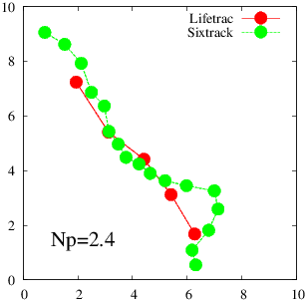
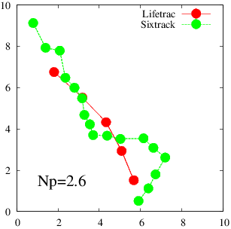
DA Studies Sixtrack vs. Lifetrac

Slide 16
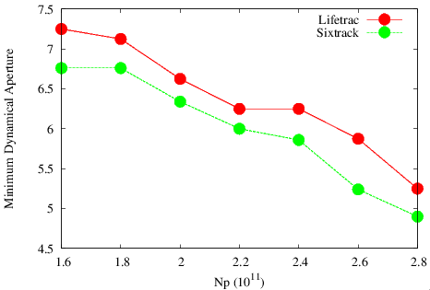
DA Studies – Intensity Scan
HL-LHC lattice without magnetic errors (only chroma sextupoles)
DA based on 10⁶ tracking turns. β*=0.15m, θ=590 μrad, ε=2.5μm
D.Banfi, A.Valishev

Slide 17
Conclusion for Baseline
Weak-strong studies predict the scenario OK
Work in progress:
Effect of multipole errors
Multiparticle tracking

Slide 18
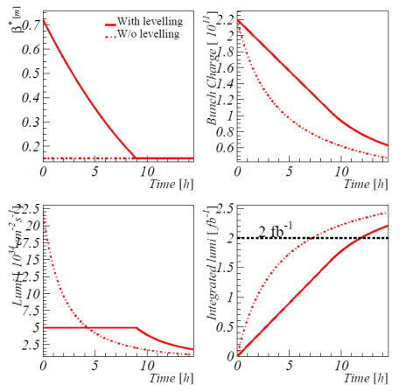
Evolving HL-LHC Baseline S.Fartoukh
 | LHC nominal | HL-LHC 25 ns
# Bunches | 2808 | 2808
p/bunch [10¹¹] | 1.15 (0.58A) | 2.2 (1.11 A)
γε_{x,y} [μm] | 3.75 | 2.5
ε_{L} [eV.s] | 2.5 | 2.5
σ_{z} [cm] | 7.5 | 7.5
σ_{δp/p} [10⁻³] | 0.1 | 0.1
β∗ [cm] | 55 | 15 (→ 10)
X-angle [μrad] | 300 (10.0 σ) | 590 (→ 720) (12.5 σ)
Lumi loss factor | 0.83 | 0.31
Peak lumi [10³⁴] (with full Piwinsky angle) | 1.0 | 7.4
Virtual lumi [10³⁴] (w/o Piwinsky angle) | 1.2 | 21.9
T_{leveling} [h] @ 5E34 | n/a | 9.0
#Pile up @5E34 | 25 | 140
β* (assuming
no bb limit)
Beam current
Lumi
Int. Lumi
Time evolution of main parameters
(assuming no emittance growth)
→ Only the β* profile will actually depend on the details of the leveling technique (bb limit, if any?)
Main HL-LHC beam & optics parameters

Slide 19
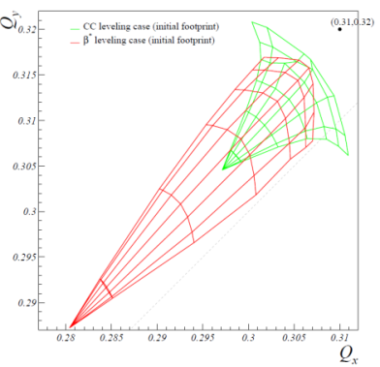
Evolving HL-LHC Baseline S.Fartoukh
→ β* leveling seems to be the main option but leading a b-b tune shift of up to ΔQ_{bb}=0.033 for 3 experiments (IR1, IR5 & IR8)
Parameters | Leveling with c.-c. | Leveling with β*
# bunches | 2808
bunch charge [10¹¹] | 2.2
emittance [μm] | 2.5
r.m.s. bunch length [cm] | 7.5
full X-angle [μrad] | 590
initial β* [cm] | 15 | 72
c.-c. initial voltage [MV] | - 6.6 (“anti-crabbing”) | 12.5 (“full crabbing”)
initial Piwinsky angle | 4.76 | 0
initial lumi loss factor | 0.21 | 1.0
levelled lumi [10³⁴cm⁻²s⁻¹] | 5.0
initial luminous region [cm] | 1.1 | 5.3
initial bb tune shift for 3 IRs (IR1, IR5 & IR8) | 0.016 (0.011+2×0.0025) | 0.033 (3×0.011)

Slide 20
HL-LHC new Beam-Beam Parameters
N_{p}=2.2x10¹¹, ε=2.5 μm
θ=590 μrad = const
β*=72➔15cm
A/σ = 26➔12.5
ξ = 0.033 (3 IPs) initially, 0.014 at the end of fill
Level with β*

Slide 21
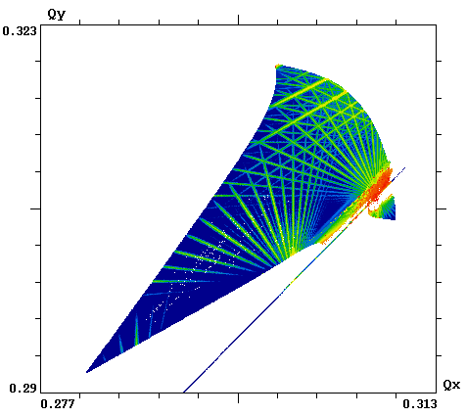
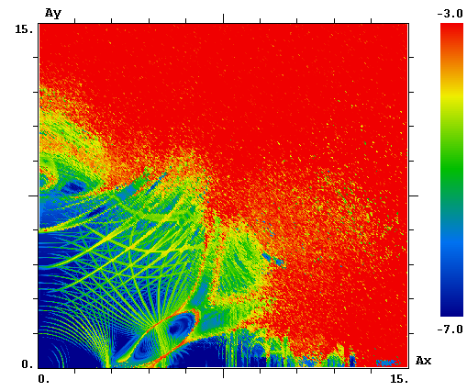
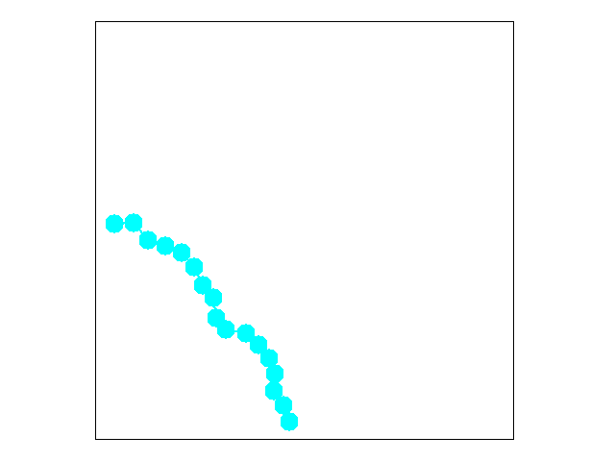
DA for Beginning of Fill
BB tune shift of ξ = 0.033 is ok even with A/σ = 12.5 !
with full crab on, no imperfections though
HL-LHC lattice without magnetic errors (only chroma sextupoles)
DA based on 10⁶ tracking turns. β*=0.15m, θ=590 μrad, ε=2.5μm

Slide 22
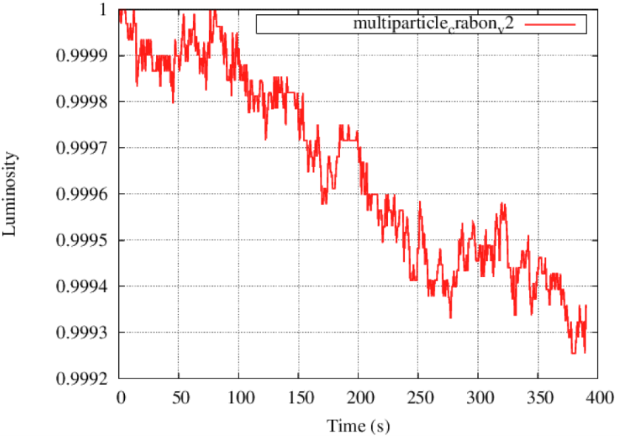
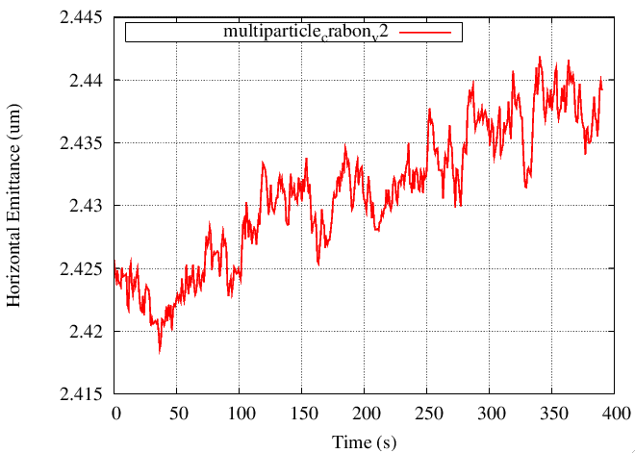
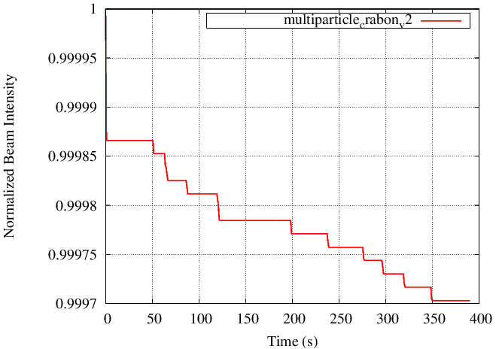
Multiparticle Tracking - Beginning of Fill
τ_{N}>500 hr, τ_{ε}=18 hr, τ_{L}=150 hr

Slide 23
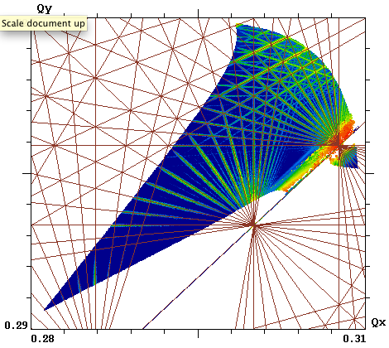
Cause of Emittance Growth
13th order
10th order
7th order
7th order does not seem to be a problem…

Slide 24
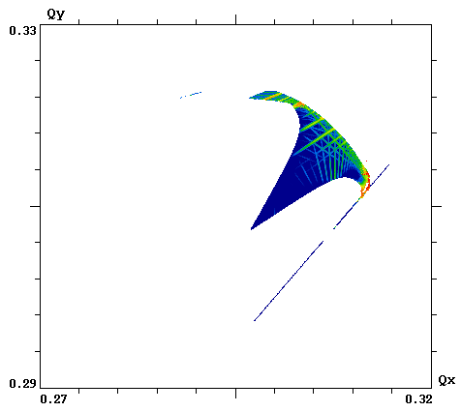
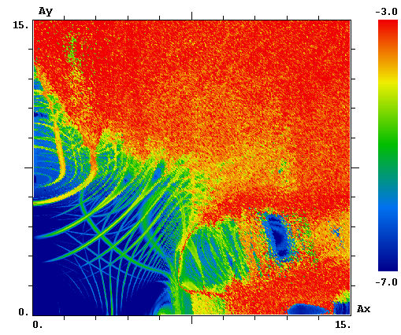
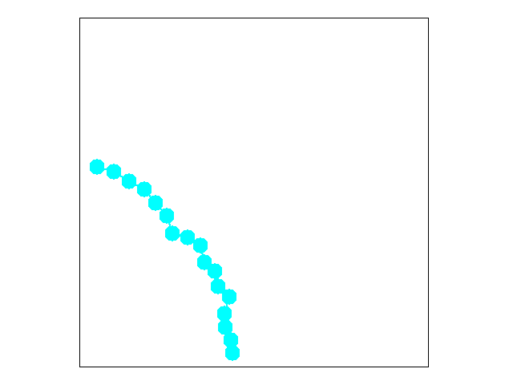
Can X-Angle (Crab Voltage) be reduced?
θ=480 μrad (Crab Voltage 10 MV) corresponds to A/σ = 10
at end of fill with Np=0.95x10¹¹ ξ=0.014 – OK, IF emittance growth is contained!
HL-LHC lattice without magnetic errors (only chroma sextupoles)
DA based on 10⁶ tracking turns. β*=0.15m, θ=480 μrad, ε=2.5μm

Slide 25
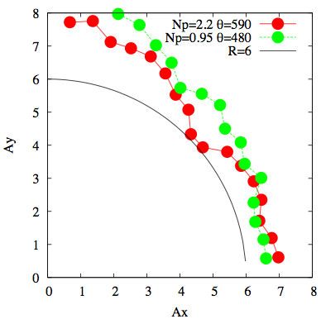
Summary of DA for full crab ON
Large margin at beginning of fill – easy to reduce x-angle
15% margin at end of fill with θ=480 μrad should allow some emittance growth
What happens at intermediate steps?

Slide 26
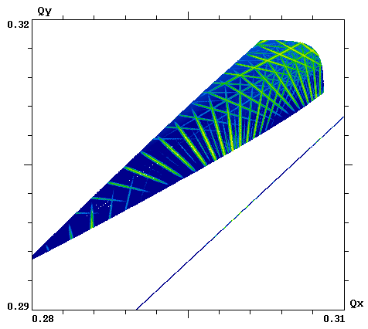
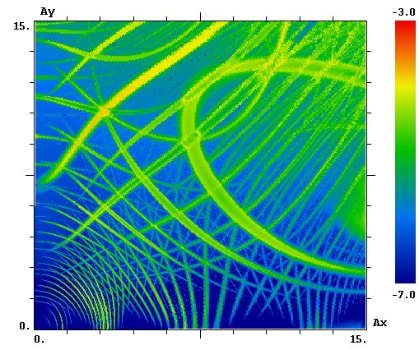
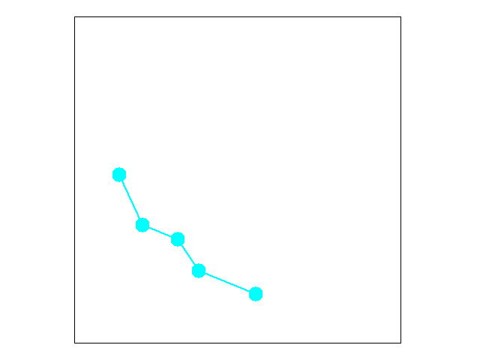
Will the New Option Work with 50ns?
β∗=1.5m θ=590 μrad corresponds to A/σ = 35
with Np=3.5x10¹¹ ε=3 μm ξ=0.043? (0.03) – preliminary OK!
HL-LHC lattice without magnetic errors (only chroma sextupoles)
DA based on 10⁶ tracking turns.
In actual simulation: β*=0.15m, θ=590x3 μrad

Slide 27
Study Topics
Investigate the options for HL-LHC
Choice of basic options – β*, crossing scheme
Luminosity leveling techniques
Imperfections, mitigation of beam-beam
Develop self-consistent simulations of the beam-beam phenomena with other dynamical effects
Interplay with machine impedance
Crab cavity, noise, offset, etc.
Help understand the experimental data from LHC as it becomes available
Also use RHIC for beam-beam experiments
Support new ideas

Slide 28
Effects of Noise K. Ohmi

Slide 29
Beam-Beam and Impedance S. White (Toohig Fellow) and X. Buffat

Slide 30
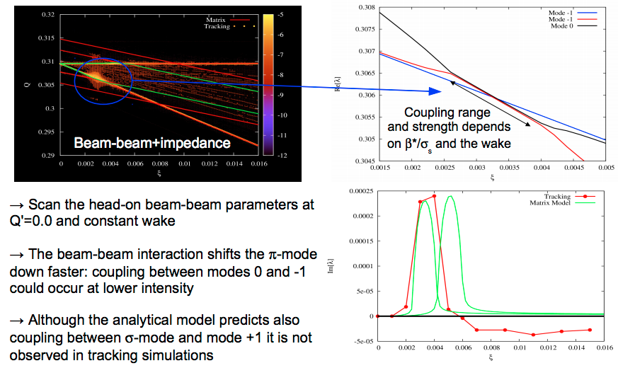
Beam-Beam and Impedance S. White (Toohig Fellow) and X. Buffat

Slide 31
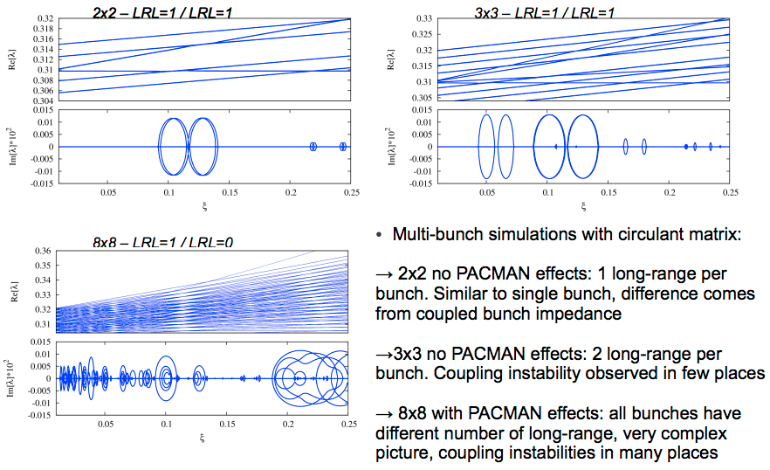
Beam-Beam and Impedance S. White (Toohig Fellow) and X. Buffat

Slide 32
Study Topics
Investigate the options for HL-LHC
Choice of basic options – β*, crossing scheme
Luminosity leveling techniques
Imperfections, mitigation of beam-beam
Develop self-consistent simulations of the beam-beam phenomena with other dynamical effects
Interplay with machine impedance
Crab cavity, noise, offset, etc.
Help understand the experimental data from LHC as it becomes available
Also use RHIC for beam-beam experiments
Support new ideas

Slide 33
Circular Modes and Flat Beams for LHC
A special type of coupled beam optics can convert planar betatron modes into circular modes
For circular modes, the Space Charge tune shift is determined by the maximal emittance, being independent of the minimal one
After acceleration, the beam can be transferred into the planar state, becoming flat – gain in luminosity
With flat beams, leveling can be done with β* in the crossing plane – no need for crab cavity

Slide 34
Luminosity Scenario with Flat Beams
 | LHC nominal | HL-LHC 25 ns | HL-LHC Flat
# Bunches | 2808 | 2808 | 2808
p/bunch [10¹¹] | 1.15 (0.58A) | 2.2 (1.11 A) | 2.2 (1.11 A)
ε_{L} [eV.s] | 2.5 | 2.5 | 2.5
σ_{z} [cm] | 7.5 | 7.5 | 7.5
σ_{δp/p} [10⁻³] | 0.1 | 0.1 | 0.1
γε_{x,y} [μm] | 3.75 | 2.5 | 4.0, 0.4
β∗ [cm] (baseline) | 55 | 15 | 55, 15
X-angle [μrad] | 285 | 590 (12.5 σ) | 318 (10 σ)
Lumi loss factor | 0.84 | 0.30 | 0.85
Peak lumi [10³⁴] | 1.0 | 7.4 | 19.7
Virtual lumi [10³⁴] | 1.2 | 24.0 | 23.6
Leveling |  | Crab cavity | βx=11m down
A.Burov, A.Valishev

Slide 35
Summary
Baseline HL-LHC scenario has been studied
No bb-imposed show-stoppers so far
Good agreement between two codes
To do: effect of imperfections, multiparticle
New scenario challenging in terms of bb
Preliminary results very encouraging – ξ=0.033 can be sustained
Crossing angle = CC voltage can be reduced ~20% assuming zero emittance growth
Multi-physics effects – good progress, more work needed

Slide 36
Asknowledgments
Many thanks to G.Arduini, D.Banfi, X.Buffat, A.Burov, S.Fartoukh, W.Herr, B.Muratori, S.Paret, T.Pieloni, J.Qiang, F.Schmidt, D.Shatilov, R.Tomas, S.White, F.Zimmermann…

