Slide 1
TOOHIG Fellowship presentation for the LARP Collaboration
Joint LARP CM20 / HiLumi Meeting – Napa Valley, CA
8-10 April, 2013

Slide 2
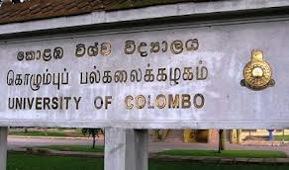
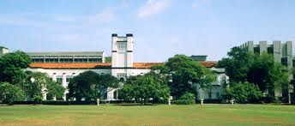
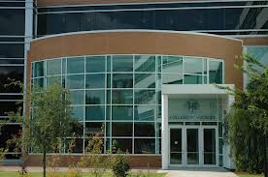

On the way to Grad School
University of Colombo, Sri Lanka
  Bachelor of Engineering Physics (2001-2004)
  Bachelor of Information Technology (2000-2004)
Old Dominion University, Norfolk, VA
  Master of Science in Physics (2006-2008)
  Ph.D. Candiate (2013)
    Advisor: Prof. Jean Delayen

Slide 3
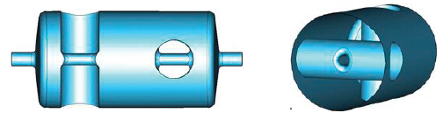
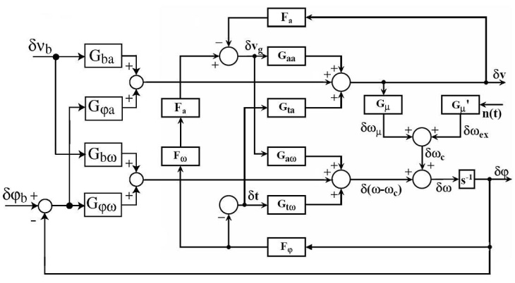
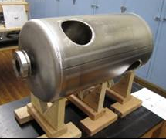
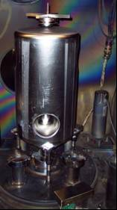
Graduate Research
Joined Center for Advanced Studies of Accelerators (CASA), Jefferson Lab – May, 2008
Electronic damping of microphonics using self excited loops (SEL) – May 2008
Self excited loop in transfer function representation
Designing of 500 MHz β =1 double spoke cavities – January 2009
S. U. De Silva, J. R. Delayen, “Analysis of Electronic Damping of Microphonics in Superconducting Cavities”, Proceedings of the LINAC 2008, Vancouver, Canada (2008), p.876.
D. Gorelov, C. H. Boulware, T. Grimm, J. R. Delayen, S. U. De Silva, C. S. Hopper, R. G. Olave, “Development of a Superconducting 500 MHz Multi-Spoke Cavity for Electron Linacs”, Proceedings of IPAC 2012, New-Orleans, USA (2012), p. 2408.

Slide 4
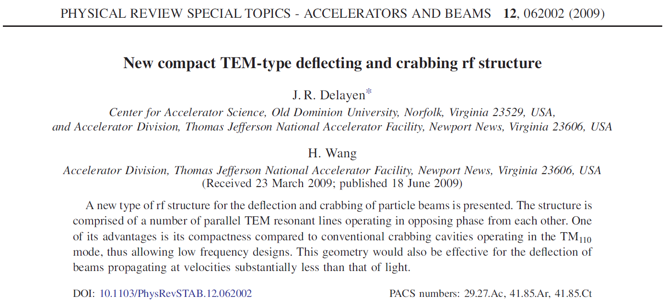
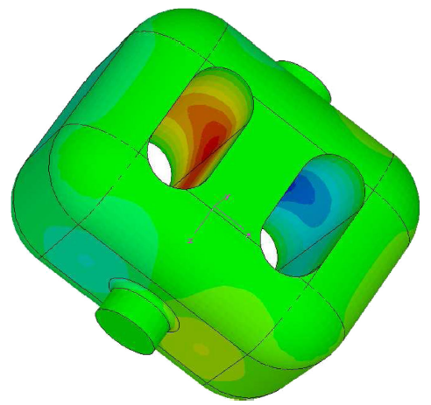
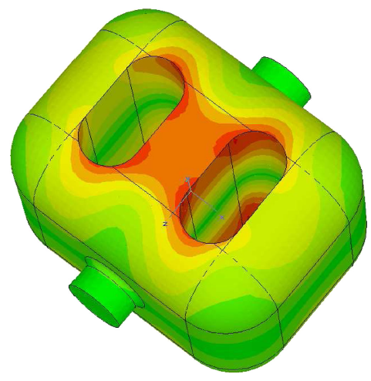
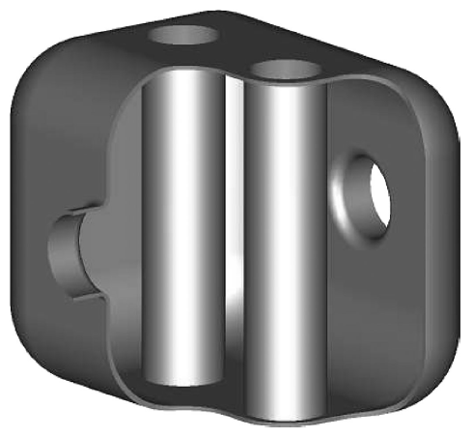
Graduate Research
July 2009 – Started working on designing parallel-bar deflecting and crabbing cavities

Slide 5
Graduate Research
Ph.D. Dissertation Work
Designing, prototyping and testing of
  499 MHz deflecting cavity
  400 MHz crabbing cavity
Collaboration
Investigation and Optimization of a New Compact Superconducting Cavity for Deflecting and Crabbing Applications
Jefferson Science Associates, LLC under U.S. DOE Contract No. DE-AC05-06OR23177
ODU – Niowave Inc. Phase I STTR
ODU – Niowave Inc. Phase I & II STTR
US Department of Energy through the US LHC Accelerator Research Program (LARP) and through the Small Business Technology Transfer (STTR) Program. The research leading to these results has received funding from the European Commission under the FP7 project HiLumi LHC, GA no. 284404, co-funded by the DoE, USA and KEK, Japan

Slide 6
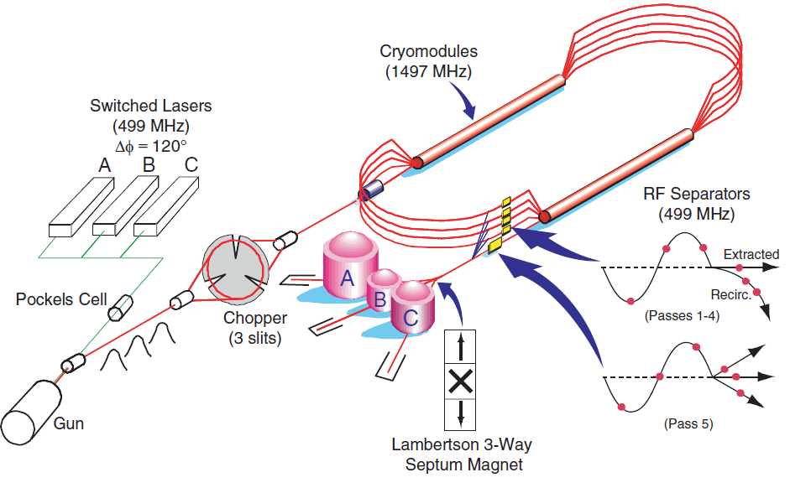
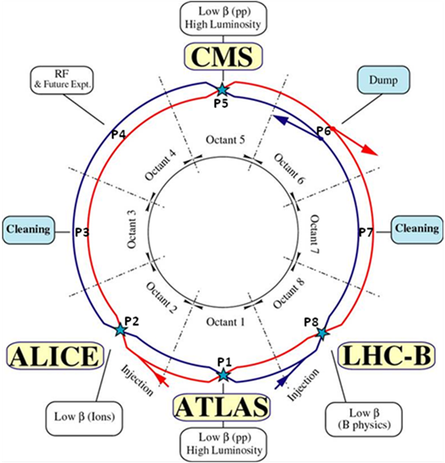
Deflecting and Crabbing Applications
499 MHz Deflecting Cavity for
Jefferson Lab 12 GeV Upgrade
400 MHz Crabbing Cavity for
LHC High Luminosity Upgrade
4th Pass Beam Line
Total transverse voltage = 5.6 MV
450 mm
R = 20 mm
R = 42 mm
< 150 mm
300 mm
5th Pass Beam Line
680 mm
Total transverse voltage = 10 MV per beam per side
194 mm

Slide 7
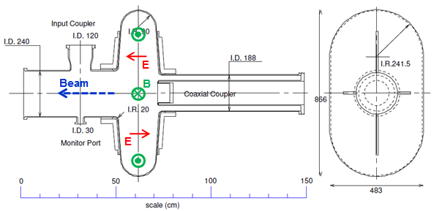
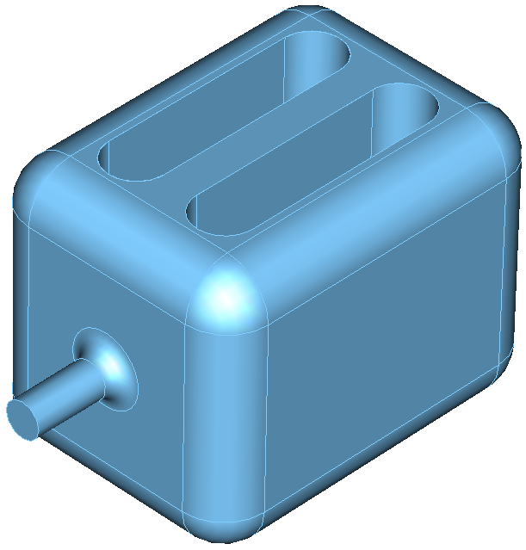
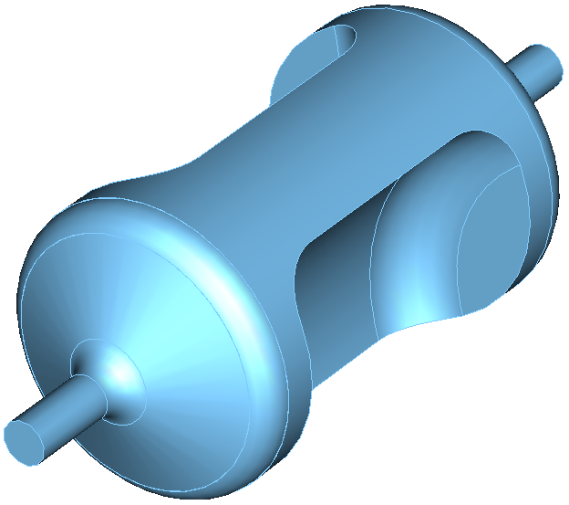
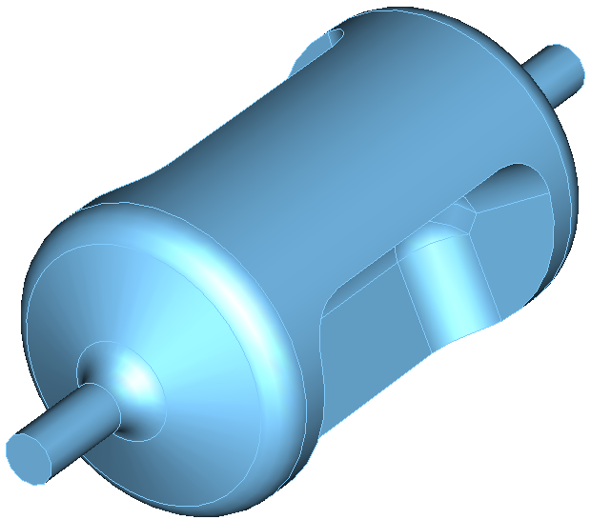
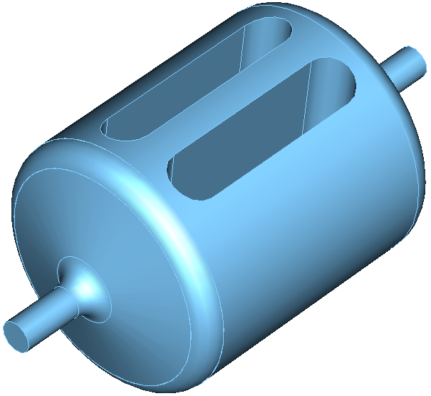
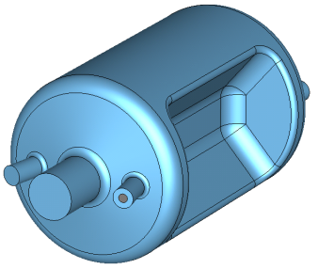
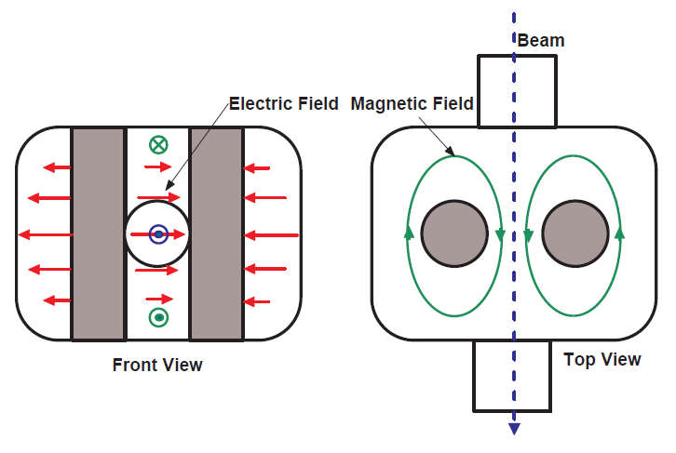
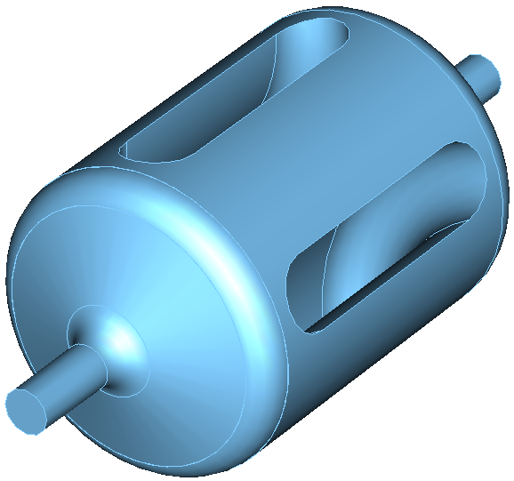
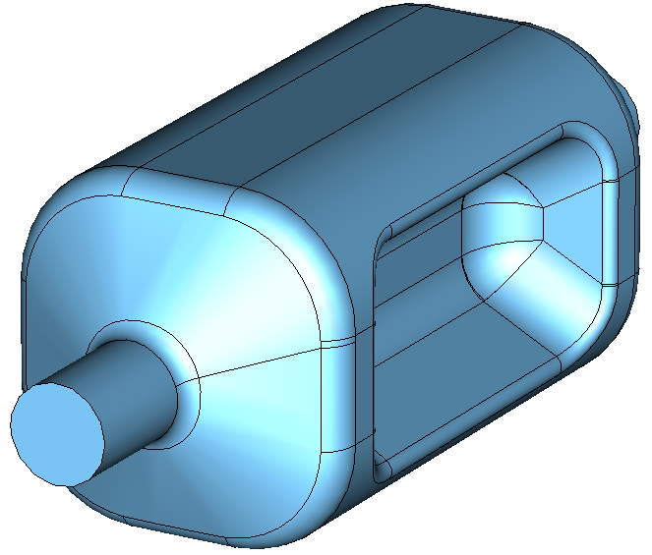
Motivation
Design superconducting compact deflecting and crabbing cavities at lower frequencies
KEK Crabbing Cavity – TM₁₁₀ mode
TEM-like Designs
TE-like Designs
Operating mode: TEM-like or TE-like modes
  Net deflection is due to the transverse electric mode
Cannot be a pure TE mode – Panofsky Wenzel Theorem
TEM-like mode

Slide 8
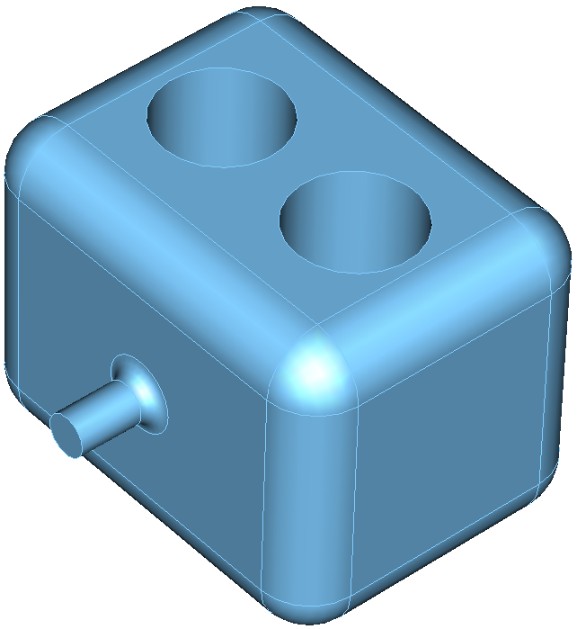
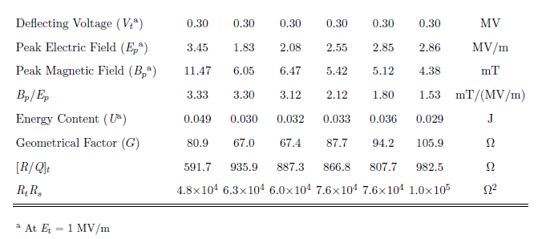
Electromagnetic Design Evolution
Optimization of the electromagnetic design to achieve
  Lower and balanced surface peak surface fields at a higher net transverse voltage
  Higher shunt impedance
499 MHz Deflecting Cavity

Slide 9
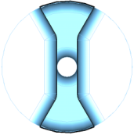
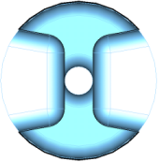
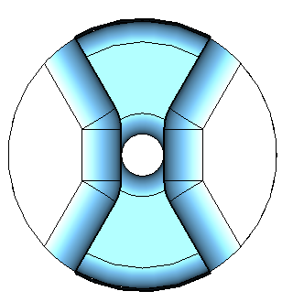
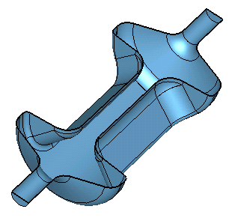
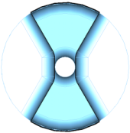
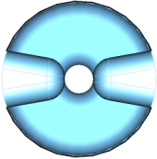
Design Optimization
Properties depend on a few parameters
  Frequency determined by diameter of the cavity design
  Bar Length ~λ/2
  Bar height and aperture determine E_{P} and B_{P}
  Angle determines B_{P}/E_{P}
499 MHz Deflecting Cavity
B_{p} / E_{p} = 2.2 mT/(MV/m)
θ
B_{p} / E_{p} = 2.0 mT/(MV/m)
Bar Height
B_{p} / E_{p} = 1.75 mT/(MV/m)
B_{p} / E_{p} = 1.5 mT/(MV/m)
Bar Length
Cavity Length

Slide 10
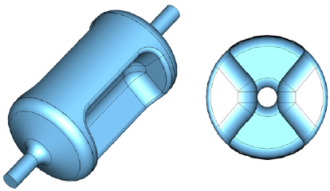
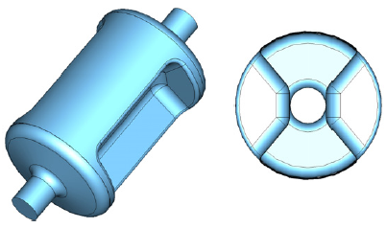
Higher Order Mode Properties
Widely separated Higher Order Modes
No Lower Order Modes
499 MHz Deflecting Cavities
10.7 MHz
18.4 MHz
127.1 MHz
264.5 MHz
255.3 MHz
278.0 MHz
499 MHz Deflecting Cavity
400 MHz Crabbing Cavity

Slide 11
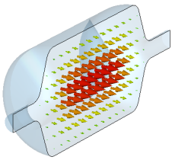
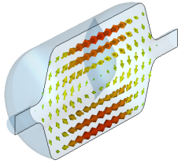
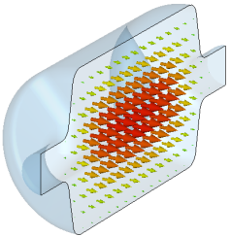
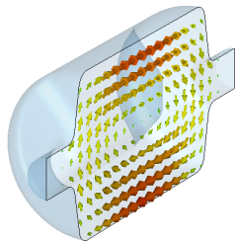
Properties of Proof of Principle Cavities
499 MHz Deflecting Cavity
400 MHz Crabbing Cavity
Frequency | 499.0 | 400.0 | MHz
Aperture Diameter (d) | 40.0 | 84.0 | mm
d/(λ/2) | 0.133 | 0.224
V_{T}* | 0.3 | 0.375 | MV/m
E_{p}* | 2.86 | 4.02 | MV/m
B_{p}* | 4.38 | 7.06 | mT
B_{p}*/E_{p}* | 1.53 | 1.76 | mT/ (MV/m)
U* | 0.029 | 0.195 | J
[R/Q]_{T} | 982.5 | 287.0 | Ω
Geometrical Factor (G) | 105.9 | 140.9 | Ω
R_{T}R_{S} | 1.0×10⁵ | 4.0×10⁴ | Ω²
At E_{T}* = 1 MV/m
V_{T} | 3.0 / 5.6 | 3.4 / 5.0 | MV
E_{p} | 28.6 / 53.4 | 36.5 / 53.6 | MV/m
B_{p} | 43.8 / 81.8 | 64.0 / 94.2 | mT
44 cm
53 cm
24 cm
34 cm
E field
H field
E field
H field
Frequency | 499.0 |  | 400.0 |  | MHz
T | 2.0 | 4.2 | 2.0 | 4.2 | K
R_{BCS} | 1.3 | 70.0 | 2.0 | 110.0 | nΩ
R_{res} | 20.0 |  | 20.0 |  | nΩ
R_{s} | 21.3 | 90.0 | 22.0 | 130.0 | nΩ
Q₀ | 4.8 | 0.9 | 6.7 | 1.6 | ×10⁹

Slide 12
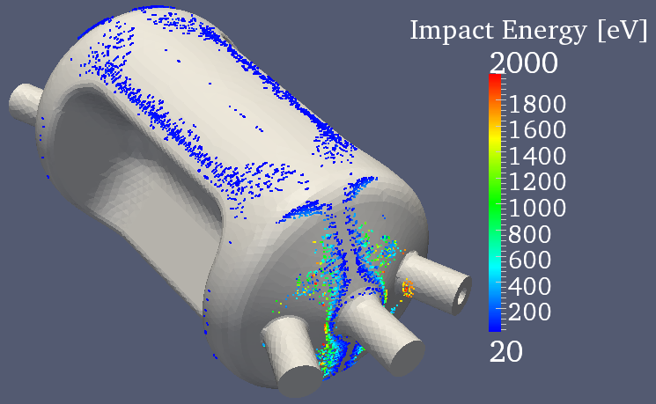
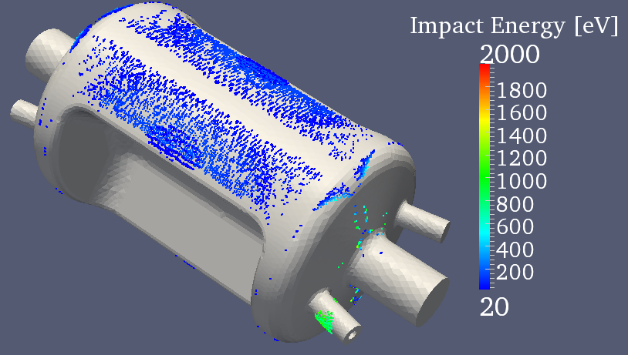
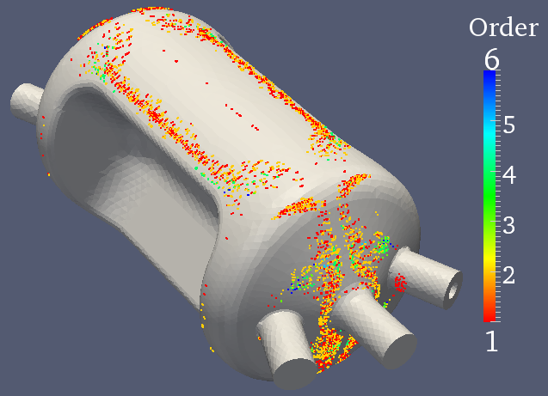
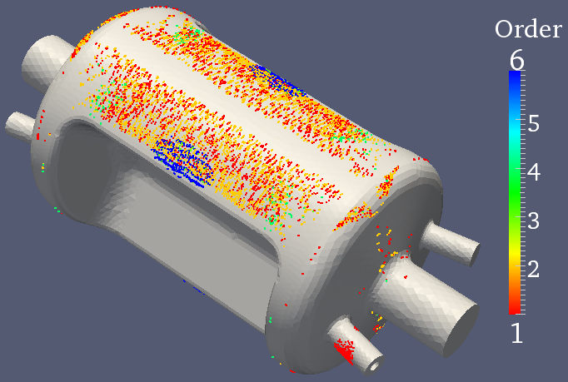
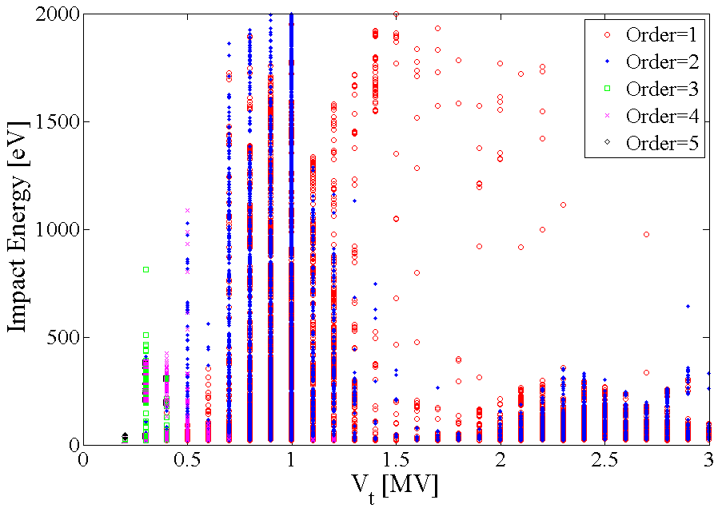
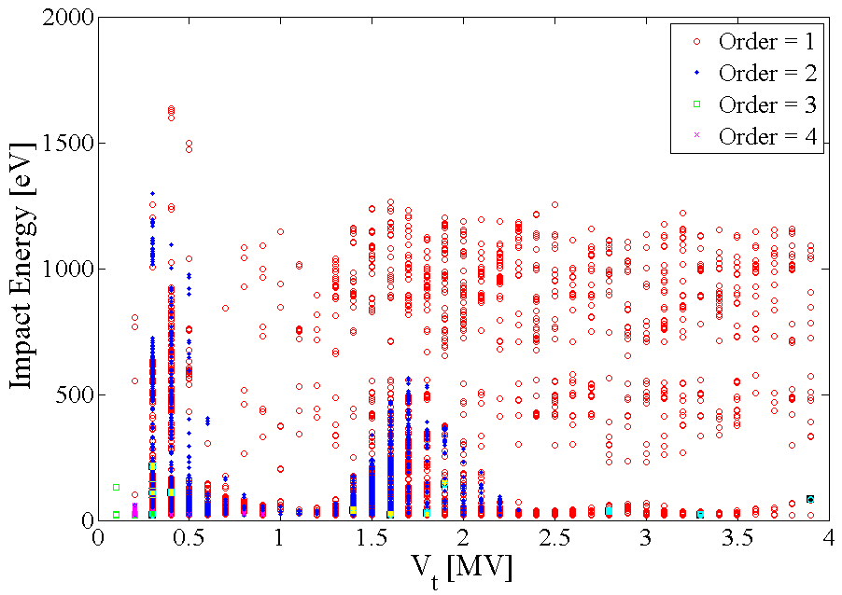
Multipacting Analysis
Track3P – Resonant particle tracking code in SLAC ACE3P suite
499 MHz Deflecting Cavity
400 MHz Crabbing Cavity

Slide 13
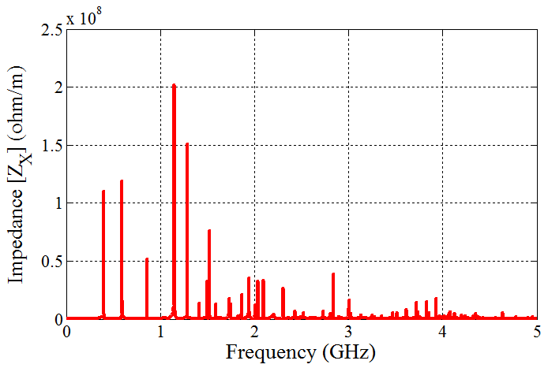
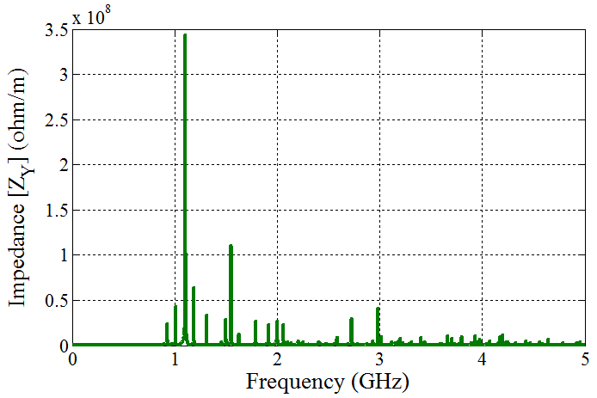
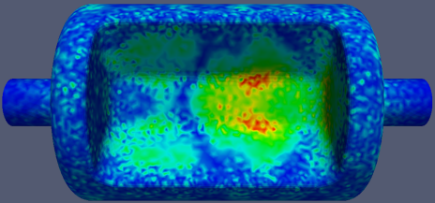
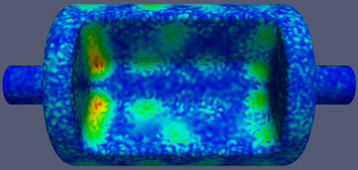
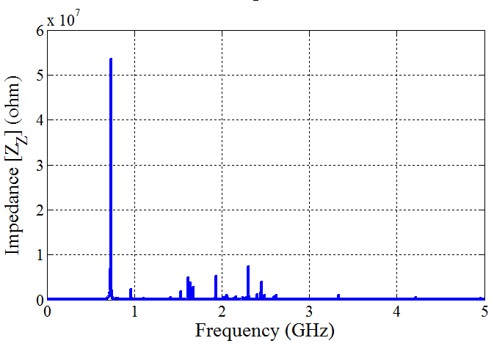
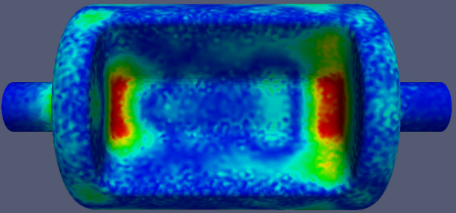
Wakefield Analysis
T3P – Time domain wakefield and transient solver in the SLAC ACE3P suite
400 MHz
Crabbing Cavity
For a Gaussian bunch of
σ_{z_rms} = 0.5 cm
For Gaussian Bunches

Slide 14
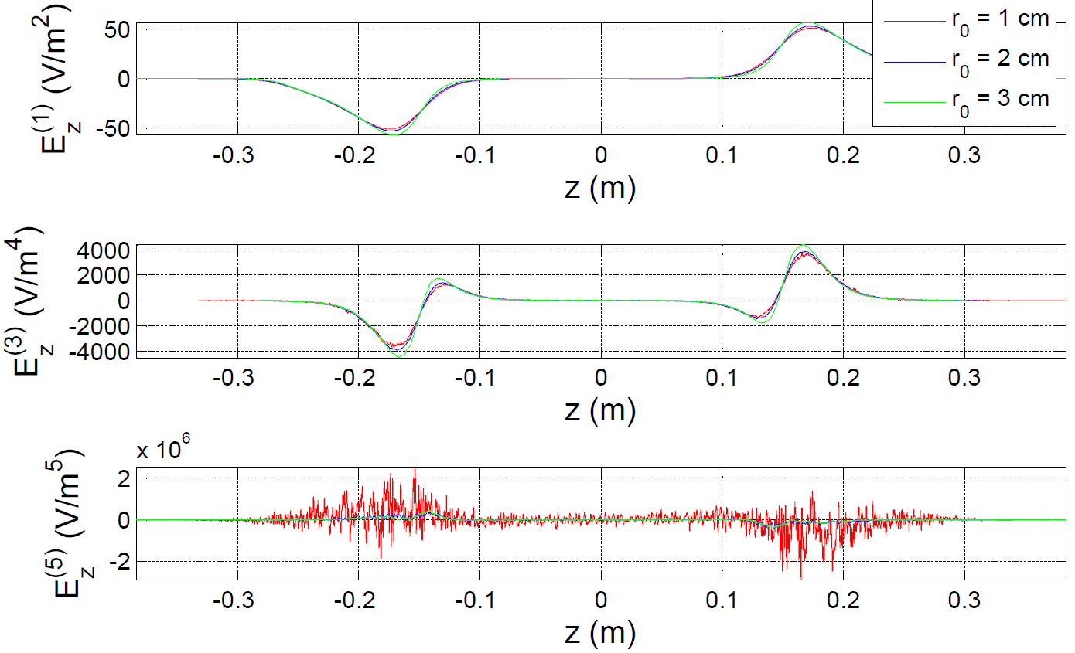
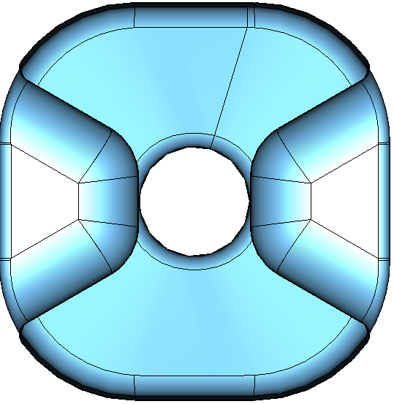





Field Non-Uniformity
400 MHz Crabbing Cavity
Dipole, sextapole, decapole components at a transverse voltage of 1 MV
(A)
(B)
 |  |  |  | Units
b₃ | 3.0×10² | 4.1×10² | 1.0×10² | mT/m
b₄ | 0.0 | 0.0 | 0.0 | mT/m²
b₅ | -4.6×10⁴ | -4.1×10⁴ | -2.2×10⁴ | mT/m³
b₆ | 0.0 | 0.0 | 0.0 | mT/m⁴
b₇ | -1.03×10⁷ | -2.0×10⁷ | -6.9×10⁷ | mT/m⁵
Voltage deviation at 20 mm
  Horizontal: 5.0% → 0.2%
  Vertical: 5.5% → 2.4%

Slide 15




RF Coupling
Possible coupling: Both electric and magnetic coupling
Coupled to the transverse electric field to reduce field enhancement
Four coupling ports to avoid asymmetry and to cancel the on-axis longitudinal electric field component
499 MHz Deflecting Cavity
Position
Off Set
Coupler Length
θ

Slide 16









Fabrication
400 MHz Crabbing Cavity
Fabricated at Niowave Inc.
499 MHz Deflecting Cavity
Fabricated at Jefferson Lab

Slide 17






Fabrication
Frequency adjustment by trimming the center piece
499 MHz Deflecting Cavity

Slide 18





Optical Inspection
400 MHz Crabbing Cavity
499 MHz Deflecting Cavity
Weld seam at equator
Weld seam at beam pipe

Slide 19

Bead Pull Study
On axis fields were measured for both
  499 MHz deflecting cavity
  400 MHz crabbing cavity
Measured components
  On–axis transverse electric field: Using a Teflon bead
  Both on–axis transverse electric and magnetic fields: Using an Al bead
Bead Pull Set UP
400 MHz Crabbing Cavity
499 MHz Deflecting Cavity
Teflon Bead
Al Bead
Teflon Bead

Slide 20

Surface Treatment
For the 400 MHz crabbing cavity
  Bulk BCP – 85 μm
  Heat treatment – At 600⁰ C for 10 hours
  Light BCP – ~10 μm
  High Pressure Rinse – 3 passes
O₁
O₁₀
81 μm
99 μm
O₂
O₁₁
O₃
O₈
O₁₂
Bulk BCP
Planned total removal – 120 μm
Acid mixture was contaminated with glycol
  Reduced etch rate from 2.7-2.8 μm /min to 1.8 μm/min
Average removal 85 microns
  Average removal in edges > 90 μm
  Average removal on flat surfaces < 70 μm
63 μm
O₄
68 μm
O₁₃
71 μm
O₅
O₉
O₁₄
O₆
O₁₅
108 μm
95 μm
O₇
O₁₆

Slide 21



Surface Treatment
Heat Treatment
For H₂ degassing
At 600⁰C – 10 hours
Light BCP
Removal of 10 μm after heat treatment
HPR
High pressure rinsing in 3 passes
H₂
T = 600⁰C

Slide 22






Cavity Assembly
Chem and room and clean room trained
Leak test
Assembly in clean room
Ultrasonic degreased hardware
Transport to clean room

Slide 23






Preparation for Testing
LLRF Control - Before
LLRF Control - After
300 – 800 MHz 500 W
RF Amplifier

Slide 24

RF Testing
Input and pick up probe calibration
  Calibrated Q → Measured Q
  Q₁ = 2.76×10⁹ → 3.0×10⁹
  Q₂ = 8.62×10¹⁰ → 1.1×10¹¹
Tests performed
  2 K high power test
  Cavity warmed up to 4 K
  4 K high power test
  Cavity cooled down to 2 K
  2 K high power test
Multipacting
  A multipacting barrier was observed in the first 2 K test at very low fields
  Increasing the power processed the cavity and no multipacting was observed in the following 4.2 K and 2 K tests
What is the V_{T} ?

Slide 25
4.2 K and 2 K Test Results
Expected Q₀
  At 4.2 K = 1.6×10⁹
  At 2 K = 6.7×10⁹
Achieved Q₀
  At 4.2 K = 1.25×10⁹
  At 2 K = 4.0×10⁹
Achieved fields at 4.2 K / 2 K
  E_{T} = 11.6 / 18.6 MV/m
  V_{T} = 4.35 / 7.0 MV
  E_{P} = 47 / 75 MV/m
  B_{P} = 82 / 131 mT
Limited by rf power at 4.2 K
Quench
3.4
5.0

Slide 26
Field Emission
No He processing

Slide 27
RF Testing
R_{S} = 34 nΩ
Frequency deviations
  Room temperature f : 402.0 MHz
  After bulk BCP : Δ f = − 51.1 kHz
  After bake : Δ f = − 30.2 kHz
  Under vacuum : Δ f = 318.5 kHz
  At 2 K : Δ f = 365.3 kHz

Slide 28
Current Status
499 MHz deflecting cavity
  Completely welded
  Awaiting chemistry and RF testing
400 MHz crabbing cavity
  RF tests performed successfully
  Achieved a transverse voltage of 7.0 MV at 2 K
    Exceeded the design requirements in transverse voltage
  The Q₀ achieved was lower due to extra losses
    Possibly due to contaminated acid, not enough Nb removed
    Consistent with losses in stainless steel flanges and copper probes in coupler ports
  Reasonably confident that 10.0 MV can be achieved with 2 cavities

Slide 29
Publications and Presentations
Invited Talk
  “Compact Superconducting Crabbing and Deflecting Cavities”, LINAC, Tel-Aviv, Israel, September 2012
Publications
  Phys. Rev. ST Accel. Beams 16, 012004 (2013)
  Phys. Rev. ST Accel. Beams 15, 022001 (2012)
Proceedings In,
  LINAC 2012, IPAC 2012
  IPAC 2011, SRF 2011, PAC 2011
  LINAC 2010 (Received 2nd student poster prize), IPAC 2010
  SRF 2009

Slide 30





400 MHz Crabbing Cavity Prototype
With the completion of the 400 MHz cylindrical rf-dipole cavity (proof of principle cavity), now focusing on the next generation of the LHC crabbing cavity design

Slide 31


Interests
Be a major participant of all aspects of the crabbing system design, development and testing
  EM design
  Mechanical analysis
  Fabrication and rf testing
  Beam physics
Be involved in the preparation and testing at CERN in SPS and commissioning LHC

Slide 32
Acknowledgments
My Advisor: Prof. Jean Delayen
ODU – HyeKyoung Park, Chris Hopper, Alex Castilla, Kevin Mitchell
JLab – HyeKyoung Park, Peter Kneisel, Rongli Geng, Tom Powers, Kirk Davis, Geoff Krafft, Joe Preble, Tony Reilly, Dave McCay & Casy Apeldoorn and his team, Bill Clemens, Pete Kushnick, Curt Macha, Danny Forehand and his team, Steve Castagnola and his team, Larry Turlington, Haipeng Wang, John Mammosser, Curt Hovater, John Musson
SLAC – Zenghai Li, Lixin Ge
Niowave – Terry Grimm, Dmitry Gorelov, Chase Boulware, Nick Miller
THANK YOU

