Slide 1
LHQ Coil Fabrication Experience and Plan
Miao Yu
04/08/2013

Slide 2
Introduction
LHQ is 3.3 m version HQ coil
Check fabrication technology for the scaling up.
Totally 3 coils will be fabricated, and one coil will be tested in the mirror structure
Winding and curing at FNAL; reaction and impregnation at BNL
LHQ coil 01 is the first coil (practice coil), to verify the fabrication procedure and all the tooling
Current status: LHQ coil 01 is being reacted at BNL, this talk is focusing on winding and curing.

Slide 3
Outline
LHQ Coil 01 fabrication experience
Cable during winding
Coil parts during winding and curing
Curing: binder, pressure and coil size
Other discrepancy report
Lifting fixture
LHQ Coil 02 Plan

Slide 4
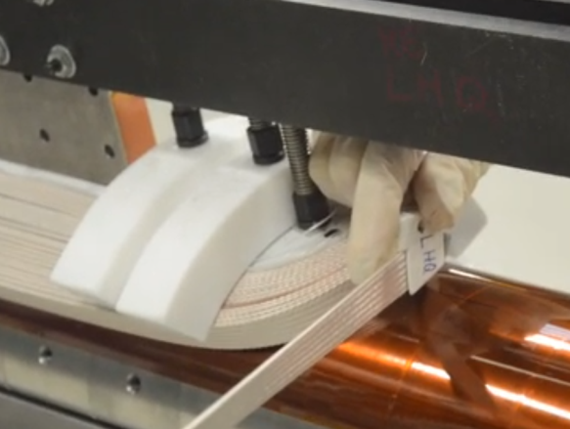
Cable during winding
360 ° twist was applied
Winding tool was used for both IL and OL
First turn in IL and OL, the tension was 20 lbs (9 kg)
IL tension 30 lbs (13.6 kg), OL 35 lbs (15.9 kg)
Location | # of pop strands | Fixed | Note
IL LE 3rd | 1 | By hand
IL LE 6th | 1 | Paint binder and cured
IL RE 6th | 2 | By hand | RE spacer was not aligned, cable was back wound, causing pop strands
IL RE 8th | 1 | By hand
IL RE 11th | 2 | By hand | The winding mandrel was rotate too fast
IL RE 14th | 4 | Paint binder and cured | The winding mandrel was rotate too fast
OL LE 2nd | 1 | Paint binder and cured | L1-L2 cable jump section, bend during L1 curing preparation
OL RE 6th | 1 | Paint binder and cured
OL LE 11th | 1 | Paint binder and cured
Might be avoided

Slide 5
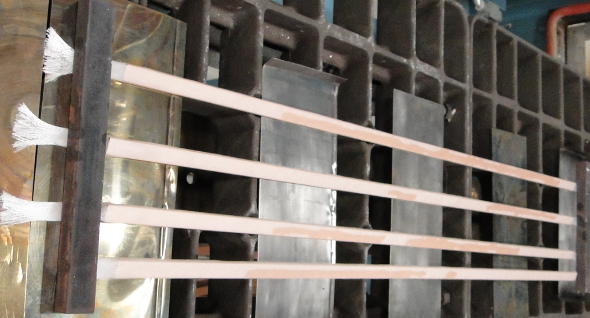
Coil Parts: Wedge Insulation
The sleeve was cut about the length of the wedge before gluing, causing the insulation loose at the end. (Solu: cut longer length insulation or glue the end first and then cut the insulation)
Two ways used to glue the insulation to the wedge:
Paint binder along the wedge and cure in the oven at 150°C for 1.5h X (debond, fluffy)
Paint binder only at the ends and cure using heat gun ˅

Slide 6
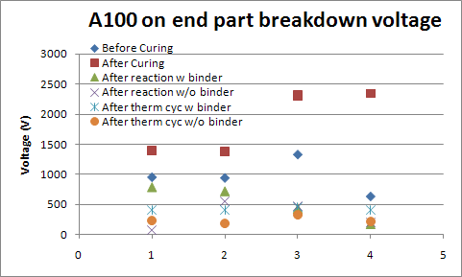
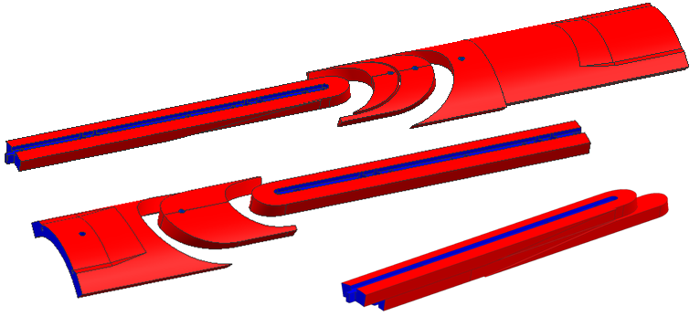
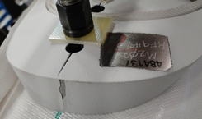
Coil Parts: Plasma Coating
To increase the dielectric strength coil to parts & coil to ground
Although the coating is porous, it will be filled with epoxy to gain better dielectric strength.
LHQ coil end parts were modified from the latest HQ design
7 mil was removed from the surface where the insulation is inserted.
Besides, 10 mil was removed from the surface where plasma coating is applied (in red).
Coating thickness did not meet the spec. from both vendors. Specs: 9mil±1mil (225µm±25µm) for flat surface; 8mil±2mil (200 µm±50µm) for the rest of surfaces
The coating surface is more abrasive than the metal surface. It may damage the insulation and the cable without any indication, so be very careful when install the parts.
Coating chips off when opening the slit
5 mil (125µm) coating thickness

Slide 7
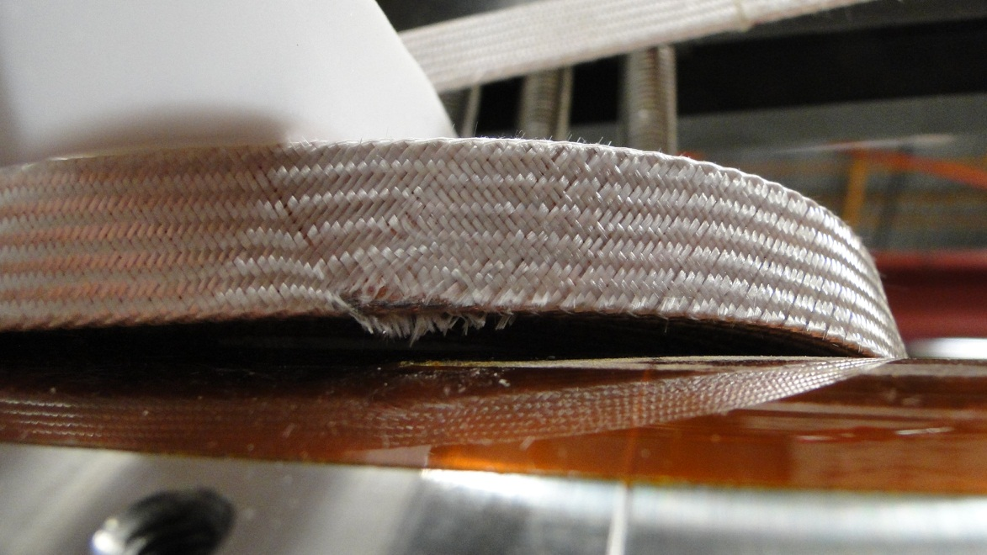
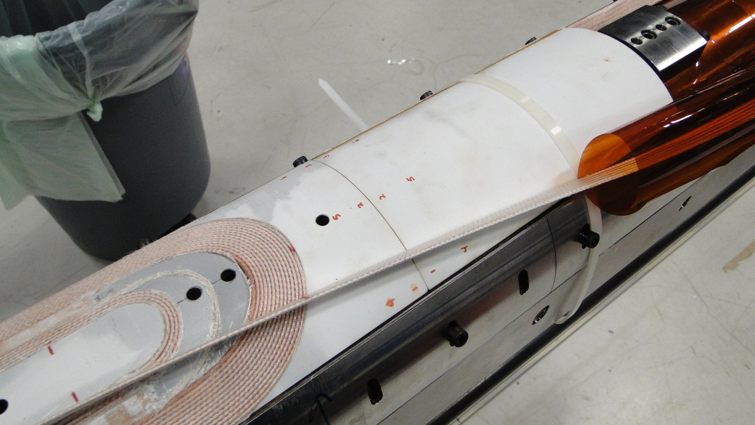
Coil Parts: End Parts Fitting
During winding
IL and OL saddles do not fit due to coil ends jumping up (new hold-down tooling was designed and practiced at LBNL)
After curing, the IL saddles were pushed in easily and fit pretty well, and OL still do not fit due to other issue (binder).
1 mil Mica was added at the tip of the parts to have better slipping plane.
After curing

Slide 8
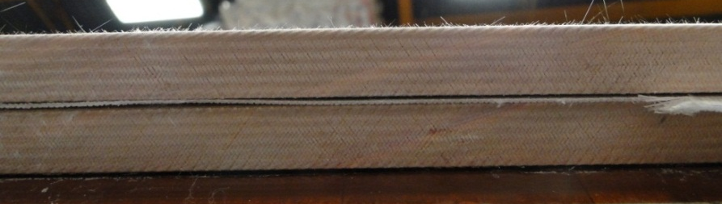
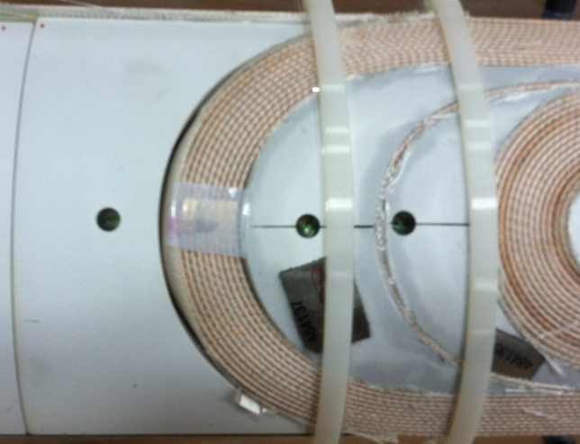
Curing: Binder
Outer Layer
Layers separation
Cable separation
Wedge jumping up
Saddle not fit
120 g binder was applied to the IL, and 140 g was applied to the OL
Scale up from HQ coil
IL 142 g (44 g for HQ)
OL 209 g (65.4 g for HQ)
Too much binder applied to the interlayer insulation (saturated before curing, very rigid after curing)
HQ: 928.22 mm, LHQ: 2985.62 mm
HQ: 938.9 mm, LHQ: 2997.65 mm

Slide 9
Curing: Pressure
30 MPa
1.5 MPa
 | Max. load/cylinder (ton/kN) | Spacing (inch/cm) | Max. load/unit Length (kN/m) | Max. load for LHQ (kN/m)
Main Cylinders | 200/1780 | 12/30 | 5934 | ~1780
Mandrel Cylinders | 15/134 | 6/15 | 894 | ~180
Inner layer curing | Load 1 | Load 2 | Load 3
Mandrel cylinder | 45 kN/m | 68 kN/m | 90 kN/m
Platen cylinder | 450 kN/m | 670 kN/m | 890 kN/m
Room T gap (mm) | 0.1 | 0.038 | 0
100°C gap (mm) | - | - | 0
150°C gap (mm) | - | - | 0
Outer layer curing | Load 1 | Load 2 | Load 3 | Load 4 | Load 5
Mandrel cylinder | 45 kN/m | 68 kN/m | 90 kN/m | 135 kN/m | 180 kN/m
Platen cylinder | 450 kN/m | 670 kN/m | 890 kN/m | 1335 kN/m | 1780 kN/m
Room T gap (mm) | 0.55 | 0.43 | 0.28 | 0.2 | 0.1
100°C gap (mm) | - | - | - | - | 0
150°C gap (mm) | - | - | - | - | 0

Slide 10
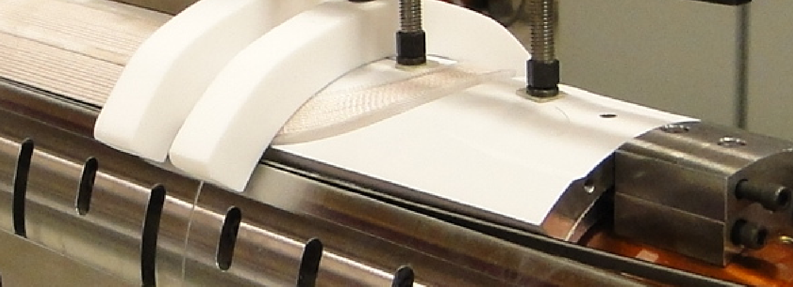
Curing: Coil Size
In LHQ coil 01 during curing, the coil was over compressed by ~125 µm azimuthally to its nominal size.
However, this additional 125 µm shim was applied from saddle to saddle extension, and these end parts are in nominal size
LHQ coil nominal size azimuthally:
125 µm to the midplane (the gap is for ground insulatoin)
Midplane shim

Slide 11
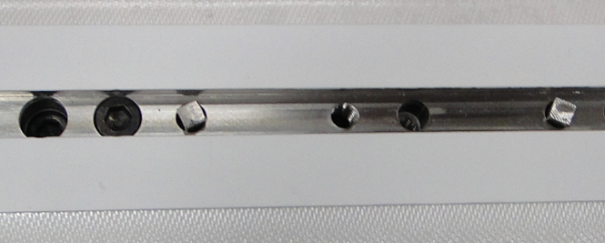
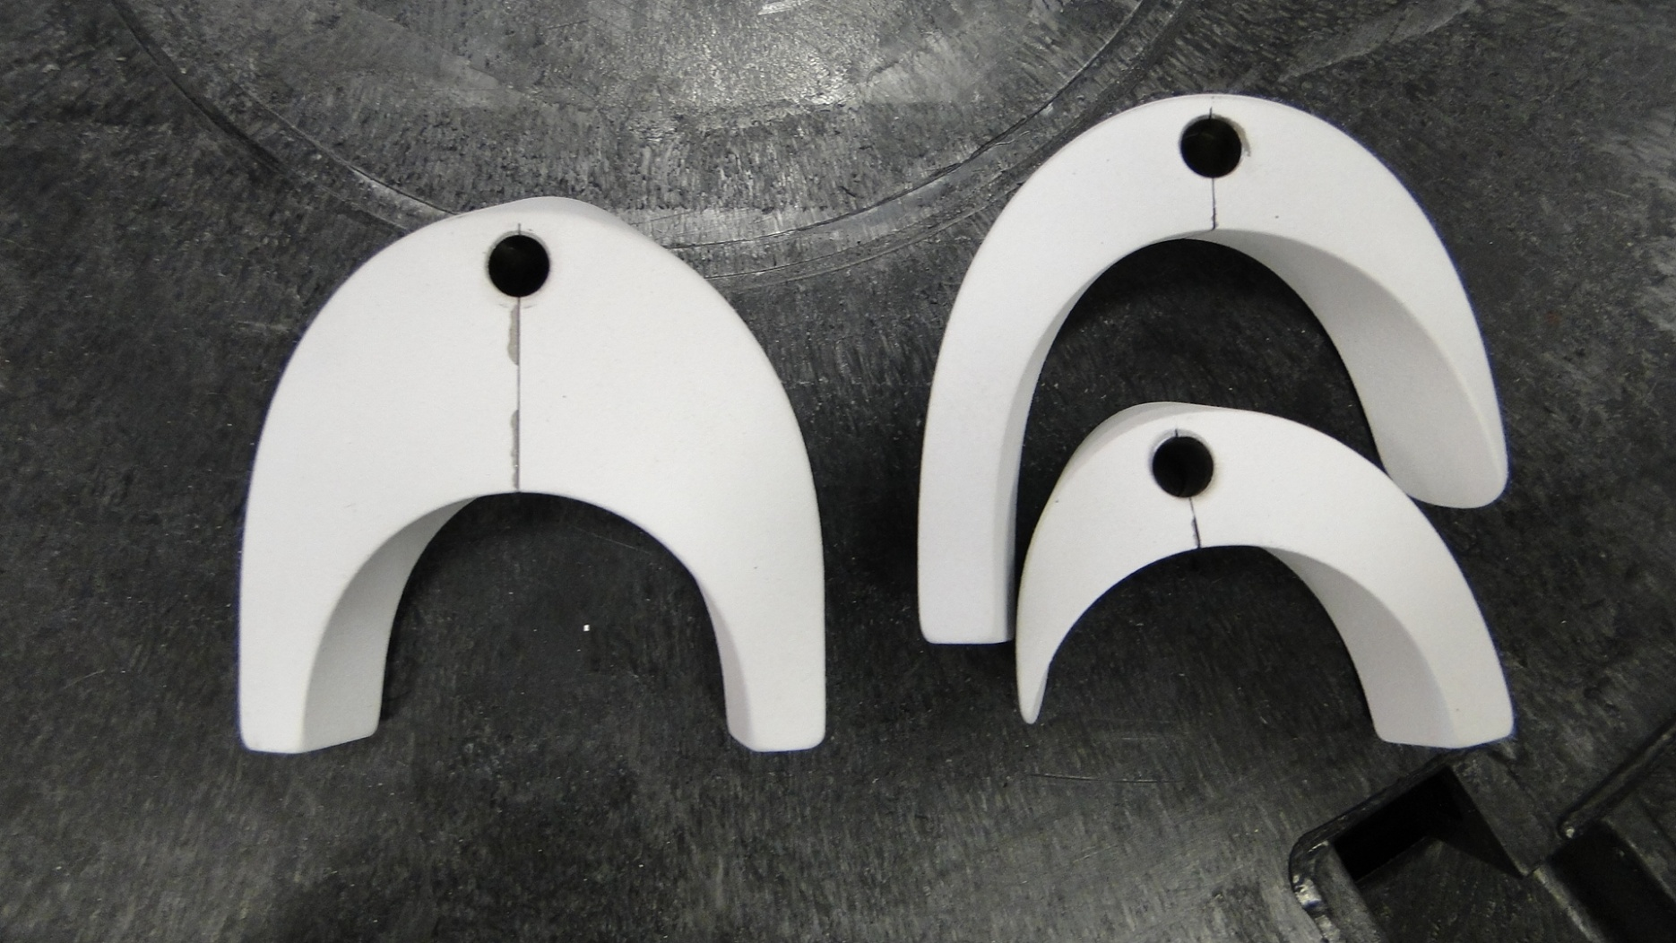
Other DR
Coil Parts: Coating chips off around slit area, causing by the vendor
Coil Parts: IL LE saddle and splice block did not align properly after coating, and was fixed (should be done before coating).
Coil Parts: ¼" key stock was used instead of ¼" dowel pin due to undersize pin hole.
Instrumentation: Voltage tap A3 and B8 were broken. The thickness of VT is thinner than nominal 1.5 mil (38 µm).

Slide 12
Lifting Fixture
Need one more clamp to hold down the coil RE

Slide 13
LHQ Coil 02 Plan
Tooling Preparation and Modification
Coil parts
Open the pin holes on the pole using 0.2505” reamers.(6.35 mm dowel pin, 6.363 mm hole, which can be adopted by QXF design +13µm/-0)
Add slit to the saddles (after HQ practice coil)
Plasma coating all parts
Winding and curing the coil without splice block (for LQXF)
Pole Gap and wedge gap
Pole gap will be determined after LHQ 01 reaction
Wedge gap will be increased (scale up from HQ wedge gap)
Cable
Try no twist on the cable between spool and the coil
Use winding tool and hold down tooling at the coil end
Use binder when pop strand is hard to fix by hand
Winding tension: 20 lbs for the first turn, and then 35 lbs

Slide 14
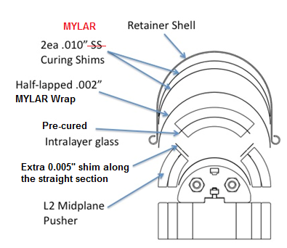
LHQ Coil 02 Plan cont.
Binder
Use less binder on interlayer insulation and quantify the amount
Use the proper amount of binder for L1 and L2 (scale up from HQ coil)
Others
Try to fit the end parts without 1 mil mica
Over compress the coil straight section by 5 mil
Use 10 mil Mylar as curing radial shims instead of SS
Need more 1.5 mil (~38 µm) thick voltage tap
Add one more clamp to the lifting fixture to secure the RE
Schedule
Coil parts will be plasma coated in end of April.
After LHQ coil 01 reaction, start fabrication of LHQ coil 02 around early May.

